Slide 1
AWS Concepts
AWS Console UPDATED 2019
PHANI KISHORE LANKA

Slide 2
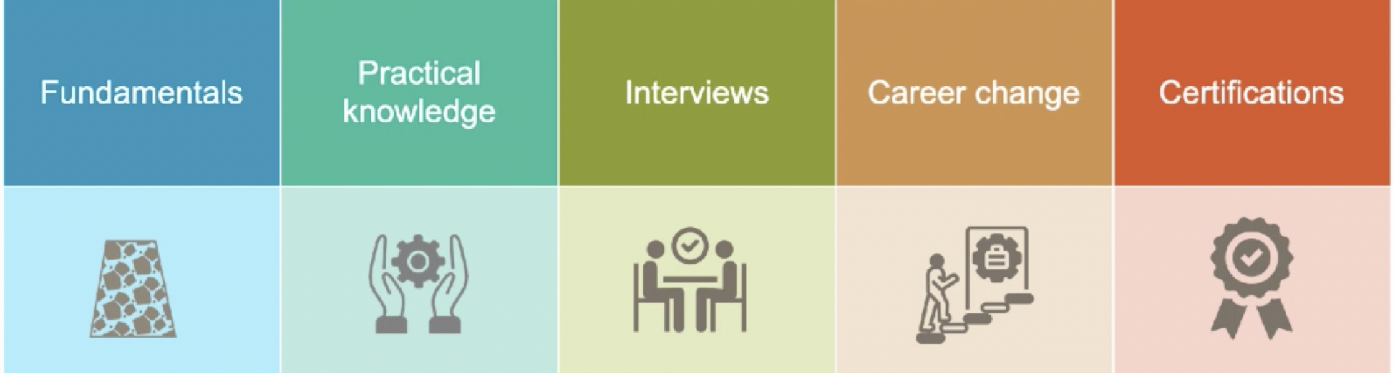
Why AWS Course ?
You Will Know Fundamentals
About cloud computing and
Knowledge on Various cloud services
You will get Hands on Various
Cloud Services offered by
AWS
You will able to easily crack
Interviews on AWS
You are good to change your career on AWS Cloud Platform.
This course will help you to
Clear AWS Associate/Sysops/Cloud Practitioner/Developer Associate Certifications.

Slide 3
10,000 FT OVERVIEW - 2019
IOT
GAME DEVELOPMENT
CUSTOMER ENGAGEMENT
BUSINESS APPLICATIONS
DESKTOP &
APP STREAMING
AR & VR
EAI
AWS COST MGMT
ANALYTICS
SECURITY , IDENTITY & COMPLIANCE
MOBILE
MANAGEMENT & GOVERNANCE
MEDIA SERVICES
ML
ROBOTICS
BLOCK CHAIN
SATELLITE SERVICES
MIGRATION & TRANSFER
N/W & CONTENT DELIVERY
Dev Tools
COMPUTE
STORAGE
DATABASES
AWS GLOBAL INFRASTRUCTURE

Slide 4
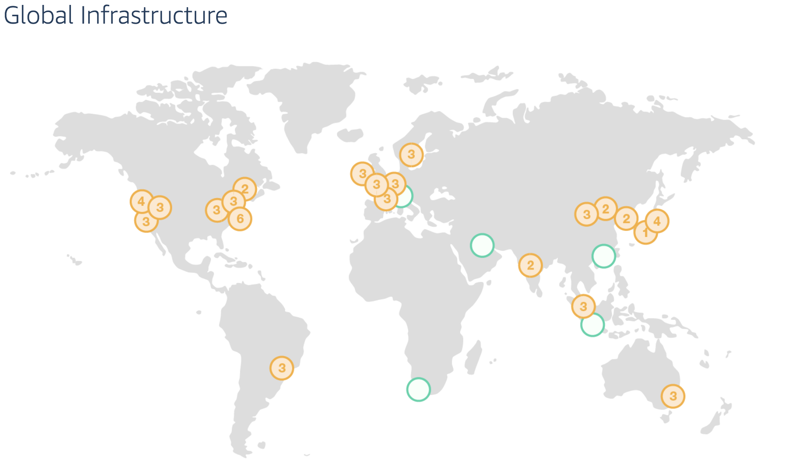
AWS Regions / AZ / Edge Locations
https://aws.amazon.com/about-aws/global-infrastructure/
As of Apr-19
19 Regions , 57 AZ

Slide 5
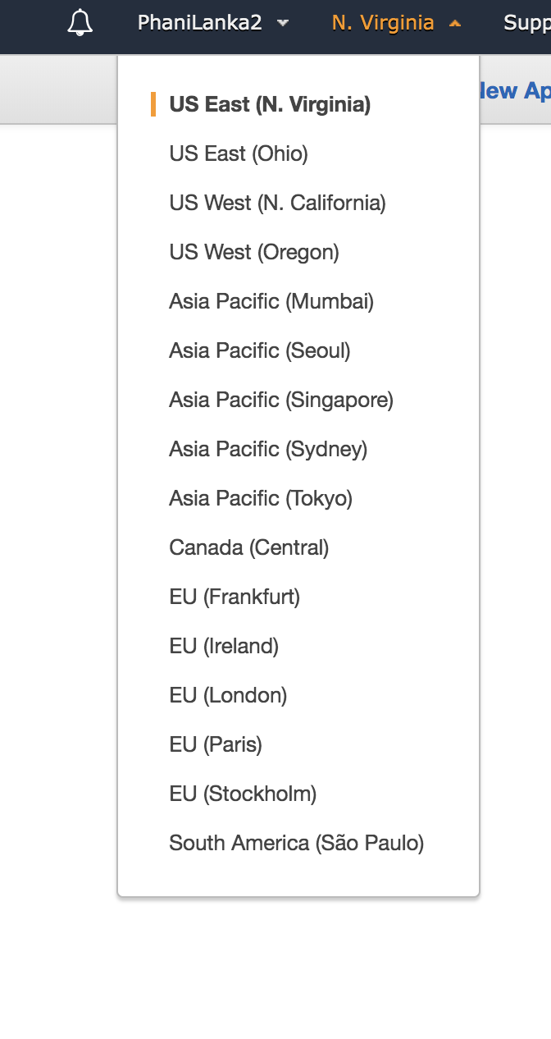
Region
Region – Geographical Area , it has 2 or more AZ

Slide 6
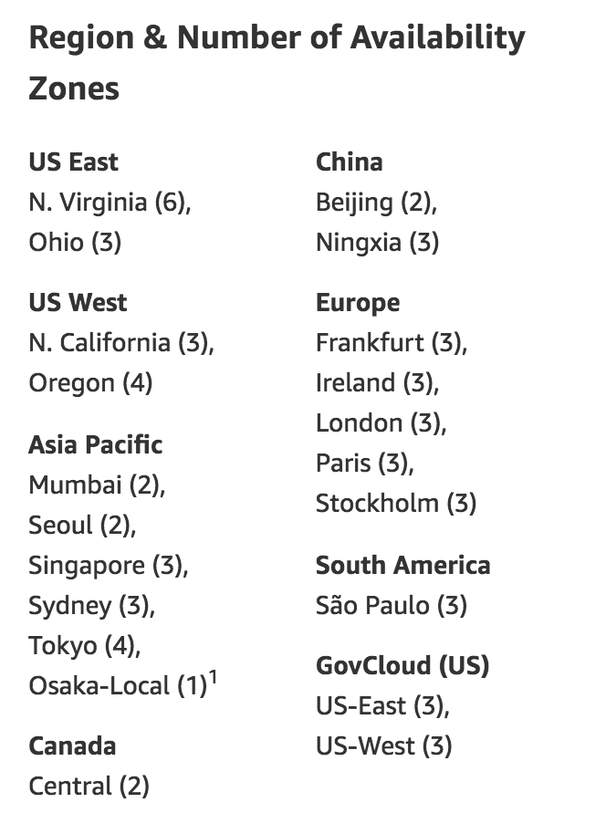
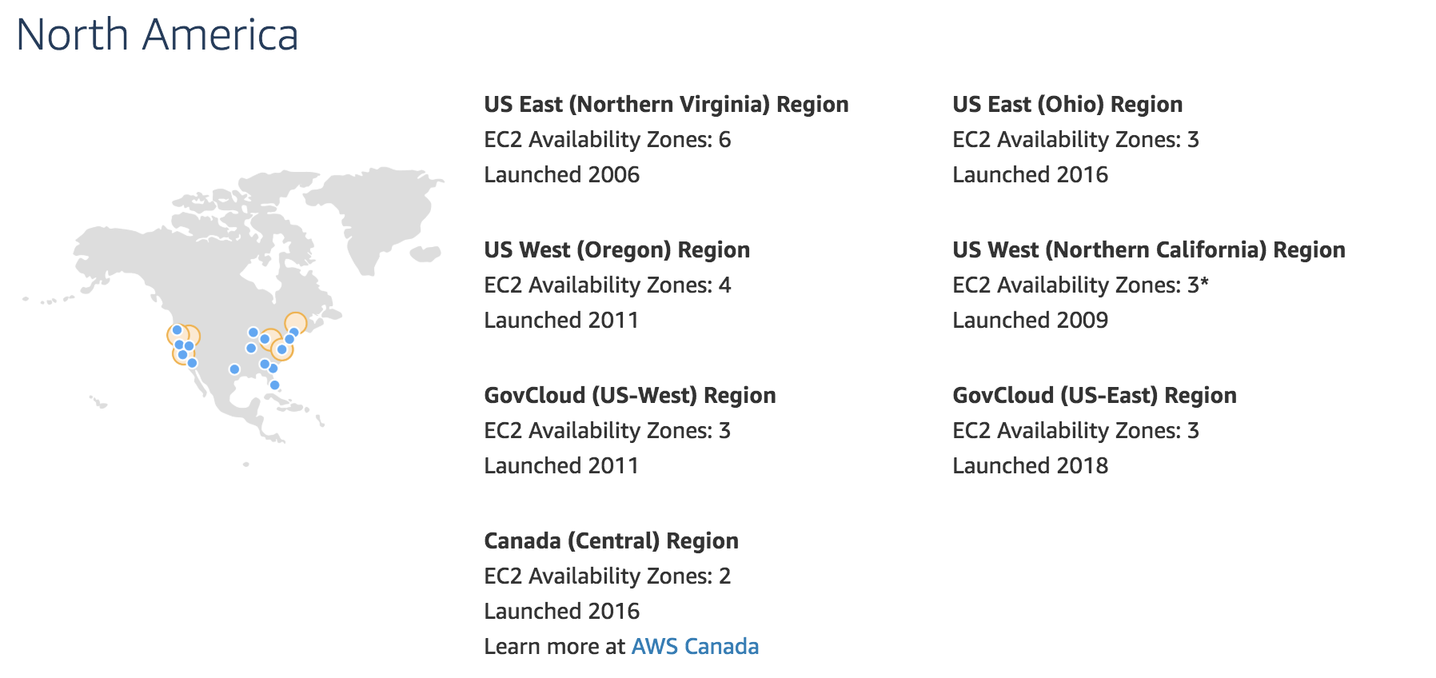
AZ
1 or more descrete Datacenter with redundant Power , Networking & Connectivity Housing in Seprate Facilites,
Each Region Multiple AZ

Slide 7

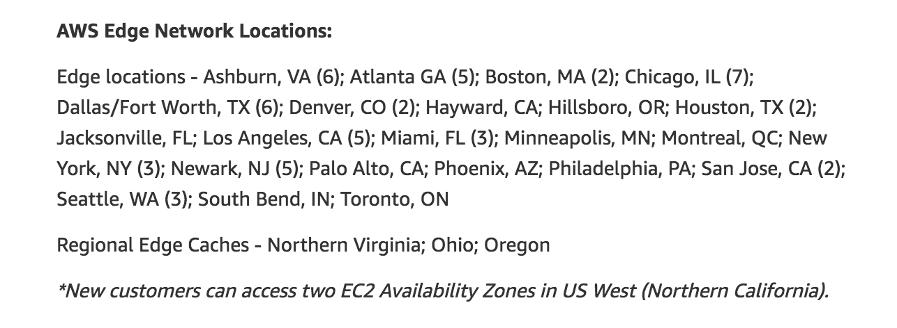
Edge Location
End Point for AWS used for Caching Content Typically consists of Cloud Front , Amazon Content Delivery Network (CDN)

Slide 8
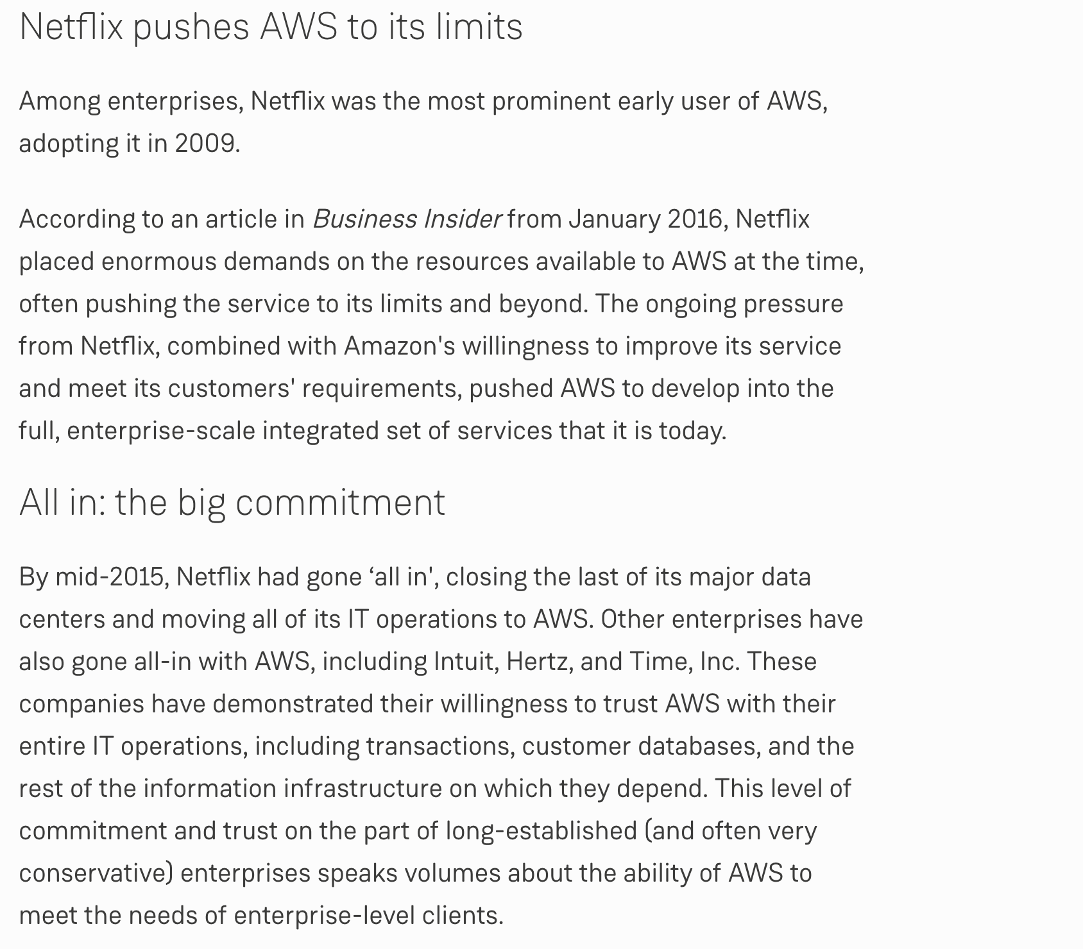
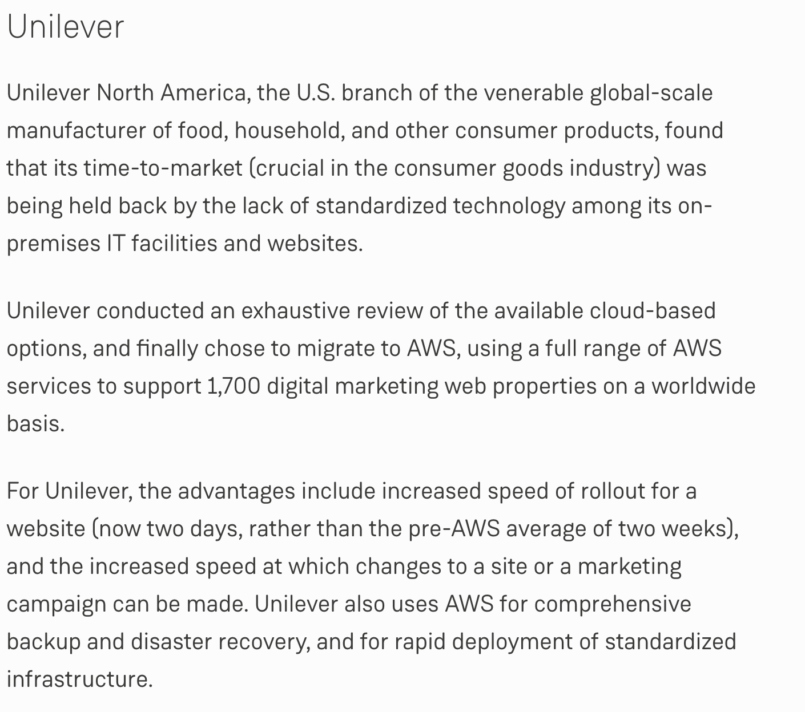
Biggest Clients & Case Studies
Biggest Customers include, AMAZON by itself is Biggest Client, Entire Amazon is on AWS , Netflix, Unilever

Slide 9
AWS SLA
Link → https://aws.amazon.com/compute/sla/

Slide 10
AWS Compliance Certificates
List of Compliance Certificates → https://aws.amazon.com/compliance/compliance-latest-news/
HDS - Hébergeur de Données de Santé , French Personal Health Information.
NIST - National Institute of Standards and Technology (NIST) Cybersecurity Framework Version 1.1, which was released in 2018
AWS Awarded PROTECTED Certification in Australia
AWS Services Now Compliant with HIPAA, ISO, PCI, and SOC at Launch
93 Services now Compliant with PCI Certification
114 Services → against ISO 9001, 27001, 27017, and 27018
GDPR – General Data Protection Regulation – Europe Privacy

Slide 11
COMPUTE
EC2 (ECC) – Elastic Cloud Compute (IAAS)
Light Sail - Lightsail includes everything you need to launch your project quickly – a virtual machine, SSD-based storage, data transfer, DNS management, and a static IP – for a low, predictable price.
ECR - Elastic Container Registry (Docker)
EKS - Elastic Kubernetes Service (Docker Containers)
LAMBDA – Serverless Architecture (Event Based - Python/Node.js/Java)
BATCH - AWS Batch enables you to run batch computing workloads on the AWS Cloud.
Elastic Beanstalk – Launch Apps without knowing what is AWS
Serverless App Repository – Repository for Serverless Apps

Slide 12
STORAGE
S3 – Simple Storage Service (Object Based)
EBS – Elastic Block Storage Linux – for 1 Server Only.
EFS – Elastic File Storage Linux(Like NFS V4, File Share b/w Machines)
FSx – Windows –Third Party File Storage
S3 Glacier – Infrequently Accessed Data (Archived > 90 days like that)
Storage Gateway – On Premise to AWS Connection
AWS Backup – for DR

Slide 13
DATABASE
RDS (Relation DB) - OLTP
Servered – MYSQL, SQL Server, Oracle, PostGres , Maria DB
Serverless – Aurora (High Performance MySQL)
DynamoDB – AMAZON No SQL DB
ElastiCache – Cached DB on Cloud (Memcached/Redis Flavours)
Neptune – Graph Based Database Engine
Amazon Redshift – BI on AWS (OLAP)
Amazon DocumentDB – Operate Mongo DB Compatible Databases

Slide 14
MIGRATION & TRANSFER
AWS Migration Hub – Hub That provides to Track migration tasks across multiple AWS tools and partner solutions, you can choose the AWS and partner migration tools that best fit your needs while providing visibility into the status of your migration projects, Provides Key Metrics also regardless which tool you are migrating to.
Application Discovery Service - helps systems integrators quickly and reliably plan application migration projects by automatically identifying applications running in on-premises data centers, their associated dependencies, and their performance profile.
Database Migration Service - you can use to migrate data from your database that is on-premises, on an Amazon Relational Database Service (Amazon RDS) DB instance
Server Migration Service - AWS Server Migration Service (AWS SMS) combines data collection tools with automated server replication to speed the migration of on-premises servers to AWS.
AWS Transfer for SFTP - AWS Transfer for SFTP is a secure transfer service that stores your data in Amazon S3 and simplifies the migration of Secure File Transfer Protocol (SFTP) workflows to AWS.
Snowball – TRANSFER HEAVY DATA like Petabytes to AWS, You ask AWS to ship Snowball to OnPrem and ship it back to AWS.
DataSync - AWS DataSync is a data-transfer service that simplifies, automates, and accelerates moving and replicating data between on-premises storage systems and AWS storage services over the internet or AWS Direct Connect.

Slide 15
Networking & Content Delivery
VPC – Virtual Private Cloud , enables you to launch Amazon Web Services (AWS) resources into a virtual network that you've defined (Architect Design)
CloudFront – Distribution of Static & Dynamic Web Content , CloudFront delivers it through a worldwide network of edge locations that provide low latency and high performance. (S3/EC2/ELB)
Route 53/DNS (DNS Service)
API Gateway – Like APIGEE, throttle & Expose API’s
Direct Connect – Direct connection from Customer DC to AWS
AWS App Mesh - AWS App Mesh makes it easy to monitor and control microservices running on AWS.
AWS Cloud Map - AWS Cloud Map lets you name and discover your cloud resources.

Slide 16
Media Services
Elastic Transcoder – Paid Service for Converting Media Files Stored in S3
Kinesis Video Streams – Kinesis makes it easy to collect, process, and analyze video and data streams in real time. (Eg:- Stock Market, Social Media Clicks)
MediaConnect - Reliable, secure, and flexible transport service for live video
MediaConvert - Service that formats and compresses offline video content for delivery to televisions or connected devices.
MediaLive - AWS Elemental MediaLive is a video service that allows easy and reliable creation of live outputs for broadcast and streaming delivery.
MediaPackage - just-in-time video packaging and origination service
MediaStore - video origination and storage service that offers the high performance, predictable low latency, and immediate consistency required for live origination
MediaTailor - Media Tailor is a personalization and monetization service that allows scalable server-side ad insertion. The service also enables you to track ad views for accurate ad reporting.

Slide 17
Security, Identity & Compliance
IAM – Indentiy & Access Management , securely controlling access to AWS services. With IAM, you can centrally manage users, security credentials such as access keys, and permissions that control which AWS resources users and applications can access.
Resource Access Manager - Enables you to share your resources with any AWS account or organization in AWS Organizations.
Cognito - service that you can use to create unique identities for your users, authenticate these identities with identity providers, and save mobile user data in the AWS Cloud. (Temp Credentials)
Secrets Manager - Securely encrypt, store, and retrieve credentials for your databases and other services.
GuardDuty – Paid Service, Continuous security monitoring service. Amazon GuardDuty can help to identify unexpected and potentially unauthorized or malicious activity in your AWS environment.
Inspector - Security vulnerability assessment service that helps improve the security and compliance of your AWS resources using Industry Best Practices , includes a knowledge base of hundreds of rules mapped to common security standards and vulnerability definitions that are regularly updated by AWS security researchers.
Amazon Macie - Security service that uses machine learning to automatically discover, classify, and protect sensitive data in AWS, Amazon Macie recognizes sensitive data such as personally identifiable information (PII) or intellectual property, and provides you with dashboards and alerts that give visibility into how this data is being accessed or moved.
AWS Single Sign-On - AWS Single Sign-On is a cloud-based service that simplifies managing SSO access to AWS accounts and business applications.
Certificate Manager - AWS Certificate Manager (ACM) makes it easy to provision, manage, and deploy SSL/TLS certificates on AWS managed resources.
Key Management Service - Encryption and key management service scaled for the cloud. KMS keys and functionality are used by other AWS services, and you can use them to protect data in your own applications that use AWS.
CloudHSM - Secure cryptographic key storage for customers by providing managed hardware security modules in the AWS Cloud.
Directory Service - Enables your directory-aware workloads and AWS resources to use a managed Active Directory in the AWS Cloud.
WAF & Shield - Web Application Firewall that lets you monitor web requests that are forwarded to Amazon CloudFront distributions or an Application Load Balancer. You can also use AWS WAF to block or allow requests based on conditions that you specify, such as the IP addresses that requests originate from or values in the requests.
Artifact - AWS Artifact is a web service that enables you to download AWS security and compliance documents such as ISO certifications and SOC reports.
Security Hub (Preview) - AWS Security Hub provides you with a comprehensive view of your security state within AWS. Security Hub collects security data from across AWS accounts and services, and helps you analyze your security trends and identify the highest priority security issues across your AWS environment.

Slide 18
Developer Tools
AWSCloud9 - AWS Cloud9 is a cloud-based integrated development environment (IDE) that you use to write, run, and debug code.
AWSCodeBuild - AWS CodeBuild is a fully managed build service that compiles your source code, runs unit tests, and produces artifacts that are ready to deploy.
AWSCodeCommit - AWS CodeCommit is a version control service that enables you to privately store and manage Git repositories in the AWS cloud.
AWSCodeDeploy - AWS CodeDeploy is a deployment service that enables developers to automate the deployment of applications to instances and to update the applications as required.
AWSCodePipeline - AWS CodePipeline is a continuous delivery service that enables you to model, visualize, and automate the steps required to release your software.
AWSCodeStar - AWS CodeStar lets you quickly develop, build, and deploy applications on AWS.

Slide 19
Analytics
Athena - Amazon Athena is an interactive query service that makes it easy to analyze data in Amazon S3 using standard SQL. Athena is serverless, so there is no infrastructure to setup or manage, and you pay only for the queries you run.
EMR - Amazon EMR is a web service that makes it easy to process large amounts of data efficiently. Amazon EMR uses Hadoop processing combined with several AWS products to do such tasks as web indexing, data mining, log file analysis, machine learning, scientific simulation, and data warehousing.
CloudSearch - Amazon CloudSearch enables you to search large collections of data such as web pages, document files, forum posts, or product information.
Elasticsearch Service - Amazon Elasticsearch Service (Amazon ES) is a managed service that makes it easy to deploy, operate, and scale Elasticsearch, a popular open-source search and analytics engine. Amazon ES also offers security options, high availability, data durability, and direct access to the Elasticsearch API.
Kinesis - Amazon Kinesis makes it easy to collect, process, and analyze video and data streams in real time.
QuickSight - Amazon QuickSight is a fast business analytics service to build visualizations, perform ad hoc analysis, and quickly get business insights from your data
Data Pipeline - AWS Data Pipeline is a web service that you can use to automate the movement and transformation of data. With AWS Data Pipeline, you can define data-driven workflows, so that tasks can be dependent on the successful completion of previous tasks.
AWS Glue - AWS Glue is a fully managed ETL (extract, transform, and load) service that makes it simple and cost-effective to categorize your data, clean it, enrich it, and move it reliably between various data stores.
MSK - Amazon Managed Streaming for Kafka (Amazon MSK) is a fully managed service that makes it easy for you to build and run applications that use Apache Kafka to process streaming data.

Slide 20
EAI – Enterprise Application Integration
Amazon MQ - Managed message broker service for Apache ActiveMQ that makes it easy to set up and operate message brokers in the cloud
Simple Notification Service(SNS) - Amazon Simple Notification Service (Amazon SNS) is a web service that enables applications, end-users, and devices to instantly send and receive notifications from the cloud. (SMS/Email/Push Notifications)
Simple Queue Service (SQS) - Amazon Simple Queue Service (Amazon SQS) is a fully managed message queuing service that makes it easy to decouple and scale microservices, distributed systems, and serverless applications
SWF - Amazon Simple Workflow Service (Amazon SWF) makes it easy to build applications that coordinate work across distributed components. In Amazon SWF, a task represents a logical unit of work that is performed by a component of your application. Coordinating tasks across the application involves managing intertask dependencies, scheduling, and concurrency in accordance with the logical flow of the application. Amazon SWF gives you full control over implementing tasks and coordinating them without worrying about underlying complexities such as tracking their progress and maintaining their state.
Step Functions - AWS Step Functions makes it easy to coordinate the components of distributed applications as a series of steps in a visual workflow.

Slide 21
Management & Governance
AWS Organizations - AWS Organizations is an account management service that lets you consolidate multiple AWS accounts into an organization that you create and centrally manage. With AWS Organizations, you can create member accounts and invite existing accounts to join your organization. You can organize those accounts into groups and attach policy-based controls.
AWS Auto Scaling - With AWS Auto Scaling, you can quickly set up dynamic and predictive scaling for your scalable AWS resources. It uses Amazon EC2 Auto Scaling to scale your EC2 instances and Application Auto Scaling to scale resources from other services.
CloudFormation - AWS CloudFormation enables you to create and provision AWS infrastructure deployments predictably and repeatedly. It helps you leverage AWS products such as Amazon EC2, Amazon Elastic Block Store, Amazon SNS, Elastic Load Balancing, and Auto Scaling to build highly reliable, highly scalable, cost-effective applications in the cloud without worrying about creating and configuring the underlying AWS infrastructure. AWS CloudFormation enables you to use a template file to create and delete a collection of resources together as a single unit (a stack).
CloudWatch - Amazon CloudWatch provides a reliable, scalable, and flexible monitoring solution that you can start using within minutes. You no longer need to set up, manage, and scale your own monitoring systems and infrastructure.
CloudTrail - With AWS CloudTrail, you can monitor your AWS deployments in the cloud by getting a history of AWS API calls for your account, including API calls made via the AWS Management Console, the AWS SDKs, the command line tools, and higher-level AWS services. You can also identify which users and accounts called AWS APIs for services that support CloudTrail, the source IP address the calls were made from, and when the calls occurred. You can integrate CloudTrail into applications using the API, automate trail creation for your organization, check the status of your trails, and control how administrators turn CloudTrail logging on and off.
Config - AWS Config provides a detailed view of the resources associated with your AWS account, including how they are configured, how they are related to one another, and how the configurations and their relationships have changed over time. Config Dashboard Exists for this.
OpsWorks - AWS OpsWorks provides a simple and flexible way to create and manage stacks and applications. With AWS OpsWorks, you can provision AWS resources, manage their configuration, deploy applications to those resources, and monitor their health.
Systems Manager - Use AWS Systems Manager to organize, monitor, and automate management tasks on your AWS resources.
Managed Services - AWS Managed Services (AMS) operates AWS on your behalf without having aws skills and experience.
Control Tower - AWS Control Tower automates the set-up of a well-architected multi-account environment based on best practices, and guides you through a step-by-step process to customize Control Tower to your organization.
AWS License Manager - AWS License Manager makes it easier to manage licenses in AWS and on-premises servers from software vendors such as Microsoft, SAP, Oracle, and IBM. AWS License Manager lets administrators create customized licensing rules that emulate the terms of their licensing agreements, and then enforces these rules when an instance of EC2 gets launched.
AWS Well-Architected Tool - The AWS Well-Architected Tool helps you review the state of your workloads and compares them to the latest AWS architectural best practices. The tool is based on the AWS Well-Architected Framework, developed to help cloud architects build secure, high-performing, resilient, and efficient application infrastructure.

Slide 22
IOT
IoT Core - AWS IoT enables secure, bi-directional communication between Internet-connected things (such as sensors, actuators, embedded devices, or smart appliances) and the AWS Cloud over MQTT and HTTP.
Amazon FreeRTOS - Amazon FreeRTOS is an operating system that makes microcontroller-based edge devices easy to program, deploy, secure, and maintain.
IoT 1-Click - AWS IoT 1-Click is a service that makes it easy for simple devices to trigger AWS Lambda functions that execute a specific action. Some examples of possible actions include calling technical support, reordering goods and services, or locking and unlocking doors and windows. Simple devices are cloud-connected, single-purpose devices such as Wi-Fi and mobile network connected buttons.
IoT Analytics - AWS IoT Analytics provides advanced data analysis for AWS IoT. You can collect large amounts of device data, process messages, and store them. You can then query the data and run sophisticated analytics to make accurate decisions in your IoT applications and machine learning use cases.
IoT Device Defender - AWS IoT Device Defender is an AWS IoT security service that allows you to audit the configuration of your devices, monitor your connected devices to detect abnormal behavior, and to mitigate security risks. It gives you the ability to enforce consistent security policies across your AWS IoT device fleet and respond quickly when devices are compromised.
IoT Device Management - AWS IoT Device Management is a cloud-based device management service that makes it easy for customers to securely manage IoT devices throughout their lifecycle. Customers can use AWS IoT Device Management to onboard device information and configuration, organize their device inventory, monitor their fleet of devices, and remotely manage devices deployed across many locations. This remote management includes over-the-air (OTA) updates to device software.

Slide 23
AR & VR
AWS Sumerian - Amazon Sumerian is a set of tools for creating high-quality virtual reality (VR) experiences on the web. With Sumerian, you can construct an interactive 3D scene without any programming experience, test it in the browser, and publish it as a website that is immediately available to users.

Slide 24
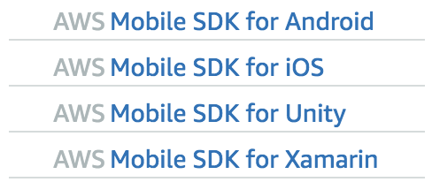
Mobile
AWS Amplify - AWS Amplify enables developers to develop and deploy cloud-powered mobile and web apps. The Amplify Console provides a continuous delivery and hosting service for web applications.
AWS AppSync - AWS AppSync is an enterprise level, fully managed GraphQL service with real-time data synchronization and offline programming features.
Device Farm - The service allows you to upload your own tests or use built-in, script-free compatibility tests. (IOS & Android)

Slide 25
AWS Important links
AWS Site → https://aws.amazon.com
AWS Documentation → https://docs.aws.amazon.com
Monthly Billing Calculator - https://calculator.s3.amazonaws.com/index.html
General Pricing calculator -- https://calculator.aws/#/configureEc2

Slide 26
OTHER TERMINOLOGIES
AMI – Amazon Machine Image
MPP – Massively Parallel Processing
X-Forwarded – when you enable this, You can get the Client IP as Public IP
Placement Groups EC2

