Slide 1
RDBMS 101

Slide 2
Agenda
What is a Database?
How the data is stored?
Normalization vs Denormalization
Reading Data
How indexes works?
How the queries are executed?
Query Optimization (1)
Read Optimization
Query Optimization (2)
Usage of Functions (1)
Index Cardinality
Implicit Type Casting
Query Optimization (3)
Usage of Functions (2)
Dependent Subqueries
Set Operations

Slide 3

What is a Database?
A magical piece of software developed by group of wizards.
Runs on top of highly special infrastructure designed by them where the general H/W, S/W and network constraints are not applicable.
Capable of storing whatever the s**ts our application generates.
Capable of giving them back whenever we want through whatever the s**ty queries that we run.

Slide 4
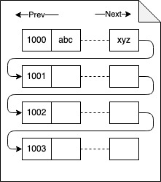
How the data is stored?
Page File
Fixed size storage block
One disk seek can read only one page at a time
All the data is stored in page files.
A row can’t span across multiple page files.

Slide 5
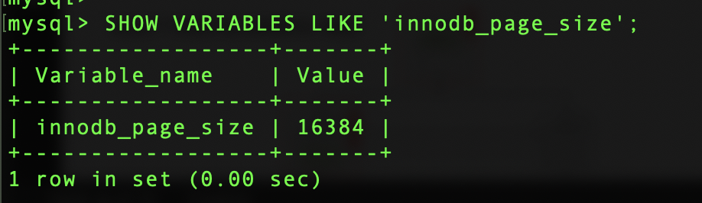
How the data is stored?
Page File
Page file size is configurable.

Slide 6

How the data is stored?
How about images and large text data?

Slide 7
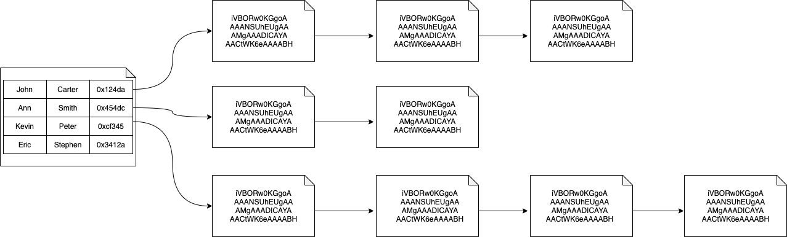
How the data is stored?
Main Data Pages
Off Page Data

Slide 8
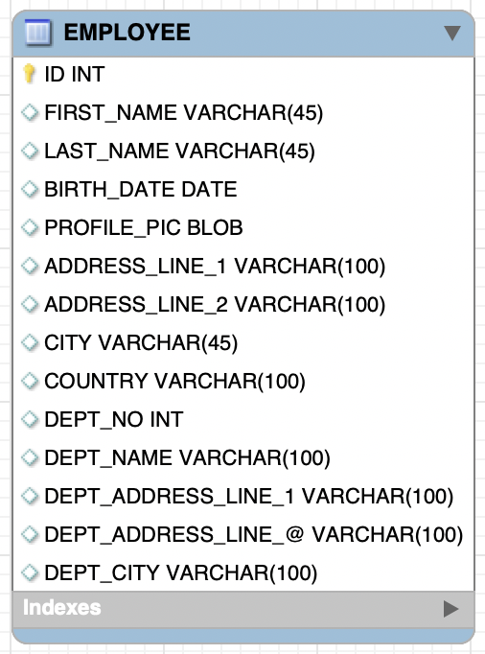
Normalization vs Denormalization
Row Size: 4K
4 Rows per
16K page

Slide 9
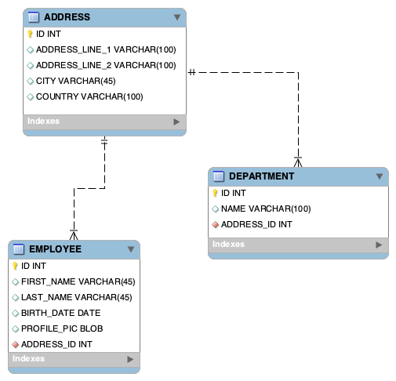
Normalization vs Denormalization
Row Size: 2K
~8 Rows per
16K page
~16 Rows per
16K page
Row Size: 1K
Row Size: 2K
~8 Rows per
16K page

Slide 10
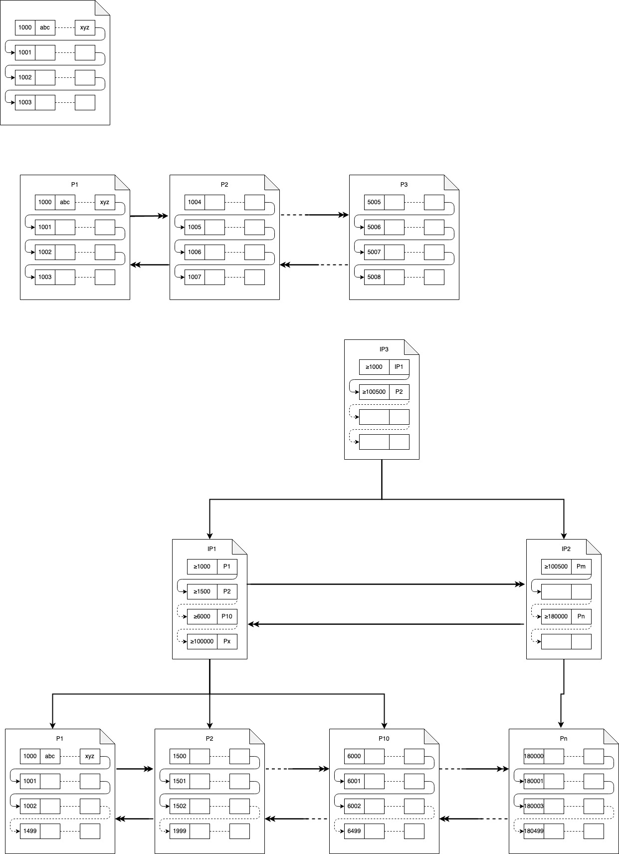
Reading Data
SELECT * FROM TBL WHERE ID = 5006

Slide 11
How indexes works (Primary Key)
SELECT * FROM TBL WHERE ID = 6002

Slide 12
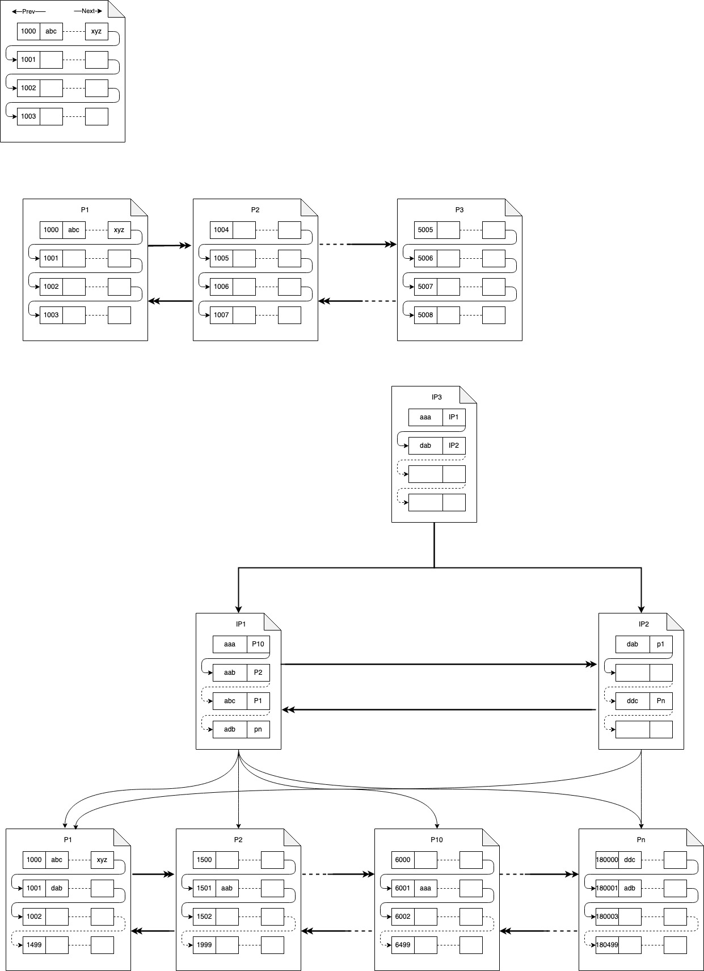
How indexes works (Secondary Index)
SELECT * FROM TBL WHERE NAME = ‘aab’

Slide 13
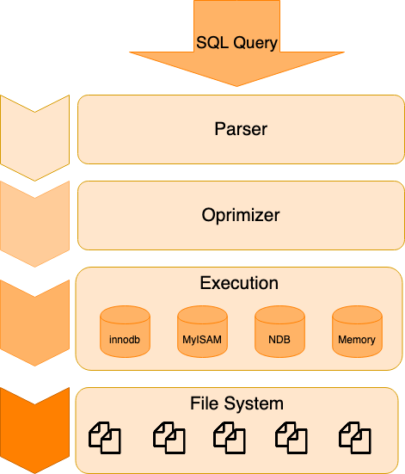
How the queries are executed?
EXPLAIN
Query Profiling

Slide 14
Let’s Optimize Some Queries!

