Slide 1
RDBMS 101

Slide 2
Agenda
What is a Database?
How the data is stored?
Normalization vs Denormalization
Reading Data
How indexes works?
How the queries are executed?
Query Optimization (1)
Read Optimization
Query Optimization (2)
Usage of Functions (1)
Index Cardinality
Implicit Type Casting
Query Optimization (3)
Usage of Functions (2)
Dependent Subqueries
Set Operations

Slide 3

What is a Database?
A magical piece of software developed by group of wizards.
Runs on top of highly special infrastructure designed by them where the general H/W, S/W and network constraints are not applicable.
Capable of storing whatever the BS our application generates.
Capable of giving them back whatever they want, whenever they want, through any BS query that they run.

Slide 4
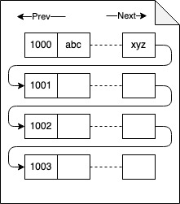
How is the data stored?
Page File
Fixed size storage block
One disk seek can read only one page at a time
All the data is stored in page files.
A row can’t span across multiple page files.

Slide 5
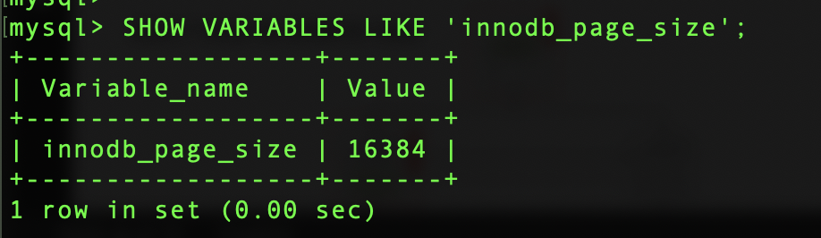
How is the data stored?
Page File
Page file size is configurable.

Slide 6

How is the data stored?
How about images and large text data?

Slide 7
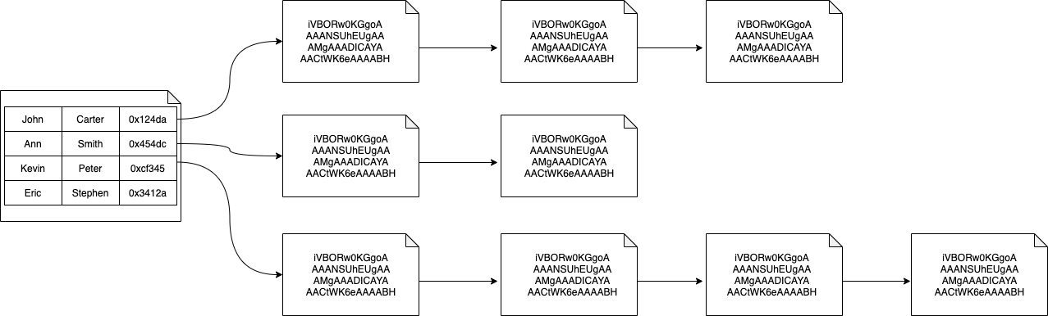
How is the data stored?
Main Data Pages
Off Page Data

Slide 8
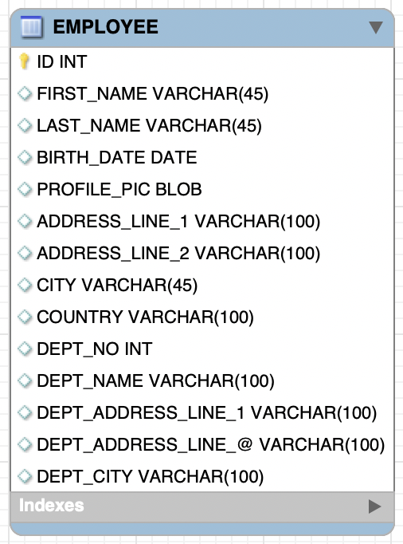
Normalization vs Denormalization
Row Size: 4K
4 Rows per
16K page

Slide 9
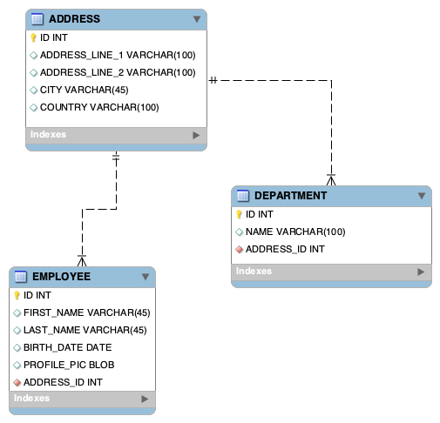
Normalization vs Denormalization
Row Size: 2K
~8 Rows per
16K page
~16 Rows per
16K page
Row Size: 1K
Row Size: 2K
~8 Rows per
16K page

Slide 10
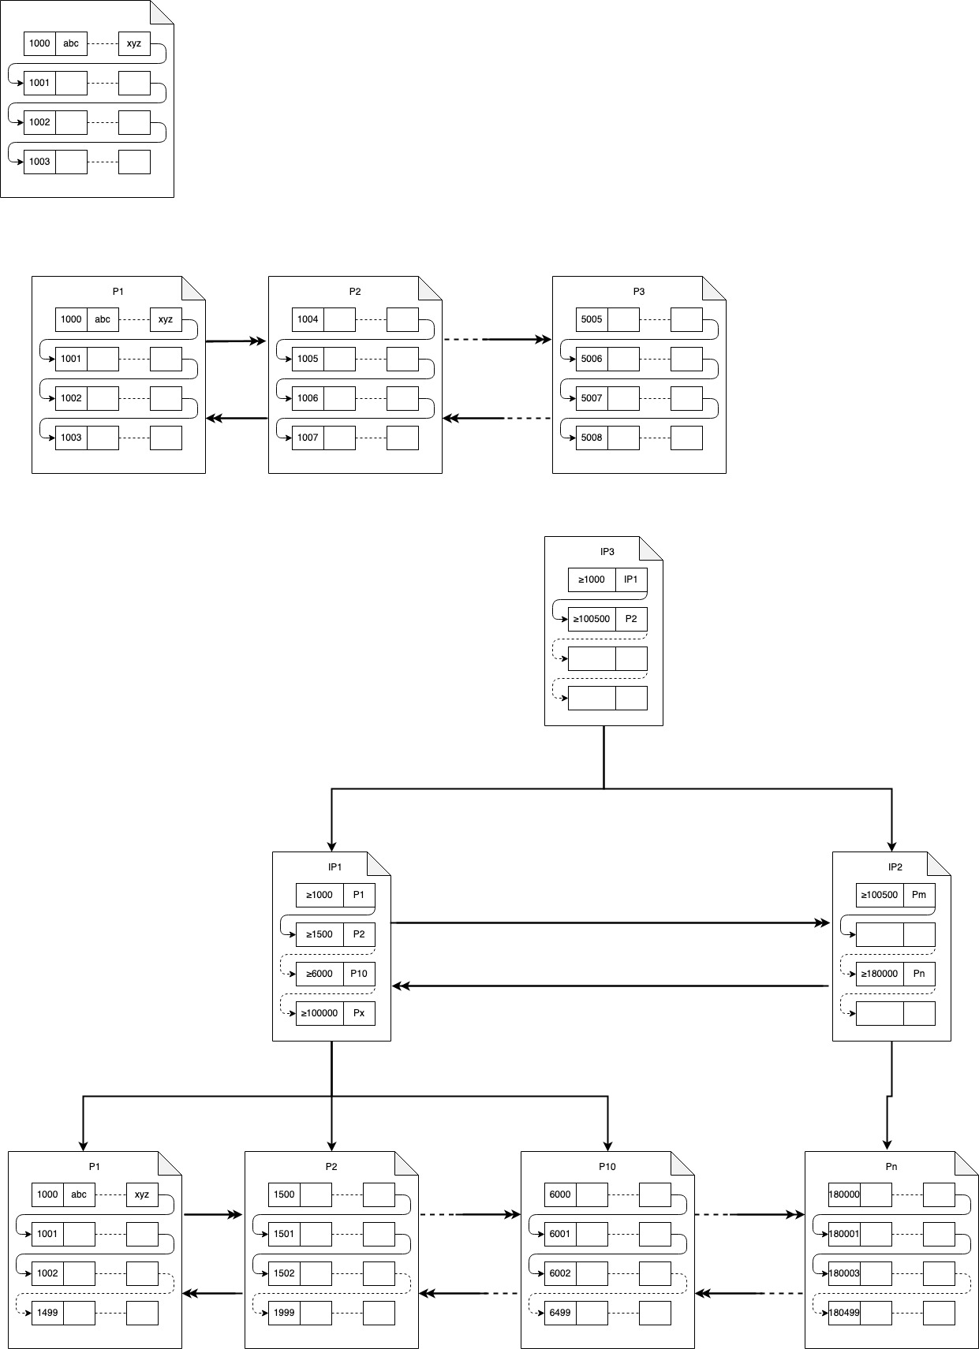
Reading Data
SELECT * FROM TBL WHERE ID = 5006

Slide 11
How does an index work (Primary Key)
SELECT * FROM TBL WHERE ID = 6002

Slide 12
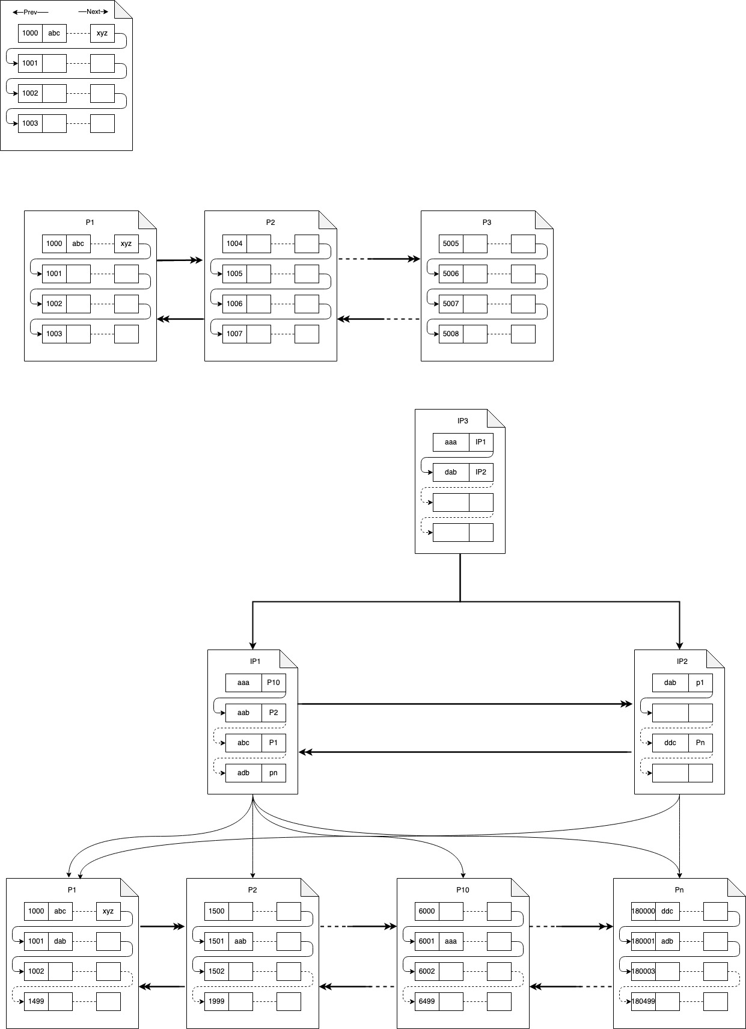
How does an index work (Secondary Index)
SELECT * FROM TBL WHERE NAME = ‘aab’

Slide 13
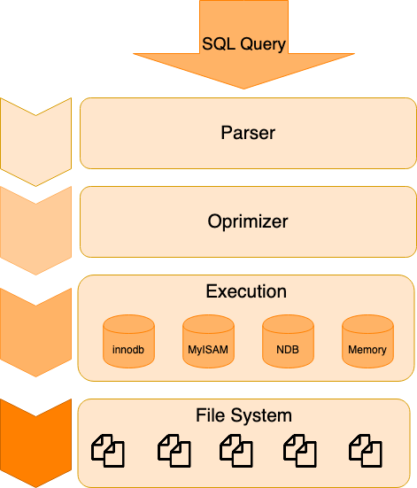
How the queries are executed?
EXPLAIN
Query Profiling

Slide 14
Thank You

