Slide 1
Karma Runner
TM Arunagiri
Apr 2016

Slide 2
Agenda
What is Karma Runner
Need for Karma Runner
How it works
Features of Karma Runner
Configurations & Settings
Know Issues
Conclusion

Slide 3
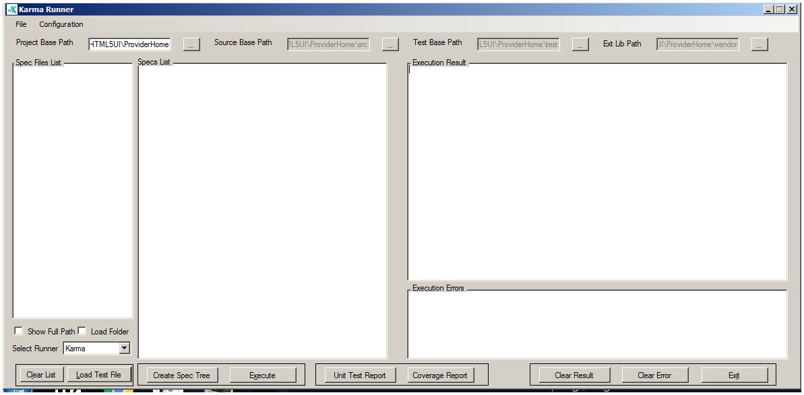
What is Karma Runner
Karma Runner is window based .NET application
It is used to execute unit tests created in jasmine
Provides test result and code coverage report

Slide 4
Need for a Karma Runner
Common problems on Unit testing
Setting up Karma and configuring is a bit complex
Need to directly modify the config for each run
Manually need to get reports
Two different settings for karma and jasmine
Cannot selectively execute specs with ease
Need to depend on developers for reports
Karma Runner eliminates all the above problems

Slide 5
How it works
Uses a template based approach for updating the user selection
Creates configuration files by using the template
Automates the activity for karma / jasmine execution
Uses Karma / Jasmine NPM packages to execute the unit test
Uses lcov /cobertura report packages to create reports

Slide 6
Features of Karma Runner
Allows the user to select a single file or a complete folder
Creates a Tree view by grouping test methods as a node for each test file
Allows to select Specs individually or completely for execution
Allows to select the execution method for Jasmine / Karma
Allows to view the Test result report and Code coverage report
Provides the result and error output.

Slide 7
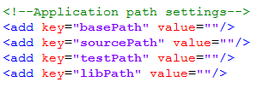
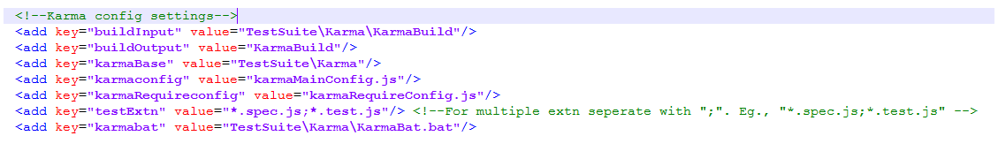
Configurations & Settings
Karma / require /jasmine Configuration can be done if required to suite project needs
Below given application setting can be configured from the application

Slide 8
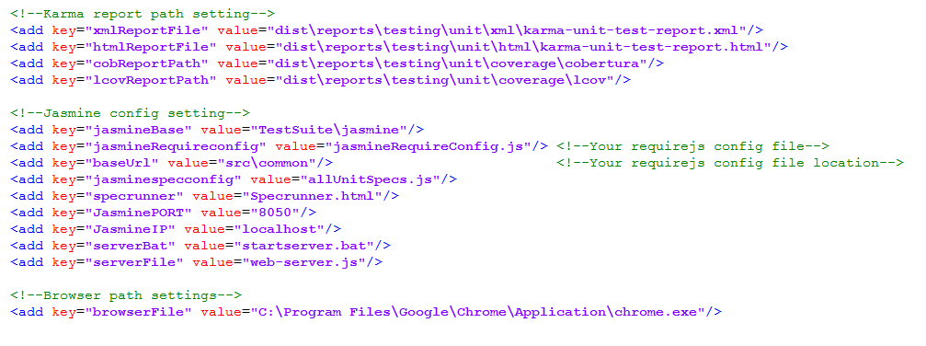
Configurations & Settings cont’d…

Slide 9
Know Issues
Issues
May get a file not found issue on generation report
May get permission denied on execution of jasmine
Resolution
Change the browser path in application setting correctly
2. It may be because the port 8050 is blocked. Change the port setting

Slide 10
Conclusion
Karma runner has following dependency
Node.js
.NET 3.5 framework
No other packages are required as it is bundled with Karma runner
Can be executed by any one without specific knowledge on either Karma / jasmine
Can get reports on a button click
Can be configured for any Angular / JavaScript project that uses jasmine

Slide 11
Thank You

