Slide 1


AI-Powered Detection of Phishing Websites Using URL and Webpage Features
Research proposal and implementation plan: a resilient, explainable, incremental learning framework that detects visually deceptive and content-driven phishing attacks while providing per-decision explanations and operational dashboards.
Team Members
M. Aruna Grace - 2420030100
G. Manaswi - 2420030182

Slide 2
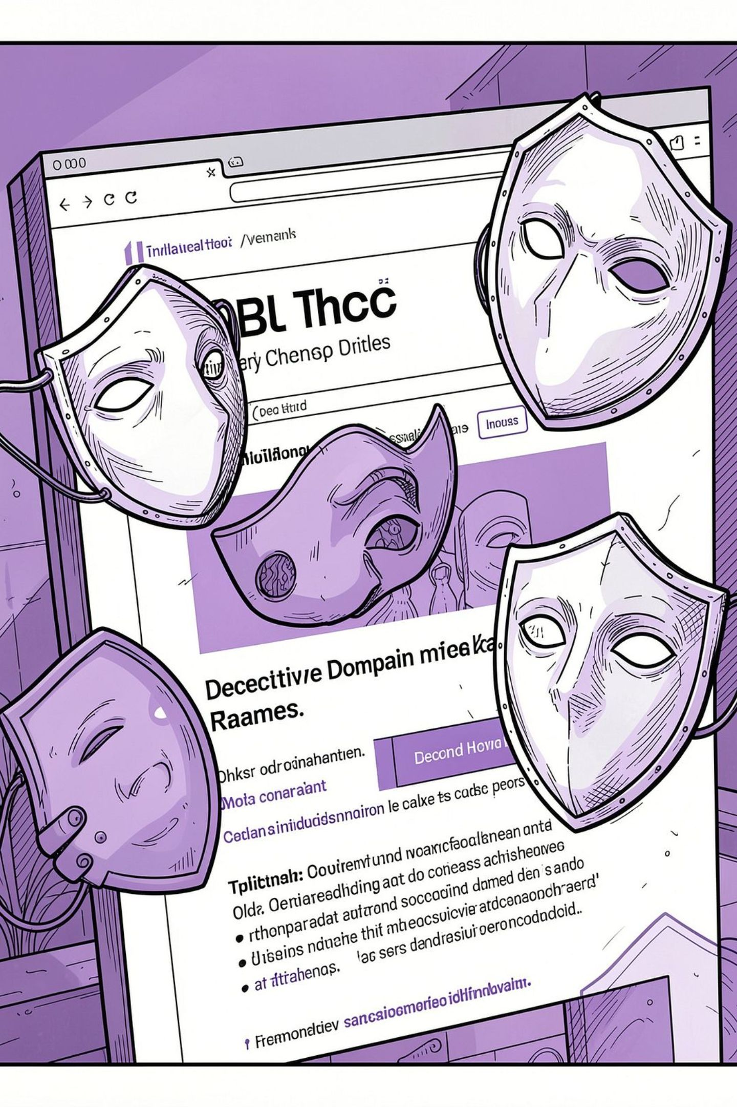

PHISHING DETECTION
PROBLEM STATEMENT
Problem Statement
Phishing sites evolve quickly and exploit visual deception (homographs, punycode, zero-width characters), domain perturbations (bit‑squatting, combo‑squatting), and content tricks to bypass static detectors and blacklists. Existing systems either stale out or lack explainability and real‑time adaptability.
Goal: detect new and visually deceptive phishing attacks with explainable, adaptive ML.

Slide 3


RESEARCH OBJECTIVES
Research Objectives
Our research focuses on addressing critical challenges in phishing detection through a comprehensive approach outlined by the following key objectives.
1
2
3
Heterogeneous Feature Integration
Cross-Dataset and Unseen-Domain Generalization
Explainable and Knowledge-Grounded Detection
To develop PhishXpert, a neural evidence-fusion architecture that independently learns URL-level and HTML-level representations and integrates them for phishing website detection.
To evaluate the proposed framework across D1 and CompPhish datasets, including domain-separated evaluation, to assess its ability to generalize to previously unseen phishing and legitimate domains.
To integrate evidence analysis, RAG-based cybersecurity knowledge retrieval, and Gemini-generated explanations to provide transparent and understandable reasons behind phishing predictions.
4
5
Real-World and Inaccessible-Webpage Handling
Integrated Practical Detection Framework
To develop an adaptive analysis workflow that supports URL + HTML analysis when webpage content is accessible and URL-only analysis when HTML retrieval is unavailable, while maintaining evidence-aware classification.
To implement an end-to-end phishing detection framework combining neural prediction, domain verification, evidence analysis, explainability, and web-based deployment for practical real-world testing.

Slide 4
Related Work: Comparative Analysis (Part 1)
Comparative analysis of phishing detection methods - Part 1
S.No. | Research Paper | Models Used | Outcomes | Main Drawbacks / Research Gap
1 | Look Before You Leap: Detecting Phishing Web Pages by Exploiting Raw URL and HTML Characteristics (WebPhish) | CNN-based deep learning | Learns phishing patterns from raw URL and HTML characteristics | Limited explainability; URL and HTML information is not explicitly modeled through a dedicated evidence-fusion framework; limited practical decision support
2 | An Effective Detection Approach for Phishing Websites Using URL and HTML Features | XGBoost, Random Forest, Logistic Regression, Naïve Bayes, Decision Tree | Demonstrates that combining URL and HTML features can improve phishing detection | Primarily conventional ML; limited explainability and evidence-grounded reasoning; no integrated real-time decision framework
3 | A Sophisticated Framework for the Accurate Detection of Phishing Websites (2024) | Stacking ensemble, feature selection, cross-validation, deep learning | Combines multiple learning approaches and feature-selection techniques for phishing detection | Complex ensemble design; limited knowledge-grounded explanation; generalization to unseen domains and real-world webpage conditions requires further investigation
4 | PhiUSI: A Diverse Security Profile Empowered Phishing URL Detection Framework Based on Similarity Index and Incremental Learning (2024) | Incremental learning, URL Similarity Index (USI) | Detects diverse phishing URLs using similarity analysis and incremental learning | Primarily URL-focused; limited HTML/webpage-content integration; limited explainable evidence and complete webpage-level analysis
5 | A High-Accuracy Phishing Website Detection Method Based on Machine Learning | Logistic Regression, KNN, Naïve Bayes, Random Forest, SVM, XGBoost | Compares multiple ML algorithms and identifies high-performing classifiers | Performance-focused approach; limited explainability and knowledge-grounded reasoning; limited integrated deployment and adaptive webpage analysis

Slide 5
Related Work: Comparative Analysis (Part 2)
Comparative analysis of phishing detection methods - Part 2
S.No. | Research Paper | Models Used | Outcomes | Main Drawbacks / Research Gap
6 | Phishing Website Detection Based on Deep Convolutional Neural Network and Random Forest Ensemble Learning | Deep CNN, Random Forest Ensemble | Combines deep learning and ensemble learning for phishing classification | Higher computational complexity; limited interpretability; does not provide an integrated evidence and knowledge-grounded explanation mechanism
7 | Improved Phishing Attack Detection with Machine Learning: A Comprehensive Evaluation of Classifiers and Features | KNN, SVM, Naïve Bayes, Decision Tree, MLP, SGD | Evaluates multiple classifiers and feature groups for phishing detection | Limited dataset scale and advanced explainability; focuses mainly on classifier comparison rather than cross-domain generalization and integrated decision support
8 | GramBeddings: A New Neural Network for URL-Based Identification of Phishing Web Pages Through N-Gram Embeddings | Deep Neural Network, N-Gram Embeddings, Attention Mechanism | Learns URL patterns automatically using embeddings and neural networks | Primarily URL-focused; lacks integrated HTML/webpage-content analysis; does not address multimodal URL–HTML evidence fusion
9 | Phishing URL Detection Generalisation Using Unsupervised Domain Adaptation | Unsupervised Domain Adaptation, Machine Learning | Investigates model performance across different datasets/domains | Focuses primarily on URL generalization; limited HTML/webpage evidence; explainability and knowledge-grounded reasoning are not central
10 | A Machine Learning-Based Phishing Detection Approach Using URL and Website Features | Random Forest, SVM, Decision Tree, Gradient Boosting | Uses URL and website characteristics to classify phishing and legitimate websites | Performance depends on engineered features; limited explainability; lacks integrated domain verification, evidence retrieval, and natural-language reasoning

Slide 6


Dataset Selection
The D1 Phishing Webpage Dataset provides the main training and evaluation base for PhishXpert, with URL and archived HTML information.
60,252
27,280
32,972
Total Webpages
Phishing
Benign
45.3%
54.7%
Features
The feature set combines 23 engineered features: 7 URL-based and 8 HTML/webpage-based signals.
URL Features
HTML & Webpage Features
7 types: length, domain/path/query length, dots/hyphens/underscores/digits, special characters, entropy, HTTPS/IP, suspicious keywords.
8 types: HTML length, text length, hyperlinks, external links/ratio, forms, password fields, login indicators, external form count/ratio.
Validation Dataset
CompPhish
Purpose
15,358 webpages — 7,204 phishing / 8,154 benign
Cross-dataset generalization and domain-unseen evaluation.

Slide 7
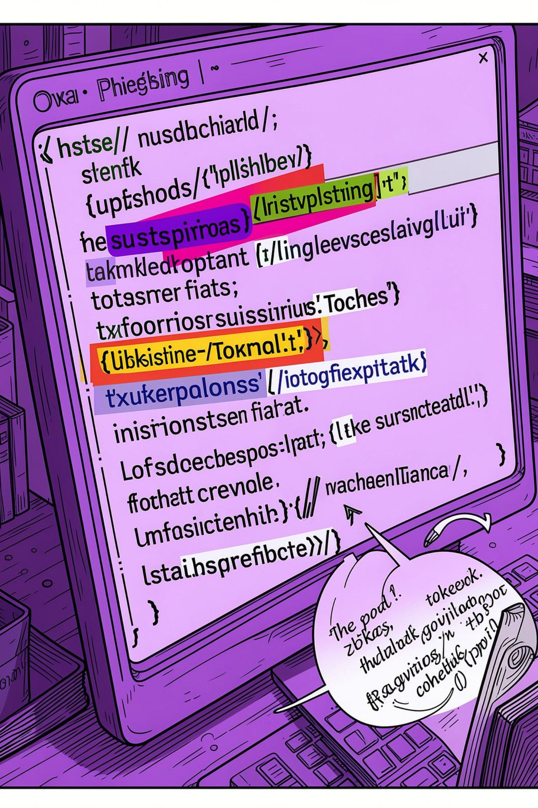
Research Gap & Value Proposition
01
02
Gap 1 — Limited URL–HTML Evidence Fusion
Gap 2 — Limited Unseen-Domain Generalization
Existing approaches often use URL and webpage features, but there is limited use of a dedicated neural architecture that learns URL and HTML representations separately and fuses them.
Many evaluations rely on random dataset splits. Their performance may not fully reflect how models behave on previously unseen domains and datasets.
03
04
Gap 3 — Limited Explainability
Gap 4 — Limited Knowledge-Grounded Reasoning
High-performing phishing classifiers often provide a prediction without sufficiently explaining the evidence contributing to the decision.
Existing detection systems generally do not combine model predictions with retrieved cybersecurity knowledge to produce grounded explanations.
05
Gap 5 — Limited Real-World Adaptive Analysis
Websites may be inaccessible or provide insufficient HTML content. A practical detector therefore needs to support URL + HTML analysis as well as URL-only analysis.
Value proposition: A practical phishing detection system should fuse URL and HTML evidence, generalize to unseen domains, explain its decisions, ground outputs in cybersecurity knowledge, and adapt gracefully when only URL evidence is available.

Slide 8
Enhancements
A clearer, stronger pipeline that expands analysis, enriches features, improves modeling, and adds explainability.
Feature | Existing System | Proposed PhishXpert
Analysis | URL + HTML analysis | Multi-modal URL + HTML analysis
Features | Conventional URL/HTML features | 23 engineered features with entropy, keywords, links and form indicators
Model | XGBoost / conventional ML | Two-branch Neural Evidence Fusion
Generalization | Dataset-based evaluation | D1 + CompPhish + domain-unseen evaluation
Explainability | Prediction-focused | Evidence + RAG + Gemini-generated explanation
Deployment | Limited integration | FastAPI + interactive frontend + URL-only fallback

Slide 9
Why This Solution Stands Out
Innovation
Novelty
Creativity
Feasibility
Two-branch URL + HTML Neural Evidence Fusion
23 engineered URL/HTML features
Adaptive URL + HTML / URL-only analysis
ML prediction + domain + webpage evidence
RAG-based cybersecurity knowledge grounding
Cross-dataset and domain-unseen evaluation
Benign / Suspicious / Phishing decisions
Confidence + evidence + explanation
Gemini-powered natural-language explanations
FastAPI + interactive web interface
Real-time URL analysis
Practical fallback for inaccessible webpages

Slide 10




Clients & Application Areas
Where phishing detection creates the most value across industries and user groups.
Banks & Financial Institutions
E-commerce Companies
Detect fake banking and payment websites.
Identify fraudulent shopping and payment pages.
Cybersecurity Organizations
Educational Institutions & Students
Monitor and detect phishing threats.
Improve awareness and protection against phishing.

Slide 11


PROJECT PLAN

Slide 12







Methodology
End-to-end workflow from data collection to deployment.
Dataset Collection
Data Preprocessing
Feature Extraction
D1 Phishing Webpage Dataset — 60,252 webpages
27,280 Phishing | 32,972 Benign
CompPhish — 15,358 webpages for cross-dataset and unseen-domain evaluation
Label mapping (-1 → Benign, 1 → Phishing), missing HTML handling, feature normalization and stratified/domain-separated dataset splits
23 URL + HTML-derived features including URL structure, entropy, suspicious keywords, hyperlink statistics, HTML/text length, forms, password fields, login indicators and external forms
Baseline Model Development
PhishXpert Model Development
Generalization & Explainability
Compare conventional ML models: Random Forest, XGBoost, CatBoost and LightGBM
Perform feature analysis and XGBoost hyperparameter optimization
Proposed two-branch Neural Evidence Fusion architecture
URL branch + HTML branch → Feature Fusion → Phishing Classification
Evaluate cross-dataset and domain-unseen generalization using D1 and CompPhish
Integrate webpage evidence, domain verification, RAG-based cybersecurity knowledge and Gemini explanations
Adaptive Detection & Deployment
FastAPI backend + interactive frontend

Slide 13
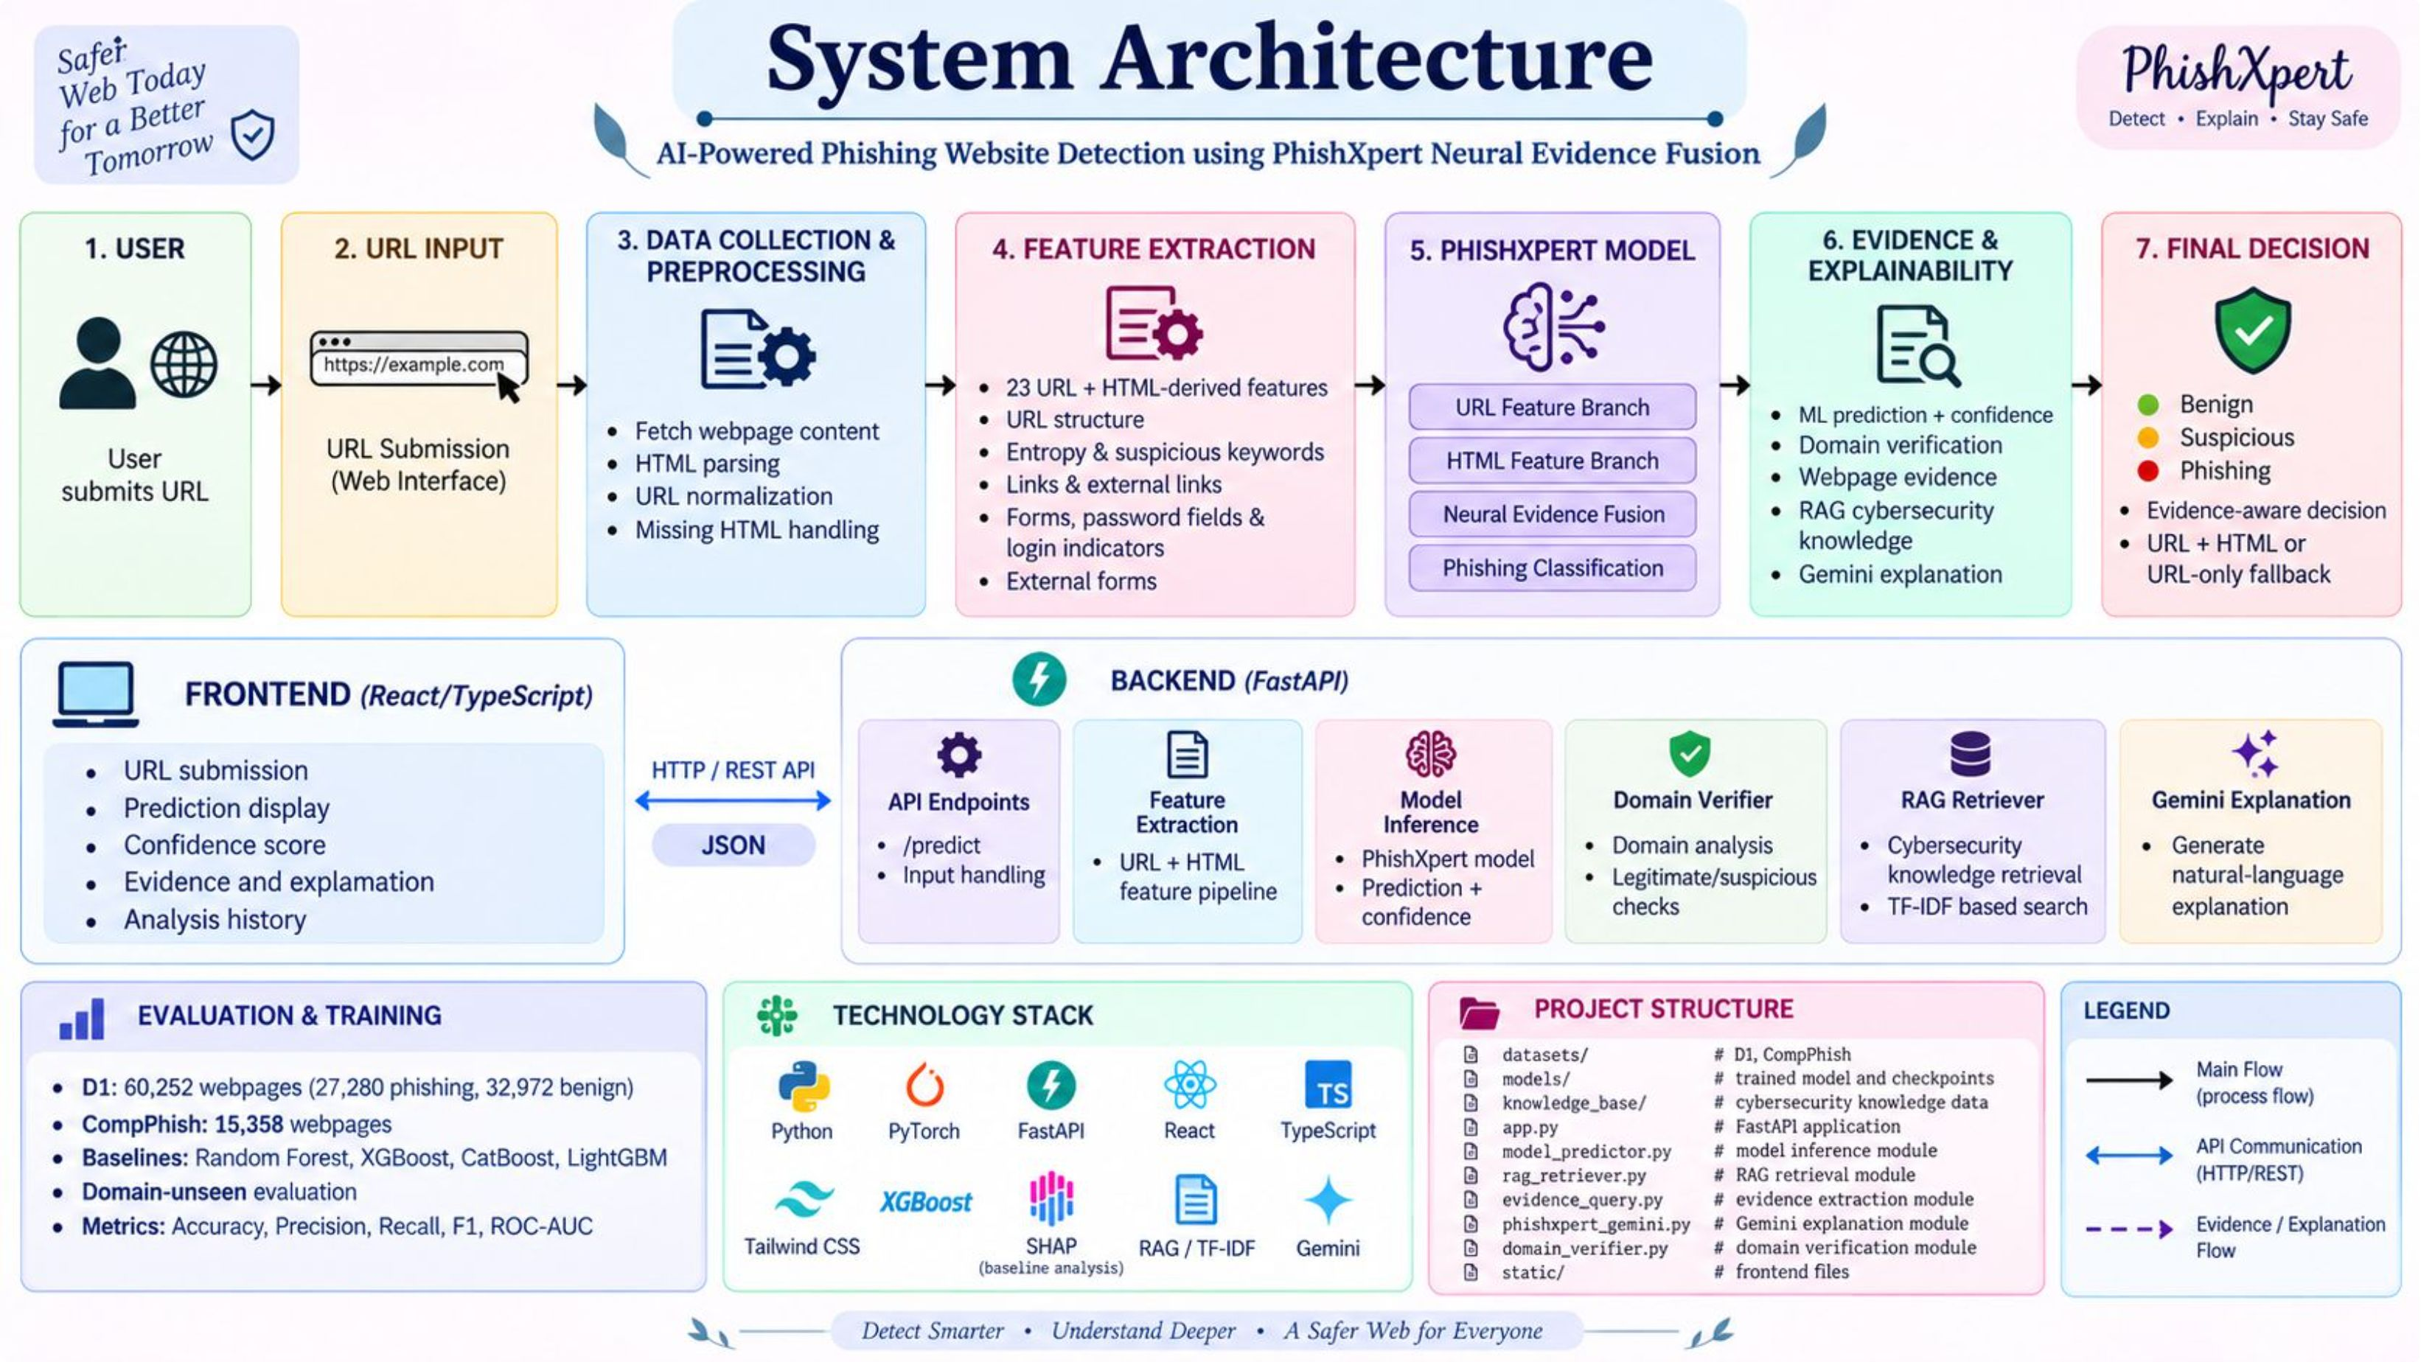
System Design

Slide 14
Modern Tools & Technologies
Core technologies used across data preparation, modeling, evidence fusion, deployment, and development.
Category | Technologies
Programming | Python, TypeScript
Data Processing | Pandas, NumPy, Scikit-learn
Feature Extraction | BeautifulSoup, Requests
Proposed ML Model | PyTorch – PhishXpert Neural Evidence Fusion
Baseline ML Models | Random Forest, XGBoost, CatBoost, LightGBM
Model Optimization | XGBoost Hyperparameter Optimization, AdamW, Early Stopping
Explainable AI | SHAP (baseline/model analysis)
Evidence & Knowledge | RAG, TF-IDF, Cosine Similarity
LLM Explanation | Google Gemini API
Domain Verification | Python-based Domain Verification
Backend | FastAPI, Uvicorn
Frontend | React, TypeScript, Vite, Tailwind CSS
Web Analysis | Requests, BeautifulSoup, HTML Parsing
Visualization | Matplotlib
Development & Version Control | VS Code, GitHub

Slide 15

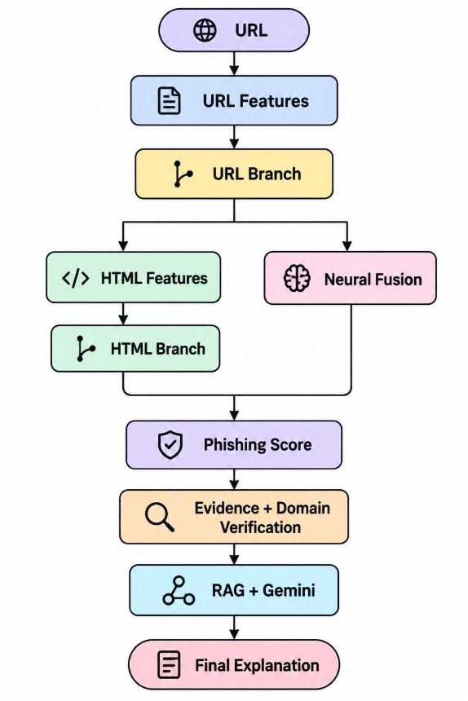
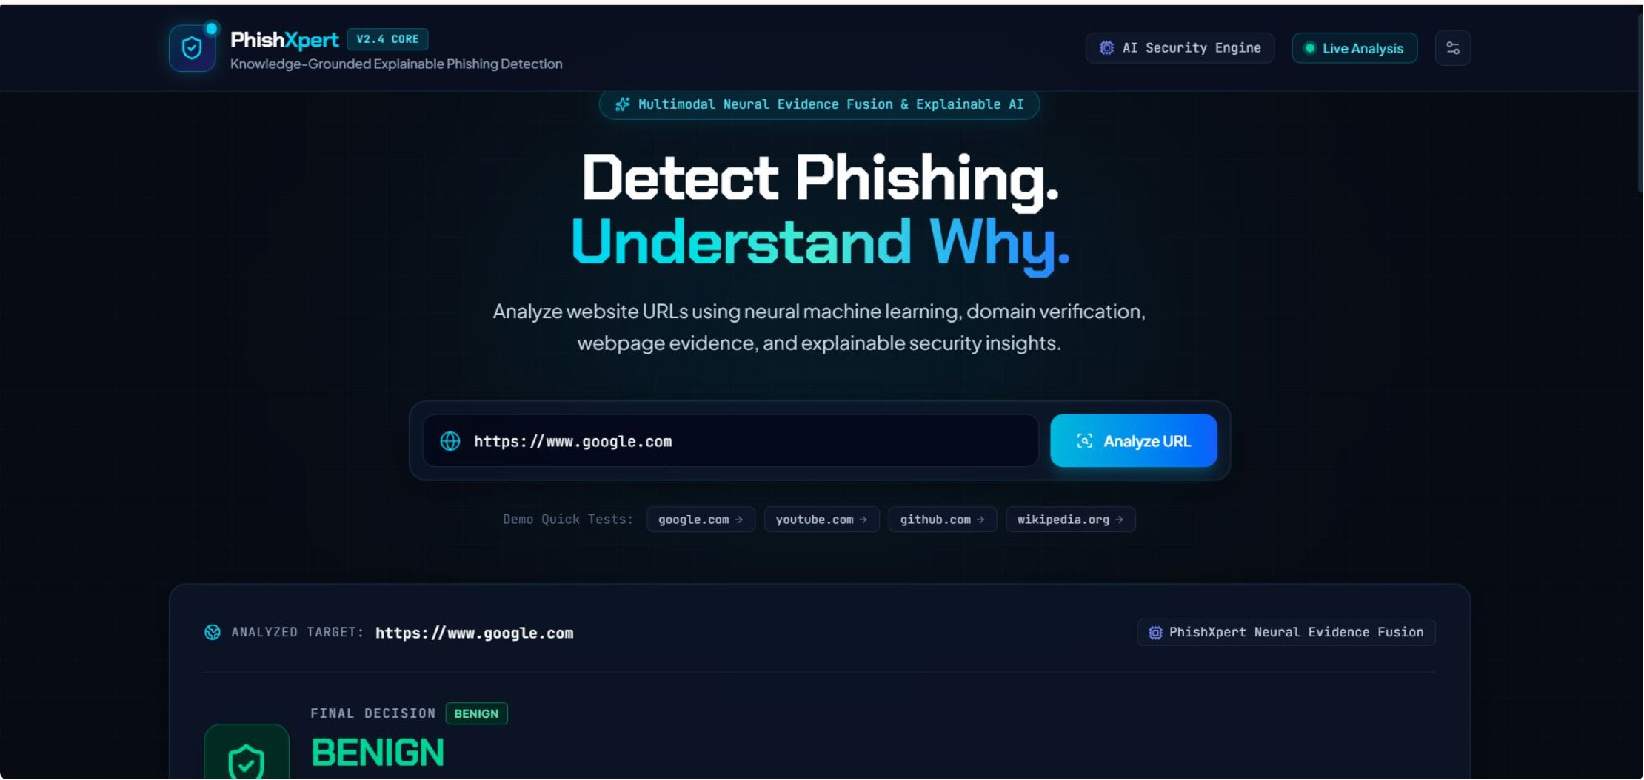
Implementation
1
2
3
4
Feature Extraction
Model Development
Explainability & Evidence
Web Application
Extract 23 URL and HTML-derived features
URL structure, entropy and suspicious keywords
HTML/text length and hyperlink statistics
Forms, password fields and login indicators
External links and external-form indicators
Implemented PhishXpert two-branch neural architecture
Separate URL and HTML feature branches
Neural feature fusion for phishing classification
AdamW optimization with early stopping
Compared against RF, XGBoost, CatBoost and LightGBM baselines
Model prediction and confidence
Domain verification
Webpage evidence analysis
TF-IDF + RAG cybersecurity knowledge retrieval
Gemini knowledge-grounded natural-language explanation
User submits URL through React interface
FastAPI fetches webpage and extracts features
PhishXpert generates prediction
Supports URL + HTML and URL-only fallback
Displays Benign / Suspicious / Phishing, confidence, evidence and explanation

Slide 16


Results
Dataset Processing
60,252
23
48,201
12,051
Total Samples
Features
Training Samples
Testing Samples
Baseline Model Comparison
Model | Accuracy | ROC-AUC
Random Forest | 88.29% | 95.21%
XGBoost | 88.48% | 95.51%
CatBoost | 87.68% | 94.95%
LightGBM | 88.09% | 95.39%
Optimized XGBoost | 88.58% | 95.73%
Proposed PhishXpert Results
PhishXpert — D1 Test Set
Accuracy: 85.68%
Precision: 84.73%
Recall: 83.39%
F1-Score: 84.06%
ROC-AUC: 93.73%
Cross-Dataset Generalization — CompPhish
Random holdout
Domain-unseen
Accuracy: 87.17%
ROC-AUC: 95.13%
Accuracy: 84.56%
ROC-AUC: 94.09%

Slide 17


Performance Evaluation
Evaluation Metrics
Accuracy
Precision
Recall
F1-Score
Measures the proportion of correctly classified benign and phishing webpages.
Measures how many webpages predicted as phishing are actually phishing.
Measures how many actual phishing webpages are correctly detected.
Provides a balance between precision and recall.
ROC-AUC
Confusion Matrix
Measures the model's ability to distinguish phishing from benign webpages across classification thresholds.
Shows correct and incorrect classifications for benign and phishing classes.
Key Observations
Optimized XGBoost baseline: 88.58% Accuracy and 95.73% ROC-AUC on the D1 test set.
PhishXpert: 85.68% Accuracy, 84.06% F1-Score and 93.73% ROC-AUC on the D1 test set.
CompPhish random holdout: 87.17% Accuracy and 95.13% ROC-AUC.
CompPhish domain-unseen evaluation: 84.56% Accuracy and 94.09% ROC-AUC.
PhishXpert combines URL–HTML neural evidence fusion with domain verification, webpage evidence, RAG and Gemini-based explanations.
The system is integrated into a working FastAPI + React web application.

