Slide 1


AI-Powered Detection of Phishing Websites Using URL and Webpage Features
Research proposal and implementation plan: a resilient, explainable, incremental learning framework that detects visually deceptive and content-driven phishing attacks while providing per-decision explanations and operational dashboards.
Team Members
M. Aruna Grace - 2420030100
G. Manaswi - 2420030182

Slide 2
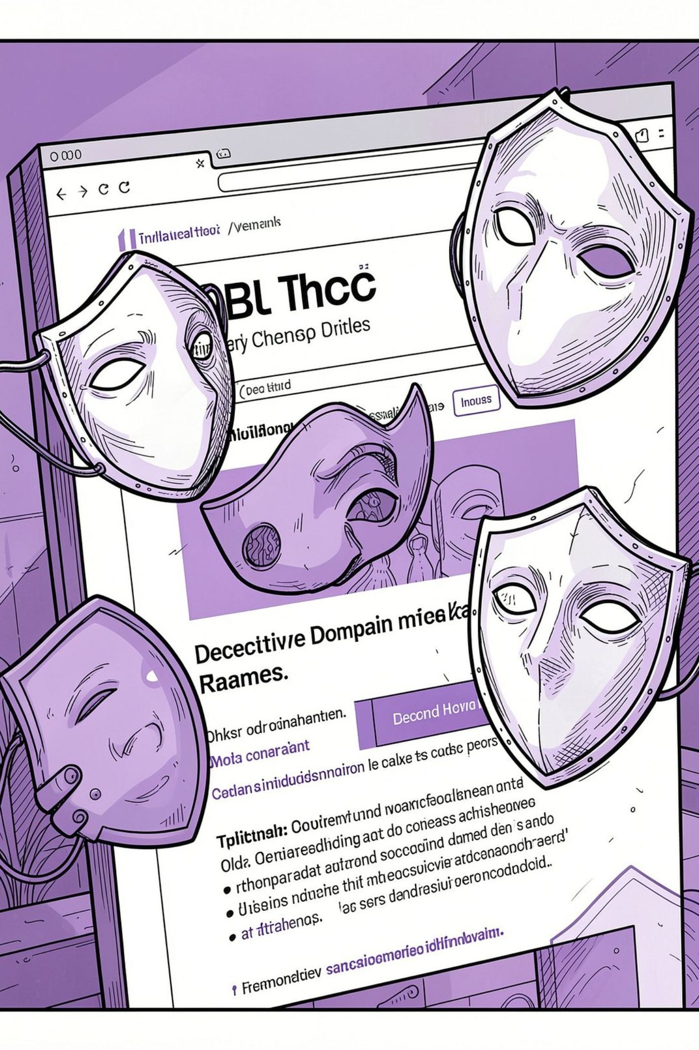

Problem Statement
Phishing sites evolve quickly and exploit visual deception (homographs, punycode, zero-width characters), domain perturbations (bit‑squatting, combo‑squatting), and content tricks to bypass static detectors and blacklists. Existing systems either stale out or lack explainability and real‑time adaptability.
Goal: detect new and visually deceptive phishing attacks with explainable, adaptive ML.

Slide 3
Objectives
AI-Powered Detection
Enhanced Feature Engineering
Optimized ML Model
To Develop a system for detecting phishing and legitimate websites by analyzing URL, HTML, and webpage text features.
To Train and compare XGBoost, CatBoost, and LightGBM models. Apply feature selection and hyperparameter optimization.
To Extract important URL, HTML, hyperlink, and text features. Introduce new features such as URL entropy and suspicious keyword score.
Text Analysis
Explainability & Accuracy
To Clean and preprocess webpage textual content. Use TF-IDF for identifying suspicious text patterns.
To Provide prediction explanations using SHAP or LIME. Improve and compare accuracy with the existing research baseline.

Slide 4
Related Work: Comparative Analysis
S.No.
Research Paper
Models Used
Outcomes
Main Drawbacks
1
Look Before You Leap: Detecting Phishing Web Pages by Exploiting Raw URL and HTML Characteristics (WebPhish)
CNN-based deep learning
Automatically learns phishing patterns from raw URL and HTML
No explainable AI; no WHOIS/SSL features; no ensemble learning; limited interpretability
2
An Effective Detection Approach for Phishing Websites Using URL and HTML Features (Scientific Reports, Nature)
XGBoost, Random Forest, Logistic Regression, Naïve Bayes, Decision Tree, ensemble methods
Demonstrates combining URL and HTML features improves detection
No explainable AI; handcrafted features; no browser deployment; no online learning
3
A Sophisticated Framework for the Accurate Detection of Phishing Websites (2024)
Stacking ensemble, feature selection, cross-validation, deep learning
Provides robust framework combining feature selection and multiple learning approaches
No explainability; no complete deployment; depends on feature engineering
4
PhiUSIIL: A Diverse Security Profile Empowered Phishing URL Detection Framework Based on Similarity Index and Incremental Learning (2024)
Incremental learning, URL similarity index (USI)
Detects diverse phishing URL attacks using similarity analysis and incremental learning
Near-perfect accuracy makes improvement difficult; no explainable AI; no full web application
5
A High-Accuracy Phishing Website Detection Method Based on Machine Learning
Logistic Regression, KNN, Naïve Bayes, Random Forest, SVM, XGBoost
Compares several ML algorithms and identifies high-performing models
Limited explainability; mainly focuses on classification performance

Slide 5
Related Work: Additional Research (Continued)
S.No.
Research Paper
Models Used
Outcomes
Main Drawbacks
6
Phishing Website Detection Based on Deep Convolutional Neural Network and Random Forest Ensemble Learning
Deep CNN, Random Forest Ensemble
Combines deep learning and ensemble learning to improve phishing website classification
Higher computational complexity; limited explainability
7
Improved Phishing Attack Detection with Machine Learning: A Comprehensive Evaluation of Classifiers and Features
KNN, SVM, Naïve Bayes, Decision Tree, MLP, SGD
Compares different classifiers and feature groups for phishing detection effectiveness
Limited dataset size; limited advanced explainability
8
GramBeddings: A New Neural Network for URL-Based Identification of Phishing Web Pages Through N-Gram Embeddings
Deep Neural Network, N-Gram Embeddings, Attention Mechanism
Learns URL patterns automatically using embeddings and neural networks
Mainly URL-focused; lacks HTML/webpage content integration
9
Phishing URL Detection Generalisation Using Unsupervised Domain Adaptation
Unsupervised Domain Adaptation, Machine Learning
Improves understanding of phishing detection model performance across different datasets
Focuses on URL generalization; limited webpage/HTML features
10
A Machine Learning-Based Phishing Detection Approach Using URL and Website Features
Random Forest, SVM, Decision Tree, Gradient Boosting
Shows URL and website characteristics can effectively classify phishing and legitimate websites
Performance depends on feature selection; limited explainability

Slide 6


Dataset Selection
D1 Phishing Webpage Dataset Overview
45%
55%
Phishing Webpages
Benign Webpages
27,280 instances providing ample data for training on malicious patterns.
32,972 instances ensuring a balanced representation of legitimate sites.
This dataset comprises a total of 60,252 webpages, offering a comprehensive base for our analysis.
Key Features Utilized
URL Features
Webpage Text
Analysis of character sequences and structural components within the URL.
Utilizing TF-IDF for identifying suspicious keywords and textual patterns.
Hyperlink Features
Login Form Features
Examining external and internal link structures for deceptive practices.
Detecting characteristics often present in phishing login pages.

Slide 7
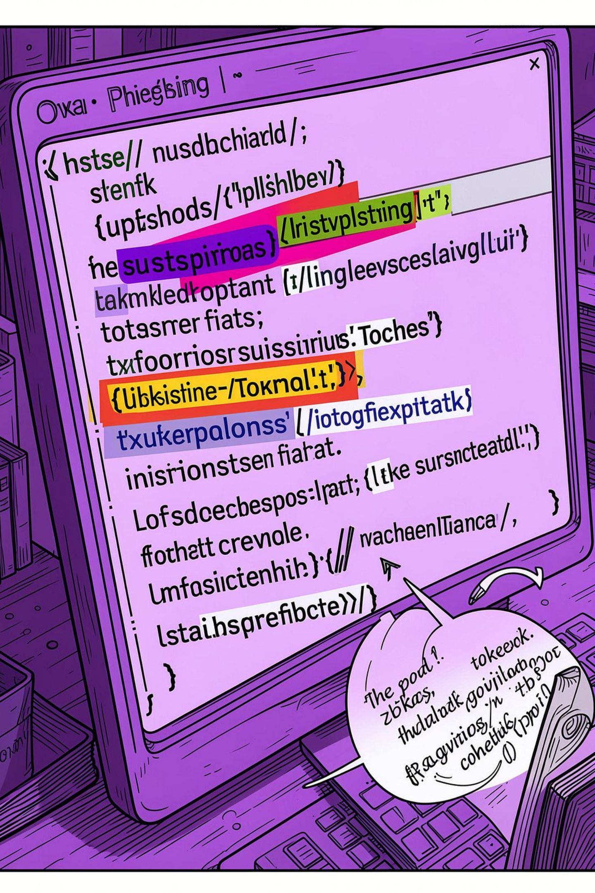
Research Gap & Value Proposition
Key gaps: (1) no robust explainability for analyst trust; (2) limited use of rendered webpage text/features; (3) lack of production-ready front-end/back-end integration. Our proposal closes these gaps by integrating SHAP/LIME, TF–IDF/text signals, UI + analytics, and incremental learners optimized for cost and stability.

Slide 8
Enhancements
Feature
Existing System
Proposed System
Analysis
URL & HTML analysis
URL + HTML + Webpage Text Analysis
Features
Basic features
Entropy + Keywords + Brand Similarity
Model
XGBoost
Optimized ML + Ensemble Models
Explainability
No explanation
SHAP-based explanations

Slide 9
Innovation
Creativity
Combine URL, HTML, and webpage text analysis for stronger phishing detection.
Add Entropy, keyword, and brand similarity features.
Display a confidence score with each check.
Offer an interactive dashboard for history and performance.
Feasibility
Novelty
Provide a simple interface for instant URL checks.
Keep the workflow fast and easy to use.
Use SHAP to explain each phishing prediction.
Show the main factors behind every result.

Slide 10




Clients & Application Areas
Banks & Financial Institutions
E-commerce Companies
Detect fake banking and payment websites.
Identify fraudulent shopping and payment pages.
Cybersecurity Organizations
Educational Institutions & Students
Monitor and detect phishing threats.
Improve awareness and protection against phishing.

Slide 11

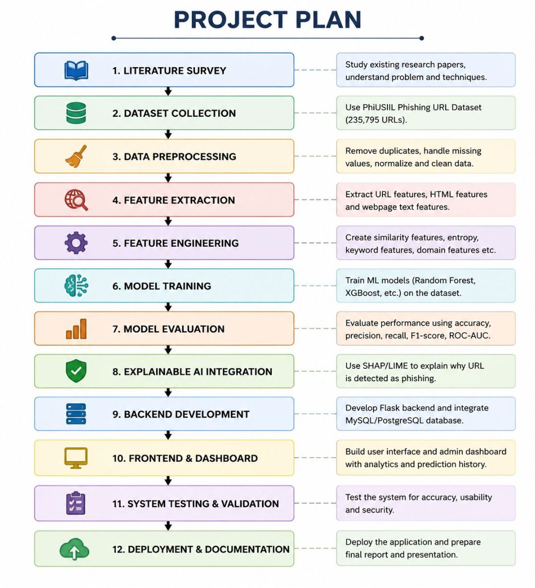
PROJECT PLAN

