Slide 1
Reactive Programming

Slide 2
What is Reactive programming?
Asynchronous programming concerned with data streams and propagation of change.
A new programming paradigm
Data flow as an event driven stream
Asynchronous & Non –blocking
Back pressure on data stream
Functional style code
Producer –Consumer
Consumer is pushing back data to Publisher to slow down the process.
Reading from file is faster where as Write into File can be slow.

Slide 3
Rest API(Traditional) Vs Reactive Rest API
Limit on number of concurrent users, using threads per request
Synchronous and Blocking
Imperative style APIs
No Back Pressure support
Asynchronous and Non blocking.
Move away from Thread per request model
Use few threads
Back Pressure Compatible

Slide 4
Why do we need Reactive programming
Past
Monolithic application were running in App server which does not support distributed systems
Today
We are into Microservices world, which are complete running on cloud, support distributed systems

Slide 5
Why do we need Reactive programming
Smooth user experience with high frequency , low latency.
Best utilization of resources
Suitable for processor intensive applications
Complex/time consuming work in the background.
Data flow as an event driven stream.

Slide 6
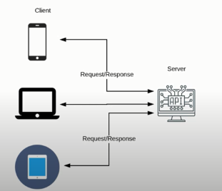
Expectations of App
Rest API request of Spring MVC/ SpringBoot App
Scale based on the load
Use resources efficiently
Low Latency (response time)

Slide 7
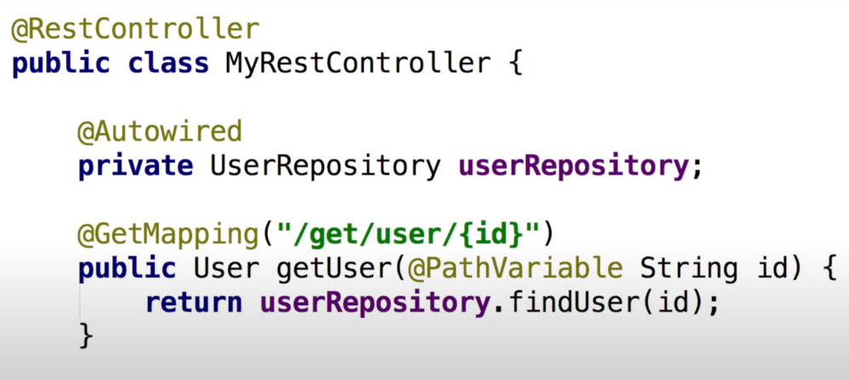

Slide 8
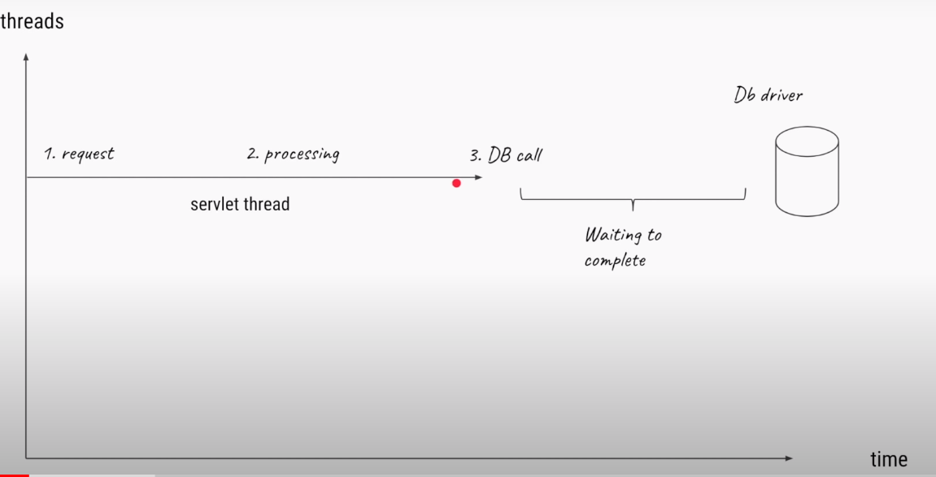
Request process in thread per request model

Slide 9
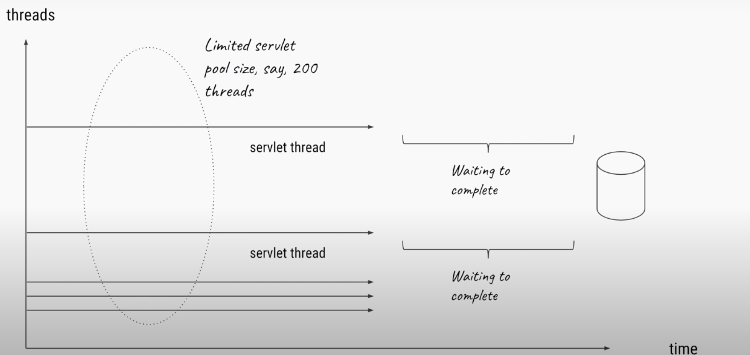
Concurrent request

Slide 10
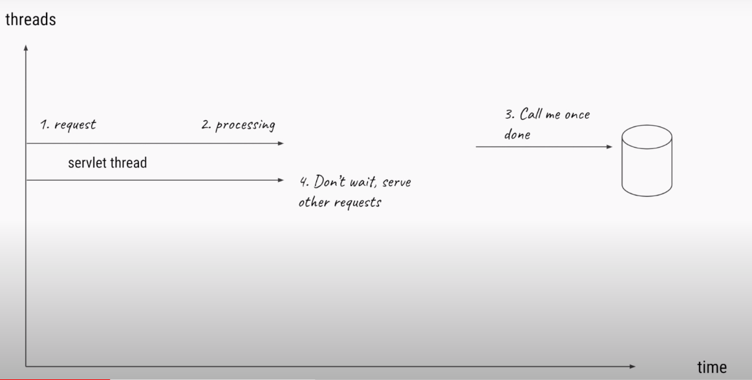
To avoid thread going blocking mode

Slide 11
Introduction
Spring WebFlux is the reactive web framework, has been added Spring 5.0.
It is fully non-blocking
Supports reactive streams
Back pressure
Runs on servers such as Netty, Undertow, and Servlet 3.1+ containers

Slide 12
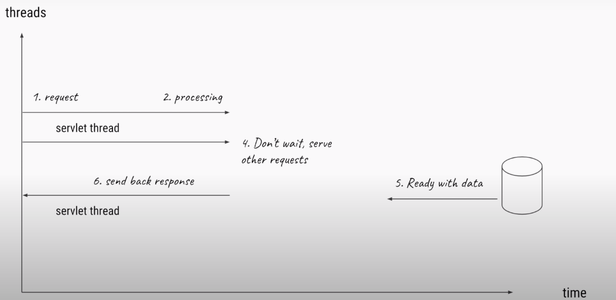

Slide 13
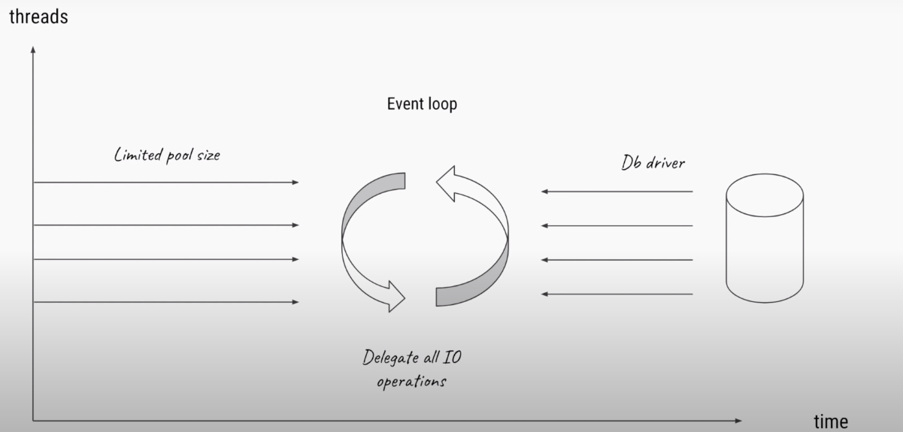
Event loop mechanism

Slide 14
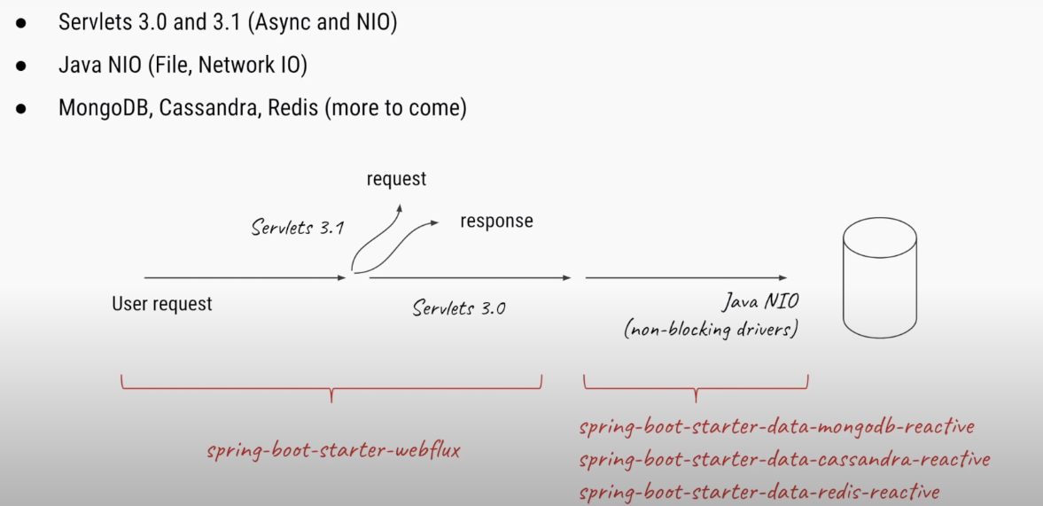
Spring WebFlux

Slide 15
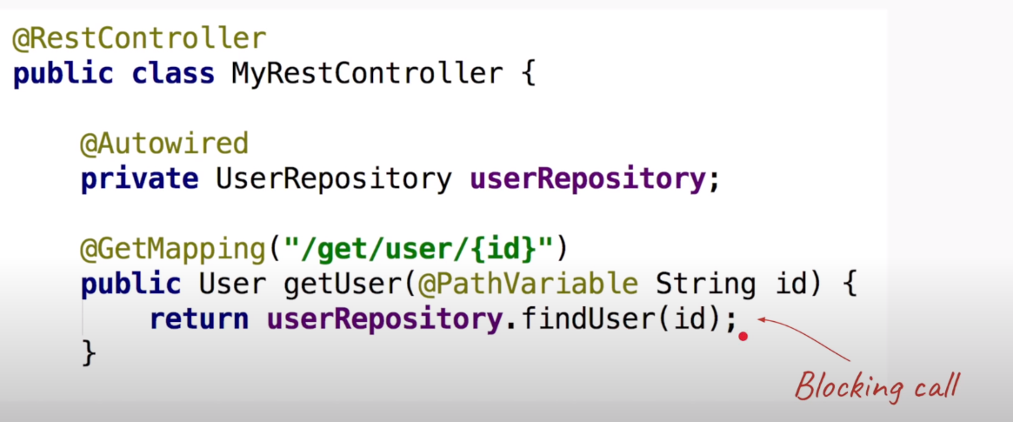
Spring WebFlux – Code perspective

Slide 16
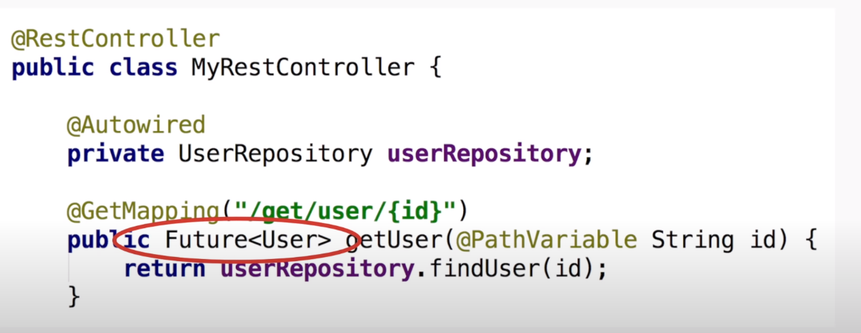

Slide 18
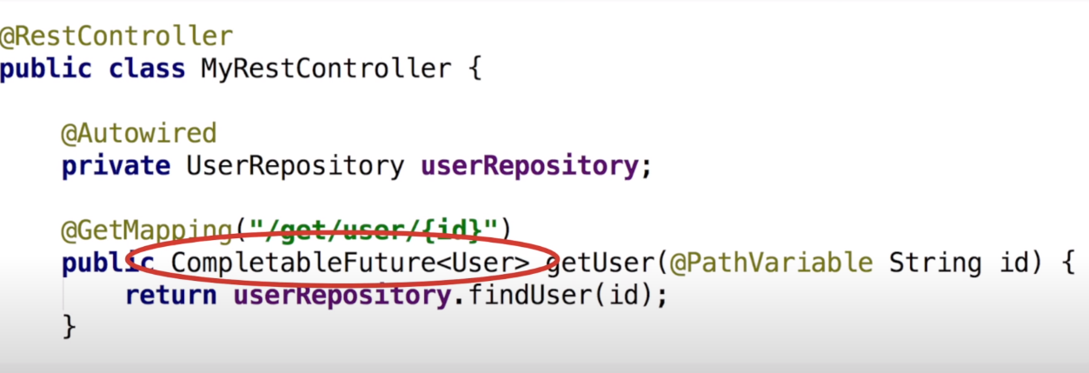

Slide 19
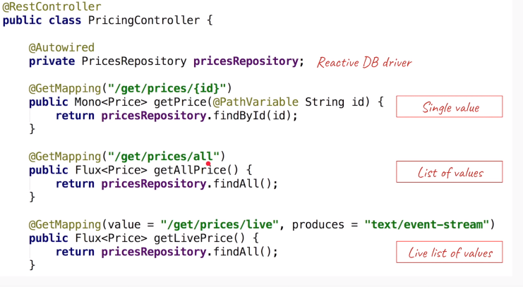
Getting data using event streams using WebFlux

Slide 20
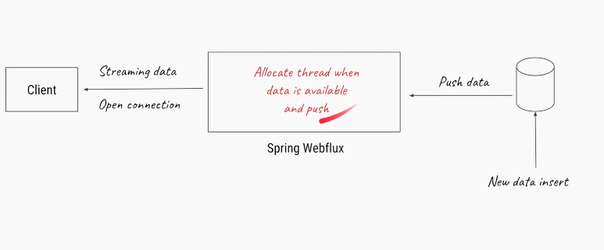

Slide 21
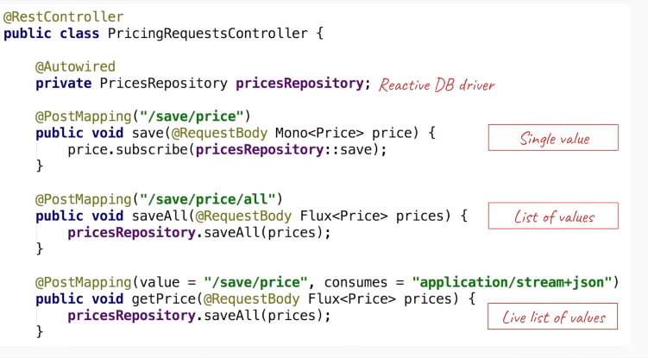
Posting data using event streams using WebFlux

Slide 22
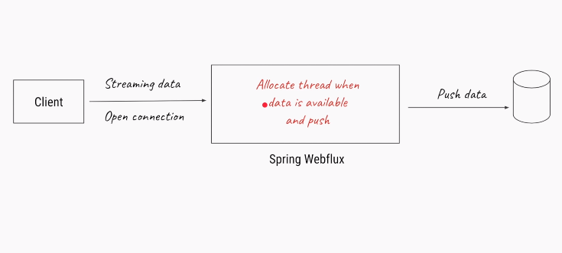

Slide 23
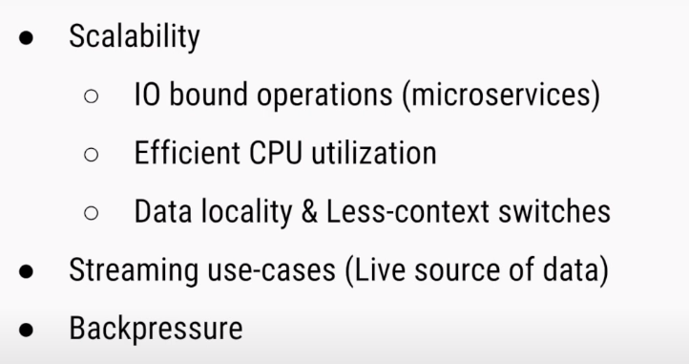
Advantages

Slide 24
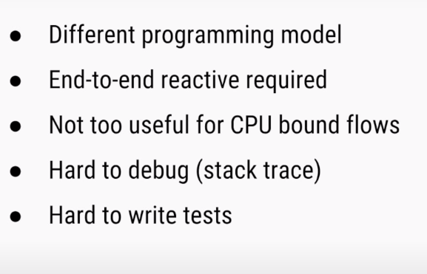
Considerations

Slide 25
Thank you

