Slide 1
J2EE
Servlets

Slide 2
What is a Web Component?
A web component is a software entity that runs on a web server, providing it with the capabilities needed for dynamically handling client requests and generating web presentation content.
2

Slide 3
What is a Servlet?
A java program that is responsible for generating dynamic content and interacting with Web clients using a request-response paradigm.
3
Notes:
3

Slide 4
Features of Servlet
Security : Inherits the security feature provided by the container.
Session Management : Maintains the identity and state of an end user across multiple requests.
Instance Persistence : Enhances the performance of the server by preventing frequent disk access.
Platform and server independent.
Available and running on all major web servers and application servers.
4
Notes:
4
1. Security: A Web container provides a runtime environment for executing a
servlet. Servlets inherit the security feature provided by the Web container. This
allows developers to focus on the servlet functionality and leave the security
issues to the Web container to handle.
2. Session management: It is the mechanism of tracking the state of a user across
multiple requests. A session maintains the client identity and state across
multiple requests.
3. Instance persistence: Servlets help to enhance the performance of the server by
preventing frequent disk access. For example, if a customer logs on to an online
banking site, the customer can perform activities, such as checking for the
balance or applying for a loan. The account number of the customer will be
validated at every stage from the database. Instead of every time checking the
account number against the database, servlets retain the account number in the
memory till the user logs out of the Web site.

Slide 5
Building a Servlet
J2EE Application Server
Web Container
Request
Servlet
Web Client (Browser)
Response
5
Notes:
5
Features of CGI:-
Written in C, C++, VB and Perl language.
Resource intensive and inefficient.
Difficult to maintain, non-scalable, non-manageable.
Platform and application specific.
Features of Servlets:
Written in Java.
Powerful, reliable and efficient.
Improves Scalability.
Platform independent and portable.

Slide 6
Building a Servlet
J2EE Application Server
Web Container
Request
Loads The Servlet class
First Client
Instantiates the Servlet
Initializes the Servlet Instance
Passes request to the Servlet Instance
Response
Sends Response
6
Notes:
6
Working of Servlets
Whenever a client sends a request to the J2EE application server for a particular
servlet, the J2EE application server passes the request to the Web container. The Web
container checks whether an instance of the requested servlet exists. If the servlet
instance exists then the Web container delegates the request to the servlet, which
process the client request and sends back the response.
In case the servlet instance does not exist, the Web container locates and loads the
servlet class. The Web container then creates an instance of the servlet and initializes
it. The servlet instance, after initialization, starts processing the request. The Web
container passes the response generated by the servlet to the client.

Slide 7
Building a Servlet
Server-Side
Presentation
Server-Side
Business Logic
Enterprise
Information
System
Browser
Web Server
EJB
Container
Pure HTML
JSP
EJB
Java Applet
Java Servlet
EJB
Desktop
Java Application
J2EE Platforms
J2EE Platforms
Other Device
J2EE Client
Web Tier
EJB Tier
Notes:
7
EIS are the different database systems like Oracle, DB2, SQL Server.

Slide 8
HTTP Basics
The Hypertext Transfer Protocol (HTTP) is an application-level protocol with the lightness and speed necessary for distributed, collaborative, hypermedia information systems.
It is a generic, stateless, object-oriented protocol which can be used for many tasks, such as name servers and distributed object management systems, through extension of its request methods (commands).
8
Notes:
Tim Berners-Lee implemented the HTTP protocol in 1990-1 at CERN, the European Center for High-Energy Physics in Geneva, Switzerland.

Slide 9
HTTP Basics ( … contd)
HTTP (Hyper Text Transfer Protocol) is one of the numerous protocols, which computers use, to talk to each other (just the same way two human beings need a common language to communicate).
When a computer initiates a connection to another computer, in HTTP jargon, it is a request.
When the server computer sends data back, it is a response.
9

Slide 10
HTTP Basics (…contd)
An HTTP request has also three parts:
A request line
One or more request headers
A message
A request line looks like:
GET /WelcomeProject/Home.html HTTP/1.1
1st token is the name of the method, in this case it is GET The
2nd token is the URI, that gives information about the location of the resource to be gotten.
The last token is the version of HTTP to be used.
10
Notes:
10
Other Methods are – POST, PUT, DELETE, HEAD
URI stands for Uniform Resource Identifier. URI gives information about the location of the resource to be gotten.

Slide 11
HTTP Basics (…contd)
HTTP Response
An HTTP response has three parts
A response line
One or more response headers
A message
A response line looks like:
HTTP/1.1 200 OK
1st token is the HTTP version.
2nd token is one of the many predefined status codes.
3rd token is an English description of the status code.
11
Notes:
11
URI stands for Uniform Resource Identifier. URI gives information about the location of the resource to be gotten.

Slide 12
Servlet API
The servlet API is made up of two packages
javax.servlet
javax.servlet.http
12

Slide 13
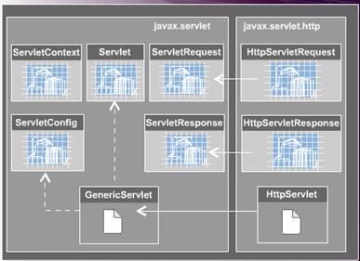
Servlet API
The servlet API is made up of two packages
javax.servlet
javax.servlet.http
13

Slide 14
Servlet API
The servlet API is made up of two packages
1.
javax.servlet
Servlet Interface, which
defines methods that all
servlets must implement
either directly, or by
extending a class that
implements Servlet.
It does not implement the
life cycle methods.
14

Slide 15
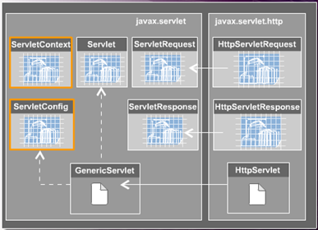
Servlet API
The servlet API is made up of two packages
1.
javax.servlet
ServletConfig interface
pass information to a
servlet during initialization.
ServletContext interface
define a set of methods
that a servlet uses to
communicate with its
container.
15

Slide 16
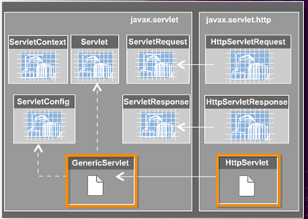
Servlet API
If a servlet does not directly implement the Servlet interface, it must directly extend the following classes:
1.
GenericServlet
2.
HttpServlet
16

Slide 17
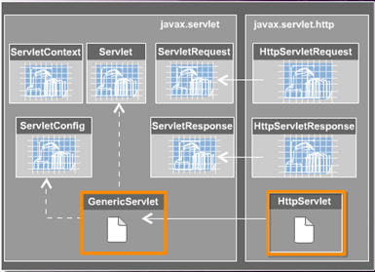
Servlet API
1.
GenericServlet
It is used to code generic,
protocol-independent
servlets.
It is used as the basis for
protocol-specific subclasses.
17

Slide 18
Servlet API
2.
HttpServlet
HttpServlet class enables to
operate over the HTTP
protocol by providing
methods such as doGet and
doPost for handling HTTP-
specific services.
18

Slide 19
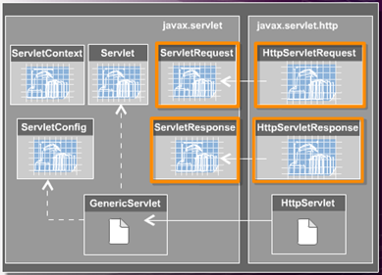
Servlet API
Request-Response API’s
1.
ServletRequest
2.
HttpServletRequest
3.
ServletResponse
4.
HttpServletResponse
19

Slide 20
Servlet API
1.
ServletRequest
ServletRequest Interface
object is used to supply
client request information to a servlet.
It is created by the servlet
container and then passed
arguments to the servlet’s
service method.
20

Slide 21
Servlet API
2.
HttpServletRequest
HttpServletRequest
Interface object is used to
supply client request
information to HTTP
servlets.
It is created by the servlet
container and then passed
arguments to the servlet’s
service method, such as
doGet and doPost.
21

Slide 22
Servlet API
3.
ServletResponse
ServletResponse
Interface object help a
servlet send a response to
a client.
It is created by the servlet
container and then passed
arguments to the servlet’s
service method.
22

Slide 23
Servlet API
4.
HttpServletResponse
HttpServletResponse
Interface object is designed
to provide HTTP-specific functionality to help HTTP servlets in sending responses to clients.
It is created by the servlet
container and then passed
arguments to the servlet’s
service method such as
doGet and doPost.
23

Slide 24
Servlet Creation
Steps to create standard packaging structure of a web application, create the following directories:
A root directory – It contains the static resources, such as, HTML, JSP and image files.
A WEB-INF directory – Resides inside the root directory. It contains the web.xml file that stores various configurations of a web application.
A classes directory – Resides under the WEB-INF directory and contains the class files of the application.
A lib directory – It also resides under the WEB-INF directory and contains JAR files.
24

Slide 25
Servlet Creation
Packaging the servlet
J2EE defines a standard packaging structure to package a servlet into a J2EE application to make it portable across different application servers.
A standard packaging structure will allow application servers to easily locate and load application files from the standard directory structure.
In most of the cases, the standard packaging structure is created by the Integrated Development Environment in use like, RAD, MyEclipse, WSAD, SunAppServer.
25

Slide 26
Directory structure of a Web Application
Root Directory
Page1.htm
Refer to WelcomeServlet.java
WEB-INF
web.xml
classes
WelcomeServlet.class
lib

Slide 27
Deployment Descriptor
The web.xml consists of :-
XML Prolog information.
Web Application display name.
Servlet Information.
Servlet Display Name.
Name of the Servlet, when it will be accessed.
Servlet Class Name.
URL Mappings.
Welcome files.
MIME types.
27
Notes:
27

Slide 28
Content of web.xml
web.xml – Deployment Descriptor
<?xml version=“1.0” encoding=“UTF-8” ?>
<web-app version=“2.4” xmlns=“http://java.sun.com/xml/ns/j2ee” xmlns:xsi=“http://www.w3.org/2001/XMLSchema-Instance xsi:schemaLocation=“http://java.sun.com/xml/ns/j2ee http://java.sun.com/xml/ns/j2ee/web-app_2_4.xsd”>
<display-name>WelcomeApplication</display-name>
<servlet>
<display-name>WelcomeServlet</display-name>
<servlet-name>WelcomeServlet</servlet-name>
<servlet-class>ibm.sample.WelcomeServlet</servlet-class>
</servlet>
<welcome-file-list>
<welcome-file>WelcomeServlet</welcome-file>
</welcome-file-list>
<servlet-mapping>
<servlet-name>WelcomeServlet</servlet-name>
<url-pattern>/WelcomeServlet</url-pattern>
</servlet-mapping>
</web-app>
Refer to web.xml
28

Slide 29
1. Creating a HTML Page – UserInfo.html
<html>
<title>Information Page</title>
<body>
<h1>User Information Page</h1>
<hr color=‘blue’ size=5>
<form action=“http://localhost:9080/WelcomeUserApplication/WelcomeUser”>
<pre>
Enter Your First Name : <input type=“text” name=“fname”>
Enter Your Last Name : <input type=“text” name=“lname”>
<input type=“submit” value=“Submit”> <input type=“reset” value=“Clear”>
</form>
</pre>
</body>
</html>
WebContextRoot
Servlet Alias Name
Refer to ThreeParamsForm.html
29
Notes:
29
Description of URL http://localost:9080/WelcomeUserApplication/WelcomeUser –
The port number specified is pertaining to RAD6.0 IDE with WebSphere Application Server6.0.
WelcomeUserApplication is the name of the WAR Module Project.
WelcomeUser is the name of the Servlet.
By default, the form method=“get”, so no need to specify.
Action attribute of <form> tag specify that which server side program will take care of the form elements data.

Slide 30
2. Creating a Servlet – WelcomeUser.java
Reads data from a text box as String
package ibm.sample;
import java.io.*;
import javax.servlet.*;
import javax.servlet.http.*;
public class WelcomeUser extends HttpServlet {
public void doGet(HttpServletRequest request, HttpServletResponse response)
throws IOEXception, ServletException {
String firstname = request.getParameter(“fname”);
response.setContentType(“text/html”);
PrintWriter out = response.getWriter();
out.println(“<h1>Welcome ! <font color=‘blue’>“+firstname+”</font></h1>”);
}
Refer to ThreeParams.java
30
Notes:
30
getParameter() method is used to read data from a request object as String.

Slide 31
3. Save The Servlet
Click on Save button in the RAD IDE, if it display some red cross marks in your code then correct it and then save to generate a .class file.
4. Deploy the Servlet
Deploy the web module containing WelcomeUser Servlet. Right click on the WelcomeUser.java and select Run -> Run on Server and respond to the dialog box that will follow.
31

Slide 32
5. Access the HTML page in the Web Browser
Open the web browser and type
http://localhost:9080/WelcomeUserApplication/UserInfo.html
32

Slide 33
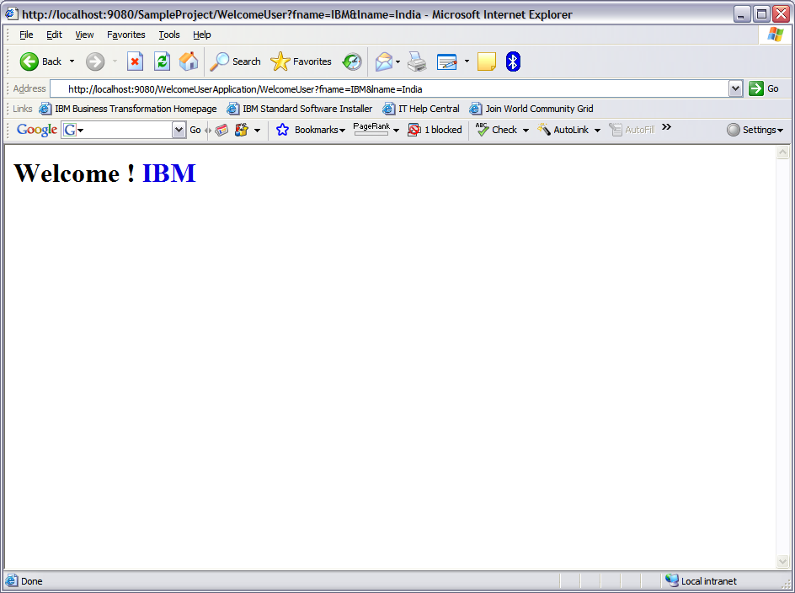
5. Access the HTML page in the Web Browser
http://localhost:9080/WelcomeUserApplication/WelcomeUser?fname=IBM&lname=India
33

Slide 34
Life Cycle of an Servlet
A servlet’s life cycle is controlled using the methods shown in the diagram.
Does Not Exist
destroy()
init()
Initialized
service()
Servicing Requests
doXXX()
34

Slide 35
Life Cycle of an Servlet (Contd.)
The init method is invoked only once during the servlet’s life lifetime – when the servlet is first created. Each subsequent request generates a thread that calls the service method of the previously created instance.
The main task of the init() method is to allow the servlet to access deployment – specific initialization parameters, such as database settings.
Does Not Exist
destroy()
init()
Initialized
service()
Servicing Requests
doXXX()
35

Slide 36
Life Cycle of an Servlet (Contd.)
Every time the server receives an incoming request for a servlet, it generates a new thread and calls the service().
The service() method then checks the HTTP request type and calls the appropriate doXXX() methods.
Does Not Exist
destroy()
init()
Initialized
service()
Servicing Requests
doXXX()
36

Slide 37
Life Cycle of an Servlet (Contd.)
The doXXX() methods are where the bulk of the programming in a servlet takes place.
The doGet() method contains the code that enables that servlet to respond to clients that make requests via the URL.
The doPost() method enables the servlet to receive any data sent by the client as part of an input stream. This is typically form data.
Does Not Exist
destroy()
init()
Initialized
service()
Servicing Requests
doXXX()
37

Slide 38
Life Cycle of an Servlet (Contd.)
A server may unload a servlet instance if its running incorrectly, or if the servlet has been idle for some time. Before it removes the servlet, it calls the destroy() method.
This provides the servlet with the opportunity to perform cleanup operations such as closing database connections, writing cookie lists, and halting background threads before it is destroyed.
Does Not Exist
destroy()
init()
Initialized
service()
Servicing Requests
doXXX()
38

Slide 39
Life Cycle of an Servlet (Contd.)
Note
Depending on how you register your servlet with the web server, it can be created either when a client first references a URL that corresponds to the servlet, or when the web server is first started.
39

Slide 40
Servlet Object
Enables sharing information among collaborating web components via
attributes maintained in scope objects.
Attributes are name / object pairs.
Attributes maintained in the Scope objects are accessed with
getAttribute() and setAttribute() method.
There are Three (3) Scope Objects
1.
WebContext
(ServletContext)
Belongs to
javax.servlet.ServletContext
2.
Session
Belongs to
javax.servlet.http.HttpSession
3.
Request
Belongs to
javax.servlet.ServletRequest
40
Notes:
40
Web Context (ServletContext) – Accessible from web components within a web context.
Session – Accessible from web components handling a request that belongs to the session.
Request – Accessible from web components handling the request.
Can be discussed in context to JSP – The fourth type of Scope Object - Page – Accessible from JSP page that creates the object.

Slide 41
Servlet Context
Shared by all servlets and JSP pages within a “web application”.
There is one ServletContext object per “web application” per JVM.
Set and get context-wide (application-wide) object valued attributes.
Access web context-wide initialization parameters set in web.xml file.
Access web resources associated with the Web Context.
The ServletContext is contained in ServletConfig object, which the web server provides to a servlet when the servlet is initialized.
Used in logging the events.
41
Notes:
41
Web Application – A web application is a collection of servlets and content installed under a specific subset of the server’s URL namespace and possibly installed via a *.war file. Logging can be done using getServletContext().log(“some message”);

Slide 42
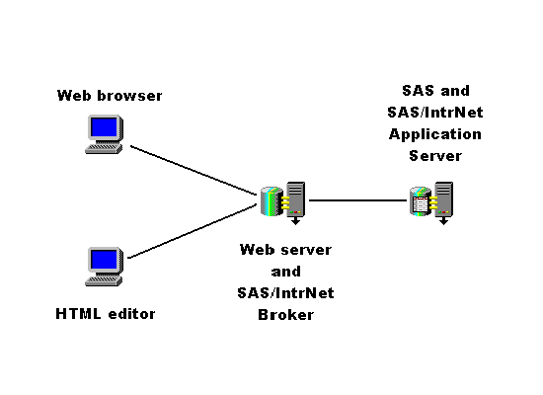
Scope of Servlet Objects.
ServletContext
Client 1
Application
Client 2
42
Notes:
42

Slide 43
Scope of Servlet Objects (Contd.)
Servlet Interface Methods
Method Name | Description
public ServletConfig getServletConfig() | Returns a ServletConfig object that contains configuration information, such as initialization parameters, to initialize a servlet.
public String getServletInfo() | It returns a string that contains information about the servlet, such as author, version, and copyright.
43
Notes:
43

Slide 44
Scope of Servlet Objects (Contd.)
ServletContext Interface Methods
Method Name | Description
public void setAttribute(String s, Object obj) | Binds the object with a name and stores the name/value pair as an attribute of the ServletContext object.
public Object getAttribute(String attributeName) | Returns the object stored in the ServletContext object with name passed as a parameter.
44
Notes:
44

Slide 45
Scope of Servlet Objects (Contd.)
How To get the ServletContext object
Refer to ServletContextSet.java
Refer to ServletContextGet.java
ServletContext context = getServletConfig().getServletContext();
OR
ServletContext context;
public void init(ServletConfig cfg)
{
context = cfg.getServletContext();
}
45
Notes:
45

Slide 46
Scope of Servlet Objects (Contd.)
Mechanism to maintain client state across a series of requests from a same user or originating from the browser over some period of time.
Example – Online Shopping Cart.
So How To Implement
46
Notes:
46

Slide 47
Scope of Servlet Objects (Contd.)
Using HTTPSession Interface
It maintains client state by using servlet getAttribute() and setAttribute() methods of session scope.
47
Notes:
47

Slide 48
Exceptions & Errors in Servlets (Contd.)
A ServletException indicates that a general exception has occurred.
Exception
(from java.lang)
ServletException
(from javax.servlet)
UnavailableException
(from javax.servlet)
48

Slide 49
Exceptions & Errors in Servlets (Contd.)
A UnavailableException is thrown when a particular servlet is temporarily or permanently unavailable cannot handle requests – for example, if a servlet is incorrectly configured, or a resource it depends on is unavailable.
Exception
(from java.lang)
ServletException
(from javax.servlet)
UnavailableException
(from javax.servlet)
49

Slide 50
How To Send Error Message To Client
public void sendError(int status_code)
OR
public void sendError(int status_code, String message)
Both the methods belong to javax.servlet.http.HttpServletResponse Interface
50
Notes:
50
public void sendError(int status_code, String message) – status_code describes the type of error occurred, message describes the error and sends the error response to the client. It throws an IllegalStateException, if it is called after a response is committed.

Slide 51
Code Snippet for sendError() method
public void doPost (HttpServletRequest request, HttpServletResponse response){
PrintWriter out =null;
try {
out= response.getWriter ();
out.println (“This page is going to give an Error”);
response.sendError (HttpServletResponse.SC_NOT_FOUND, “Sorry the resource you are requesting for is not available.”);
/* Do not try to write to the response buffer after invoking the sendError() method.*/
} catch(Exception ex){
out.println(ex.printStackTrace());
}
}
51
Notes:
51

Slide 52
How To Set the Status Information About A Servlet
public void setStatus(int status_code)
OR
public void setStatus(int status_code, String message)
Both the methods belong to javax.servlet.http.HttpServletResponse Interface
52
Notes:
52
public void setStatus(int status_code, String message) – status_code represents the status code, message describes the status of the servlet.

Slide 53
Code Snippet for setStatus() method
public void doPost(HttpServletRequest request, HttpServletResponse response){
PrintWriter out =null;
try {
out= response.getWriter ();
out.println(“This page is going to display a status code”);
response.setStatus (HttpServletResponse.SC_OK);
} catch(Exception ex){
out.println(ex.printStackTrace());
}
}
53
Notes:
53

Slide 54
Session Management in Servlets
Session Management – or tracking – is a server’s ability to store data about the state of a client for as long as it is using a web application.
54

Slide 55
Session Management in Servlets (Contd.)
HTTP is a stateless protocol.
This means:
Contextual information about a client is not automatically maintained as a client browses a web site.
Clients open a separate connection to the web server each time they want to retrieve a web page.
55

Slide 56
Session Management in Servlets (Contd.)
The kind of information that is useful to track varies from user to the contents of shopping carts. It can also be useful to track the parts of your web site most frequented by visitors.
56

Slide 57
Session Management in Servlets (Contd.)
The solutions of the problem of HTTP’s statelessness are
1.
Hidden Form Fields
2.
Cookies
3.
URL Rewriting
4.
HttpSession
57

Slide 58
Session Management in Servlets (Contd.)
Session Management in Servlets (Contd.)
The solutions of the problem of HTTP’s statelessness are
a) Hidden form fields are fields on HTML forms
that are hidden from the user.
b) This information is included in POST or GET
data.
How to create a Hidden Form Field
<input type=“hidden”
name=“HUser”
value=“SomeValue”>
1.
Hidden Form Fields
2.
Cookies
3.
URL Rewriting
4.
HttpSession
58
Notes:
58
A hidden form field method will not work if the user comes across a static document.

Slide 59
Demonstration on Hidden Form Fields – Login.htm
Track User Demo Through Hidden Form Fields
<HTML>
<TITLE>ONLINE SHOPPING</TITLE>
<BODY>
<FORM ACTION=“http://localhost:9080/HiddenWorldProject/FirstWorld”>
UserName <INPUT Type=“Text” Name=“user”><br>
<INPUT Type=Submit value=“Login”>
</FORM>
</BODY>
</HTML>
Refer to HiddenForm.html
59
Notes:
59

Slide 60
Demonstration on Hidden Form Fields – FirstWorld.java
package ibm.sample.session;
import java.io.*;
import javax.servlet.*;
import javax.servlet.http.*;
public class FirstWorld extends HttpServlet
{
public void doGet(HttpServletRequest req, HttpServletResponse res)throws IOException, ServletException
{
String username = req.getParameter(“user”);
PrintWriter out = res.getWriter();
out.println(“”Welcome! Click To Proceed….”);
out.println(“<form name=login
action=http://localhost:9080/HiddenWorldProject/SecondWorld>
out.println(“<input type=hidden name=user value=“+username+”>”);
out.println(“<input type=submit value=submit></form>”);
}// end of doPost() method
}// end of FirstWorld class
Refer to FirstWorld.java
60
Notes:
60

Slide 61
Demonstration on Hidden Form Fields – SecondWorld.java
package ibm.sample.session;
import java.io.*;
import javax.servlet.*;
import javax.servlet.http.*;
public class SecondWorld extends HttpServlet
{
public void doGet(HttpServletRequest req, HttpServletResponse res)throws IOException, ServletException
{
String username = req.getParameter(“user”);
PrintWriter out = res.getWriter();
out.println(“Hello! “+username);
}// end of doPost() method
}// end of SecondWorld class
Refer to SecondWorld.java
61
Notes:
61

Slide 62
Session Management in Servlets (Contd.)
Cookies are small bits of data, size of each cookie is maximum of 4 KB, that are stored on the client machine by the web server.
Cookies include a session ID to represent the specific client. It has a key-value pair.
The cookie information stored on the client machine is returned to the server in subsequent sessions to allow the server to retrieve this information without having to prompt the client for it again.
It is not suitable for maintaining sensitive information, and clients can refuse to accept cookies.
The solutions of the problem of HTTP’s statelessness are
1.
Hidden Form Fields
2.
Cookies
3.
URL Rewriting
4.
HttpSession
62

Slide 63
Cookies Methods
a) public String getName()
Returns the name of the cookie.
b) public void setMaxAge(int expiry)
Sets the maximum time for which the client browser retains the cookie value.
c) public int getMaxAge()
Returns the maximum age of the cookie in seconds.
d) public void setValue(String val)
Sets a new value to the cookie.
e) public String getValue()
Returns the value of the String.
The solutions of the problem of HTTP’s statelessness are
1.
Hidden Form Fields
2.
Cookies
3.
URL Rewriting
4.
HttpSession
63

Slide 64
Demonstration on Adding a Cookie
Refer to Item.html
Refer to CreateCookieServlet.java
Refer to ReadingCookieServlet.java
64

Slide 65
Session Management in Servlets (Contd.)
The solutions of the problem of HTTP’s statelessness are
URL Rewriting is a solution in which extra data, including a session ID is appended to the end of each URL. So as the client browses through a site, the session id is passed from page to page.
This solution works when the browser does not support cookies or user has disabled them.
In URL Rewriting the server process has to ensure that the session ID is appended in the URL, if not redirection lead to session information being lost.
1.
Hidden Form Fields
2.
Cookies
3.
URL Rewriting
4.
HttpSession
Notes:
65
To counteract URL Rewriting associated problem of losing information during redirection, the HttpServletResponse encodeURL() method can be used to rewrite internal links so that they include the session ID.

Slide 66
Demonstration on URL Rewriting – Login.htm
Track User Demo Through URL Rewriting
<HTML>
<TITLE>ONLINE SHOPPING</TITLE>
<BODY>
<FORM ACTION=“http://localhost:9080/URLRewitingWorldProject/URLFirstWorld” METHOD=“POST”>
UserName <INPUT Type=“Text” Name=“user”><br>
<INPUT Type=Submit value=“Login”>
</FORM>
</BODY>
</HTML>
Refer to URL.html
66
Notes:
66

Slide 67
Demonstration on URL Rewriting – URLFirstWorld.java
package ibm.sample.session;
import java.io.*;
import javax.servlet.*;
import javax.servlet.http.*;
public class URLFirstWorld extends HttpServlet
{
public void doPost(HttpServletRequest req, HttpServletResponse res)throws IOException, ServletException
{
String username = req.getParameter(“user”);
res.setContentType(“text/html”);
PrintWriter out = res.getWriter();
out.println(“Hello! <a href=http://localhost:9080/URLRewitingWorldProject/URLSecondWorld?uname=“+username+”> Click Here </a> to proceed”);
}// end of doPost() method
}// end of URLFirstWorld class
Refer to URLFirstWorld.java
67
Notes:
67

Slide 68
Demonstration on URL Rewriting – URLFirstWorld.java
http://localhost:8080/URLRewritingWorldProject/URLFirstWorld
68
Notes:
68

Slide 69
Demonstration on URL Rewriting – URLSecondWorld.java
package ibm.sample.session;
import java.io.*;
import javax.servlet.*;
import javax.servlet.http.*;
public class URLSecondWorld extends HttpServlet
{
public void doPost(HttpServletRequest req, HttpServletResponse res)throws IOException, ServletException
{
String username = req.getParameter(“uname”);
res.setContentType(“text/html”);
PrintWriter out = res.getWriter();
out.println(“Hello! ”+username);
}// end of doPost() method
}// end of URLSecondWorld class
Refer to URLSecondWorld.java
69
Notes:
69

Slide 70
Session Management in Servlets (Contd.)
The solutions of the problem of HTTP’s statelessness are
1.
Hidden Form Fields
2.
Cookies
3.
URL Rewriting
4.
HttpSession
Notes:
70
To counteract URL Rewriting associated problem of losing information during redirection, the HttpServletResponse encodeURL() method can be used to rewrite internal links so that they include the session ID.

Slide 71
Session Management in Servlets: Using HttpSession
Java Servlets can maintain session information by using a built-in session tracking mechanism that provides objects that represent a user’s session.
71

Slide 72
Session Management in Servlets: Using HttpSession (Contd.)
Each client that uses a servlet for the first time is assigned a new session object. The servlet generates a unique ID for each session and its this session ID that is stored in the client browser as a cookie
When a client makes a subsequent request to the server, the servlet receives that client’s session ID cookie. It uses this cookie as a key to find the session object associated with that request.
72

Slide 73
Session Management in Servlets: Using HttpSession (Contd.)
How To Manage multiple client Access to the Servlet?
Obtain an HttpSession object for each client and store this object on the server

Slide 74
Session Management in Servlets: Using HttpSession (Contd.)
Each session id corresponds to an instance of HttpSession. And each of these instances stores all the data for the relevant client.
The session object stores the state information in the form of name/value pairs.
74

Slide 75
Session Management in Servlets: Using HttpSession (Contd.)
User-specific information can be stored as attributes in the session object using
75
Notes:
75
You can use the session object to store and retrieve valid Java objects. But you can’t use it to store primitive datatypes.

Slide 76
Demonstration on HttpSession: UserSession.java
Refer to UserSession.java
76

Slide 77
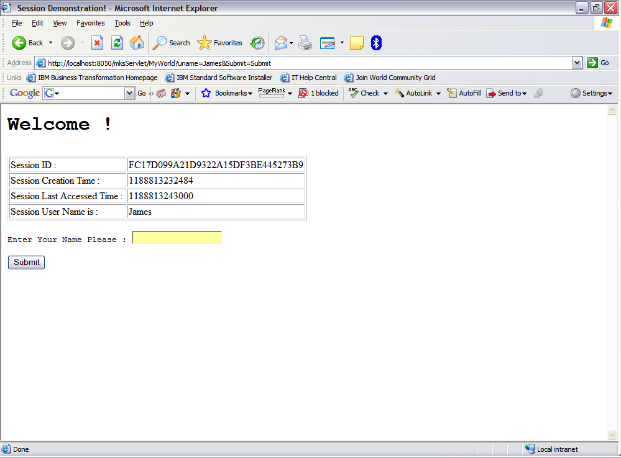
Demonstration on HttpSession: UserSession.java
77

Slide 78
Session Management in Servlets: Using HttpSession (Contd.)
How To Make Session InActive or Terminate
public void setMaxInactiveInterval(int interval) - When Session timeout occurs any objects bound to the HttpSession object are automatically unbound.
To retrieve Inactive interval
public int getMaxInactiveInterval()
78
Notes:
78
Session will never time out if the second parameter used is negative.
In the web.xml file also you can mention the timeout in the <session-timeout><session-timeout> element.

Slide 79
Session Management in Servlets: Using HttpSession (Contd.)
To deactivate a session - use
public void invalidate() method
This method explicitly ends the session and unbinds all objects associated with it. It should be used with care to prevent destroying data being used by another servlet or JSP page.
79

Slide 80
Session Management in Servlets: Using HttpSession (Contd.)
Refer to SessionProducer.java
Refer to SessionConsumer.java
Refer to LogoutServlet.java

Slide 81
Inter-Servlet Communication
A process where two or more servlets communicates with each other to process the client request.
A servlet can forward the request to another servlet to the process the client request.
A servlet can include the output of another servlet to process the client request.

Slide 82
Inter-Servlet Communication (Contd.)
Inter-Servlet Communication can be implemented in the following two ways:
RequestDispatcher
ServletRequest object
82

Slide 83
Inter-Servlet Communication (Contd.)
1. Inter-Servlet Communication Using RequestDispatcher
RequestDispatcher is an object of javax.servlet.RequestDispatcher Interface that allows inter-servlet communication.
Object is used to include the content of another servlet.
Implemented using include() method of RequestDispatcher interface.
Object is used to forward the request to another servlet.
Implemented using forward() method of RequestDispatcher interface.
83
Notes:
83
Can make a servlet call the methods of other servlet. Possible if both servlets are a part of the same web application.
The following code snippet shows the how to call getCounterInfo() method from a servlet Counter.
ServletContext context = getServletContext();
Counter ctr = (Counter) context.getServlet(“Counter”); // “Counter” passed as parameter to getServlet() method is the alias of the Servlet.
ctr.getCounterInfo();

Slide 84
Inter-Servlet Communication (Contd.)
Inter-Servlet Communication Using Servlet Request Object
Stores the calculated data as attribute to the request object in the servlet.
Forwards the request to the second servlet using the RequestDisptacher.
Retrieves the data from the request object and displays the result using the second servlet.
84
Notes:
84

Slide 85
Inter-Servlet Communication: Request Dispatcher Object Methods
1.
include() method
When you wish to include content from another web resource within your own web resource before returning a response – Use include() method.
Example:
Including a banner with every page returned.
85

Slide 86
Request Dispatcher Object Methods
The RequestDispatcher object uses the include() method to include a specified resource in the response at the point at which it is called.
The user is unaware that any such call was made – it will seem as though only one resource, such as JSP page, was generated.
86

Slide 87
Demonstration: Using Include
Write a servlet that will include the contact information of the web administrator from an another Servlet in the footer section and in the body section it will greet the user with a welcome message.
87

Slide 88
Login Page – Login.html
<HTML>
<BODY>
<FORM ACTION ="http://localhost:9080/IncludeServletProject/UserLoginServlet">
<TABLE ALIGN = "CENTER">
<TR>
<TD ALIGN = "RIGHT">User Name </TD>
<TD> <INPUT TYPE = "TEXT" NAME="uname"> </TD>
</TR>
<TR>
<TD ALIGN = "RIGHT">Password </TD>
<TD> <INPUT TYPE = "PASSWORD" NAME=“password"> </TD>
</TR>
<TR>
<TD ALIGN = "RIGHT"> </TD>
<TD ALIGN = "RIGHT"> <INPUT TYPE = "SUBMIT" NAME="SUBMIT" VALUE = "Login"> </TD>
</TR>
</TABLE>
</FORM>
</BODY>
</HTML>
88

Slide 89
Servlet-1: ContactServlet.java
package ibm.sample.include;
import javax.servlet.*;
import javax.servlet.http.*;
import java.io.*;
public class ContactServlet extends HttpServlet
{
public void doGet(HttpServletRequest req, HttpServletResponse res) throws ServletException, IOException
{
PrintWriter out=res.getWriter();
res.setContentType("text/html");
out.println(“<address>Web Admin Name : GoodJava<br>");
out.println("Email Address : goodname@goodjava.com</address><br>");
}
}
89

Slide 90
Servlet-2: UserLoginServlet.java
package ibm.sample.include;
import javax.servlet.*;
import javax.servlet.http.*;
import java.io.*;
public class UserLoginServlet extends HttpServlet {
public void doGet(HttpServletRequest req, HttpServletResponse res) throws ServletException, IOException {
PrintWriter out=res.getWriter();
/* Set content type to text/html */
res.setContentType("text/html");
String user_name=req.getParameter("uname");
out.println(“<pre><h3> Hello &nbsp;" + uname +"! &nbsp;Welcome to the Inter-Servlet Communication</h3>");
out.println("<b>Contact information of Application Administrator is</b><br>");
/* Forward request to ContactServlet servlet */
RequestDispatcher disp = req.getRequestDispatcher(“ContactServlet”);
disp.include(req, res);
}
}
90

Slide 91
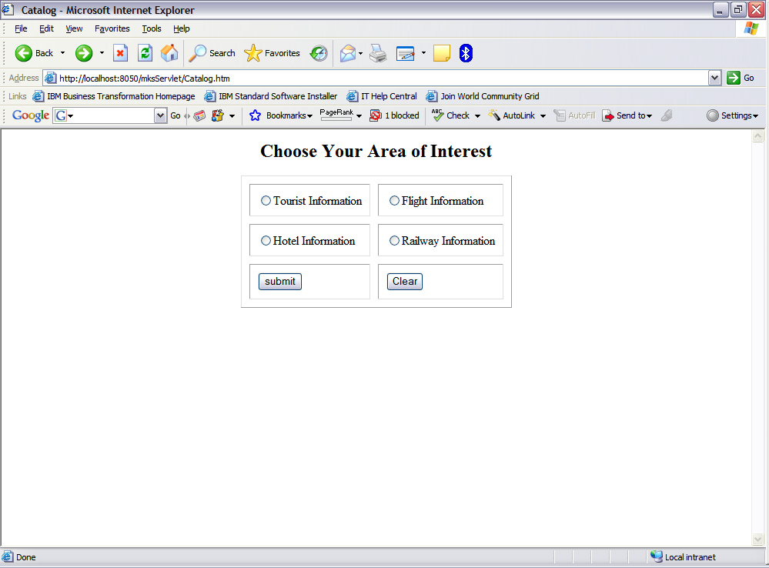
Request Dispatcher Object Methods
2.
forward() method
When you wish to forward the request and response to another servlet for further processing or final output
– Use forward() method.
Example:
Processing a catalog request and forwarding the request to designated servlet page.
91

Slide 92
Demonstration: Using forward
Write a servlet that will dispatch the request to designated servlet based on the choice made in the Catalog page.
92

Slide 93
Catalog Page – Catalog.html
<html>
<title>Catalog</title>
<body>
<center>
<form action="http://localhost:9080/ForwardServletProject/ChoiceServlet">
<h2>Choose Your Area of Interest</h2>
<table cellspacing =10 cellpadding=10 border=1>
<tr><td><input type="radio" name="r1" value="Tourist">Tourist Information</td>
<td><input type="radio" name="r1" value="Flight">Flight Information</td></tr>
<tr>
<td><input type="radio" name="r1" value="Hotel">Hotel Information</td>
<td><input type="radio" name="r1" value="Railway">Railway Information</td>
</td>
</tr>
<tr><td><input type="submit" value="submit"></td><td><input type="reset" value="Clear"></td></tr>
</table>
</form>
</center>
</body>
</html>
93

Slide 94
Choice Servlet– ChoiceServlet.java
import java.io.*;
import javax.servlet.*;
import javax.servlet.http.*;
public class ChoiceServlet extends HttpServlet {
public void doGet(HttpServletRequest request, HttpServletResponse response) throws IOException, ServletException {
String type = request.getParameter("r1");
if(type.equals("Tourist")) {
RequestDispatcher rd = getServletContext().getRequestDispatcher("/Tourist");
rd.forward(request,response);
}
if(type.equals("Flight")) {
RequestDispatcher rd = getServletContext().getRequestDispatcher("/Flight");
rd.forward(request,response);
}
if(type.equals("Hotel")) {
RequestDispatcher rd = getServletContext().getRequestDispatcher("/Hotel");
rd.forward(request,response);
}
if(type.equals("Railway")) {
RequestDispatcher rd = getServletContext().getRequestDispatcher("/Railway");
rd.forward(request,response);
}
}
}
94

Slide 95
Tourist Servlet – Tourist.java
package ibm.sample.forward;
import java.io.*;
import javax.servlet.*;
import javax.servlet.http.*;
public class Tourist extends HttpServlet {
public void doGet(HttpServletRequest request, HttpServletResponse response) throws IOException, ServletException {
response.setContentType("text/html");
PrintWriter out = response.getWriter();
out.println("<h2>Tourist Place Details Will Be Available Shortly...</h2>");
out.println("<hr color='blue' size=5>");
}
}
95

Slide 96
Flight Servlet – Flight.java
package ibm.sample.forward;
import java.io.*;
import javax.servlet.*;
import javax.servlet.http.*;
public class Flight extends HttpServlet {
public void doGet(HttpServletRequest request, HttpServletResponse response)
throws IOException, ServletException {
response.setContentType("text/html");
PrintWriter out = response.getWriter();
out.println("<h2>Flight Information Will Be Available Shortly...</h2>");
out.println("<hr color='blue' size=5>");
}
}
96

Slide 97
Hotel Servlet – Hotel.java
package ibm.sample.forward;
import java.io.*;
import javax.servlet.*;
import javax.servlet.http.*;
public class Hotel extends HttpServlet {
public void doGet(HttpServletRequest request, HttpServletResponse response) throws IOException, ServletException {
response.setContentType("text/html");
PrintWriter out = response.getWriter();
out.println("<h2>Hotel Information Will Be Available Shortly...</h2>");
out.println("<hr color='blue' size=5>");
}
}
97

Slide 98
Railway Servlet – Railway.java
package ibm.sample.forward;
import java.io.*;
import javax.servlet.*;
import javax.servlet.http.*;
public class Railway extends HttpServlet {
public void doGet(HttpServletRequest request, HttpServletResponse response)
throws IOException, ServletException {
response.setContentType("text/html");
PrintWriter out = response.getWriter();
out.println("<h2>Railway Time-Table Information Shortly Available...</h2>");
out.println("<hr color='blue' size=5>");
}
}
98

Slide 99

Inter-Servlet Communication: Do’s & Don’ts of RequestDispatcher
Do’s of RequestDispatcher
allows inter-servlet communication by forwarding request to another servlet and including response from another servlet.
Don'ts of RequestDispatcher
it does not allow servlets to share data.
99

Slide 100
Inter-Servlet Communication: ServletRequest Object
To share data among the servlets use –
ServletRequest object methods
setAttribute()
To set the values of the data in the request object.
getAttribute()
To retrieve the value of the data.
100

Slide 101
Demonstration: Using Servlet Request Object
Create a web application that performs arithmetic calculation on two numbers provided by the user. Another servlet of the web application displays the calculation result.
101

Slide 102
User Interface To Enter Two Numbers: TwoNo.html
<html>
<title>Input Form</title>
<body>
<center>
<form action="http://localhost:9080/RequestObjectProject/ArithmeticServlet">
<h2><u>Input Screen</u></h2>
<table cellspacing =10 cellpadding=10 border=1>
<tr><td>Enter 1st Number : </td><td><input type=“text” name=“no1”></td></tr>
<tr><td>Enter 2nd Number : </td><td><input type=“text” name=“no2”></td></tr>
<tr><td><input type="submit" value=“Add"></td><td><input type="reset" value="Clear"></td></tr>
</table>
</form>
</center>
</body>
</html>
102

Slide 103
Servlet To Calculate Sum: ArithmeticServlet.java
package ibm.sample.sum;
import java.io.*;
import javax.servlet.*;
import javax.servlet.http.*;
public class ArithmeticServlet extends HttpServlet {
public void doGet(HttpServletRequest request, HttpServletResponse response)
throws IOException, ServletException
{
int number1 = Integer.parseInt(request.getParameter(“no1”));
int number2 = Integer.parseInt(request.getParameter(“no2”));
int sum = number1 + number2;
request.setAttribute(“sumresult”,new Integer(sum));
ServletContext context = getServletConfig().getServletContext();
RequestDispatcher rd = context.getRequestDispatcher(“/DisplaySumServlet”);
rd.forward(request,response);
}
}
103

Slide 104
Servlet To Display Sum: DisplaySumServlet.java
package ibm.sample.sum;
import java.io.*;
import javax.servlet.*;
import javax.servlet.http.*;
public class DisplaySumServlet extends HttpServlet {
public void doGet(HttpServletRequest request, HttpServletResponse response)
throws IOException, ServletException
{
Integer res = (Integer) request.getAttribute(“sumresult”);
response.setContentType(“text/html”);
PrintWriter out = response.getWriter();
out.println(“<h1>Result </h1><br><hr color=‘blue’ size=5>”);
out.println(“<h2>The summation of two number is = <font color=‘blue’>“+res.toString()+ “</font></h2>”);
}
}
104

Slide 105
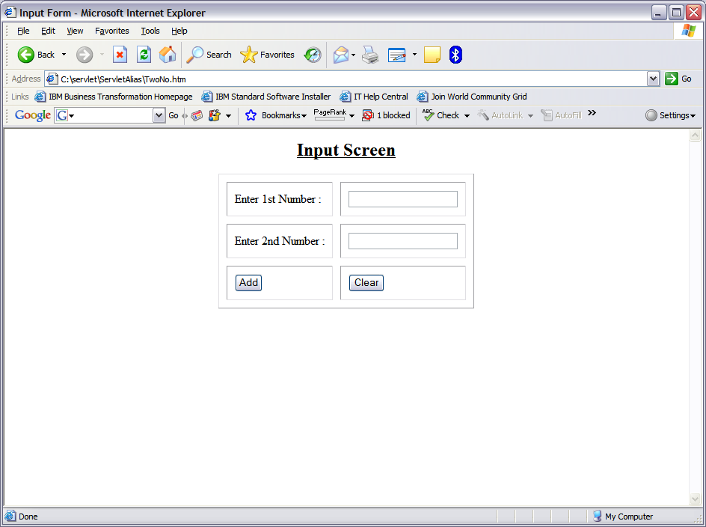
Output of TwoNo.html
http://localhost:8080/RequestObjectProject/TwoNo.html
105

Slide 106
sendRedirect() Vs forward()
sendRedirect() | forward()
sendRedirect() is a method of HttpServletResponse interface. | forward() is a method of RequestDispatcher interface.
It sends a redirect response back to the client’s browser. The browser will normally interpret this response by initiating a new request to the redirect URL given in the response. | forward does not involve the client’s browser. It just takes browser’s current request, and hands it off to another servlet/jsp than they originally called.
Because a new request is being submitted all previous stored in the request will be unavailable. | forward is performed internally by the servlet.
106
Notes:
106

Slide 107
sendRedirect() Vs forward()
sendRedirect() | forward()
This method is useful for redirecting to pages on other servers and domains. | This method is useful when communicating between server resources (servlet to servlet).
A browser reload of the second URL will not repeat the original request, but will rather fetch the second URL. The back and forward button will work. | Browser is completely unaware that it has taken place, so its original URL remains intact. So, back and forward button of web browser will not work.
Redirect is always slower than a forward, since it requires a second browser request. | No network round trip is required to the server, so it is faster.
107
Notes:
107
There are different situations where you want to use one or the other. For example, if you want to hide the fact that you're handling the browser request with multiple servlets/jsp, and all of the servlets/jsp are in the same web application, use forward() or include(). If you want the browser to initiate a new request to a different servlet/jsp, or if the servlet/jsp you want to forward to is not in the same web application, use sendRedirect().

Slide 108
Exercise on Session Management
HappyVisit online shopping wants to keep track of the Trouser’s selection made by the shopper and accordingly calculate the Invoice price at the last.
A diagram is shown in the next slide to demonstrate the working of the total module.
108

Slide 109
Exercise on Session Management
LoginScreen
Accept UserName and Password and on submission call DisplayTrouserListServlet.
DisplayTrouserListServlet
This servlet displays the list of trouser available in the stock and on submission call a Servlet known as ChoiceProcessingServlet for further processing.
ChoiceProcessingServlet
This servlet keep track of the user selection of the trouser and forward the selected trouser list to the FinalServlet for Billing the user.
FinalServlet
This servlet calculate the total bill for the user based on the Trouser selected (Trouser selection information retrieved from ChoiceProcessingServlet)
109

Slide 110
HappyVisit Login Page – Login.html
<HTML>
<TITLE>HappyVisit Online Shopping Portal</TITLE>
<BODY>
<FORM ACTION = "http://localhost:9080/SessionServletProject/DisplayTrouserListServlet" align=“CENTER”>
Username: <INPUT TYPE = TEXT NAME = "user" align=CENTER><BR>
Password: <INPUT TYPE = PASSWORD NAME = "password" align=CENTER><BR>
<INPUT TYPE = SUBMIT VALUE = "Login" align=CENTER>
</FORM>
</BODY>
</HTML>
110

Slide 111
HappyVisit Servlet -1: DisplayTrouserListServlet.java
package ibm.sample.login;
import java.io.*;
import javax.servlet.*;
import javax.servlet.http.*;
public class DisplayTrouserListServlet extends HttpServlet {
public void doGet(HttpServletRequest req, HttpServletResponse res) throws ServletException, IOException {
String username = req.getParameter("user");
String password = req.getParameter("password");
int counter = 0;
PrintWriter out = res.getWriter();
out.println( username + "! Welcome to HappyVisit Online Shopping.<BR>");
111

Slide 112
HappyVisit Servlet -1: DisplayTrouserListServlet.java
counter = 0;
/* Create a session for the user and store the value of username. */
HttpSession session = req.getSession(true);
session.setAttribute("user", username);
}
else
{
out.println("Sorry! Invalid username and password");
counter = 1;
}
if (counter == 0)
{
/* Display the contents to the user. */
out.println("<HTML><BODY>");
out.println("<HR>");
out.println("<FORM ACTION = http://localhost:9080/SessionServletProject/ChoiceProcessingServlet METHOD=POST>");
112

Slide 113
HappyVisit Servlet -1: DisplayTrouserListServlet.java
out.println("<TABLE WIDTH=500>");
out.println("<TR><TH>ITEM NO</TH> <TH>Brands of Trousers </TH> <TH>BUY</TH> </TR> ");
out.println("<TR><TD> 1 </TD><TD> PeterEngland </TD> <TD> <INPUT NAME = c1 TYPE = CHECKBOX VALUE = PeterEngland ></TD> </TR> ");
out.println("<TR><TD> 2 </TD><TD> Moustache </TD> <TD> <INPUT NAME = c2 TYPE = CHECKBOX VALUE = Moustache ></TD> </TR> ");
out.println("<TR><TD> 3 </TD><TD> Allen Solly </TD> <TD> <INPUT NAME = c3 TYPE = CHECKBOX VALUE = Allen Solly></TD> </TR> ");
out.println("<TR><TD> 4 </TD><TD> Zodiac </TD> <TD> <INPUT NAME = c4 TYPE = CHECKBOX VALUE = Zodiac></TD> </TR> ");
out.println("</TABLE>");
out.println("<INPUT TYPE = SUBMIT VALUE = SUBMIT>");
out.println("</FORM>");
out.println("</BODY></HTML>"); out.close();
}
}
}
113

Slide 114
HappyVisit Servlet - 2: ChoiceProcessingServlet.java
Refer to ChoiceProcessingServlet.java
114

Slide 115
HappyVisit Servlet - 3: FinalServlet.java
Refer to FinalServlet.java
115

Slide 116
Listener
•Listeners can be registered to be notified when events occur in the Servlet container
•ServletContext (application)
–Creation, destruction, attributes setting
•Servlet
–Creation or destruction
•Session
–Creation, destruction, attribute setting, passivation

Slide 117
Listener
Implement the interface appropriate for the event you wish to be notified about
or example ServletContextListener listens for evens on the ServletContext
Register the listener in web.xml
<listener> element supports a <listener-class> which will register the listener

Slide 118
Listener
ServletContextListener
Web application initialized / shut down
ServletRequestListener
request handler starting / finishing
HttpSessionListener
session created / invalidated
ServletContextAttributeListener
context attribute added / removed / replaced
HttpSessionAttributeListener
session attribute added / removed / replaced

Slide 119
Listener (example)
Refer to SessionMonitor.java

Slide 120
Listener
Registration in web.xml:
<listener>
<listener-class>SessionMonitor</listener-class>
<listener>

Slide 121
What are Java Servlet Filters
New component framework for intercepting and modifying requests and responses
Allows ranges of custom activities
Marking access, blocking access.
Caching, Logging
Compression
Authentication, access control, encryption.
121
Notes:
121
Java Servlet Filter is introduced in Servlet 2.3 version

Slide 122
What can a Servlet Filter Can Do?
Examine the request headers
Customize the request object if it wishes to modify request headers or data.
Customize the response header object if it wishes to modify response headers or data.
Invoke the next entity in the filter chain.
Throw an exception to indicate an error in processing.
122

Slide 123
How are Servlet Filters Chained?
Servlet Container
Filter Chain
Servlet
Filter 1
Filter 2
Filter n
service(ServletRequest,ServletResponse)
123

Slide 124
How Servlet Filter Chain Works?
Multiple filters can be chained
Order is dictated by the order of <filter> elements in the web.xml deployment descriptor.
The first filter of the filter chain is invoked by the container.
via doFilter(ServletRequest req, ServletResponse res,
FilterChain chain)
The filter then perform whatever filter logic and then call the next filter in the chain by calling chain.doFilter(…) method.
The last filter’s call to chain.doFilter() ends up calling service() method of the Servlet.
124

Slide 125
How Servlet Filter Chain Works? (Contd.)
doFilter(ServletRequest req, ServletResponse res, FilterChain chain)
gets called each time a filter is invoked.
contains most of filtering logic.
ServletRequest object is casted to HttpServletRequest if the request is HTTP request type.
may wrap request / response objects.
invoke next filter by calling chain.doFilter(…).
or block request processing
By omitting calling chain.doFilter(…)
filter has to provide output the client.
set headers on the response for next entity.
125

Slide 126
Steps For Building a Servlet Filter
Decide what custom filtering behavior you want to implement for a web resource.
Create a class that implements Filter interface
Implement filtering logic in the doFilter() method.
Call the doFilter() method of the FilterChain object.
Configure the filter with target servlets
use <filter> and <filter-mapping> elements.
126

Slide 127
Configuration in web.xml file (Deployment Descriptor)
<filter>
<filter-name> -> assigns a name of your choosing to the filter.
<filter-class> -> used by the container to identify the filter class.
</filter>
<filter-mapping>
<filter-name> -> assigns a name of your choosing to the filter.
<url-pattern> -> declares a pattern URLs (Web Resources) to which the filter applies.
<filter-mapping>
127
Notes:
127
A series of <filter> and <filter-mapping> elements for each filter.

Slide 128
javax.servlet.Filter Interface
init(FilterConfig)
Called only once when the filter is first intialized
get ServletContext object from FilterConfig object and save it somewhere so that doFilter() method can access it.
read filter initialization parameters from FilterConfig object through getInitParameter() method.
destroy()
called only once when the container removes filter object.
close files or database connections.
128

Slide 129
Example On Servlet Filter
package ibm.filters;
public class LogFilter implements Filter {
public void doFilter(ServletRequest request,ServletResponse response, FilterChain chain)throws ServletException, IOException {
response.setContentType(“text/html”);
PrintWriter out = response.getWriter();
out.println(req.getRemoteHost() + " tried to access " + req.getRequestURL() + " on "+new Date() + ".");
chain.doFilter(request,response);
}
public void init(FilterConfig config)throws ServletException { }
public void destroy() { }
}
Refer to LogFilter.java

Slide 130
Declaring Filter in Web.xml File
<web-app>
<!-- Register the name “Log"
for LogFilter. -->
<filter>
<filter-name>Log</filter-name>
<filter-class>ibm.filters.LogFilter</filter-class>
</filter>
…
</web-app>
Important note
Servers load filters into memory when the Web application first comes up.

Slide 131
Mapping The Filter With a Servlet in Web.xml File
<web-app>
…
<filter-mapping>
<filter-name>Log</filter-name>
<servlet-name>ibm.servlet.SomeServlet</servlet-name>
</filter-mapping>
…
</web-app>
Refer to web.xml
Important note
Multiple entries of filter-mapping can be their depending upon how many servlets or JSP are mapped to the same Filter. In case of JSP the <servlet-name> element will be replaced by <url-pattern></url-pattern>

