Slide 1
Concurrency Vs Parallelism

Slide 2
Applications
Online bus/anything ticket booking : here many users trying to book available ticket at same time (ex : tatkal booking ) , here application needs to handle different threads (diff users request to server ) , if tickets sold out/not available then rest users will get correct response as not available to book .
Joint Account holder having multiple ATM cards for same account and trying to perform operation same time . at time one operation is handled for account and then next one on updated data.

Slide 3
A few real-life use-cases (in context to software engg.) Animation and Games.
Most of the GUI tools like Swing uses thread to keep track of events generated from widgets.
Internally Junit uses threads for executing test cases parallel.
Most of the web servers uses multithreading to entertain HTTP Requests parallel

Slide 4
Single threaded application
LAME, the open source audio encoder, is a good example of a single-threaded application. It will never use more than one thread

Slide 5
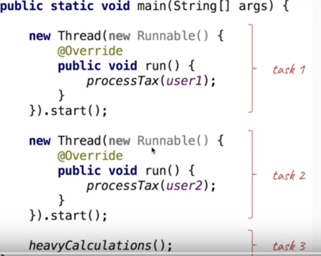
Parallelism

Slide 6
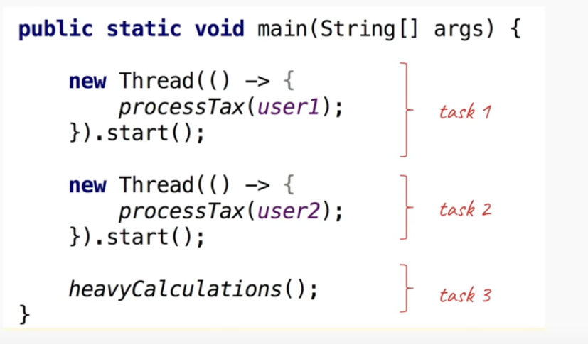

Slide 7
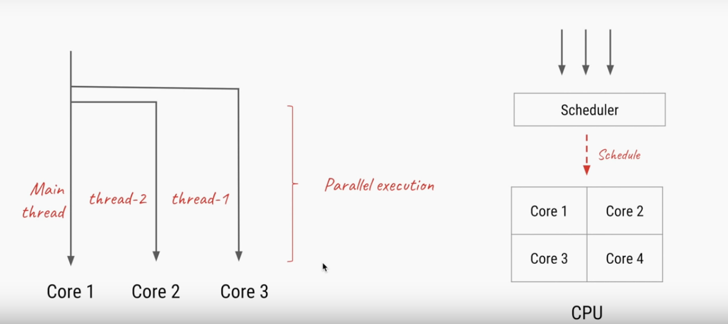

Slide 8
“Parallelism is all about doing lot of things at once “ –Rob Pike

Slide 9
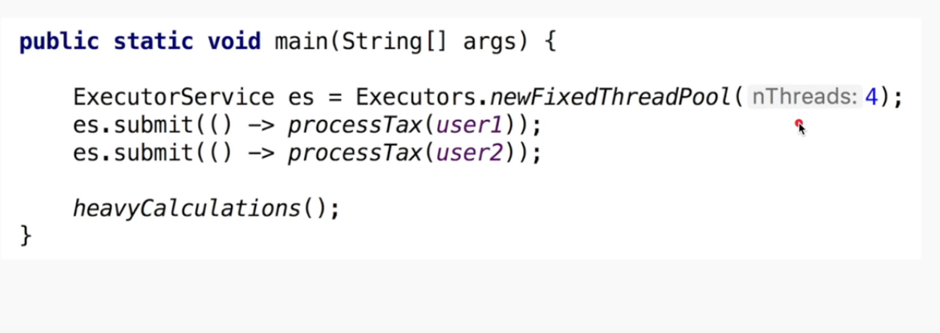
Paralleilism using -JavaThread Pool

Slide 10
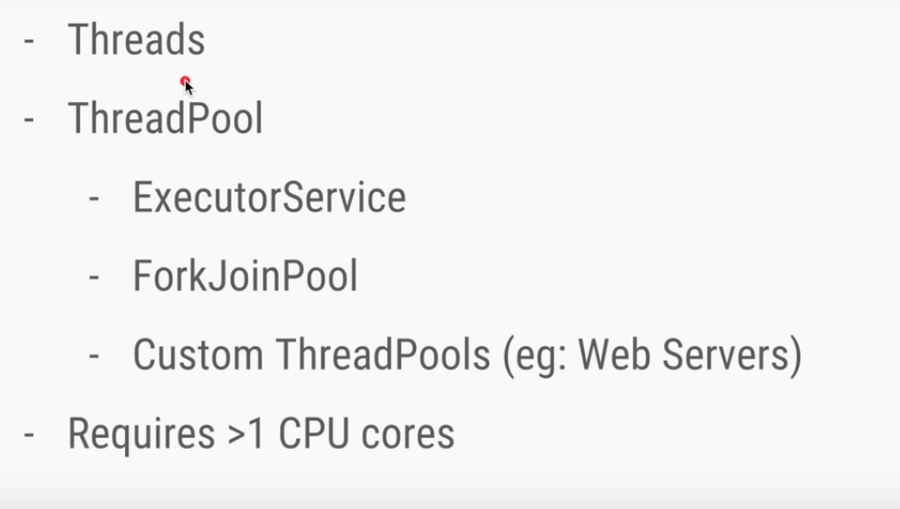
Tools to enable Parallelism

Slide 11
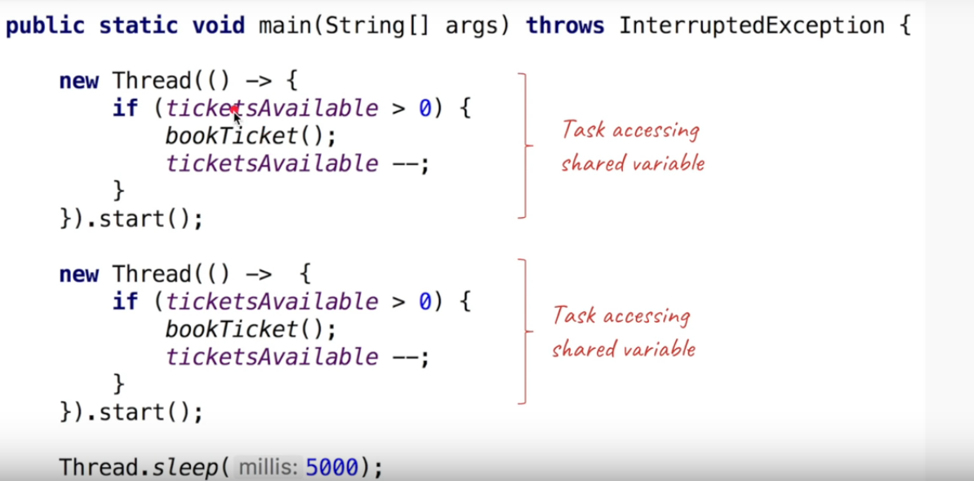
Concurrency- code

Slide 12
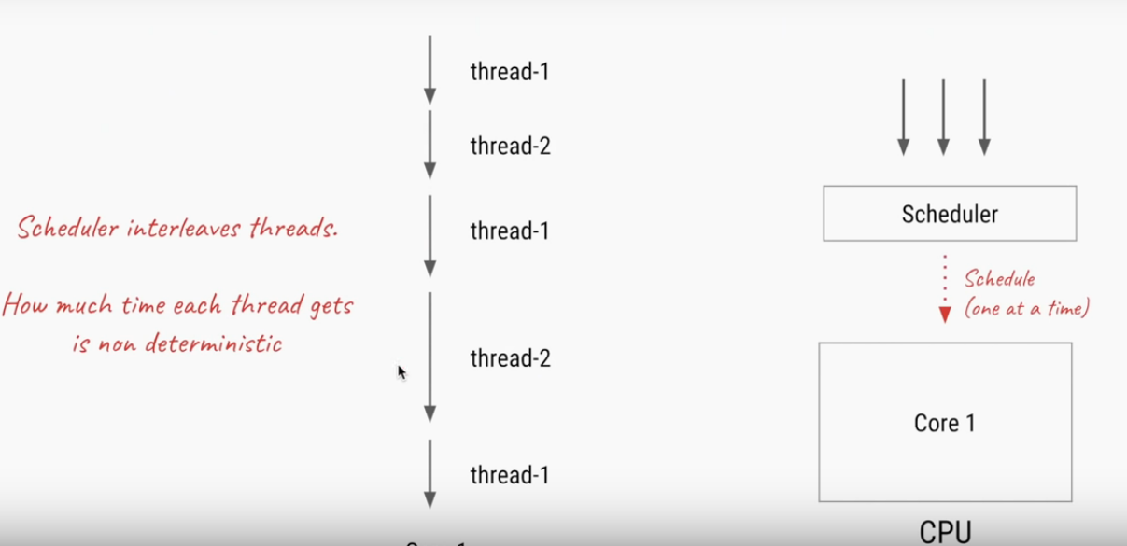

Slide 13
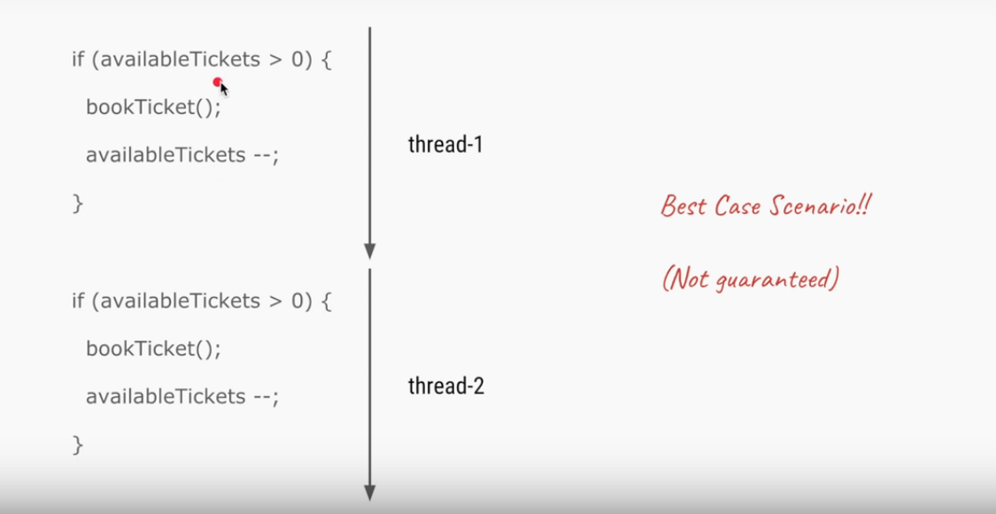

Slide 14
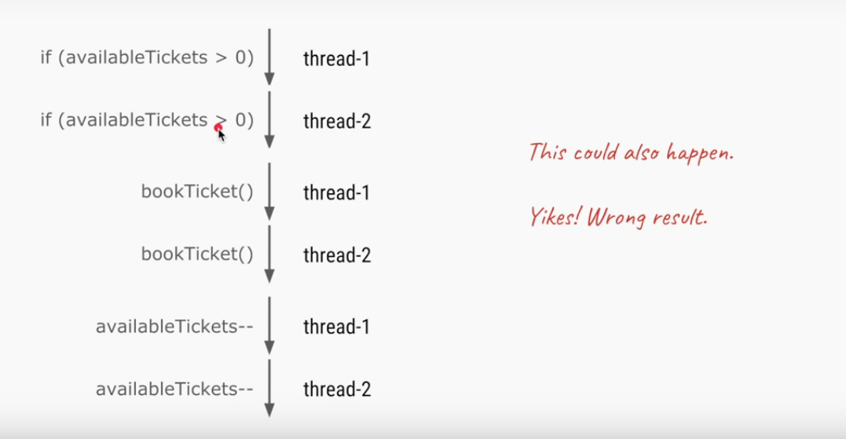

Slide 15
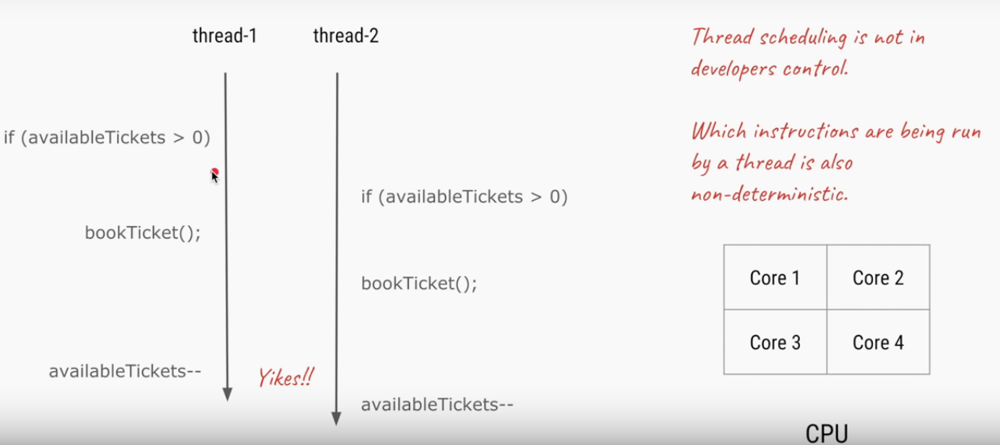

Slide 16
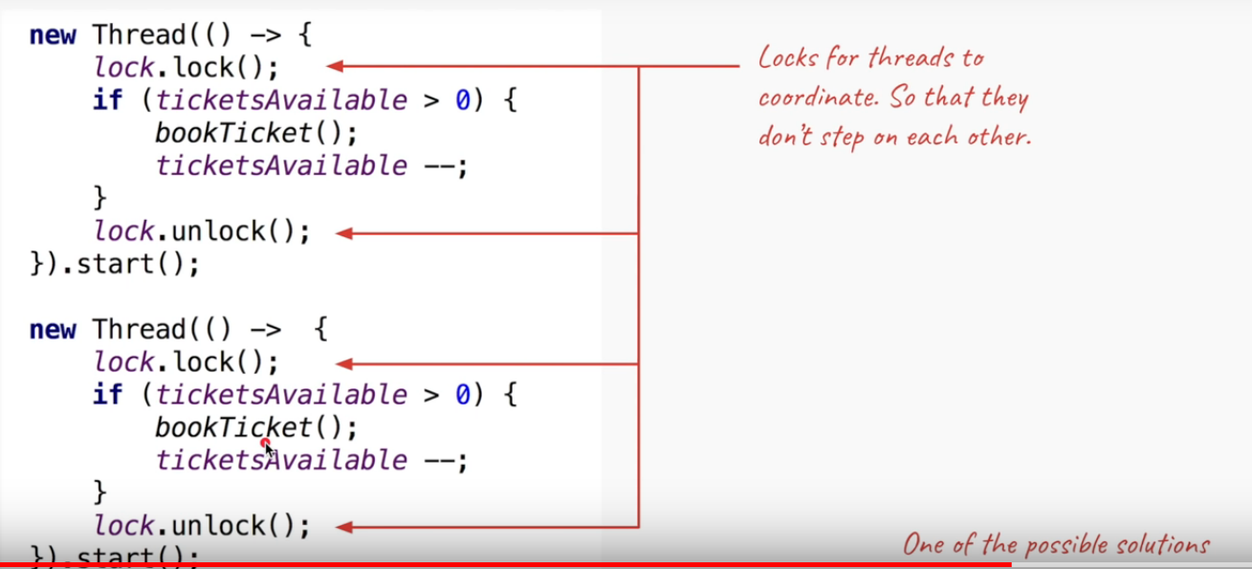

Slide 17
“Concurrency is all about dealing with lot of things at once” –Rob Pike

Slide 18
Concurrency
Shared resource is to be accessed/updated
OR
Multiple tasks need to coordinate

Slide 19
Tools to deal with concurrency
Locks/ syncronized
Atomic classes
Concurrent data structures(eg: ConcurrentHashMap,Blockingqueue)
CompletableFuture
CountDownLatch/Phaser/CyclicBarrier/ Semaphore etc.

Slide 20
Split sequential flow into independent components
Use threads/ThreadPool to parallelise(to speed up)
When shared resource need to be updated use concurrency tools to manage state
Whenever independent components(running on threads) need to be coordinate use concurrency tools

Slide 21
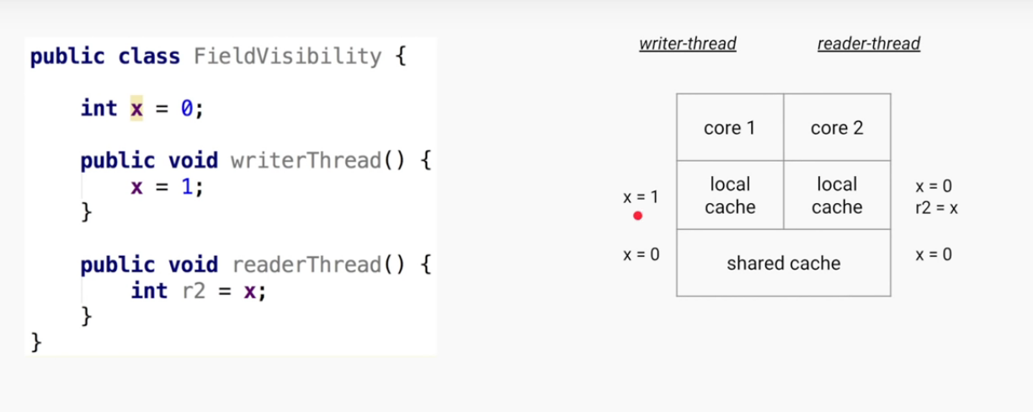
Java Memory Model-Field Visibility

Slide 22
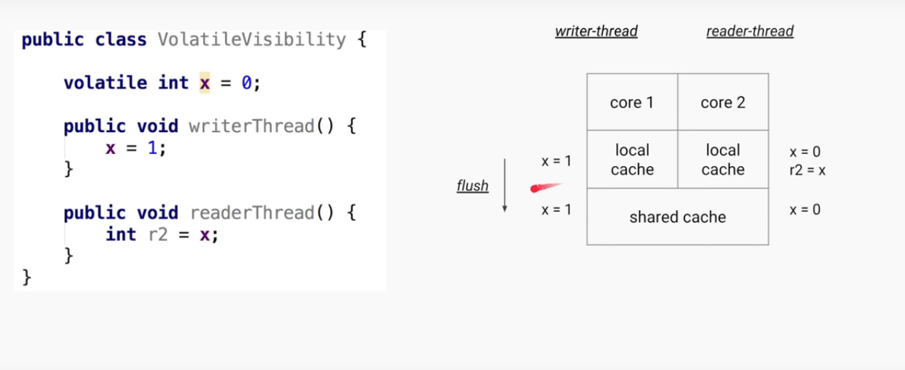
Volatile-Field visibility

Slide 23
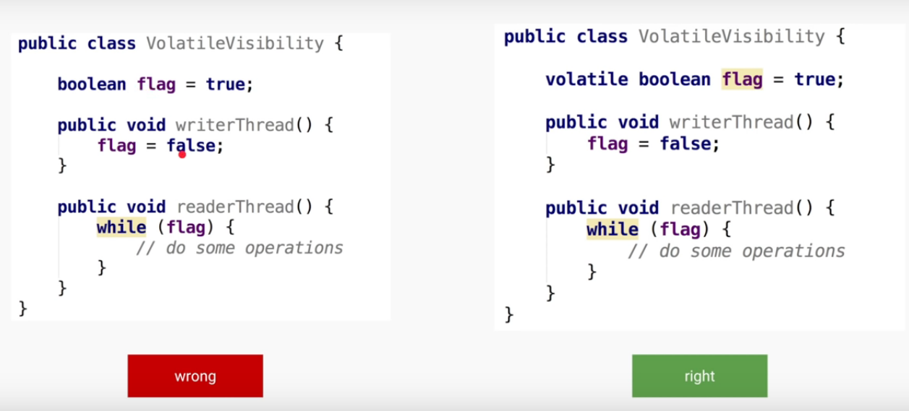

Slide 24
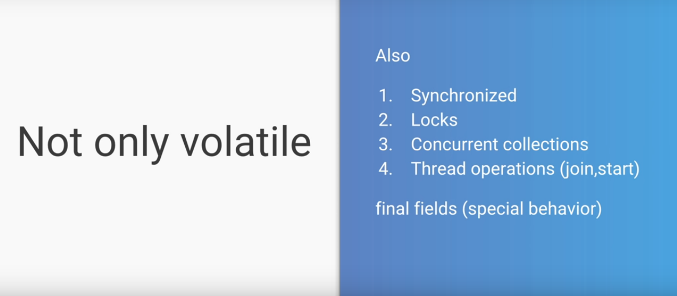

Slide 25
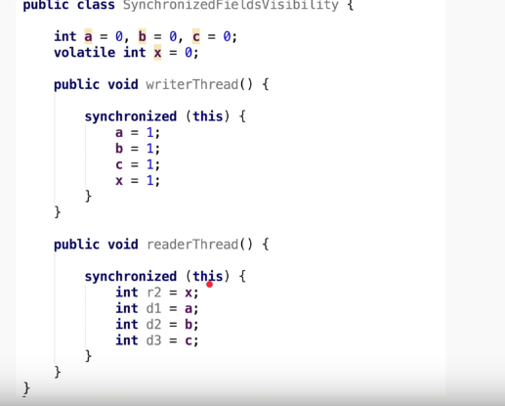

Slide 26
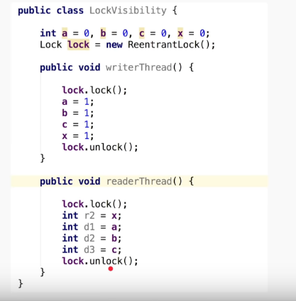

Slide 27
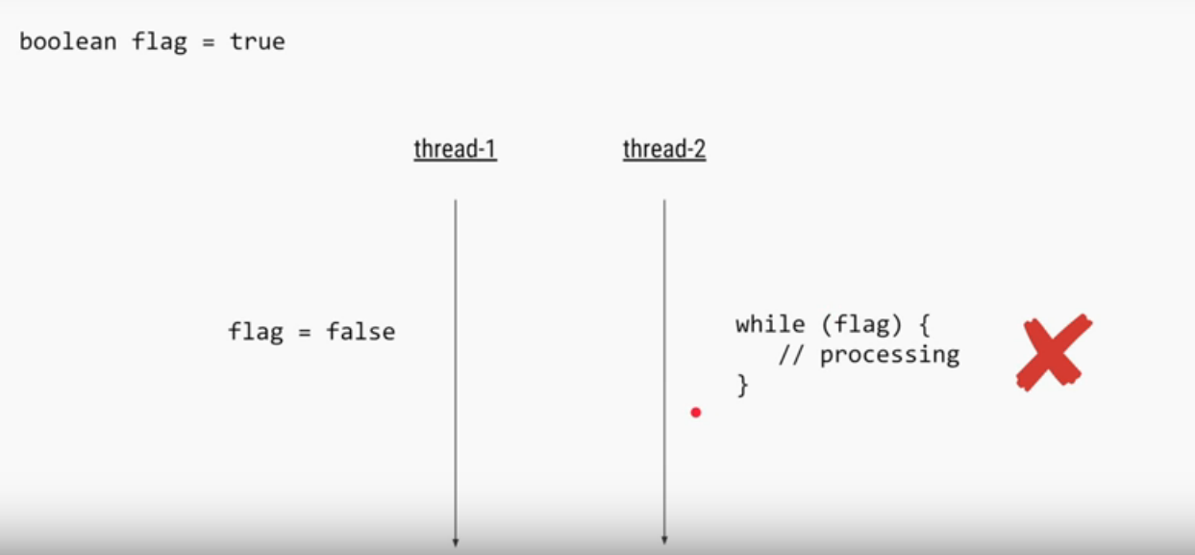

Slide 28
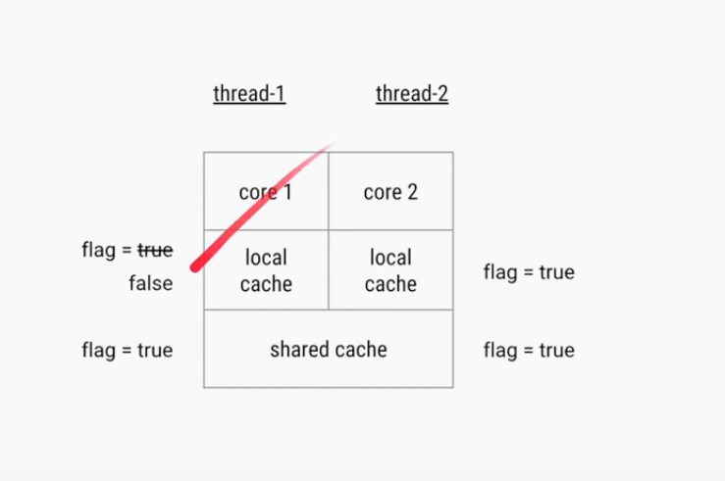

Slide 29
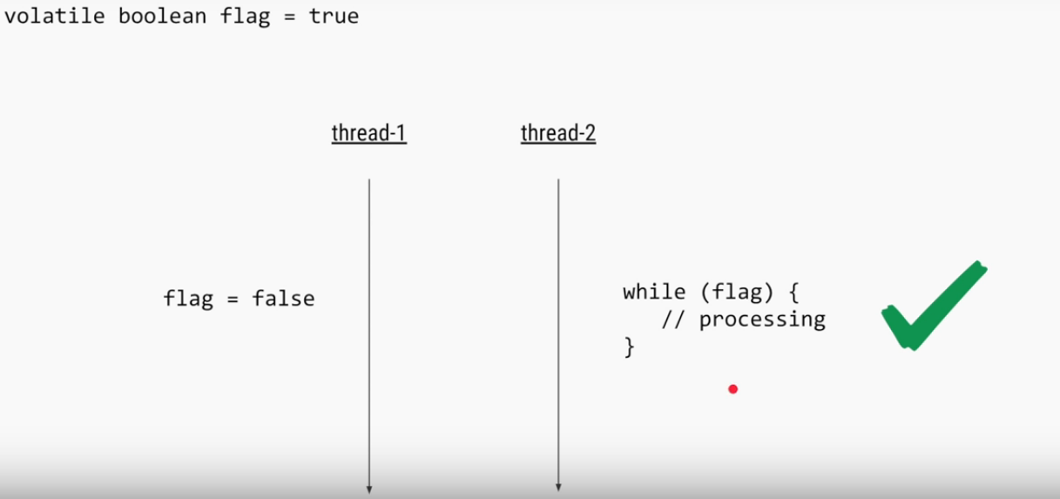

Slide 30
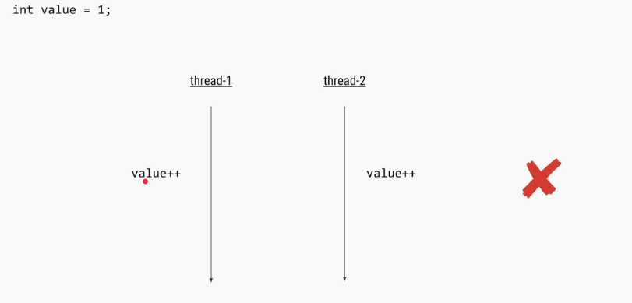
Visibility problem

Slide 31
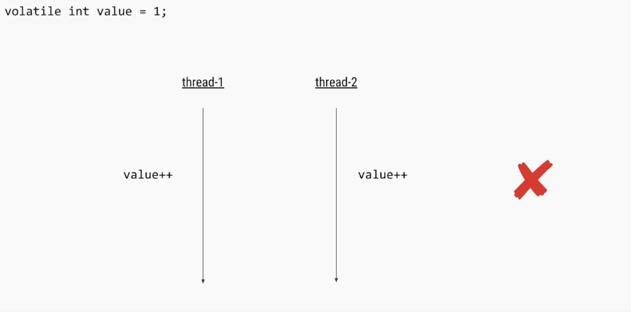
Synchronization problem

Slide 32
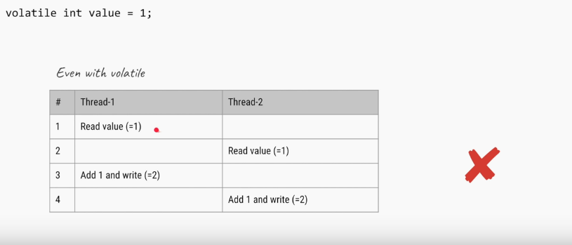

Slide 33
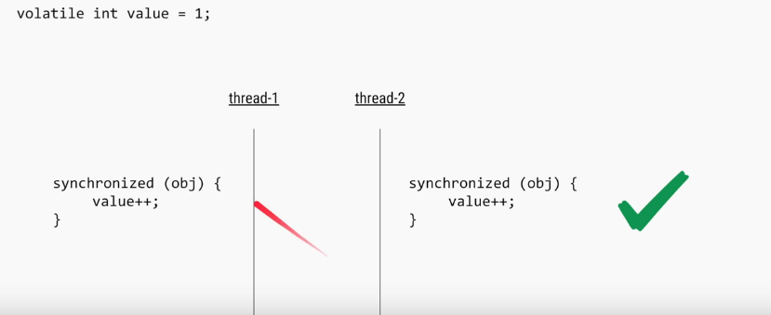

Slide 34
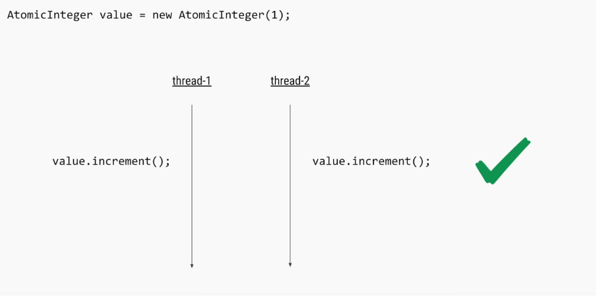
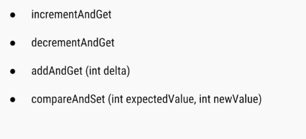

Slide 35
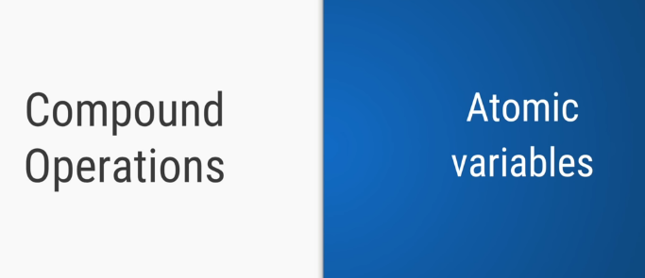

Slide 36
