Slide 1
E-Letter Management System

Slide 2
OUR TEAM
Anjana Suharika Pothureddy
Hakeem Aini Khan
Hemanth Srinivas Dokka
Hemanjali Padibandla
Lakshmi Nishitha Padi
Sirisha Kollipara

Slide 3

Agenda
Introduction
Empathy Maps
E-R Diagram
User Story
Workflow
Screenshots
Tech Stack

Slide 4

iNTRODUCTION
In today's fast-paced recruitment landscape, efficient offer letter management is crucial for companies to attract and retain top talent. However, traditional methods of generating, reviewing, and approving offer letters can be time-consuming and prone to errors.
To address this challenge, we present our E-Letter Management Project. This innovative solution streamlines the offer letter process, providing HR professionals with a user-friendly platform to generate, review, and send offer letters to candidates. By automating these tasks, our project not only saves time but also ensures accuracy and compliance with organizational policies.

Slide 5
EMPATHY MAP - HRMANAGER
Says Convey our company culture and values through offer letter. I want the candidate to feel valued and excited about joining our company. Are there any specific benefits or perks the candidate values. | Thinks Are there any innovative approaches or benefits that we can incorporate into the offer. How can I make this offer standout & be compelling to the candidate. What steps can be taken to continuously improve the overall offer process.
Does Review company policies and guidelines for offer creation. Conduct market research to ensure the offer is competitive. Seeks feedback from both candidates and hiring teams for continuous improvement. | Feels Apprehension Satisfaction Responsibility Anticipation Pressure

Slide 6
EMPATHY MAP - HRASSOCIATE
Says Communicating with candidate to collect any missing details and preferences. I need to gather all necessary documents and information for the offer letter. I must efficiently handle a large volume of candidate information for bulk hiring. | Thinks How can I communicate offer details clearly to avoid any misunderstandings. Managing time efficiently to meet offer related deadlines. Ensuring the offer adheres to company policies, legal requirements and industry standards.
Does Communication with the candidate to clarify any details and preferences. Keeps the candidate updated on the status of the offer process. Collaborates with different departments to finalize offer details, including compensation and benefits. Collects and organizes candidate information for offer creation. Drafts a personalized offer letter. | Feels Responsible Frustration Satisfaction Concern Pressure

Slide 7
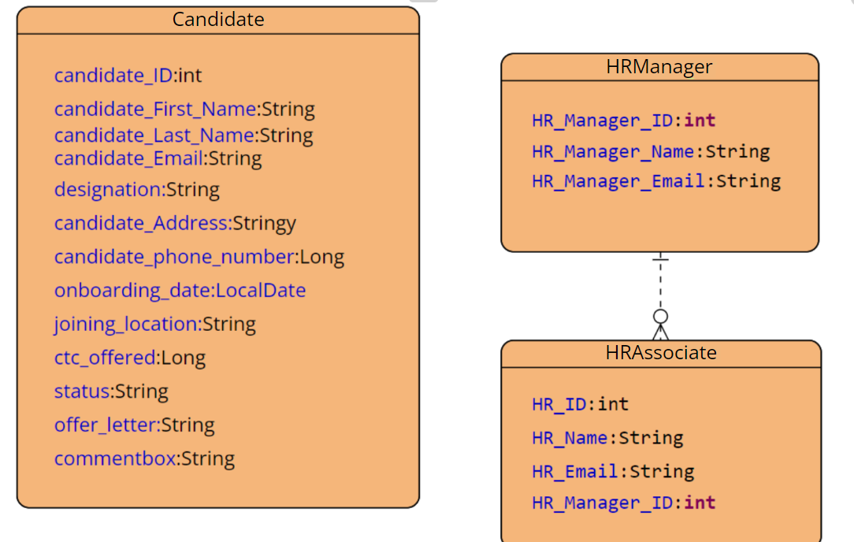
ER DIAGRAM

Slide 8
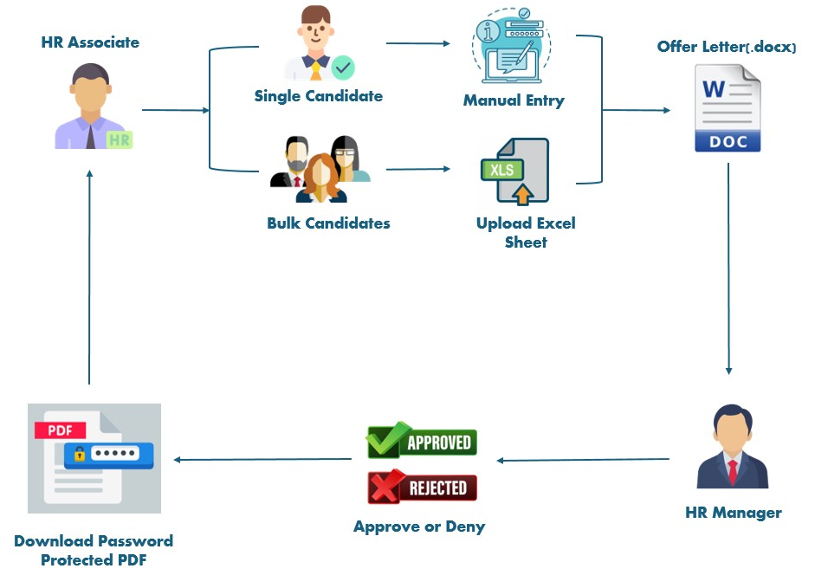
Workflow

Slide 9












Tech Stack
1) Spring boot
2) React js
3) Maven
4) Junit
5) HTML
6) CSS
7) JavaScript
8) Docker
9) Jenkins
10) Bit Bucket
11) Oracle

Slide 10
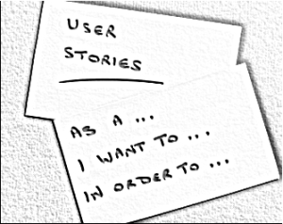
User Stories-HrManager
User story: 01 Usecase: Login Management Description : As a HR Manager, I want to successfully login into the portal. Acceptance Criteria:
1.When successful login, I should be redirected to the next page for offer letter generation.
2.When unsuccessful login, I should be noticed with an error message "Invalid Login Credentials!".
User story: id-02 Usecase: Filtration of candidates Description : As a HR Manager, I
Should be able to approve or deny the candidates based on details.
Acceptance Criteria: 1. On Filtration, approved or denied status should be shown to avoid redundancy. 2. On Denial, I should be able to give feedback or comment that is to be passed to HR Associate.

Slide 11
User Stories-HRASSOCIATE
User story: 01 Usecase: Login Management Description:As a HR Associate, I want to successfully login into the portal. Acceptance Criteria:
1.When successful login, I should be redirected to the next page for offer letter generation
2.When unsuccessful login, I should be noticed with an error message "Invalid Login Credentials!".
Userstory:02 Usecase: Candidate Details. Description: I want to pass information that can be either of single candidate or in bulk . Acceptance Criteria:
1.Single or Multiple Candidate information must be validated and placed in the offer letter documents accordingly.
2. After this, generation of offer letter documents and the list of candidates should be sent to HRManager.

Slide 12
User Stories-HRASSOCIATE
User story: 03 Usecase : History. Description : A Separate page for history to be displayed. Acceptance Criteria:
Search bar present in the top must display candidate details upon custom filters.
User story: 04 Usecase: Approved Candidatelist Description: After Manager approves, the approved candidate list must be displayed. Acceptance Criteria:
The comments passed upon denial must be shown.
User story: 05 Usecase: Password Protected Description:As a HR Associate, I want password protection for files generated. Acceptance Criteria:
1. When I open a file, It should be password protected.

Slide 13
ScreenShots

Slide 14
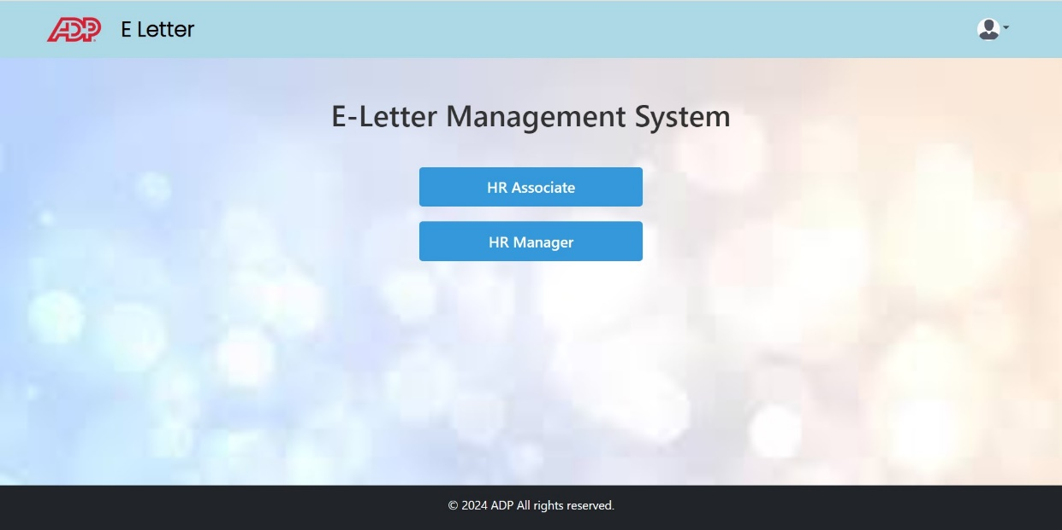
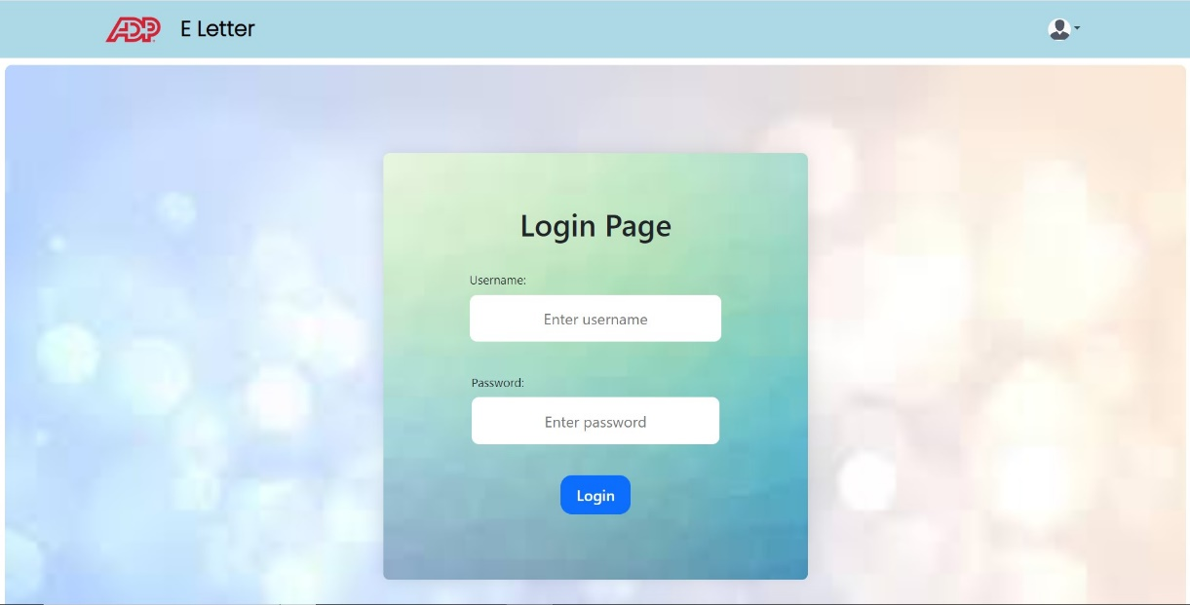
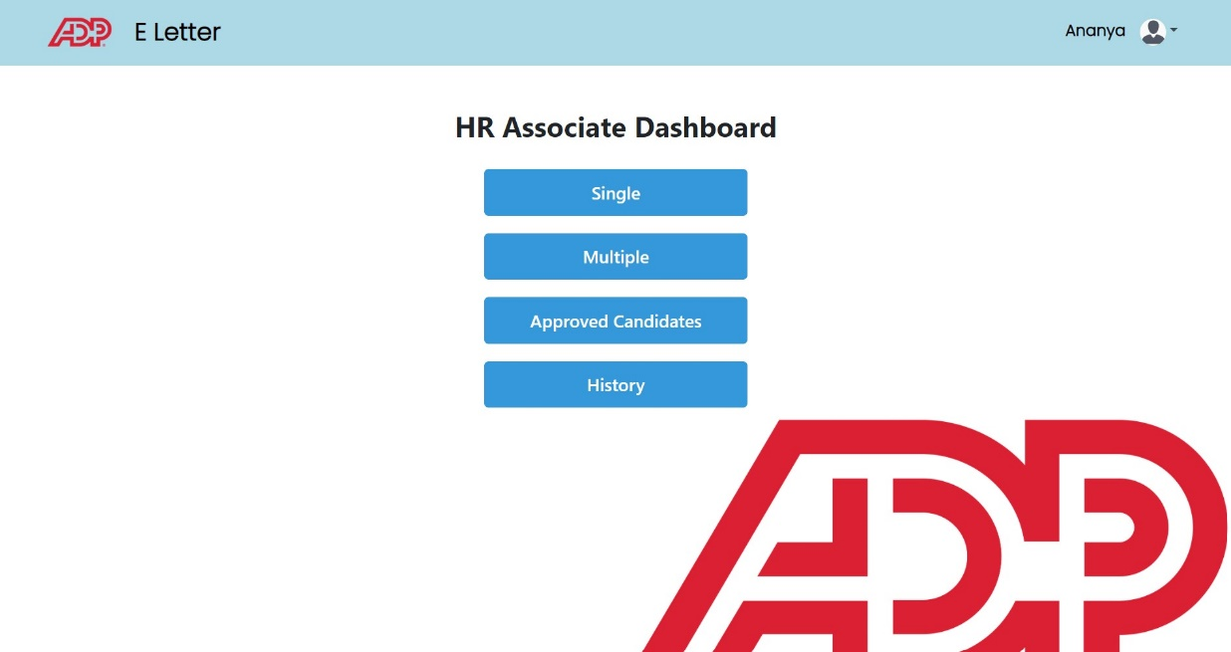
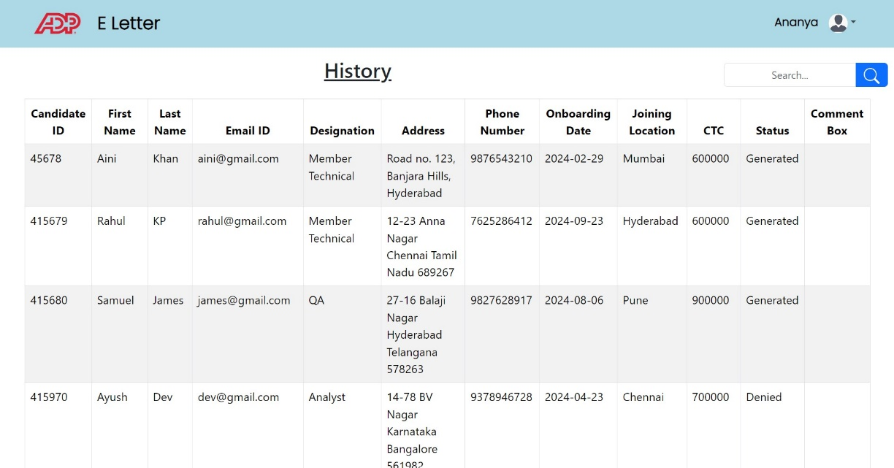

Slide 15
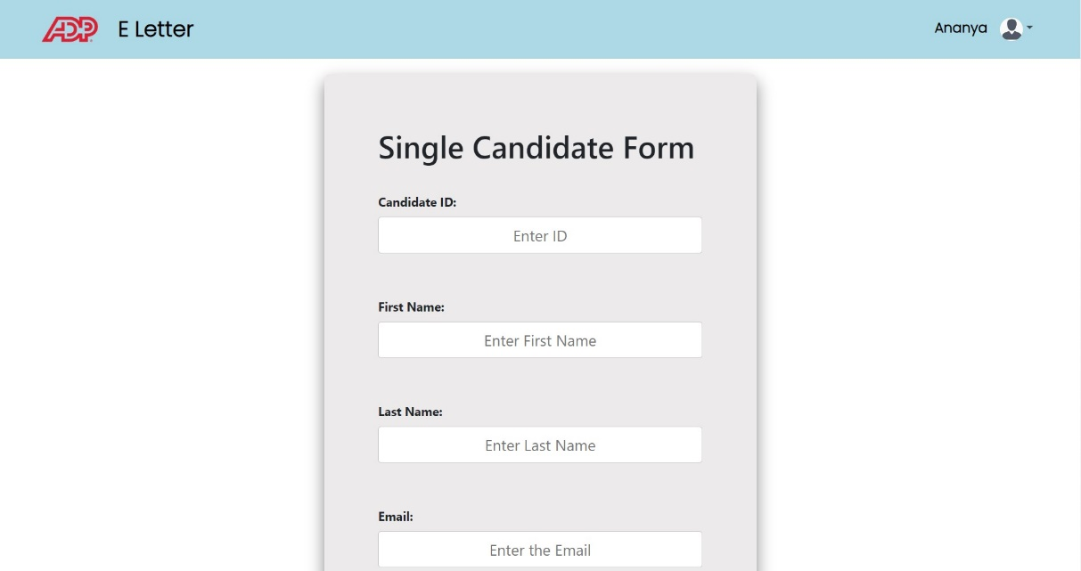
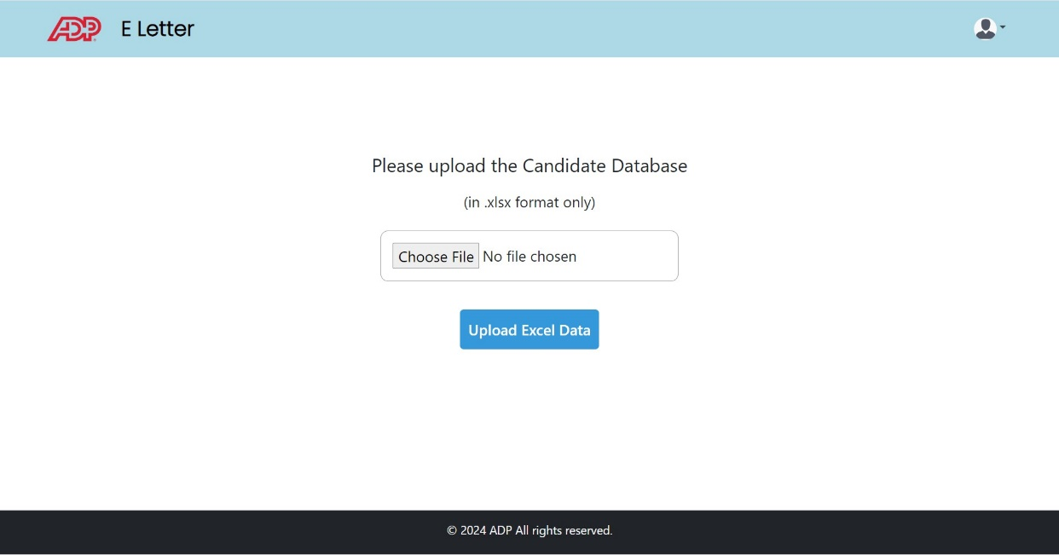
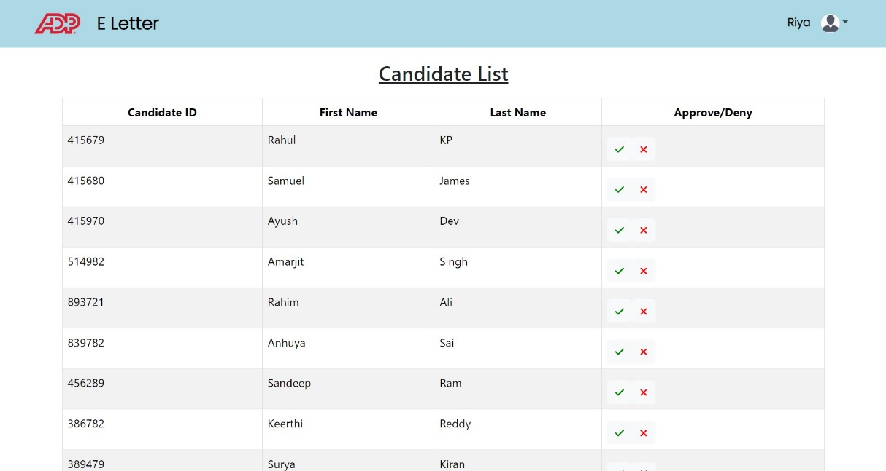
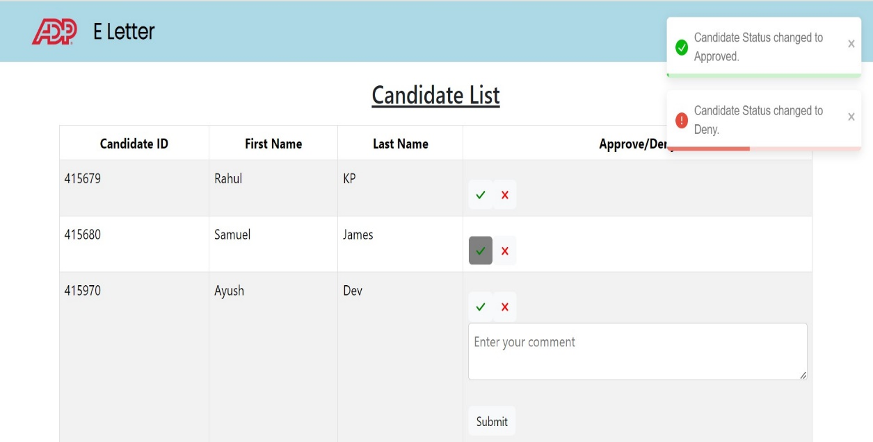

Slide 16
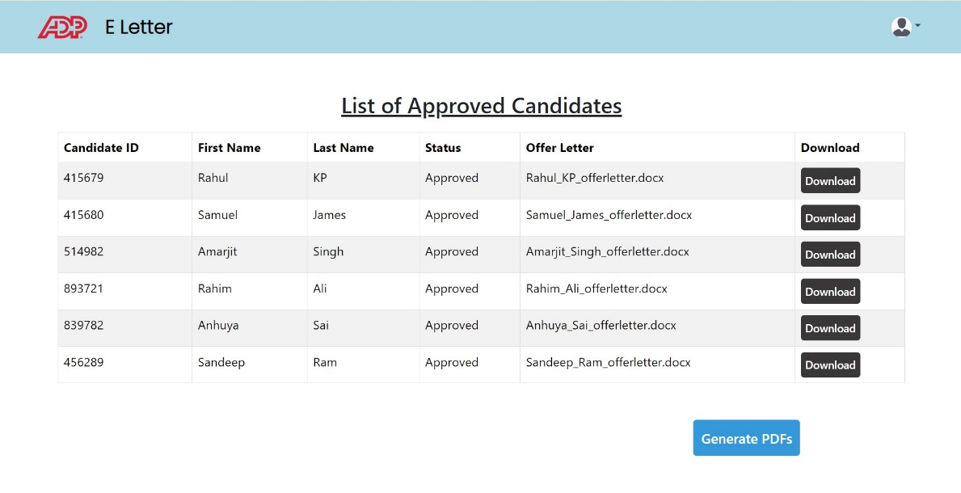
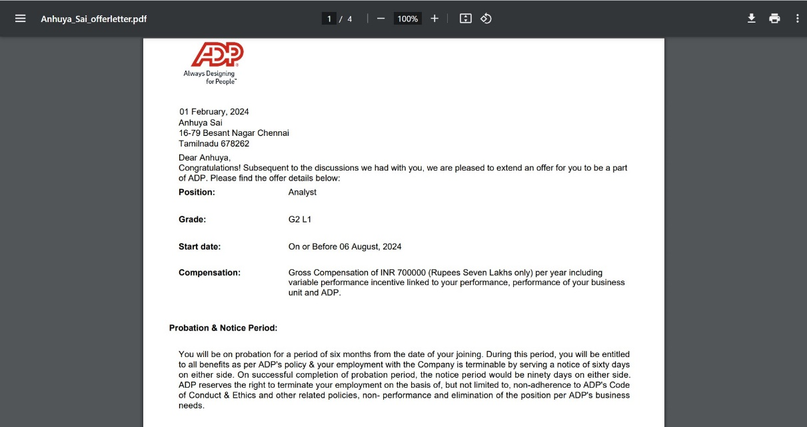
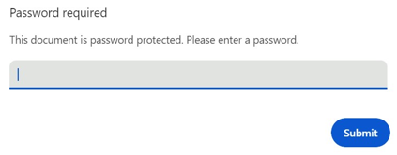

Slide 17
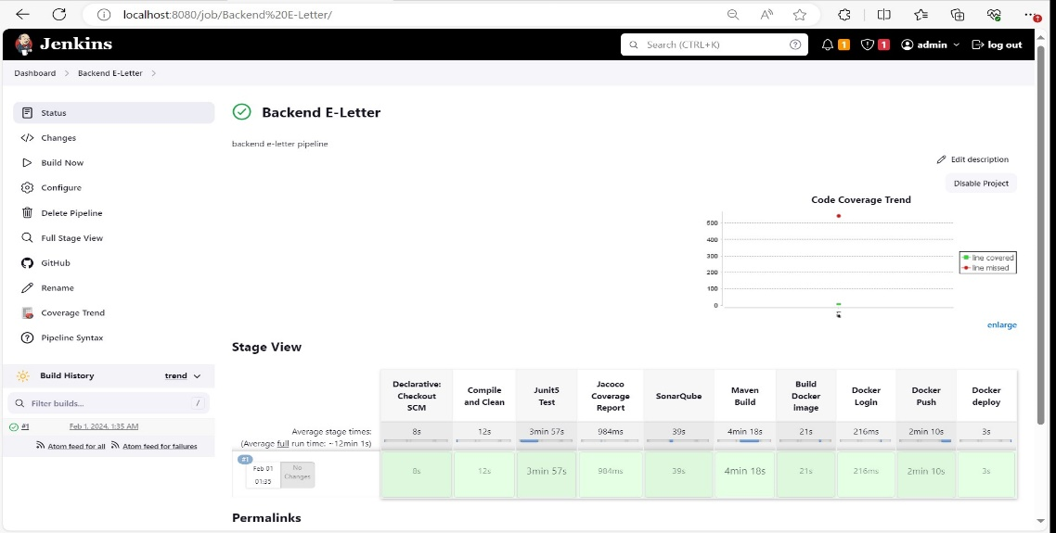
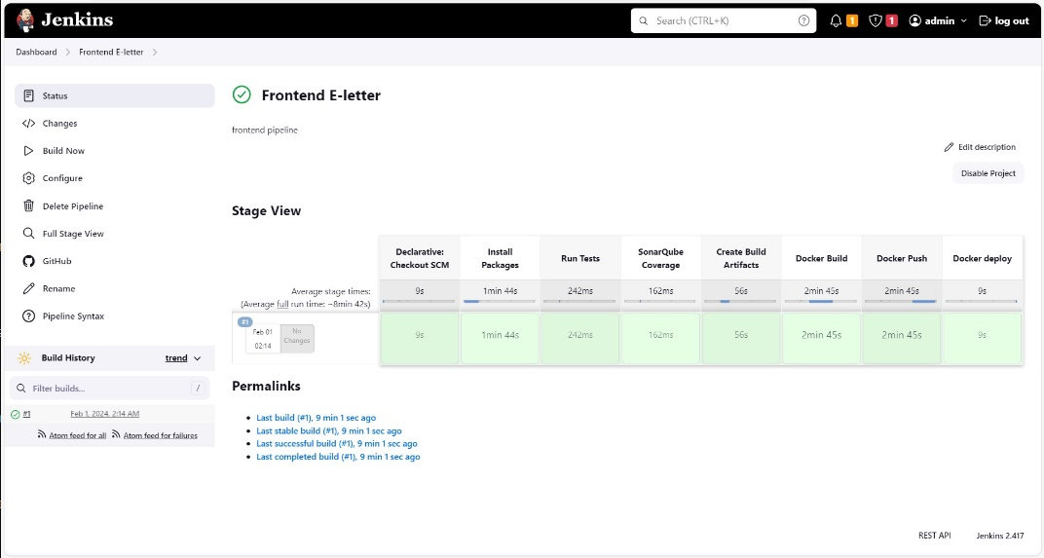
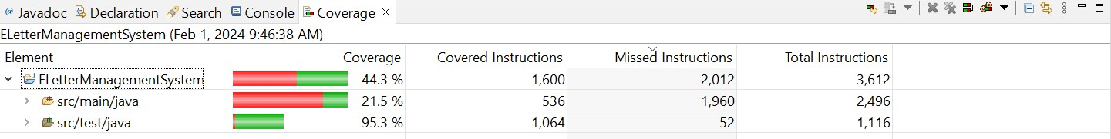
Jenkins
Code Coverage

Slide 18
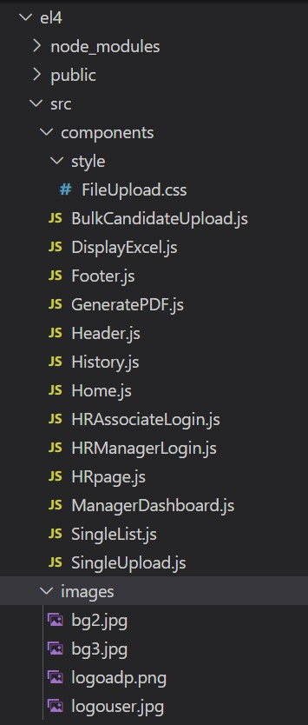
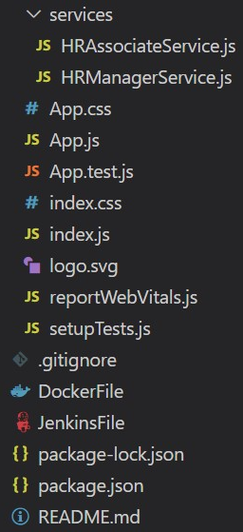
FRONTEND SCREENSHOTS

Slide 19
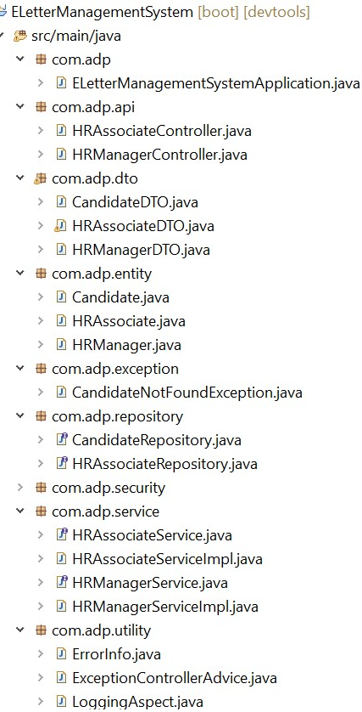
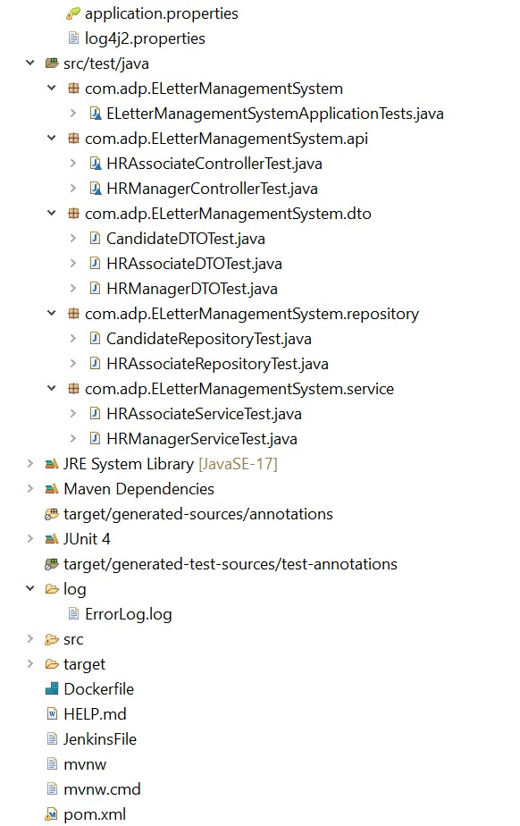
Backend Screenshots

Slide 20
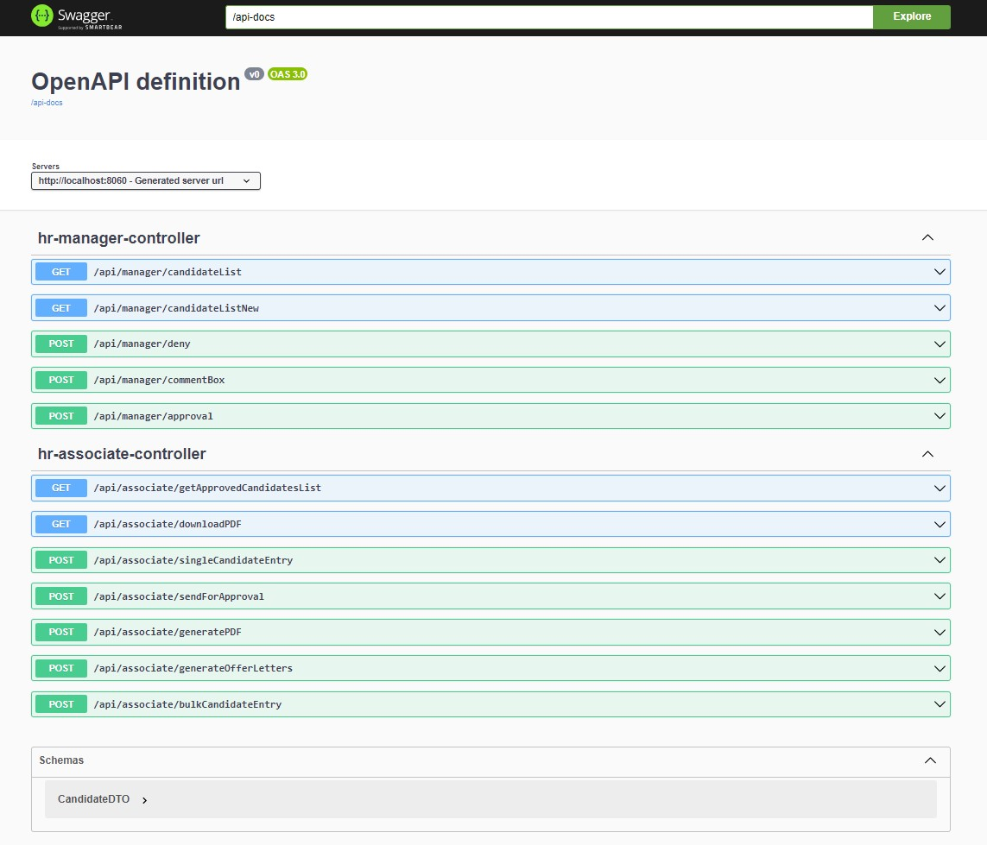
Swagger

Slide 21


