Slide 1
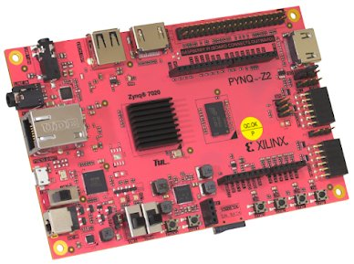
Real-Time FPGA-Accelerated Object Detection and Counting System using Pynq-Z2 board
PS + PL Implementation on PYNQ-Z2 Board using AXI DMA & YOLOv3-tiny
Vivado 2023.1
PYNQ v2.7
AXI DMA
YOLOv3-tiny
OpenCV DNN

Slide 2
Hardware Platform — PYNQ-Z2 Board
Board Specifications
SoC:
Xilinx Zynq-7000 (xc7z020clg400-1)
PS:
Dual-core ARM Cortex-A9 @ 650 MHz
PL:
85K logic cells FPGA fabric
RAM:
512 MB DDR3 Memory
OS:
PYNQ v2.7 flashed on SD card
Interface:
USB, HDMI, Ethernet, Pmod
Camera:
USB Camera via USB-A port
Language:
Python 3.8 + Jupyter Notebook
The Zynq SoC enables true PS+PL co-design — ARM CPU and FPGA fabric on a single chip

Slide 3
Introduction & Problem Statement
Problem Statement
Traditional object detection runs on CPUs or GPUs. Embedded FPGA platforms like PYNQ-Z2 offer a unique opportunity to split processing between ARM CPU (PS) and FPGA fabric (PL) — enabling real-time detection on low-power hardware.
Why PYNQ-Z2?
PYNQ-Z2 combines a Xilinx Zynq SoC with a Python-friendly framework, making it ideal for PS+PL co-design projects. It supports AXI DMA, Jupyter Notebook, and hardware overlays — perfect for real-time embedded vision.
Objective 1
Objective 2
Objective 3
Implement AXI DMA-based PS to PL data transfer on PYNQ-Z2 using Vivado 2023.1
Capture real-time video from USB camera and run YOLOv3-tiny object detection on ARM CPU
Demonstrate a complete PS+PL co-design with live bounding box output and frame logging
Scope: PYNQ-Z2 | Vivado 2023.1 | Python 3.8 | YOLOv3-tiny (80 COCO classes) | USB Camera

Slide 4
Project Overview
Goal
Build a real-time object detection system on PYNQ-Z2 that uses both the ARM Processing System (PS) and FPGA Programmable Logic (PL) together via AXI DMA.
PL Side (FPGA)
PS Side (ARM CPU)
PS ↔ PL Interface
▸ AXI DMA block
▸ USB camera capture
▸ AXI DMA transfer
▸ AXI Stream FIFO loopback
▸ CLAHE brightness fix
▸ 64×64 thumbnail sent
▸ Generates .bit + .hwh
▸ YOLOv3-tiny inference
▸ 4096 bytes per frame
▸ Vivado 2023.1 design
▸ OpenCV DNN engine
▸ Within 16KB DMA limit

Slide 5
System Architecture & Data Flow
📷
USB
Camera
🖼
Capture
(OpenCV)
✨
CLAHE
Enhance
➡
DMA Send
PS → PL
⚙
FPGA
Loopback
⬅
DMA Recv
PL → PS
🧠
YOLO
Inference
💾
Save
JPEG
DMA Buffer Challenge & Fix
Frame (640×480×3) = 921,600 bytes | DMA limit = 16,383 bytes → Send 64×64 grayscale = 4,096 bytes ✔
Software Stack
PYNQ v2.7
Python 3.8
OpenCV 4.2
NumPy
PYNQ lib
OS / Framework
Language
DNN + Vision
Array ops
Overlay / DMA

Slide 6
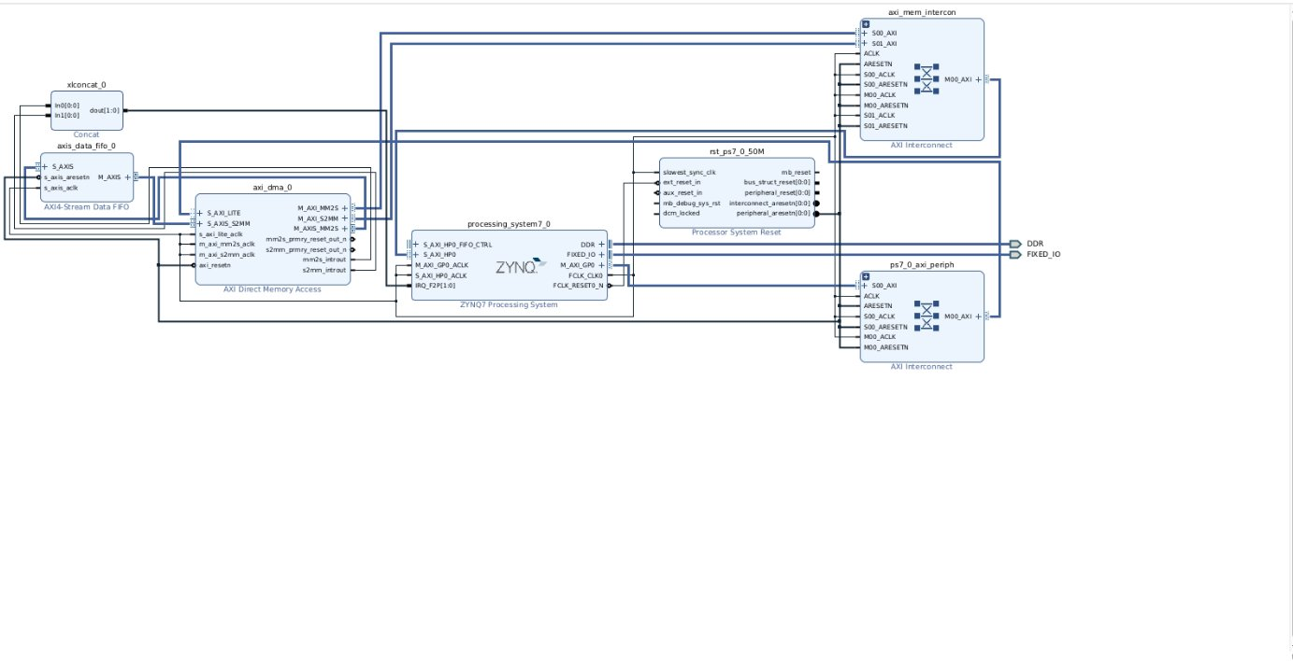
Vivado Block Design (Vivado 2023.1)
IP Blocks Used
ZYNQ7 PS
ARM CPU + HP0 AXI port
AXI DMA
Memory transfer engine
AXI Stream FIFO
Data loopback buffer
AXI Interconnect
Bus routing (×2)
Proc Sys Reset
Clock & reset manager
XLConcat
Interrupt aggregator

Slide 7
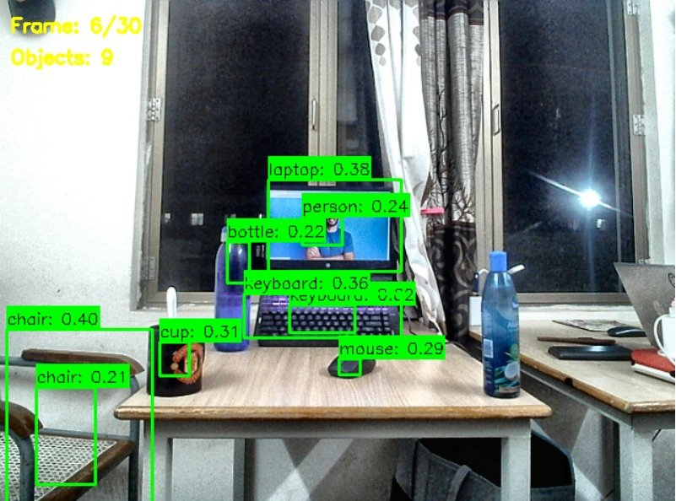
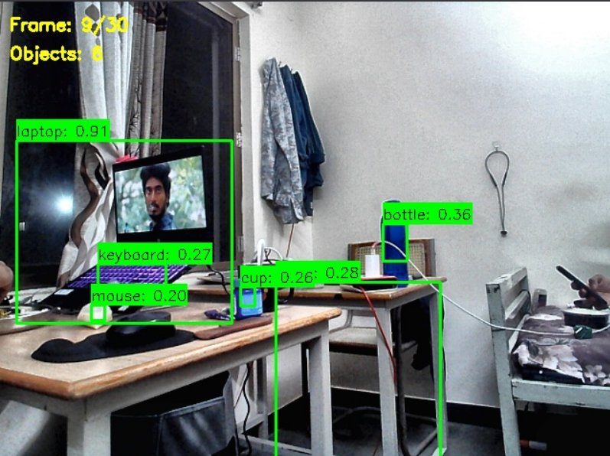
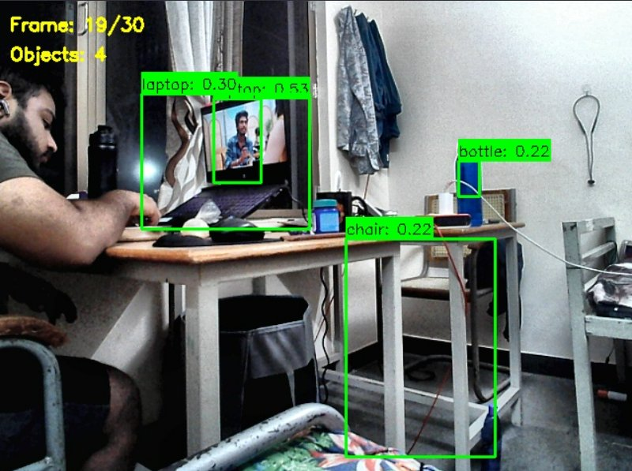
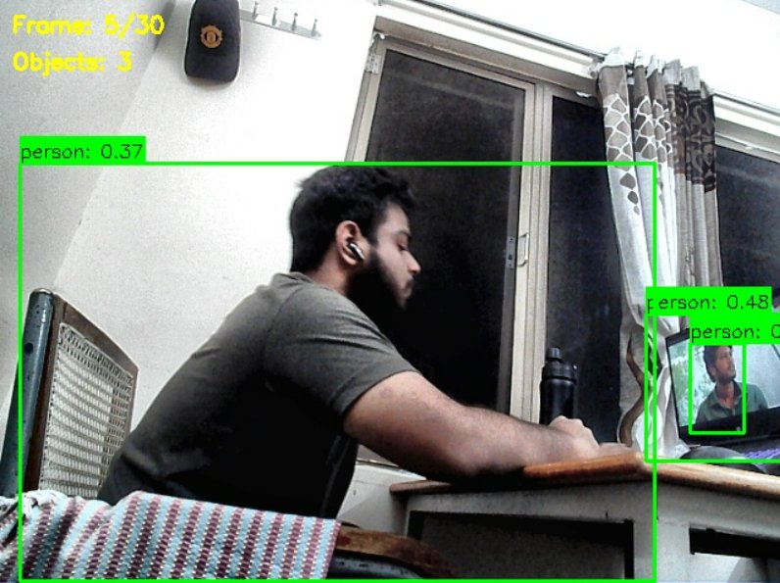
Live Detection Output Frames
Frame 6/30 — 9 Objects
Frame 9/30 — 8 Objects
Frame 19/30 — 4 Objects
laptop · person · bottle · keyboard · cup · mouse · chair (×2)
laptop · keyboard · mouse · cup · bottle
person · laptop · bottle · chair
Confidence threshold: 0.15 | NMS threshold: 0.30 | Model: YOLOv3-tiny | 80 COCO classes | Input: 416×416

Slide 8
Key Challenges & Solutions
Problem:
Problem:
onnxruntime not available for ARM 32-bit (armv7l)
YOLOv5n ONNX uses FLOAT16 — unsupported by OpenCV 4.2
Solution:
Solution:
Used OpenCV DNN — already installed on PYNQ v2.7
Switched to YOLOv3-tiny (.cfg + .weights) — fully compatible
Problem:
Problem:
DMA buffer limit 16,383 bytes vs frame 921,600 bytes
No internet on PYNQ board — pip install fails
Solution:
Solution:
Send 64×64 grayscale thumbnail = 4,096 bytes through DMA
Downloaded on PC and uploaded via Jupyter file browser
Problem:
Problem:
Poor detection in backlit and dark scenes
Steel bottle misdetected as 'vase'
Solution:
Solution:
Applied CLAHE contrast enhancement before inference
Added LABEL_REMAP: vase→bottle, tv→laptop, bowl→cup

Slide 9
Results & Conclusion
30
8
80
1–3
4 KB
Frames
Processed
Max Objects
per Frame
COCO
Classes
FPS on
ARM CPU
DMA Transfer
per Frame
What Was Achieved
Future Scope
✅ PS + PL co-design on real PYNQ-Z2 hardware
▸ HLS preprocessing IP block in PL
✅ AXI DMA transfer working (PS → PL → PS)
▸ Larger DMA buffer in Vivado design
✅ Real-time USB camera capture & processing
✅ YOLOv3-tiny detecting 80 COCO classes
▸ Full YOLOv3 for better accuracy
✅ CLAHE enhancement fixes dark/backlit scenes
▸ HDMI output for monitor display
✅ Live frame counter & detection log in Jupyter
▸ GPIO LED triggers on detections

Slide 10
Thank You

