Slide 1
Automation Testing
Selenium

Slide 2
Why is Automation needed in Software Testing?
Why is Automation needed in Software Testing?
Test Automation involves automating manual test steps via the use of specialized software to repetitively execute test cases multiple times without human intervention
>>
VALUE OF TEST AUTOMATION
1
2
3
4
Faster Go-to-Market
Testing Effort Reduction
Better Quality
Wider Coverage
Saves Business Users Time
Business teams can leverage automated scripts to expedite UAT
Provides Automated Test Logs
Log files can be analyzed and retesting can be done efficiently
Improves Accuracy of Testing
Minimizes chances of missing bugs
Provides Better Testing Coverage
Enables wider and deeper test coverage
Frees Up Resources
Testing resources can focus more on new functionality, exploratory testing
Expedites Regression Testing
Test execution of can be completed in less time
Allows Execution Any Time
Scripts can be scheduled to kickoff any hour of the day

Slide 3
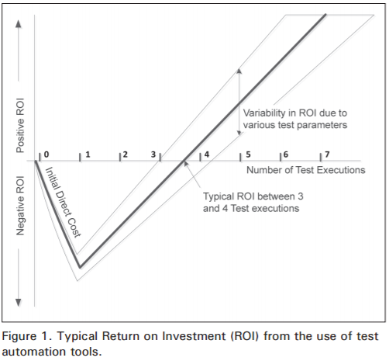
When automation makes sense?
Not everything can be and should be targeted for automation. Asking for 100% automation coverage is like asking for a 100% defect free software which is never possible.
For some tests, the automation effort is much more than their manual effort. A better approach is to identify the Return on Investment (ROI) of the tests.
High volume activity path
High dollar impact path
Applications with a Reasonable Life Span
Critical Business Processes
Repetitive Testing
Multiple Environments
Frequent Changes in Functionality
No Change in Software
Short Product Life Span
Inadequate Skillset
Low Return of Investment in Automation
Lack of Management Support

Slide 4



Automation Testing Areas
Alpha
Testing
Acceptance Testing
Unit Testing
Regression Testing
Integration Testing
System Testing
Component Testing
Business Team
Functional Team
Development Team
API Testing
Web Services Testing
UI Functional Testing
Mobile Testing

Slide 5
INTRODUCTION TO SELENIUM
Selenium is a suite of testing automation tools used for Web-Base applications: Selenium IDE, Selenium RC, Selenium WebDriver and Selenium Grid
These tools provide a rich set of testing functions specifically geared to varied testing scenarios of all types of Web applications
The operations provided by these tools are highly flexible and afford many options for comparing UI elements to expected application behavior
Selenium tests can be executed on multiple browser platforms

Slide 6
components of SELENIUM
Selenium RC aka Selenium 1
It ‘inject’ JavaScript functions into the browser when the browser is loaded and then uses its JavaScript to drive the AUT within the browser
Provides support for several programming languages
Selenium WebDriver
Designed to provide a simpler, more concise programming interface in addition to addressing some limitations in the Selenium-RC API
Developed to better support dynamic web pages where elements of a page may change without the page itself being reloaded
Makes direct calls to the browser using each browser’s native support for automation.
Selenium Grid
Tests can be run in parallel with simultaneous execution (different tests on different remote machines)
It allows for running your tests in a distributed test execution environment
Used to run your tests against multiple browsers, multiple versions of browser, and browsers running on different operating systems
It reduces the time it takes for the test suite to complete a test pass

