Slide 1
Credit Risk Modelling
Presenters:
Arunangshu Podder
Nikhil Gupta
Madhvi Gaur
Garima Bajpai

Slide 2
Business Problem
identified the factors that influence a loan getting repaid successfully or closed on account of default,
based on those factors, built a model that can predict whether a borrower will eventually default on his loan or not, and
built separate model that will, in the event of a default, predict the net impact of the default on the lender.
How it helps the Lending Industry?
Credit Risk Modelling (calculate the chances of a borrower’s loan default) is a field with a lot of ongoing research.
our solution is aimed at helping individual lenders or lending institutions minimize the risk of losing money due to bad loans.
help lenders evaluate and fund risky loans as well.
Most of the research work is happening around ways to predict default on a loan. We have also tried to predict how the default is affecting the lender financially.

Slide 3
Proposed Solution
Default Prediction (Classification Problem) – from the current attributes determine whether a borrower will default or not.
Loss Given Default (Regression Problem) – in the event of a loan default determine how much is at risk for the lender.
These form 2 important factors for Credit Risk Modelling.
Load data and select loan samples no longer active
Data cleaning and pre-processing
Build Model
Determine the best features for Default Prediction
Default Prediction
Select samples predicted as probable default loans
Load data and select only default loan samples
Data cleaning and pre-processing
Build Model
Run model on loan samples predicted as probable default loans
Loss Given Default

Slide 4
Dataset
Difficult to obtain real-time bank or lending institute data. Hence, focused on P2P platforms.
Several P2P platforms like Lending Club, Prosper and Fynanz.
Used Lending Club dataset available on Kaggle (https://www.kaggle.com/wordsforthewise/lending-club).
Dataset has 2 million+ samples with loan applications recorded between 2007 to 2018.
Total of 151 variables can be categorized as:
Borrower’s personal information
Borrower’s credit history
Loan Application details

Slide 5
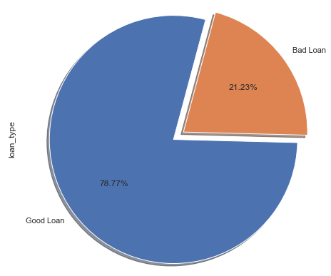
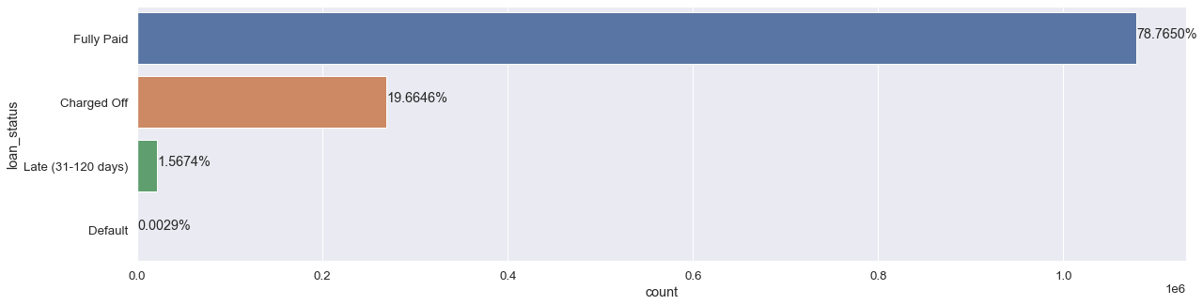
Exploratory Data Analytics
Loan Status
The feature “loan_status” has the following values as:
Current: Active Loan.
Fully Paid: The full principal with interest rates is paid back.
Charged Off: The loan will never be paid back in full amount.
In Grace Period: Payment of instalment is delayed by 1 to 15 days.
Late (16-30 days): Payment of instalment delayed by 16 to 30 days.
Late (31-120 days): Payment of instalment delayed by 31 to 120 days.
Default: Payment of instalment is delayed by more than 120 days.
Note:
For Classification Model training, we consider only Good and Bad loans.
For Regression Model training, we consider only Bad (Charged Off) loans.

Slide 6
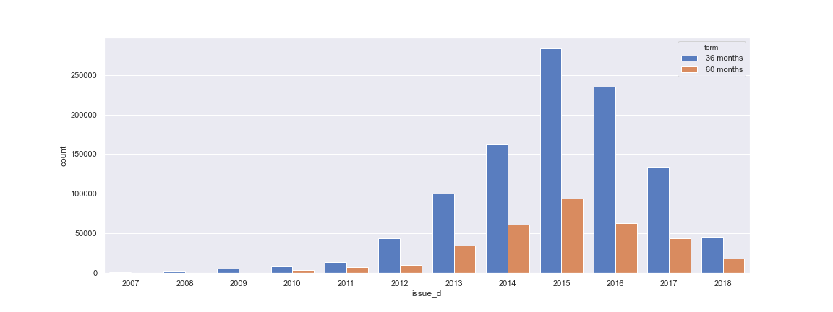
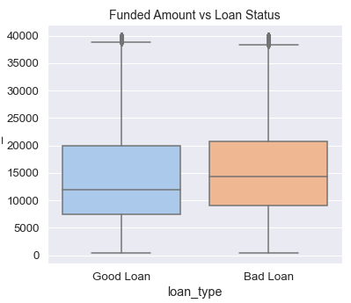
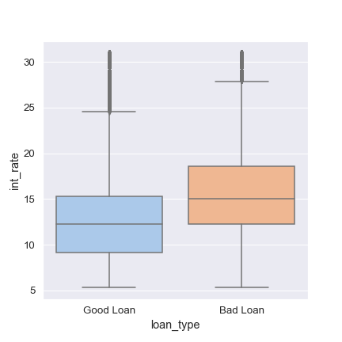
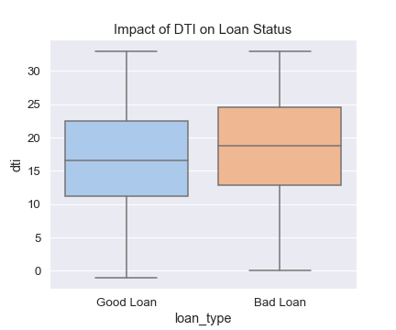
Exploratory Data Analytics
Issue Date and Term:
How Loan Status is influenced by Loan Amount, Rate of Interest and DTI

Slide 7
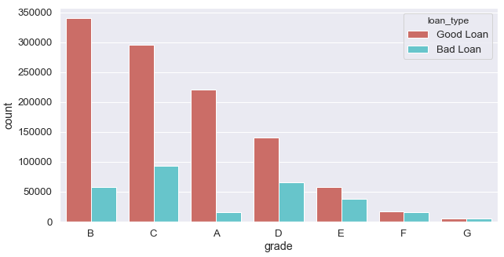
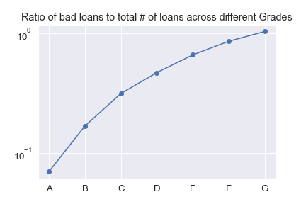
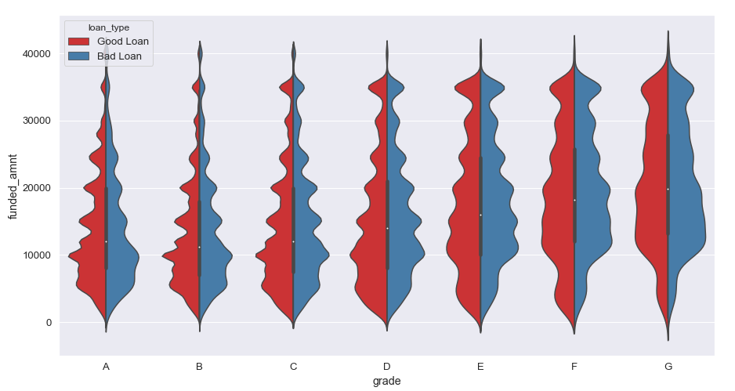
Exploratory Data Analytics
Grades applied to loan applications by Lending Club
Relationship between Funded Amount and Grade

Slide 8
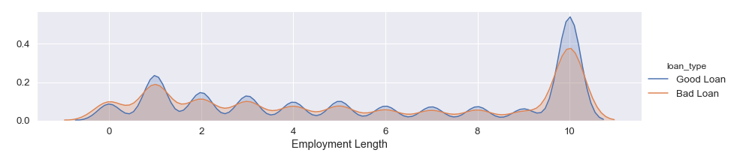
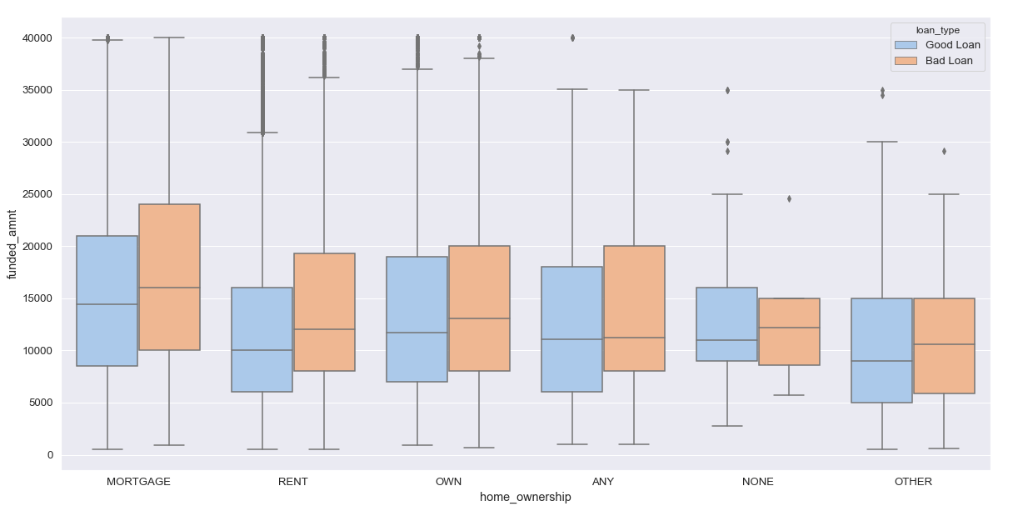
Exploratory Data Analytics
Length of Employment and its relationship with Loan Status
Effect of Home Ownership on the Loan Amount

Slide 9
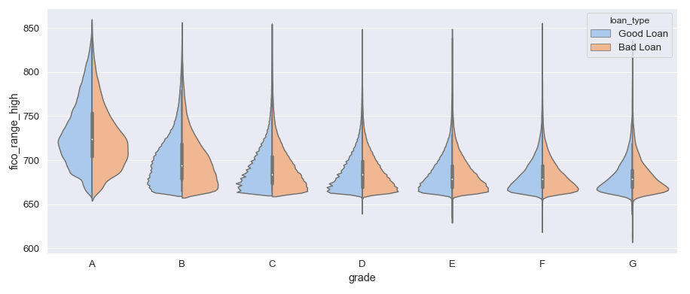
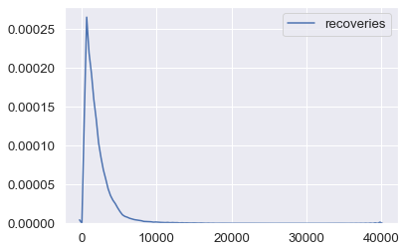
Exploratory Data Analytics
Effect of FICO score on Grade and Loan Status
Recoveries

Slide 10
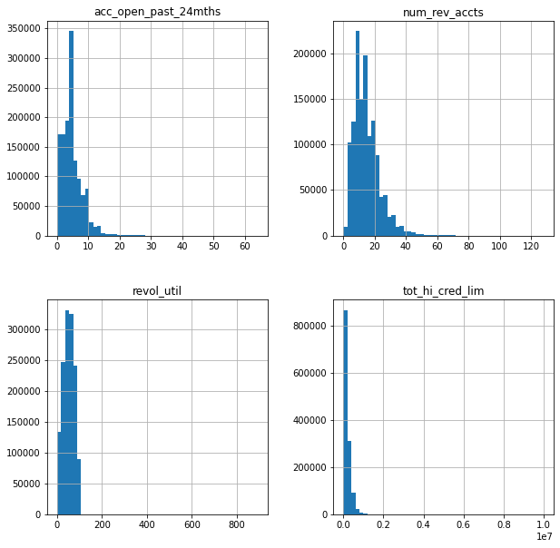
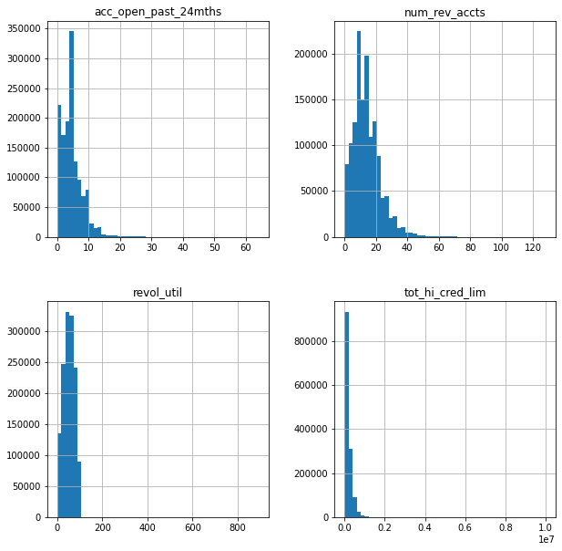
Feature Engineering
Different Missing Value Imputation techniques used:
Mean Value Imputation
Median Value Imputation
Zero Value Imputation
Missing Indicator Imputation
Dropped variables with missing values greater than 50%.
Before Imputation
After Imputation

Slide 11
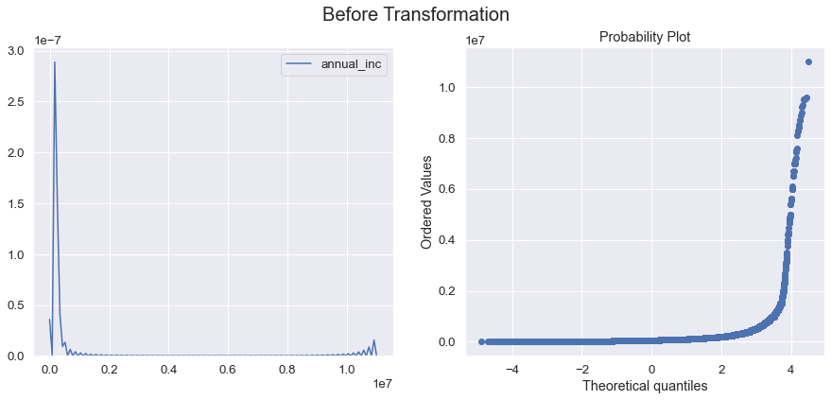
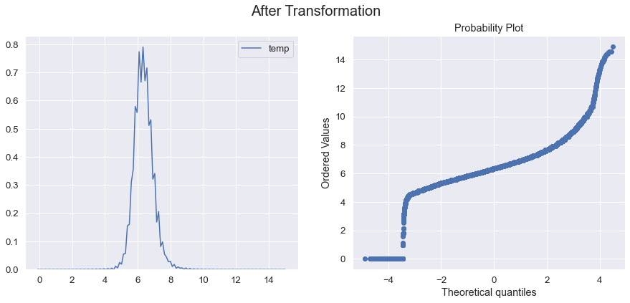
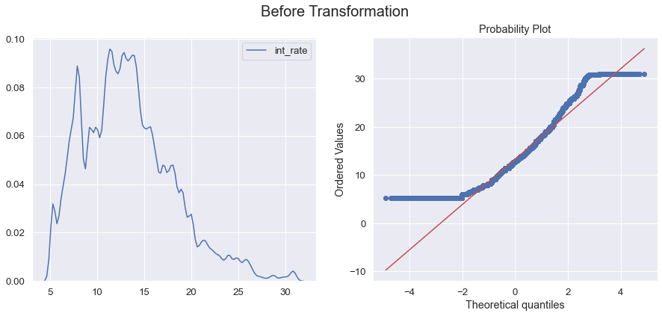
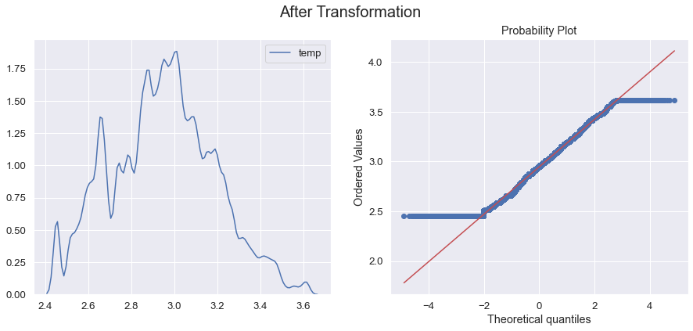
Feature Engineering
Different Variable Transformation techniques applied (in order to normalize the variables)
log
power (including square root and cube root)
reciprocal
boxcox
yeo-johnson
Variable transformation techniques have only been applied to regression problem.

Slide 12
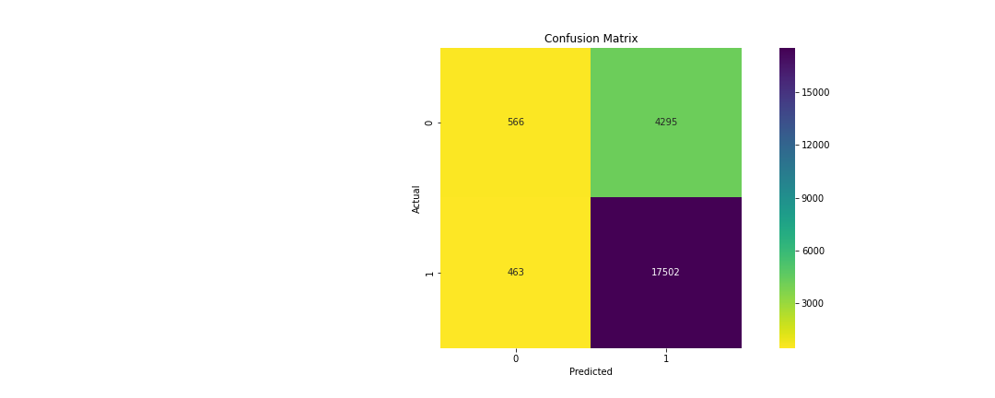
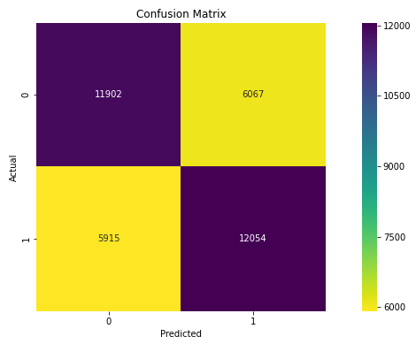
Handling Data Imbalance
Huge imbalance between good and bad loans.
Used Oversampling (Random Oversampler and SMOTE) techniques to handle data imbalance.
Selected Random Oversampler as execution time of SMOTE was too high.
Observed considerable improvement in results.
Without Oversampling
With Oversampling
** Results are on 10% sample of the data and model built without any parameter hyper tuning.

Slide 13
Algorithms Tested – Default Prediction
Different algorithms were tested to build our Classification model. Listed below:
Logistic Regression – Very effective for Binary Classification problems. However, not very powerful and ineffective on dataset with highly correlated features.
Decision Tree – Although prone to overfitting, easy to visualize and explain. However, prone to over-fitting.
Random Forest Classifier – Performs well in handling large datasets and also any imbalance in the dataset. Also, not much impact of outliers. However, interpretation can be difficult.
K-Nearest Neighbors – Good for constantly evolving data. However, its works very slow for large datasets and does not work well for imbalanced data.
Support Vector Machines – Performs well for data with higher dimensions (like image data) and when classes are easily inseparable. But training time is too high. So, difficult to train

Slide 14
Algorithms Tested – Loss Given Default
Different algorithms were tested to build our Regression model. Listed below:
Linear and Polynomial Regression – Straight forward and easy to explain. However, performs well only for linear data.
Random Forest Regressor – Performs well in handling large datasets and also any imbalance in the dataset. Also, not much impact of outliers. However, interpretation can be difficult.
Ridge and Lasso Regression – Helps to avoid overfitting. However, can lead to high bias.
Support Vector Regression – Performs well for data with higher dimensions (like image data) and when classes are easily inseparable. But training time is too high. So, difficult to train.
Artificial Neural Network – Can give excellent results for complex, non-linear data. However, can be computationally very expensive.

Slide 15
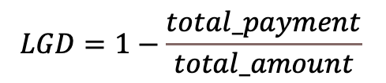
Solution Architecture – Target Variables
Default Prediction:
“loan_status” selected as target variable.
defined as current status of the loan.
Binary Classification problem to determine Good or Bad loans.
Loan samples with status “Fully Paid” labelled as “Good Loan”, samples with statuses “Charged Off”, “Late (31-120 days)” and “Default” labelled “Bad Loan”.
Rest labelled as “Active Loan”. Not considered during model building phase.
LGD Prediction:
“recoveries” selected as target variable.
defined as post charge–off gross recovery.
Loan samples with status as “Charged Off” considered during model building phase.
$$LGD=1−\frac{total_payment}{total_amount}$$

Slide 16
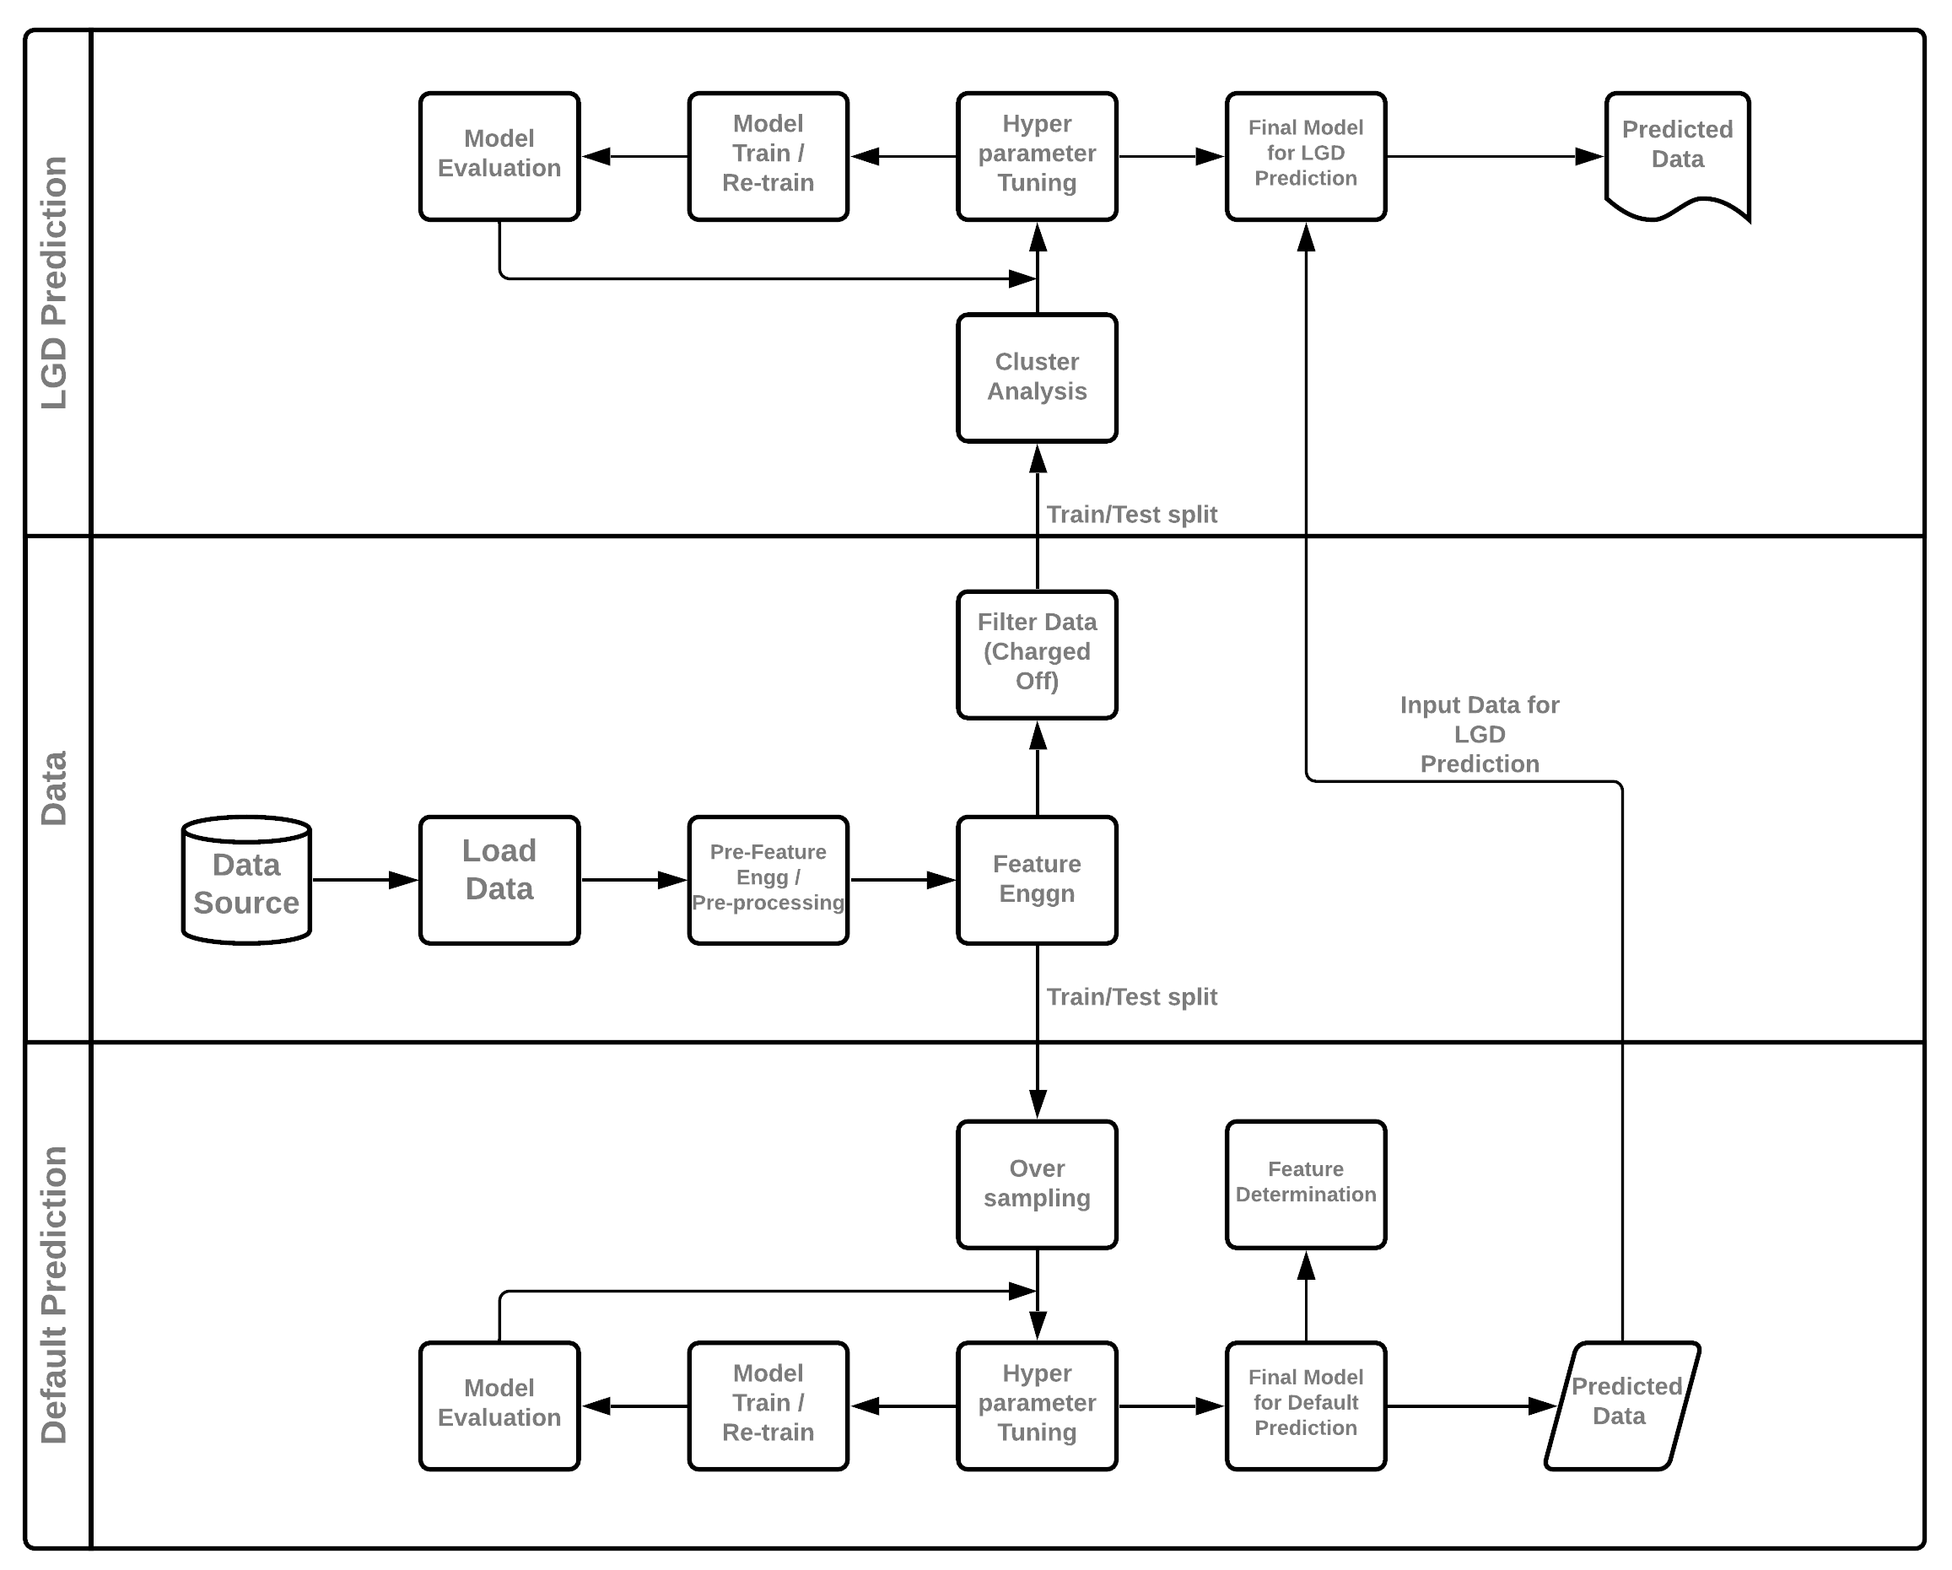
Solution Architecture - Process Overview

Slide 17
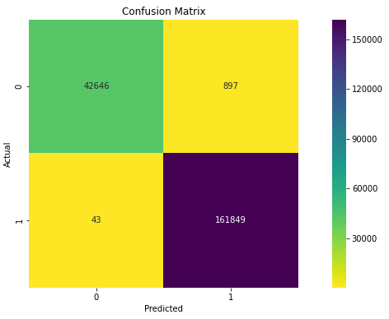
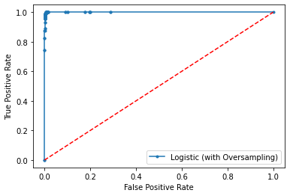
Classification Model Performance
Final Model Selected for Default Prediction – Logistic Regression
Metric Name | Score
Accuracy | 0.9939
Precision | 0.9925
Recall | 0.9998
F1 | 0.9961
AUC Score | 0.9999

Slide 18
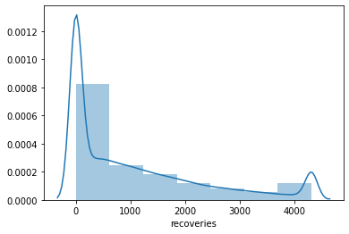
Regression Model Performance
Final Model Selected for LGD – Random Forest Regressor
Metric Name | Score
RMSE | 977.44
R^2 | 0.4254
Adjusted R^2 | 0.4244

Slide 19
Most Influencing Features for Default Prediction
Features deciding Bad Loans | Feature Importance | Feature deciding Good Loans | Feature Importance
funded_amnt | -20.220704 | initial_list_status | 0.001824
total_rec_int | -0.991154 | mths_since_recent_bc | 0.003452
hardship_flag | -0.217384 | pub_rec_bankruptcies | 0.007054
total_rec_late_fee | -0.177522 | mths_since_last_delinq | 0.008429
total_acc | -0.128451 | tax_liens | 0.008641
bc_open_to_buy | -0.108019 | mo_sin_old_il_acct | 0.011208
mo_sin_old_rev_tl_op | -0.104005 | num_sats | 0.017962
num_bc_tl | -0.073505 | mort_acc | 0.020196
bc_util | -0.071255 | annual_inc | 0.021126
last_credit_pull_d | -0.064792 | avg_cur_bal | 0.029781
fico_range_high | -0.064197 | dti_joint | 0.031385
open_acc | -0.061272 | num_accts_ever_120_pd | 0.036386
dti | -0.051507 | num_il_tl | 0.039755
emp_length | -0.046502 | verification_status_joint | 0.040833
num_op_rev_tl | -0.042417 | acc_open_past_24mths | 0.046516
num_tl_90g_dpd_24m | -0.034761 | percent_bc_gt_75 | 0.050051
verification_status | -0.033956 | revol_util | 0.058122
total_bal_ex_mort | -0.031669 | delinq_2yrs | 0.060393
num_actv_bc_tl | -0.027890 | pct_tl_nvr_dlq | 0.063277
home_ownership | -0.027810 | total_il_high_credit_limit | 0.087392
inq_last_12m | -0.026653 | num_rev_accts | 0.100289
pub_rec | -0.023027 | num_bc_sats | 0.123038
annual_inc_joint | -0.021780 | sub_grade | 0.169488
revol_bal | -0.020074 | issue_d | 0.220179
purpose | -0.019149 | last_pymnt_d | 0.378949
mths_since_recent_inq | -0.017456 | term | 0.501807
total_bc_limit | -0.014192 | last_fico_range_high | 1.526253
addr_state | -0.013939 | total_rec_prncp | 22.765821

Slide 20
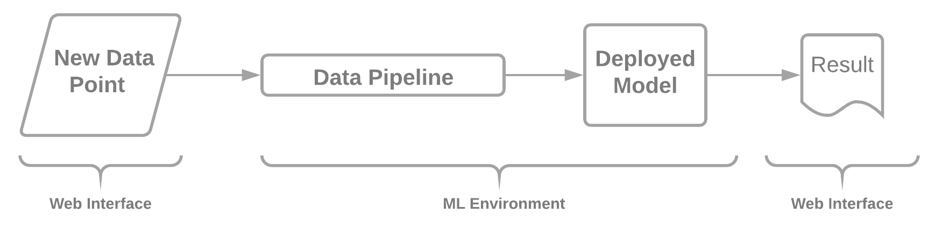
Productionize the model
Model built for P2P platforms whose data is publicly available.
Hence, deployment can be done on cloud.
Can be used for real-time prediction.
Roadmap to Production
Business
ML Engineering
Data Science
Data Pipeline
Train Model
Deploy Model
Monitor Model
Data Engineering
API Model Structure

Slide 21
Conclusion
Through this project, we have predicted events of Loan Default with very high accuracy.
certain limitations in predicting LGD and that can be a scope of future research.
Funded Amount, Total Received Principal and Interest (in case of active loans), FICO scores are some of the most important features that determine whether a person will default or not.

Slide 22
Potential Future Works
Find better ways for LGD prediction
Probable Solutions:
Use algorithms like SMOGN to remove imbalance from target variable “recoveries”.
Look at other variables to predict LGD more accurately.

Slide 23
Questions

