Slide 1
AutoExplorer - Personalized Car Selection Group-20
Course Project: MTH208
Under : Prof. Dootika Vats

Slide 2
About Us
Team Members
Aviral
Arunansh
Pulak
Rutvik

Slide 3
Objective of the project
1) Data Exploration and Insights: Provide users with an easy-to-navigate interface to explore key car attributes like name, company, fuel type, price, variants, and available colors.
2) Image Representation : Display images of cars, offering users a visual representation to accompany the data.
3) Summary Statistics: Provide key statistical insights and summaries, such as most common car features and trends, to help users make informed decisions.
4) Interactive Filtering: Enable users to filter and sort car data based on multiple parameters, including fuel type, price range, and seating capacity, to tailor their exploration.

Slide 4
What does the app do?
The app consists of four navigation pages that allows the user:
1. Car Data Exploration: Users can filter and view detailed car information in a dynamic table.
2. Car Image Viewer: View car images based on selected filters.
3. Car Comparison: Compare two cars side-by-side with key attributes and images.
4. Interactive Visualizations: Analyse rankings, price categories, and fuel types through interactive plots.

Slide 5
Video
Video Link-
https://drive.google.com/file/d/1XlQOJmIZmUuGNSZH35fd_hKHIXNyUQMO/view?usp=drive_link

Slide 6
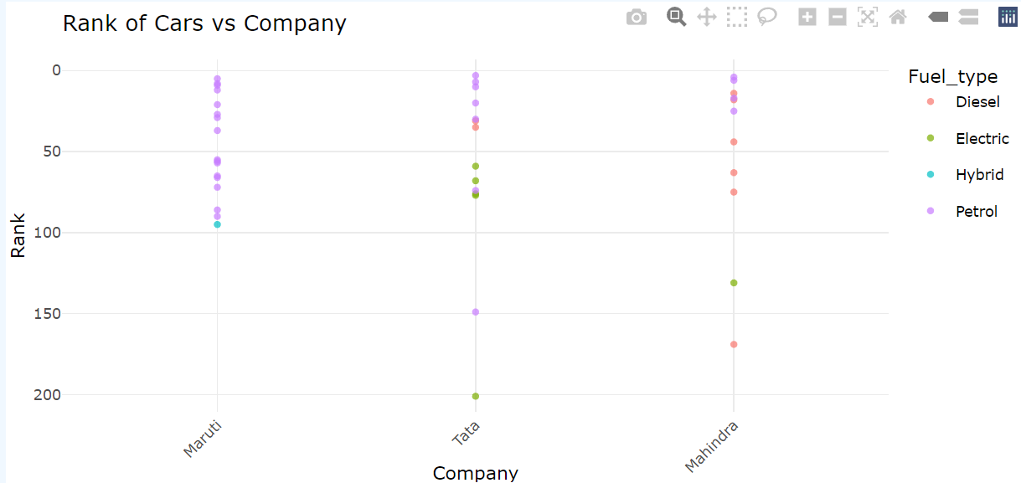
Inferences
Indian brands like Maruti, Tata, and Mahindra are the only ones with more than 10 models in the top 100 best-selling cars in India, likely due in part to nationalist sentiment.

Slide 7
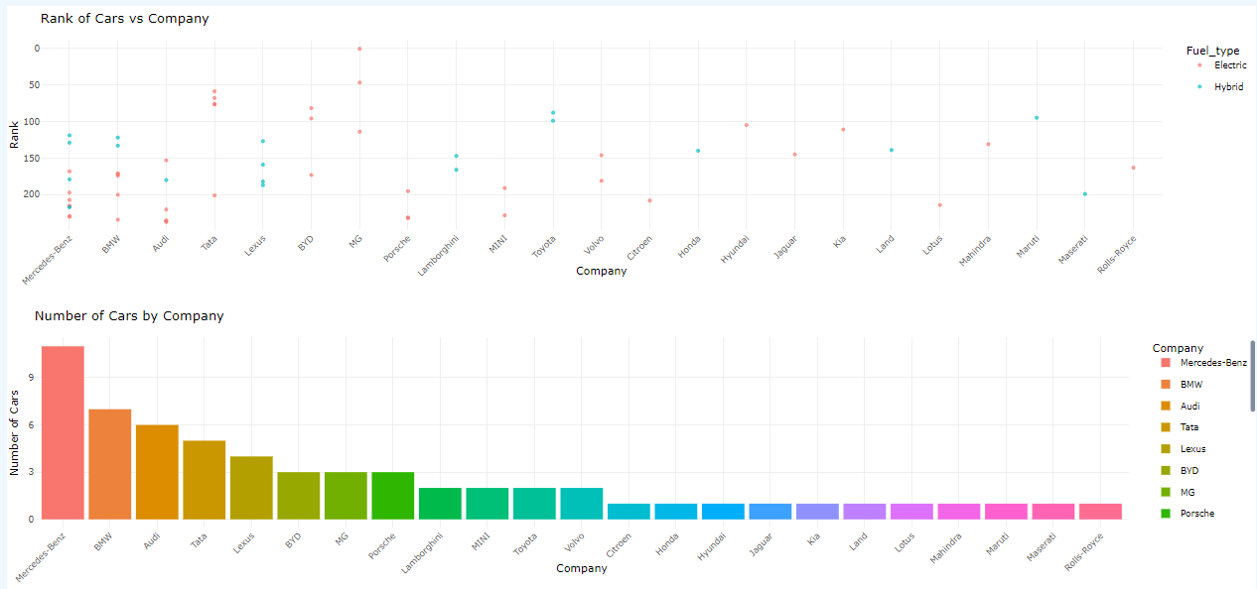
Inferences
Indian brands however, offer very few electric or hybrid options compared to foreign manufacturers and most of the top ranked cars are either Petrol or Diesel.

Slide 8
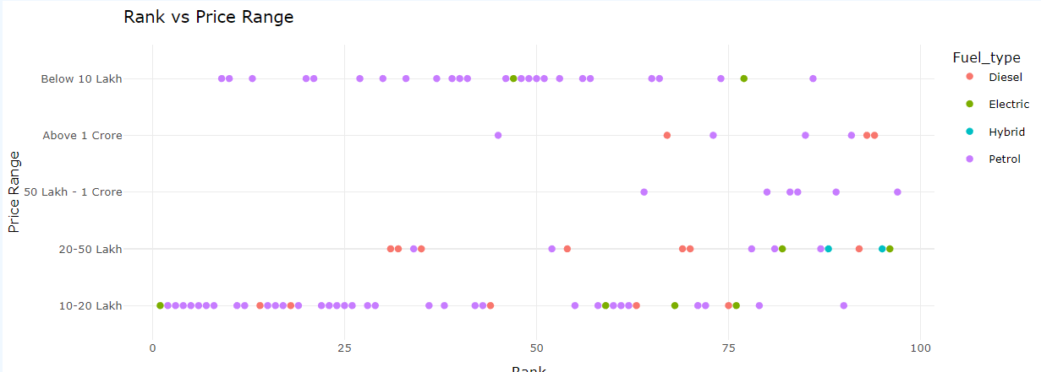
Inferences
Petrol run cars dominate the Indian market by a very big margin
All the collected evidence points to the fact that Indian market lags much behind rest of the world in clean fuel adoption, and in fact is only driven by foreign MNCs. The lag can be majorly attributed to comparatively poor clean energy infra.

Slide 9
Resources
Website link : https://www.cartrade.com/new-cars/best-cars-in-india/

Slide 10
Thanks!

