Slide 1


 | ZEAL EDUCATION SOCIETY’S ZEAL COLLEGE OF ENGINEERING AND RESEARCH NARHE │PUNE -41 │ INDIA COMPUTER ENGINEERING DEPARTMENT
Academic Year: 2025-2026 Semester: II
First Year Engineering Internship Projects Presentation
“VaultKeep – Digital Warranty & Service Book”
Presented By:
S.N. | Name of the student | Roll No
1. | Krishna Chaudhari | CO1607
2. | Vishwajeet Chaudhari | CO1608
3. | Om Kadam | CO1623
4. | Gayatri Kawale | CO1625
5. | Parth Patil | CO1637
6. | Shital Shelke | CO1648
Guided By:
Under the Guidance of
Prof. Arunadevi Khapla

Slide 2
Index
Introduction
Objective
Problem Statement
Motivation
System’s Architecture
Algorithms/Methodology
Hardware and Software Requirements
Comparison With Existing Systems
Outcome
Applications
Conclusion
References

Slide 3
INTRODUCTION
VaultKeep is a web-based digital vault that centralises warranty cards, purchase invoices and service/repair records for every electronic product a household or business owns.
It replaces fragile paper receipts and scattered photos/PDFs with one searchable, secure dashboard, built as per the project's Software Requirements Specification (SRS v1.0).
Every registered product gets a live SVG warranty ring — Green (Active), Yellow (Expiring within 30 days) or Red (Expired) — computed automatically from the purchase date.
The system is split into a User Module (personal product vault, analytics, reminders, QR passport, PDF reports) and an Admin Module (accounts, categories, system-wide settings).
Front end: HTML5, CSS3 and JavaScript (ES6+) with Chart.js, SweetAlert2, QRCode.js and jsPDF. Back end: PHP REST-style APIs with a MySQL/MariaDB database.

Slide 4
OBJECTIVE
Design a centralised digital platform to store product warranty cards, invoices and service history.
Automatically compute and visually display warranty status (Active / Expiring / Expired) for every product.
Send timely expiry reminders at 30-day, 15-day and 3-day thresholds so no claim window is missed.
Provide analytics — category-wise asset breakdown and warranty-health charts — for quick decisions.
Enable a Digital QR Passport for instant lookup of a product's ownership and warranty details.
Build an Admin Module for managing user accounts, category taxonomy and notification thresholds.
Ensure secure authentication (bcrypt password hashing) and injection-safe data access (prepared statements).

Slide 5
Problem Statement
Most consumers keep warranty cards, purchase invoices and repair receipts as loose paper slips or scattered photos and PDFs, with no reminder mechanism before a warranty lapses. This leads to lost paperwork, missed claim deadlines, and no easy way to track cumulative repair costs or service history over a product's lifetime. What is needed is a single, secure, searchable digital platform that stores this information, calculates warranty status in real time, and proactively reminds the owner before coverage expires.

Slide 6
MOTIVATION
Warranty cards and bills are frequently misplaced, torn or faded, causing users to lose out on eligible free repairs or replacements.
Manual tracking in notebooks or a phone gallery does not scale once a household owns 10–20+ electronic devices.
General note-taking or cloud-storage apps store files but do not understand “warranty” as a concept — no expiry maths, no status view, no reminders.
A centralised, automated tracker can genuinely save money by ensuring claims are filed before expiry, and gives peace of mind through one searchable vault.

Slide 7
FlowChart
User Registration / Login
Add Product (name, brand, purchase date, invoice)
System Auto-Calculates Expiry Date & Warranty Status
Dashboard shows Status Rings, Category & Health Analytics
Automated Reminders (30d / 15d / 3d before expiry)
Log Service / Repair History + Generate QR Passport / PDF Report
The cycle repeats for every new product added, keeping the entire portfolio's warranty health continuously up to date.

Slide 8
SYSTEM DESIGN
PRESENTATION LAYER
HTML5 • CSS3 • JavaScript (ES6+) Chart.js • SweetAlert2 • QRCode.js • jsPDF • FontAwesome 6
APPLICATION / API LAYER
PHP REST-style Endpoints auth.php • products.php • services.php • admin.php • cron_reminders.php (PHPMailer)
DATA LAYER
MySQL / MariaDB users • categories • products • service_histories • system_settings
Client browser ↔ PHP API (JSON over HTTP) ↔ MySQL database — a clean 3-tier separation of concerns.

Slide 9
Hardware and Software requirements:
HARDWARE REQUIREMENTS | SOFTWARE REQUIREMENTS
Processor: Intel Core i3 (or equivalent) and above | OS: Windows 10/11, Linux or macOS
RAM: 4 GB minimum (8 GB recommended) | Browser: Chrome, Edge
Storage: 500 MB free disk space | Server stack: XAMPP — Apache + PHP 7.4+ + MariaDB/MySQL
Display: 1366×768 or higher resolution | Code editor: VS Code (or equivalent)
Stable Internet connection (for CDN libraries & email alerts) | Libraries: Chart.js, jsPDF, FontAwesome 6

Slide 10
Algorithms/Methodology:
Warranty Expiry Calculation: expiry_date = purchase_date + warranty_period_months; the ring's “days remaining” and “% remaining” are derived by comparing today against that window.
Status Classification: Expired if days remaining ≤ 0, Warning if ≤ 30 days, Active otherwise — this drives the red / yellow / green colour of each product's SVG warranty ring.
Secure Authentication: passwords are hashed with bcrypt (password_hash / password_verify); every database query uses PDO prepared statements to prevent SQL injection.
Notification Scheduling: a daily cron-style job selects products where DATEDIFF(expiry_date, CURDATE()) IN (30, 15, 3) and triggers a PHPMailer email alert for each match.
QR Passport Generation: a unique per-product payload is encoded client-side into a scannable QR code (QRCode.js) for instant ownership and warranty lookup.
Report Export: aggregated inventory data is rendered client-side into a downloadable PDF using jsPDF.

Slide 11
Comparison with Existing systems :
Parameter | Paper Records | Cloud Storage (Drive / Photos) | VaultKeep (Proposed)
Centralised for all brands | No | Partially | Yes
Automatic expiry tracking | No | No | Yes
Reminders before expiry | No | No | Yes (30/15/3-day)
Service / repair history log | No | No | Yes
Analytics & PDF reports | No | No | Yes

Slide 12
Applications:
Households managing warranties for electronics, appliances and wearables purchased over several years.
Small businesses and offices tracking IT assets — laptops, printers, routers — and their AMC/warranty status.
Electronics retailers and service centres offering a digital warranty card to customers at the point of sale.
Insurance and extended-warranty providers verifying purchase and service history during a claim.
Resale / second-hand marketplaces, where a verifiable service and warranty history increases buyer trust.

Slide 13
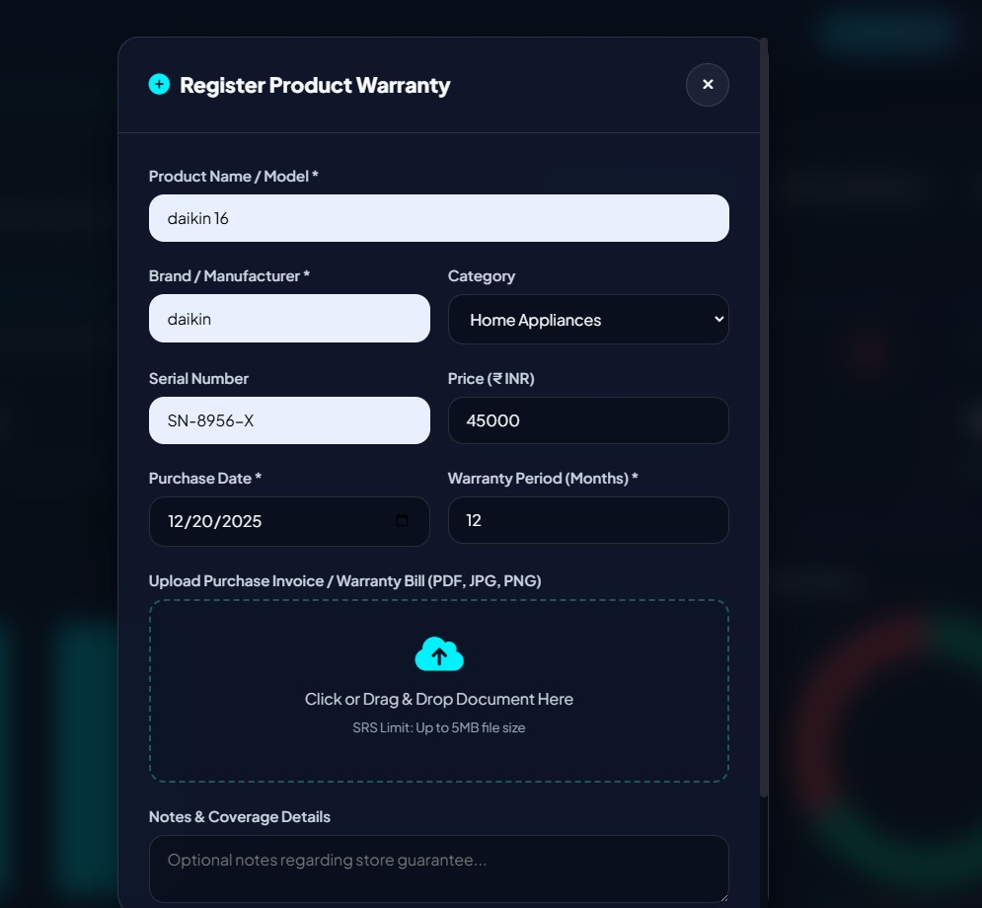
Implementation Snapshots:
Digital QR Passport
Dell Inspiron 15 Laptop
Service History
Add New Product

Slide 14
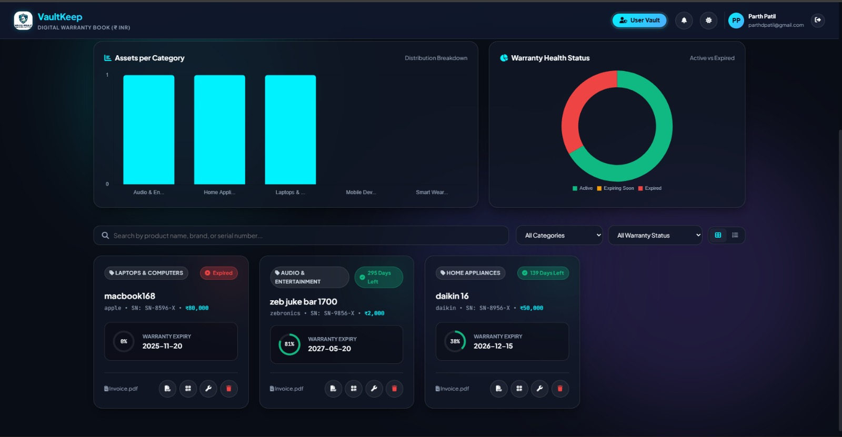
Implementation Snapshots:
Illustrative UI mock-up — replace with an actual dashboard screenshot from your running app.

Slide 15
Conclusion:
VaultKeep demonstrates how a lightweight HTML/CSS/JavaScript front end paired with a PHP-MySQL back end can solve a genuine everyday problem — tracking product warranties, invoices and repair history in one place. The system automatically classifies each asset's warranty status, visualises portfolio health through interactive charts, and proactively reminds users before coverage lapses, while the Admin module gives system-wide oversight of accounts and categories. The project meets the objectives defined in the SRS and lays a practical foundation for future enhancements such as a native mobile app, WhatsApp/SMS reminders, and OCR-based invoice scanning.

Slide 16
References:
Software Requirements Specification (SRS v1.0), Zeal College of Engineering and Research.
Chart.js Documentation — chartjs.org
jsPDF Documentation — github.com/parallax/jsPDF
PHP Manual — php.net/manual/en
MySQL 8.0 Reference Manual — dev.mysql.com/doc
FontAwesome 6 Icon Library — fontawesome.com

Slide 17
Thank You....!!!!

