Slide 1
Deep Learning and other advanced methods in healthcare: non-imaging examples
Arun Aryasomayajula
Data Science
@PopHealthCare®
Greater Nashville Healthcare Analytics Meetup
20 Feb 2018

Slide 2
Agenda
About PopHealthCare®
A primer on types of predictive algorithms
Deep Learning architectures
Autoencoders – a case study.
CNN for cancer immunotherapy– a case study.
NLP and Word Embedding Models.
Questions
Announcements

Slide 3
About PopHealthCare®
PopHealthCare (www.pophealthcare.com), PHC in short is an industry leader who partners with payers and providers to deliver proven risk adjustment, HEDIS, and high-risk population management programs.
PHC has corporate offices in both Tempe, AZ and Nashville, TN.
We currently serve over 40 health plan clients, impacting members in 49 states and Puerto Rico.
PHC joined the GuideWell group of companies. http://www.guidewell.com/blog/guidewell-mutual-holding-corporation-acquires-pophealthcare-llc
PHC makes informed decisions impacting its business with the help of Data Science and Analytics organization ranging from predictive modeling, machine learning, interactive visualizations etc.

Slide 4
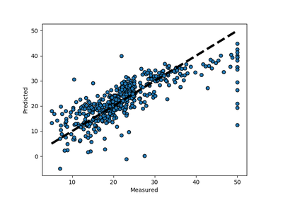
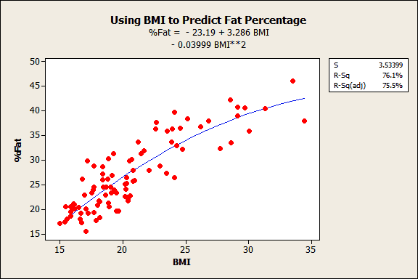
A primer on predictive algorithms
Predictive algorithms can be categorized broadly into three types depending on what we create as an end product after training:
Structural equations:
Y = f(x) where f(x) is algebraically defined.
Ex: Y = a*x+b*y+c or
Y = exp(-(x-mu)/sig^2) etc.
We start by assuming the form of relationship between our prediction and predictors.
Eg: linear regression assumes a linear relationship.

Slide 5
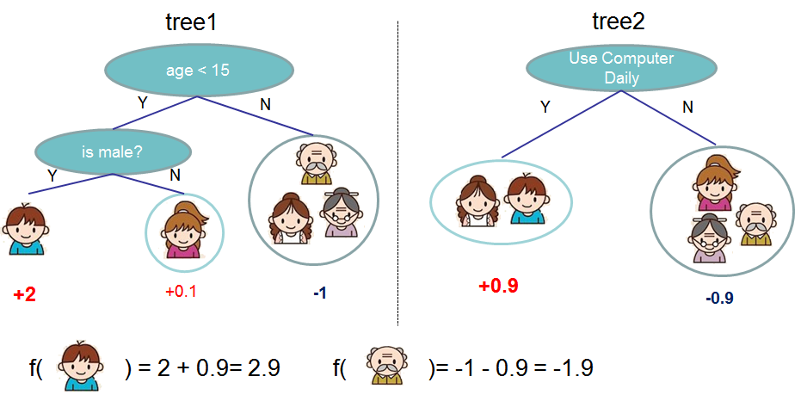
A primer on predictive algorithms
Tree based algorithms:
These don’t assume a structural relationship.
The algorithm creates a tree like structure with nodes and branches with each node representing a decision point. The data is divided at each node.
These models in essence produce business rules derived from the data directly towards a goal like classification or regression problems.
Very popular with lots of advanced ensemble methods available like RandomForest, Gradient Boosted Machines, XGBoost, Light-GBM, CatBoost etc.

Slide 6
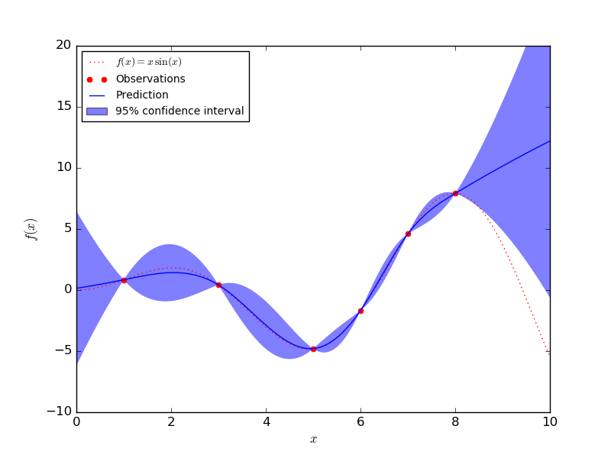
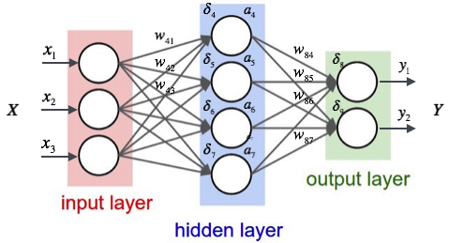
A primer on predictive algorithms
Function approximation algorithms:
These assume a structural relationship of the kind Y = f(X). The form of the function isn’t assumed but is regressed from data.
Eg: Gaussian Processes (some assumption required), Deep Learning Models (Aha!).
For reference,
https://en.wikipedia.org/wiki/Gaussian_process
https://en.wikipedia.org/wiki/Deep_learning

Slide 7
Types of Deep Learning Architectures
Autoencoders
Convolutional Neural Networks (CNN)
Recurrent Neural Networks (RNN)
Long Short Term Memory Networks (LSTM)
Generative Adversarial Networks (GAN) and lots more (literally 1000s more!)

Slide 8
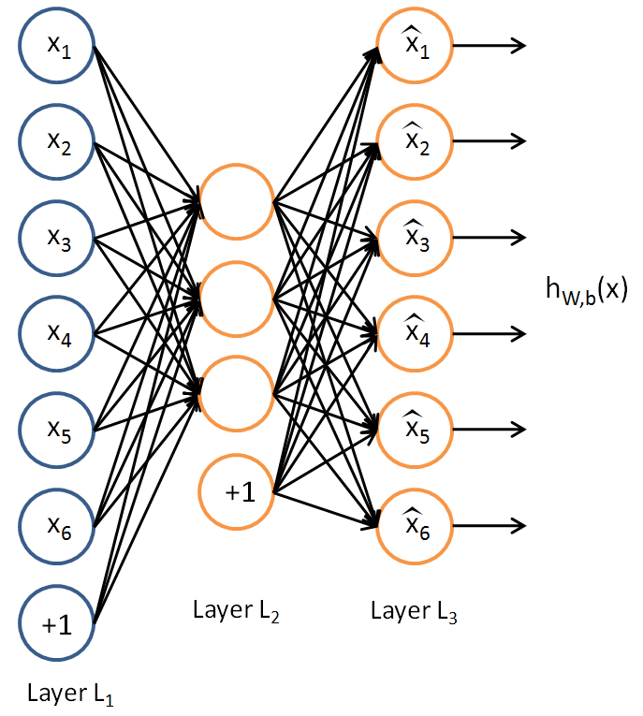
Autoencoders
An autoencoder neural network is an unsupervised learning algorithm that applies backpropagation, setting the target values to be equal to the inputs.
The autoencoder tries to learn the identity function f(x) = x
By putting constraints on the number of layers and units one can uncover a great deal about hidden patterns in the data.
Autoencoders are related to PCA and other dimensionality reduction techniques, but can learn more complex mappings due to their nonlinear nature.
A wide range of autoencoder architectures exist, including Denoising Autoencoders, Variational Autoencoders, or Sequence Autoencoders.
Ref:http://ufldl.stanford.edu/tutorial/unsupervised/Autoencoders/

Slide 9
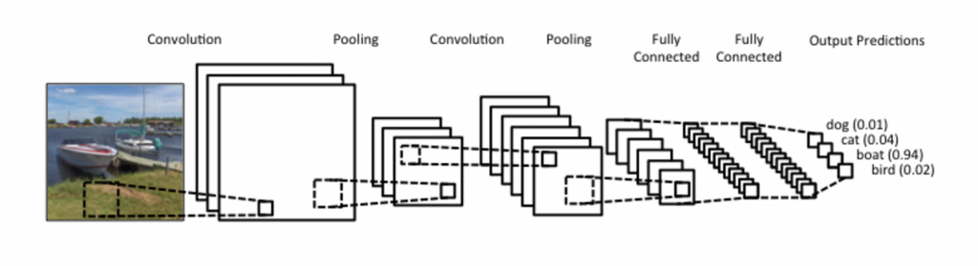
Convolutional Neural Networks (CNN)
A CNN uses convolutions to connected extract features from local regions of an input.
Most CNNs contain a combination of convolutional, pooling and affine layers.
CNNs have gained popularity particularly through their excellent performance on visual recognition tasks, where they have been setting the state of the art for several years.
Stanford CS231n class – Convolutional Neural Networks for Visual Recognition
Understanding Convolutional Neural Networks for NLP

Slide 10
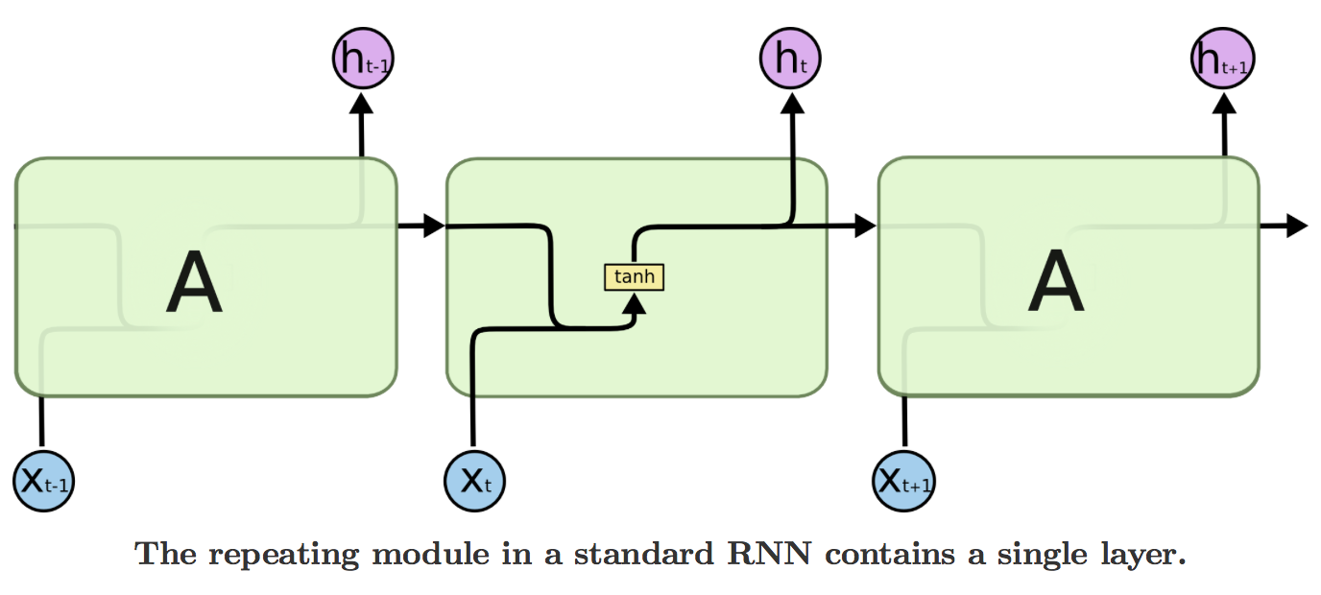
Recurrent Neural Networks (RNN)
A RNN models sequential interactions through a hidden state, or memory.
It can take up to N inputs and produce up to N outputs. For example, an input sequence may be a sentence with the outputs being the part-of-speech tag for each word (N-to-N).
An input could be a sentence, and the output a sentiment classification of the sentence (N-to-1). An input could be a single image, and the output could be a sequence of words corresponding to the description of an image (1-to-N).
At each time step, an RNN calculates a new hidden state (“memory”) based on the current input and the previous hidden state.
The “recurrent” stems from the facts that at each step the same parameters are used and the network performs the same calculations based on different inputs.
Recurrent Neural Networks Tutorial, Part 1 – Introduction to RNNs

Slide 11
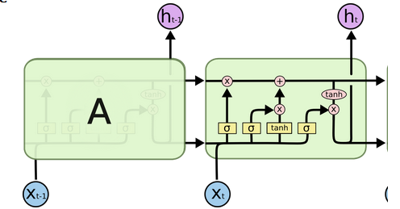
Long Short Term Memory Networks(LSTM)
Long Short-Term Memory networks were invented to prevent the vanishing gradient problem in Recurrent Neural Networks by using a memory gating mechanism.
Using LSTM units to calculate the hidden state in an RNN we help to the network to efficiently propagate gradients and learn long-range dependencies.
Long Short-Term Memory
Understanding LSTM Networks
Recurrent Neural Network Tutorial, Part 4 – Implementing a GRU/LSTM RNN with Python and Theano

Slide 12
Case Study 1: How to make better classifiers using AutoEncoders?
In this use case, a prostate cancer dataset is separated into “easy” vs “hard” to model subsets using autoencoders and to gain predictive accuracy in classifying cancer vs non-cancer.
The dataset has about 380 rows with 153 positives.
H2O.ai’s deep autoencoder and anomaly detection models are used within R.
H2O is an open-source software for machine learning and big-data analysis. It’s a JVM based truly parallel platform with both R and Python wrappers. (https://www.h2o.ai/download/ )
It offers various models such as GLM, GBM and Random Forest, but more importantly, offers deep learning framework and a distributed computing architecture.

Slide 13
Prostate Cancer dataset glossary
Gleason Score: Pathologists grade prostate cancers using numbers from 1 to 5 based on how much the cells in the cancerous tissue look like normal prostate tissue under the microscope. This is called the Gleason system. Grades 1 and 2 are not often used for biopsies − most biopsy samples are grade 3 or higher. (integer from 1-10)
PSA: Prostate-specific antigen, or PSA, is a protein produced by normal, as well as malignant, cells of the prostate gland. The PSA test measures the level of PSA in a man’s blood. For this test, a blood sample is sent to a laboratory for analysis. The results are usually reported as nanograms of PSA per milliliter (ng/mL) of blood. (mg/ml)
DCAPS: Capsular involvement on rectal exam(yes or no)
DPROS: digital prostate exam (factor)
VOL: Tumor Volume (cm3)
CAPSULE: Tumor penetration of prostatic capsule (yes or no)
RACE: Race (White or Black)
library(h2o)
prosPath = system.file("extdata", "prostate.csv", package = "h2o")
prostate_df <- read.csv(prosPath)

Slide 14
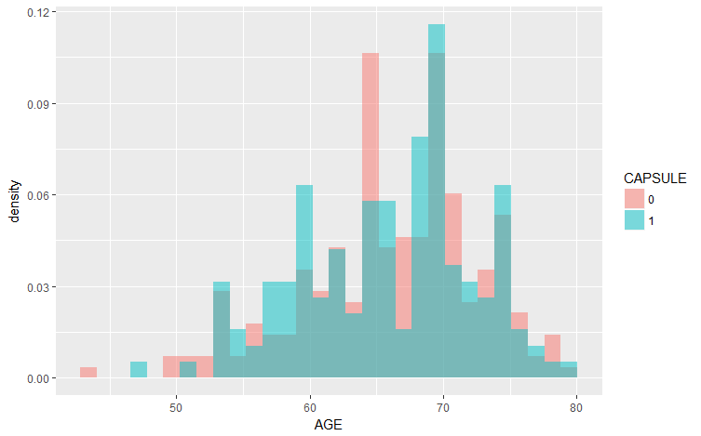
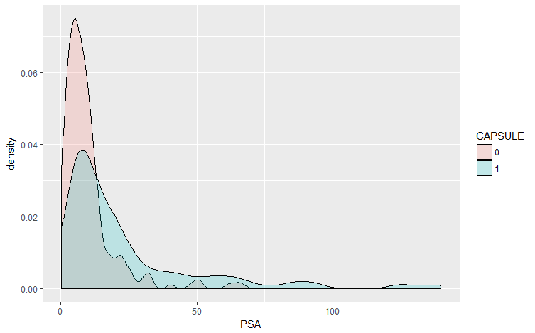
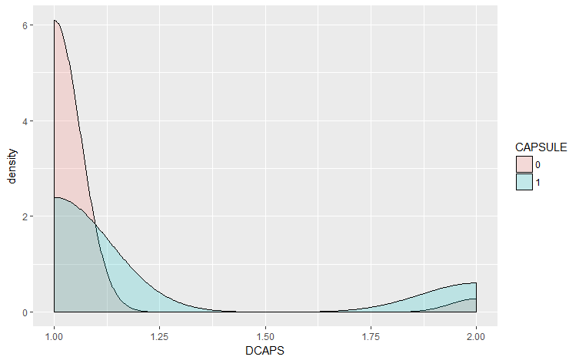
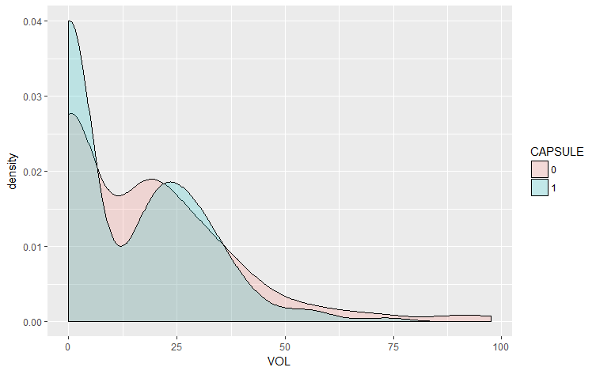
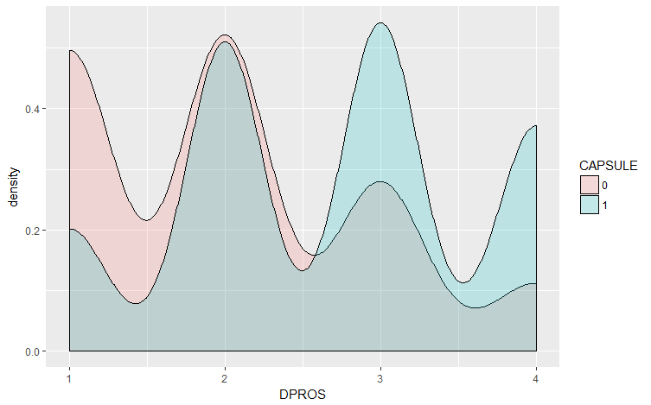
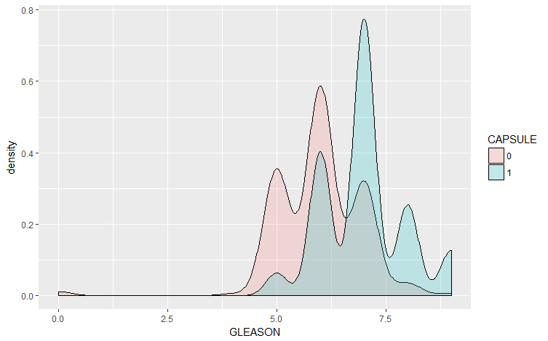
Prostate Cancer Dataset

Slide 15
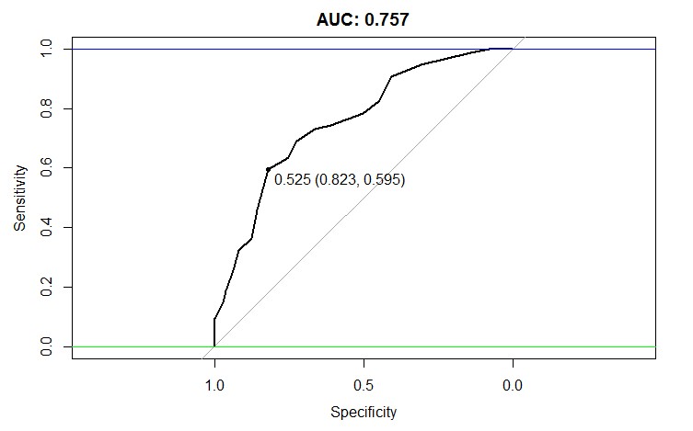
Building RandomForest Model for Benchmarking in R
library(randomForest)
feature_names <- setdiff(names(prostate_df), “CAPSULE”)
set.seed(1234)
rf_model <- randomForest(x=train_df[,feature_names],
y=as.factor(train_df[,outcome_name]),
importance=TRUE, ntree=20, mtry = 3)
validate_predictions <- predict(rf_model, newdata=validate_df[,feature_names], type="prob")
install.packages('pROC’)
library(pROC)
auc_rf = roc(response=as.numeric(as.factor(validate_df[,outcome_name]))-1,
predictor=validate_predictions[,2])
plot(auc_rf, print.thres = "best", main=paste('AUC:',round(auc_rf$auc[[1]],3)))
abline(h=1,col='blue')
abline(h=0,col='green')

Slide 16
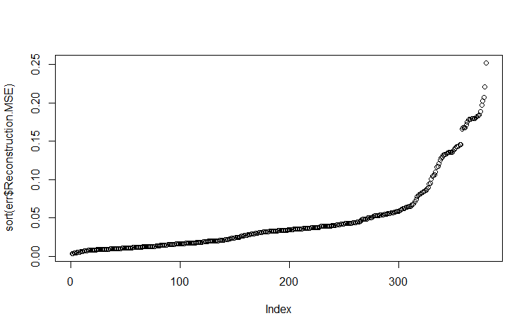
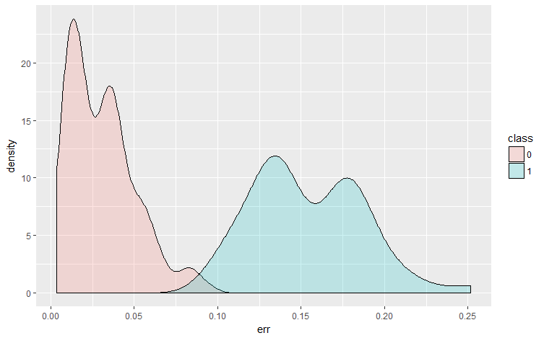
Building autoencoder model in H2O
library(h2o)
localH2O = h2o.init()
prostate.hex<-as.h2o(prostate_df, destination_frame="train.hex")
prostate.dl = h2o.deeplearning(x = feature_names, training_frame = prostate.hex,
autoencoder = TRUE,
reproducible = T,
seed = 1234,
hidden = c(6,5,6), epochs = 50)
# interesting per feature error scores
prostate.anon = h2o.anomaly(prostate.dl, prostate.hex, per_feature=TRUE)
head(prostate.anon)
prostate.anon = h2o.anomaly(prostate.dl, prostate.hex, per_feature=FALSE)
head(prostate.anon)
err <- as.data.frame(prostate.anon)
# interesting reduced features (defaults to last hidden layer)
reduced_new <- h2o.deepfeatures(prostate.dl, prostate.hex,layer=2)
head(reduced_new)
plot(sort(err$Reconstruction.MSE))
DF.L2.C1 DF.L2.C2 DF.L2.C3 DF.L2.C4 DF.L2.C5
0.0000000 0.0000000 0.000000 0.0000000 0.04857907
0.4997092 1.0766817 1.600740 0.6755628 0.35198803
0.3719157 0.8298017 1.207336 0.4863282 0.03690014
0.0000000 0.0000000 0.000000 0.0000000 0.70372806
0.0000000 0.0000000 0.000000 0.0000000 0.37891354
0.4616853 1.0687052 1.568674 0.6392847 0.41436466

Slide 17
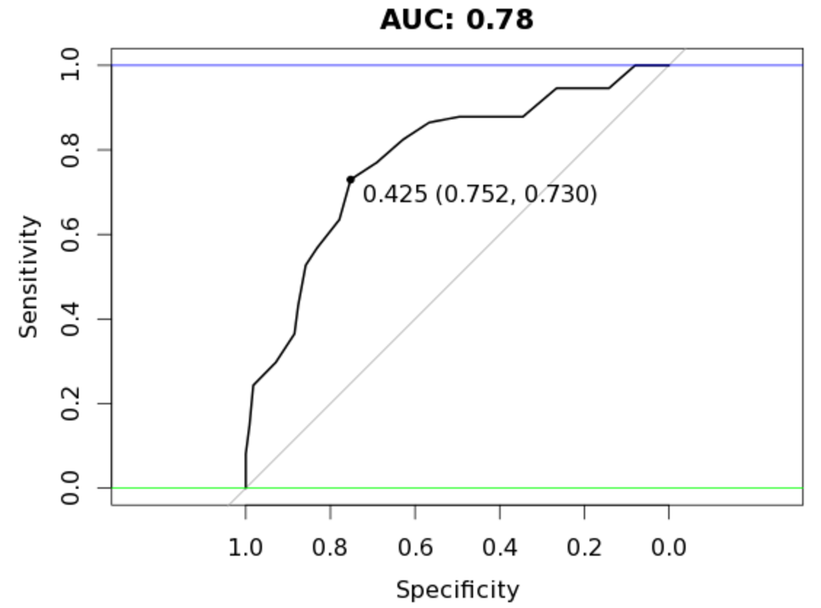
Build RandomForest model: separate by reconstruction error
Reconstruction Error <0.1
# rebuild train_df_auto with best observations
train_df_auto <- train_df[err$Reconstruction.MSE < 0.1,]
set.seed(1234)
rf_model <- randomForest(x=train_df_auto[,feature_names],
y=as.factor(train_df_auto[,outcome_name]),
importance=TRUE, ntree=20, mtry = 3)
validate_predictions_known <- predict(rf_model,
newdata=validate_df[,feature_names], type="prob")
auc_rf <-roc(response=as.numeric(as.factor(validate_df[,outcome_name]))-1, predictor=validate_predictions_known[,2])
plot(auc_rf, print.thres = "best", main=paste('AUC:',round(auc_rf$auc[[1]],3)))
abline(h=1,col='blue')
abline(h=0,col='green')

Slide 18
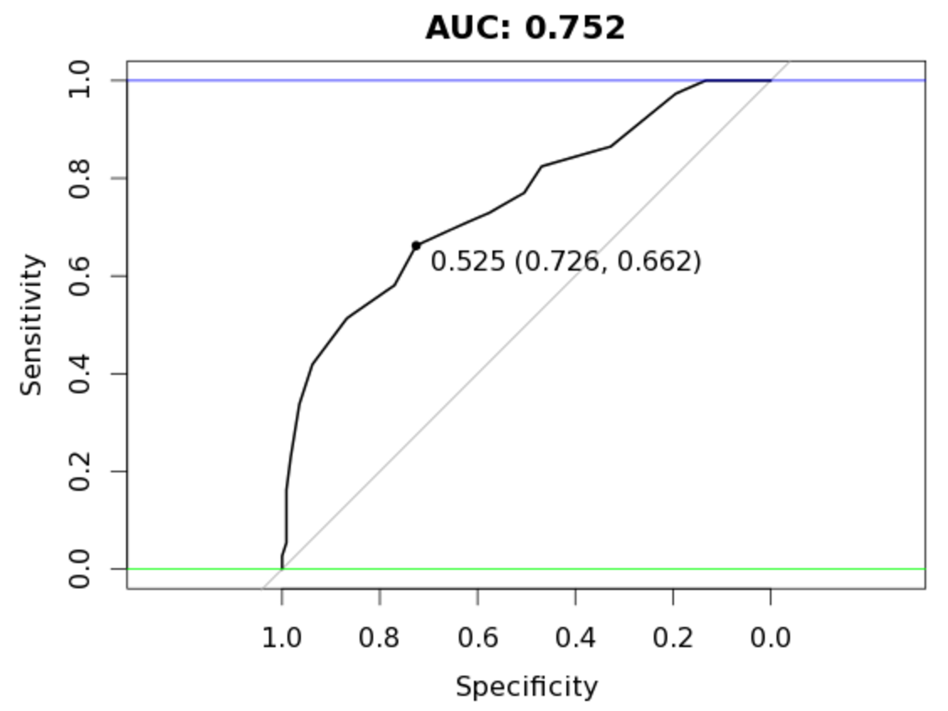
Build RandomForest model: separating by reconstruction error
ReconstructionError >=0.1
# rebuild train_df_auto with best observations
train_df_auto <- train_df[err$Reconstruction.MSE >= 0.1,]
set.seed(1234)
rf_model <- randomForest(x=train_df_auto[,feature_names],
y=as.factor(train_df_auto[,outcome_name]),
importance=TRUE, ntree=20, mtry = 3)
validate_predictions_unknown <- predict(rf_model, newdata=validate_df[,feature_names], type="prob")
auc_rf = roc(response=as.numeric(as.factor(validate_df[,outcome_name]))-1, predictor=validate_predictions_unknown[,2])
plot(auc_rf, print.thres = "best", main=paste('AUC:',round(auc_rf$auc[[1]],3)))
abline(h=1,col='blue')
abline(h=0,col='green')

Slide 19
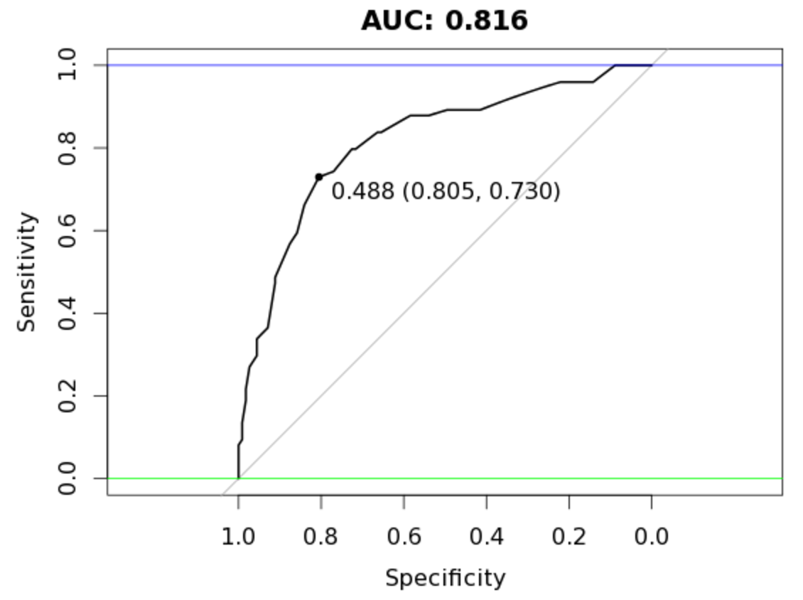
Bagging the results from both models
valid_all <- (validate_predictions_known[,2] + validate_predictions_unknown[,2]) / 2
auc_rf = roc(response=as.numeric(as.factor(validate_df[,outcome_name]))-1,
predictor=valid_all)
plot(auc_rf, print.thres = "best", main=paste('AUC:',round(auc_rf$auc[[1]],3)))
abline(h=1,col='blue')
abline(h=0,col='green')

Slide 20
Case Study 2:CNN Deep Learning for Cancer Immunotherapy
Peptide Classification Model
The input data for this use case was created by generating 1,000,000 random 9-mer peptides by sampling the one-letter code for the 20 amino acids, i.e. ARNDCQEGHILKMFPSTWYV, and then submitting the peptides to MHCI binding prediction using the current state-of-the-art model netMHCpan.
For this use case, we applied three models to classify whether a given peptide is a ‘strong binder’ SB, ‘weak binder’ WB or ‘non-binder’ NB. to MHCI (Specific type: HLA-A*02:01). Thereby, the classification uncovers which peptides, will be presented to the T-cells.
Since n(SB) < n(WB) << n(NB), the data was subsequently balanced by down sampling, such that n(SB) = n(WB) = n(NB) = 7,920. Thus, a data set with a total of 23,760 data points was created. 10% of the data points were randomly assigned as test data and the remainder as train data. It should be noted that since the data set originates from a model, the outcome of this particular use case will be a model of a model. However, netMHCpan is very accurate (96.5% of natural ligands are identified at a very high specificity 98.5%).
In the following each peptide will be encoded by assigning a vector of 20 values, where each value is the probability of the amino acid mutating into 1 of the 20 others as defined by the BLOSUM62 matrix using the pep_encode() function from the PepTools package. This way each peptide is converted to an ‘image’ matrix with 9 rows and 20 columns.

Slide 21
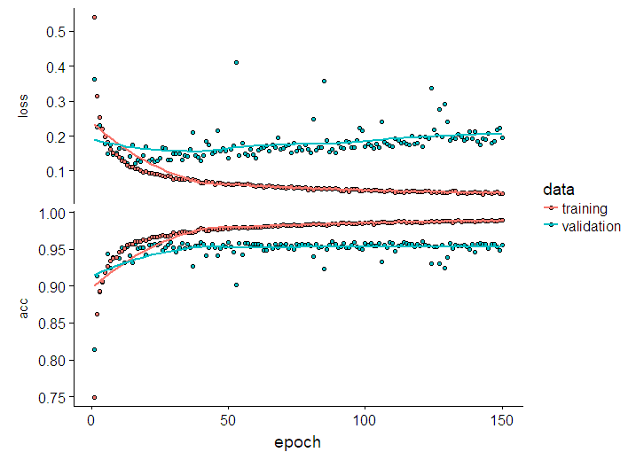
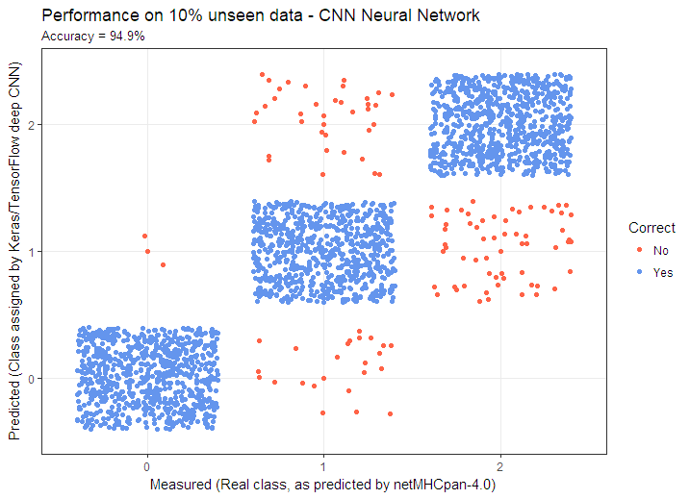
Building a CNN model for Peptide classification
library(keras)
model <- keras_model_sequential() %>%
layer_conv_2d(filters = 32, kernel_size = c(3,3), activation = 'relu',
input_shape = c(9, 20, 1)) %>%
layer_dropout(rate = 0.25) %>%
layer_flatten() %>%
layer_dense(units = 180, activation = 'relu') %>%
layer_dropout(rate = 0.4) %>%
layer_dense(units = 90, activation = 'relu') %>%
layer_dropout(rate = 0.3) %>%
layer_dense(units = 3, activation = 'softmax')
model %>% compile(
loss = 'categorical_crossentropy',
optimizer = optimizer_rmsprop(),
metrics = c('accuracy'))
history = model %>% fit( x_train, y_train,
epochs = 150,
batch_size = 50,
validation_split = 0.2)

Slide 22
Natural Language Programming and Deep Learning
Word2vec and Med2vec

Slide 23
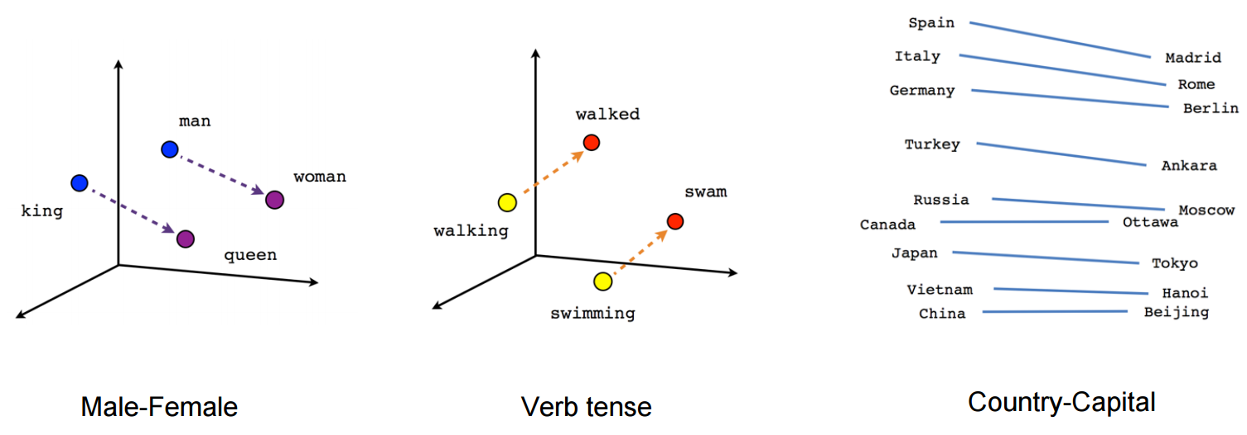
Word Embeddings and Vector models
Word embedding is where words or phrases from the vocabulary are mapped to vectors of real numbers.
Conceptually it involves a mathematical embedding from a space with one dimension per word to a continuous vector space with much lower dimension.

Slide 24
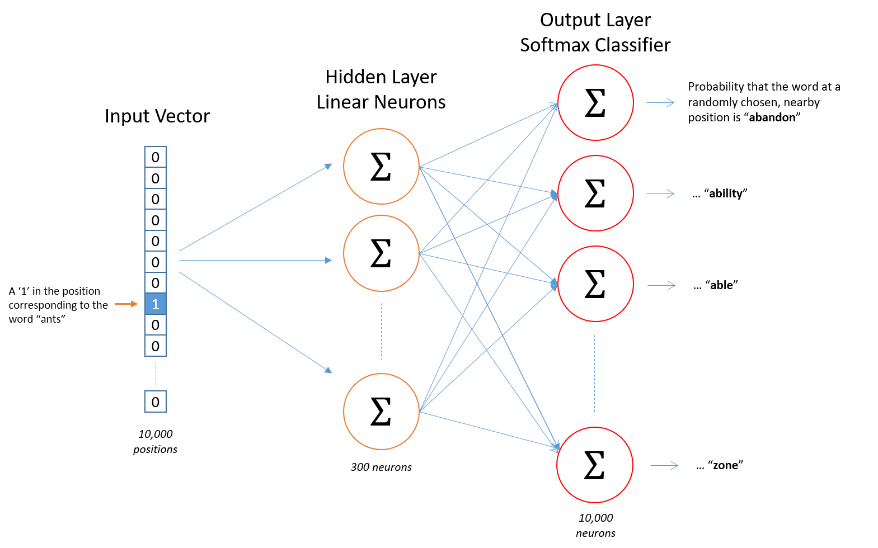
Types of Vector Embedding Models
Word2vec is a group of related models that are used to produce word embeddings.
These models are shallow, two-layer neural networks that are trained to reconstruct linguistic contexts of words.
Word2vec takes as its input a large corpus of text and produces a vector space, typically of several hundred dimensions, with each unique word in the corpus being assigned a corresponding vector in the space.
GloVe is an unsupervised learning algorithm for obtaining vector representations for words. Training is performed on aggregated global word-word co-occurrence statistics from a corpus, and the resulting representations showcase interesting linear substructures of the word vector space.
Facebook’s FastText → https://github.com/facebookresearch/fastText
Gensim → https://radimrehurek.com/gensim/tutorial.html

Slide 25
Med2Vec for learning medical concepts
Edward Choi etal. From GeorgiaTech teamed up Children Healthcare of Atlanta to create a 2-layer Word2Vec model which learn embeddings for medical codes (CPT, ICD codes) into a 200 dimensional vector space. The 2nd layer is an RNN that learns the temporal correlation between visits as well.
The concepts learned can then be used in predicting:
Clinical Risk Groups(CRG)
and/or medical codes for future visits.
Diagnosis representations learned through skip grams:
http://mp2893.com/scatterplot/nnsg_h200e49_category10.html
http://mp2893.com/scatterplot/skipgram.html
http://mp2893.com/scatterplot/glove.html
http://mp2893.com/scatterplot/gru_glove.html

Slide 26
Language Generation models using LSTM
https://csaurav.shinyapps.io/SpeechPrediction/
https://github.com/saurav2608/speechPrediction

Slide 27
References
Autoencoders
https://wiseodd.github.io/techblog/2016/12/03/autoencoders/
http://amunategui.github.io/anomaly-detection-h2o/
https://blog.keras.io/building-autoencoders-in-keras.html
CNN/FFNN
https://tensorflow.rstudio.com/blog/dl-for-cancer-immunotherapy.html
LSTM
https://machinelearningmastery.com/multivariate-time-series-forecasting-lstms-keras/
http://colah.github.io/posts/2015-08-Understanding-LSTMs/
General
https://mattmazur.com/2015/03/17/a-step-by-step-backpropagation-example/
WordEmbedding and NLP
https://nlp.stanford.edu/projects/glove/
http://mccormickml.com/2016/04/19/word2vec-tutorial-the-skip-gram-model/
https://github.com/bmschmidt/wordVectors
https://tensorflow.rstudio.com/blog/word-embeddings-with-keras.html
https://github.com/mp2893/med2vec
https://arxiv.org/pdf/1602.05568.pdf

Slide 28
Questions???

Slide 29

PopHealthCare is Hiring!!!
Job Portal:
https://goo.gl/dZcsKX
LinkedIn: https://www.linkedin.com/in/arran-hoek-3125215

