Slide 1
Entrance and Exit Management using Video processing
By:
Bharadwaj
Nirali M Dave
Aruneswari S

Slide 2
OBJECTIVE
The aim of the method is to count pedestrians that are in a metro station automatically using video surveillance camera or any other public forum.

Slide 3
METHODOLOGY
To implement this counter, both OpenCV and dlib are used.
OpenCV- for standard computer vision/image processing functions, along with the deep learning object detector for people counting.
Dlib- for its implementation of correlation filters. We could use OpenCV here as well; however, the dlib object tracking implementation was a bit easier to work with for this project.

Slide 4
From the pyimagesearch module, we import our custom CentroidTracker and TrackableObject
classes.
The VideoStream and FPS modules from imutils.video will help us to work with a webcam and to calculate the estimated Frames Per Second (FPS) throughput rate.
We need imutils for its OpenCV convenience functions.
The dlib library will be used for its correlation tracker implementation.
OpenCV will be used for deep neural network inference, opening video files, writing video files, and displaying output frames to our screen.

Slide 5
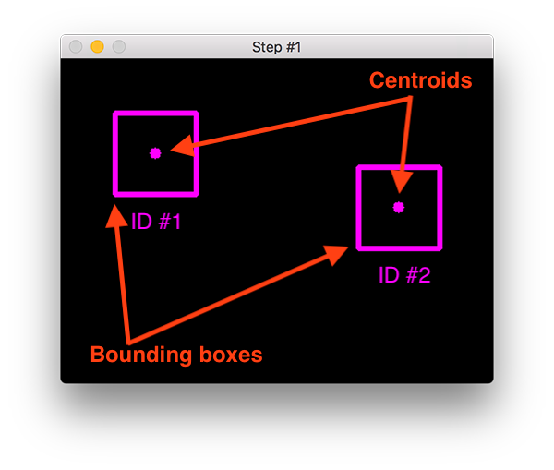
Centroid Tracker
At Step #1 we accept a set of bounding boxes and compute their corresponding centroids (i.e., the centre of the bounding boxes):

Slide 6
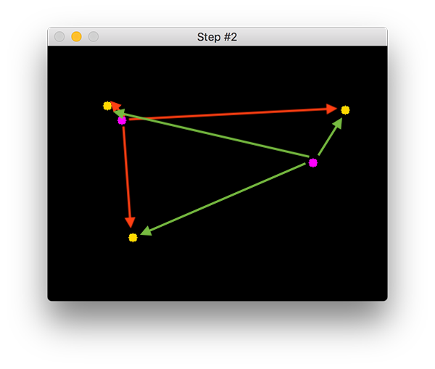
During Step #2 we compute the Euclidean distance between any new centroids (yellow) and existing centroids (purple):
The centroid tracking algorithm makes the assumption that pairs of centroids with minimum Euclidean distance between them must be the same object ID.

Slide 7
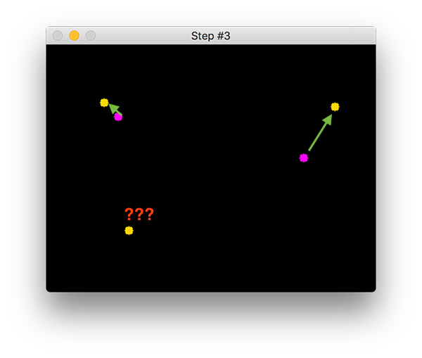
Once we have the Euclidean distances, we attempt to associate object IDs in Step #3:

Slide 8
Registering simply means that we are adding the new object to our list of tracked objects by:
Assigning it a new object ID
Storing the centroid of the bounding box coordinates for the new object
For our people counter, we will deregister people IDs when they cannot be matched to any existing person objects for 40 consecutive frames.

Slide 9
Creating a “trackable object”
In order to track and count an object in a video stream, we need an easy way to store information regarding the object itself, including:
It’s object ID
It’s previous centroids (so we can easily to compute the direction the object is moving)
Whether or not the object has already been counted

Slide 10
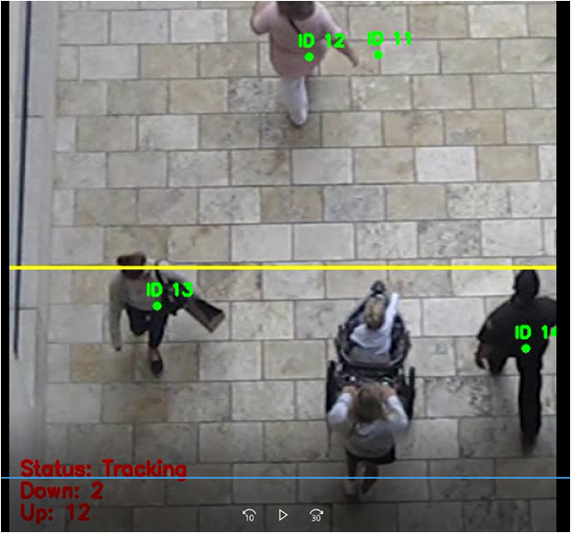
Output

