Slide 1
OPEN LAB PROJECT
PREDICTION OF FAKE NEWS
Group Name : JAB01
Team:
Aruneswari S - CB.EN.U4ECE18107
Ramakrishna - CB.EN.U4ECE18110
Chandhana S - CB.EN.U4ECE18112
Nirali M Dave - CB.EN.U4ECE18136
R.R.Prathiksha - CB.EN.U4ECE18144

Slide 2
INTRODUCTION:
PROBLEM STATEMENT:
Due to diverse origin of information,fraudulent news is being widely spread nowadays. People tend to spread false information on social media or world wide web which has adverse effects on society.
There is increasing evidence that consumers have reacted absurdly to news that later proved to be fake.
GOAL:
Develop a model that classifies a given news as fake or real news using Machine Learning algorithms: Logistic Regression , Random forest classification , Decision tree classification.
Comparing the accuracy of the three machine learning algorithms.

Slide 3
LITERATURE SURVEY:
S.no | Title | Author | Year | Approach | Data Set
 | Weakly Supervised Learning for Fake News Detection on Twitter | Stefan Helmstetter Heiko Paulheim | 2018 | Basic Classifiers: Decision Trees Support Vector Machines (SVM) | Twitter API
2. | Fakebuster: Fake News Detection System Using Logistic Regression Technique In Machine Learning | Muhammad Syahmi Mokhtar, Yusmadi Yah Jusoh, Novia Admodisastro, Noraini Che Pa | 2019 | Logistic Regression | Malaysian Websites
3 | Fake News Detection using Machine Learning Algorithms | Uma Sharma, Sidarth Saran, Shankar M. Patil | 2020 | Random Forest Logistic Regression Naive Bayes | LIAR

Slide 4
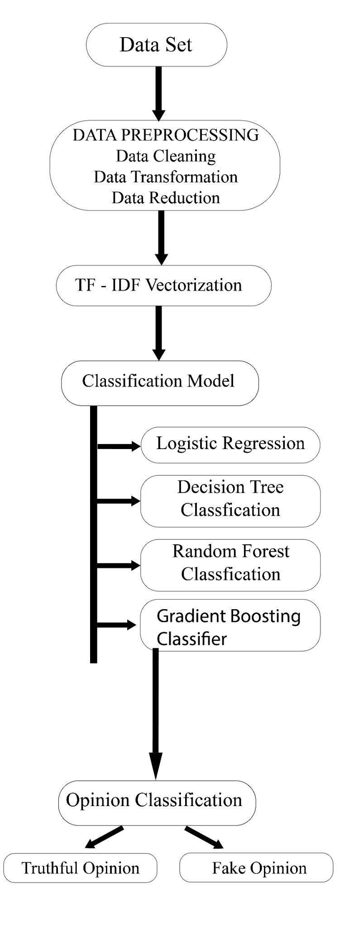
SYSTEM DESCRIPTION:
Dataset : US news article from Kaggle
Data Preprocessing : Removal of meaningless characters.
Reduction of duplicate characters and cleaning of data.
3. Vectorization : Conversion of data into numeric format
4 .Classifier Model : Train the model using the train dataset.
Given a news it predicts true or false using 4 ML models.
5. Output : Real or Fake news
6. Comparison of Accuracy of the four models

Slide 5
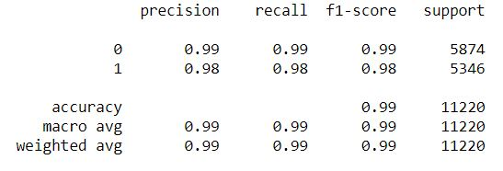
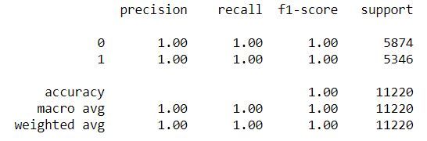
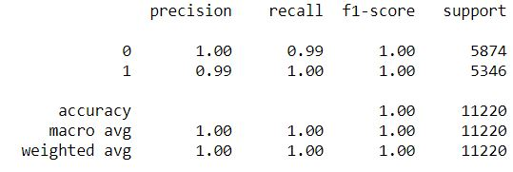
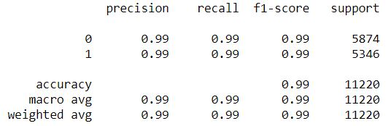
RESULTS:
Logistic Regression | Decision Tree Classifier
Gradient Boosting Classifier | Random Forest Classifier

Slide 6
CONCLUSION AND OUTCOMES:
Fake news detection on the given dataset is performed by making use of Logistic Regression, Decision Tree Classification, Random Forest Classification and Gradient Boosting Classification.
Performance metrics of 4 different classifier models are observed.
While the accuracy of all four models is either 0.99 or 1, decision tree classifier model and gradient boosting classifier model predict whether a news is fake or real with the highest accuracy.

