Slide 1
IMDB Review Dataset
Classification Models Comparison, Feature Selection &
Class Imbalance Techniques

Slide 2
Binary Classification
Identify which class a new observation belongs to based on training data whose classes are known.
There are 2 class labels in binary classification.
25,000 movie reviews from IMDB as training dataset.
25,000 test data, classify them into positive or negative labels.

Slide 3
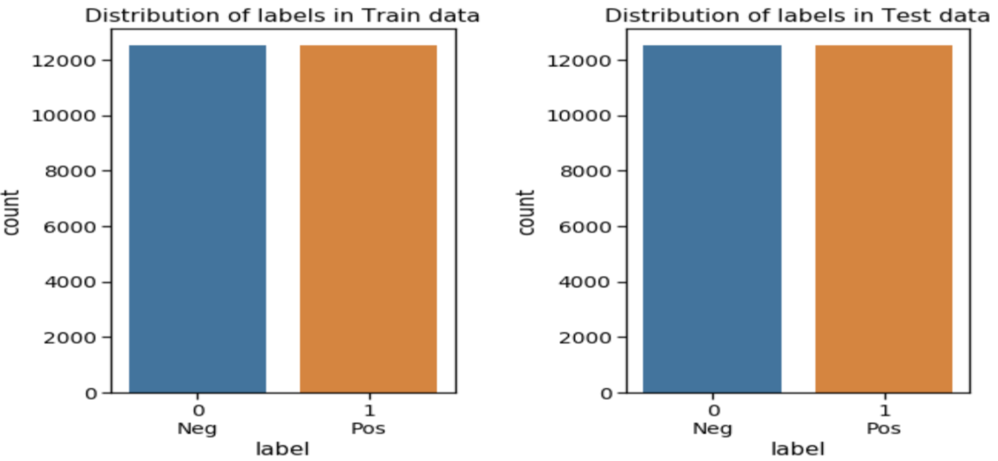
IMDB Movie Review Dataset
*dataset provided by Stanford AI Lab

Slide 4
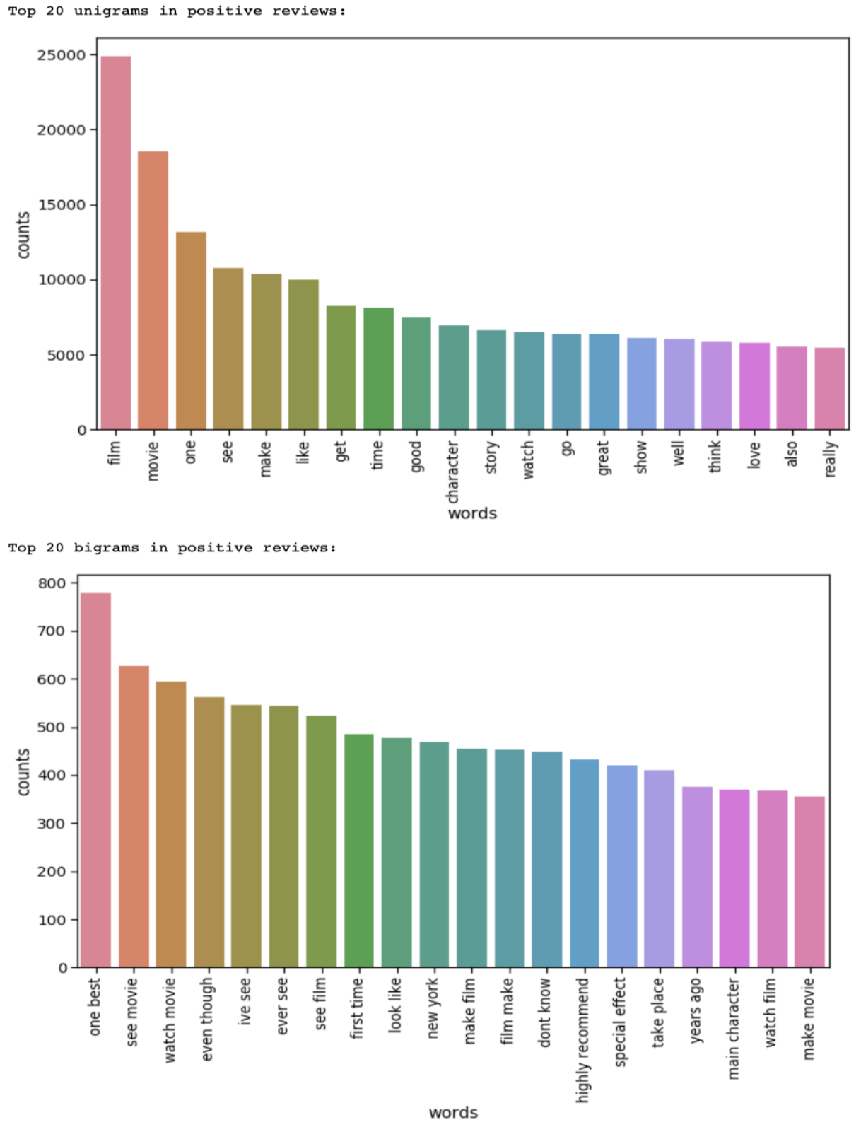
EDA
20 most common unigrams & bigrams in the positive reviews

Slide 5
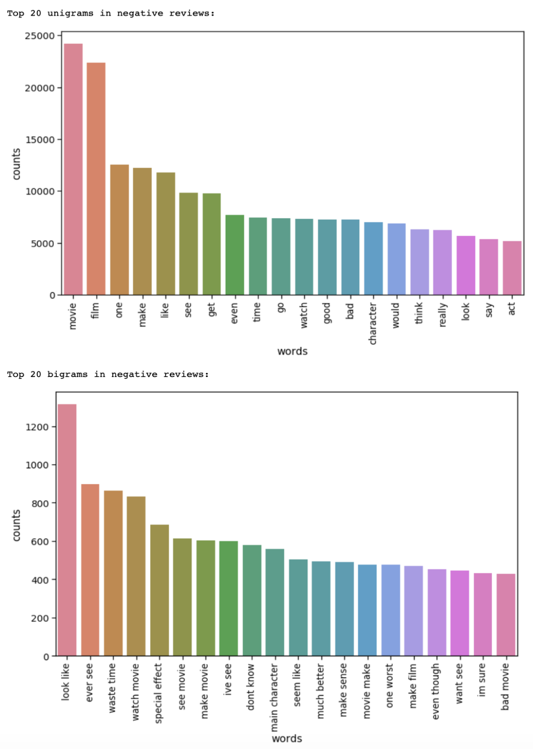
EDA
20 most common unigrams & bigrams in the negative reviews

Slide 6
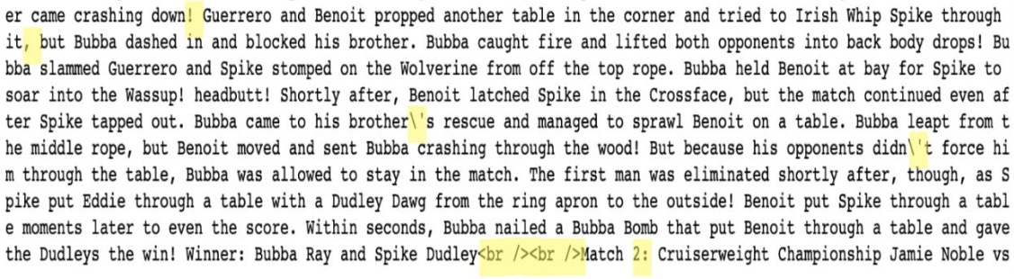
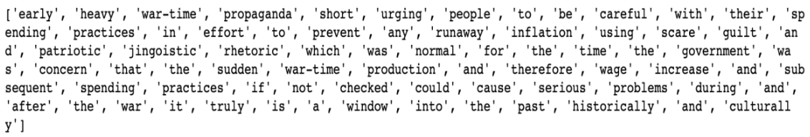
Text Preprocessing
normalize_text()
nltk.tokenize.word_tokenizer()

Slide 7
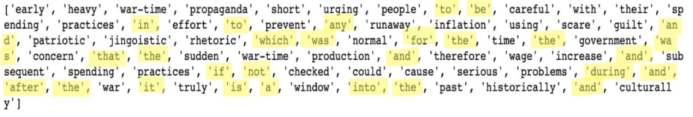
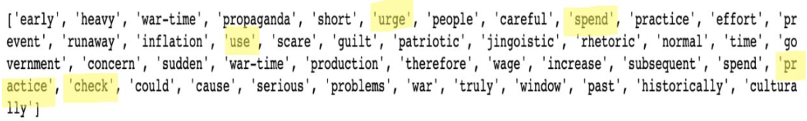
Text Preprocessing
nltk.corpus.stopwords
nltk.stem.WordNetLemmatizer()

Slide 8
Text Preprocessing
Count Vectorizer
sklearn.feature_extraction.text.CountVectorizer(min_df = 50, ngram_range=(1,2))
Tfidf Transformer
sklearn.feature_extraction.text.TfidfTransformer()

Slide 9
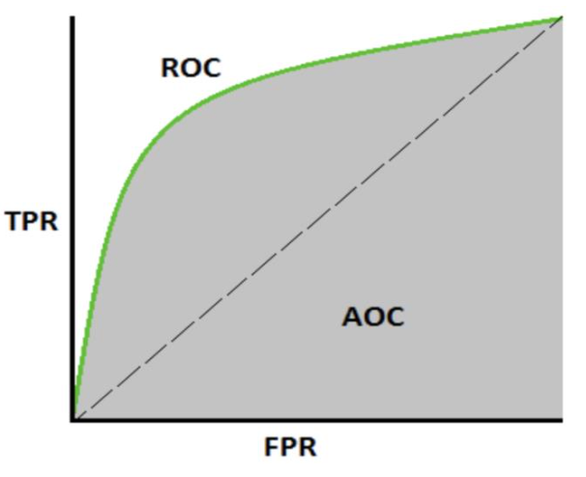
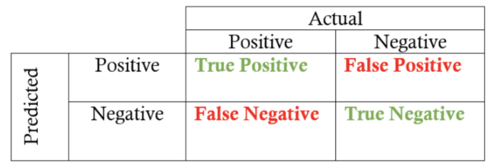


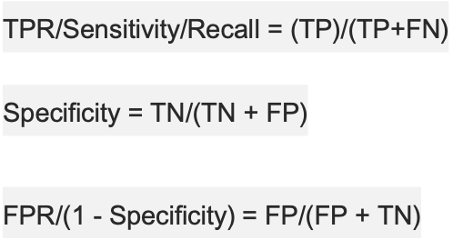


Classification Model Metrics

Slide 10
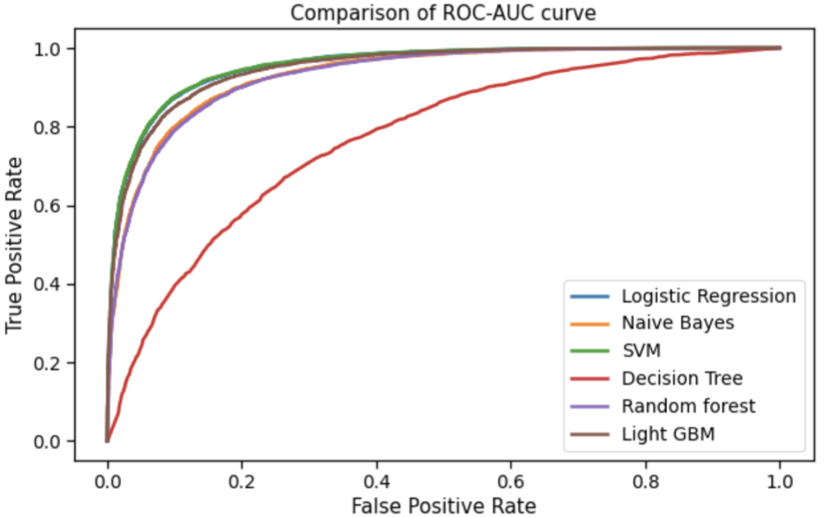
Six Classification Models
Logistic Regression
Naïve Bayes
SVM
Decision Tree
Random Forest
Light GBM

Slide 11
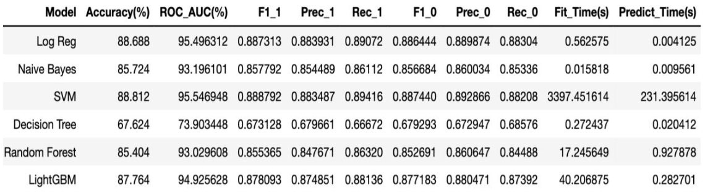
Model Comparison

Slide 12
Feature Selection Techniques
feature_importances_ attribute
7957 -> 1386
Recursive Feature Elimination (RFE)
7957 -> 6415

Slide 13
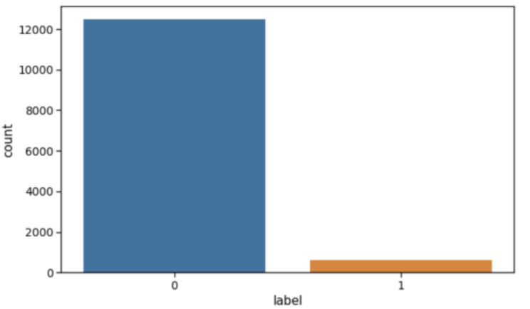
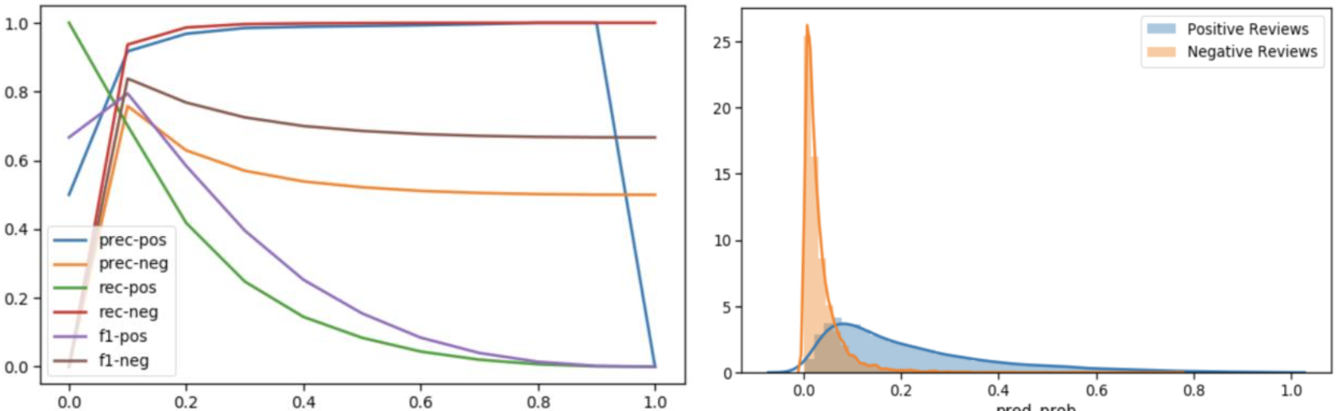
Class Imbalance
Poor performance of Logistic Regression model due to class imbalance

Slide 14
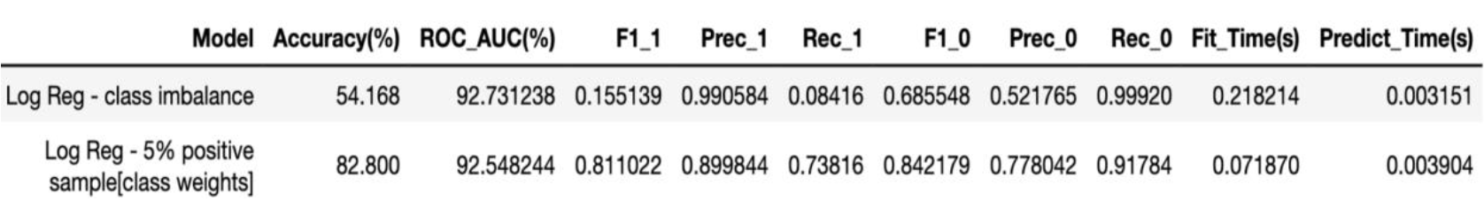
class_weight parameter
higher the class weight means more emphasis on that class
{0:.05, 1:.95}

Slide 15
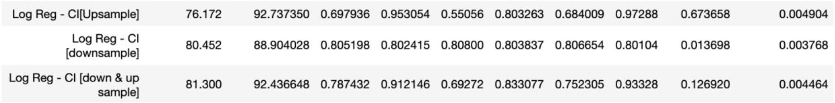
Resampling
Upsampling
Downsampling
Up & Down Sampling

Slide 16
SMOTE
Synthetic Minority Oversampling Technique
selecting examples that are close in the feature space using KNN
New information

Slide 17
Thank you

