Slide 1
IMDB Review Dataset
Classification Models Comparison, Feature Selection &
Class Imbalance Techniques

Slide 2
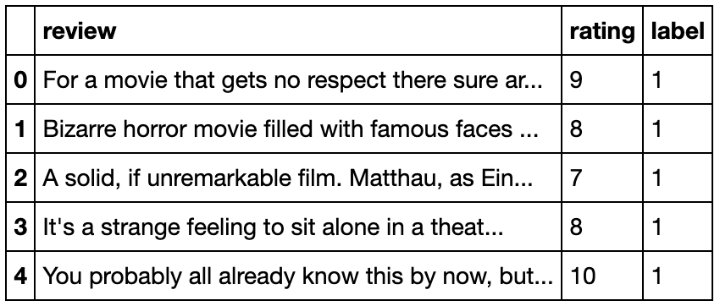
Binary Classification
Identify which class a new observation belongs to based on training data whose classes are known.
There are 2 class labels in binary classification.
IMDB Movie Review dataset provided by Stanford AI Lab
25,000 movie reviews from IMDB as training dataset.
25,000 test data, classify them into positive or negative labels.

Slide 3
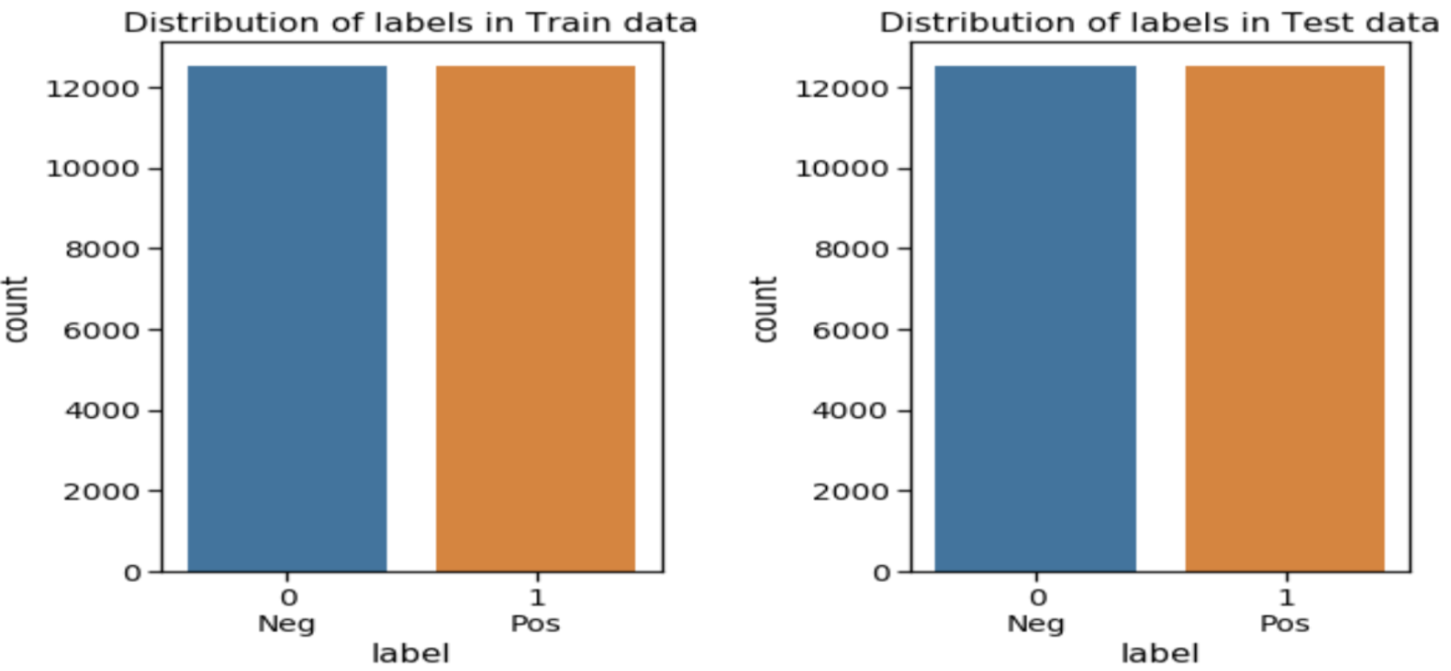
IMDB Movie Review Dataset

Slide 4
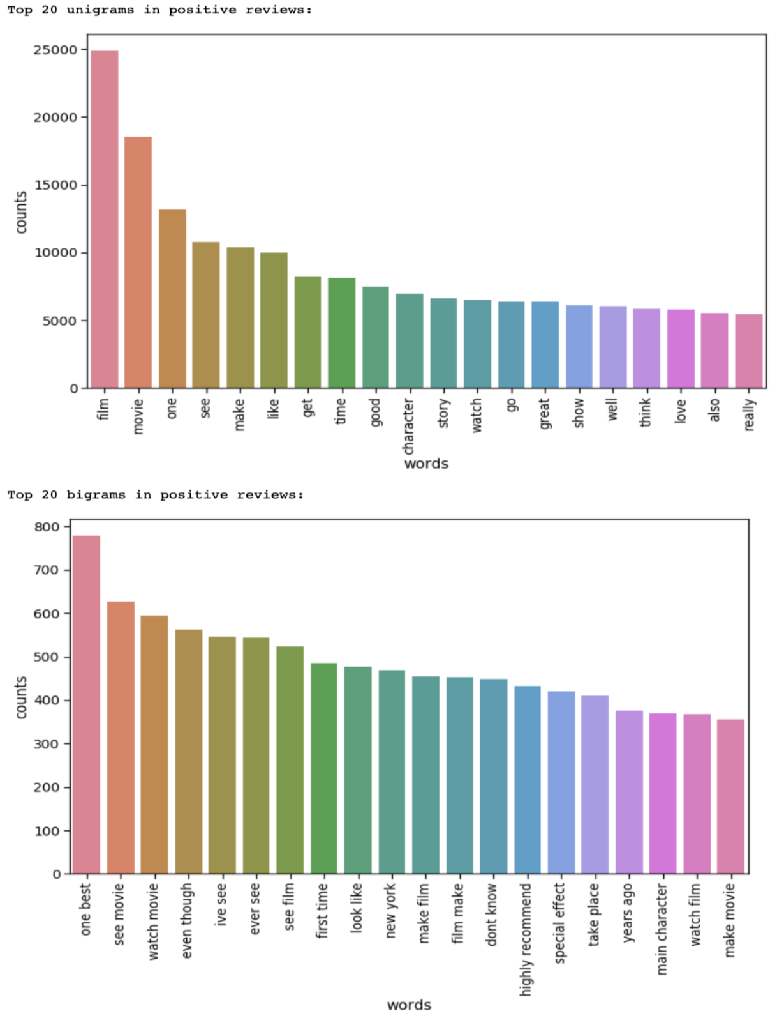
EDA
20 most common unigrams & bigrams in the positive reviews

Slide 5
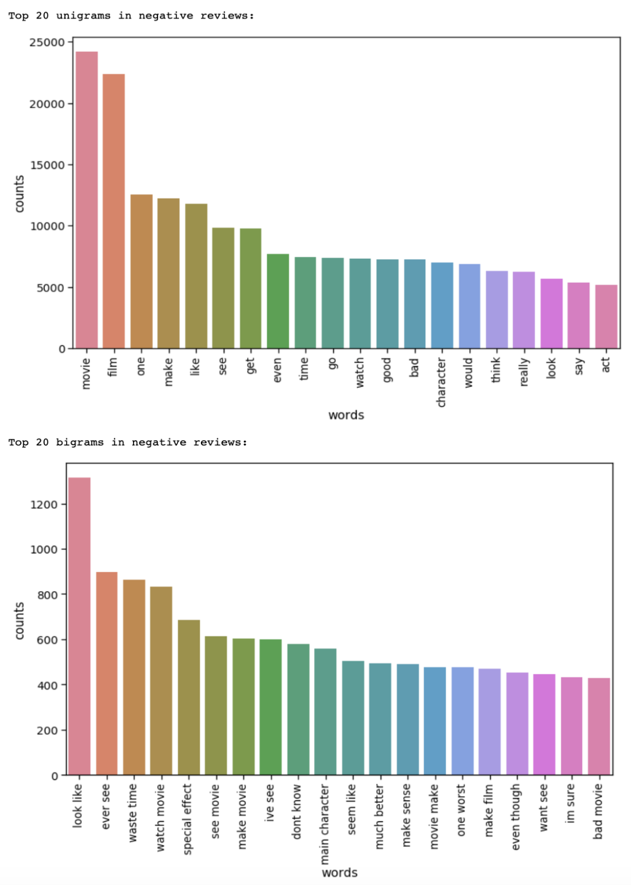
EDA
20 most common unigrams & bigrams in the negative reviews

Slide 6
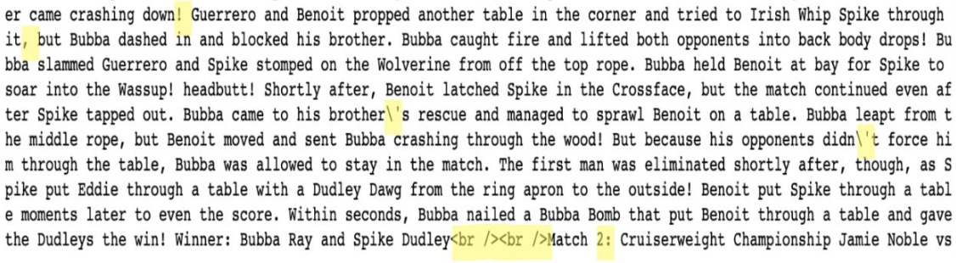
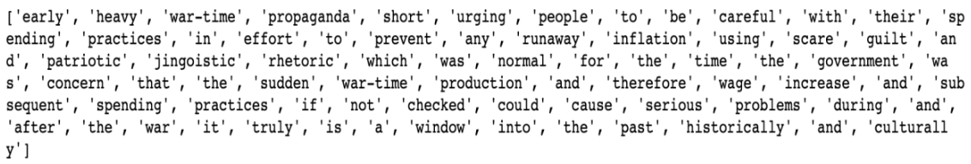
NLP Text Preprocessing
normalize_text()
nltk.tokenize.word_tokenizer()

Slide 7
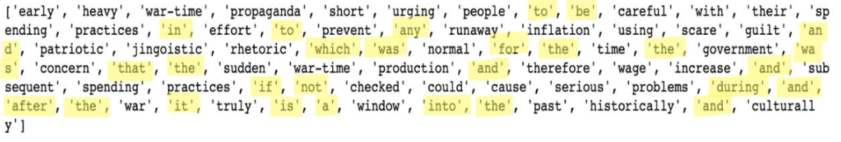
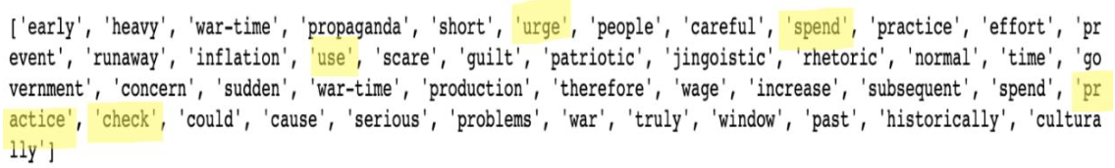
Text Preprocessing
nltk.corpus.stopwords
nltk.stem.WordNetLemmatizer()

Slide 8
Text Preprocessing
Count Vectorizer
sklearn.feature_extraction.text.CountVectorizer(min_df = 50, ngram_range=(1,2))
Tfidf Transformer
sklearn.feature_extraction.text.TfidfTransformer()

Slide 9
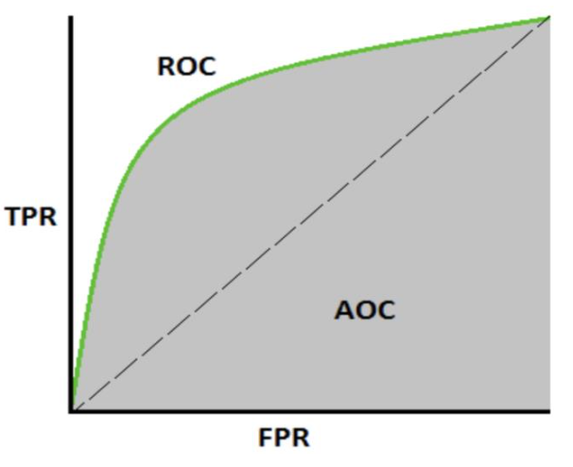
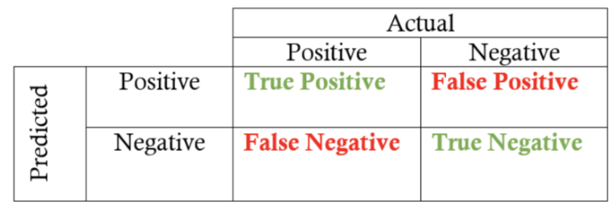


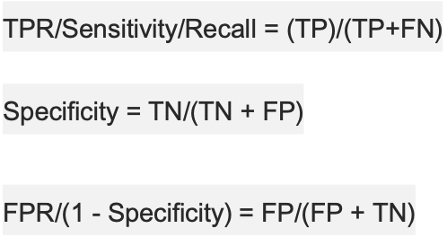


Classification Model Metrics

Slide 10
Six Classification Models
Logistic Regression
Naïve Bayes
SVM
Decision Tree
Random Forest
Light GBM

Slide 11
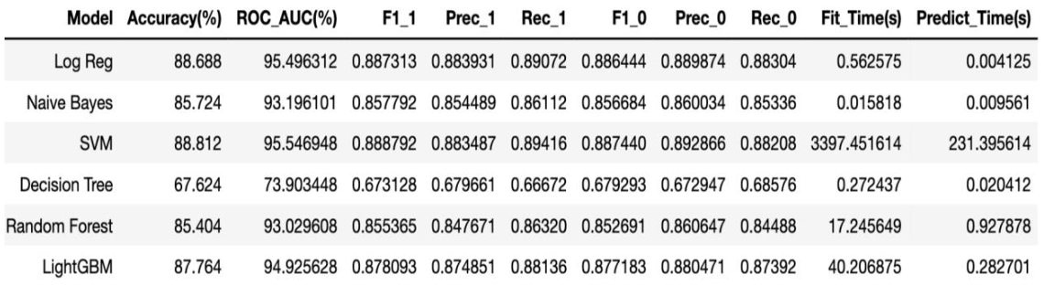
Model Comparison

Slide 12
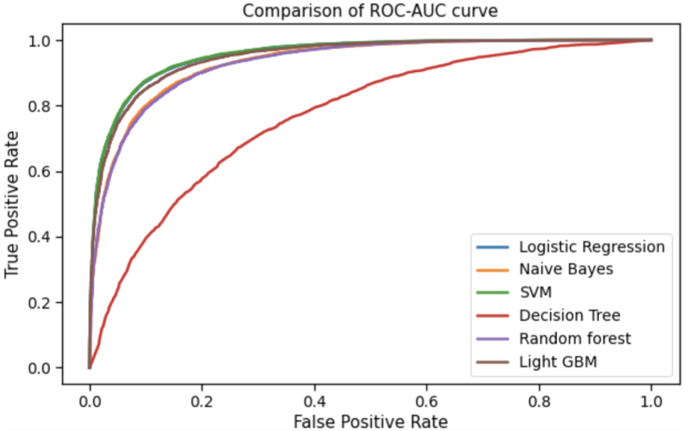

Slide 13
Feature Selection Techniques
feature_importances_ attribute
7957 -> 1386
Recursive Feature Elimination (RFE)
7957 -> 6415

Slide 14
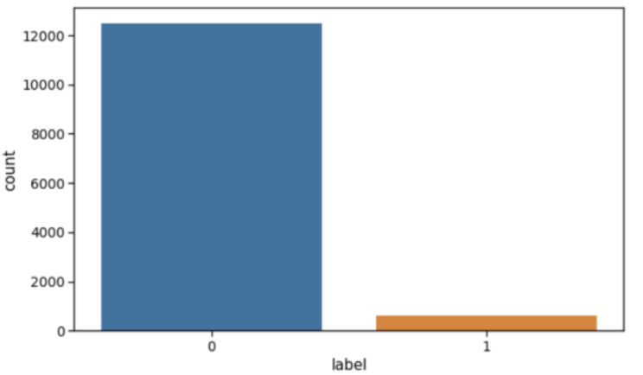
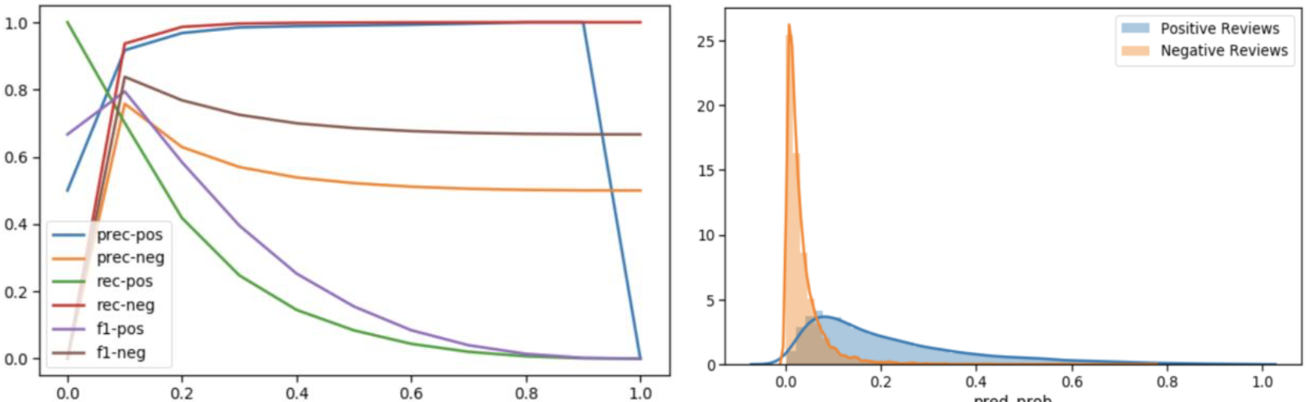
Class Imbalance
Poor performance of Logistic Regression model due to class imbalance

Slide 15
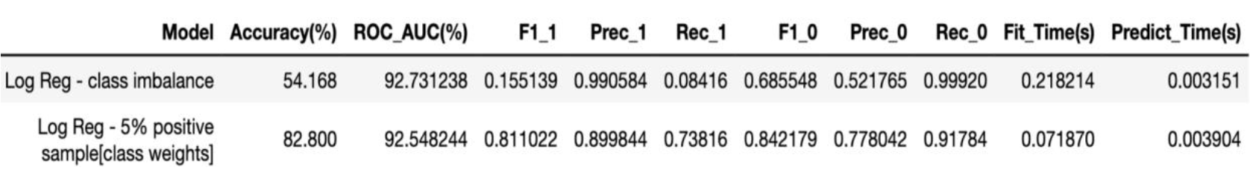
class_weight parameter
higher the class weight means more emphasis on that class
{0:.05, 1:.95}

Slide 16
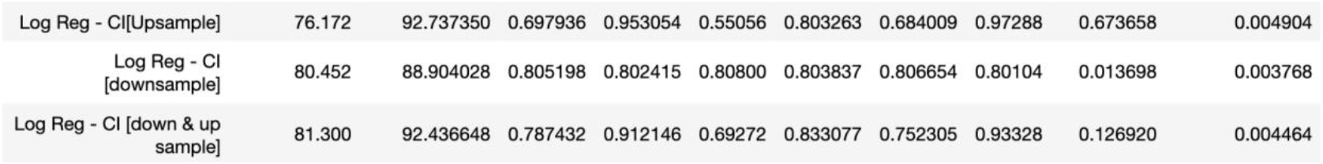
Resampling
Upsampling
Downsampling
Up & Down Sampling

Slide 17
SMOTE
Synthetic Minority Oversampling Technique
selecting examples that are close in the feature space using KNN
New information

Slide 18
Thank you

