Slide 1

Inventory Demand Prediction
Aruna Venkatasubramaniam 678860489
Gughanraj Selvaraju 662075168
Meenakshi Janardanan 671917004

Slide 2
Problem background
A national fresh produced baking goods in Mexico wants to estimate their weekly demand.
If we produce too much and there is no enough demand the products will be returned/expired and if we don’t produce enough goods revenue won’t be maximized.
Therefore accurately estimating demand is important.

Slide 3
Goal
Input will be sales of these baked goods for 9 weeks and we forecast the demand for a given week.
Each transaction consists of sales and returns. The demand for a product in a certain week is defined as the sales this week subtracted by the return next week.
The goal of the project is to analyze and predict the demand of a baked goods product for a given week, at a particular store.

Slide 4



Architecture
Input Data
Processing & Modelling
Front End

Slide 5
Data source and Variables
The data is obtained from Kaggle - https://www.kaggle.com/c/grupo-bimbo-inventory-demand/data
The variables in the dataset are as follows:
Train Data
Week number
Sales Depot ID
Sales Channel ID
Client ID
Client name
Product ID
Product Name
Sales unit this week (integer)
Sales this week (unit: pesos)
Returns unit next week (integer)
Returns next week (unit: pesos)
Adjusted Demand (integer)
Test Data
Week number
Sales Depot ID
Sales Channel ID
Client ID
Client name
Product ID
Product Name
Product Data
Product Id
Product Description
Location Data
Sales Depot Id
Town
District

Slide 6
About Data
Size of the data: 3.3gb
Numbers of Rows: 74180464 ~ 74 million
# of Products : 2591
# of Clients : 935362
# of Product-Client Pair in train data: 12573

Slide 7
Descriptive Statistics
Statistic | Adjusted Demand | Sales | Returns
Mean | 7.22 | 7.34 | 0.12
Stddev | 21.77 | 25.89 | 2.3
Min | 0 | 0 | 0
Max | 5000 | 5000 | 500
25th quartile | 2.0 | 2.0 | 0
Median | 3 | 3 | 0
75th quartile | 6 | 6 | 0
Key Points:
The demand for each client product pair has a minimum of 0 and a maximum of 4777. The majority of the demand lies between 0 and 6, which means the data has a lot of variance.
Same goes for Returns all of the returns are 0 but the maximum value is up to 500.

Slide 8
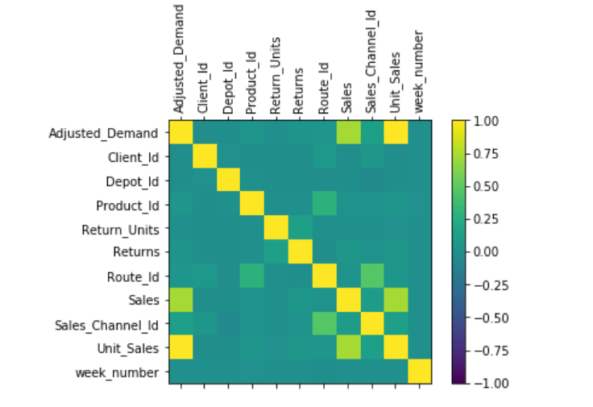
Correlation Analysis

Slide 9
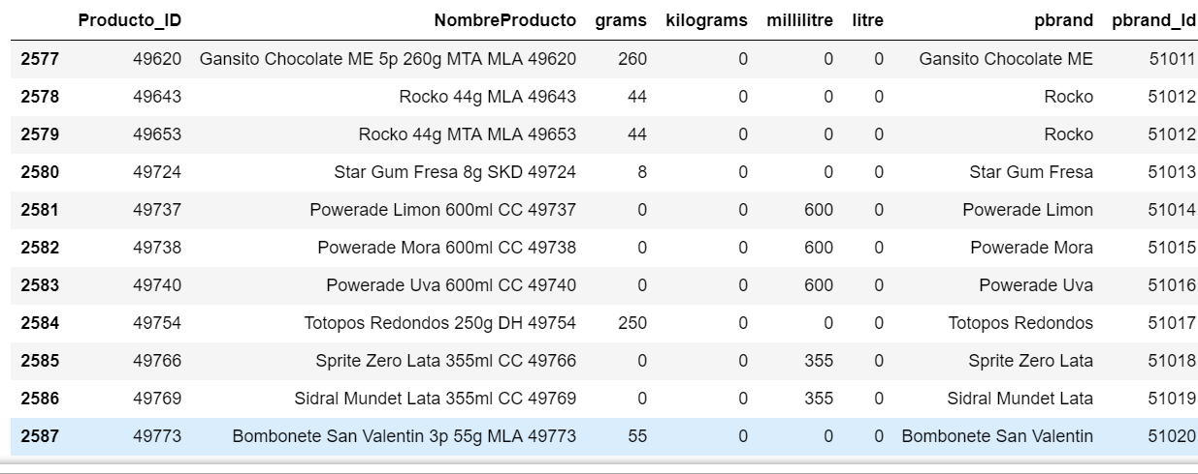
Feature Engineering
Extracted the sub brand and product weight from product data
Similarly combined District and Town from the location data with train data

Slide 10
Modelling
Combine New features with original data
One hot encoding of Categorical variables
Creating Spark modelling pipeline
Create models in MLib

Slide 11
Results
Model | RMSE
Random Forest Regressor | 33.50
Gradient Boosted Regressor | 23.20

Slide 12
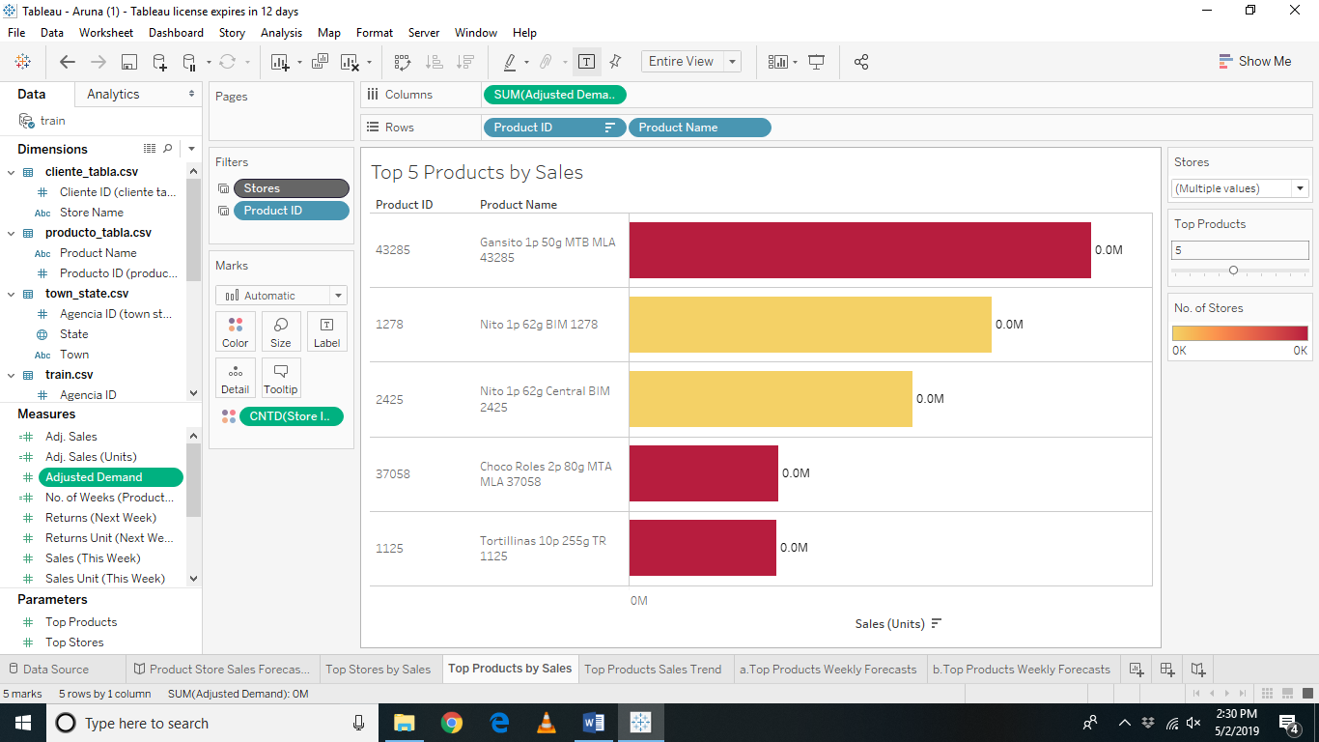
Front end Tableau

Slide 13
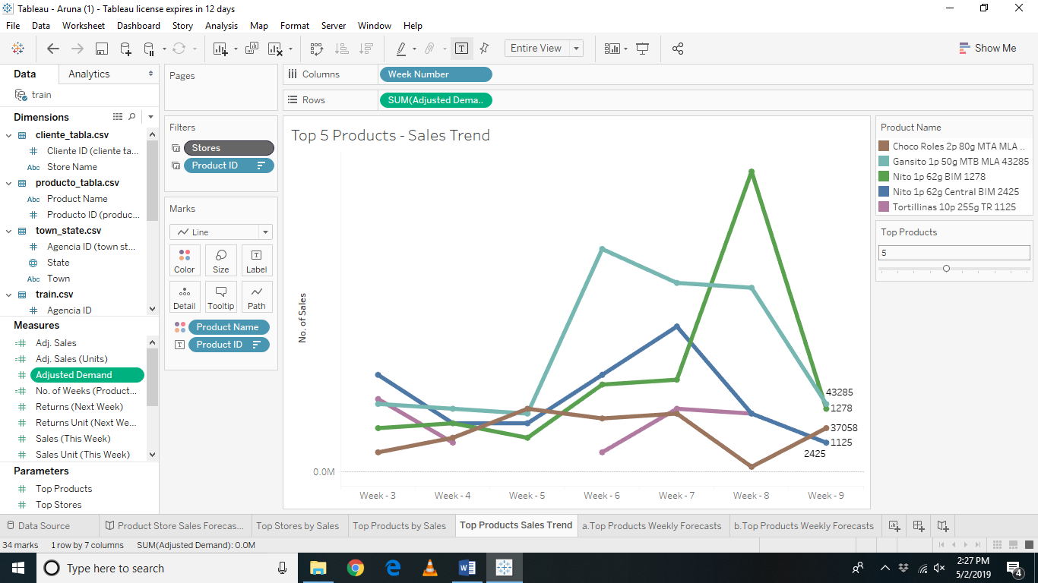
Front end Tableau

Slide 14
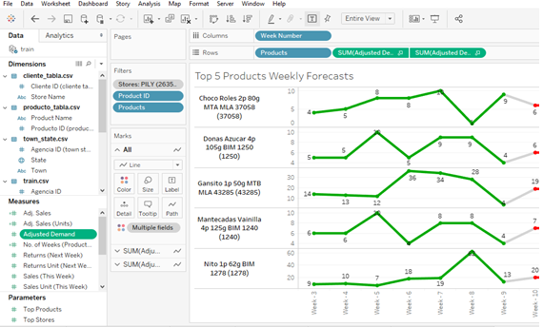
Front end Tableau

Slide 15


