Slide 1
Bezier Curves
© Jeff Parker, Nov 2009

Slide 2
Goal
We often wish to draw generate curves
  Through selection of arbitrary points
  Smooth (many derivatives)
  Fast to compute
  Easy to deal with
It is hard to get all of these
We will talk about some ideas used to achieve some of these

Slide 3
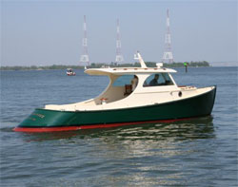
History
These ideas were developed twice:
  Pierre Bézier, at Renault
  Paul de Casteljau, at Citroën
Used by people who needed to bend sheet metal or wood to achieve a smooth shape

Slide 4
Background
Given a set of n points (x_{i}, y_{i}) we may be able to define a polynomial that goes through each point.
Lagrange Polynomial
Assumes that we don't have two points with the same x but different ys.
As the number of points rises, the curve can start to wobble to hit each mark.

Slide 5
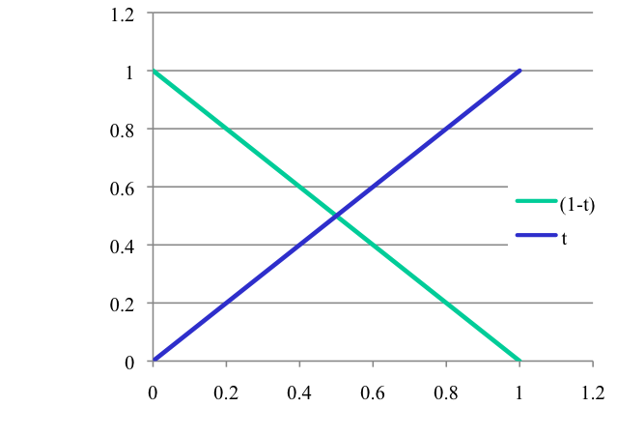
Reminder
Wrote line segment as weighted sum of endpoints
Can view this as the convex sum of two points
The curves below lie in [0..1], sum to 1

Slide 6
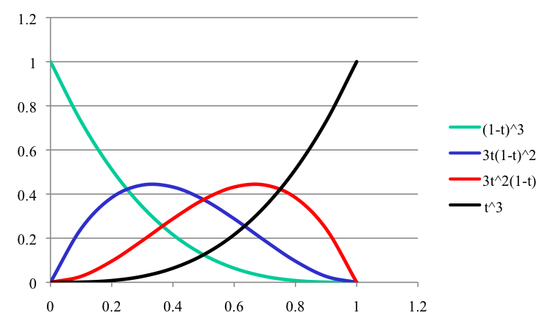
Bezier Curve
We write a Bezier as the weighted sum of control points
The control points are multiplied by Bernstein polynomials
Convex sum of polynomials with values in [0..1] that sum to 1
Each polynomial pulls curve towards it's control point

Slide 7
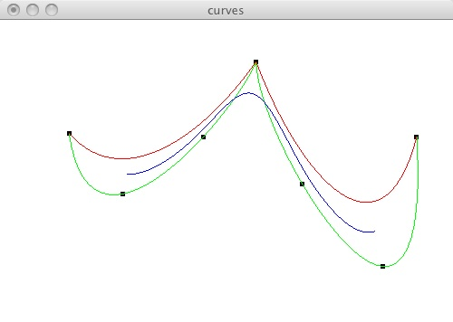
Interactive Examples
Angel's bezier.c
He draws cubic curves –
  I - Interpolation (green)
  B - Bezier (red)
  S - Splines (blue)
Note that Bezier and splines lie in convex hull of control points.

Slide 8
Interactive Websites to try
Bill Casselman's Bezier Applet
  http://www.math.ubc.ca/people/faculty/cass/gfx/bezier.html
Wikepedia Animation
  http://en.wikipedia.org/wiki/Bezier_curve
Edward A. Zobel's Animation
  http://id.mind.net/~zona/mmts/curveFitting/bezierCurves/bezierCurve.html
POV-Ray Cyclopedia Tutorial
  http://www.spiritone.com/~english/cyclopedia/bezier.html
Andy Salter's Spline Tutorial
  http://www.doc.ic.ac.uk/%7Edfg/AndysSplineTutorial/index.html
Evgeny Demidov's Interactive Tutorial
  http://ibiblio.org/e-notes/Splines/Intro.htm

Slide 9
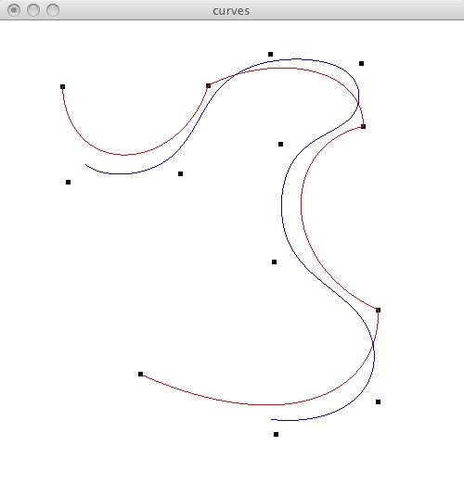
Drawbacks
Corners where we patch curves together
Note that Bezier and splines lie in convex hull of control points.

Slide 10
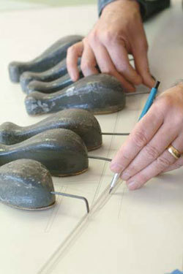
Splines
Make everything a central control point
  (Image is of a traditional spline used in boat building)

Slide 11
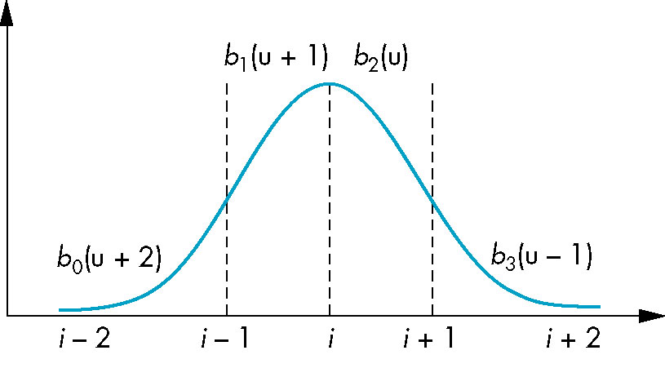
Basis Functions
In terms of the blending polynomials

Slide 12
In OpenGL
We could evaluate these by hand, given the formulas above.
It is simpler to use Evaluators, provided by OpenGL
Evaluators provide a way to use polynomial or rational polynomial mapping to produce vertices, normals, texture coordinates, and colors. The val-ues produced by an evaluator are sent to further stages of GL processing just as if they had been presented using glVertex, glNormal, glTexCoord, and glColor commands, except that the generated values do not update the current normal, texture coordinates, or color.
All polynomial or rational polynomial splines of any degree (up to the maximum degree supported by the GL implementation) can be described using evaluators. These include almost all splines used in computer graphics: B-splines, Bezier curves, Hermite splines, and so on. (From the man page)

Slide 13
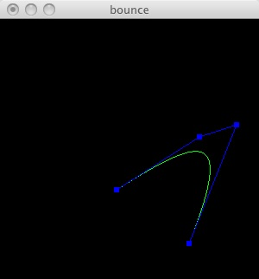
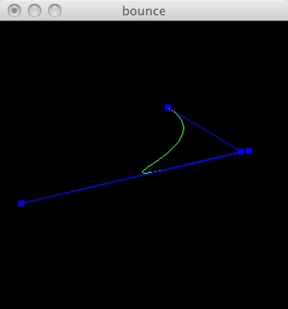
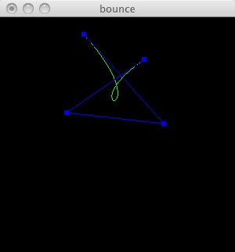
Bezier Curve
void drawCurve() {
  int i;
  GLfloat pts[4][3];
  /* Copy the coordinates from balls to array */
  for (i = 0; i < 4; i++) {
    pts[i][0] = (GLfloat)cp[i]->x;
    pts[i][1] = (GLfloat)wh - (GLfloat)cp[i]->y;
    pts[i][2] = (GLfloat)0.0;
  }
  // Define the evaluator
  glMap1f(GL_MAP1_VERTEX_3, 0.0, 1.0, 3, 4, &pts[0][0]);
  /* type, u_min, u_max, stride, num points, points */
  glEnable(GL_MAP1_VERTEX_3);
  setLineColor();
  glBegin(GL_LINE_STRIP);
    for (i = 0; i <= 30; i++)
      /* Evaluate the curve when u = i/30 */
      glEvalCoord1f((GLfloat) i/ 30.0);
  glEnd();

Slide 14
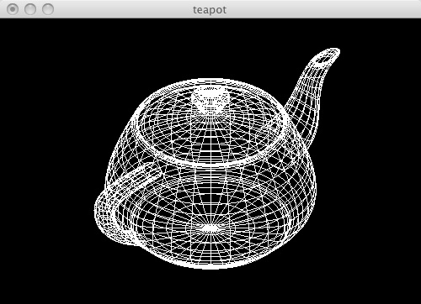
bteapot.c
// vertices.h
GLfloat vertices[306][3]={{1.4 , 0.0 , 2.4}, {1.4 , -0.784 , 2.4},
{0.784 , -1.4 , 2.4}, {0.0 , -1.4 , 2.4}, {1.3375 , 0.0 , 2.53125},
{1.3375 , -0.749 , 2.53125}, {0.749 , -1.3375 , 2.53125}, {0.0 , -1.3375 , 2.53125},
{1.4375 , 0.0 , 2.53125}, {1.4375 , -0.805 , 2.53125}, {0.805 , -1.4375 , 2.53125},
...
// patches.h
int indices[32][4][4]={{1, 2, 3, 4, 5, 6, 7, 8, 9, 10, 11, 12, 13, 14, 15, 16},
{4, 17, 18, 19, 8, 20, 21, 22, 12, 23, 24, 25, 16, 26, 27, 28},
{19, 29, 30, 31, 22, 32, 33, 34, 25, 35, 36, 37, 28, 38, 39, 40},
...

Slide 15
bteapot.c
/* 32 patches each defined by 16 vertices, arranged in a 4 x 4 array */
/* NOTE: numbering scheme for teapot has vertices labeled from 1 to 306 */
/* remnent of the days of FORTRAN */
#include "patches.h"
void display(void)
{
  int i, j, k;
  glClear(GL_COLOR_BUFFER_BIT | GL_DEPTH_BUFFER_BIT);
  glColor3f(1.0, 1.0, 1.0);
  glLoadIdentity();
  glTranslatef(0.0, 0.0, -10.0);
  glRotatef(-35.26, 1.0, 0.0, 0.0);
  glRotatef(-45.0, 0.0, 1.0, 0.0);
  /* data aligned along z axis, rotate to align with y axis */
  glRotatef(-90.0, 1.0,0.0, 0.0);

Slide 16
bteapot.c
for(k=0;k<32;k++)
{
  glMap2f(GL_MAP2_VERTEX_3, 0, 1, 3, 4, 0, 1, 12, 4, &data[k][0][0][0]);
  for (j = 0; j <= 8; j++)
  {
    glBegin(GL_LINE_STRIP);
      for (i = 0; i <= 30; i++)
        glEvalCoord2f((GLfloat)i/30.0, (GLfloat)j/8.0);
    glEnd();
    glBegin(GL_LINE_STRIP);
      for (i = 0; i <= 30; i++)
        glEvalCoord2f((GLfloat)j/8.0, (GLfloat)i/30.0);
    glEnd();
  }
}
glFlush();
}

Slide 17
Implementation
Look at the Lab for class to experiment with some examples
curves.c uses Bezier curves and Splines
Look at Angel's bteapot to see how to use 2-D Bezier patches

