Slide 1
Graphics, Day 2
Based on lecture by Ed Angel
© Ed Angel

Slide 2
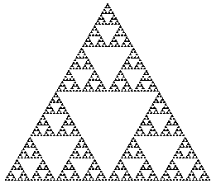
Objectives
Brief historical introduction
  Meet our first Pioneer – Ivan Sutherland
Fundamental imaging notions
Physical basis for image formation
  Light
  Color
  Perception
Synthetic camera model
Other models – Ray Tracing
Mathematics: meaning of Dot product, applications
Serpinski Gasket and the Chaos Game

Slide 3
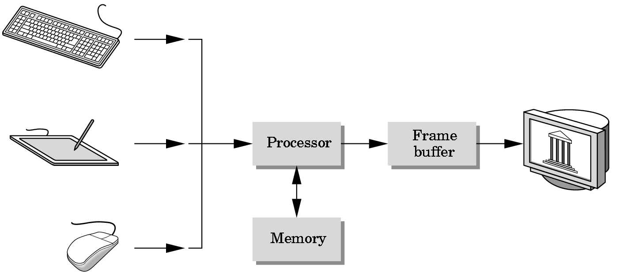
Basic Graphics System
Output device
Input devices
Image formed in Frame Buffer

Slide 4
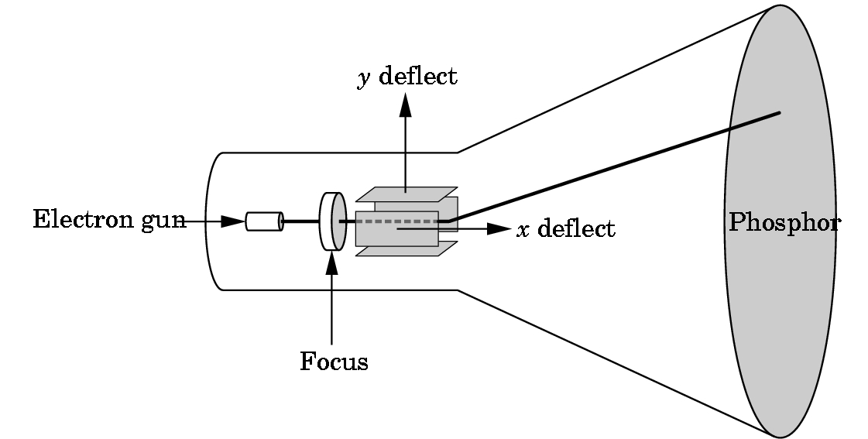
CRT
Can be used either as a line-drawing device (calligraphic) or to display contents of frame buffer (raster mode)

Slide 5
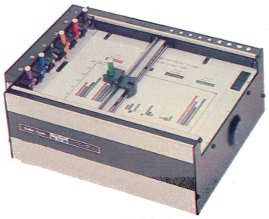
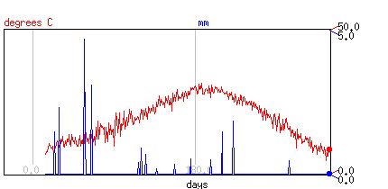
Computer Graphics: 1950-1960
Computer graphics goes back to the earliest days of computing
  Strip charts
  Pen plotters
  Simple displays using A/D converters to go from computer to calligraphic CRT
Cost of refresh for CRT too high
  Computers slow, expensive, unreliable
  API very device specific

Slide 6
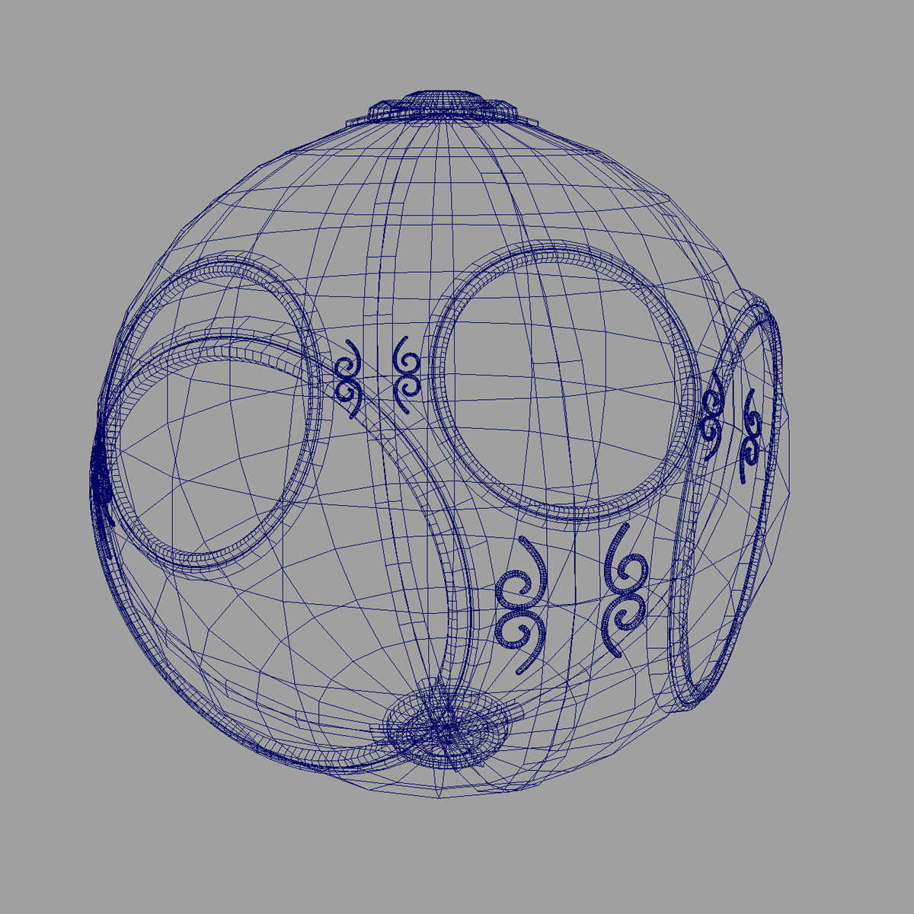
Computer Graphics: 1960-1970
Wireframe graphics
  Draw only lines
Ivan Sutherland's Sketchpad
Display Processors
Storage tube
wireframe representation
of sun object

Slide 7
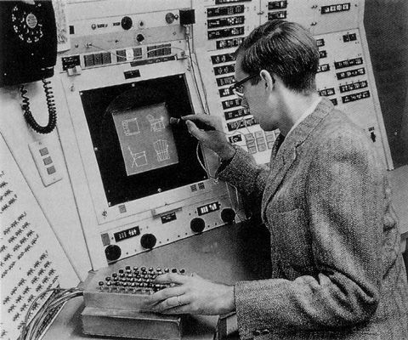
Sketchpad
Ivan Sutherland’s PhD thesis at MIT
  Recognized the potential of man-machine interaction
  Loop
    Display something
    User moves light pen
    Computer generates new display
  Sutherland also created many of the now common algorithms for computer graphics
http://www.youtube.com/watch?v=mOZqRJzE8xg

Slide 8
Sketchpad

Slide 9
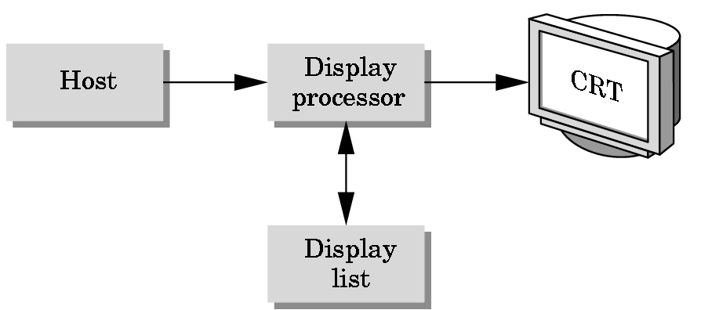
Display Processor
Rather than have the host computer try to refresh display use a special purpose computer called a display processor (DPU)
Graphics stored in display list (display file) on display processor
Host compiles display list and sends to DPU

Slide 10
Direct View Storage Tube
Created by Tektronix
  Did not require constant refresh
  Standard interface to computers
    Allowed for standard software
    Plot3D in Fortran
  Relatively inexpensive
    Opened door to use of computer graphics for CAD community
  Drew lines - vector graphics

Slide 11
Computer Graphics: 1970-1980
Raster Graphics
Beginning of graphics standards
  IFIPS
    GKS: European effort
      Becomes ISO 2D standard
    Core: North American effort
      3D but fails to become ISO standard
Workstations and PCs

Slide 12
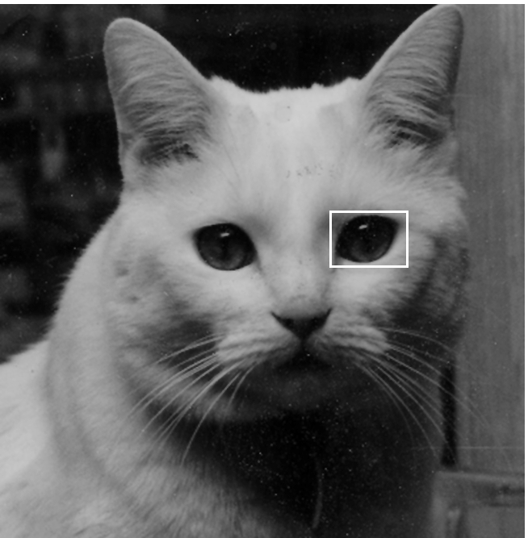
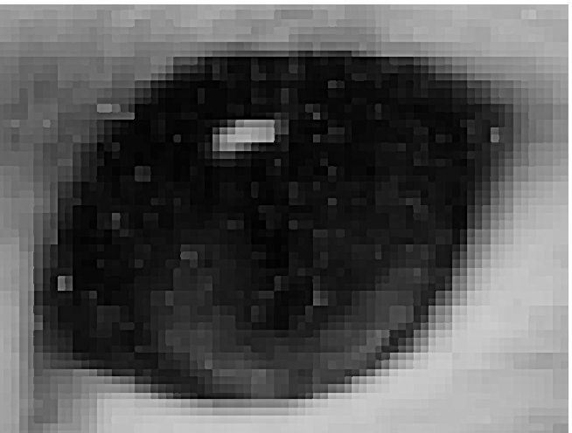
Raster Graphics
Image produced as an array (the raster) of picture elements (pixels) in the frame buffer

Slide 13
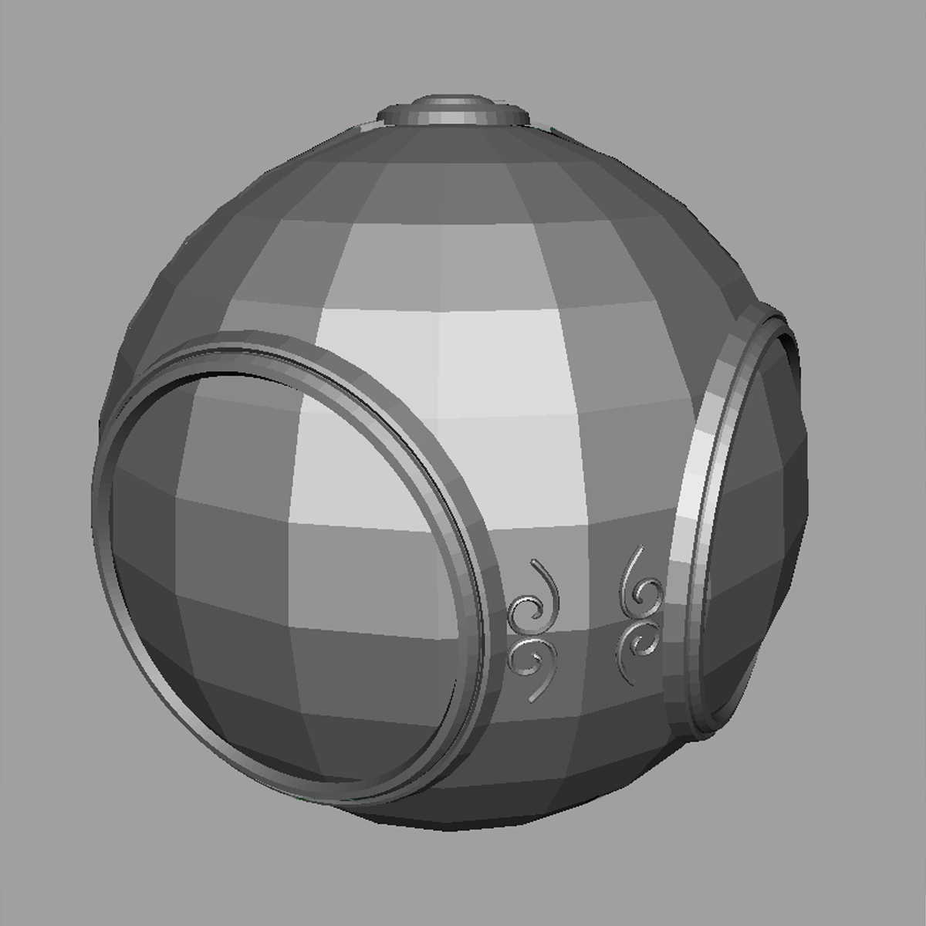
Raster Graphics
Allows us to go from lines and wire frame images to filled polygons

Slide 14
PCs and Workstations
Although we no longer make the distinction between workstations and PCs, historically they evolved from different roots
  Early workstations characterized by
    Networked connection: client-server model
    High-level of interactivity
  Early PCs included frame buffer as part of user memory
    Easy to change contents and create images

Slide 15



Computer Graphics: 1980-1990
Realism comes to computer graphics
smooth shading
environment
mapping
bump mapping

Slide 16
Bump Map
Change surface plane
  Normal vector

Slide 17
Computer Graphics: 1980-1990
Special purpose hardware
  Silicon Graphics geometry engine
    VLSI implementation of graphics pipeline
Industry-based standards
  PHIGS
  Pixar's RenderMan API
Networked graphics: X Window System
Human-Computer Interface (HCI)

Slide 18
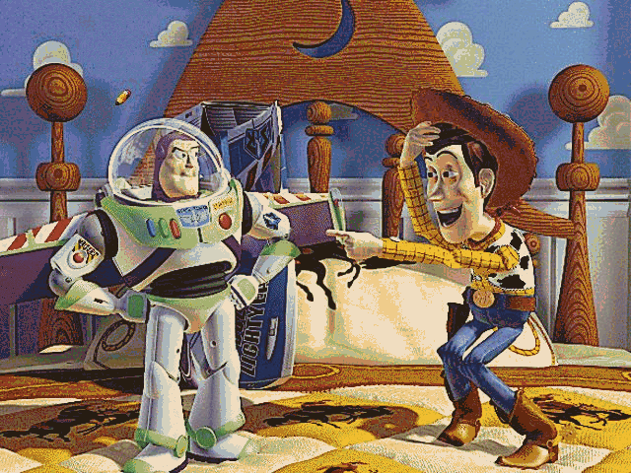
Computer Graphics: 1990-2000
OpenGL API
Completely computer-generated feature-length movies (Toy Story) are successful
New hardware capabilities
  Texture mapping
  Blending
  Accumulation, stencil buffers

Slide 19
Computer Graphics: 2000-
Photorealism
Graphics cards for PCs dominate market
  Nvidia, ATI, 3DLabs
Game boxes and game players determine direction of market
Computer graphics routine in movie industry: Maya, Lightwave
Programmable pipelines

Slide 20
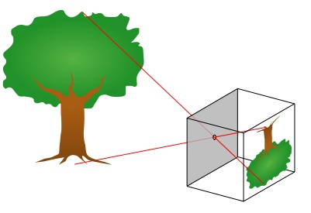
Image Formation
In computer graphics, we form images which are generally two dimensional using a process analogous to how images are formed by physical imaging systems
  Cameras
  Microscopes
  Telescopes
  Human visual system

Slide 21
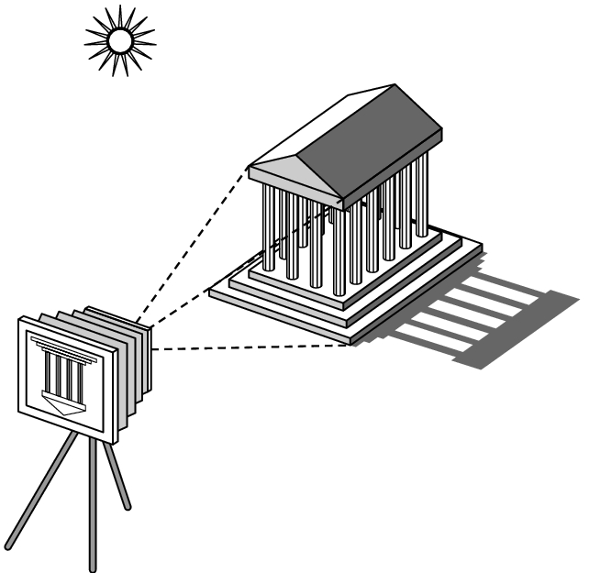
Elements of Image Formation
Objects
Viewer
Light source(s)
How light interacts with material
  Glossy or matt?
Note the independence of the objects, the viewer, and the light source(s)
Generating shadows is not easy – a theme we will return to

Slide 22
Light
Light is the part of the electromagnetic spectrum that causes a reaction in our visual systems
Generally these are wavelengths in the range of about 350-750 nm (nanometers)
Long wavelengths appear as reds and short wavelengths as blues

Slide 23
Luminance and Color Images
Luminance Image
  Monochromatic
  Values are gray levels
  Analogous to working with black and white film or television
Color Image
  Has perceptional attributes of hue, saturation, and lightness
  Do we have to match every frequency in visible spectrum? No!

Slide 24
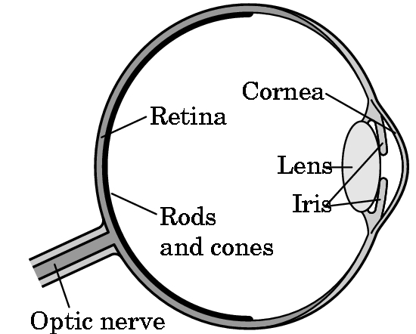
Three-Color Theory
Human visual system has two types of sensors
  Rods: monochromatic, night vision
  Cones
    Color sensitive
    Three types of cones
    Only three values (the tristimulus
    values) are sent to the brain
Need only match these three values to fool eye
  Need only three primary colors

Slide 25
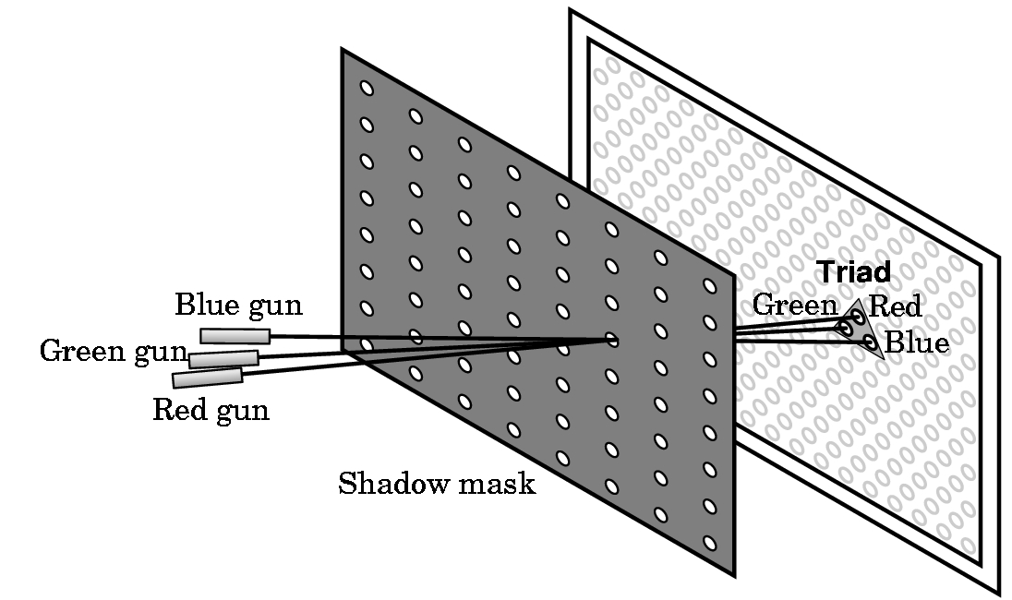
Shadow Mask CRT

Slide 26
Additive and Subtractive Color
Additive color
  Form a color by adding amounts of three primaries
    CRTs, projection systems, positive film
  Primaries are Red (R), Green (G), Blue (B)
Subtractive color
  Form a color by filtering white light with cyan (C), Magenta (M), and Yellow (Y) filters
    Light-material interactions
    Printing
    Negative film

Slide 27
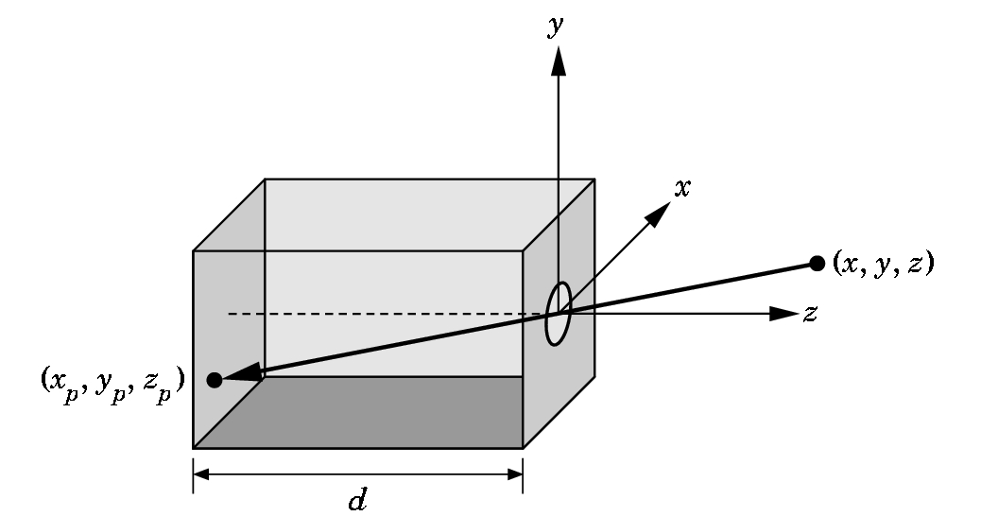
Pinhole Camera
Use similar trianges to find projection of point at (x,y,z)
z_{p}= d
x_{p}= -x/z/d
y_{p}= -y/z/d
These are equations of simple perspective

Slide 28
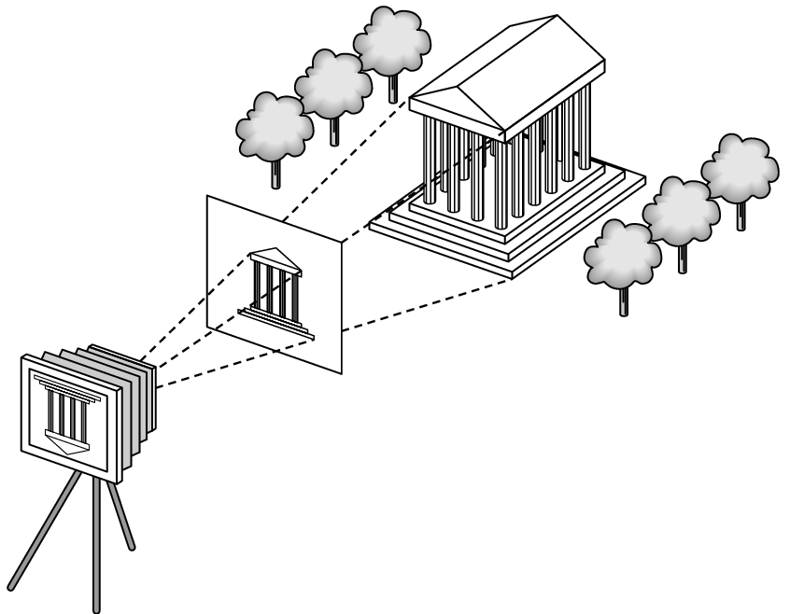
Synthetic Camera Model
projector
p
image plane
projection of p
center of projection

Slide 29
Advantages
Separation of objects, viewer, light sources
Two-dimensional graphics is a special case of three-dimensional graphics
Leads to simple software API
  Specify objects, lights, camera, attributes
  Let implementation determine image
Leads to fast hardware implementation

Slide 30
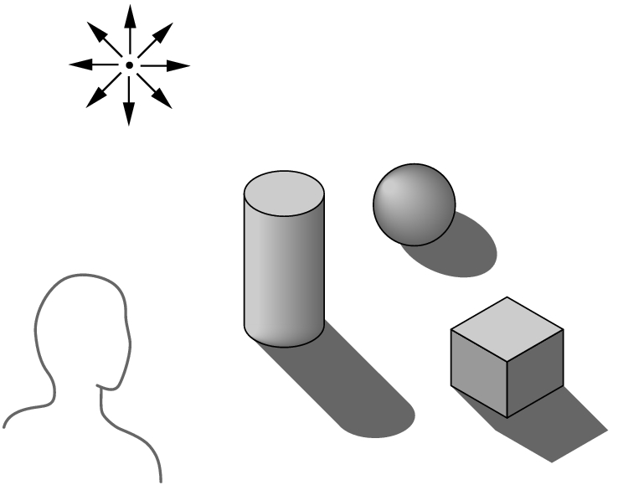
Global vs Local Lighting
Cannot compute color or shade of each object independently
  Some objects are blocked from light
  Light can reflect from object to object
  Some objects might be translucent

Slide 31
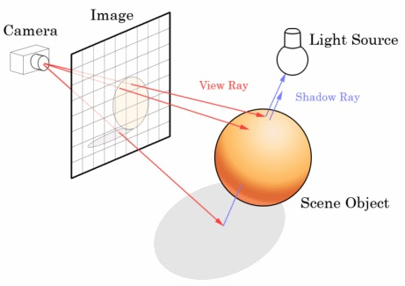
Alternatives
Ray Tracing and Ray Casting

Slide 32
Why not ray tracing?
Ray tracing seems more physically based so why don’t we use it to design a graphics system?
Possible and is actually simple for simple objects such as polygons and quadrics with simple point sources
In principle, can produce global lighting effects such as shadows and multiple reflections but ray tracing is slow and not well-suited for interactive applications

Slide 33
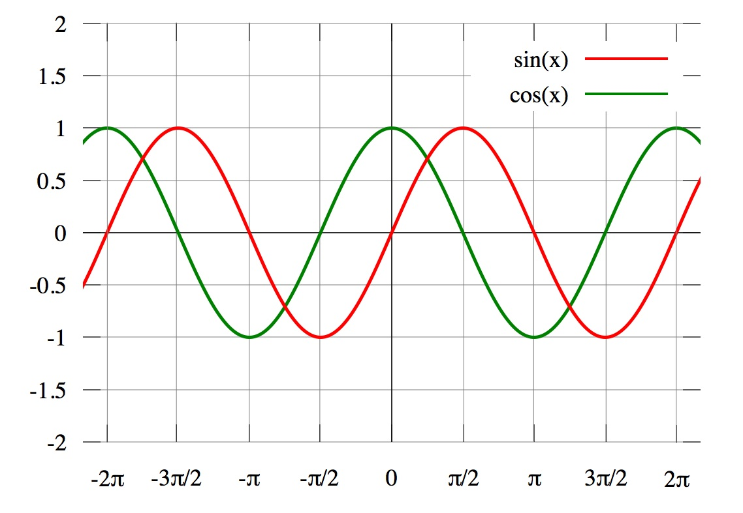
More Vector Mathematics
Dot product – measures length and angle – can tease out one term
  A•B = |A| |B| cos (theta)
    cos(theata) = A•B/|A||B|
  http://mathproofs.blogspot.com/2006/07/dot-product-and-cosine.html
Perpendicular vectors have a dot product of 0
Projection of vector A onto vector B
  (A•B) B/|B|²
Given vector v₁ = (a, b)
Build vector v₂ = (-b, a)
v₁ . v₂ = -ab + ba = 0, so they are perpendicular
  Could also use (b, -a) = -v₂
Given vector v = (a, b, c) we have many choices for perpendiculars
  (-b, a, 0), (0, -c, b), (-c, 0, a) and combinations of these.

Slide 34
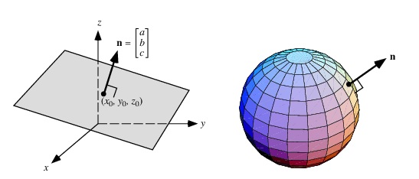
Applications
If AB == 0 and |A| =/= 0 and |B| =/= 0, then A and B are perpendicular
We can define a line through the origin as the set of points that are the endpoints of vectors perpendicular to a fixed vector v
The vector is called the normal vector to the line
    v = (a, b), then the line is ax + by = 0
    All (x, y) such that (x, y)•(a, b) = ax + by = 0
We can translate the line from the origin to get - ax + by = c
  A normal vector can also be used to define a plan in three space

Slide 35
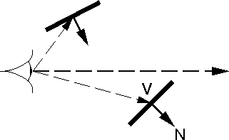
Applications
Backface culling – We use the fact that AB < 0 means that the angle is > 90
When deciding if a triangle is facing the camera or is facing away, we compute the dot product of the normal vector to the polygon with the vector from the camera to one of the polygon's vertices.
Gives fast test to see if we need to draw the triangle: those that are facing away are culled (removed)

Slide 36
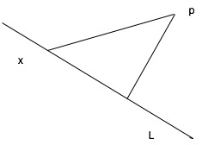
Applications
We want to know the distance between a point p and a line L
Take a point on the line L, and draw a vector from to p
Project the vector v onto the line and onto a perpendicular
Distance from p to the line is length of perpendicular

Slide 37
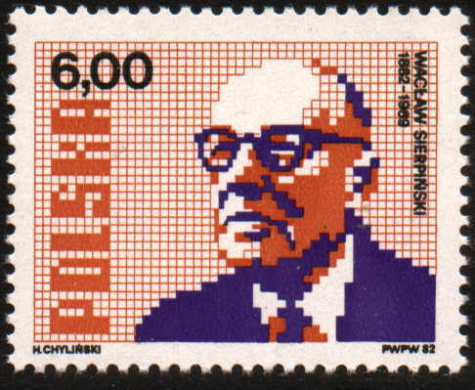
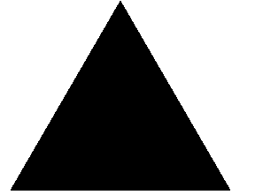
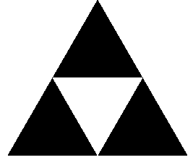
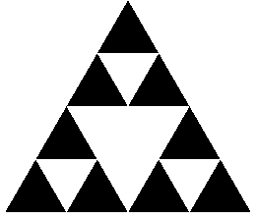
Sierpinski Gasket
Discovered by Waclaw Sierpinski in 1915
  Start with a triangle
  In each step, remove 25% of the remaining area
    We are left with a shape with area 0

Slide 38
Sierpinski Gasket
The odd numbers in Pascal’s Triangle are in bold
  Can view trio of three bold numbers as a black triangle
    See also S. Wolfram’s Cellular Automata rule 90
1
1 1
1 2 1
1 3 3 1
1 4 6 4 1
1 5 10 10 5 1
1 6 15 20 15 6 1
1 7 21 35 35 21 7 1

Slide 39
More Overhead
void display() {
  glClear(GL_COLOR_BUFFER_BIT);
  glBegin(GL_TRIANGLES);
  divide_triangle(v[0], v[1], v[2], n);
  glEnd();
  glFlush();
}
void myinit() {
  glMatrixMode(GL_PROJECTION);
  glLoadIdentity();
  gluOrtho2D(-2.0, 2.0, -2.0, 2.0);
  glMatrixMode(GL_MODELVIEW);
  glClearColor (1.0, 1.0, 1.0, 1.0);
  glColor3f(0.0,0.0,0.0);
}

Slide 40
More Overhead Explained
Let’s run through the calls in myinit().
glMatrixMode(GL_PROJECTION);
    Change to Projection Matrix
    OpenGL keeps several matrixes. We will be using the Projection Matrix and the Modelview Matrix. There is also a Color Matrix and a Texture Matrix. I won’t try to explain these today
glLoadIdentity();
    Replace the current transformation matrix with the identity matrix
gluOrtho2D(-2.0, 2.0, -2.0, 2.0);
    Set the clipping planes. Parameters are left, right, top, bottom
glMatrixMode(GL_MODELVIEW);
    Change to Modelview Matrix
glClearColor (1.0, 1.0, 1.0, 1.0);
    Set the colors used when glClear is called
glColor3f(0.0,0.0,0.0);
    Set a new color. This color is white.

Slide 41
OpenGL model
To draw in OpenGL, we will
  Initialize things, opening a session with graphics pipeline
  Tell the pipeline what kind of things we will be drawing
    In this example, it is a series of triangles
  Send a series of triangles
  End the session
  Flush, forcing the images onto the screen
    glClear(GL_COLOR_BUFFER_BIT);
    glBegin(GL_TRIANGLES);
      glVertex2fv(a);
      glVertex2fv(b);
      glVertex2fv(c);
    glEnd();
    glFlush();

Slide 42
OpenGL Model in more detail
glClear(GL_COLOR_BUFFER_BIT);
    Clear the buffers in the viewport
glBegin(GL_TRIANGLES);
    Begin and End delimit a sequence of primitives.
    These primitives will be triangles. In the next example, we will use this idiom on GL_POINTS
glVertex2fv(a);
    Specify a vertex of the first triangle. There are many ways to specify a Vertex: we are passing in an array of 2 floats. Other choices are glVertex2f(float, float) or glVertex2dv(double v[2])
glVertex2fv(b);
glVertex2fv(c);
glEnd();
    End the sequence of primitives we started above
glFlush();
    Force the pending OpenGL commands to run now

Slide 43
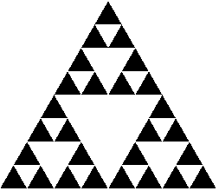
Drawing Triangle in OpenGL
/* Routine that paints image */
void display() {
  glClear(GL_COLOR_BUFFER_BIT);
  glBegin(GL_TRIANGLES);
    divide_triangle(v[0], v[1], v[2], level);
  glEnd();
  glFlush();
}
void divide_triangle(GLfloat *a, GLfloat *b, GLfloat *c, int m) {
  ...
    triangle(a,b,c);
}
/* specify one triangle */
void triangle( GLfloat *a, GLfloat *b, GLfloat *c) {
  glVertex2fv(a);
  glVertex2fv(b);
  glVertex2fv(c);
}

Slide 44
Recursion
void divide_triangle(GLfloat *a, GLfloat *b, GLfloat *c, int m) {
  GLfloat v0[2], v1[2], v2[2];
  int j;
  if (m>0) {
    for(j=0; j<2; j++)
      v0[j]=(a[j]+b[j])/2;
    for(j=0; j<2; j++)
      v1[j]=(a[j]+c[j])/2;
    for(j=0; j<2; j++)
      v2[j]=(b[j]+c[j])/2;
    divide_triangle(a, v0, v1, m-1);
    divide_triangle(c, v1, v2, m-1);
    divide_triangle(b, v2, v0, m-1);
  }
  else
    triangle(a,b,c); /* draw triangle */
}
We are representing points as ordered pairs
Find the midpoints of the three sides, and recurse
a
v0
v1
b
v2
c

Slide 45
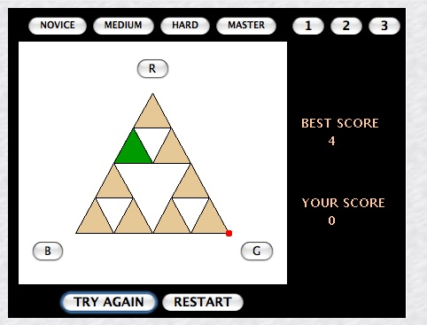
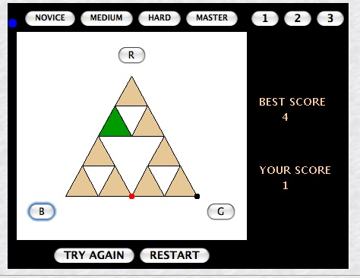
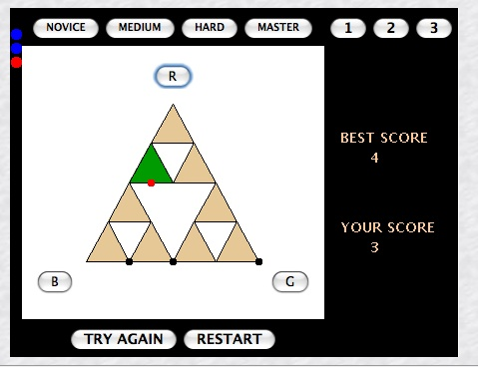
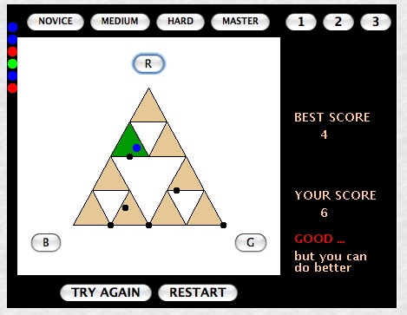
Chaos Game
http://math.bu.edu/DYSYS/applets/chaos-game.html

Slide 46
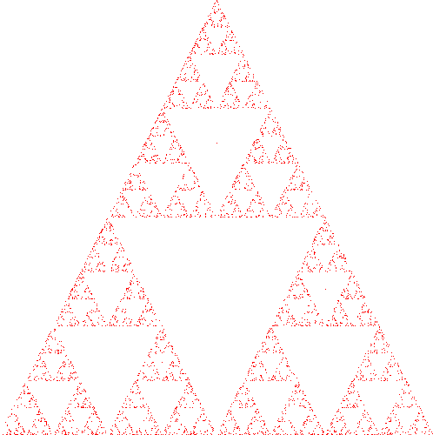
Use game to generate set of points
// Here is the outline of the OpenGL calls we use to plot a point
glClear(GL_COLOR_BUFFER_BIT); /*clear the window */
glBegin(GL_POINTS);
  p[0] = ...
  p[1] = ...
  /* plot new point */
  glVertex2fv(p);
glEnd();
glFlush(); /* clear buffers */

Slide 47
Chaos Game Routine
/* In this version, we plot one point at a time */
void display() {
  GLfloat vertices[3][2]={{0.0,0.0},{25.0,50.0},{50.0,0.0}};
  int j, k;
  int rand(); /* standard random number generator */
  GLfloat p[2] ={25.0, 17.0}; /* worst possible point: center of triangle */
  glClear(GL_COLOR_BUFFER_BIT); /*clear the window */
  glBegin(GL_POINTS);
  /* compute and plot new points */
  for( k = 0; k < NUM_ITER; k++) {
    j=rand()%3; /* pick a vertex at random */
    /* compute point halfway between selected vertex and old point */
    p[0] = (p[0]+vertices[j][0])/2.0;
    p[1] = (p[1]+vertices[j][1])/2.0;
    /* plot new point */
    glVertex2fv(p);
  }
  glEnd();
  glFlush(); /* clear buffers */
}

Slide 48
Chaos Game Main Loop
GLfloat vertices[3][2]={{0.0,0.0},{25.0,50.0},{50.0,0.0}};
GLfloat p[2] ={25.0, 17.0}; /* worst point: center of triangle */
/* compute and plot new points */
for( k = 0; k < NUM_ITER; k++) {
  j=rand()%3; /* pick a vertex at random */
  /* compute point halfway between selected vertex and old point */
  p[0] = (p[0]+vertices[j][0])/2.0;
  p[1] = (p[1]+vertices[j][1])/2.0;
  /* plot new point */
  glVertex2fv(p);
}
Starting point
Second point
Second Random Vertex

Slide 49
Why does this work?
In my version the starting point is in the center of the middle triangle
Each time we move halfway towards a corner, we move into a blank triangle
We will never land in a shaded triangle
So why does the resulting set look the the Sierpinski Gasket?

Slide 50
Why does this work?
Imagine our random vertex is on the north, so we map all points north
At each step, our point is in the center of a blank triangle
But at every step, the new triangle is half as big, so point is closer to curve
  In the limit, point lies within epsilon of the Sierpinski curve
If the choice of next vertex is not random, we do not get the full set
A
B
C

Slide 51
OpenGL Overhead
/* Header file with definitions for OpenGL API */
#include <GL/glut.h>
...
int main(int argc, char **argv) {
  glutInit(&argc, argv);
  glutInitDisplayMode(GLUT_SINGLE | GLUT_RGB);
  glutInitWindowSize(500, 500);
  glutCreateWindow("Sierpinski Gasket");
  glutDisplayFunc(display);/* Display Callback */
  myinit(); /* Local init */
  glutMainLoop(); /* Wait for events */
}

Slide 52
OpenGL Overhead Explained
I will skip the details: see the glut-3.spec, a PDF you can download from the OpenGL site or my webpage
glutInit(&argc, argv);
    Initialize the GLUT Library
glutInitDisplayMode(GLUT_SINGLE | GLUT_RGB);
    Set the initial Display Mode.
      GLUT_SINGLE - Single buffered window (not double buffered)
      GLUT_RGB - Red, Green, Blue color mode
glutInitWindowSize(500, 500);
    Window size in pixels
glutCreateWindow("Sierpinski Gasket");
    Create a window, with title Sierpinski Gasket
glutDisplayFunc(display); /* Display Callback */
    Register a callback for display. We redisplay when the window moves
myinit(); /* Local init */
    Local initialization. This is our routine, so name is arbitrary
glutMainLoop(); /* Wait for events */
    Main loop of OpenGL programs. Wait for the user to do something

Slide 53
Coordinate Systems
The units in glVertex are determined by the application and are called object or problem coordinates
The viewing specifications are also in object coordinates and it is the size of the viewing volume that determines what will appear in the image
Internally, OpenGL will convert to camera (eye) coordinates and later to screen coordinates
OpenGL also uses some internal representations that usually are not visible to the application

Slide 54
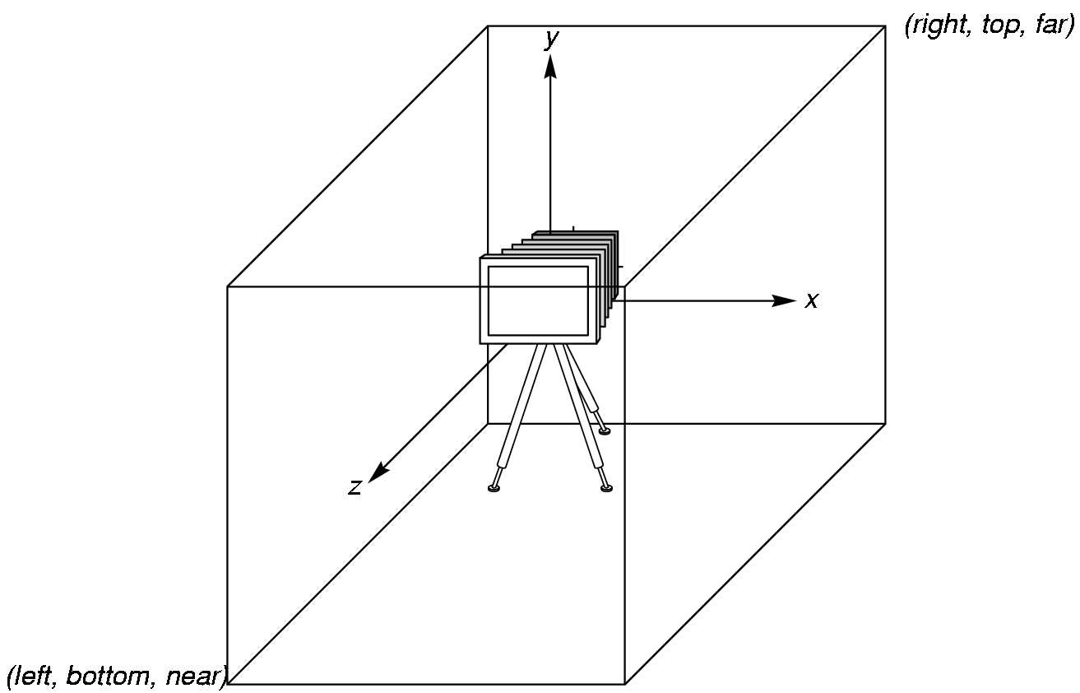
OpenGL Camera
OpenGL places a camera at the origin in object space pointing in the negative z direction
The default viewing volume is a
box centered at the origin with a side of length 2

Slide 55
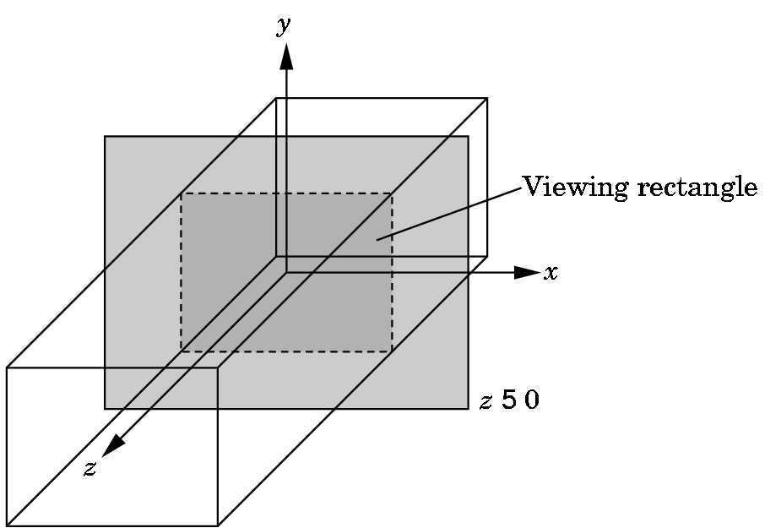
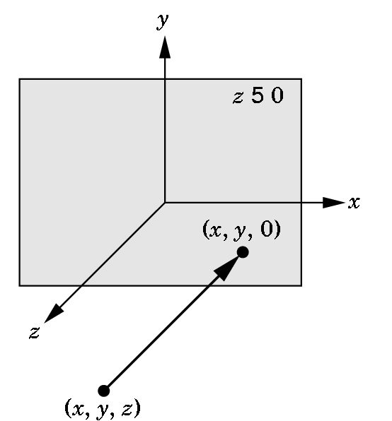
Orthographic Viewing
In the default orthographic view, points are
projected forward along the z axis onto the
plane z=0
z=0
z=0

Slide 56
Transformations and Viewing
In OpenGL, projection is carried out by a projection matrix (transformation)
There is only one set of transformation functions so we must set the matrix mode first
  glMatrixMode (GL_PROJECTION)
Transformation functions are incremental so we start with an identity matrix and alter it with a projection matrix that gives the view volume
  glLoadIdentity();
  glOrtho(-1.0, 1.0, -1.0, 1.0, -1.0, 1.0);

Slide 57
2- and 3-dimensional viewing
  glLoadIdentity();
  glOrtho(-1.0, 1.0, -1.0, 1.0, -1.0, 1.0);
In glOrtho(left, right, bottom, top, near, far) the near and far distances are measured from the camera
Two-dimensional vertex commands place all vertices in the plane z=0
If the application is in two dimensions, we can use the function
gluOrtho2D(left, right, bottom, top)
In two dimensions, the view or clipping volume becomes a clipping window

Slide 58
OpenGL Primitives
GL_POINTS
GL_POLYGON
GL_LINES
GL_LINE_STRIP
GL_LINE_LOOP
GL_TRIANGLES
GL_QUAD_STRIP
GL_TRIANGLE_STRIP
GL_TRIANGLE_FAN

Slide 59
Polygon Issues
OpenGL will only display polygons correctly that are
  Simple: edges cannot cross
  Convex: All points on line segment between two points in a polygon are also in the polygon
  Flat: all vertices are in the same plane
User program can check if above true
  OpenGL will produce output if these conditions are violated but it may not be what is desired
Triangles satisfy all conditions: can reduce to this situation
nonconvex polygon
nonsimple polygon

Slide 60
Attributes
Attributes are part of the OpenGL state and determine the appearance of objects
  Color (points, lines, polygons)
  Size and width (points, lines)
  Stipple pattern (lines, polygons)
  Polygon mode
    Display as filled: solid color or stipple pattern
    Display edges
    Display vertices

Slide 61
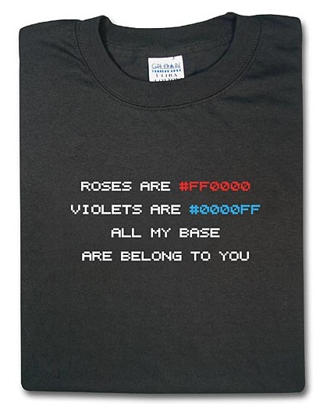
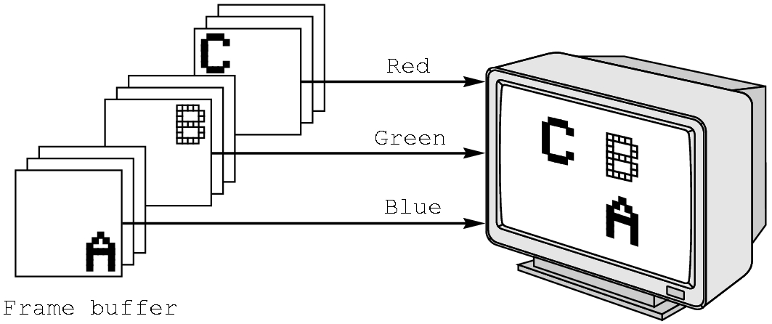
RGB color
Each color component is stored separately in the frame buffer
Usually 8 bits per component in buffer: 24 bit color
  8 bits can store numbers from 0 to 255 as Unsigned Bytes
Note in glColor3f the color values range from 0.0 (none) to 1.0 (all), whereas in glColor3ub the values range from 0 to 255

Slide 62
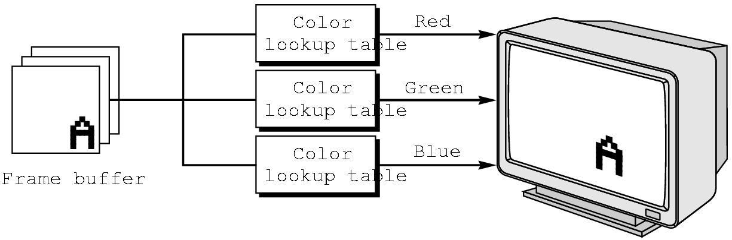
Indexed Color
An alternative is Index Color
Colors are indices into tables of RGB values (see next slide for GIF scheme)
Requires less memory for
  indices usually 8 bits
  not as important now
    Memory inexpensive
    Need more colors for shading

Slide 63

GIF Color Map
GIF, introduced by CompuServe, uses the idea of indirection
  Rather than store the value, store a reference to the value
We have an image with 24-bit colors for each pixel
To save storage, store index into a small table of colors (color map)
Rather than store 24 bits, we typically pick 256 colors and store 8 bits
  Lossy if original has more than 256 colors
    Works better for the Simpsons than the Sopranos
Store the color map first, then the array of references to map
0x00ED9D
0xFF69F0
0xFF0000
0x00ED9D
0x00ED9D
0x00ED9D
0x00ED9D
0x00ED9D
0
0
0
0
0
0x00ED9D
0x00ED9D
0xFF69F0
0xFF69F0
0xFF69F0
0
0
2
2
2
0x00ED9D
0xFF69F0
0x00ED9D
0x00ED9D
0x00ED9D
0
2
0
0
0
0xFF69F0
0x00ED9D
0x00ED9D
0x00ED9D
0x00ED9D
2
0
0
0
0
0xFF69F0
0x00ED9D
0xFF0000
0x00ED9D
0x00ED9D
2
0
1
0
0
0xFF69F0
0x00ED9D
0x00ED9D
0x00ED9D
0x00ED9D
2
0
0
0
0
0xFF69F0
0x00ED9D
0x00ED9D
0x00ED9D
0x00ED9D
2
0
0
0
0
0xFF69F0
0x00ED9D
0x00ED9D
0xFF0000
0xFF0000
2
0
0
1
1
Original Image
Compressed Image

Slide 64
Color and State
The color as set by glColor becomes part of the state and will be used until changed
  Colors and other attributes are not part of the object but are assigned when the object is rendered
We can create conceptual vertex colors by code such as
  glColor(…)
  glVertex(…)
  glColor(…)
  glVertex(…)
We will see an example in the sample program cube.c

Slide 65
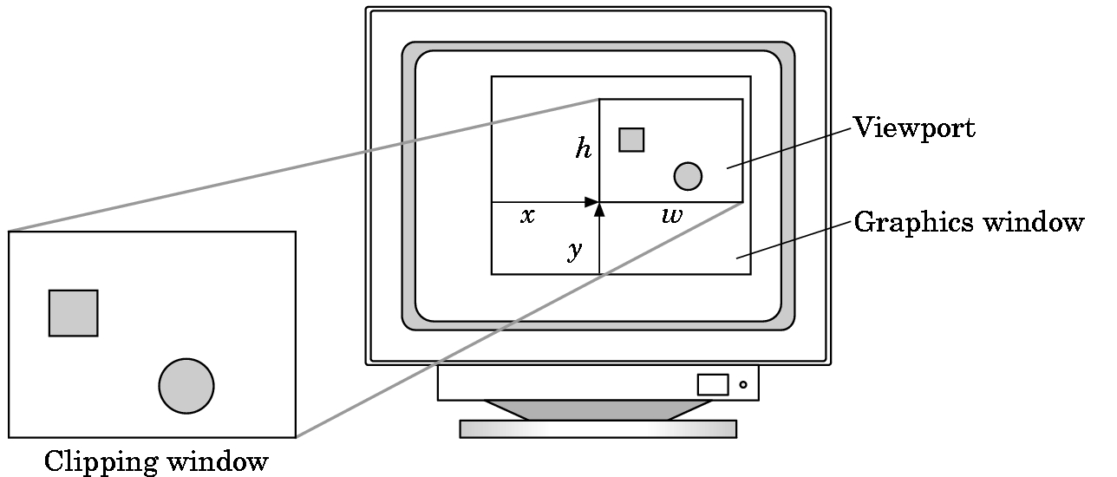
Viewports
Do not have use the entire window for the image: glViewport(x,y,w,h)
Values in pixels (screen coordinates)

Slide 66
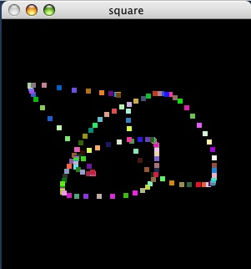
square.c
/* program illustrates the use of the GLUT library for interfacing with a window system */
/* The program opens a window, clears it to black, then draws a
box at the location of the mouse each time the left button is
clicked. The right button exits the program. The program also
reacts correctly when the window is moved or resized by clearing
the new window to black.*/
#include <GL/glut.h>
/* globals */
GLsizei wh = 500, ww = 500; /* initial window size */
GLfloat size = 3.0; /* half side length of square */
void drawSquare(int x, int y)
{
  y=wh-y;
  glColor3ub( (char) rand()%256, (char) rand()%256, (char) rand()%256);
  glBegin(GL_POLYGON);
  glVertex2f(x+size, y+size);
  glVertex2f(x-size, y+size);
  glVertex2f(x-size, y-size);
  glVertex2f(x+size, y-size);
  glEnd();
  glFlush();
}

Slide 67
drawSquare
void drawSquare(int x, int y)
{
  y=wh-y;
  glColor3ub( (char) rand()%256,
  (char) rand()%256, (char) rand()%256);
  glBegin(GL_POLYGON);
  glVertex2f(x+size, y+size);
  glVertex2f(x-size, y+size);
  glVertex2f(x-size, y-size);
  glVertex2f(x+size, y-size);
  glEnd();
  glFlush();
}

Slide 68
init
void myinit()
{
  glClearColor (0.0, 0.0, 0.0, 1.0);
  glViewport(0, 0, ww, wh);
  /* Pick 2D clipping window to match size of screen window. This choice avoids having to scale object coordinates each time window is resized. */
  glMatrixMode(GL_PROJECTION);
  glLoadIdentity();
  glOrtho(0.0, (GLdouble) ww , 0.0, (GLdouble) wh , -1.0, 1.0);
  /* set clear color to black and clear window */
  glClearColor (0.0, 0.0, 0.0, 1.0);
  glClear(GL_COLOR_BUFFER_BIT);
  glFlush();
}

Slide 69
reshape
/* reshaping routine called whenever window is resized or moved */
void myReshape(GLsizei w, GLsizei h)
{
  /* adjust clipping box */
  glMatrixMode(GL_PROJECTION);
  glLoadIdentity();
  glOrtho(0.0, (GLdouble)w, 0.0, (GLdouble)h, -1.0, 1.0);
  glMatrixMode(GL_MODELVIEW);
  glLoadIdentity();
  /* adjust viewport and clear */
  glViewport(0, 0, w, h);
  glClear(GL_COLOR_BUFFER_BIT);
  glFlush();
  /* set global size for use by drawing routine */
  ww = w;
  wh = h;
}

Slide 70
main
void mouse(int btn, int state, int x, int y)
{
  if (btn==GLUT_RIGHT_BUTTON && state==GLUT_DOWN)
    exit(0);
}
/* display callback required by GLUT */
void display()
{}
int main(int argc, char** argv)
{
  glutInit(&argc,argv);
  glutInitDisplayMode (GLUT_SINGLE | GLUT_RGB);
  glutCreateWindow("square");
  myinit ();
  glutReshapeFunc (myReshape);
  glutMouseFunc (mouse);
  glutMotionFunc(drawSquare);
  glutDisplayFunc(display);
  glutMainLoop();
}
Hey! Who draws the square?

Slide 71
main
/* display callback required by GLUT */
void display()
{
  /* we don’t remember anything - cannot recreate it - jdp */
}
int main(int argc, char** argv)
{
  glutInit(&argc,argv);
  glutInitDisplayMode (GLUT_SINGLE | GLUT_RGB);
  glutCreateWindow("square");
  myinit ();
  glutReshapeFunc (myReshape);
  glutMouseFunc (mouse);
  glutMotionFunc(drawSquare);
  glutDisplayFunc(display);
  glutMainLoop();
}
Hey! Who draws the square?

