Slide 1
Day 4 Transformation and 2D
Based on lectures by Ed Angel

Slide 2
Objectives
Introduce standard transformations
  Rotation
  Translation
  Scaling
  Shear
Learn to build arbitrary transformation matrices from simple transformations
Look at some 2 dimensional examples, with an excursion to 3D
We start with a simple example to motivate this

Slide 3
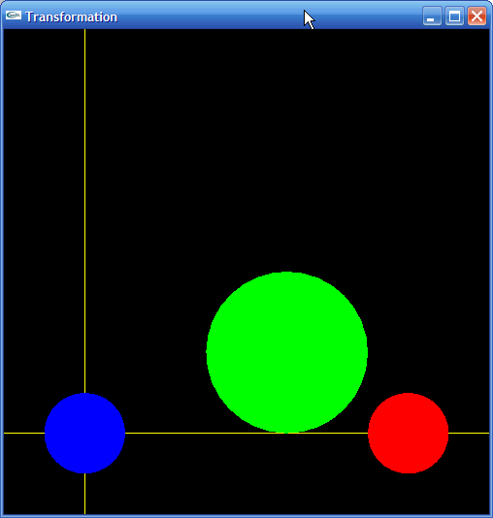
Using transformations
void display()
{
...
setColorBlue();
drawCircle();
setColorRed();
glTranslatef(8,0,0);
drawCircle();
setColorGreen();
glTranslatef(-3,2,0);
glScalef(2,2,2);
drawCircle();
glFlush();
}

Slide 4
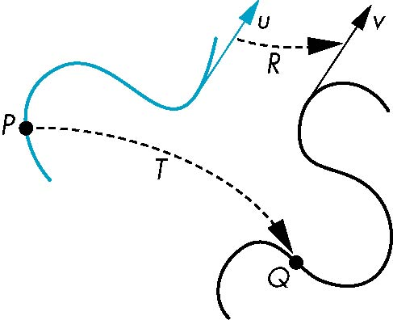
General Transformations
Transformation maps points to other points and/or vectors to other vectors
v=T(u)
Q=T(P)

Slide 5
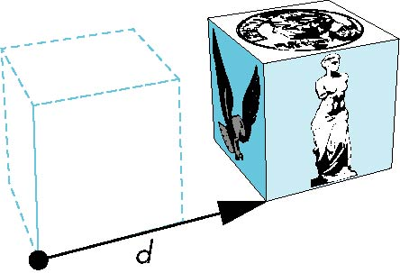

How many ways?
Although we can move a point to a new location in infinite ways, when we move many points there is usually only one way
object
translation: every point displaced
by same vector

Slide 6
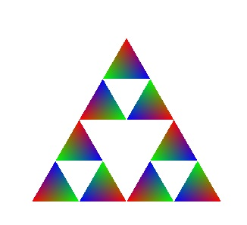
Pipeline Implementation
T
frame
buffer
u
transformation
T(u)
rasterizer
v
T(v)
T(v)
T(v)
v
T(u)
u
T(u)
vertices
vertices
pixels

Slide 7
Affine Transformations
So we want our transformations to be Line Preserving
Characteristic of many physically important transformations
  Rigid body transformations: rotation, translation
  Scaling, shear
Importance in graphics is that we need only transform endpoints of line segments and let implementation draw line segment between the transformed endpoints

Slide 8
Translation
Move (translate, displace) a point to a new location
Displacement determined by a vector d
  Three degrees of freedom
  P’=P+d
P’
d
P

Slide 9
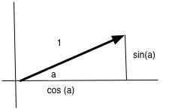
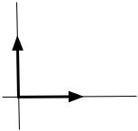
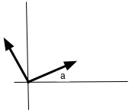
Define Transformations
We wish to take triplets (x, y, z) and map them to new points (x', y', z')
While we will want to introduce operations that change scale, we will start with rigid body translations, and we will start in 2-space
Translation (x, y) → (x + delta, y)
Translation (x, y) → (x + deltaX, y + deltaY)
Rotation (x, y) → ?
Insight: fix origin, and track (1, 0) and (0, 1) as we rotate through angle a

Slide 10
Not Commutative
While often A x B = B x A, transformations are not usually commutative
If I take a step left, and then turn left, not the same as
Turn left, take a step left
  This is fundamental, and cannot be patched or fixed.

Slide 11
Rotations
Any point (x, y) can be expressed in terms of (1, 0), (0, 1)
    These unit vectors form a basis
  The coordinates of the rotation of T(1, 0) = (cos(a), sin(a))
  The coordinates of the rotation of T(0, 1) = (-sin(a), cos(a))
The coordinates of T (x, y) = (x cos(a) + y sin(a), -x sin(a) + y cos(a))
Each term of the result is a dot product
  (x, y) • ( cos(a), sin(a)) = (x cos(a) - y sin(a))
  (x, y) • (-sin(a), cos(a)) = (x sin(a) + y cos(a))

Slide 12
Matrices
Matrices provide a compact representation for rotations, and many other transformation
T (x, y) = (x cos(a) - y sin(a), x sin(a) + y cos(a))
To multiply matrices, multiply the rows of first by the columns of second

Slide 13
Determinant
If the length of each column is 1, the matrix preserves the length of vectors (1, 0) and (0, 1)
We also will look at the Determinant. 1 for rotations.

Slide 14
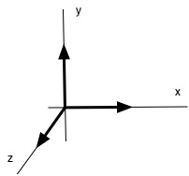
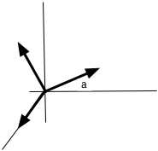
3D Matrices
Can act on 3 space
T (x, y, z) = (x cos(a) + y sin(a), -x sin(a) + y cos(a), z)
  This is called a "Rotation about the z axis" – z values are unchanged

Slide 15
3D Matrices
Can rotate about other axes
  Can also rotate about other lines through the origin…

Slide 16
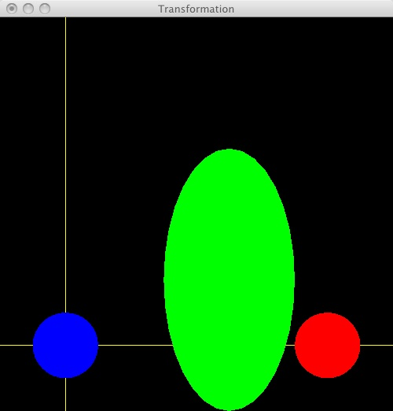
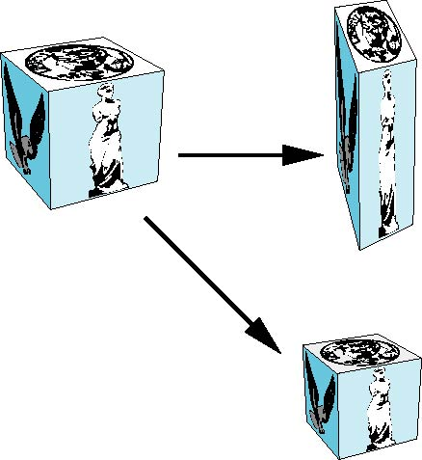
Scaling
Expand or contract along each axis (fixed point of origin)
x’=s_{x}x
y’=s_{y}x
z’=s_{z}x
p’=Sp
S = S(s_{x}, s_{y}, s_{z}) =

Slide 17
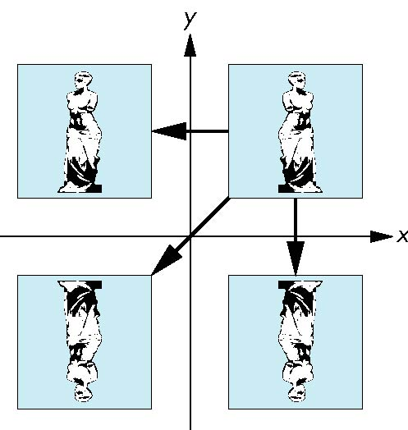
Reflection
corresponds to negative scale factors
Example below sends (x, y, z) → (-x, y, z)
Note that the product of two reflections is a rotation
s_{x} = -1 s_{y} = 1
original
s_{x} = -1 s_{y} = -1
s_{x} = 1 s_{y} = -1

Slide 18
Limitations
We cannot define a translation in 2D space with a 2x2 matrix
  There are no choices for a, b, c, and d that will move the origin, (0, 0), to some other point, such as (5, 3) in the equation above
Further, perspective divide can not be handled by a matrix operation alone
We will see ways to get around each of these problems

Slide 19
Image Formation
We can describe movement with a matrix
Or implicitly
glTranslatef(8,0,0);
glTranslatef(-3,2,0);
glScalef(2,2,2);

Slide 20
Using transformations
void display()
{
...
setColorBlue();
drawCircle();
setColorRed();
glTranslatef(8,0,0);
drawCircle();
setColorGreen();
glTranslatef(-3,2,0);
glScalef(2,2,2);
drawCircle();
glFlush();
}

Slide 21
Absolute vs Relative move
void display()
{
  ...
  setColorBlue();
  glLoadIdentity();
  drawCircle();
  setColorRed();
  glLoadIdentity(); /* Not really needed... */
  glTranslatef(8,0,0);
  drawCircle();
  setColorGreen();
  glLoadIdentity(); /* Return to known position */
  glTranslatef(5,2,0);
  glScalef(2,2,2);
  drawCircle();
  glFlush();
}

Slide 22
Order of Transformations
Note that matrix on the right is the first applied to the point p
Mathematically, the following are equivalent
p’ = ABCp = A(B(Cp))
Note many references use column matrices to represent points. In terms of row matrices
p^{’T} = p^{T}C^{T}B^{T}A^{T}

Slide 23
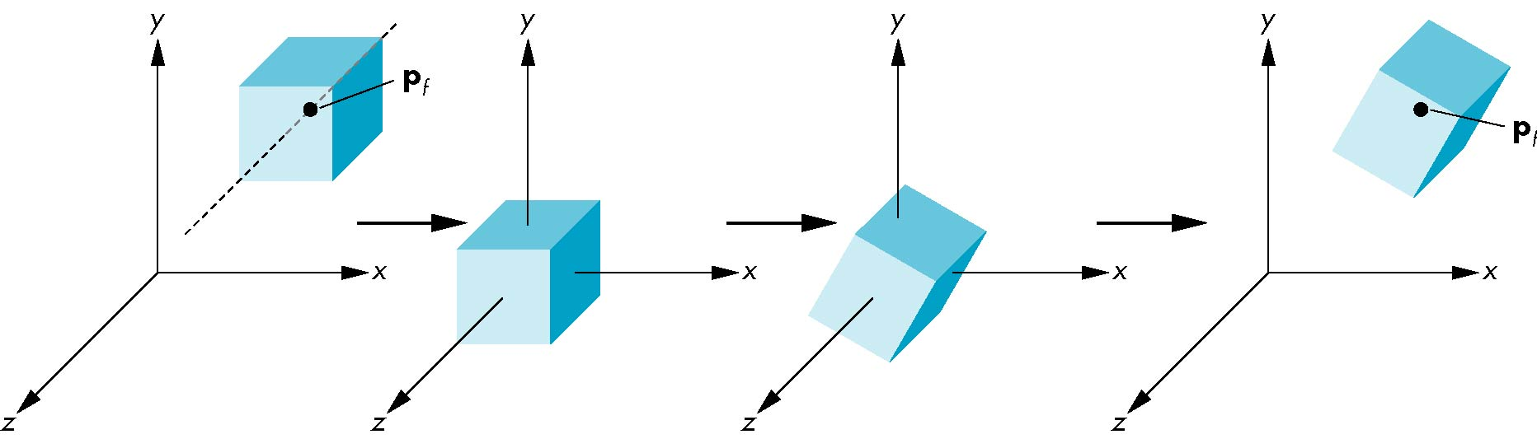
Rotation About a Fixed Point other than the Origin
Move fixed point to origin
Rotate
Move fixed point back
M = T(p_{f}) R(θ) T(-p_{f})

Slide 24
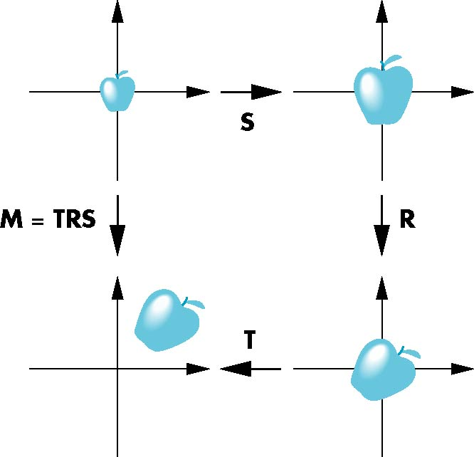
Instancing
In modeling, we often start with a simple object centered at the origin, oriented with the axis, and at a standard size
We apply an instance transformation to its vertices to
Scale
Orient (rotate)
Locate (translate)

Slide 25
Example
void display()
{
  ...
  setColorGreen();
  glLoadIdentity();
  glTranslatef(5,2,0);
  glRotatef(45.0, 0.0, 0.0, 1.0); /* z axis */
  glScalef(2,4,0);
  drawCircle();
  ...
}

Slide 26
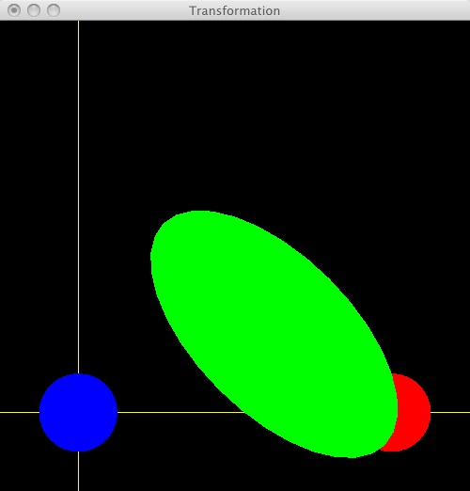
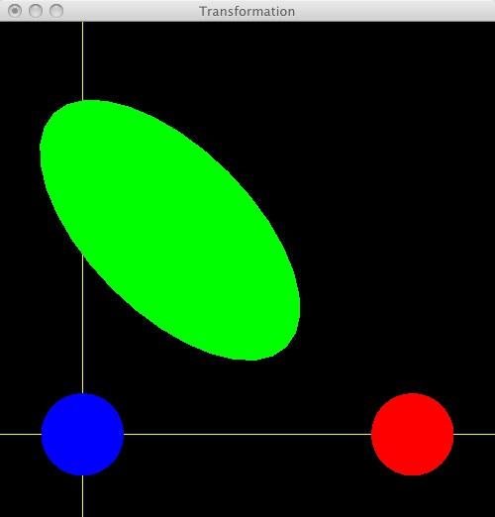
Example
setColorGreen();
glLoadIdentity();
glRotatef(45.0, 0.0, 0.0, 1.0); /* z axis */
glTranslatef(5,2,0);
glScalef(2,4,0);
drawCircle();
setColorGreen();
glLoadIdentity();
glTranslatef(5,2,0);
glRotatef(45.0, 0.0, 0.0, 1.0);
glScalef(2,4,0);
drawCircle();
setColorGreen();
glLoadIdentity();
glTranslatef(5,2,0);
glScalef(2,4,0);
glRotatef(45.0, 0.0, 0.0, 1.0);
drawCircle();

Slide 27
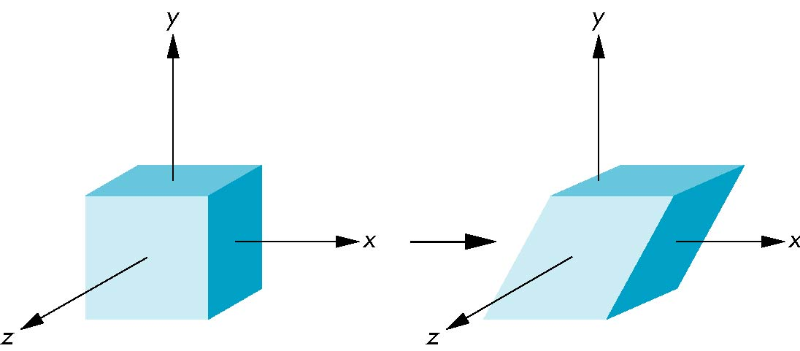
Shear
Helpful to add one more basic transformation
Equivalent to pulling faces in opposite directions

Slide 28
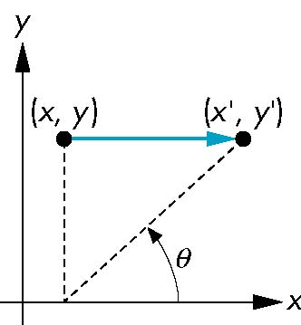
Shear Matrix
Consider simple shear along x axis
x’ = x + y cot θ
y’ = y
z’ = z
H(θ) =

Slide 29
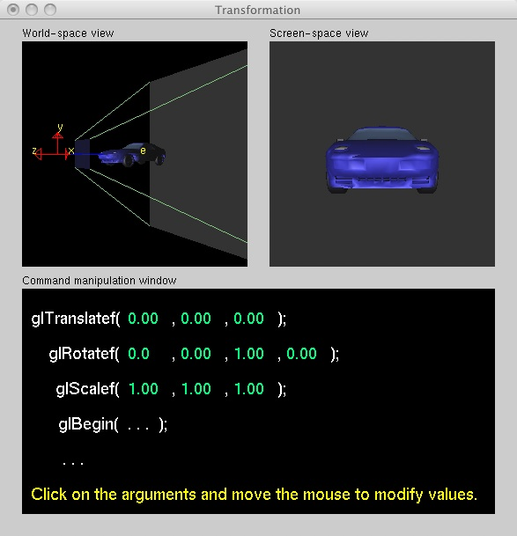
Example
Be sure to play with Nate Robin's Transformation example

Slide 30
Matrix Stack
It is useful to be able to save the current transformation
  We can push the current state on a stack, and then
  Make new scale, translations, rotations
Then pop the stack and return to status quo ante

Slide 31
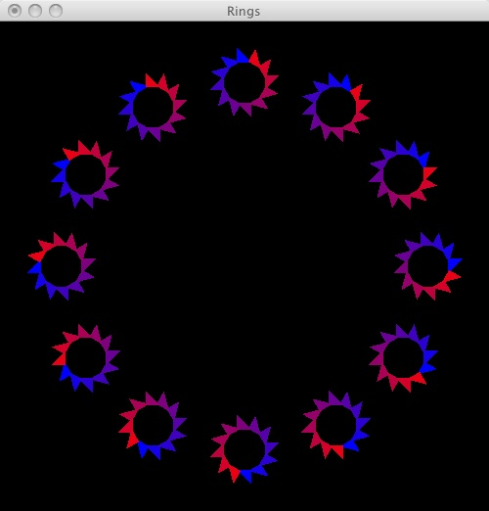
Example

Slide 32
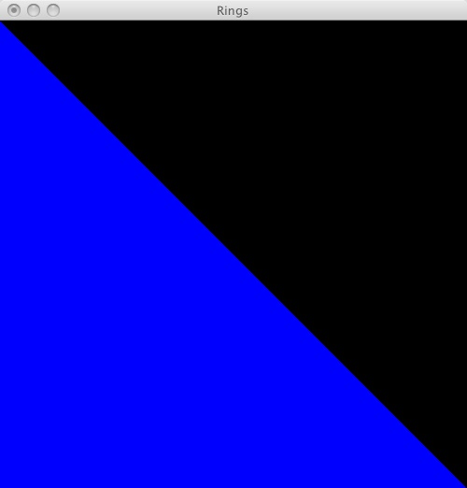
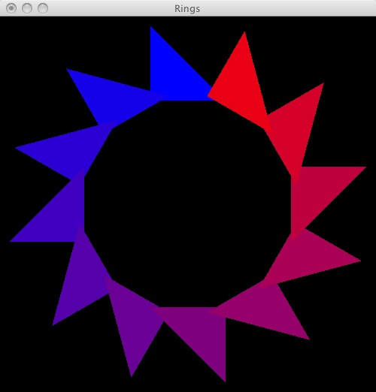
Example
Image is made up of subimages

Slide 33
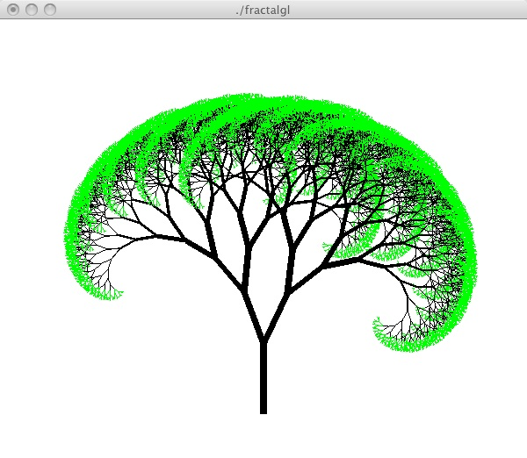
Tree
Jon Squire's fractalgl – on examples page
This is harder to do from scratch

Slide 34
Rings
void display()
{
  int angle;
  glClear(GL_COLOR_BUFFER_BIT);
  for (angle = 0; angle < 360; angle = angle + STEP)
  {
    glPushMatrix(); /* Remember current state */
    glRotated(angle, 0, 0, 1);
    glTranslatef(0.0, 0.75, 0.0);
    glScalef(0.15, 0.15, 0.15);
    drawRing();
    glPopMatrix(); /* Restore orignal state */
  }
  glFlush();
}

Slide 35
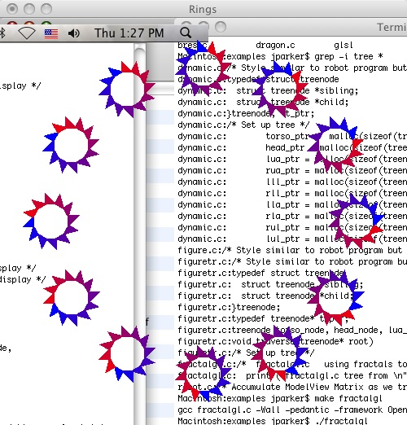
Rings
void display()
{
  int angle;
  // glClear(GL_COLOR_BUFFER_BIT);
  for (angle = 0; angle < 360; angle = angle + STEP)
  {
    glPushMatrix(); /* Remember current state */
    glRotated(angle, 0, 0, 1);
    glTranslatef(0.0, 0.75, 0.0);
    glScalef(0.15, 0.15, 0.15);
    drawRing();
    glPopMatrix(); /* Restore orignal state */
  }
  glFlush();
}

Slide 36
drawRing
void drawRing()
{
  int angle;
  for (angle = 0; angle < 360; angle = angle + STEP)
  {
    glPushMatrix(); /* Remember current state */
    glRotated(angle, 0, 0, 1);
    glTranslatef(0.0, 0.75, 0.0);
    glScalef(0.2, 0.2, 0.2);
    glColor3f((float)angle/360, 0, 1.0-((float)angle/360));
    drawTriangle();
    glPopMatrix(); /* Restore orignal state */
  }
  glFlush();
}

Slide 37
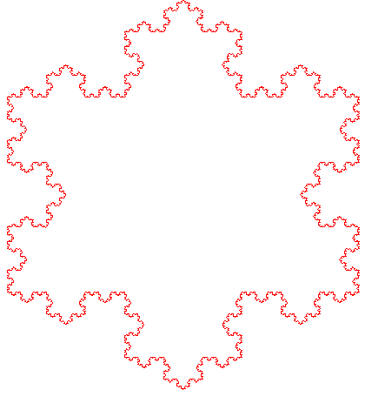
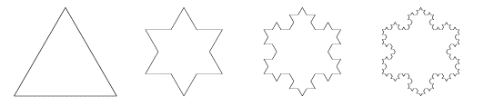
Fractals - Snowflake curve
The Koch Snowflake was discovered by Helge von Koch in 1904.
Start with a triangle inscribed in the unit circle
To build the level n snowflake, we replace each edge in the level n-1 snowflake with the following pattern
The perimeter of each version is 4/3 as long
  Infinite perimeter, but snowflake lies within unit circle, so has finite area
We will use Turtle Geometry to draw the snowflake curve
  Also what Jon Squire used for Fractal Tree

Slide 38
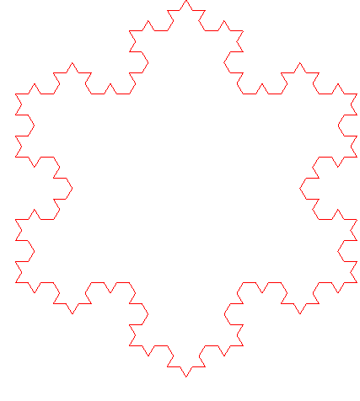
Recursive Step
void toEdge(int size, int num) {
  if (1 >= num)
    turtleDrawLine(size);
  else {
    toEdge(size/3, num-1);
    turtleTurn(300);
    toEdge(size/3, num-1);
    turtleTurn(120);
    toEdge(size/3, num-1);
    turtleTurn(300);
    toEdge(size/3, num-1);
  }
}

Slide 39
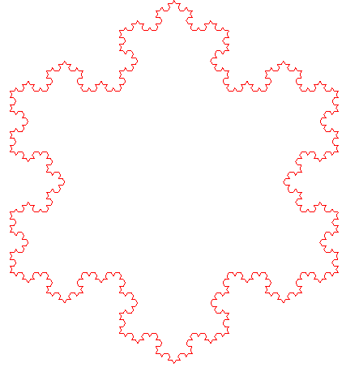
Turtle Library
/** Draw a line of length size */
void turtleDrawLine(GLint size)
  glVertex2f(xPos, yPos);
  turtleMove(size);
  glVertex2f(xPos, yPos);
}
int turtleTurn(int alpha) {
  theta = theta + alpha;
  theta = turtleScale(theta);
  return theta;
}
/** Move the turtle. Called to move and by DrawLine */
void turtleMove(GLint size) {
  xPos = xPos + size * cos(DEGREES_TO_RADIANS * theta);
  yPos = yPos + size * sin(DEGREES_TO_RADIANS * theta);
}

Slide 40
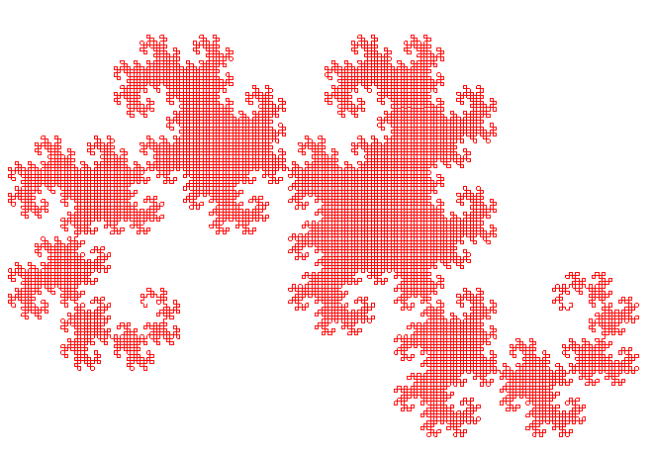
Dragon Curve
The Dragon Curve is due to Heighway
One way to generate the curve is to start with a folded piece of paper
We can describe a curve as a set of turtle directions
The second stage is simply
  Take one step, turn Right, and take one step
The next stage is
  Take one step, turn Right, take one step
  Turn Right
  Perform the original steps backwards, or
    Take one step, turn Left, take one step
  Since the step between turns is implicit, we can write this as RRL
The next stage is
  …

Slide 41
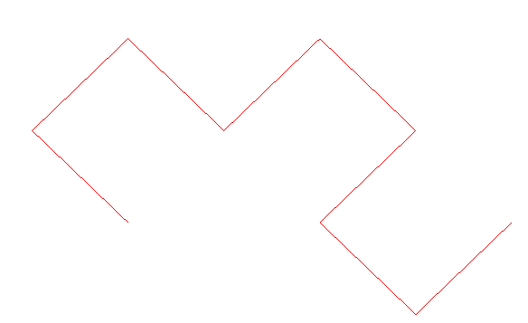
Dragon Curve
The Dragon Curve is due to Heighway
One way to generate the curve is to start with a folded piece of paper
We can describe a curve as a set of turtle directions
The second stage is simply
  Take one step, turn Right, and take one step
The next stage is
  Take one step, turn Right, take one step
  Turn Right
  Perform the original steps backwards, or
    Take one step, turn Left, take one step
  Since the step between turns is implicit, we can write this as RRL
The next stage is
  RRL R RLL

Slide 42
How can we program this?
We could use a large array representing the turns
  RRL R RLL
To generate the next level, append an R and walk back to the head, changing L’s to R’s and R’s to L’s and appending the result to end of array
But there is another way.
Start with a line
At every stage, we replace the line with a right angle
We have to remember which side of the line to decorate (use variable “direction”)
One feature of this scheme is that the “head” and “tail” are fixed
R
R
L
R
R
L
L

Slide 43
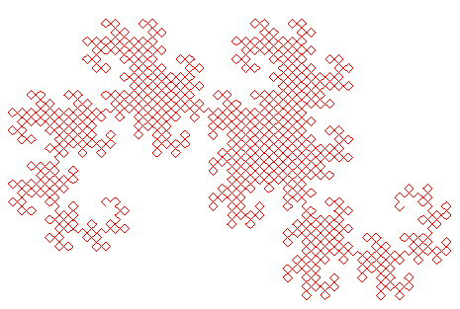
Dragon Curve
void dragon(int size, int level, int direction, int alpha)
{
  /* Add on left or right? */
  int degree = direction * 45;
  turtleSet(alpha);
  if (1 == level) {
    turtleDrawLine(size);
    return;
  }
  size = size/scale; /* scale == sqrt(2.0) */
  dragon(size, level - 1, 1, alpha + degree);
  dragon(size, level - 1, -1, alpha - degree);
}

Slide 44
Dragon Curve
When we divide an int (size) by a real (sqrt(2.0)) there is roundoff error, and the dragon slowly shrinks
The on-line version of this program precomputes sizes per level and passes them through, as below
int sizes[] = {0, 256, 181, 128, 90, 64, 49, 32, 23, 16, 11, 8, 6, 4, 3, 2, 2, 1, 0};
  ...
  dragon(sizes[level], level, 1, 0);
  ...
void dragon(int size, int level, int direction, int alpha)
{
  ...
  /* size = size/scale; */
  dragon(size, level - 1, 1, alpha + degree);
  dragon(size, level - 1, -1, alpha - degree);
}

Slide 45
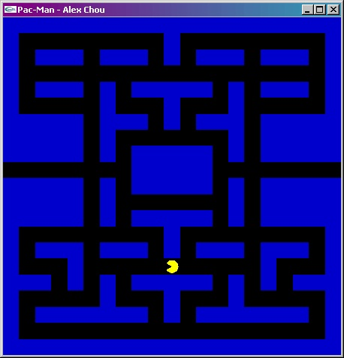
From last class
Alex Chou's Pac Man

Slide 46
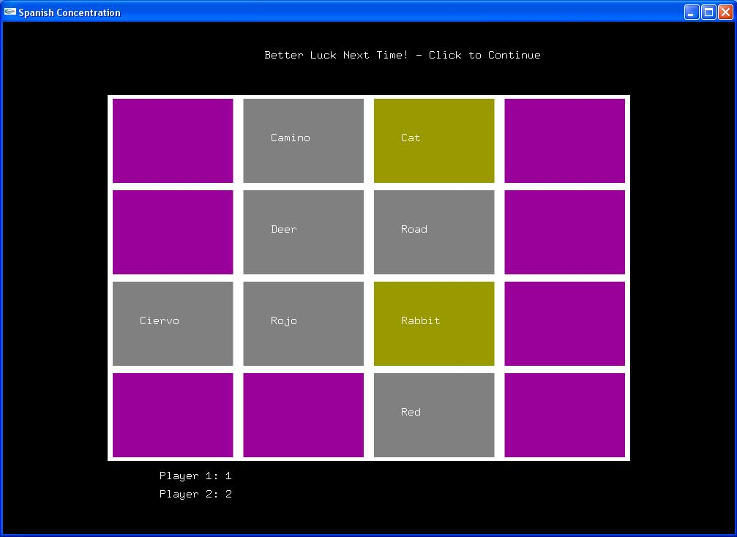
Sample Projects
From last class

Slide 47
Summary
We have played with transformations
  Spend today looking at movement in 2D
    Next week, we are onto the Third Dimension!
In OpenGL, transformations are defined by matrix operations
  In new version, glTranslate, glRotate, and glScale are deprecated
We have seen some 2D matrices for rotation and scaling
  You cannot define a 2x2 matrix that performs translation
    A puzzle to solve
The most recently applied transformation works first
You can push the current matrix state and restore later
Turtle Graphics provides an alternative

