Slide 1
3D Transformations
CS 234
Day 5
Jeff Parker

Slide 2
Objectives
Representing 2D translations with matrix multiplication
  Representing 3D translations
Build some 3D examples
Move the camera
Parametric form for the equation of a line

Slide 3
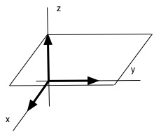
Translation
We cannot perform a 2D transformation with a 2x2 Matrix.
  We cannot move the origin to an arbitrary point, such as (5, 3)
    Briefly, no solution for a, b, c, d in the equation above
To address this, we consider 2D movements in 3D
We pick a representative – we let (x, y, 1) represent (x, y)
  Like points on glass coffee table above the floor
Track the movement of these representatives

Slide 4
Translation
We use a shear transformation T(x, y, z) in 3D
  Note that T(0, 0, 0) = (0, 0, 0)
  However, T(0, 0, 1) = (5, 3, 1)
Combines with scaling, reflection, and rotation

Slide 5
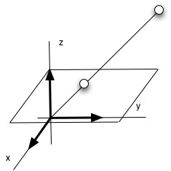
Projective Space
What happens if transformation moves point (x, y, 1) off the plane z = 1?
  We rescale - divide by the z value
For example, the point (9, 21, 3) → (3, 7, 1)
  Project onto the plane z = 1
We have many representatives of the form: (3t, 7t, t)
There are all equivalent in our Projective Model
  We may wish to reduce to "lowest form" – z = 1

Slide 6
Projective Space
The same trick works to perform 3D movement
  Represent triples (x, y, z) as (x, y, z, 1) in 4-Space
Harder to visualize this
Mathematicians reason by analogy to smaller dimensions

Slide 7
Inverses
We can find inverses for all of our translations
Focus on the basic moves we have studied –
  Translation – translate back in the opposite direction
  Rotation – rotate the the same angle, backwards
  Reflection – reflect a second time in the same plane
  Scale – rescale by the reciprocal: If you doubled x, halve x.

Slide 8
Old Homework
I found it almost impossible to test one case by hand
  Difficult to hita pixel on a line
  Most of the pixels we draw are not on the line they represent
Example x + 5y = 6
  The points (6, 0) and (1, 1) are on this line
  No other integer points in the first quadrant satisfy the equation
OpenGL will draw many pixel that are close to (but not on) the line
  What are the odds that you will hit a pixel that fit the equation?
The simplest way to test this is to create synthetic examples

Slide 9
Homework
For next time you will be looking at rotations of a cube
I suggest you do this with a prop in hand.
We start with two 90 degree rotations, about Z and X axes
Can generate all the rotations of a cube

Slide 10
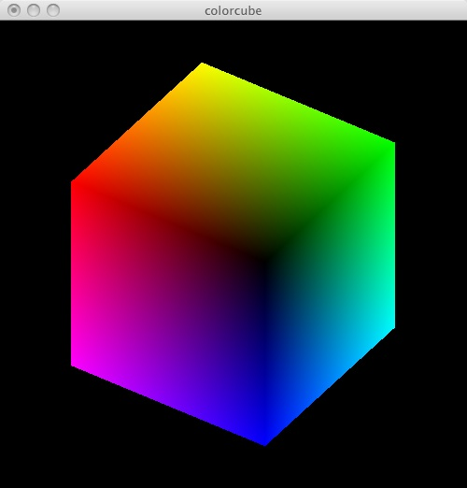
Cube Example
GLfloat vertices[][3] = {{-1.0,-1.0,-1.0},{1.0,-1.0,-1.0},
  {1.0,1.0,-1.0}, {-1.0,1.0,-1.0}, {-1.0,-1.0,1.0},
  {1.0,-1.0,1.0}, {1.0,1.0,1.0}, {-1.0,1.0,1.0}};
GLfloat normals[][3] = {{-1.0,-1.0,-1.0},{1.0,-1.0,-1.0},
  {1.0,1.0,-1.0}, {-1.0,1.0,-1.0}, {-1.0,-1.0,1.0},
  {1.0,-1.0,1.0}, {1.0,1.0,1.0}, {-1.0,1.0,1.0}};
GLfloat colors[][3] = {{0.0,0.0,0.0},{1.0,0.0,0.0},
  {1.0,1.0,0.0}, {0.0,1.0,0.0}, {0.0,0.0,1.0},
  {1.0,0.0,1.0}, {1.0,1.0,1.0}, {0.0,1.0,1.0}};
void polygon(int a, int b, int c , int d)
{
  /* draw a polygon via list of vertices */
  glBegin(GL_POLYGON);
    glColor3fv(colors[a]);
    glNormal3fv(normals[a]);
    glVertex3fv(vertices[a]);
    glColor3fv(colors[b]);
    glNormal3fv(normals[b]);
    glVertex3fv(vertices[b]);...

Slide 11
Polygon
GLfloat vertices[][3] = {{-1.0,-1.0,-1.0},{1.0,-1.0,-1.0},...
GLfloat normals[][3] = {{-1.0,-1.0,-1.0},{1.0,-1.0,-1.0},...
GLfloat colors[][3] = {{0.0,0.0,0.0},{1.0,0.0,0.0},...
void polygon(int a, int b, int c , int d) {
  /* draw a polygon via list of vertices */
  glBegin(GL_POLYGON);
    glColor3fv(colors[a]);
    glNormal3fv(normals[a]);
    glVertex3fv(vertices[a]);
    glColor3fv(colors[b]);
    glNormal3fv(normals[b]);
    glVertex3fv(vertices[b]);
    glColor3fv(colors[c]);
    glNormal3fv(normals[c]);
    glVertex3fv(vertices[c]);
    glColor3fv(colors[d]);
    glNormal3fv(normals[d]);
    glVertex3fv(vertices[d]);
  glEnd();
}

Slide 12
ColorCube
GLfloat vertices[][3] = {{-1.0,-1.0,-1.0},{1.0,-1.0,-1.0},…
GLfloat normals[][3] = {{-1.0,-1.0,-1.0},{1.0,-1.0,-1.0},…
GLfloat colors[][3] = {{0.0,0.0,0.0},{1.0,0.0,0.0},...
void polygon(int a, int b, int c , int d) {...}
void colorcube(void)
{
  /* map vertices to faces */
  polygon(0,3,2,1);
  polygon(2,3,7,6);
  polygon(0,4,7,3);
  polygon(1,2,6,5);
  polygon(4,5,6,7);
  polygon(0,1,5,4);
}

Slide 13
Display
static GLfloat theta[] = {0.0, 0.0, 0.0};
static GLint axis = 2;
void display(void)
{
  /* display callback, clear frame buffer and z buffer,
  rotate cube and draw, swap buffers */
  glClear(GL_COLOR_BUFFER_BIT | GL_DEPTH_BUFFER_BIT);
  glLoadIdentity();
  glRotatef(theta[0], 1.0, 0.0, 0.0);
  glRotatef(theta[1], 0.0, 1.0, 0.0);
  glRotatef(theta[2], 0.0, 0.0, 1.0);
  colorcube();
  glFlush();
  glutSwapBuffers(); /* Double Buffering */
}

Slide 14
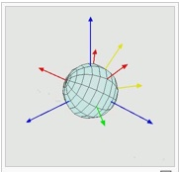
Euler Angles
We can create any rotation through rotations about
x, y, and z axis in prescribed order
  And rotations have multiple representations
The angles picked are called the Euler Angles, after Leonard Euler.
  http://en.wikipedia.org/wiki/Euler_angles
void display(void)
{
  /* display callback, clear frame buffer and z buffer,
  rotate cube and draw, swap buffers */
  glClear(GL_COLOR_BUFFER_BIT | GL_DEPTH_BUFFER_BIT);
  glLoadIdentity();
  glRotatef(theta[0], 1.0, 0.0, 0.0);
  glRotatef(theta[1], 0.0, 1.0, 0.0);
  glRotatef(theta[2], 0.0, 0.0, 1.0);

Slide 15
Updates
But what changes the angles?
static GLfloat theta[] = {0.0, 0.0, 0.0 };
static GLint axis = 2;
void spinCube() {
  /* Idle callback, spin cube 2 degrees about selected axis */
  theta[axis] += 2.0;
  if( theta[axis] > 360.0 ) theta[axis] -= 360.0;
  display();
}
void mouse(int btn, int state, int x, int y) {
  /* mouse callback, selects an axis about which to rotate */
  if(btn==GLUT_LEFT_BUTTON && state == GLUT_DOWN) axis = 0;
  if(btn==GLUT_MIDDLE_BUTTON && state == GLUT_DOWN) axis = 1;
  if(btn==GLUT_RIGHT_BUTTON && state == GLUT_DOWN) axis = 2;
}

Slide 16
Main
Highlight changes from previous examples
  Animation and 3D
int main(int argc, char **argv)
{
  glutInit(&argc, argv);
  /* need both double buffering and z buffer */
  glutInitDisplayMode(GLUT_DOUBLE | GLUT_RGB | GLUT_DEPTH);
  glutInitWindowSize(500, 500);
  glutCreateWindow("colorcube");
  glutReshapeFunc(myReshape);
  glutDisplayFunc(display);
  glutIdleFunc(spinCube);
  glutMouseFunc(mouse);
  glEnable(GL_DEPTH_TEST); /* Enable hidden--surface--removal */
  glutMainLoop();
}

Slide 17
Take Stock
What did we need to do for 3D?
  Define points as triples (x, y, z)
  Enable some form of hidden-surface removal
    We used the "Z buffer"
What did we do for Animation?
  Create some way of updating the scene
    We used the IdleHandler
  Used Double Buffering to reduce flicker
Problems with this program?
  Turning is too rapid

Slide 18
Slow Cube
/* This is now called from the timer callback - jdp */
void spinCube() { ...}
static void timerCallback (int value)
{
  /* Do timer processing */
  spinCube(value);
  /* Call glutPostRedisplay() if needed – here done in spinCube */
  /* call back again after elapsedUSecs have passed */
  glutTimerFunc (50, timerCallback, value);
}
int main(int argc, char **argv)
{
  /* glutIdleFunc(spinCube); Commented out - jdp */
  glutTimerFunc (50, timerCallback, 1); /* jdp - setup timer */

Slide 19
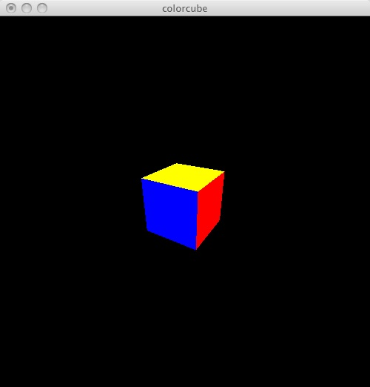
cube_view
GLfloat vertices[][3] = {{-1.0,-1.0,-1.0},{1.0,-1.0,-1.0},
  {1.0,1.0,-1.0}, {-1.0,1.0,-1.0}, {-1.0,-1.0,1.0},
  {1.0,-1.0,1.0}, {1.0,1.0,1.0}, {-1.0,1.0,1.0}};
GLfloat colors[][3] = {{0.0,0.0,0.0},{1.0,0.0,0.0},
  {1.0,1.0,0.0}, {0.0,1.0,0.0}, {0.0,0.0,1.0},
  {1.0,0.0,1.0}, {1.0,1.0,1.0}, {0.0,1.0,1.0}};
void polygon(int a, int b, int c , int d)
{
  glBegin(GL_POLYGON);
    glColor3fv(colors[a]);
    glVertex3fv(vertices[a]);
    glVertex3fv(vertices[b]);
    glVertex3fv(vertices[c]);
    glVertex3fv(vertices[d]);
  glEnd();
}

Slide 20
Movement
void mouse(int btn, int state, int x, int y) {
  if(btn==GLUT_LEFT_BUTTON && state == GLUT_DOWN) axis = 0;
  if(btn==GLUT_MIDDLE_BUTTON && state == GLUT_DOWN) axis = 1;
  if(btn==GLUT_RIGHT_BUTTON && state == GLUT_DOWN) axis = 2;
  theta[axis] += 2.0;
  if( theta[axis] > 360.0 ) theta[axis] -= 360.0;
  display();
}
void keys(unsigned char key, int x, int y) {
  /* use x, X, y, Y, z, and Z keys to move viewer */
  if(key == 'x') viewer[0]-= 1.0;
  if(key == 'X') viewer[0]+= 1.0;
  if(key == 'y') viewer[1]-= 1.0;
  if(key == 'Y') viewer[1]+= 1.0;
  if(key == 'z') viewer[2]-= 1.0;
  if(key == 'Z') viewer[2]+= 1.0;
  display();
}

Slide 21
State
static GLfloat theta[] = {0.0,0.0,0.0};
static GLint axis = 2;
static GLdouble viewer[]= {0.0, 0.0, 5.0}; /* initial viewer location */
void display() {
  glClear(GL_COLOR_BUFFER_BIT | GL_DEPTH_BUFFER_BIT);
  /* update viewer position in model-view matrix */
  glLoadIdentity();
  gluLookAt(viewer[0],viewer[1],viewer[2], 0.0, 0.0, 0.0, 0.0, 1.0, 0.0);
  /* rotate cube */
  glRotatef(theta[0], 1.0, 0.0, 0.0);
  glRotatef(theta[1], 0.0, 1.0, 0.0);
  glRotatef(theta[2], 0.0, 0.0, 1.0);
  colorcube();
  glFlush();
  glutSwapBuffers();
}

Slide 22
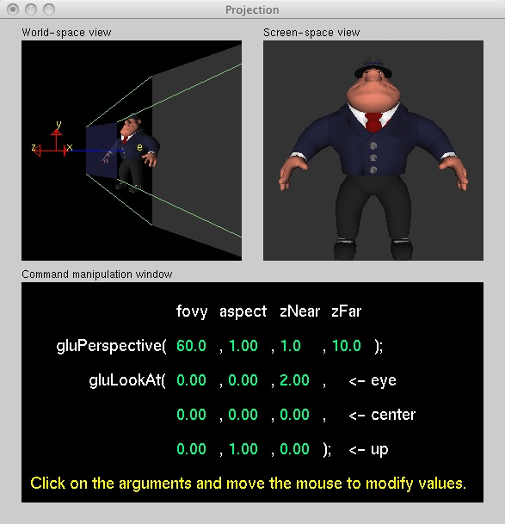
gluLookAt
  http://www.xmission.com/~nate/tutors.html
void gluLookAt( eyex, eyey, eyez, centerx, centery, centerz, upx, upy, upz)
Parameters
  eyex, eyey, eyez
    The position of the eye point.
  centerx, centery, centerz
    The position of the reference point.
  upx, upy, upz
    The direction of the up vector.

Slide 23
Perspective
void myReshape(int w, int h)
{
  glViewport(0, 0, w, h);
  /* use a perspective view */
  glMatrixMode(GL_PROJECTION);
  glLoadIdentity();
  // void glFrustum( GLdouble left, GLdouble right, GLdouble bottom, GLdouble top, GLdouble znear, GLdouble zfar);
  if(w<=h) glFrustum(-2.0, 2.0, -2.0 * (GLfloat) h/ (GLfloat) w,
    2.0* (GLfloat) h / (GLfloat) w, 2.0, 20.0);
  else glFrustum(-2.0, 2.0, -2.0 * (GLfloat) w/ (GLfloat) h,
    2.0* (GLfloat) w / (GLfloat) h, 2.0, 20.0);
  /* or we can use gluPerspective */
  /* gluPerspective(45.0, w/h, 1.0, 10.0); */
  glMatrixMode(GL_MODELVIEW);
}

Slide 24
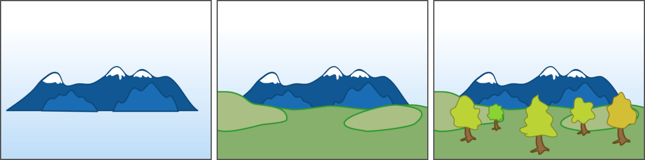
Painter's Algorithm
One way to perform hidden surface removal is called the painter's algorithm
Sort the objects by their distance from the eye
Paint the furthest things first, working your way to the front

Slide 25
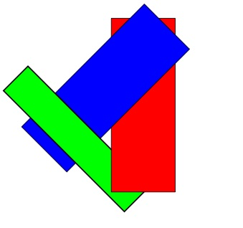
Painter's Algorithm
One difficulty is that we have to sort the objects
A second difficulty is that most objects don't have a fixed depth
We can have circular chains
We can solve the problem by throwing memory at it
Assign a buffer to hold depth of pixel
As we paint each pixel that will appear,
remember the depth in the Z-Buffer

Slide 26
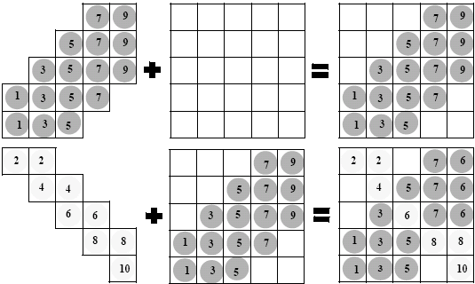
ZBuffer
We start with two images: remember color and depth

Slide 27
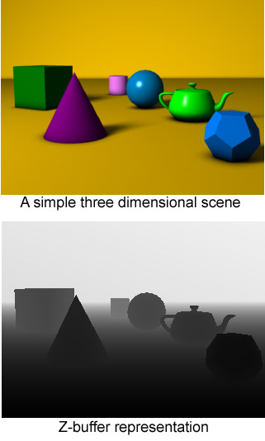
ZBuffer

Slide 28
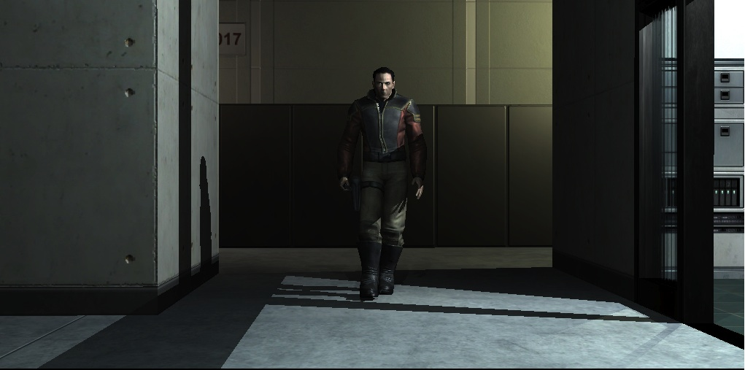
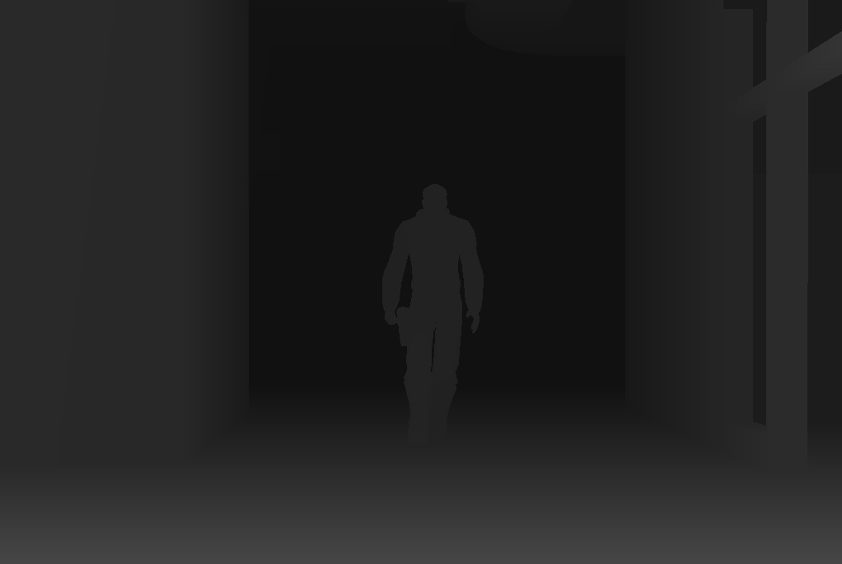
ZBuffer

Slide 29
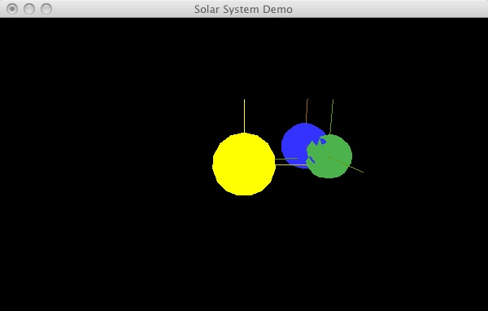
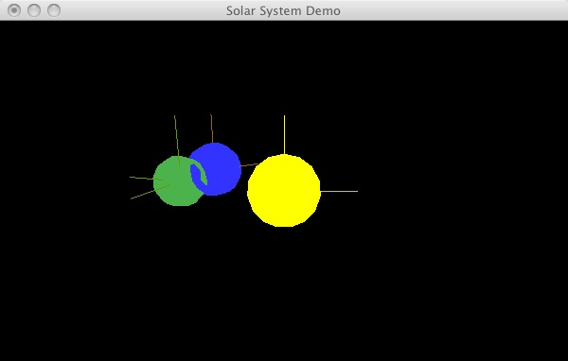
Using z-Buffer
To use the z-Buffer, you must
  1) Ask for a depth buffer when you create your window.
  2) Place a call to glEnable (GL_DEPTH_TEST) in your program's initialization routine, after a context is created and made current.
  3) Ensure that your zNear and zFar clipping planes are set correctly and in a way that provides adequate depth buffer precision. In particular, zNear and zFar should be positive (not zero or negative) values.
  4) Pass GL_DEPTH_BUFFER_BIT as a parameter to glClear
When zNear is too small, you get "z fighting"

Slide 30
cube_view.c
/* Relevant statements in cube_view.c, in order */
void display() {
  glClear(GL_COLOR_BUFFER_BIT | GL_DEPTH_BUFFER_BIT); /* 4 */
  ...
}
void myReshape(int w, int h) {
  glViewport(0, 0, w, h);
  /* use a perspective view */
  glMatrixMode(GL_PROJECTION);
  glLoadIdentity();
  if(w<=h) glFrustum(-2.0, 2.0, -2.0 * (GLfloat) h/ (GLfloat) w,
    2.0* (GLfloat) h / (GLfloat) w, 2.0, 20.0); /* 3 */
  ...
}
int main(int argc, char **argv) {
  glutInitDisplayMode(GLUT_DOUBLE | GLUT_RGB | GLUT_DEPTH); /* 1 */
  ...
  glEnable(GL_DEPTH_TEST); /* 2 */
}

Slide 31
Parametric Equations
We have seen several ways to describe a line
(1) Point-slope form
(2) General Equation
  Can describe a vertical line
(3) General Equation as dot product
(4) Two Point form
We will look at a new form
(5) Parametric –
parameterized by a variable t
First, we look at parameterized versions of other curves

Slide 32
Parametric Equations
Consider the circle
While this is a form you recognize, has problems
  It is not a function: when x = b, there are two legal values for y
  Does not give instructions on how to traverse the curve (!?!)
    Why would we worry about this?
      Important in animation: characters move on curves
An alternative is to describe the points as traced by point
  We Parameterize the point via the angle
  As theta runs from 0 to 2pi, we trace out the unit circle
The general form is as follows

Slide 33
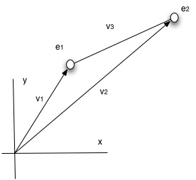
Parameterized Lines
Once again, we start with a line defined by two endpoints
We will start at e₁ and travel to e₂
Define v₁ as the vector from the origin to e₁
Define v₂ as the vector from the origin to e₂
Define v₃ = v₂ – v₁
Consider
  v₁ + tv₃ = v₁ + t(v₂ – v₁)
When t = 0, this is v₁
When t = 1, this is v₁ + (v₂-v₁) = v₂
In between, this is (1-t)v₁ + tv₂

Slide 34
Application
Do two line segments intersect?
Let's be specific: does line ( (1, 1,), (4, 3)) intersect ((5, 1), (3, 2))?
  v₃ = v₂ – v₁ = (4, 3) – (1, 1) = (3, 2)
We define the first line segment as (1, 1) + t(3, 2) = (1 + 3t, 1 + 2t)
We define the second line segment as the set of (x,y) such that (x, y)•(1, 2) = 7
We are looking to see if we can find a value of t such that
  (1 + 3t, 1 + 2t)•(1, 2) = 7
  1 + 3t + 2 + 4t = 3 + 7t = 7
  7t = 4
  t = 4/7
Since 0 ≤ t ≤ 1, point (1 + 12/7, 1 + 8/7) = (19/7, 15/7) is on the line segment L₁.
We need only check to see if it is on the line segment L₂ as well.
Check to see if the point, (19/7, 15/7) lies between the endpoints (5,1) and (3, 2)
  It does not, so the line segments do not intersect
It is even simpler if we are looking at lines parallel to axis, such as y=2
  Where does (1 + 2t = 2)? When t = 1/2.

Slide 35
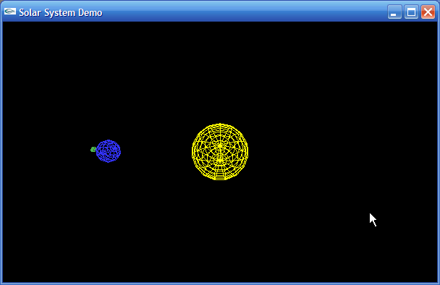
Solar
/*
* Solar.c
*
* Program to demonstrate how to use a local
* coordinate method to position parts of a
* model in relation to other model parts.
*
* Draws a simple solar system, with a sun, planet and moon.
* Based on sample code from the OpenGL programming guide
* by Woo, Neider, Davis. Addison-Wesley.
*
* Author: Samuel R. Buss
*
* Software accompanying the book
* 3D Computer Graphics: A Mathematical Introduction with OpenGL,
* by S. Buss, Cambridge University Press, 2003.
*
* Software is "as-is" and carries no warranty.
* Web page: http://math.ucsd.edu/~sbuss/MathCG
*/

Slide 36
Normal Keys
static GLenum spinMode = GL_TRUE;
static GLenum singleStep = GL_FALSE;
// These three variables control the animation's state and speed.
static float HourOfDay = 0.0;
static float DayOfYear = 0.0;
static float AnimateIncrement = 24.0; // Time step for animation (hours)
// glutKeyboardFunc is called below to set this function to handle
// all normal key presses.
static void KeyPressFunc( unsigned char Key, int x, int y ) {
  switch ( Key ) {
    case 'R':
    case 'r':
      Key_r();
      break;
    case 's':
    case 'S':
      Key_s();
      break;
    case 27: // Escape key
      exit(1);
  }
}

Slide 37
Arrow Keys
// glutSpecialFunc is called below to set this function to handle
// all special key presses. See glut.h for the names of
// special keys.
static void SpecialKeyFunc( int Key, int x, int y )
{
  switch ( Key ) {
    case GLUT_KEY_UP:
      Key_up();
      break;
    case GLUT_KEY_DOWN:
      Key_down();
      break;
  }
}

Slide 38
Interface logic
static void Key_r(void) {
  if ( singleStep ) { // If ending single step mode
    singleStep = GL_FALSE;
    spinMode = GL_TRUE; // Restart animation
  }
  else
    spinMode = !spinMode; // Toggle animation on and off.
}
static void Key_s(void) {
  singleStep = GL_TRUE;
  spinMode = GL_TRUE;
}
static void Key_up(void) {
  AnimateIncrement *= 2.0; // Double the animation time step
}
static void Key_down(void) {
  AnimateIncrement /= 2.0; // Halve the animation time step
}

Slide 39
Animate
static void Animate(void) {
  // Clear the redering window
  glClear(GL_COLOR_BUFFER_BIT | GL_DEPTH_BUFFER_BIT); /* 4 – jdp */
  if (spinMode) {
    // Update the animation state
    HourOfDay += AnimateIncrement;
    DayOfYear += AnimateIncrement/24.0;
    HourOfDay = HourOfDay - ((int)(HourOfDay/24))*24;
    DayOfYear = DayOfYear - ((int)(DayOfYear/365))*365;
  }
  // Clear the current matrix (Modelview)
  glLoadIdentity();
  // Back off eight units to be able to view from the origin.
  glTranslatef ( 0.0, 0.0, -8.0 );
// I have marked statements used to enable the zBuffer, using the numbers from our list - jdp

Slide 40
Animate
// Back off eight units to be able to view from the origin.
glTranslatef ( 0.0, 0.0, -8.0 );
// Rotate the plane of the elliptic
// (rotate the model's plane about the x axis by fifteen degrees)
glRotatef( 15.0, 1.0, 0.0, 0.0 );
// Draw the sun -- as a yellow, wireframe sphere
glColor3f( 1.0, 1.0, 0.0 );
glutWireSphere( 1.0, 15, 15 );
// Draw the Earth
// First position it around the sun
// Use DayOfYear to determine its position
glRotatef( 360.0*DayOfYear/365.0, 0.0, 1.0, 0.0 );
glTranslatef( 4.0, 0.0, 0.0 );
glPushMatrix(); // Save matrix state
// Second, rotate the earth on its axis.
// Use HourOfDay to determine its rotation.
glRotatef( 360.0*HourOfDay/24.0, 0.0, 1.0, 0.0 );

Slide 41
Animate
// Draw the Earth
// First position it around the sun
// Use DayOfYear to determine its position
glRotatef( 360.0*DayOfYear/365.0, 0.0, 1.0, 0.0 );
glTranslatef( 4.0, 0.0, 0.0 );
glPushMatrix(); // Save matrix state
// Second, rotate the earth on its axis.
// Use HourOfDay to determine its rotation.
glRotatef( 360.0*HourOfDay/24.0, 0.0, 1.0, 0.0 );
// Third, draw the earth as a wireframe sphere.
glColor3f( 0.2, 0.2, 1.0 );
glutWireSphere( 0.4, 10, 10);
glPopMatrix(); // Restore matrix state
// Draw the moon.
// Use DayOfYear to control its rotation around the earth
glRotatef( 360.0*12.0*DayOfYear/365.0, 0.0, 1.0, 0.0 );
glTranslatef( 0.7, 0.0, 0.0 );

Slide 42
Animate
  // Draw the moon.
  // Use DayOfYear to control its rotation around the earth
  glRotatef( 360.0*12.0*DayOfYear/365.0, 0.0, 1.0, 0.0 );
  glTranslatef( 0.7, 0.0, 0.0 );
  glColor3f( 0.3, 0.7, 0.3 );
  glutWireSphere( 0.1, 5, 5 );
  // Flush the pipeline, and swap the buffers
  glFlush();
  glutSwapBuffers();
  if ( singleStep ) {
    spinMode = GL_FALSE;
  glutPostRedisplay(); // Request a re-draw for animation purposes
}

Slide 43
Main
int main( int argc, char** argv ) {
  // Need to double buffer for animation
  glutInit(&argc,argv);
  glutInitDisplayMode(GLUT_DOUBLE | GLUT_RGB | GLUT_DEPTH ); /* 1 – jdp */
  // Create and position the graphics window
  glutInitWindowPosition( 0, 0 );
  glutInitWindowSize( 600, 360 );
  glutCreateWindow( "Solar System Demo" );
  // Initialize OpenGL.
  OpenGLInit();
  // Set up callback functions for key presses
  glutKeyboardFunc( KeyPressFunc );
  glutSpecialFunc( SpecialKeyFunc );
  // Set up the callback function for resizing windows
  glutReshapeFunc( ResizeWindow );
  // Callback for graphics image redrawing
  glutDisplayFunc( Animate );
  // Start the main loop. glutMainLoop never returns.
  glutMainLoop( );
  return(0); // Compiler requires this to be here. (Never reached)
}

Slide 44
Animate
// Initialize OpenGL's rendering modes
void OpenGLInit(void)
{
  glShadeModel( GL_FLAT );
  glClearColor( 0.0, 0.0, 0.0, 0.0 );
  glClearDepth( 1.0 );
  glEnable( GL_DEPTH_TEST ); /* 2 – jdp */
}

Slide 45
Animate
// ResizeWindow is called when the window is resized
static void ResizeWindow(int w, int h)
{
  float aspectRatio;
  h = (h == 0) ? 1 : h;
  w = (w == 0) ? 1 : w;
  glViewport( 0, 0, w, h ); // View port uses whole window
  aspectRatio = (float)w/(float)h;
  // Set up the projection view matrix (not very well!)
  glMatrixMode( GL_PROJECTION );
  glLoadIdentity();
  // void gluPerspective(fovy, aspectRatio, zNear, zFar);
  gluPerspective( 60.0, aspectRatio, 1.0, 30.0 ); /* 3 – jdp */
  // Select the Modelview matrix
  glMatrixMode( GL_MODELVIEW );
}

Slide 46
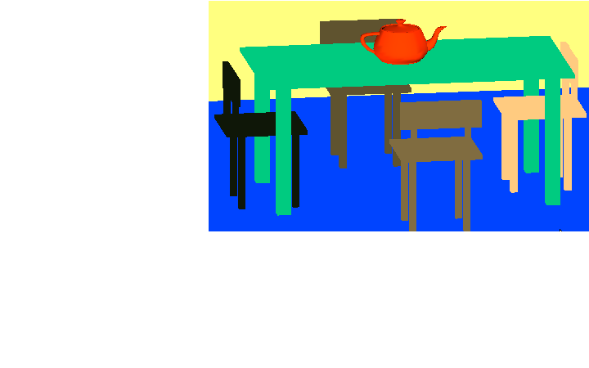
Summary
We have moved to the 3rd Dimension
We have found a way to represent translations
  Next week, look at transformations to provide perspective
We have discovered how to move the camera
  Lights! Action! Roll!
We have seen a new way to write the equation of a line
Our next two projects will be to
  1 Create a 3D scene
  2 Move the viewer through the scene
    Using turtle geometry or otherwise

Slide 47
References
Euler Angles
  http://en.wikipedia.org/wiki/Euler_angles
Nate Robins
  http://www.xmission.com/~nate/tutors.html

