Slide 1

Implementation
Ed Angel
Professor of Computer Science, Electrical and Computer Engineering, and Media Arts
University of New Mexico
Angel: Interactive Computer Graphics 4E © Addison-Wesley 2005
22

Slide 2
Objectives
Introduce basic implementation strategies
Clipping
Scan conversion
Angel: Interactive Computer Graphics 4E © Addison-Wesley 2005
23

Slide 3
Overview
At end of the geometric pipeline, vertices have been assembled into primitives
Must clip out primitives that are outside the view frustum
  Algorithms based on representing primitives by lists of vertices
Must find which pixels can be affected by each primitive
  Fragment generation
  Rasterization or scan conversion
Angel: Interactive Computer Graphics 4E © Addison-Wesley 2005
24

Slide 4
Required Tasks
Clipping
Rasterization or scan conversion
Transformations
Some tasks deferred until fragement processing
  Hidden surface removal
  Antialiasing
Angel: Interactive Computer Graphics 4E © Addison-Wesley 2005
25

Slide 5
Rasterization Meta Algorithms
Consider two approaches to rendering a scene with opaque objects
For every pixel, determine which object that projects on the pixel is closest to the viewer and compute the shade of this pixel
  Ray tracing paradigm
For every object, determine which pixels it covers and shade these pixels
  Pipeline approach
  Must keep track of depths
Angel: Interactive Computer Graphics 4E © Addison-Wesley 2005
26

Slide 6
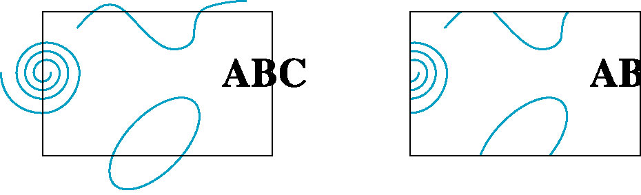
Clipping
2D against clipping window
3D against clipping volume
Easy for line segments polygons
Hard for curves and text
  Convert to lines and polygons first
Angel: Interactive Computer Graphics 4E © Addison-Wesley 2005
27

Slide 7
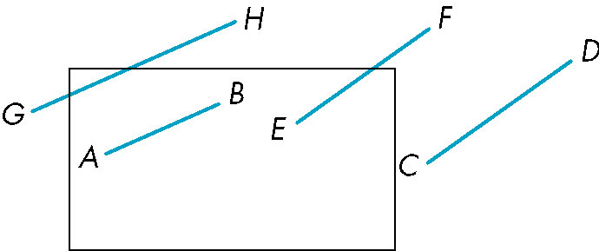
Clipping 2D Line Segments
Brute force approach: compute intersections with all sides of clipping window
  Inefficient: one division per intersection
Angel: Interactive Computer Graphics 4E © Addison-Wesley 2005
28

Slide 8
Cohen-Sutherland Algorithm
Idea: eliminate as many cases as possible without computing intersections
Start with four lines that determine the sides of the clipping window
y = y_{max}
x = x_{min}
x = x_{max}
y = y_{min}
Angel: Interactive Computer Graphics 4E © Addison-Wesley 2005
29

Slide 9
The Cases
Case 1: both endpoints of line segment inside all four lines
  Draw (accept) line segment as is
Case 2: both endpoints outside all lines and on same side of a line
  Discard (reject) the line segment
y = y_{max}
x = x_{min}
x = x_{max}
y = y_{min}
Angel: Interactive Computer Graphics 4E © Addison-Wesley 2005
30

Slide 10
The Cases
Case 3: One endpoint inside, one outside
  Must do at least one intersection
Case 4: Both outside
  May have part inside
  Must do at least one intersection
y = y_{max}
x = x_{min}
x = x_{max}
Angel: Interactive Computer Graphics 4E © Addison-Wesley 2005
31

Slide 11
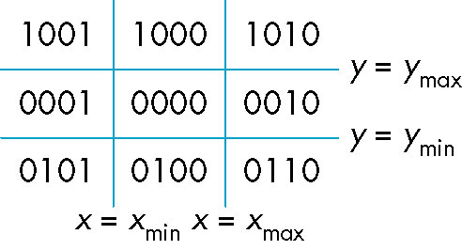
Defining Outcodes
For each endpoint, define an outcode
Outcodes divide space into 9 regions
Computation of outcode requires at most 4 subtractions
b₀b₁b₂b₃
b₀ = 1 if y > y_{max}, 0 otherwise
b₁ = 1 if y < y_{min}, 0 otherwise
b₂ = 1 if x > x_{max}, 0 otherwise
b₃ = 1 if x < x_{min}, 0 otherwise
Angel: Interactive Computer Graphics 4E © Addison-Wesley 2005
32

Slide 12
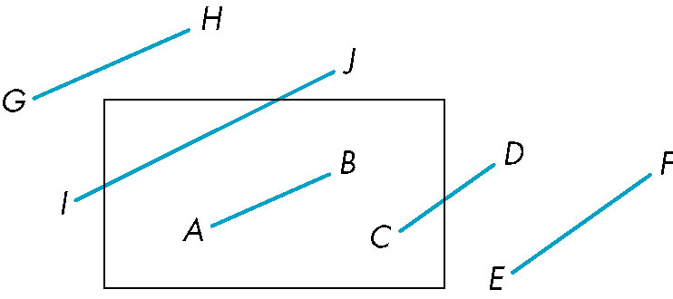
Using Outcodes
Consider the 5 cases below
AB: outcode(A) = outcode(B) = 0
  Accept line segment
Angel: Interactive Computer Graphics 4E © Addison-Wesley 2005
33

Slide 13
Using Outcodes
CD: outcode (C) = 0, outcode(D) ≠ 0
  Compute intersection
  Location of 1 in outcode(D) determines which edge to intersect with
  Note if there were a segment from A to a point in a region with 2 ones in outcode, we might have to do two interesections (see addition)
Angel: Interactive Computer Graphics 4E © Addison-Wesley 2005
34

Slide 14
Using Outcodes
EF: outcode(E) logically ANDed with outcode(F) (bitwise) ≠ 0
  Both outcodes have a 1 bit in the same place
  Thus and is non-zero
  Line segment is outside of corresponding side of clipping window
  reject
Angel: Interactive Computer Graphics 4E © Addison-Wesley 2005
35

Slide 15
Using Outcodes
GH and IJ: same outcodes, neither zero but logical AND yields zero
Shorten line segment by intersecting with one of sides of window
Compute outcode of intersection (new endpoint of shortened line segment)
Reexecute algorithm
Angel: Interactive Computer Graphics 4E © Addison-Wesley 2005
36

Slide 16
Efficiency
In many applications, the clipping window is small relative to the size of the entire data base
  Most line segments are outside one or more side of the window and can be eliminated based on their outcodes
Inefficiency when code has to be reexecuted for line segments that must be shortened in more than one step
Angel: Interactive Computer Graphics 4E © Addison-Wesley 2005
37

Slide 17
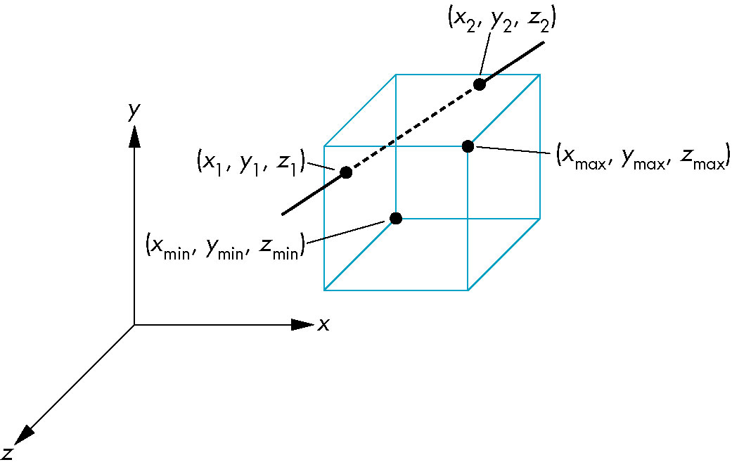
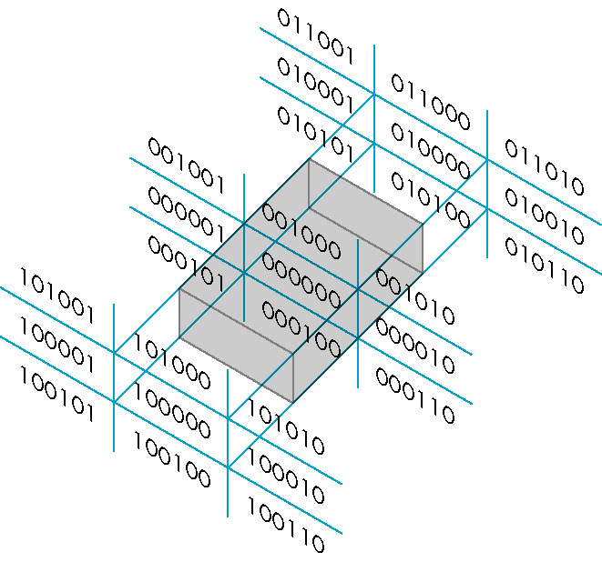
Cohen Sutherland in 3D
Use 6-bit outcodes
When needed, clip line segment against planes
Angel: Interactive Computer Graphics 4E © Addison-Wesley 2005
38

Slide 18
Liang-Barsky Clipping
Consider the parametric form of a line segment
We can distinguish between the cases by looking at the ordering of the values of α where the line determined by the line segment crosses the lines that determine the window
p(α) = (1-α)p₁+ αp₂ 1 ≥ α ≥ 0
p₂
p₁
Angel: Interactive Computer Graphics 4E © Addison-Wesley 2005
39

Slide 19
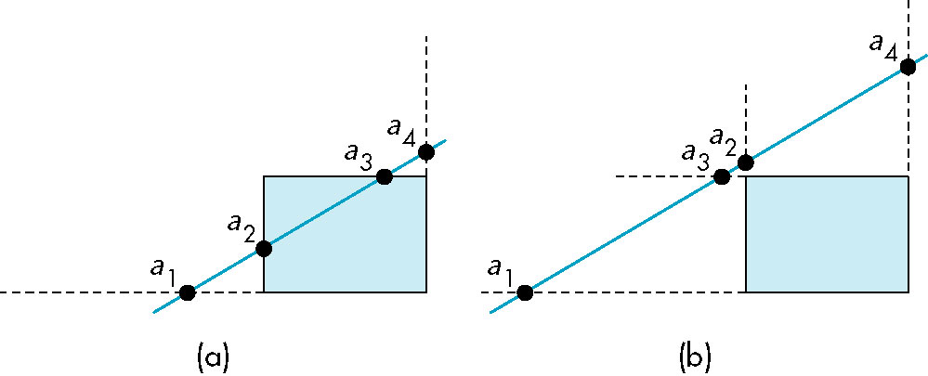
Liang-Barsky Clipping
In (a): α₄ > α₃ > α₂ > α₁
  Intersect right, top, left, bottom: shorten
In (b): α₄ > α₂ > α₃ > α₁
  Intersect right, left, top, bottom: reject
Angel: Interactive Computer Graphics 4E © Addison-Wesley 2005
40

Slide 20
Advantages
Can accept/reject as easily as with Cohen-Sutherland
Using values of α, we do not have to use algorithm recursively as with C-S
Extends to 3D
Angel: Interactive Computer Graphics 4E © Addison-Wesley 2005
41

Slide 21
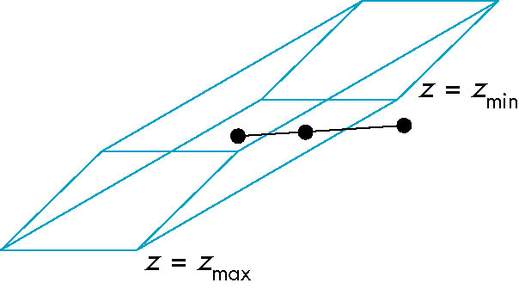
Clipping and Normalization
General clipping in 3D requires intersection of line segments against arbitrary plane
Example: oblique view
Angel: Interactive Computer Graphics 4E © Addison-Wesley 2005
42

Slide 22
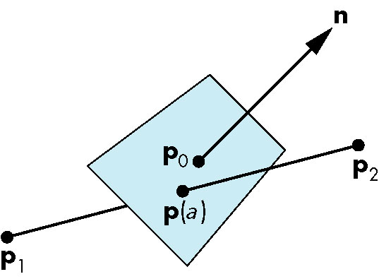
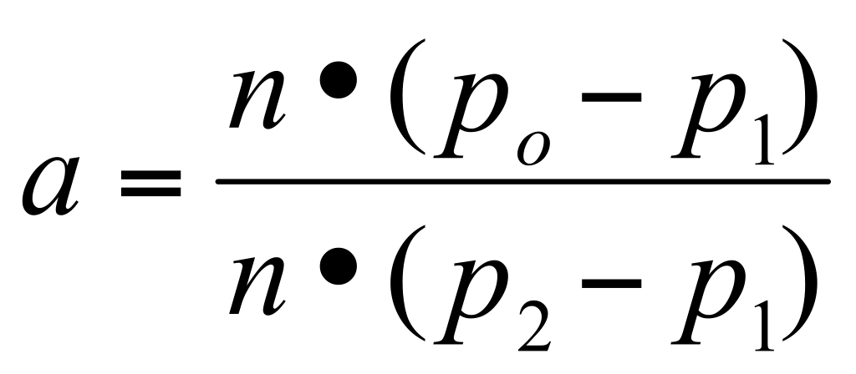
Plane-Line Intersections
Angel: Interactive Computer Graphics 4E © Addison-Wesley 2005
43

Slide 23
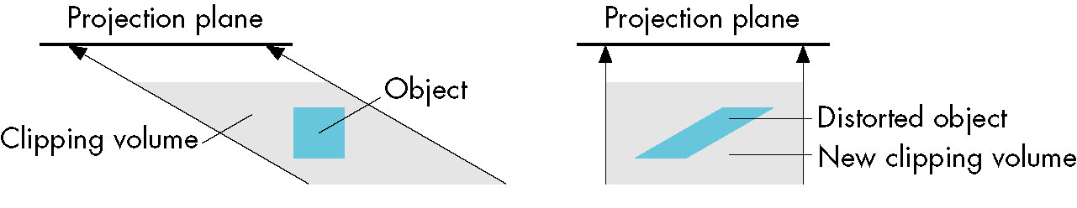
Normalized Form
top view
before normalization
after normalization
Normalization is part of viewing (pre clipping)
but after normalization, we clip against sides of
right parallelepiped
Typical intersection calculation now requires only
a floating point subtraction, e.g. is x > x_{max} ?
Angel: Interactive Computer Graphics 4E © Addison-Wesley 2005
44

Slide 24
Rasterization
Rasterization (scan conversion)
  Determine which pixels that are inside primitive specified by a set of vertices
  Produces a set of fragments
  Fragments have a location (pixel location) and other attributes such color and texture coordinates that are determined by interpolating values at vertices
Pixel colors determined later using color, texture, and other vertex properties
Angel: Interactive Computer Graphics 4E © Addison-Wesley 2005
3

Slide 25
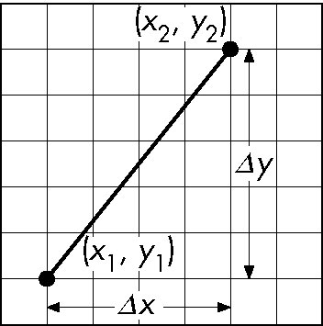
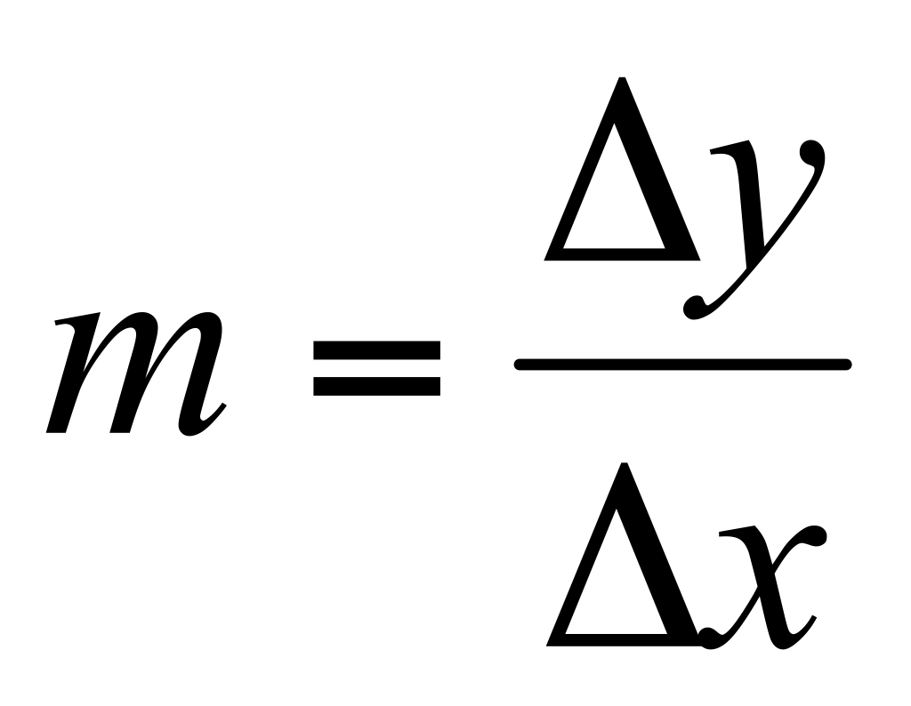
Scan Conversion of Line Segments
Start with line segment in window coordinates with integer values for endpoints
Assume implementation has a write_pixel function
y = mx + h
Angel: Interactive Computer Graphics 4E © Addison-Wesley 2005
4

Slide 26
Draw a Line
We start with the problem of drawing a line between two pixels
  Thus endpoints are integral
Without loss, assume we have line with positive slope and p1 is on left of p2
We will derive Bresenham’s algorithm

Slide 27
Take 1
m = (y2-y1)/(x2-x1);
for (x = x1; x <= x2; x++) {
  y = m*x + y1
  draw_pixel(x, y)
}

Slide 28
Speedup
m = (y2-y1)/(x2-x1);
y = y1
for (x = x1; x <= x2; x++)
  draw_pixel(x, y)
  y = y + m
Replace multiplication with addition

Slide 29
Goals
We want to draw the right pixels
(What are they?)
We want to do it quickly
We want to do it correctly
We want to handle all cases

Slide 30
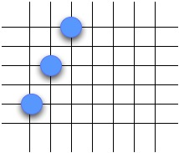
Problems
Works well if delta y <= delta x
Otherwise, we need to reverse the roles
So the “right” points mean at least one in every row and column from start to finish
We add assumption that delta y <= delta x for now

Slide 31
Problems
m = (y2-y1)/(x2-x1);
for (x = x1; x <= x2; x++)
  draw_pixel(x, m*x + y1)
m is not an integer
Values of y are not integral
But we can only draw integral pixels

Slide 32
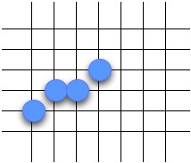
Draw Integeral Points
m = (y2-y1)/(x2-x1);
y = y1
for (x = x1; x <= x2; x++)
  draw_pixel(x, round(y))
  y = y + m
// Better - there is no round in C
  draw_pixel(x, trunc(y + 1/2))

Slide 33
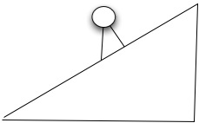
Error Term
We want to minimize the error
The best way to measure the error is the distance to the line, as measured by perpendicular
Since we have fixed slope, this is proportional to the vertical distance
We minimize by rounding (trunc(y+ 1/2))

Slide 34
Restate - move addition
m = (y2-y1)/(x2-x1);
y = y1 + 1/2
for (x = x1; x <= x2; x++)
  draw_pixel(x, trunc(y))
  y = y + m
x is an int, while m and y are real numbers
Well, m is a rational number, so y is as well

Slide 35
Split y
m = (y2-y1)/(x2-x1);
y = y1 + 1/2
Split y into two parts: integer and real
  y = yi+ yf
  0 <= yf < 1
yi = y1
yf = 1/2
y
for (x = x1; x <= x2; x++)
  draw_pixel(x, trunc(y))
  y = y + m
x is an int: m and y are real numbers

Slide 36

Restate with split y
m = (y2-y1)/(x2-x1); // 2/3 in our example
yi = y1; yf = 1/2
for (x = x1; x <= x2; x++)
  draw_pixel(x, yi)
  if (yf + m) >= 1
    yi = yi + 1;
    yf = (yf + m) - 1;
  else yf = (yf + m)
    y = y + m
x is an int: m and y are real numbers
x | yi | yf | yi | yf
0 | 1 | 1/2
1 | 1 | 1 1/6 | 2 | 1/6
2 | 2 | 5/6
3 | 2 | 1 1/2 | 3 | 1/2

Slide 37
Next change
Recall m = ∆y / ∆x = (y2-y1)/(x2-x1)
So (m * ∆x) is an integer
To convert 1/2 to an integer, multiply by 2
Let r = 2∆y + 2(yf - 1)∆x
At start yf = 1/2, so start at r = 2∆y - ∆x
Increasing yf by m is increasing r by 2∆y
Decreasing yf by 1 is decreasing r by 2∆x

Slide 38
Restate with r
m = (y2-y1)/(x2-x1);
yi = y1; r = 2(y2-y1) - (x2-x1)
for (x = x1; x <= x2; x++)
  draw_pixel(x, yi)
  if (r >= 0)
    yi = yi + 1;
    r = r - [2∆x - 2∆y]
  else r = r + 2∆y
    y = y + m
x | yi | r
0 | 1 | 1
1 | 2 | -1
2 | 2 | 3
3 | 3 | 1

Slide 39
Reconsider
?
?
All the steps seem small: let’s review
We made assumptions to simplify things
Boiled down to the following case:
As x moves from left to right, which y?
Boiled it down to two choices: old y or y+1

Slide 40
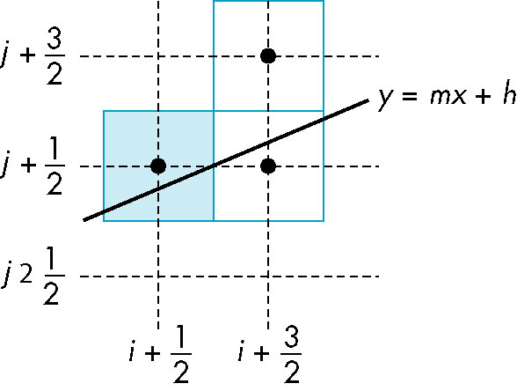
Candidate Pixels
1 ≥ m ≥ 0
candidates
last pixel
Note that line could have
passed through any
part of this pixel
Angel: Interactive Computer Graphics 4E © Addison-Wesley 2005
9

Slide 41
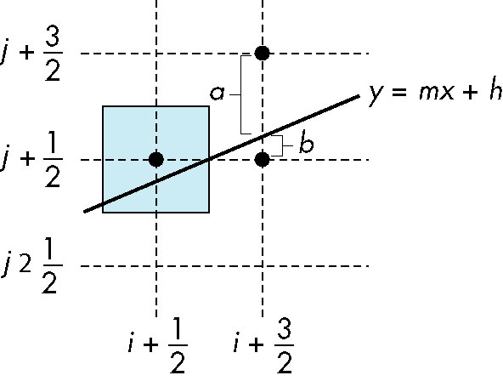
Decision Variable
d = Δx(a-b)
d is an integer
d < 0 use upper pixel
d > 0 use lower pixel
-
Angel: Interactive Computer Graphics 4E © Addison-Wesley 2005
10

Slide 42

Aliasing
Ideal rasterized line should be 1 pixel wide
Choosing best y for each x (or visa versa) produces aliased raster lines
Angel: Interactive Computer Graphics 4E © Addison-Wesley 2005
19

Slide 43
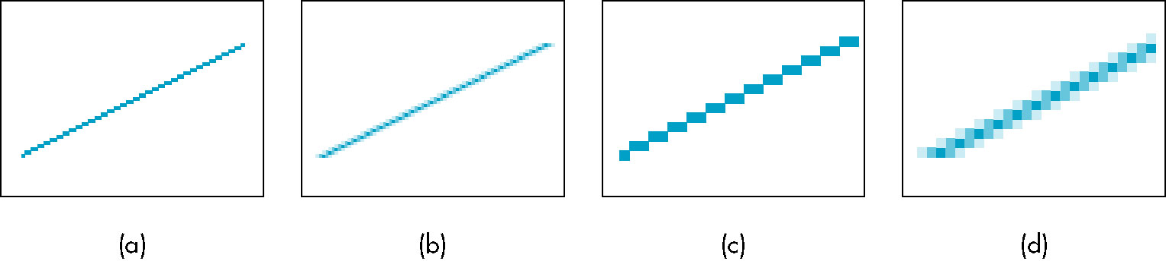
Antialiasing by Area Averaging
Color multiple pixels for each x depending on coverage by ideal line
original
antialiased
magnified
Angel: Interactive Computer Graphics 4E © Addison-Wesley 2005
20

Slide 44
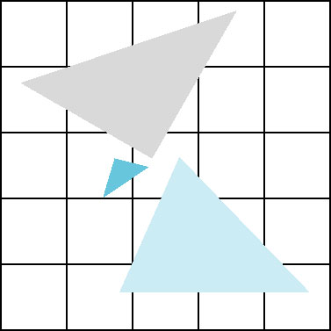
Polygon Aliasing
Aliasing problems can be serious for polygons
  Jaggedness of edges
  Small polygons neglected
  Need compositing so color
  of one polygon does not
  totally determine color of
  pixel
All three polygons should contribute to color
Angel: Interactive Computer Graphics 4E © Addison-Wesley 2005
21

Slide 45
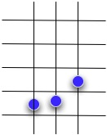
Wu Antialiasing
Xialin Wu - An Efficient Antialiasing Technique
Assume we have a function with 0 ≤ m ≤ 1
Consider this example

Slide 46

Wu Antialiasing
First point is rounded down
Second point is rounded up
This misrepresents the shape
Had we moved the graph up or down, would have digitized differently

Slide 47

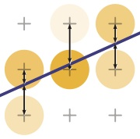

Wu Antialiasing
Idea: Bracket point with 2 pixels
  North-South when m < 1
  East-West when m > 1
Dark shade represents closeness

Slide 48
Gupta-Sproull
Wu does not address the issue of line width
Gupta and Sproull provide a way to sample
  Can deal with arbitrary line widths
Provide a lookup table to compute the samples quickly
Not as fast as Wu’s algorithm

Slide 49
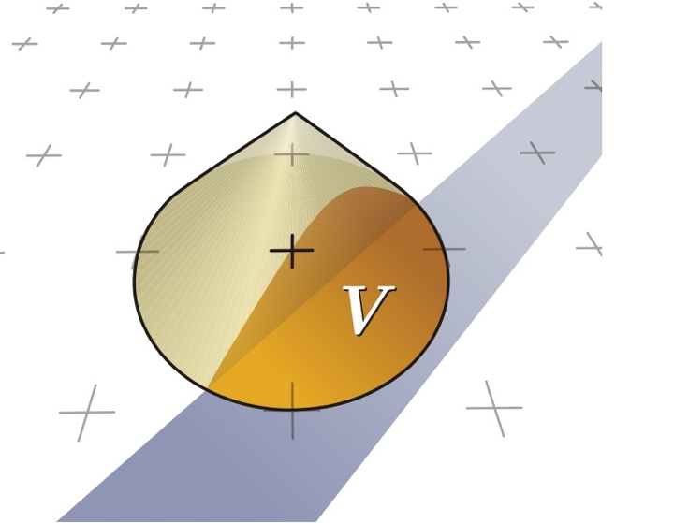
Gupta-Sproull
Problem: Wu does not address the issue of line width
Gupta and Sproull provide a way to sample
  Can deal with arbitrary line widths
Provide a way to compute the samples quickly

Slide 50
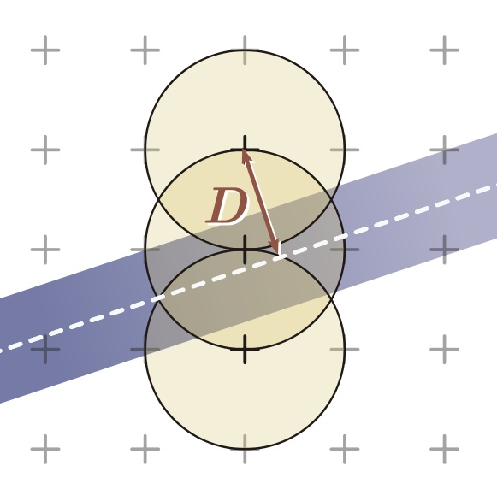
Gupta-Sproull
Problem: Wu does not address the issue of line width
Gupta and Sproull provide a way to sample
  Can deal with arbitrary line widths
Provide a way to compute the samples quickly

Slide 51
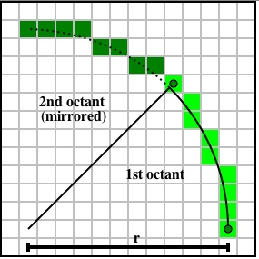
Drawing Circles
Bresenham addressed the problem of drawing circles and ellipses
We deal with range shown
Slope goes from 0 to -1
Generate other 7 octants at same time

Slide 52
Drawing Circles
Decision Function
D(x, y) = x² + y² - R²
Initialize error term
e = -D(x, y)
At each step, we update x
Do we pick y, or y-1?

Slide 53
Update Error Term
New error term based on old
D(x, y) = x² + y² - R²
If we move to (x+1, y)
D(x+1, y) = D(x, y) + 2x + 1
D(x+1, y-1) = D(x, y) + 2(x-y) + 2

Slide 54
Drawing Circles
void Circle( int cx, int cy, int radius )
{
int x = 0, y = radius, e = 1-radius;
DrawPoint( x + cx, y + cy );
while (y > x)
{
if (e < 0) // Go “east”
{
e += 2*x + 3;
}
else // Go “south-east”
{
e += 2*(x-y) + 5;
y--;
}
x++;
DrawPoint( x + cx, y + cy );
}
}

Slide 55
Drawing Circles
void Circle( int cx, int cy, int radius )
{
int x = 0, y = radius, e = 1-radius;
int incrE = 3, incrSE = -2*radius + 5
DrawPoint( x + cx, y + cy );
while (y > x)
{
if (e < 0) // Go “east”
{
e += incrE;
incrE += 2; incrSE += 2;
}
else // Go “south-east”
{
e += incrSE;
incrE += 2; incrSE += 4;
y--;
}
x++;
DrawPoint( x + cx, y + cy );
}
}

Slide 56

Polygon Scan Conversion
Scan Conversion = Fill
How to tell inside from outside
  Convex easy
  Nonsimple difficult
  Odd even test
    Count edge crossings
  Winding number
odd-even fill
Angel: Interactive Computer Graphics 4E © Addison-Wesley 2005
12

Slide 57
Winding Number
Count clockwise encirclements of point
Alternate definition of inside: inside if winding number ≠ 0
winding number = 1
winding number = 2
Angel: Interactive Computer Graphics 4E © Addison-Wesley 2005
13

Slide 58
Filling in the Frame Buffer
Fill at end of pipeline
  Convex Polygons only
  Nonconvex polygons assumed to have been tessellated
  Shades (colors) have been computed for vertices (Gouraud shading)
  Combine with z-buffer algorithm
    March across scan lines interpolating shades
    Incremental work small
Angel: Interactive Computer Graphics 4E © Addison-Wesley 2005
14

Slide 59
Using Interpolation
C₁ C₂ C₃ specified by glColor or by vertex shading
C₄ determined by interpolating between C₁ and C₂
C₅ determined by interpolating between C₂ and C₃
interpolate between C₄ and C₅ along span
C₁
C₄
C₂
scan line
C₅
span
C₃
Angel: Interactive Computer Graphics 4E © Addison-Wesley 2005
15

Slide 60
Flood Fill
Fill can be done recursively if we know a seed point located inside (WHITE)
Scan convert edges into buffer in edge/inside color (BLACK)
flood_fill(int x, int y) {
if(read_pixel(x,y)= = WHITE) {
write_pixel(x,y,BLACK);
flood_fill(x-1, y);
flood_fill(x+1, y);
flood_fill(x, y+1);
flood_fill(x, y-1);
} }
Angel: Interactive Computer Graphics 4E © Addison-Wesley 2005
16

Slide 61
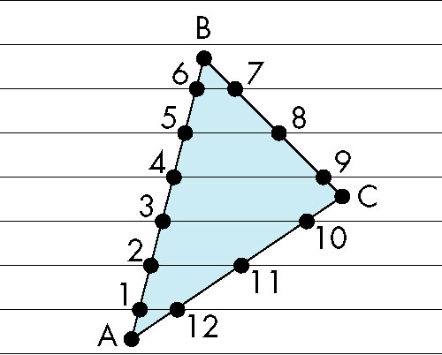
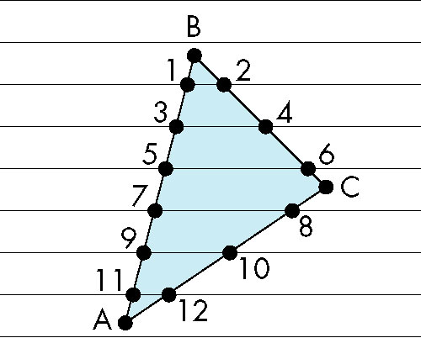
Scan Line Fill
Can also fill by maintaining a data structure of all intersections of polygons with scan lines
  Sort by scan line
  Fill each span
vertex order generated
by vertex list
desired order
Angel: Interactive Computer Graphics 4E © Addison-Wesley 2005
17

Slide 62
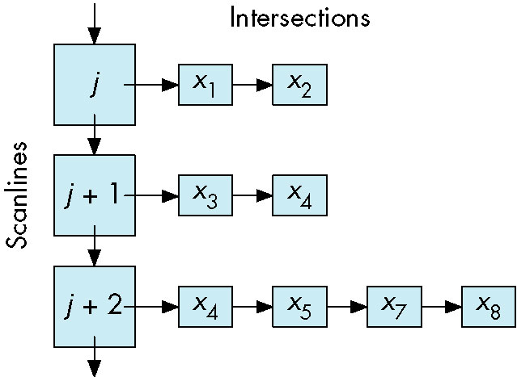
Data Structure
Angel: Interactive Computer Graphics 4E © Addison-Wesley 2005
18

