Slide 1
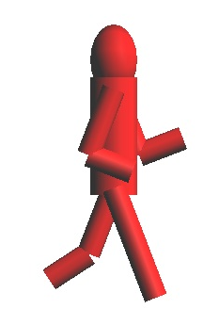
Animation
Jeff Parker, 2008
Thanks to Prof. Okan Arikan, UT Austin

Slide 2
Outline
Classical Animation
  History
  Computer Animation
Kinematics
Hierarchical Models
  Why?
  How?

Slide 3
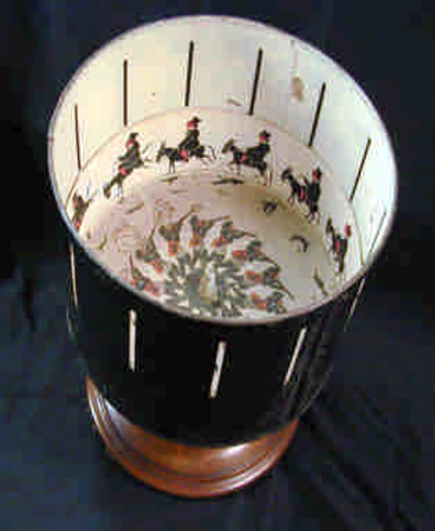
Brief History of Animation
Shadow Puppets
Persistence of Vision
  Flipbook
  Thaumotrope
  Phenakistiscope
  Zoetrope

Slide 4
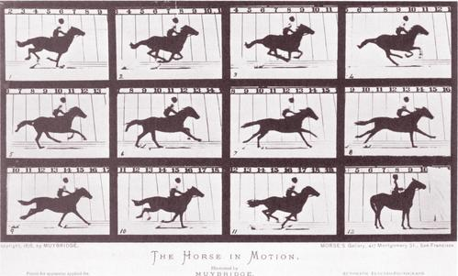
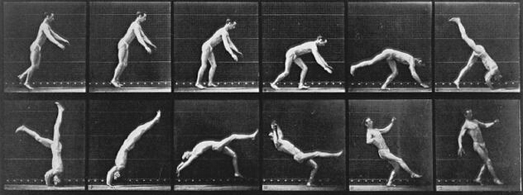
Photography
Eadweard J. Muybridge
  Standord and “Unsupported Transit”
  Solution: Muybridge and John D. Isaccs
    http://en.wikipedia.org/wiki/Eadweard_Muybridge

Slide 5
Disney’s 12 Principles of Animation
1. Squash and stretch
2. Anticipation
3. Staging
4. Straight Ahead Action and Pose to Pose
5. Follow through and overlapping action
6. Slow In and Slow Out
7. Arcs
8. Secondary Action
9. Timing
10. Exaggeration
11. Solid Drawing
12. Appeal

Slide 6
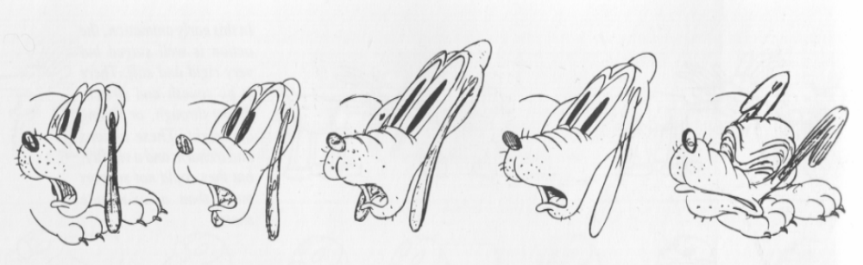
Squash and stretch
Exaggerate deformation for comedic effect.
However, the volume should remain fixed.

Slide 7
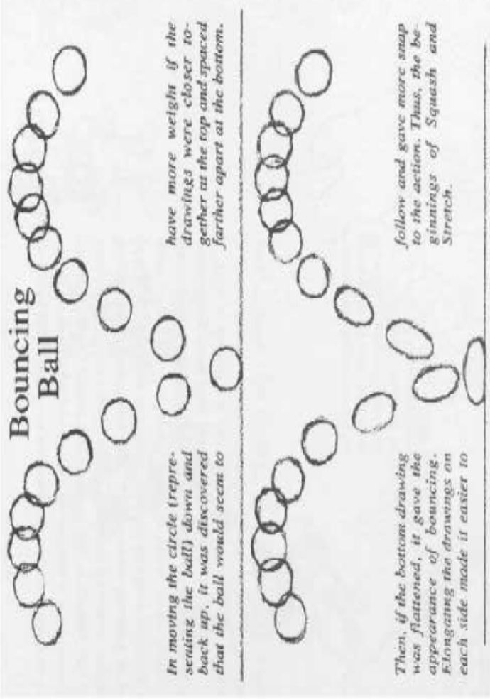
Stretch and Squash Example
Bouncing Ball
http://www.idleworm.com/how/anm/01b/bball.shtml

Slide 8
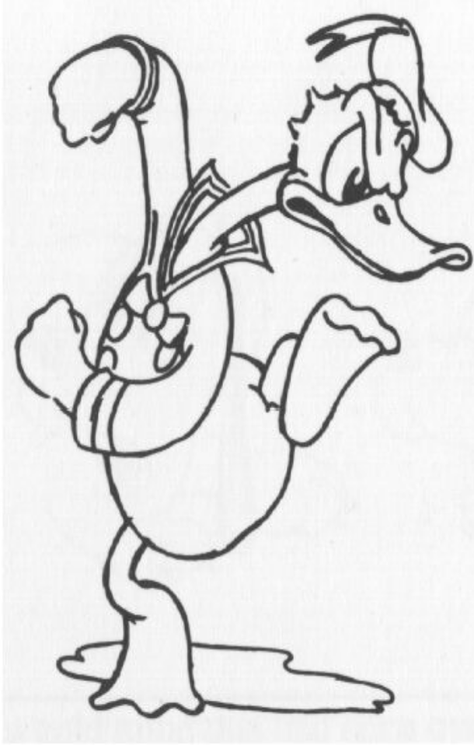
Anticipation
Direct the audience’s attention to where the action is about to happen

Slide 9
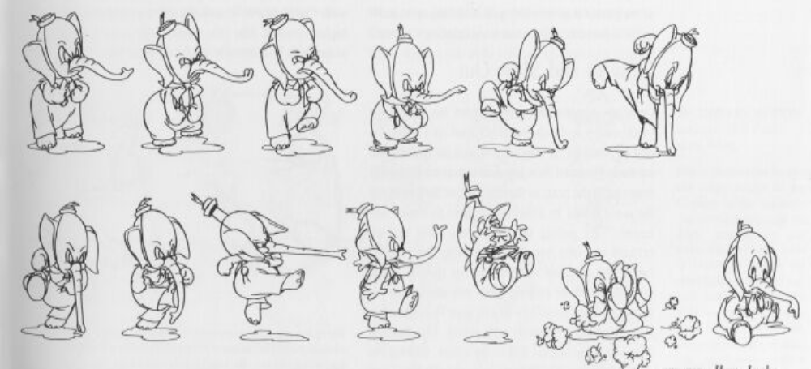
Follow through
Each action leads to the next
Audience needs to see the resolution
  50 seconds in
    http://www.youtube.com/watch?v=5V-QsiPiN_k

Slide 10
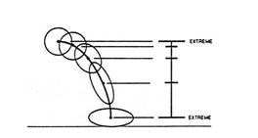
Slow In and Out
Bouncing Ball
http://www.siggraph.org/education/materials/HyperGraph/animation/character_animation/principles/bouncing_ball_example_of_slow_in_out.htm

Slide 11
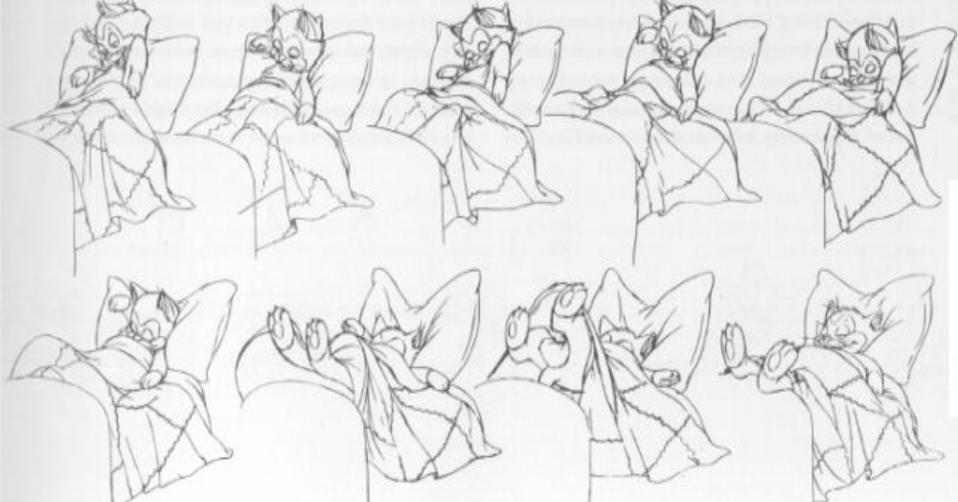
Secondary Motion
A secondary action caused by the primary action
Increases interest, if it does not detract from primary

Slide 12
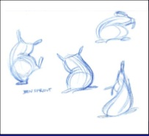
Flour Sack
Can we use these simple ideas to inject personality?
Common challenge: animate a half filled flour sack
http://www.youtube.com/watch?v=FbG3UCY-9Xw

Slide 13
Traditional Animation Process
Storyboard
  Sequence of drawings with descriptions
  Story-based description
Voice recording
  Match animation to draft soundtrack
  Final soundtrack with music and sound effects done last
Key frames
  Draw key frames as line drawings
  Fill in the intermediate images (Inbetweens)
Painting
  Paint the drawings

Slide 14
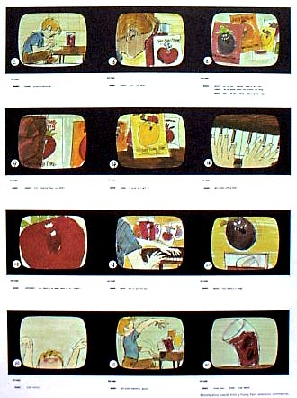
Story Board

Slide 15
Key Frames
(Keyframes) – draw key poses in a sequence
Often a way of splitting up work: senior artist draws keyframees
Novice draws the transitions - inbetweening

Slide 16
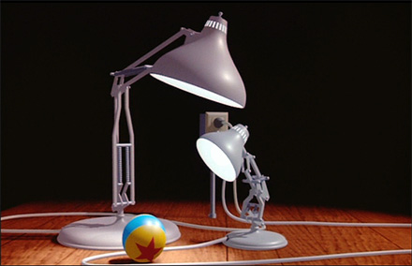
Putting it all together
Which effects you can recognize in Pixar's Luxo Jr?
  Graphical effects
  Taditional animation effects
How does Lasseter convey personality? Emotions?
How does he direct your attention?
http://www.youtube.com/watch?v=PvCWPZfK8pI

Slide 17
Kinematics
Given a description of a system, describe how it moves
Interested in positions of each component, not in the speed

Slide 18
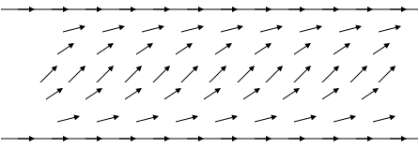
Kinematics
Kinematics
  Considers only motion given the disposition
Dynamics
  Considers underlying forces
  Compute motion from initial conditions and physics
    Easy to do with particles

Slide 19
Sample Point system
We often use differential equations to model behavior
Our particles are corks bobbing in sea currents
Differential equations define a vector field
Our goal is to follow the path of a cork

Slide 20
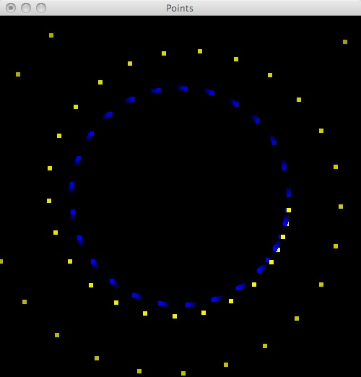
Evaluating path
The program pointDiffyQ.c
compares two ways to follow paths
  Euler method - yellow
  Trapezoid method – blue
The point this visualization tries to make is that the additional work for the trapazoid method gives a much more stable solution
Higher order methods, such as Runge-Kutta, are not much more work, but are much more stable

Slide 21
Animation
/* One step of the animation */
void tic()
{ ...
updatePoint(euler[i], deltaT);
}
/* The timer has rung: update the animation */
static void timerCallback (int value)
{
tic();
glutTimerFunc (value, timerCallback, value);
}
int main(int argc, char** argv)
{ ...
glutTimerFunc (100, timerCallback, 50);
glutMainLoop();
...
}

Slide 22
Fountain of points
/* One step of the animation */
void tic()
{
static int count = 0;
if (count < 2*NUM_BALLS)
{
if (count % 2) {
euler[count/2] = malloc(sizeof(struct point));
initPoint(euler[count/2]);
}
else {
rk[count/2] = malloc(sizeof(struct point));
initPoint(rk[count/2]);
}
count++;
}

Slide 23
Euler Update
/* dx/dt: how x will change this step */
double xprime(double x, double y)
{
return (cy - y);
}
/* dy/dt: how y will change this step */
double yprime(double x, double y)
{
return (x - cx);
}
/* Use the slope at (x, y) to predict the next step */
/* This is simple, but not very good */
void eulerUpdate(double x, double y, double *newx, double *newy, double deltaT)
{
*newx = x + deltaT*xprime(x, y);
*newy = y + deltaT*yprime(x, y);
}

Slide 24
Trapezoid Update
double xprime(double x, double y);
double yprime(double x, double y);
/* Average slope at (x, y)
* and the slope at the endpoint Euler would predict */
/* This is better than simple Euler */
void trapUpdate(double x, double y, double *newx, double *newy, double deltaT)
{
double approxX = x + deltaT*xprime(x, y);
double approxY = y + deltaT*yprime(x, y);
*newx = x + deltaT*(xprime(x, y) + xprime(approxX, approxY))/2.0;
*newy = y + deltaT*(yprime(x, y) + yprime(approxX, approxY))/2.0;
}

Slide 25
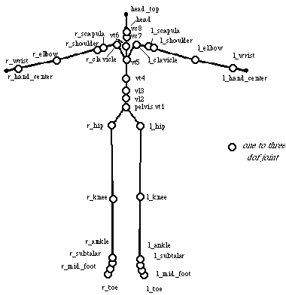
Hierarchical Modeling
System needs to be complex to capture realistic movement
You have over two dozen bones in each foot
We will settle for less
What is focus for figure running?
  Core
  Foot on the ground
Look at a very small example

Slide 26
Kinematics
x₂
This simple system is described by two angles
Given a₁, θ₁, a₂ and θ₂
We can compute O₁, O₂
This is Forward Kinematics
y₂
O₂
y₀
a₂
y₁
θ₂
x₁
a₁
O₁
θ₁
x₀
O₀

Slide 27
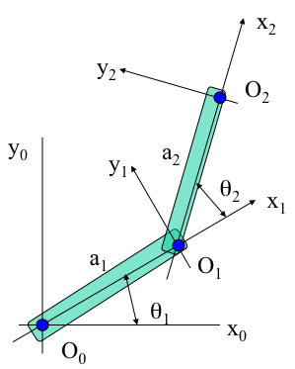
Forward Kinematics

Slide 28
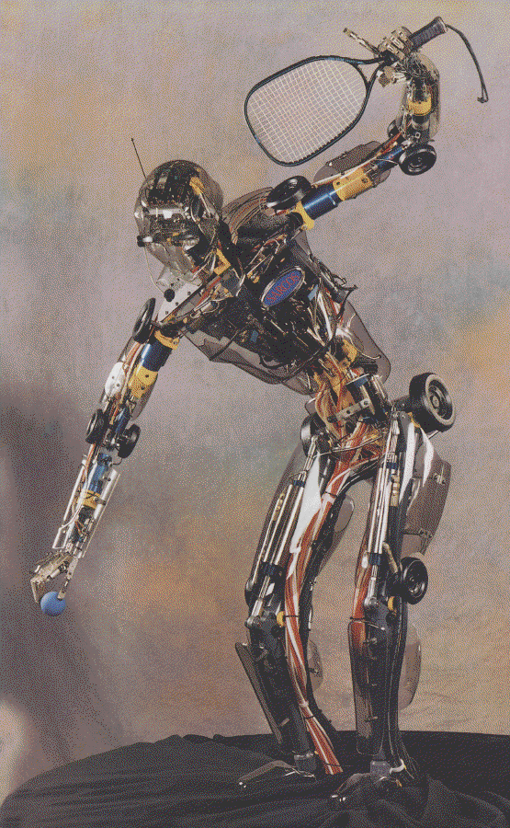
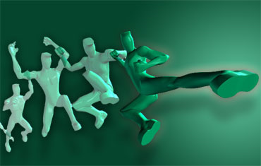
Inverse Kinematics
Given a complex system, figure out how to make it reach an object
Typically we position a tool
  Pen for writing
  Soldering Gun
  Tongue for eating snowflakes
Description is a vector of joint angles
Or a sequence of such vectors
Jeff Lew

Slide 29
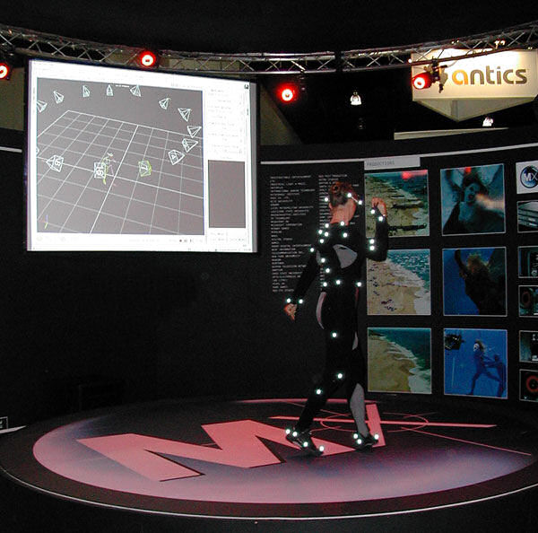
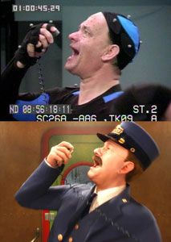
Motion Capture
One way to solve the problem
Record motion from live actor
Tom Hanks in Polar Express

Slide 30
Work Space vs. Configuration Space
Work space
  Object space: 3D for our Burning Man
  Dimensionality:
    R³ for most things
    R² for our extended example
Configuration space
  The space of possible object configurations
    Often much higher dimension than work space
  Degrees of Freedom
    The number of parameters that necessary and sufficient to define position in configuration

Slide 31
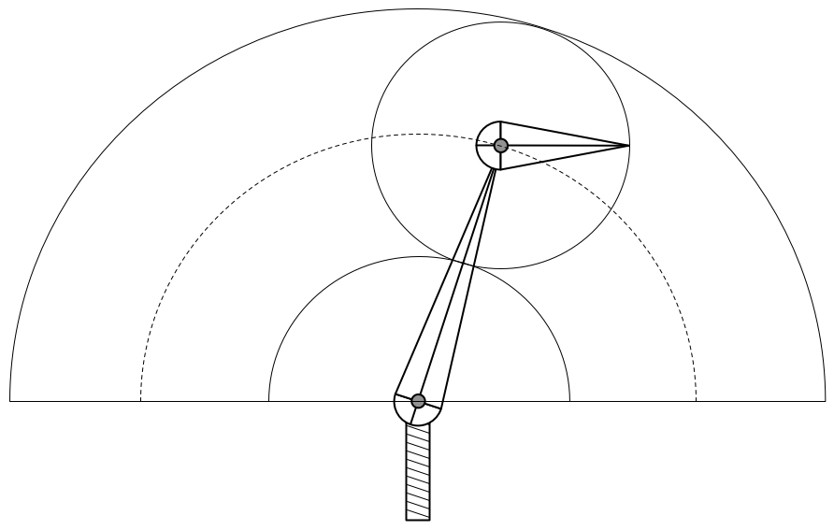
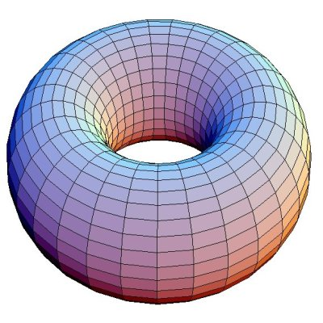
Return to our Example
Work space: 2D Washer
Configuration Space: 2D Torus (2π == 0)
  Ambiguity in the middle: two ways to reach a position
    Elbow up or down?
  Singularities at the boundaries of Work Space

Slide 32
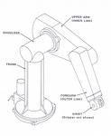
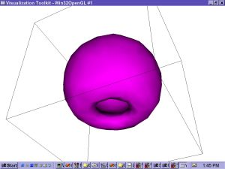
Puma Robot
Degrees of Freedom?
  Base
  Shoulder
  Elbow
  Wrist
Work space
http://www.youtube.com/watch?v=kEed8DVO21I

Slide 33
Solving Inverse Kinematics
Given end effector position, compute required joint angles
In simple case, analytic solution exists
  Use trig, geometry, and algebra to solve
In larger examples, need to use Numerical Methods
Why is the problem hard?
  Solutions may not exist
  Might not be unique
In our case, solution is simple
  Compute distance from tip to tail
  Position second arm for distance,
  First arm to position it

Slide 34
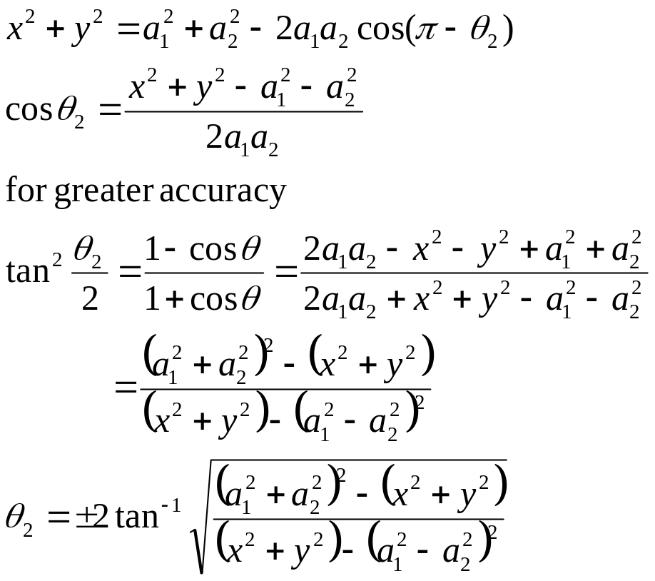
x₂
y₂
(x,y)
O₂
θ₂
y₀
y₁
a₂
θ₂
x₁
ψ
a₁
O₁
φ
θ₁
Twin solutions: elbow up or down
x₀
O₀

Slide 35
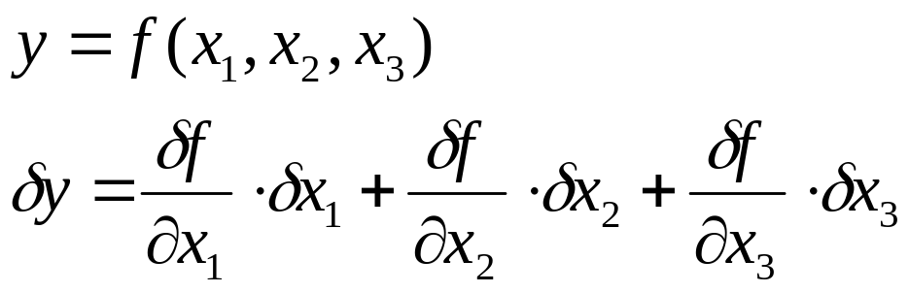
Iterative Solutions
Frequently it is not possible to find a closed form
One technique is to use the multi-dimensional derivative
The Jacobian is the the derivative relative to each input
If y is function of three inputs and one output

Slide 36
Compute Jacobian
In our case, Jacobian is a square matrix since dimension of configuration space = dimension of the work space
  Not true for 3 segment planar linkage, or the Puma
To move towards a goal, invert the Jacobian and use that as directive on where to start to move
Make small change, recompute Jacobian, and try again

Slide 37
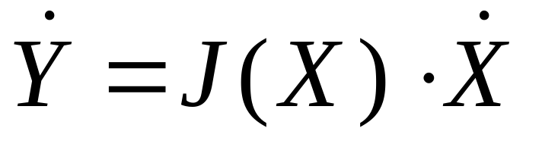
Jacobian
The Jacobian tells us how the output changes as we change the input
We know current position of the effector, and know where we want it
  The difference is Delta Y (Y dot)
We want to find Delta X (X dot) that gets us there
  Invert the Jacobian and solve for Delta X

Slide 38
Invert Jacobian
We can invert non-singular square matrices
There is also a pseudo inverse that can be used if the matrix is not square
Inverting a 2x2 matrix is especially easy
Jacobian is non-singular when we can divide by (ad-bc)

Slide 39
Singularities
Consider the case when the angles are both 0
  Linkage lies on x axis
Assume we wish to move endpoint towards origin
Small changes in either angle move us in y direction
  Happens whenever linkage touches rim of workspace:
    when θ₂ = 0 or π Below, we have used 0
Solution – Jiggle the linkage and try again

Slide 40
Hierarchical Models
Examine the limitations of linear modeling
  Symbols and instances
Introduce hierarchical models
  Articulated models
  Robots
Introduce Tree and DAG models
Angel: Interactive Computer Graphics 4E © Addison-Wesley 2005

Slide 41
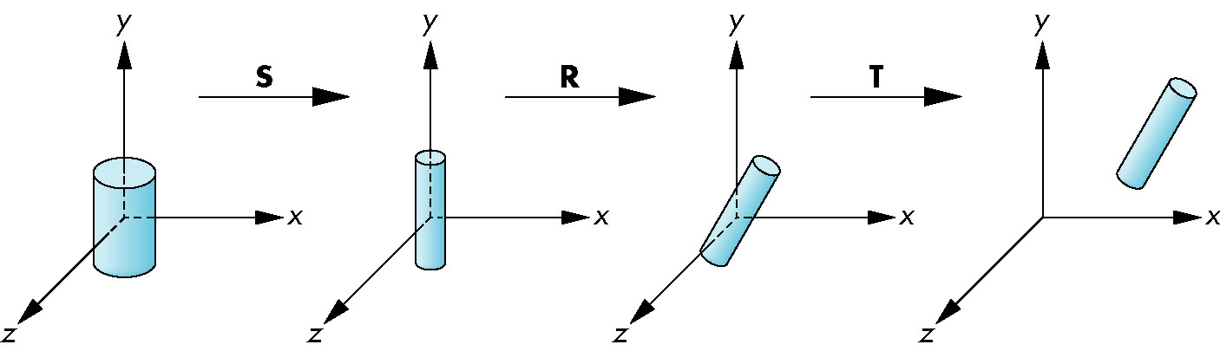
Instance Transformation
Start with a prototype object (a symbol)
Each appearance of the object in the model is an instance
  Must scale, orient, position
  Defines instance transformation
Angel: Interactive Computer Graphics 4E © Addison-Wesley 2005

Slide 42
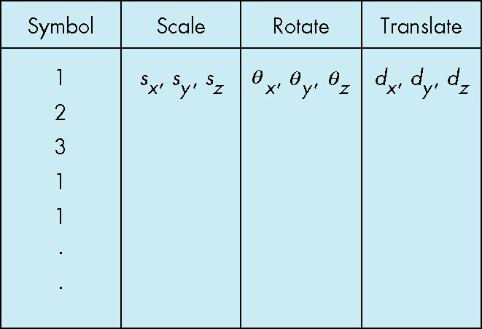
Symbol-Instance Table
Can store a model by assigning a number to each symbol and storing the parameters for the instance transformation
Angel: Interactive Computer Graphics 4E © Addison-Wesley 2005

Slide 43
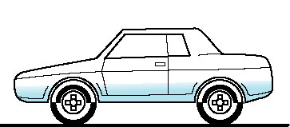
Relationships in Car Model
Symbol-instance table does not show relationships between parts of model
Consider model of car
  Chassis + 4 identical wheels
  Two symbols
Rate of forward motion determined by rotational speed of wheels
Angel: Interactive Computer Graphics 4E © Addison-Wesley 2005

Slide 44
Structure Through Function Calls
car(speed)
{
chassis()
wheel(right_front);
wheel(left_front);
wheel(right_rear);
wheel(left_rear);
}
Fails to show relationships well
Look at problem using a graph
Angel: Interactive Computer Graphics 4E © Addison-Wesley 2005

Slide 45
Tree
Graph in which each node (except the root) has exactly one parent node
  May have multiple children
  Leaf or terminal node: no children
root node
leaf node
Angel: Interactive Computer Graphics 4E © Addison-Wesley 2005

Slide 46
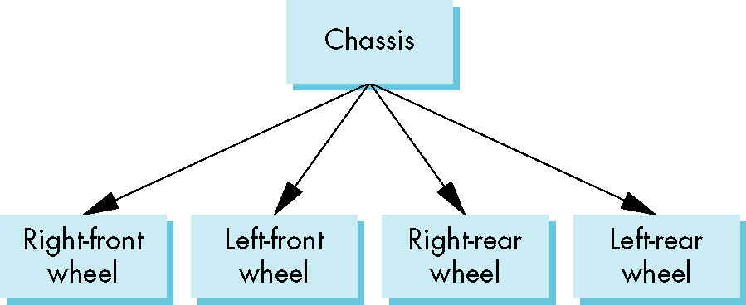
Tree Model of Car
Angel: Interactive Computer Graphics 4E © Addison-Wesley 2005

Slide 47
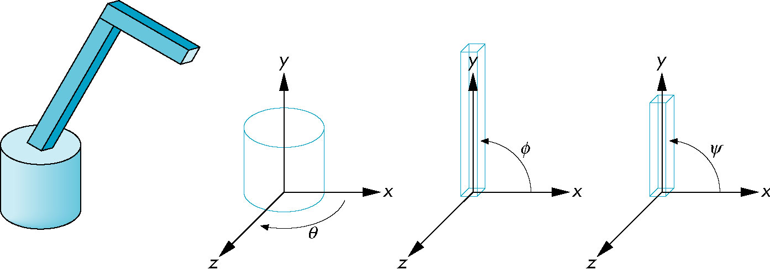
Robot Arm
parts in their own
coodinate systems
robot arm
Angel: Interactive Computer Graphics 4E © Addison-Wesley 2005

Slide 48
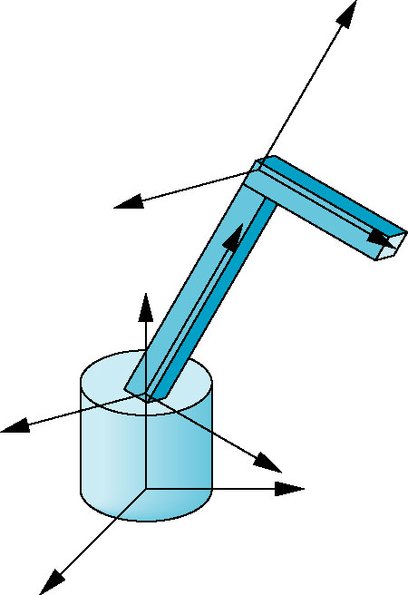
Articulated Models
Robot arm is an example of an articulated model
  Parts connected at joints
  Can specify state of model by
  giving all joint angles
Angel: Interactive Computer Graphics 4E © Addison-Wesley 2005

Slide 49
Relationships in Robot Arm
Base rotates independently
  Single angle determines position
Lower arm attached to base
  Its position depends on rotation of base
  Must also translate relative to base and rotate about connecting joint
Upper arm attached to lower arm
  Its position depends on both base and lower arm
  Must translate relative to lower arm and rotate about joint connecting to lower arm
Angel: Interactive Computer Graphics 4E © Addison-Wesley 2005

Slide 50
Required Matrices
Rotation of base: R_{b}
  Apply M = R_{b} to base
Translate lower arm relative to base: T_{lu}
Rotate lower arm around joint: R_{lu}
  Apply M = R_{b} T_{lu} R_{lu} to lower arm
Translate upper arm relative to upper arm: T_{uu}
Rotate upper arm around joint: R_{uu}
  Apply M = R_{b} T_{lu} R_{lu} T_{uu} R_{uu} to upper arm
Angel: Interactive Computer Graphics 4E © Addison-Wesley 2005

Slide 51
OpenGL Code for Robot
robot_arm()
{
glRotate(theta, 0.0, 1.0, 0.0);
base();
glTranslate(0.0, h1, 0.0);
glRotate(phi, 0.0, 1.0, 0.0);
lower_arm();
glTranslate(0.0, h2, 0.0);
glRotate(psi, 0.0, 1.0, 0.0);
upper_arm();
}
Angel: Interactive Computer Graphics 4E © Addison-Wesley 2005

Slide 52
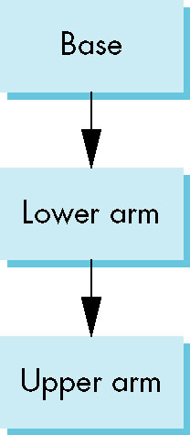
Tree Model of Robot
Note code shows relationships between parts of model
  Can change “look” of parts easily without altering relationships
Simple example of tree model
Want a general node structure for nodes
Angel: Interactive Computer Graphics 4E © Addison-Wesley 2005

Slide 53
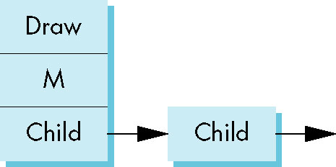
Possible Node Structure
Code for drawing part or
pointer to drawing function
linked list of pointers to children
matrix relating node to parent
Angel: Interactive Computer Graphics 4E © Addison-Wesley 2005

Slide 54
Generalizations
Need to deal with multiple children
  How do we represent a more general tree?
  How do we traverse such a data structure?
Animation
  How to use dynamically?
  Can we create and delete nodes during execution?
Angel: Interactive Computer Graphics 4E © Addison-Wesley 2005

Slide 55
Objectives
Build a tree-structured model of a humanoid figure
Examine various traversal strategies
Build a generalized tree-model structure that is independent of the particular model
Angel: Interactive Computer Graphics 4E © Addison-Wesley 2005

Slide 56
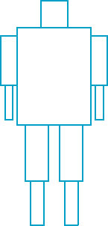
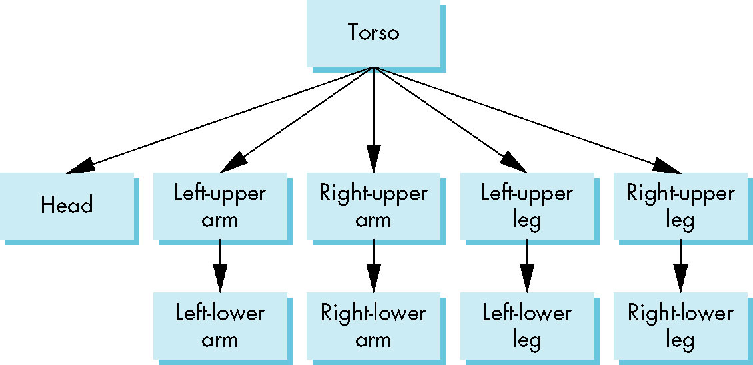
Humanoid Figure
Angel: Interactive Computer Graphics 4E © Addison-Wesley 2005

Slide 57
Building the Model
Can build a simple implementation using quadrics: ellipsoids and cylinders
Access parts through functions
  torso()
  left_upper_arm()
Matrices describe position of node with respect to its parent
  M_{lla} positions left lower leg with respect to left upper arm
Angel: Interactive Computer Graphics 4E © Addison-Wesley 2005

Slide 58
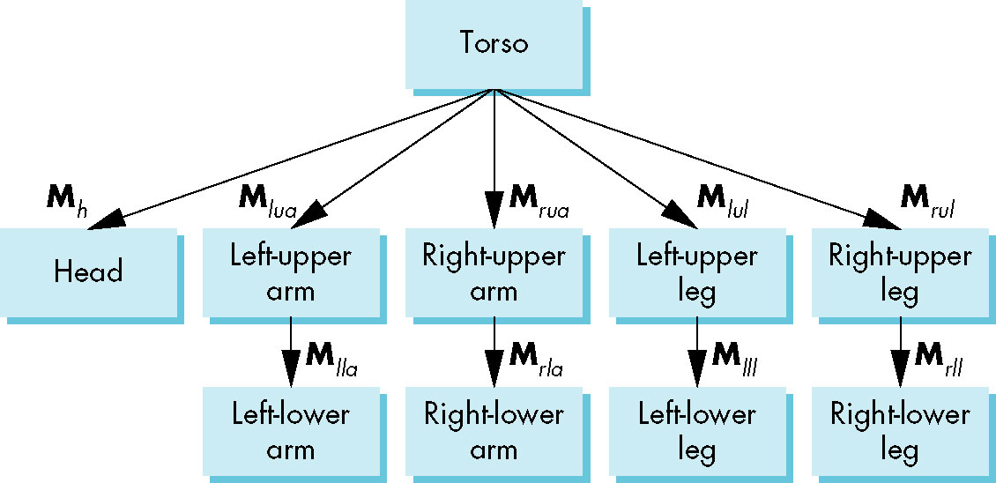
Tree with Matrices
Angel: Interactive Computer Graphics 4E © Addison-Wesley 2005

Slide 59
Display and Traversal
The position of the figure is determined by 11 joint angles (two for the head and one for each other part)
Display of the tree requires a graph traversal
  Visit each node once
  Display function at each node that describes the part associated with the node, applying the correct transformation matrix for position and orientation
Angel: Interactive Computer Graphics 4E © Addison-Wesley 2005

Slide 60
Transformation Matrices
There are 10 relevant matrices
  M positions and orients entire figure through the torso which is the root node
  M_{h} positions head with respect to torso
  M_{lua}, M_{rua}, M_{lul}, M_{rul} position arms and legs with respect to torso
  M_{lla}, M_{rla}, M_{lll}, M_{rll} position lower parts of limbs with respect to corresponding upper limbs
Angel: Interactive Computer Graphics 4E © Addison-Wesley 2005

Slide 61
Stack-based Traversal
Set model-view matrix to M and draw torso
Set model-view matrix to MM_{h} and draw head
For left-upper arm need MM_{lua} and so on
Rather than recomputing MM_{lua} from scratch or using an inverse matrix, we can use the matrix stack to store M and other matrices as we traverse the tree
Angel: Interactive Computer Graphics 4E © Addison-Wesley 2005

Slide 62
Traversal Code
save present model-view matrix
figure() {
glPushMatrix()
torso();
glRotate3f(…);
head();
glPopMatrix();
glPushMatrix();
glTranslate3f(…);
glRotate3f(…);
left_upper_arm();
glPopMatrix();
glPushMatrix();
update model-view matrix for head
recover original model-view matrix
save it again
update model-view matrix
for left upper arm
recover and save original
model-view matrix again
rest of code
Angel: Interactive Computer Graphics 4E © Addison-Wesley 2005

Slide 63
Analysis
The code describes a particular tree and a particular traversal strategy
  Can we develop a more general approach?
Note that the sample code does not include state changes, such as changes to colors
  May also want to use glPushAttrib and glPopAttrib to protect against unexpected state changes affecting later parts of the code
Angel: Interactive Computer Graphics 4E © Addison-Wesley 2005

Slide 64
General Tree Data Structure
Need a data structure to represent tree and an algorithm to traverse the tree
We will use a left-child right sibling structure
  Uses linked lists
  Each node in data structure is two pointers
  Left: next node
  Right: linked list of children
Angel: Interactive Computer Graphics 4E © Addison-Wesley 2005

Slide 65
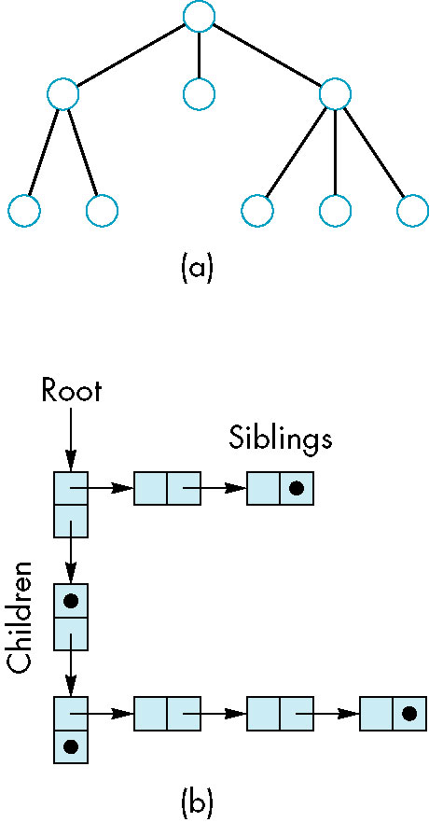
Left-Child Right-Sibling Tree
Angel: Interactive Computer Graphics 4E © Addison-Wesley 2005

Slide 66
Left-Child Right-Sibling Tree
I cannot make sense of Angel's drawing
Here is my version of this tree
Left pointer is to first child
Right pointer is to sibling
Angel: Interactive Computer Graphics 4E © Addison-Wesley 2005

Slide 67
Tree node Structure
At each node we need to store
  Pointer to sibling
  Pointer to child
  Pointer to a function that draws the object represented by the node
  Homogeneous coordinate matrix to multiply on the right of the current model-view matrix
    Represents changes going from parent to node
    In OpenGL this matrix is a 1D array storing matrix by columns
Angel: Interactive Computer Graphics 4E © Addison-Wesley 2005

Slide 68
C Definition of treenode
typedef struct treenode
{
GLfloat m[16];
void (*f)();
struct treenode *sibling;
struct treenode *child;
} treenode;
Angel: Interactive Computer Graphics 4E © Addison-Wesley 2005

Slide 69
Defining the torso node
treenode torso_node, head_node, lua_node, … ;
/* use OpenGL functions to form matrix */
glLoadIdentity();
glRotatef(theta[0], 0.0, 1.0, 0.0);
/* move model-view matrix to m */
glGetFloatv(GL_MODELVIEW_MATRIX, torso_node.m)
torso_node.f = torso; /* torso() draws torso */
Torso_node.sibling = NULL;
Torso_node.child = &head_node;
Angel: Interactive Computer Graphics 4E © Addison-Wesley 2005

Slide 70
Notes
The position of figure is determined by 11 joint angles stored in theta[11]
Animate by changing the angles and redisplaying
We form the required matrices using glRotate and glTranslate
  More efficient than software
  Because the matrix is formed in model-view matrix, we may want to first push original model-view matrix on matrix stack
Angel: Interactive Computer Graphics 4E © Addison-Wesley 2005

Slide 71
Preorder Traversal
void traverse(treenode *root)
{
if(root == NULL) return;
glPushMatrix();
glMultMatrix(root->m);
root->f();
if(root->child != NULL)
traverse(root->child);
glPopMatrix();
if(root->sibling != NULL)
traverse(root->sibling);
}
Angel: Interactive Computer Graphics 4E © Addison-Wesley 2005

Slide 72
Notes
We must save model-view matrix before multiplying it by node matrix
  Updated matrix applies to children of node but not to siblings which contain their own matrices
The traversal program applies to any left-child right-sibling tree
  The particular tree is encoded in the definition of the individual nodes
The order of traversal matters because of possible state changes in the functions
Angel: Interactive Computer Graphics 4E © Addison-Wesley 2005

Slide 73
Dynamic Trees
If we use pointers, the structure can be dynamic
typedef treenode *tree_ptr;
tree_ptr torso_ptr;
torso_ptr = malloc(sizeof(treenode));
Definition of nodes and traversal are essentially the same as before but we can add and delete nodes during execution
Angel: Interactive Computer Graphics 4E © Addison-Wesley 2005

Slide 74
Keyframes
T = 0 | 1.5 | 2 | 3
θ₁= 45 | 90 | 45 | 90
θ₂= 0 | 15 | 30 | 45
θ₃= 180 | 175 | 200 | 120
To reduce the work of animating, define key frames
Two dimensional array: time vs angle
  Each column has all the angles for one pose
Interpolate between key frames
Metadata might include
  Time, so poses are not at fixed intervals
  Movement between poses – linear? Slow in, out?

Slide 75
Sumary
Review steps
  Model
  Scripting – how the models will move
    Inverse Kinematics, Dynamic Modeling
  Inbetweening to thread between steps in the script
  Rendering
  Image processing – post processing for effects
Animation is a huge industry
Computers are widely used
Goal is to remove the tedium, while preserving room for artistry

Slide 76
Resources
Muybridge http://en.wikipedia.org/wiki
  http://www.youtube.com/watch?v=Q8X0sHS0g8A
Classic Animation http://www.idleworm.com/how/anm/01b/bball.shtml
http://www.siggraph.org/education/materials/HyperGraph/animation/character_animation/principles/bouncing_ball_example_of_slow_in_out.htm
Ball + Flour sack: http://www.youtube.com/watch?v=FbG3UCY-9Xw
Walk cycle http://www.angryanimator.com/word/2008/11/01/animation-tutorial-2-walk-cycle/
Luxo, Jr http://www.youtube.com/watch?v=PvCWPZfK8pI
Puma Robot http://www.youtube.com/watch?v=kEed8DVO21I
Wall-E Trailer http://www.youtube.com/watch?v=TpDcVDAPAeo

