Slide 1
Mandlebrot Explorer
© Jeff Parker, 2009

Slide 2
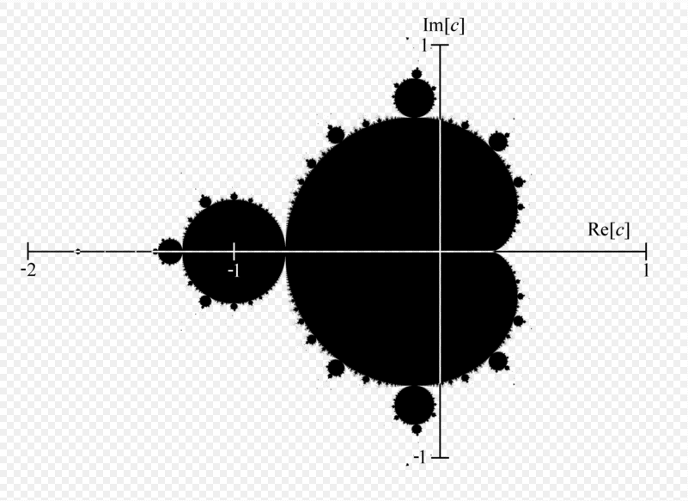
Mandlebrot Set
Interesting Fractal
Self Similar
Has a wide range of interesting habitats

Slide 3
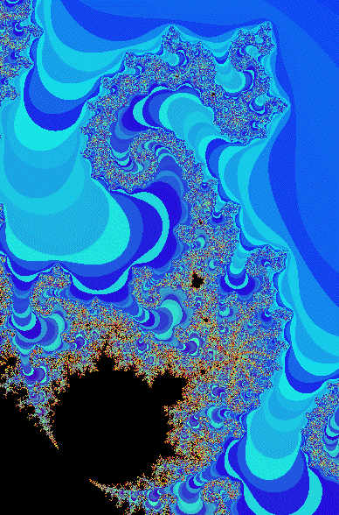
Mandelbrot Set
The Mandelbrot Set M is based on work by Fatou and Julia
Description of set M is quite indirect
Define a function f_{c} from the complex plane to itself
    f_{c} : C ---> C
    f_{c}(z) = z² + c
We look at iterations of f_{c} upon the point z₀ = 0
    f_{c}³(z₀) = f_{c}³(0) = f_{c}(f_{c}(f_{c}(0)))
We say c is in the Mandelbrot Set M if
    lim f_{c}^{n}(z₀) is finite as n goes to infinity

Slide 4
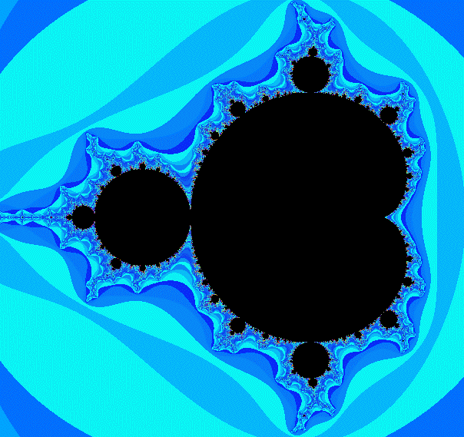
Let’s compute some examples
Reminder: f_{c}(z) = z² + c
If c = 0, the sequence f_{c}^{n}(0) is
  0, 0, 0, 0, 0, 0… So point 0 is in the set
If c = 1, the sequence f_{c}^{n}(0) is
  0, 1, 2, 5, 26, … So point 1 is not in the set
  (We start with f_{c}⁰(0) = 0 in all examples)
If c = 1/2, the sequence f_{c}^{n}(0) is
  0, 1/2, 3/4, 1 1/16, 1 161/256, … So 1/2 is not in the set
If c = -2, the sequence f_{c}^{n}(0) is
  0, -2, 2, 2, 2… So point -2 is in the set
If c = -1, the sequence f_{c}^{n}(0) is periodic
  0, -1, 0, -1, 0, -1… So point -1 is in the set
If c = i, the sequence f_{c}^{n}(0) is
  0, i, -1 + i, -i, -1 + i, -i… So point i is in the set

Slide 5
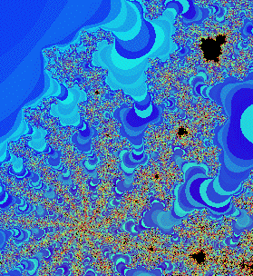
Computing Mandelbrot Set
We say c is in the Mandelbrot Set M if
    lim f_{c}^{n}(0) does not go to infinity as n goes to infinity
Practically, we say that point c is not in M if for some k,
    | f_{c}^{k}(0) | > 2 where f_{c}(z) = z² + c
Our algorithm is:
  For each c in the complex plane build function f_{c}
    Iterate, computing f_{c}^{k}(0) until the magnitude is greater than 2, or until k > MAX
    If k is MAX, color point c black (c is in the set)
    If k is small, color point c blue (really cold: escaped quickly)
    If k is large, color point c red (really warm: almost made it)
      We use random green values at different levels to give contours
When we have colored an internal array we paint the screen via the glDrawPixels() call

Slide 6
Generating an image by hand
/* Generate Mandelbrot Set. (c) E. Angel */
/* N x M array to be generated */
#define N 500
#define M 500
int n=N;
int m=M;
/* Use unsigned bytes for image */
GLubyte image[N][M];
void display()
{
glClear(GL_COLOR_BUFFER_BIT);
glDrawPixels(n, m, GL_COLOR_INDEX, GL_UNSIGNED_BYTE, image);
glFlush();
}

Slide 7
glDrawPixels
glDrawPixels(n, m, GL_COLOR_INDEX, GL_UNSIGNED_BYTE, image);
void glDrawPixels( GLsizei width, GLsizei height, GLenum format, GLenum type, const GLvoid *pixels )
formatSpecifies the format of the pixel data. GL_COLOR_INDEX, GL_STENCIL_INDEX, GL_DEPTH_COMPONENT, GL_RGBA,GL_RED, GL_GREEN, GL_BLUE, GL_ALPHA, GL_RGB, GL_LUMINANCE, and GL_LUMINANCE_ALPHA are accepted.
typeSpecifies the data type for pixels. Symbolicconstants GL_UNSIGNED_BYTE, GL_BYTE,GL_BITMAP, GL_UNSIGNED_SHORT, GL_SHORT, GL_UNSIGNED_INT, GL_INT, and GL_FLOAT are accepted.
pixelsSpecifies a pointer to the pixel data.

Slide 8
GL_COLOR_INDEX
void myinit()
{
float redmap[256], greenmap[256],bluemap[256];
int i;
glClearColor (1.0, 1.0, 1.0, 1.0);
gluOrtho2D(0.0, 0.0, (GLfloat) n, (GLfloat) m);
/* Define pseudocolor maps, ramps for red and blue, random for green */
for (i=0; i<256; i++)
{
redmap[i] = i/255.;
greenmap[i]= ((double)(rand() % 255))/255;
bluemap[i] = 1.0 - i/255.;
}
glPixelMapfv(GL_PIXEL_MAP_I_TO_R, 256, redmap);
glPixelMapfv(GL_PIXEL_MAP_I_TO_G, 256, greenmap);
glPixelMapfv(GL_PIXEL_MAP_I_TO_B, 256, bluemap);
}

Slide 9
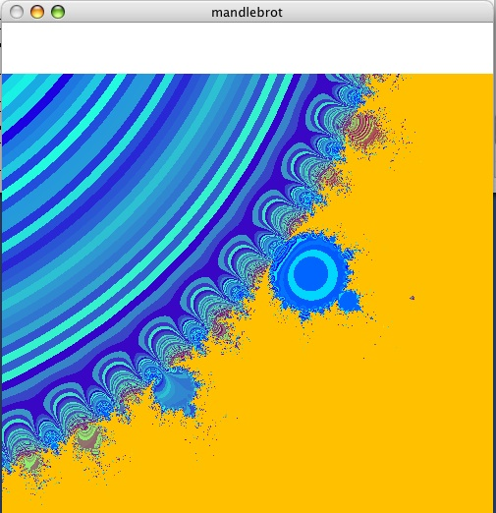
Main loop
for (i=0; i<n; i++) for(j=0; j<m; j++)
{
  /* starting point */
  x= i *(width/(n-1)) + cx -width/2;
  y= j *(height/(m-1)) + cy -height/2;
  form(0,0,c);
  form(x,y,c0);
  /* complex iteration */
  for(k=0; k<max; k++)
  {
    mult(c,c,d);
    add(d,c0,c);
    v=mag2(c);
    if(v>4.0) break; /* assume not in set if mag > 4 */
  }
  /* assign gray level to point based on its magnitude */
  if(v>1.0) v=1.0; /* clamp if > 1 */
  image[i][j]=255*v;
}

Slide 10
Reformat Main
for (i=0; i<n; i++)
  for(j=0; j<m; j++)
  {
    /* starting point */
    x= i *(width/(n-1)) + cx -width/2;
    y= j *(height/(m-1)) + cy -height/2;
    form(0,0,c);
    form(x,y,c0);
    /* complex iteration */
    for(k=0; k<max; k++)
    {
      mult(c,c,d);
      add(d,c0,c);
      v=mag2(c);
      if(v>4.0)
        break; /* assume not in set if mag > 4 */
    }
    /* assign gray level to point based on its magnitude */
    if(v>1.0)
      v=1.0; /* clamp if > 1 */
    image[i][j]=255*v;
  }
We recompute x, even when i has not changed
We can replace multiplication with addition

Slide 11
Angel's use of Color
/* complex iteration */
for(k=0; k<max; k++)
{
  mult(c,c,d);
  add(d,c0,c);
  v=mag2(c); /* Compute mag squared */
  if (v > 4.0)
    break; /* assume not in set if mag > 4 */
}
if ( v > 1.0)
  v=1.0; /* clamp if > 1 */
image[i][j]=255*v;
Practically, we say that point c is not in M if for some k,
    | f_{c}^{k}(0) | > 2 where f_{c}(z) = z² + c
What is the effect of Angel's use of color?

Slide 12
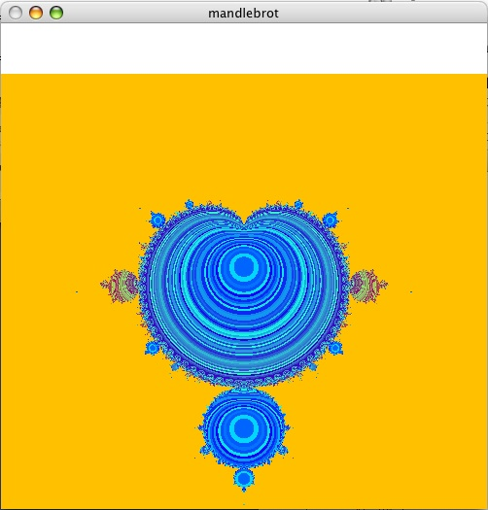
Assignment
The current version draws only a part of the set: start with the full set.
The current version does not present the standard view: modify it so that the curve is symmetric about the x axis rather than the y axis.
Rework the color scheme. Usually items in the set are colored black, and points outside the set are given different colors depending on the number of iterations it takes to escape a circle of radius 2.
The current version uses floats: to explore the set in detail, you will want to use doubles to hold the values.
Revise the computation of x and y on lines 128 and 129 to reduce the amount of work
Rewrite the evaluations of the function to reduce the number of floating point operations and function calls. This is the inner loop, and deserves attention. (See next slide)
Add a mouse handler to control zooming in and out. You will find it simplest to take a mouse click, translate to model coordinates, and then recalibrate.
    A single click should zoom in.
    A shift click should zoom out.
Add comments to explain what Angel is doing.

Slide 13
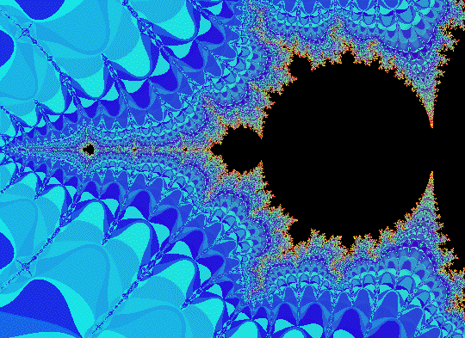
Faster inner loop
for(k=0; k<max; k++)
{
  mult(c,c,d);
  add(d,c0,c);
  v=mag2(c);
  if (v > 4.0)
    break; /* assume not in set if mag > 4 */
}
void mult(complex a, complex b, complex p)
{
  p[0]=a[0]*b[0]-a[1]*b[1];
  p[1]=a[0]*b[1]+a[1]*b[0];
}
void add(complex a, complex b, complex p)
{
  p[0]=a[0]+b[0];
  p[1]=a[1]+b[1];
}
float mag2(complex a)
{
  return(a[0]*a[0]+a[1]*a[1]);
}
But we have a special multiplication: z*z, so a[0] = b[0] and a[1] =b[1]
This is the inner loop: it may pay to undwind it, avoiding the 3 function calls
Note that Angel avoids taking square root

Slide 14
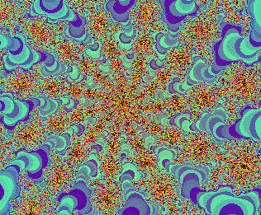
Mouse Callback
When we click here
Zoom in centered on this point
When the user clicks on the screen, want to map from screen coordinates back to world coordinates
Take that as the new center, and change the width we display
Double if shift is down (zoom out)
Halve if not (zoom in)

Slide 15
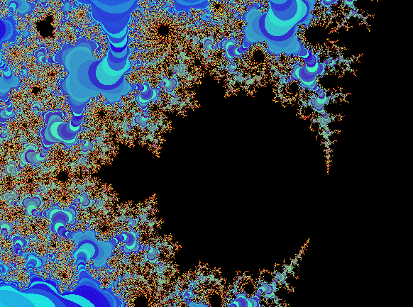
Mapping back
What does a click here mean?
Map this back to the x and y coordinate
How do you take a mouse position and map back to the real coordinates?
Image is N pixels wide

