Slide 1
User Interaction
Includes material by Ed Angel
Jeff Parker

Slide 2
Objectives
Review pipeline architecture
Software components for an interactive graphics system
Alternatives
  Read mouse position
  Back Buffer
  Picking
A look at a simple Paint program

Slide 3

Pipeline
Process objects as they are generated by the application
  Can consider only local lighting
Pipeline architecture
  All steps can be implemented in hardware on the graphics card
application
program
display

Slide 4
Vertex Processing
Much of the work in the pipeline is in converting object representations from one coordinate system to another
  Object coordinates
  Camera (eye) coordinates
  Screen coordinates
Every change of coordinates is equivalent to a matrix transformation (next week)
Vertex processor also computes vertex colors
application
program
display

Slide 5
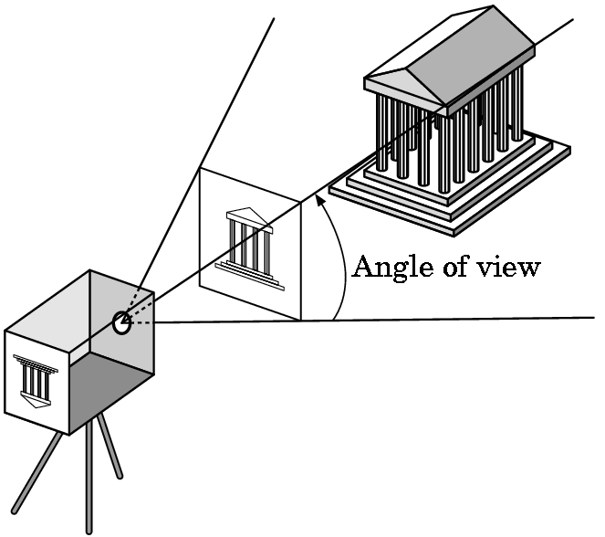
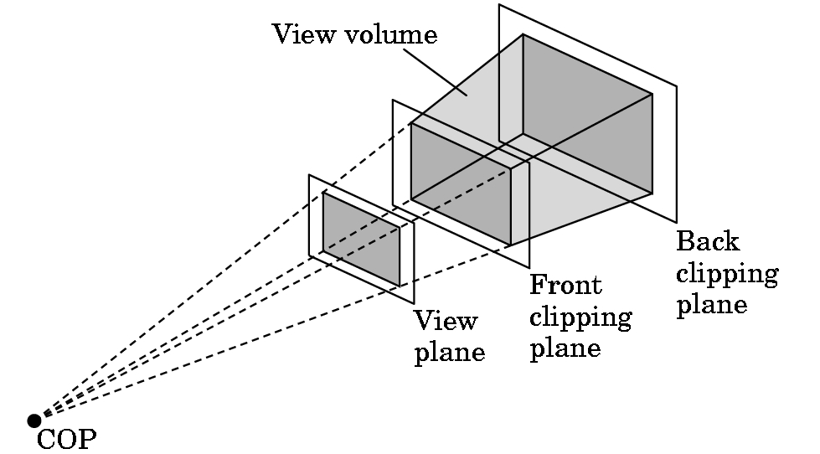
Clipping
Just as a real camera cannot “see” the whole world, the virtual camera can only see part of the world or object space
  Objects that are not within this volume are said to be clipped out of the scene
Current collision problem: does line intersect square?

Slide 6
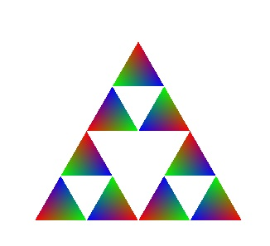
Rasterization
If object remains after clipping, appropriate pixels in frame buffer must be colored
Rasterizer produces a set of fragments for each object
Fragments are “potential pixels” - Each has
    Location in frame buffer
    Color and depth attributes
Vertex attributes are interpolated over objects by the rasterizer
application
program
display

Slide 7
Fragment Processing
Each fragment is processed to determine color of pixel in frame buffer
Colors can be define by texture mapping or interpolation of vertex colors
Fragments may be blocked by other fragments closer to the camera
  Hidden-surface removal
application
program
display

Slide 8
User Interaction
Provided via GLUT callbacks
  Mouse
  Keyboard
  Reshape
Learn to build more sophisticated interactive programs using
  Select objects from the display
    Three methods
  Rubberbanding
    Interactive drawing of lines and rectangles

Slide 9
Application: Connect Dots
/*
* ConnectDots.c
*
* This program draws straight lines connecting dots placed with mouse clicks.
*
* Author: Samuel R. Buss
*
* Software accompanying the book
* 3D Computer Graphics: A Mathematical Introduction with OpenGL,
* by S. Buss, Cambridge University Press, 2003.
*
* Usage:
* Left click to place a control point.
* Maximum number of control points allowed is currently set at 64.
* Press "f" to remove the first control point
* Press "l" to remove the last control point.
* Press escape to exit.
*/
#include "ConnectDots.h"
Great example of header: Please follow this example

Slide 10
Prototypes
/*
* ConnectDots.h
*
* Author: Samuel R. Buss
*
* Software accompanying the book
* 3D Computer Graphics: A Mathematical Introduction with OpenGL,
* by S. Buss, Cambridge University Press, 2003.
*
* Bug reports: Sam Buss, sbuss@ucsd.edu.
* Web page: http://math.ucsd.edu/~sbuss/MathCG
*/
// Function prototypes
void myKeyboardFunc( unsigned char key, int x, int y );
void myMouseFunc( int button, int state, int x, int y );
void displayLines(void);
void removeFirstPoint();
void removeLastPoint();
void addNewPoint( float x, float y );
void initRendering();
void resizeWindow(int w, int h);

Slide 11
The mouse callback
glutMouseFunc(mymouse)
void mymouse(GLint button, GLint state, GLint x, GLint y)
When called, we are passed
  Which button (GLUT_LEFT_BUTTON, GLUT_MIDDLE_BUTTON, GLUT_RIGHT_BUTTON) caused event
  State of that button (GLUT_UP, GLUT_DOWN)
  Position in window (x, y)

Slide 12
Positioning
The position in the screen window is usually measured in pixels with the origin at the top-left corner
  Historical consequence of refresh done from top to bottom
OpenGL uses a world coordinate system with origin at the bottom left
  Must invert y coordinate returned by callback by height of window
  y = h – y;
(0,0)
h
w

Slide 13
Mouse position as float
// Left button presses place a control point.
void myMouseFunc( int button, int state, int x, int y )
{
  if ( button==GLUT_LEFT_BUTTON && state==GLUT_DOWN )
  {
    float xPos = ((float)x)/((float)(WindowWidth-1));
    float yPos = ((float)y)/((float)(WindowHeight-1));
    yPos = 1.0f - yPos; // Flip y value
    addNewPoint( xPos, yPos );
    glutPostRedisplay();
  }
}

Slide 14
Mouse position as integer
/* Handle a mouse click – Set center for the ball */
void mouse (int button, int state, int x, int y )
{
  /* Is the left button down? */
  if ( button==GLUT_LEFT_BUTTON && state==GLUT_DOWN )
  {
    int xPos = x;
    int yPos = height - y;

Slide 15
Obtaining the window size
To invert the y position we need the window height
  Height can change during program execution due to resize by user
  Alternatives
    Track with a global variable
      New height returned to reshape() callback that we see later
    Use query functions on the fly. Can use
      glGetIntegerv(State, *ptr)
      glGetFloatv(State, *ptr)
    to obtain any value that is part of the OpenGL state
Example: to get the current position and size of window:
  GLint vp[4];
  glGetIntegerv(GL_VIEWPORT, vp);

Slide 16
Keyboard
void myKeyboardFunc (unsigned char key, int x, int y)
{
  switch (key) {
    case 'f':
      removeFirstPoint();
      glutPostRedisplay();
      break;
    case 'l':
      removeLastPoint();
      glutPostRedisplay();
      break;
    case 27: // Escape key
      exit(0);
      break;
  }
}
In main, there is a call
glutKeyboardFunc(myKeyboardFunc);

Slide 17
Special and Modifier Keys
GLUT defines the special keys in glut.h
Need a separate handler, registered with glutSpecialFunc() – see next page
  Function key 1: GLUT_KEY_F1
  Up arrow key: GLUT_KEY_UP
    if (key == GLUT_KEY_UP ……
Can also check of one of the modifiers
  GLUT_ACTIVE_SHIFT
  GLUT_ACTIVE_CTRL
  GLUT_ACTIVE_ALT
  is depressed by
  glutGetModifiers()
  Allows emulation of three-button mouse with one- or two-button mice

Slide 18
Special and Modifier Keys
static void key(unsigned char k, int x, int y) {....} /* end key function */
static void special(int k, int x, int y) {
switch (k) {
  case GLUT_KEY_UP: /* up arrow */
    lightpy += 1.0;
    break;
  …
  case GLUT_KEY_LEFT: /* left arrow */
    lightpx -= 1.0;
    break;
  …
  default:
    return;
}
int main(int argc, char **argv)
{
  …
  glutKeyboardFunc(key);
  glutSpecialFunc(special);

Slide 19
Adding points
// Add a new point to the end of the list.
// Remove the first point in the list if too many points.
void addNewPoint( float x, float y )
{
  if ( NumPts>=MaxNumPts )
    removeFirstPoint();
  PointArray[NumPts][0] = x;
  PointArray[NumPts][1] = y;
  NumPts++;
}

Slide 20
Drawing shape
void displayLines(void)
{
  int i;
  glClear(GL_COLOR_BUFFER_BIT);
  // Draw the line segments
  glColor3f(1.0f, 0.0f, 0.8f); // Reddish/purple lines
  if ( NumPts>1 ) {
    glBegin( GL_LINE_STRIP );
    for ( i=0; i<NumPts; i++ )
      glVertex2f( PointArray[i][0], PointArray[i][1] );
    glEnd();
  }
  // Draw the points second.
  glColor3f( 0.0f, 0.0f, 0.0f); // Draw points in black
  glBegin( GL_POINTS ); // Primitive hidden line removal
  for ( i=0; i<NumPts; i++ )
    glVertex2f( PointArray[i][0], PointArray[i][1] );
  glEnd();
  glFlush();
}

Slide 21
Set attributes
void initRendering()
{
  glClearColor( 1.0f, 1.0f, 1.0f, 1.0f );
  // Make big points and wide lines.
  glPointSize(8);
  glLineWidth(5);
  // The following commands should induce OpenGL to create round
  // points and antialias points and lines. (This is implementation
  // dependent and may slow down rendering considerably.)
  glEnable(GL_POINT_SMOOTH);
  glEnable(GL_LINE_SMOOTH);
  glHint(GL_POINT_SMOOTH_HINT, GL_NICEST); // Make round points
  glHint(GL_LINE_SMOOTH_HINT, GL_NICEST); // Antialias the lines
  glEnable(GL_BLEND);
  glBlendFunc(GL_SRC_ALPHA, GL_ONE_MINUS_SRC_ALPHA);
}

Slide 22
Reshaping the window
We can reshape and resize the OpenGL display window by pulling the corner of the window
What happens to the display?
  Must redraw from application
    Some applications (square.c) do not keep state: start over
  Two possibilities for reshape
    Display part of world
    Display whole world but force to fit in new window
      Can alter aspect ratio

Slide 23
Reshape possiblities
original
reshaped

Slide 24
The Reshape callback
glutReshapeFunc(myreshape)
void myreshape( int w, int h)
  Returns width and height of new window (in pixels)
  A redisplay is posted automatically at end of execution of the callback
  GLUT has default reshape callback but you should define your own
The reshape callback is good place to put viewing functions (eg perspective) because it is invoked when the window is first opened
This is our first example of a program that remembered state, and thus has an interesting reshape function

Slide 25
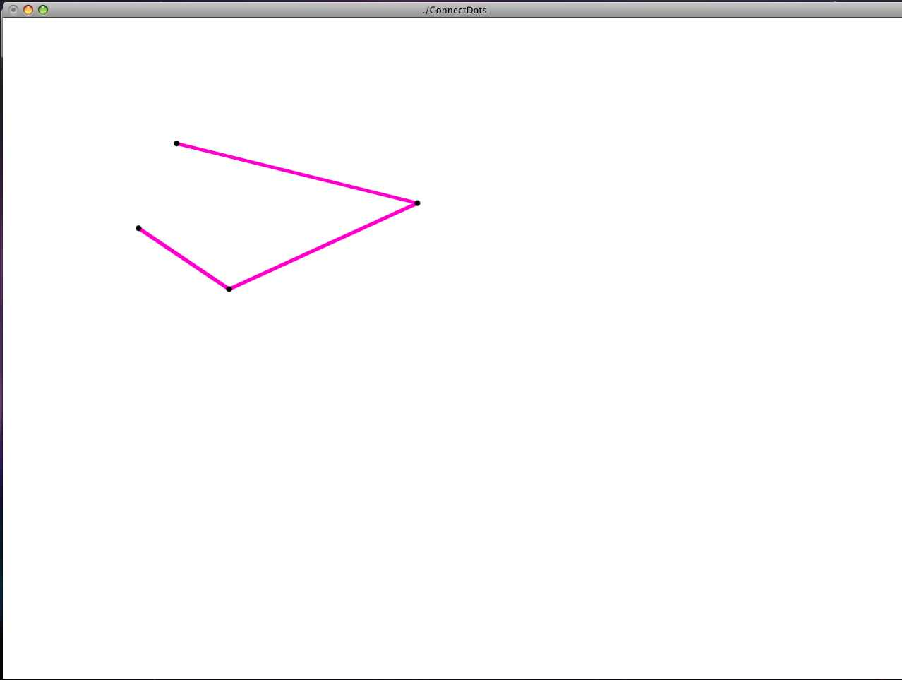
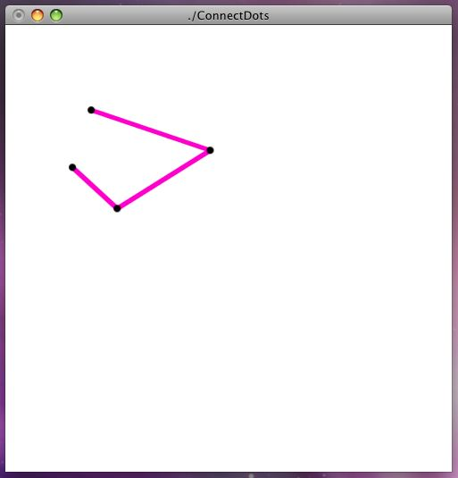
ConnectDots Reshape

Slide 26
Reshape Routine
void resizeWindow(int w, int h)
{
    WindowHeight = (h>1) ? h : 2;
    WindowWidth = (w>1) ? w : 2;
    glViewport(0, 0, (GLsizei) w, (GLsizei) h);
    glMatrixMode(GL_PROJECTION);
    glLoadIdentity();
    // Always view [0,1]x[0,1].
    gluOrtho2D(0.0f, 1.0f, 0.0f, 1.0f);
    glMatrixMode(GL_MODELVIEW);
    glLoadIdentity();
}

Slide 27
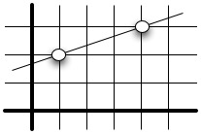
Equation of Line
Given two points, we can define a line using the two-point form
Consider the example given the points (1, 2) and (4, 3)
Note the relationship to the normal vector, (-1, 3)

Slide 28
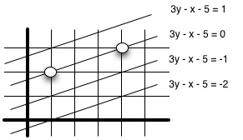
Other points
Given pair (x, y), we can see if it is on line by plugging into the equation
(7, 4) is on the line, as: 3 x 4 – 7 – 5 = 0
(1, 1) is not, as: 3 x 1 – 1 – 5 = -1
(2, 4) is not, as: 3 x 4 – 2 – 5 = 5
We have additional information:
Sign tells us which side of line we are on

Slide 29
Computation
In fact, you don't need to create the equation: you can simply take the dot product of the point of interest with the normal vector.
The endpoints of the line were (1,2) and (4,3)
The dot products with the normal vector, n = (-1, 3), and the endpoints
  (1, 2) (-1, 3) = -1 + 6 = 5
  (4, 3) (-1, 3) = -4 + 9 = 5
We return to the examples from the last slide
  (7, 4) is on the line, as: (7, 4) (-1, 3) = -7 + 12 = 5
  (1, 1) is not, as: (1, 1)(-1, 3) = -1 + 3 = 2
  (2, 4) is not, as: (2, 4)(-1, 3) = (-2, + 12 = 10
We can tell which side they are on by comparing to the "right" value: 5
  But why is this valid? These are not vectors, they are points!?!

Slide 30
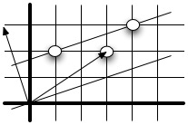
What is going on?
In problem 2, we needed the distance from a point to a line.
What we need now is simpler: Which side of the line is the point?
The construction is similar. Again the solution is to compute the dot product of the vector from origin to the point with the normal vector.
  In this case, we only need to know relative distance
    We are computing the relative distance from the line 3y – x = 0
    Points on our line lie 5 units above the line through the origin
If we needed the true distance, we would take the absolute value and divide by the length of the normal vector.
In illustration: the point (3, 2) is below our line
  (-1, 3)(3, 2) = -3 + 6 = 3 < 5

Slide 31
Picking
Allow the user to select an object on the display
In principle, it should be simple because the mouse gives the position and we should be able to determine to which object(s) are there
Practical difficulties
  Pipeline architecture is one directional - hard to go from screen back to world
  Screen is 2D, world is 3D
  How close do we have to come to object to say we selected it?
    Objects that are thin, such as lines, may be hard to hit

Slide 32
Three Approaches
Hit list
  Most general approach but most difficult to implement
Use back or some other buffer to store object ids as the objects are rendered
Rectangular maps
  Easy to implement for many applications
  See paint program in text

Slide 33
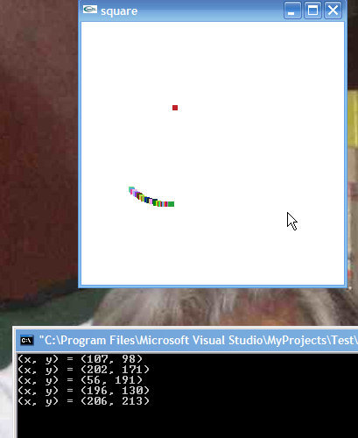
A hint…
You may find it simplest to check vs area
  It is helpful print in handler
void mouse(int btn, int state, int x, int y)
{
  ... // Real stuff
  // output mouse position
  if (state==GLUT_DOWN)
    printf("(x, y) = (%d, %d)\n", x, y);
}

Slide 34
Area Maps
Have the application keep track of regions of interest
Match the cursor to the areas
Simplest to do with rectangles
We will see this in the paint program
Tool pallets are above the drawing area

Slide 35
Back Buffer
Use the back buffer to image the scene
Draw each object in a distinct color (even if they were in the same color in the original drawing)
  Keep a table mapping objects to color
Peek at the pixel in the back buffer under the mouse position
  glReadPixels
Map the color under the mouse to the object

Slide 36
Picking to get Hit List
We take the cursor position, and use that to define a new, narrow clipping region so that only the area near the cursor will be displayed
We then render the full image in GL_SELECT mode
Any region that was hit (was not clipped) goes into a hit list, which the program can examine later
Clearly we do not want to display the image we are creating.

Slide 37
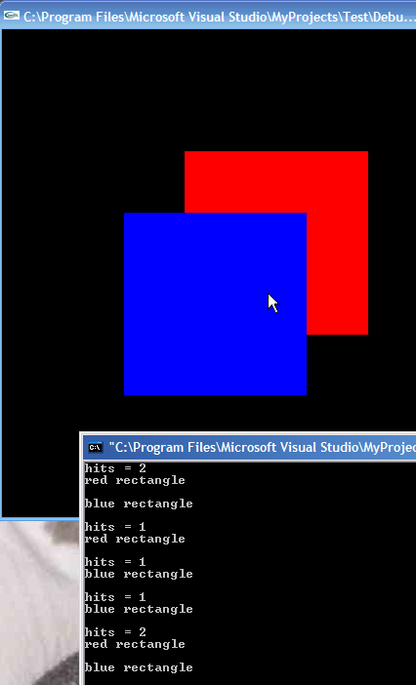
Pick program
Displays two rectangles
Tells you which you selected

Slide 38
Rendering Modes
OpenGL can render in one of three modes selected by glRenderMode(mode)
  GL_RENDER: normal rendering to the frame buffer (default)
  GL_FEEDBACK: provides list of primitives rendered but no output to the frame buffer
    Not used in this example
  GL_SELECTION: Each primitive in the view volume generates a hit record that is placed in a name stack which can be examined later

Slide 39
Render the image
void drawObjects(GLenum mode)
{
  if(mode == GL_SELECT) glLoadName(1);
  glColor3f(1.0, 0.0, 0.0);
  glRectf(-0.5, -0.5, 1.0, 1.0);
  if(mode == GL_SELECT) glLoadName(2);
  glColor3f(0.0, 0.0, 1.0);
  glRectf(-1.0, -1.0, 0.5, 0.5);
}
void display()
{
  glClear(GL_COLOR_BUFFER_BIT);
  drawObjects(GL_RENDER);
  glFlush();
}

Slide 40
Display
#include <stdlib.h>
#include <stdio.h>
#include <GL/glut.h>
void init()
{
  glClearColor (0.0, 0.0, 0.0, 0.0);
}
…
void display()
{
glClear(GL_COLOR_BUFFER_BIT);
drawObjects(GL_RENDER);
glFlush();
}

Slide 41
mouse
#define SIZE 512
void mouse(int button, int state, int x, int y)
{
  GLuint selectBuf[SIZE];
  GLint hits;
  GLint viewport[4];
  if (button == GLUT_LEFT_BUTTON && state == GLUT_DOWN)
  {
  …

Slide 42
Selection Mode Functions
glSelectBuffer(): specifies name buffer
glInitNames(): initializes name buffer
glPushName(id): push id on name buffer
glPopName(): pop top of name buffer
glLoadName(id): replace top name on buffer
id is set by application program to identify objects

Slide 43
Mouse (cont)
glGetIntegerv (GL_VIEWPORT, viewport);
glSelectBuffer (SIZE, selectBuf);
glRenderMode(GL_SELECT);
glInitNames();
glPushName(0); /* Something is on the stack top */
glMatrixMode (GL_PROJECTION);
glPushMatrix ();
glLoadIdentity ();
/* create 5x5 pixel picking region near cursor location */
gluPickMatrix ((GLdouble) x, (GLdouble) (viewport[3] - y),
5.0, 5.0, viewport);
gluOrtho2D (-2.0, 2.0, -2.0, 2.0);
drawObjects(GL_SELECT);
glMatrixMode (GL_PROJECTION);
glPopMatrix ();
glFlush ();
hits = glRenderMode (GL_RENDER);
processHits (hits, selectBuf);
glutPostRedisplay();

Slide 44
Using Selection Mode
Define and Initialize name buffer (hit list)
Build a picking region around the current cursor
  Clip scene against this region
Render scene in selection Mode
  Before each new object, replace top of stack with new "name"
Return to Render mode
  The call to modify render mode also returns number of hits
    hits = glRenderMode (GL_RENDER);
Examine contents of name buffer (hit list)
  Hit records include id and depth information

Slide 45
Select an object
void drawObjects(GLenum mode)
{
  if(mode == GL_SELECT) glLoadName(1);
  glColor3f(1.0, 0.0, 0.0);
  glRectf(-0.5, -0.5, 1.0, 1.0);
  if(mode == GL_SELECT) glLoadName(2);
  glColor3f(0.0, 0.0, 1.0);
  glRectf(-1.0, -1.0, 0.5, 0.5);
}
void mouse(int button, int state, int x, int y)
{
  ...
  if (button == GLUT_LEFT_BUTTON && state == GLUT_DOWN)
  {
    ...
    drawObjects(GL_SELECT);
    ...
    hits = glRenderMode (GL_RENDER);
    processHits (hits, selectBuf);
    ...
  }
}

Slide 46
Process Hits
Step through the name list, looking for the names of objects we hit
void processHits (GLint hits, GLuint buffer[])
{
unsigned int i, j;
GLuint names, *ptr;
printf ("hits = %d\n", hits);
ptr = (GLuint *) buffer;
for (i = 0; i < hits; i++)
{ /* for each hit */
names = *ptr;
ptr+=3;
for (j = 0; j < names; j++)
{ /* for each name */
if(*ptr==1) printf ("red rectangle\n");
else printf ("blue rectangle\n");
ptr++;
}
printf ("\n");
}
}

Slide 47
Resources
The hit record consists of the number of names in the name stack at the time of the event; followed by the minimum and maximum depth values of all vertices that hit since the previous event; followed by the name stack contents, bottom name first.
Using the hit list requires many “moving parts.”
I suggest reading the text, and then turning to some of the many on-line tutorials
  www.lighthouse3d.com/opengl/picking
  www.cs.uccs.edu/~semwal/indexGLTutorial.html

Slide 48
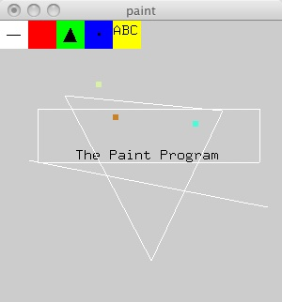
The Paint Program
An interesting example
Many ideas to steal

Slide 49
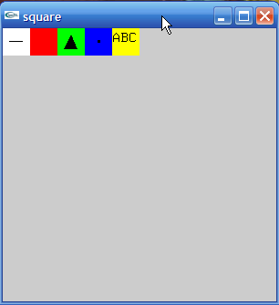
Global State and #defines
#define NULL 0
#define LINE 1
#define RECTANGLE 2
#define TRIANGLE 3
#define POINTS 4
#define TEXT 5
GLsizei wh = 500, ww = 500; /* initial window size */
GLfloat size = 3.0; /* half side length of square */
int draw_mode = 0; /* drawing mode */
int rx, ry; /* raster position*/
GLfloat r = 1.0, g = 1.0, b = 1.0; /* drawing color */
int fill = 0; /* fill flag */

Slide 50
Using Regions of the Screen
Many applications use a simple rectangular arrangement of the screen
  Example: paint/CAD program
tools
menus
drawing area
Easier to look at mouse position and determine which area of screen it is in than using selection mode picking

Slide 51
Pick
int pick(int x, int y)
{
  y = wh - y;
  if (y < wh-ww/10) return 0;
  else if(x < ww/10) return LINE;
  else if(x < ww/5) return RECTANGLE;
  else if(x < 3*ww/10) return TRIANGLE;
  else if(x < 2*ww/5) return POINTS;
  else if(x < ww/2) return TEXT;
  else return 0;
}
Note that is wh – (ww/10)

Slide 52
Mouse Handler
void mouse(int btn, int state, int x, int y)
{
  static int count;
  int where;
  static int xp[2],yp[2];
  if (btn==GLUT_LEFT_BUTTON && state==GLUT_DOWN)
  {
    glPushAttrib(GL_ALL_ATTRIB_BITS);
    where = pick(x,y);
    glColor3f(r, g, b);
    if (where != 0)
    {
      count = 0;
      draw_mode = where;
    }
    else switch(draw_mode)
    {
      case(LINE):
        ...

Slide 53
Mouse Handler
case(RECTANGLE):
if(count == 0)
{
  count++;
  xp[0] = x;
  yp[0] = y;
}
else
{
if(fill) glBegin(GL_POLYGON);
else glBegin(GL_LINE_LOOP);
  glVertex2i(x,wh-y);
  glVertex2i(x,wh-yp[0]);
  glVertex2i(xp[0],wh-yp[0]);
  glVertex2i(xp[0],wh-y);
glEnd();
draw_mode=0;
count=0;
}
break;
case(LINE):
if (count==0)
{
  count++;
  xp[0] = x;
  yp[0] = y;
}
else
{
  glBegin(GL_LINES);
    glVertex2i(x,wh-y);
    glVertex2i(xp[0],wh-yp[0]);
  glEnd();
  draw_mode=0;
  count=0;
}
break;
Note that we reset the draw_mode after each operation

Slide 54
Triangle
case (TRIANGLE):
  switch(count)
  {
    case(0):
      count++;
      xp[0] = x;
      yp[0] = y;
      break;
    case(1):
      count++;
      xp[1] = x;
      yp[1] = y;
      break;
    case(2):
      if(fill) glBegin(GL_POLYGON);
      else glBegin(GL_LINE_LOOP);
        glVertex2i(xp[0],wh-yp[0]);
        glVertex2i(xp[1],wh-yp[1]);
        glVertex2i(x,wh-y);
      glEnd();
      draw_mode=0;
      count=0;
  }
  break;

Slide 55
Handlers
int main(int argc, char** argv)
{
...
glutReshapeFunc (myReshape);
glutKeyboardFunc(key);
glutMouseFunc (mouse);
glutMainLoop();
}

Slide 56
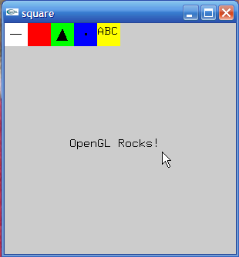
Keyboard handler
void key(unsigned char k, int xx, int yy)
{
  if (draw_mode!=TEXT)
    return;
  glColor3f(0.0,0.0,0.0);
  glRasterPos2i(rx,ry);
  glutBitmapCharacter(GLUT_BITMAP_9_BY_15, k);
  /*glutStrokeCharacter(GLUT_STROKE_ROMAN,i); */
  rx+=glutBitmapWidth(GLUT_BITMAP_9_BY_15,k);
}

Slide 57
Menus
GLUT supports pop-up menus
  A menu can have submenus
Three steps
  Define entries for the menu
  Define action for each menu item
    Action carried out if entry selected
  Attach menu to a mouse button

Slide 58
Defining a simple menu
In main.c
menu_id = glutCreateMenu(mymenu);
glutAddmenuEntry(“clear Screen”, 1);
gluAddMenuEntry(“exit”, 2);
glutAttachMenu(GLUT_RIGHT_BUTTON);
clear screen
exit
entries that appear when
right button depressed
identifiers

Slide 59
Menu actions
  Menu callback
void mymenu(int id)
{
if(id == 1) glClear();
if(id == 2) exit(0);
}
Note each menu has an id that is returned when it is created
  glutAddmenuEntry(“clear Screen”, 1);
Add submenus by
  glutAddSubMenu(char *submenu_name, submenu id)
entry in parent menu

Slide 60
Create the Menus
int main(int argc, char** argv)
{
int c_menu, p_menu, f_menu;
glutInit(&argc,argv);
glutInitDisplayMode (GLUT_SINGLE | GLUT_RGB);
glutCreateWindow("square");
glutDisplayFunc(display);
c_menu = glutCreateMenu(color_menu);
glutAddMenuEntry("Red",1);
glutAddMenuEntry("Green",2);
glutAddMenuEntry("Blue",3);
glutAddMenuEntry("Cyan",4);
glutAddMenuEntry("Magenta",5);
glutAddMenuEntry("Yellow",6);
glutAddMenuEntry("White",7);
glutAddMenuEntry("Black",8);
p_menu = glutCreateMenu(pixel_menu);

Slide 61
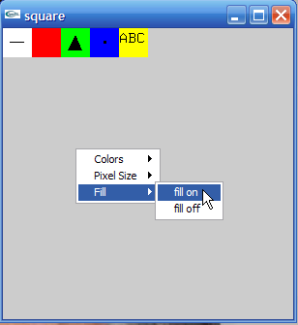
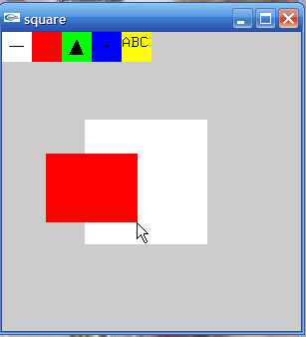
Menu Actions
void pixel_menu(int id)
{
  if (id == 1)
    size = 2 * size;
  else if (size > 1)
    size = size/2;
}
void fill_menu(int id)
{
  if (id == 1)
    fill = 1;
  else
    fill = 0;
}

Slide 62
Menu Actions
void fill_menu(int id)
{
  if (id == 1)
    fill = 1;
  else
    fill = 0;
}
f_menu = glutCreateMenu(fill_menu);
glutAddMenuEntry("fill on", 1);
glutAddMenuEntry("fill off", 2);
glutAttachMenu(GLUT_RIGHT_BUTTON);
glutCreateMenu(middle_menu);
glutAddSubMenu("Colors", c_menu);
glutAddSubMenu("Pixel Size", p_menu);
glutAddSubMenu("Fill", f_menu);
glutAttachMenu(GLUT_MIDDLE_BUTTON);

Slide 63
Handle Color Menu
void color_menu(int id)
{
  if (id == 1) {r = 1.0; g = 0.0; b = 0.0;}
  else if(id == 2) {r = 0.0; g = 1.0; b = 0.0;}
  else if(id == 3) {r = 0.0; g = 0.0; b = 1.0;}
  else if(id == 4) {r = 0.0; g = 1.0; b = 1.0;}
  else if(id == 5) {r = 1.0; g = 0.0; b = 1.0;}
  else if(id == 6) {r = 1.0; g = 1.0; b = 0.0;}
  else if(id == 7) {r = 1.0; g = 1.0; b = 1.0;}
  else if(id == 8) {r = 0.0; g = 0.0; b = 0.0;}

Slide 64
Other functions in GLUT
Dynamic Windows
  Create and destroy during execution
Subwindows
Multiple Windows
Changing callbacks during execution
Timers
Portable fonts
  glutBitmapCharacter
  glutStrokeCharacter

Slide 65
Rubberband
second point
first point
draw line with mouse
in XOR mode
initial display
mouse moved to
new position
Draw lines
Could erase lines: hides background

Slide 66
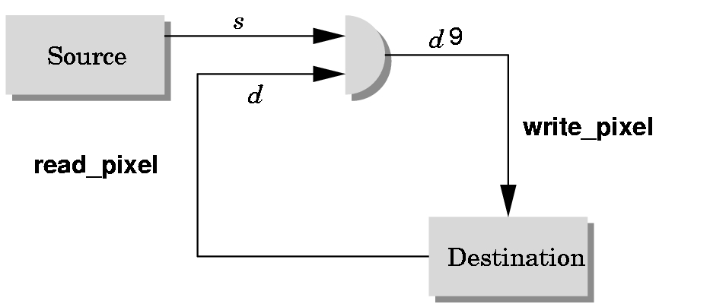
Writing Modes
bitwise logical operation
application
‘
frame buffer

Slide 67
XOR write
Usual (default) mode: source replaces destination (d’ = s)
  Cannot write temporary lines this way because we cannot recover what was “under” the line in a fast simple way
Exclusive OR mode (XOR) (d’ = d ⊕ s)
  x ⊕ y ⊕ x =y
  Hence, if we use XOR mode to write a line, we can draw it a second time and line is erased!

Slide 68
Rubberbanding
Switch to XOR write mode
Draw object
  For line can use first mouse click to fix one endpoint and then use motion callback to continuously update the second endpoint
  Each time mouse is moved, redraw line which erases it and then draw line from fixed first position to to new second position
  At end, switch back to normal drawing mode and draw line
  Works for other objects: rectangles, circles

Slide 69
Rubberband Lines
second point
first point
draw line with mouse
in XOR mode
initial display
mouse moved to
new position
original line redrawn
with XOR
new line drawn
with XOR

Slide 70
XOR in OpenGL
There are 16 possible logical operations between two bits
All are supported by OpenGL
  Must first enable logical operations
    glEnable(GL_COLOR_LOGIC_OP)
  Choose logical operation
    glLogicOp(GL_XOR)
    glLogicOp(GL_COPY) (default)

Slide 71
Immediate and Retained Modes
Recall that in a standard OpenGL program, once an object is rendered there is no memory of it and to redisplay it, we must re-execute the code for it
  Known as immediate mode graphics
  Can be especially slow if the objects are complex and must be sent over a network
Alternative is define objects and keep them in some form that can be redisplayed easily
  Retained mode graphics
  Accomplished in OpenGL via display lists

Slide 72
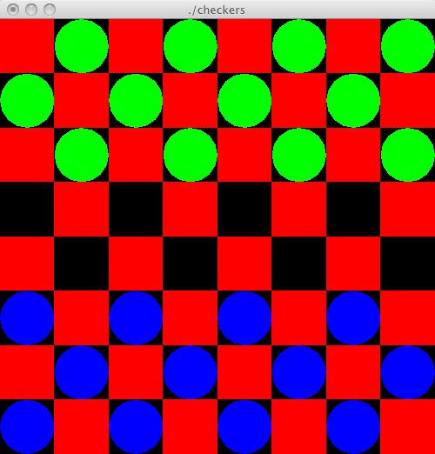
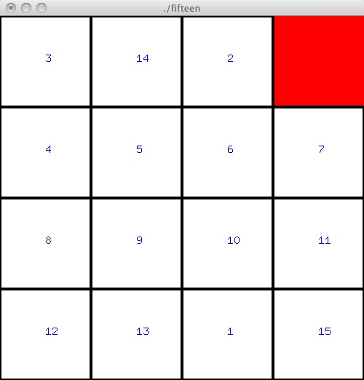
Summary
We know enough to make a realistic application
Task – Write a program that displays an image, and uses user input to update the image. Don't worry about logic behind the display

