Slide 1
Viewing
CS 234
Day 6
Jeff Parker

Slide 2
Objectives
Perspective
  What it looks like
  How we make it happen
  The limitations of the zBuffer
Debugging with –gldebug and glGetError()
Determinates
Cross Product
First Person Movement
Making a Maze

Slide 3
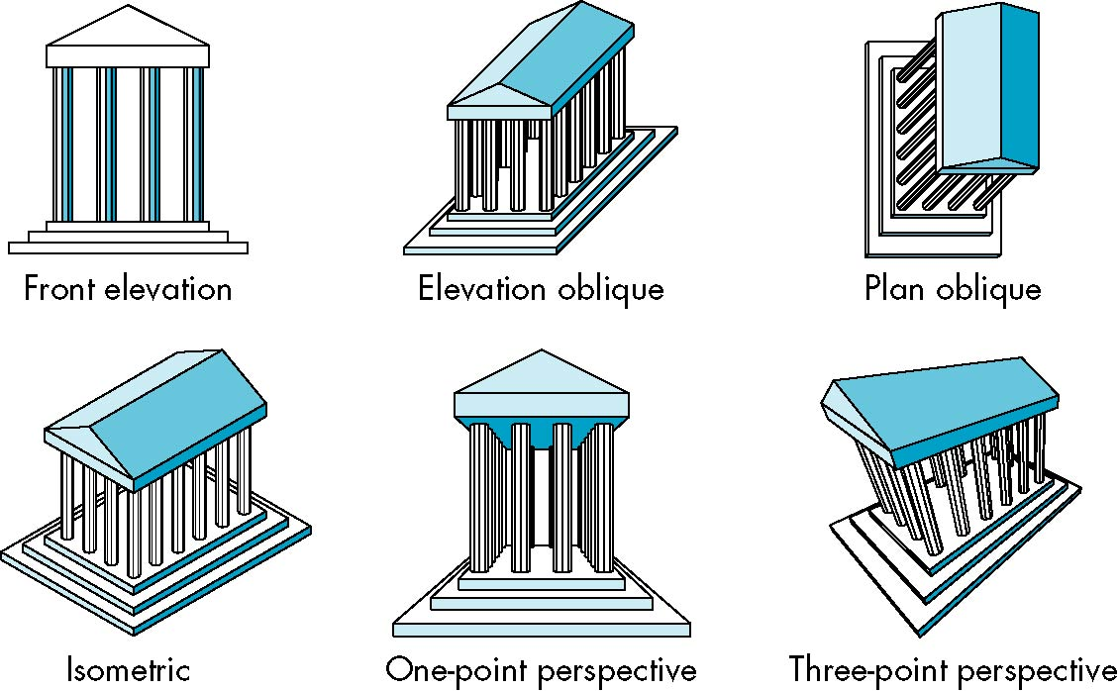

Architectural Perspectives

Slide 4
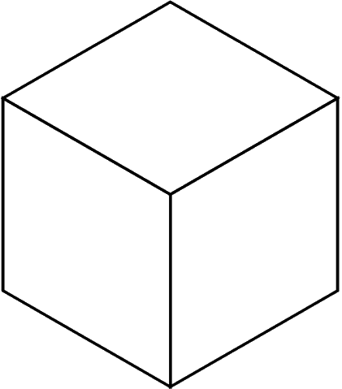
Perspective and Geometry
Where is the eye for each of these elevations?
Let's review the geometry of the cube
Where is the eye for one point, two point, and three point perspective?

Slide 5
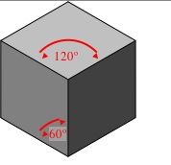
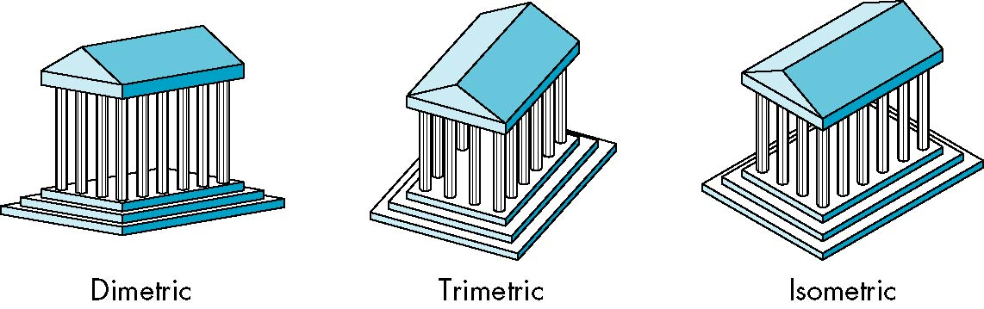
Projections
How many angles on the corner are the same?
  none: trimetric
  two: dimetric
  three: isometric
Isometric is particularly easy to fake: see next slide

Slide 6
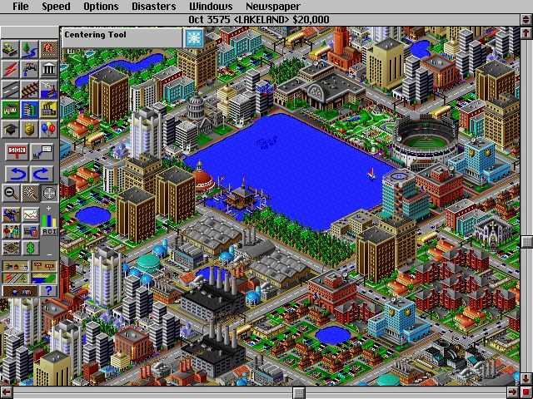
What is going on?
v

Slide 7
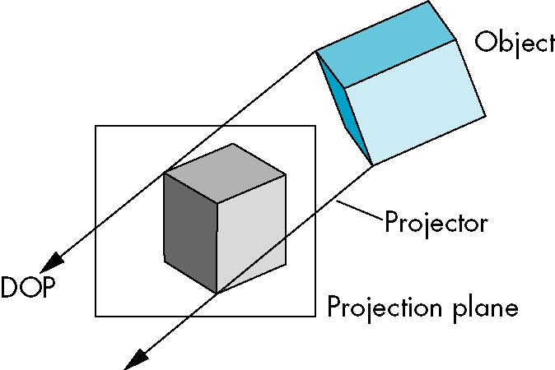
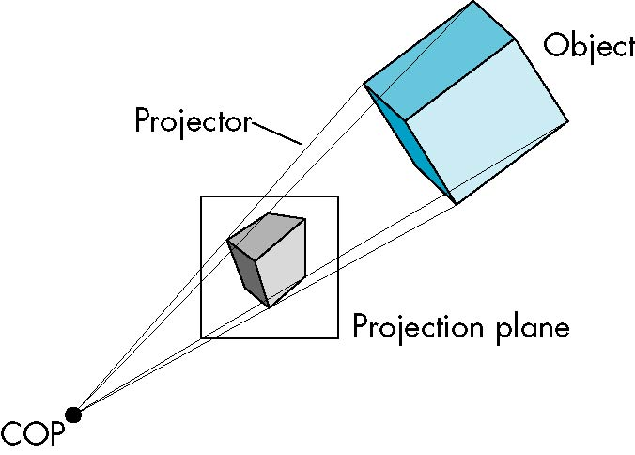
Perspective Projection
Orthogonal vs Perspective Projection

Slide 8
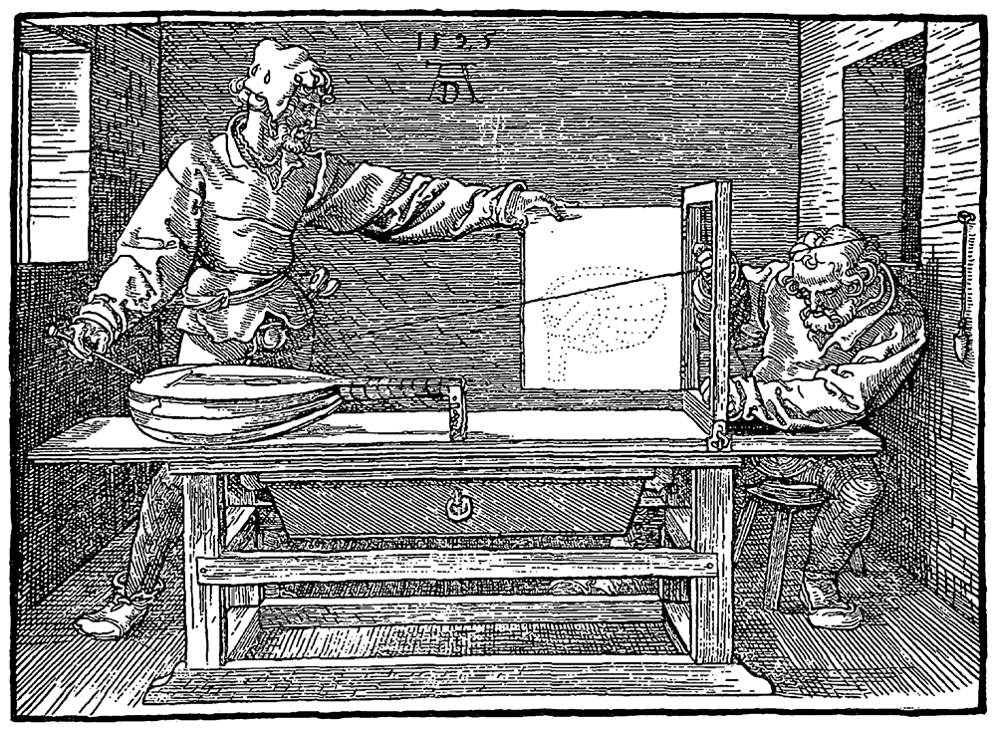
Perspective Projection
Discovered in Renaissance

Slide 9
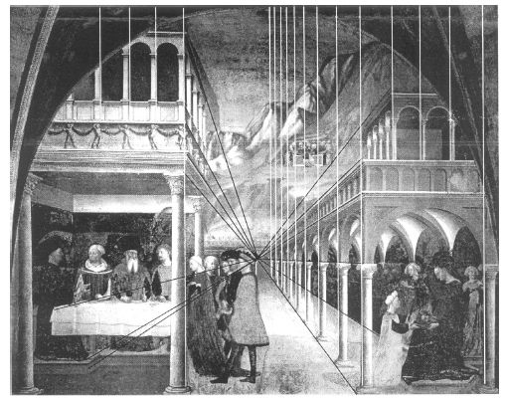
Perspective Projection
Discovered in Renaissance

Slide 10
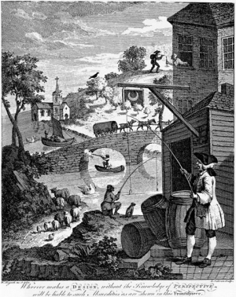
Foolishness

Slide 11
Transformations
OpenGL keeps track of these matrices as part of the state
  Model-View (GL_MODELVIEW)
  Projection (GL_PROJECTION)
  Texture (GL_TEXTURE) (ignore for now)
  Color(GL_COLOR) (ignore for now)
Single set of functions for manipulation
Select which to manipulated by
  glMatrixMode(GL_MODELVIEW);
  glMatrixMode(GL_PROJECTION);
C
p
p’=Cp
vertices
CTM
vertices

Slide 12
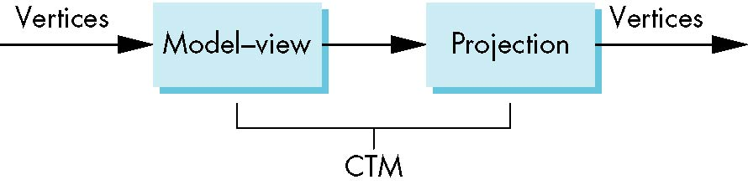
Current Transformation Matrix
The following are combined to define a 4x4 matrix called the Current Transformation Matrix (CTM)
  glMatrixMode(GL_MODELVIEW);
  glMatrixMode(GL_PROJECTION);
We can manipulate them independently, but all vertices go through both

Slide 13
Handling Raw Matrix
Can load and multiply by matrices defined in the application program
  glLoadMatrixf(m)
  glMultMatrixf(m)
The matrix m is a one dimensional array of 16 elements which are the components of the desired 4 x 4 matrix stored by columns
In glMultMatrixf, m multiplies the existing matrix on the right
We can save the current state with push, restore it with pop
Can also query the current matrix
  double m[16];
  glGetFloatv(GL_MODELVIEW, m);

Slide 14
Smooth Transitions
From a practical standpoint, we are often want to use transformations to move and reorient an object smoothly
  Problem: Given a starting point M₀ and endpoint M₁, wish to find sequence M_{t} that moves from M₀ to M₁
  We want a parameterized set of steps
  Consider the case that M₀ is I
For orientating an object, we can use the fact that every rotation corresponds to part of a great circle on a sphere
  Find the axis of rotation and angle a, and go from 0 to a
    Virtual trackball example
  Find the Euler angles a_{x}, a_{y}, a_{z}, and use (ta_{x}, ta_{y}, ta_{z})
Use quaternions - http://en.wikipedia.org/wiki/Quaternion
  See paper by Shoemaker now on course website

Slide 15
Defining Perspective
It is often simplest to define Model View transformations in terms of translations, rotations, scaling, etc.
We can also define Projection View this way: move the camera back, rotate to pan over a scene
However, it is most natural to use some special calls
Two parts: position camera, and define perspective
glLookAt(eyex, eyey, eyez, atx, aty, atz, upx, upy, upz)
glOrtho(left,right,bottom,top,near,far)
glFrustum(left,right,bottom,top,near,far)
gluPerpective(fovy, aspect, near, far)

Slide 16
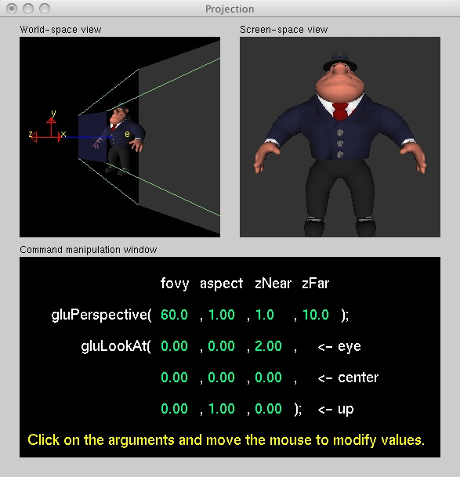
gluLookAt
  http://www.xmission.com/~nate/tutors.html
void gluLookAt( eyex, eyey, eyez, centerx, centery, centerz, upx, upy, upz)
Parameters
  eyex, eyey, eyez
    The position of the eye point.
  centerx, centery, centerz
    The position of the reference point.
  upx, upy, upz
    The direction of the up vector.
Can change the projection: o, f, p

Slide 17
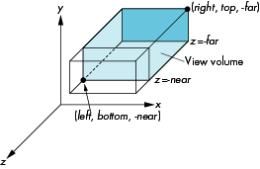
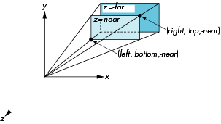
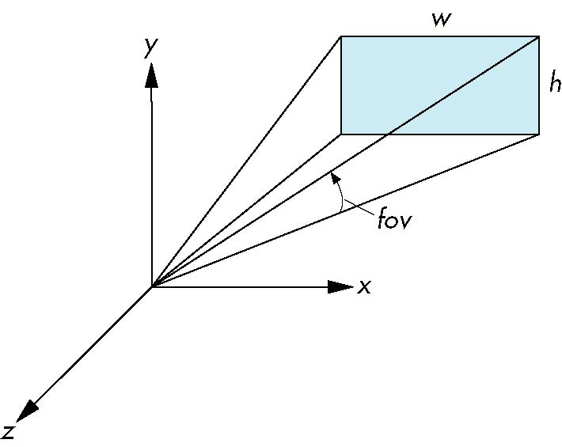
Perspective Projection
glOrtho(left,right,bottom,top,near,far)
glFrustum(left,right,bottom,top,near,far)
gluPerpective(fovy, aspect, near, far)

Slide 18
Orthographic Projection
Let's define these projections by hand
We will look at simple examples before looking at the most general example
The simplest is an orthographic: (x, y, z, 1) → (x, y, 0, 1)
Singular – sends non-zero items, such as (0, 0, 1, 0) to zero
  Singular matrices have a determinate of 0

Slide 19
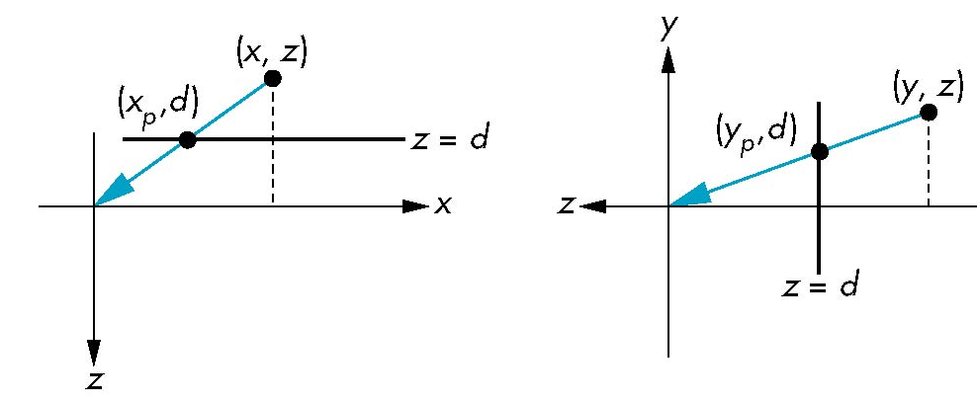
Review perspective
Look at xz and yz planes

Slide 20
Perspective Divide
How do we express that with a matrix?
Remember that (tx, ty, tz, t) = (z, y, z, 1)

Slide 21
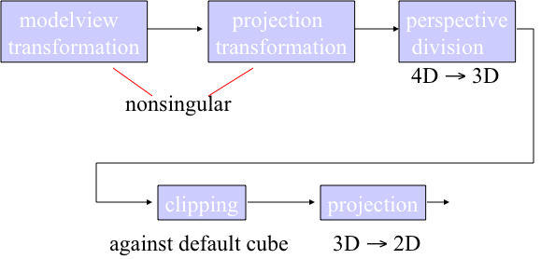
In practice
Rather than derive a projection matrix for each type of projection, convert all projections to orthogonal projections with default view volume
Allows us to use standard transformations in the pipeline and makes for efficient clipping
Delay projection to preserve z-depth for z-Buffer computation

Slide 22
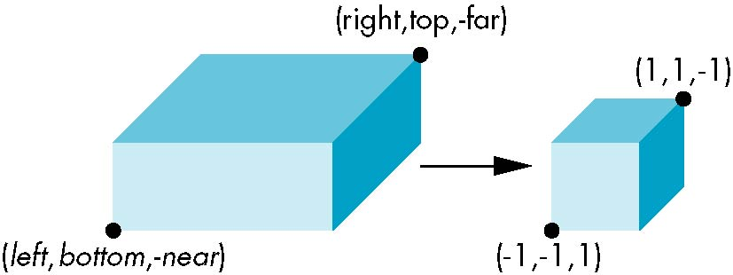
Orthographic Projection
Convert clipping box to standard cube
Two steps –
  Move center to origin
    T(-(left + right)/2, -(bottom+top)/2, -(near+far)/2
  Scale sides
    S(2/(left-right), 2/(top-bottom), 2(near-far)
P = ST

Slide 23
Orthographic Projection
T(-(left + right)/2, -(bottom+top)/2, -(near+far)/2
S(2/(left-right), 2/(top-bottom), 2(near-far)
P = ST

Slide 24
Perspective Projection
Orthographic vs Perspective

Slide 25
Perspective Projection
Effect on (left, bottom, near)

Slide 26
z-Buffer
General effect on z

Slide 27
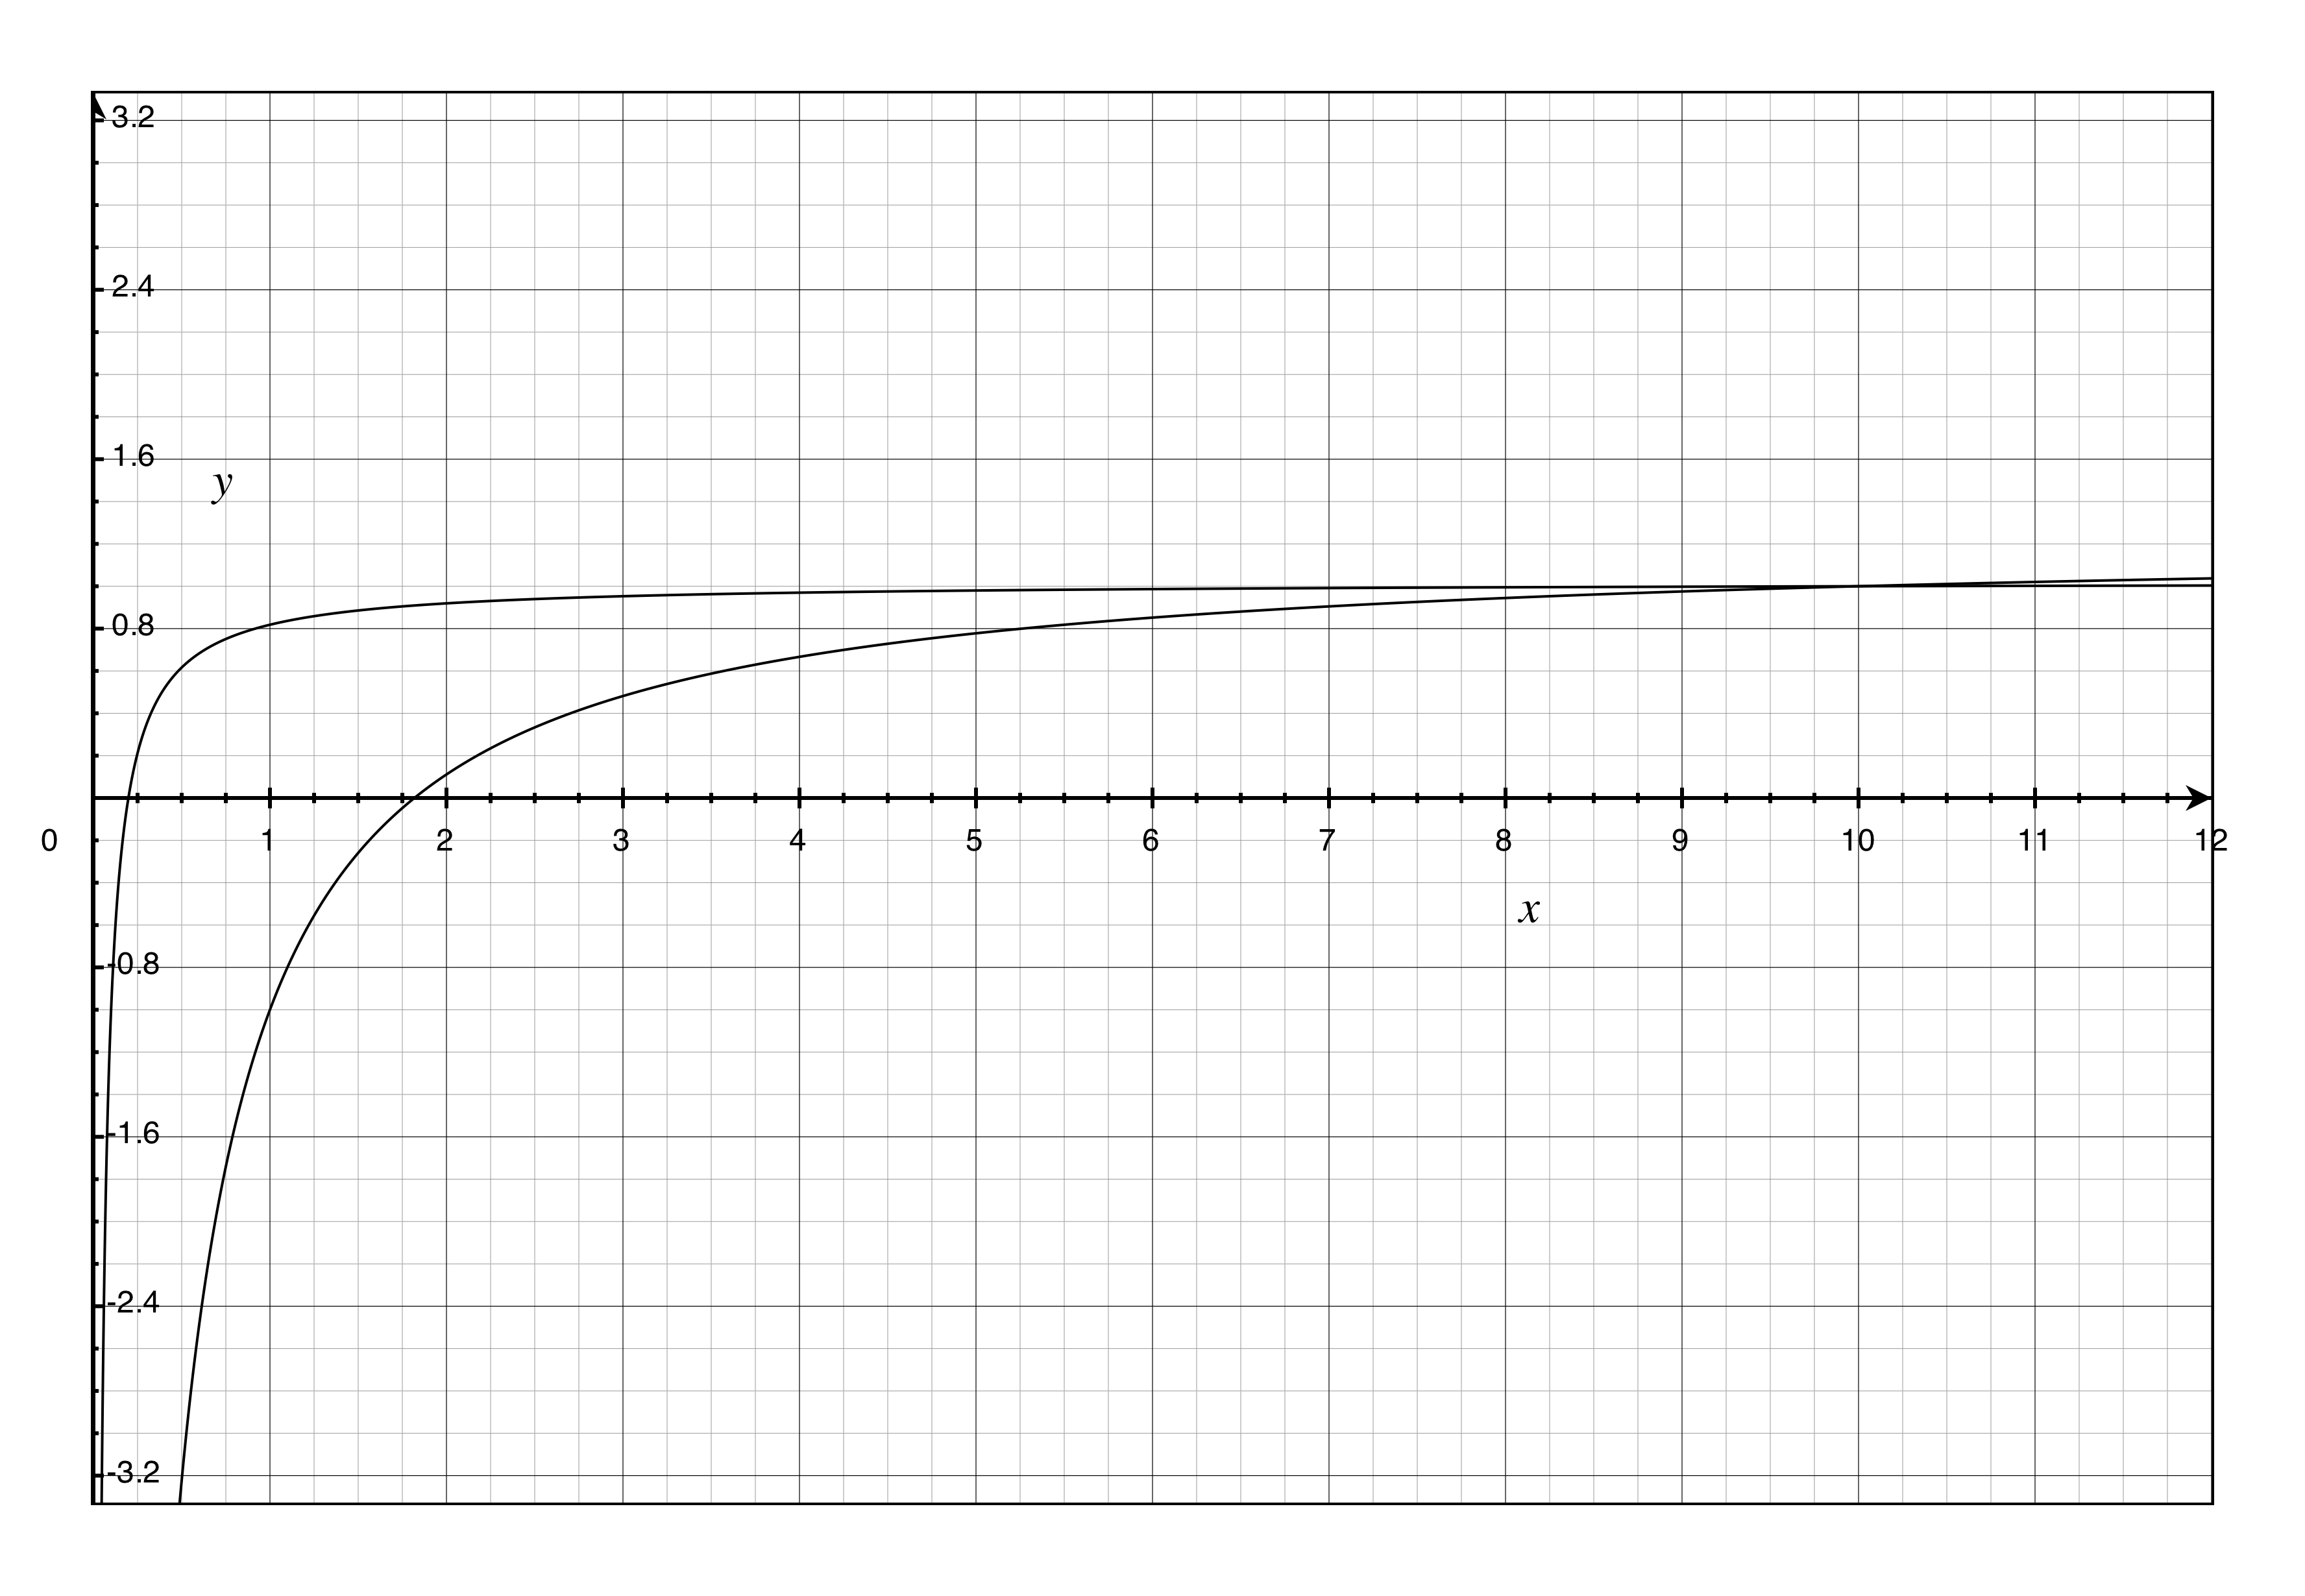
Z-Buffer
Range for (Z_{min}, Z_{max}) = (0.1, 10)
Range for (Z_{min}, Z_{max}) = (1, 10)
Uniform distances in z do not give us uniform distances in z'
Pick as large a value for near as you can

Slide 28
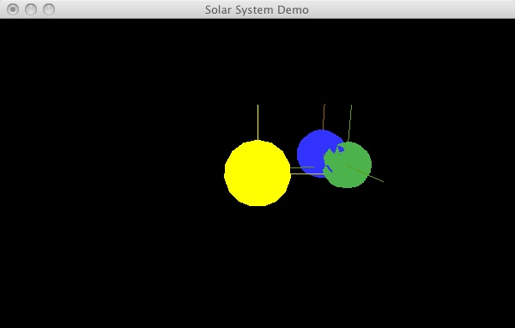
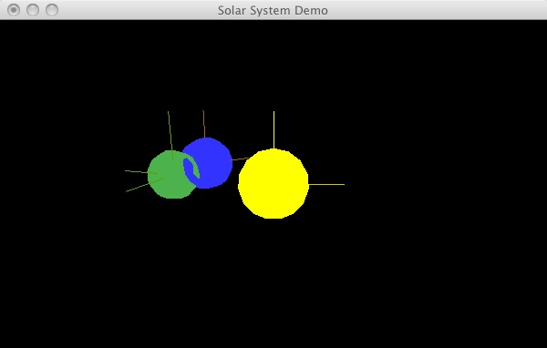
Using z-Buffer
To use the z-Buffer, you must
  1) Ask for a depth buffer when you create your window.
  2) Place a call to glEnable (GL_DEPTH_TEST) in your program's initialization routine, after a context is created and made current.
  3) Ensure that your zNear and zFar clipping planes are set correctly and in a way that provides adequate depth buffer precision. In particular, zNear and zFar should be positive (not zero or negative) values.
  4) Pass GL_DEPTH_BUFFER_BIT as a parameter to glClear
When zNear is too small, you get "z fighting"

Slide 29
OpenGL Errors
Finding and fixed problems with OpenGL calls
The manual tells you what to expect
glClear(GLbitfield mask)
  The glClear function clears buffers to preset values.
  Parameters mask: Bitwise OR operators of masks that indicate the buffers to be cleared. The four masks are as follows.
GL_COLOR_BUFFER_BIT The buffers currently enabled for color writing.
GL_DEPTH_BUFFER_BIT The depth buffer.
GL_ACCUM_BUFFER_BIT The accumulation buffer.
GL_STENCIL_BUFFER_BIT The stencil buffer.
Return Value Returns the following error codes and their conditions.
GL_INVALID_VALUE Any bit other than the four defined bits was set in mask.
GL_INVALID_OPERATION glClear was called between a call to glBegin and the corresponding call to glEnd.
My standard advice is to check the return code for every function call.

Slide 30
gldebug
When you run your program, can pass in command line parameters such as -gldebug
You program must be able to ignore them
  main(int argc, char *argv[]){
    int i;
    glutInit(&argc, argv);
-gldebug After processing callbacks and/or events, check if there are any OpenGL errors by calling glGetError. If an error is reported, print out a warning by looking up the error code with gluErrorString.
% ./my_cube_view -gldebug
2009-10-01 10:46:24.067 cube_view[75593:10b] GLUT Warning: GL error: invalid operation

Slide 31
glGetError()
void glGetError(void);
The glGetError function returns the value of the error flag. Each detectable error is assigned a numeric code and symbolic name. When an error occurs, the error flag is set to the appropriate error code value.
  No other errors are recorded until glGetError is called, the error code is returned, and the flag is reset to GL_NO_ERROR.
  If a call to glGetError returns GL_NO_ERROR, there has been no detectable error since the last call to glGetError, or since OpenGL was initialized.
To allow for distributed implementations, there may be several error flags. If any single error flag has recorded an error, the value of that flag is returned and that flag is reset to GL_NO_ERROR when glGetError is called. If more than one flag has recorded an error, glGetError returns and clears an arbitrary error flag value.
  If all error flags are to be reset, you should always call glGetError in a loop until it returns GL_NO_ERROR.

Slide 32
glGetError()
We know there is a problem, but we don't know where it is.
We could add a check to every call, or we could sprinkle calls between blocks of calls that check for an error.
For example, let's sprinkle our code with the following
  if (glGetError() != GL_NO_ERROR)
    printf("GL Error: (%s)\n", gluErrorString(glGetError()));
When we run the program, we see the following
  % ./cube_view
  GL Error: no error
  GL Error: no error
  GL Error: no error
  GL Error: no error
  GL Error: no error
  GL Error: no error

Slide 33
glGetError()
The first call to glGetError returns the error, and clears it
  if (glGetError() != GL_NO_ERROR)
    printf("GL Error: (%s)\n", gluErrorString(glGetError()));
What we should say is
  GLenum error;
  if ((error = glGetError()) != GL_NO_ERROR)
    printf("GL Error: %s\n", gluErrorString(error));
With this code added, I see the following
  % ./cube_view
  GL Error: invalid operation
  GL Error: invalid operation
  GL Error: invalid operation…

Slide 34
Define function
void checkError(char *str) {
  GLenum error;
  if ((error = glGetError()) != GL_NO_ERROR)
    printf("GL Error: %s (%s)\n", gluErrorString(error), str);
}
void polygon(int a, int b, int c , int d {
  checkError("Poly 1");
  glBegin(GL_POLYGON);
  glClear(GL_COLOR_BUFFER_BIT | GL_DEPTH_BUFFER_BIT);
  glColor3fv(colors[a]);
  glVertex3fv(vertices[a]);
  ...
  glEnd();
  checkError("Poly 2");
}
% ./cube_view
GL Error: invalid operation (Poly 2)
GL Error: invalid operation (Poly 2)
GL Error: invalid operation (Poly 2)
GL Error: invalid operation (Poly 2)
GL Error: invalid operation (Poly 2)
GL Error: invalid operation (Poly 2)

Slide 35
checkError()
void checkError(char *str) {
  GLenum error;
  if ((error = glGetError()) != GL_NO_ERROR)
    printf("GL Error: %s (%s)\n", gluErrorString(error), str);
}
void polygon(int a, int b, int c , int d {
  checkError("Poly 1");
  glBegin(GL_POLYGON);
  glClear(GL_COLOR_BUFFER_BIT | GL_DEPTH_BUFFER_BIT);
  glColor3fv(colors[a]);
  glVertex3fv(vertices[a]);
  ...
  glEnd();
  checkError("Poly 2");
}
% ./cube_view
GL Error: invalid operation (Poly 2)
GL Error: invalid operation (Poly 2)
GL Error: invalid operation (Poly 2)
GL Error: invalid operation (Poly 2)
GL Error: invalid operation (Poly 2)
GL Error: invalid operation (Poly 2)

Slide 36
Determinates
We review determinates for a 3x3 matrix.
  Measures the volume of the image of the unit cube.
Some transformations mash 3 dimensions into 2
  Projection of (x, y, z) onto (x, y, 0)
  These are said to be singular
These will have a determinate of 0
  The volume of the unit square is 0

Slide 37
Cross Product
We have defined one kind of vector multiplication – dot product
  Goes from R³ x R³ → R¹
Today we define another multiplication – the cross product
Goes from R³ x R³ → R³
  Many useful properties – find the vector normal to plane
Like the dot product, measures how close to colinear the vectors are

Slide 38
Notation
It is often useful to give names to the different unit vectors
In Complex Analysis, we use 1 and i for the x and y unit normals
In Physics we often use i, j, and k for (1, 0, 0), (0, 1, 0), and (0, 0, 1)

Slide 39
Computing Cross Product
One way to define the cross product is as the determinate of a 3x3 matrix
Rows represent the unit vectors i, j, and k and the two vectors a and b
Note that the top row holds vectors, while the next two rows hold scalars

Slide 40
Computing Cross Product
Another way to compute the cross product is as a matrix multiplication with the skew symmetric matrix

Slide 41
Application
Given three points, find the plane that contains them
Result will be something of the form
  ax + by + cz = d
    Where (a, b, c) is the normal vector.
But what is the normal vector?
Given points
  p₁ = (1, 2, 3)
  p₂ = (3, 7, 4)
  p₃ = (2, 2, 4)
v₁ = p₂ – p₁ = (2, 5, 1)
v₂ = p₃ – p₁ = (1, 0, 1)
n = v₁ x v₂ = 5i + j + 0k – 5k – 0i – 2j = 5i – j -5k = (5, -1, -5)
Check: is dot product of n with v₁ = 0? Is dot product with v₂ = 0?
  Is the dot product with (p₂ – p₃) = 0?

Slide 42
Application (cont)
Given points
  p₁ = (1, 2, 3)
  p₂ = (3, 7, 4)
  p₃ = (2, 2, 4)
n = (5, -1, -5)
Equation of plane is
  5x –y - 5z = d
Now just need to plug in one of the points to find d
  5 x 1 – 1 x 2 – 5 x 3 = -12
Check: do all three points lie on the plane?
  5 x 3 – 1 x 7 – 4 x 5 = 15 – 7 -20 = -12
  5 x 2 – 1 x 2 – 5 x 4 = 10 – 2 – 20 = -12

Slide 43
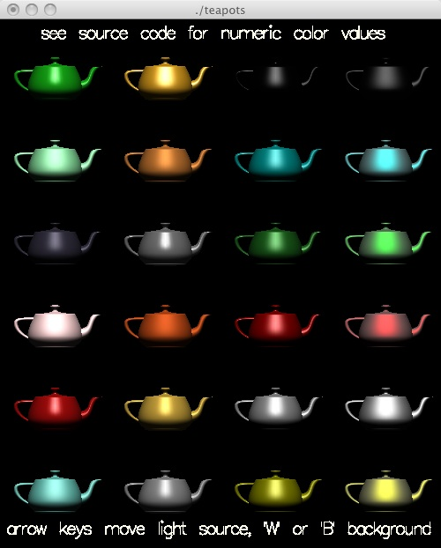
Application
Advanced shading uses specular reflection
Need to know where rays will bounce
To figure this out, we use the normal to a plane
Given three points, find normal vector

Slide 44
Homework
Pen and Paper – Given a plane, defined as ax + by + cz = d, and a line segment defined by two endpoints, decide if the line segments intersects the plane
Project – Create (or reuse your last project) a 3D world, and use the keys to let the user wander through the world

Slide 45
Turtle Graphics
Our turtle graphics had the following state
  theta – our heading
  (x, y) – our current position
Challenge is to allow the user to move in your world without getting lost
  Do not worry about physics, or moving through walls, etc.
Some guidelines
  Give the user something to look at (a blank screen is disconcerting)
  Move in increments: sudden changes are hard to follow
    Don't turn 90 degrees – turn 15 or 30 degrees, or continuously
  If you need to stay on a grid, disable movement off grid
  Some perspective is good: too much is hard to follow
  Allow the user to return to known configuration by typing 'r'

Slide 46
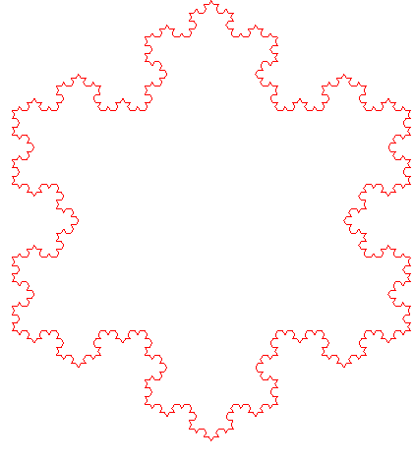

Turtle Library
/** Draw a line of length size */
void turtleDrawLine(GLint size)
  glVertex2f(xPos, yPos);
  turtleMove(size);
  glVertex2f(xPos, yPos);
}
int turtleTurn(int alpha) {
  theta = theta + alpha;
  theta = turtleScale(theta);
  return theta;
}
/** Move the turtle. Called to move and by DrawLine */
void turtleMove(GLint size) {
  xPos = xPos + size * cos(DEGREES_TO_RADIANS * theta);
  yPos = yPos + size * sin(DEGREES_TO_RADIANS * theta);
}

Slide 47
First Person Movement
Use the gluLookAt() call, and point to a point 10 yards in front of your nose
  Where would I be if I took 10 steps?
/** Move the turtle. Called to move and by DrawLine */
void turtleMove(GLint size) {
  xPos = xPos + size * cos(DEGREES_TO_RADIANS * theta);
  yPos = yPos + size * sin(DEGREES_TO_RADIANS * theta);
}

Slide 48
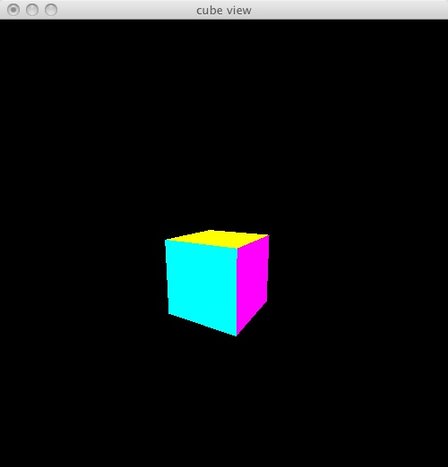
Turning
Some edits to cube_view.c
#define DEGREES_TO_RADIANS 3.14159/180.0
int alpha = 270;
void turn(int deg)
{
  alpha += deg;
  if (alpha > 360)
    alpha -= 360;
  if (alpha < 0)
    alpha += 360;
  if (debug)
    printf("Alpha %d\n", alpha);
}

Slide 49
Edit colorcube() to remove Black
void polygon(int a, int b, int c , int d) {
  glBegin(GL_POLYGON);
    glColor3fv(colors[a]);
    glVertex3fv(vertices[a]);
    glVertex3fv(vertices[b]);
    glVertex3fv(vertices[c]);
    glVertex3fv(vertices[d]);
  glEnd();
}
void colorcube() {
  polygon(1,0,3,2);
  polygon(2,3,7,6);
  polygon(3,0,4,7);
  polygon(5,1,2,6);
  polygon(7,4,5,6);
  polygon(4,0,1,5);
}
void colorcube()
{
  polygon(0,3,2,1);
  polygon(2,3,7,6);
  polygon(0,4,7,3);
  polygon(1,2,6,5);
  polygon(4,5,6,7);
  polygon(0,1,5,4);
}

Slide 50
Turn your gaze
void display() {
  glClear(GL_COLOR_BUFFER_BIT | GL_DEPTH_BUFFER_BIT);
  /* update viewer position in model-view matrix */
  glLoadIdentity();
  checkError("Before call");
  gluLookAt(viewer[0],viewer[1],viewer[2],
    10*cos(DEGREES_TO_RADIANS * alpha) + viewer[0], 0.0, 10*sin(DEGREES_TO_RADIANS * alpha) + viewer[2],
    0.0, 1.0, 0.0);
  /* gluLookAt(viewer[0],viewer[1],viewer[2], 0.0, 0.0, 0.0, 0.0, 0.0, 1.0); */
  checkError("After call");
  /* rotate cube *
  glRotatef(theta[0], 1.0, 0.0, 0.0);
  glRotatef(theta[1], 0.0, 1.0, 0.0);
  glRotatef(theta[2], 0.0, 0.0, 1.0);
  colorcube();
  ...

Slide 51
Mazes
Many games need to create a random Maze
This note shows a simple way to do so, using the notion of Spanning Trees
We discuss three ways to build a spanning tree
  The first of these, Depth First Search, does not give interesting mazes
We then look at ways to speed up the relevant algorithms

Slide 52
Spanning Tree
Problem: find a subgraph that is connected but has no loops
  Many application should be loop free
Application: Making a Maze

Slide 53
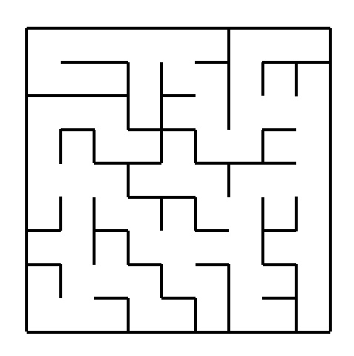
Maze
We start with a two dimensional maze
Can build walls using standard office furniture
Start with a grid
Remove walls
Which walls can we remove?

Slide 54
How do we make a maze?
  We look at the "dual graph" to a maze
    Idea of dual graphs is important.
      In the Platonic solids, cube is dual to octahedron, etc
  Start with the underlying grid of rooms without doors
  Think of each room as a vertex, and a wall as an edge connecting the two rooms on either side
  Select a loop-free subset of the edges: destroy those walls.
  The walls remaining are our maze

Slide 55
Spanning Tree Algorithms
Depth First Search provides an easy algorithm to make a spanning tree
  At each step, add the edge (source, this) to a list we accumulate
We visit every vertex connected to our starting point once
We visit only one (so there are no loops)
void dfs(Vertex source) {
  mark this visited, set source to source;
  add <source, this> to spanning tree
  while (null != (next= this.getNextSuccessor()))
    if (!next.visited())
      next.dfs(this); // this is the source for vertex next
  }
}

Slide 56
Back to our application
  while (null != (next= this.getNextSuccessor()))
If your dfs always takes successors in the same order, we will wind up with a very dull maze
We can randomize the choices.
One way is to put random costs on walls and compute minimal spanning tree

Slide 57
Minimal Spanning Tree
Problem: find the cheapest subgraph that is connected
Many applications: Cheapest set of roads
Application: put random costs on walls and make maze

Slide 58
Kruskal's MST algorithm
A greedier algorithm starts with all edges
We add the cheapest edge that helps us to our MST
At the start, each city in it's own set
  This example has 8 sets
Pick the cheapest edge.
  Does it help us?
  If it connects two sets, add to MST
There are 5 sets now
If cheapest edge connects two points in the same set, toss the edge

Slide 59
Kruskal's Maze
Start with Grid. Assign random weights to the walls.
Pick the cheapest wall
If rooms on either side are not connected yet, remove the wall

Slide 60
Kruskal's Maze
How do we know which walls we want to remove and which to keep?
We place the squares in equivalence classes. Two squares are in the same class if they are connected.
We don't remove a wall unless it will combine two classes
We need an efficient way to store and test equivalence classes

Slide 61
Kruskal Algorithm
Initialize: each vertex is a separate equivalence class
While there is more than one class
  Pick the least expensive remaining edge
  If it joins verticies in different classes
    add to the MSTree
    Merge the two classes
  else
    discard the edge
Another application for Priority Queue: pick cheapest edge
New problem is to merge sets and test to see if two cities are in same set
Krushkal is better than Pim for sparse graphs: few edges

Slide 62
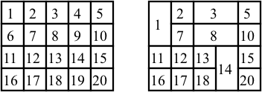
Kruskal Implementation
Number the squares with different numbers
Use the number as a representative of elements in the same set
When you combine two sets, pick (say) the lowest number
Use flood-fill algorithm to spread labeling

Slide 63
Flood Fill algorithm
We have decided to remove a wall
Pick the higher number
Wish to place the lower number in all cells in the same set
Do not wish to enter new sets
This is like the “fill” function in Draw programs

Slide 64
Flood Fill algorithm
floodFill(int row, int col, int oldSet, int newSet)
{
  if (row is out of range) return;
  if (col is out of range) return;
  if (array[row][col] != oldSet)
    return;
  set array[row][col] = newSet;
  floodFill(row+1, col, oldSet, newSet);
  floodFill(row-1, col, oldSet, newSet);
  floodFill(row, col+1, oldSet, newSet);
  floodFill(row, col-1, oldSet, newSet);
}

Slide 65
Data Structures for Union-Find
We fast way of representing disjoint sets for union (join two sets) and find (are these two cities already in the same set?)
One way to do this is to have each set nominate a representative. Each city keeps a pointer to a representative city
find - We are in the same set if we have the same representative
union - We become the same set if your representative points to mine
  Our pointers to representatives may become linked lists that terminate in a representative

Slide 66
Rooted Tree
Each (disjoint) set is represented as a "rooted tree"
Each element has two fields: a pointer to it's parent (root), and a count (not shown in the diagrams)
The tree above represents a set with three elements: 1, 2, and 4
The representative (name) of the set is 2
  2's parent pointer is null
We use the field count to decide which tree should point at the other when merging (larger set elects it's representative). This reduces average length

Slide 67
Algorithm
node find(node p){
  while (p.parent != null)
    p = p.parent;
  return p;
}
union (node p, node q) { // p and q are representatives
  if (p.count > q.count)
    union(q, p);
  else {
    q.count += p.count; // All that is mine is yours
    p.parent = q;
  }
}

Slide 68
Improvements
Whenever you perform a find, you trace a path from your current location to the root
Why not take some extra time and shorten the path for the next search?
Two methods are used:
  Path squashing
  Path halving

Slide 69
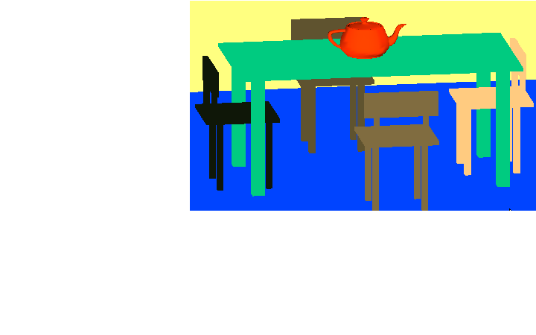
Summary
Look at Perspective
Our next project is Move the viewer through the scene
Pen and Paper – Given a plane and a line segment, decide if the line segment cuts the plane

Slide 70
References for Graph algorithms
Standish has a short introduction to Graphs at the end of chapter 8
Robert Sedgewick's "Algorithms in C", Addison-Wesley
Sara Baase and Allen van Gelder's "Computer Algorithms", Addison-Wesley, third edition
The Design and Analysis of Computer Algorithms, by Aho, Hopcroft, and Ullman (Addison-Wesley)
The first version of the rooted-trees algorithm is due to McIlroy and Morris.
  Path compression is attributed to Tritter
  The analysis of the time was proved by Tarjan, and described in his excellent book on Network Algorithms.
  Tarjan has introduced a large number of very clever data structures
For an unusual application of graphs
  http://www.firstmonday.dk/issues/issue7_4/krebs/

