Slide 1
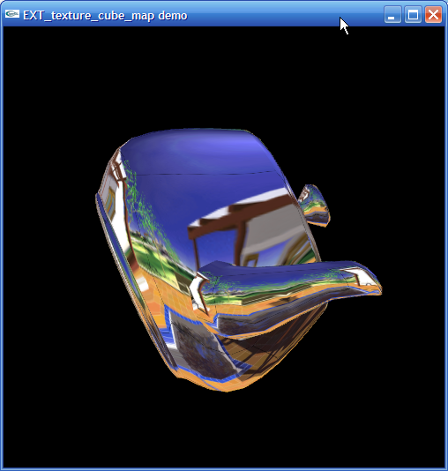
Texture Maps
Oct 2009

Slide 2
Objectives
Introduce Mapping Methods
  Texture Mapping
  Environment Mapping
  Bump Mapping
Consider basic strategies
  Forward vs backward mapping
  Point sampling vs area averaging

Slide 3
Three Types of Mapping
We will talk about thee kinds of mapping tonight
Texture Mapping
  Uses images to fill inside of polygons
Environment (reflection mapping)
  Uses a picture of the environment for texture maps
  Allows simulation of highly specular surfaces
Bump mapping
  Emulates altering normal vectors during the rendering process

Slide 4
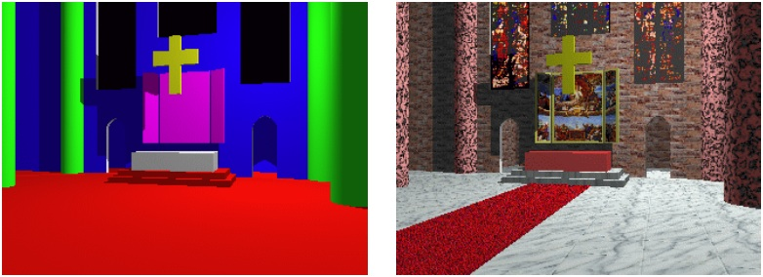
Limits of Geometric Modeling
We can create well lit spheres and cones, but geometry lacks visual interest
  Needed to spice things up

Slide 5
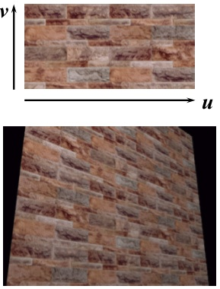
Bricks

Slide 6
Basic Stragegy
Three steps to applying a texture
  specify the texture
    read or generate image
    assign to texture
    enable texturing
  assign texture coordinates to vertices
    Proper mapping function is left to application
  specify texture parameters
    wrapping, filtering

Slide 7
Texture Mapping and the OpenGL Pipeline
Images and geometry flow through separate pipelines
  Join at the rasterizer
  “complex” textures do not affect geometric complexity
vertices
geometry pipeline
rasterizer
image
pixel pipeline

Slide 8
Specifying a Texture Image
Define a texture image from an array of
texels (texture elements) in CPU memory
  Glubyte my_texels[512][512];
Define as any other pixel map
  Scanned image
  Generate by application code
Enable texture mapping
  glEnable(GL_TEXTURE_2D)
  OpenGL supports 1-4 dimensional texture maps

Slide 9
Define Image as a Texture
glTexImage2D( target, level, components,
w, h, border, format, type, texels );
target: type of texture, e.g. GL_TEXTURE_2D
level: used for mipmapping (discussed later)
components: elements per texel
w, h: width and height of texels in pixels
border: used for smoothing (discussed later)
format and type: describe texels
texels: pointer to texel array
glTexImage2D(GL_TEXTURE_2D, 0, 3, 512, 512, 0, GL_RGB, GL_UNSIGNED_BYTE, my_texels);

Slide 10
Converting A Texture Image
OpenGL requires texture dimensions to be powers of 2
If dimensions of image are not powers of 2
gluScaleImage( format, w_in, h_in,
type_in, *data_in, w_out, h_out,
type_out, *data_out );
  data_in is source image
  data_out is for destination image
Image interpolated and filtered during scaling
See test.c – my system says…
    GL_ARB_texture_non_power_of_two
Notes:
If

Slide 11
Mapping a Texture
Based on parametric texture coordinates
glTexCoord*() specified at each vertex
Texture Space
Object Space
t
1, 1
(s, t) = (0.2, 0.8)
0, 1
A
a
c
(0.4, 0.2)
b
B
C
0, 0
1, 0
s
(0.8, 0.4)

Slide 12
Applying Textures II
specify textures in texture objects
set texture filter (minification/magnification)
set texture function
set texture wrap mode
set optional perspective correction hint
bind texture object
enable texturing
supply texture coordinates for vertex
  coordinates can also be generated

Slide 13
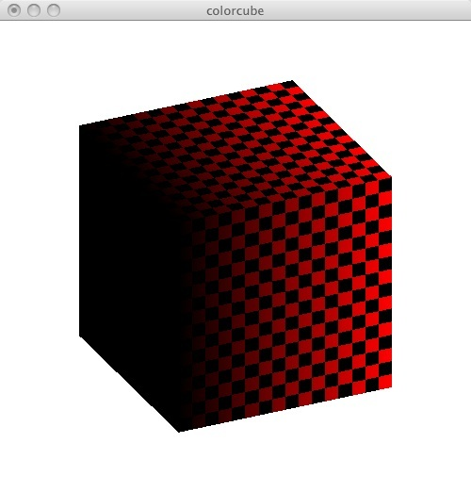
In practice
Let's walk through a simple example
We create a texture
As we image the object (a cube) we tie a texture coordinate to each vertex
We enable texture mapping

Slide 14
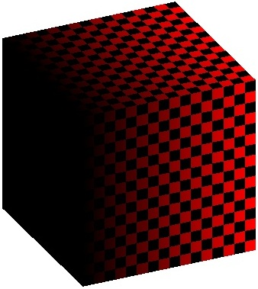
Build a texture
/* Build a simple checkerboard texture */
void buildTexture(GLubyte image[MAX][MAX][3])
{
  int i, j;
  for (i = 0; i < MAX; i++)
  {
    for (j = 0; j < MAX; j++)
    {
      int c = ((((i&0x8)==0)^((j&0x8))==0))*255;
      image[i][j][0]= (GLubyte) c;
      image[i][j][1]= (GLubyte) 0;
      image[i][j][2]= (GLubyte) 0;
    }
  }
}

Slide 15
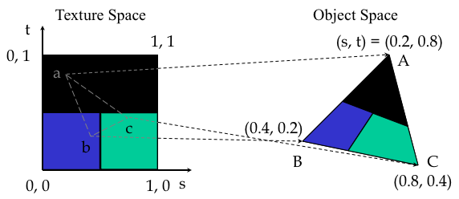
Map textures to Object Space
void polygon(int a, int b, int c, int d) {
  glBegin(GL_POLYGON);
    glColor4fv(colors[a]);
    glTexCoord2f(0.0,0.0);
    glVertex3fv(vertices[a]);
    glColor4fv(colors[b]);
    glTexCoord2f(0.0,1.0);
    glVertex3fv(vertices[b]);
    glColor4fv(colors[c]);
    glTexCoord2f(1.0,1.0);
    glVertex3fv(vertices[c]);
    glColor4fv(colors[d]);
    glTexCoord2f(1.0,0.0);
    glVertex3fv(vertices[d]);
  glEnd();
}

Slide 16
main
int main(int argc, char **argv)
{
  GLubyte image[MAX][MAX][3];
  if ((argc > 1) && (argv[1][0] != '-'))
    readPPMFile(image, argv[1]);
  else
    buildTexture(image);
  glutInit(&argc, argv);
  glutInitDisplayMode(GLUT_DOUBLE | GLUT_RGB | GLUT_DEPTH);

Slide 17
Enable Textures in main
  glutCreateWindow("colorcube");
  glutReshapeFunc(myReshape);
  glutDisplayFunc(display);
  glutIdleFunc(spinCube);
  glutMouseFunc(mouse);
  glEnable(GL_DEPTH_TEST);
  glEnable(GL_TEXTURE_2D);
  glTexImage2D(GL_TEXTURE_2D,0,3,MAX,MAX,0,GL_RGB,GL_UNSIGNED_BYTE, image);
  glTexParameterf(GL_TEXTURE_2D,GL_TEXTURE_WRAP_S,GL_REPEAT);
  glTexParameterf(GL_TEXTURE_2D,GL_TEXTURE_WRAP_T,GL_REPEAT);
  glTexParameterf(GL_TEXTURE_2D,GL_TEXTURE_MAG_FILTER,GL_NEAREST);
  glTexParameterf(GL_TEXTURE_2D,GL_TEXTURE_MIN_FILTER,GL_NEAREST);
  glutKeyboardFunc(key);
  glClearColor(1.0,1.0,1.0,1.0);
  glutMainLoop();
  return 0;
}

Slide 18
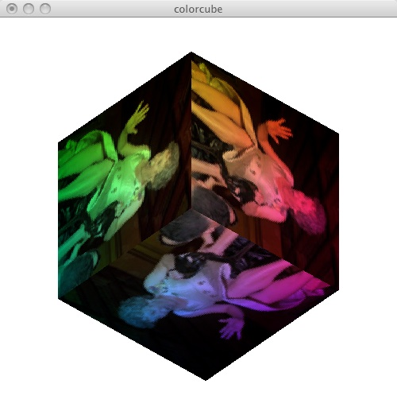
PPM Files
Portable Pixel Map (PPM) files are a simple, uncompressed format
Can be read by xv and gimp (GNU Image Manipulation Program).
  I use GraphicConverter from Lemksoft
Header holds
  Version String
  # One or more comments
  width height maxval
Example
  P6
  # Created by Paint Shop Pro 5
  128 128
  # Could have more comments between values
  255
  &@#$5%%...
OpenGL does not support reading or writing graphical images (JPG, PNG, etc)
The .ppm format is simple enough for us to create utility to read a file

Slide 19
ReadPPMFile Header
/* Read a P6 PPM File */
int readPPMFile(GLubyte image[MAX][MAX][3], char *filename) {
  FILE* fp;
  int i, w, h, m;
  char head[70]; /* max line <= 70 in PPM (per spec). */
  fp = fopen(filename, "rb");
  if (!fp) {
    perror(filename);
    exit(1);
  }
  /* Check for the PPM Magic number, P6 */
  fgets(head, 70, fp);
    if (strncmp(head, "P6", 2)) {
      fprintf(stderr, "%s: Not a raw PPM file\n", filename);
      exit(1);
    }

Slide 20
ReadPPMFile Header
/* grab the three elements in the header (width, height, maxval). */
i = 0;
while (i < 3) {
  fgets(head, 70, fp);
  if (head[0] == '#') /* skip comments. */
    continue;
  if (i == 0)
    i += sscanf(head, "%d %d %d", &w, &h, &m);
  else if (i == 1)
    i += sscanf(head, "%d %d", &h, &m);
  else if (i == 2)
    i += sscanf(head, "%d", &m);
}
if ((w != MAX) || (h != MAX) || (m > 255))

Slide 21
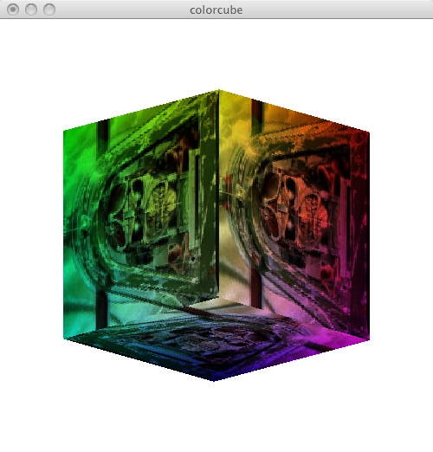
The work in ReadPPMFile
/* Read a P6 PPM File */
int readPPMFile(GLubyte img[MAX][MAX][3], char *fname) {
  ...
  fread(image, sizeof(unsigned char), w*h*3, fp);
  fclose(fp);
  return 1;
}
int main(int argc, char **argv) {
  ...
  if ((argc > 1) && (argv[1][0] != '-'))
    readPPMFile(image, argv[1]);
  ...

Slide 22
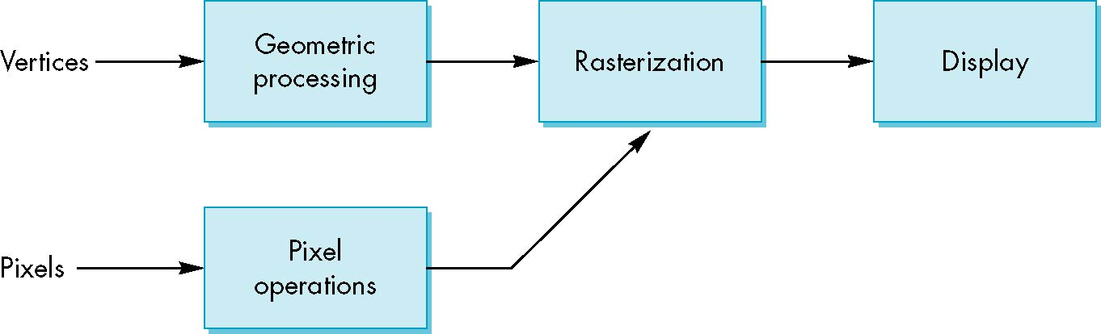
Where does mapping take place?
Mapping is implemented at the end of the rendering pipeline
  Texture is loaded into Pixel Memory
  Merged during Rasterization
  Efficient as few polygons make it past the clipper

Slide 23
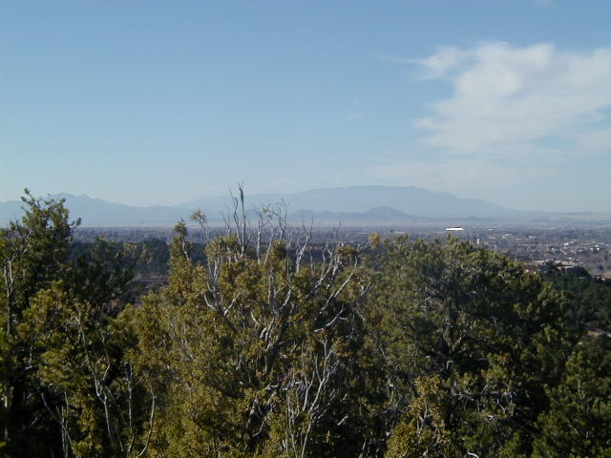
Texture Mapping
y
z
x
geometry
display
t
image
Look at Nate Robins' Tutor
s

Slide 24
Texture Parameters
OpenGL has a variety of parameters that determine how texture is applied
  Wrapping parameters determine what happens if s and t are outside the (0,1) range
  Filter modes allow us to use area averaging instead of point samples
  Mipmapping allows us to use textures at multiple resolutions
  Environment parameters determine how texture mapping interacts with shading

Slide 25
Texture Functions
Controls how texture is applied
glTexEnv{fi}[v]( GL_TEXTURE_ENV, prop, param )
GL_TEXTURE_ENV_MODE modes
  GL_MODULATE: modulates with computed shade
  GL_BLEND: blends with an environmental color
  GL_REPLACE: use only texture color
  GL(GL_TEXTURE_ENV, GL_TEXTURE_ENV_MODE, GL_MODULATE);
Set blend color with GL_TEXTURE_ENV_COLOR

Slide 26
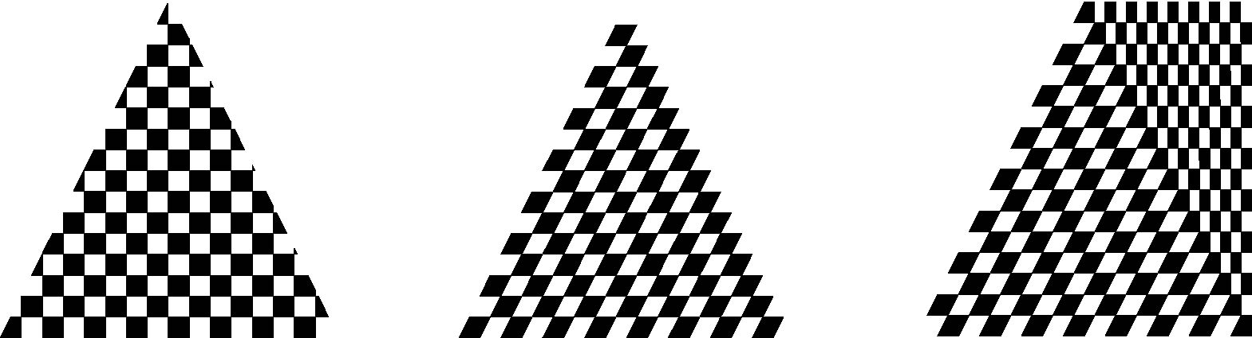
Interpolation
OpenGL uses interpolation to find proper texels from specified texture coordinates
Can be distortions
texture stretched
over trapezoid
showing effects of
bilinear interpolation
good selection
of tex coordinates
poor selection
of tex coordinates

Slide 27
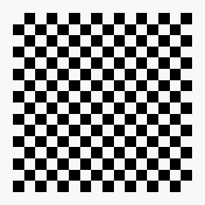
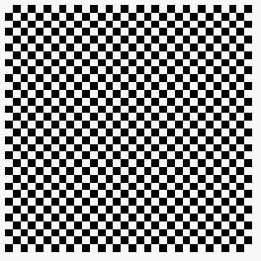

Wrapping Mode
Clamping: if s,t > 1 use 1, if s,t <0 use 0
Wrapping: use s,t modulo 1
  glTexParameteri( GL_TEXTURE_2D,
  GL_TEXTURE_WRAP_S, GL_CLAMP )
  glTexParameteri( GL_TEXTURE_2D,
  GL_TEXTURE_WRAP_T, GL_REPEAT )
t
s
GL_REPEAT
wrapping
GL_CLAMP
wrapping
texture

Slide 28
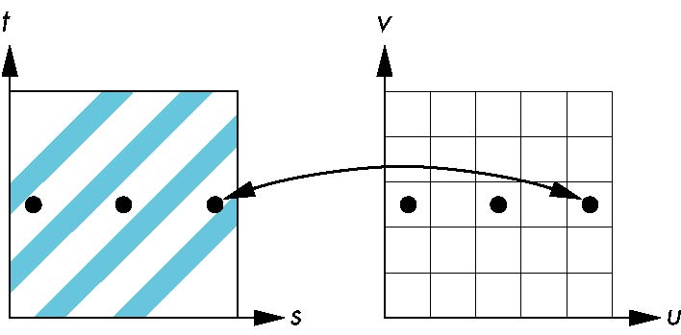
Aliasing
Point sampling of the texture can lead to aliasing errors
miss blue stripes
point samples in u,v
(or x,y,z) space
point samples in texture space

Slide 29
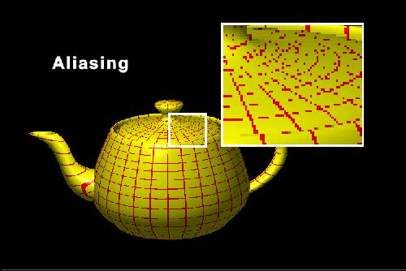

Slide 30
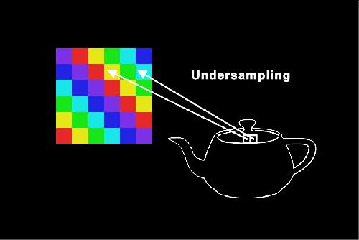
Undersampling - holes

Slide 31
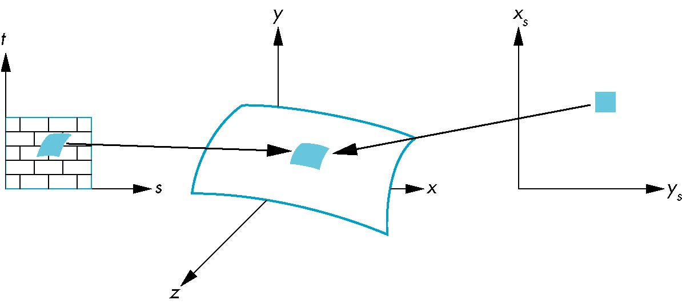
Area Averaging
A better but slower option is to use area averaging
pixel
preimage
Note that preimage of pixel is curved

Slide 32
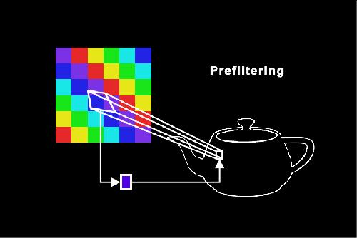
Prefiltering

Slide 33
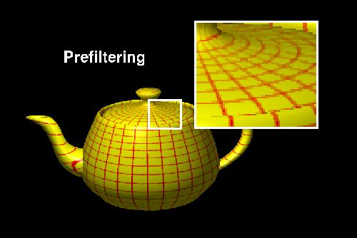
Compare

Slide 34
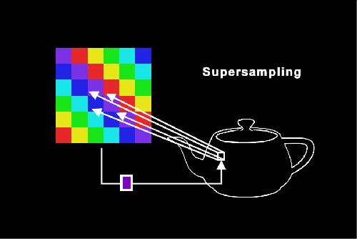
Supersampling

Slide 35
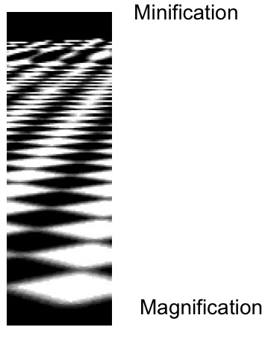
With change in Z

Slide 36
Magnification and Minification
More than one texel can cover a pixel (minification) or
more than one pixel can cover a texel (magnification)
Can use point sampling (nearest texel) or linear filtering
( 2 x 2 filter) to obtain texture values
Texture
Polygon
Texture
Polygon
Magnification
Minification

Slide 37
Filter Modes
Modes determined by
  glTexParameteri( target, type, mode )
glTexParameteri(GL_TEXTURE_2D, GL_TEXURE_MAG_FILTER,
GL_NEAREST);
glTexParameteri(GL_TEXTURE_2D, GL_TEXURE_MIN_FILTER,
GL_LINEAR);
Note that linear filtering requires a border of an
extra texel for filtering at edges (border = 1)

Slide 38
Mipmapped Textures
Mipmapping allows for prefiltered texture maps of decreasing resolutions
Lessens interpolation errors for smaller objects
Declare mipmap level during texture definition
  glTexImage2D( GL_TEXTURE_*D, level, … )
GLU mipmap builder routines will build all the textures from a given image
  gluBuild*DMipmaps( … )

Slide 39
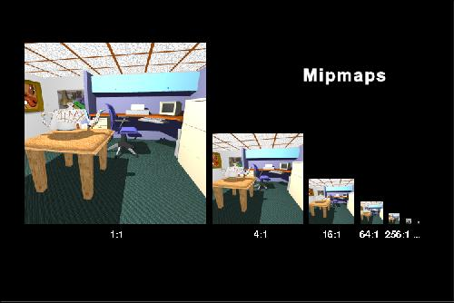
MipMapping

Slide 40
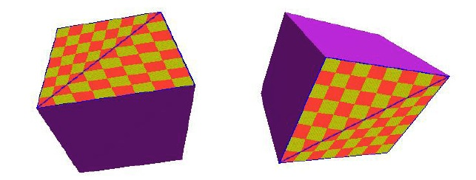
Perspective Correction Hint
Texture coordinate and color interpolation
  either linearly in screen space
  or using depth/perspective values (slower)
Noticeable for polygons “on edge”
glHint(GL_PERSPECTIVE_CORRECTION_HINT, hint)
  where hint is one of
      GL_DONT_CARE
      GL_NICEST
      GL_FASTEST

Slide 41
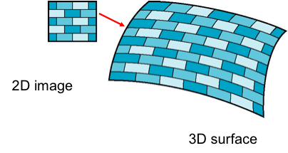
Coordinate Systems
Although the idea is simple---map an image to a surface---there are 3 or 4 coordinate systems involved
Parametric coordinates
  May be used to model curves and surfaces
Texture coordinates
  Used to identify points in the image to be mapped
Object or World Coordinates
  Conceptually, where the mapping takes place
Window Coordinates
  Where the final image is really produced

Slide 42
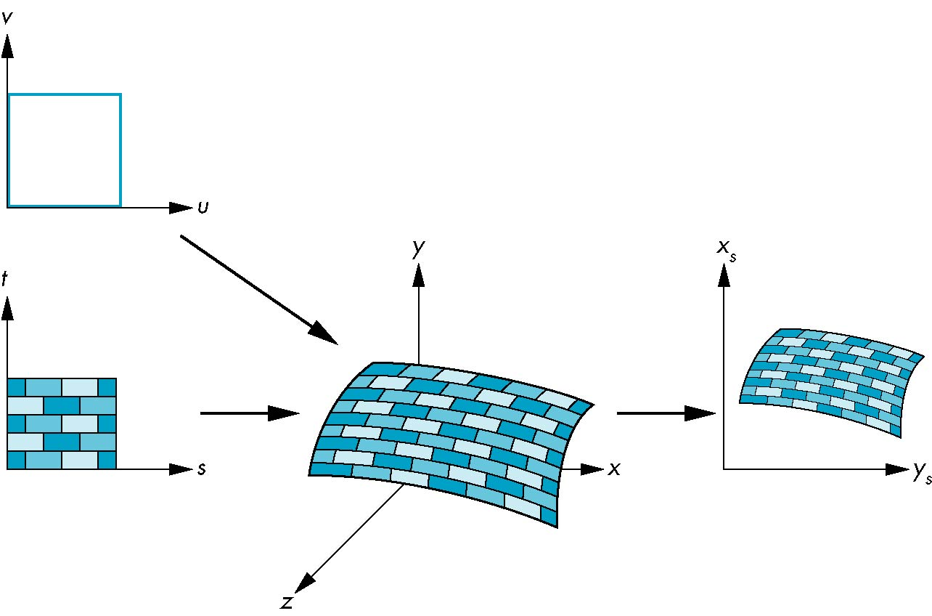
Texture Mapping
parametric coordinates
texture coordinates
window coordinates
world coordinates

Slide 43
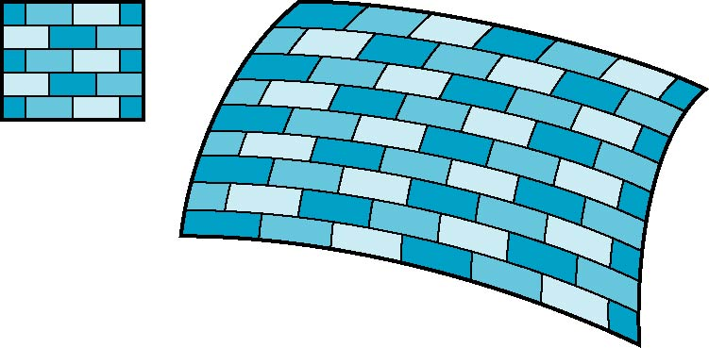
Mapping Functions
Consider mapping from texture coordinates to a point a surface
For example, the torus from Sam Buss's LightTorus example
But we really want to go the other way
From (x, y, z) to (s, t)
(x,y,z)
t
s

Slide 44
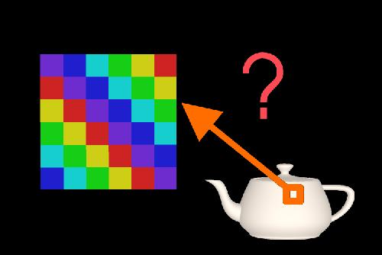
Where is my color?

Slide 45
Backward Mapping
Given a pixel in screen space, we want to know to which point on an object it corresponds
Given a point on an object, we want to know to which point in the texture it corresponds
Need a map of the form
    s = s(x,y,z)
    t = t(x,y,z)
Such functions are difficult to find in general
In our cube example, we can interpolate over the corners
  Issues with Perspective, Aliasing

Slide 46
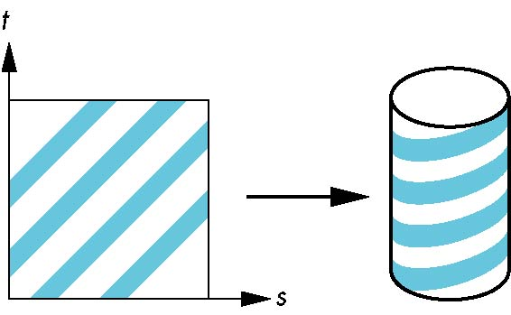
Two-part mapping
One solution to the mapping problem is to first map the texture to a simple intermediate surface
Example: map to cylinder

Slide 47
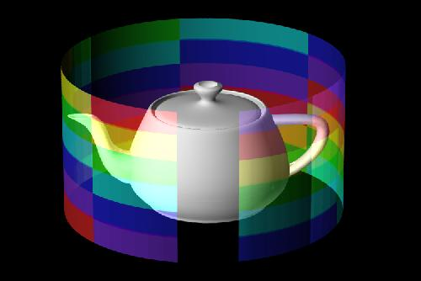
Cylinder

Slide 48
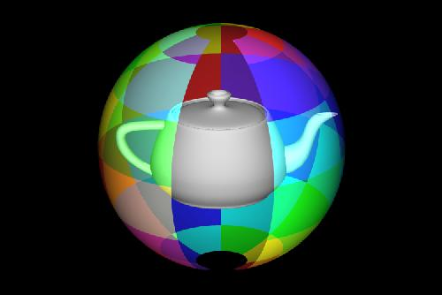
Spherical Map

Slide 49
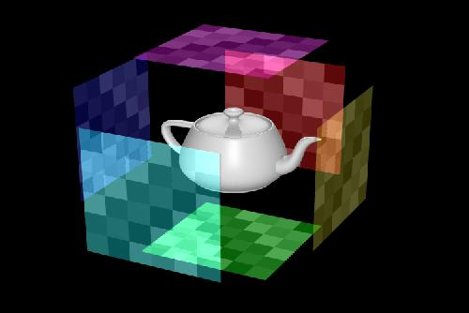
Cube Map

Slide 50
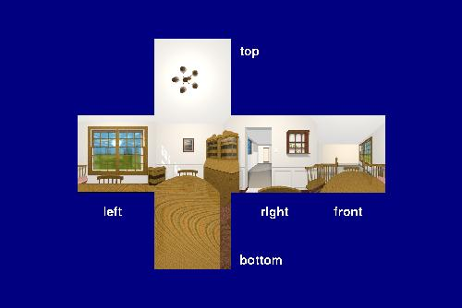
Environment Map

Slide 51
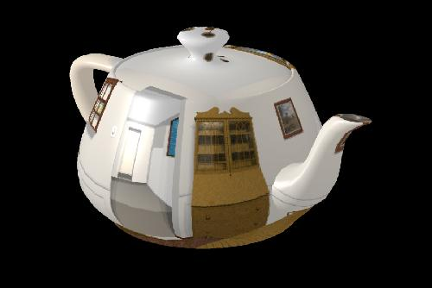
Result

Slide 52
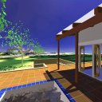
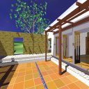
Environment Map Example
An example from NVIDIA
http://developer.nvidia.com/object/cube_map_ogl_tutorial.html
Uses cube environment map, mipmaps
  Options – ' ', c, s, m, a, z
  Also Menu choices

Slide 53
Main (start)
int main(int argc, char **argv) {
  int i;
  glutInitWindowSize(500, 500);
  glutInit(&argc, argv);
  for (i=1; i<argc; i++) {
    if (!strcmp(argv[i], "-nomipmap")) {
      mipmaps = 0;
    }
    if (!strcmp(argv[i], "-v")) {
      gliVerbose(1);
    }
  }
  glutInitDisplayMode(GLUT_RGB | GLUT_DOUBLE | GLUT_DEPTH);
  glutCreateWindow("EXT_texture_cube_map demo");
  if (!glutExtensionSupported("GL_EXT_texture_cube_map")) { ...

Slide 54
Main (start)
int main(int argc, char **argv) {
  int i;
  glutInitWindowSize(500, 500);
  glutInit(&argc, argv);
  for (i=1; i<argc; i++) {
    if (!strcmp(argv[i], "-nomipmap")) {
      mipmaps = 0;
    }
    if (!strcmp(argv[i], "-v")) {
      gliVerbose(1);
    }
  }
  glutInitDisplayMode(GLUT_RGB | GLUT_DOUBLE | GLUT_DEPTH);
  glutCreateWindow("EXT_texture_cube_map demo");
  if (!glutExtensionSupported("GL_EXT_texture_cube_map")) { ...

Slide 55
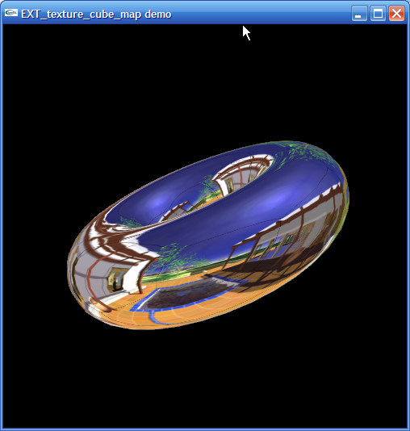
Filenames for faces
/* Pre-generated cube map images. */
char *faceFile[6] = {
  "cm_left.tga",
  "cm_right.tga",
  "cm_top.tga",
  "cm_bottom.tga",
  "cm_back.tga",
  "cm_front.tga",
};
/* Menu items. */
enum {
  M_TEAPOT, M_TORUS, M_SPHERE,
  M_SHINY, M_DULL,
  M_REFLECTION_MAP, M_NORMAL_MAP,
};

Slide 56
Load a face
void loadFace(GLenum target, char *filename) {
  FILE *file;
  gliGenericImage *image;
  file = fopen(filename, "rb");
  ...
  image = gliReadTGA(file, filename);
  fclose(file);
  if (mipmaps) {
    gluBuild2DMipmaps(target, image->components, image->width, image->height, image->format, GL_UNSIGNED_BYTE, image->pixels);
  } else {
    glTexImage2D(target, 0, image->components, image->width, image->height, 0, image->format, GL_UNSIGNED_BYTE, image->pixels);
  }
}

Slide 57
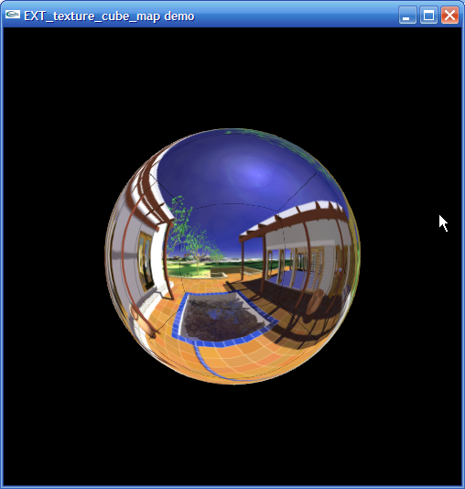
Make the cube map
void makeCubeMap(void) {
  int i;
  for (i=0; i<6; i++) { loadFace(faceTarget[i], faceFile[i]); }
  if (mipmaps) {
    glTexParameteri(GL_TEXTURE_CUBE_MAP_EXT, GL_TEXTURE_MIN_FILTER, GL_LINEAR_MIPMAP_LINEAR);
    glTexParameteri(GL_TEXTURE_CUBE_MAP_EXT, GL_TEXTURE_MAG_FILTER, GL_LINEAR);
  } else {
    glTexParameteri(GL_TEXTURE_CUBE_MAP_EXT, GL_TEXTURE_MIN_FILTER, GL_LINEAR);
    glTexParameteri(GL_TEXTURE_CUBE_MAP_EXT, GL_TEXTURE_MAG_FILTER, GL_LINEAR);
  }
  glEnable(GL_TEXTURE_CUBE_MAP_EXT);
  updateTexgen();
  updateWrap();
  glEnable(GL_TEXTURE_GEN_S);
  glEnable(GL_TEXTURE_GEN_T);
  glEnable(GL_TEXTURE_GEN_R);
}

Slide 58
main (cont)
hasTextureLodBias = glutExtensionSupported("GL_EXT_texture_lod_bias");
glutDisplayFunc(display);
glutReshapeFunc(reshape);
glutKeyboardFunc(keyboard);
glutMouseFunc(mouse);
glutMotionFunc(motion);
glMatrixMode(GL_PROJECTION);
glLoadIdentity();
gluPerspective( /* fov */ 40.0, /* aspect ratio */ 1.0, /* Z near */ 1.0, /* Z far */ 10.0);
glMatrixMode(GL_MODELVIEW);
glLoadIdentity();
gluLookAt(0.0, 0.0, 5.0, 0.0, 0.0, 0.0, 0.0, 1.0, 0.);
glEnable(GL_DEPTH_TEST);
makeCubeMap();

Slide 59
main (cont)
trackball(curquat, 0.0, 0.0, 0.0, 0.0);
glutCreateMenu(menu);
glutAddMenuEntry("Teapot", M_TEAPOT);
glutAddMenuEntry("Torus", M_TORUS);
glutAddMenuEntry("Sphere", M_SPHERE);
glutAddMenuEntry("Reflection map", M_REFLECTION_MAP);
glutAddMenuEntry("Normal map", M_NORMAL_MAP);
if (hasTextureLodBias) {
  glutAddMenuEntry("Shiny reflection", M_SHINY);
  glutAddMenuEntry("Dull reflection", M_DULL);
} else {
  printf("cm_demo: Your OpenGL does not support EXT_texture_lod_bias.\n");
  printf("cm_demo: Therefore dull reflections are not supported.\n");
}
glutAttachMenu(GLUT_RIGHT_BUTTON);
glutMainLoop();

Slide 60
Trackball
/*
* Ok, simulate a track-ball. Project the points onto the virtual
* trackball, then figure out the axis of rotation, which is the cross
* product of P1 P2 and O P1 (O is the center of the ball, 0,0,0)
* Note: This is a deformed trackball-- is a trackball in the center,
* but is deformed into a hyperbolic sheet of rotation away from the
* center. This particular function was chosen after trying out
* several variations.
*
* It is assumed that the arguments to this routine are in the range
* (-1.0 ... 1.0)
*/
void
trackball(float q[4], float p1x, float p1y, float p2x, float p2y)
{

Slide 61
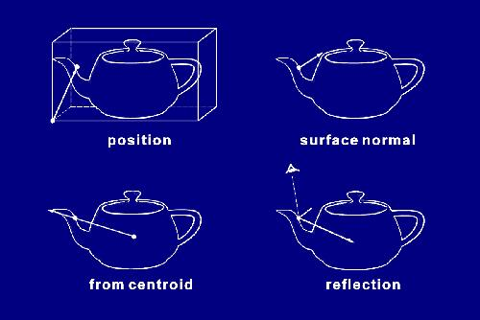
Second Mapping

Slide 62
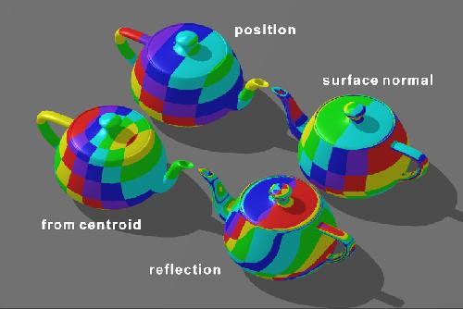

Slide 63
Setting Mode
void updateTexgen(void) {
  assert(mode == GL_NORMAL_MAP_EXT || mode == GL_REFLECTION_MAP_EXT);
  glTexGeni(GL_S, GL_TEXTURE_GEN_MODE, mode);
  glTexGeni(GL_T, GL_TEXTURE_GEN_MODE, mode);
  glTexGeni(GL_R, GL_TEXTURE_GEN_MODE, mode);
}
void keyboard(unsigned char c, int x, int y) {
  switch (c) {
    case ' ':
    if (mode == GL_REFLECTION_MAP_EXT) {
      mode = GL_NORMAL_MAP_EXT;
    } else {
      mode = GL_REFLECTION_MAP_EXT;
    }
    updateTexgen();

Slide 64
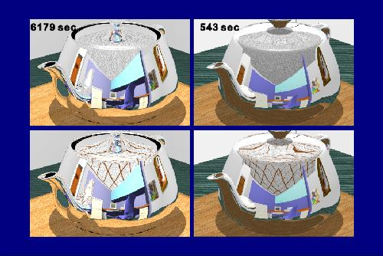
Ray Tracing vs Env Map

Slide 65
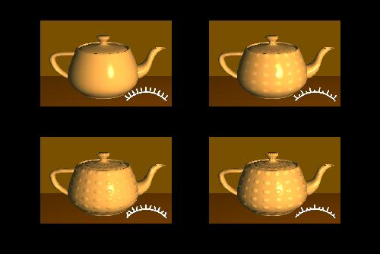
Bump Mapping

Slide 66
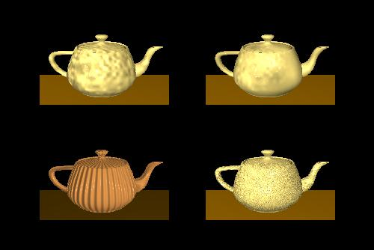

Slide 67
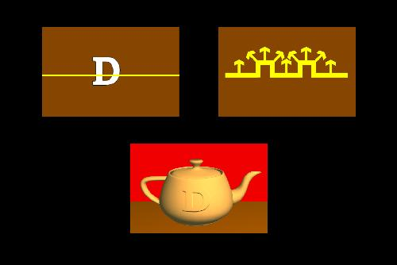

Slide 68
Summary
Texture mapping is an efficient way to add visual interest
The texture can be procedural, or defined by an image
It is not easy to paste an image onto a curved surface in perspective
OpenGL provides many options to work around these issues.
Resources: NVIDIA tutorial (links page) – cubemap example
Nate Robins "Iron Maiden" demo – under his website, in SGI section
TextureCube in examples

