Slide 1
GPU Programming
Lecture 9
© Jeff Parker, Nov 2009

Slide 2
Outline
What is a GPU?
Why perform GPU processing?
Challenges of Parallel Processing
Basics of GPU
  Vertex Shader
  Fragment Shader
Programming Paradigm
Examples

Slide 3
What is a GPU?
Specialized silicon for offloading graphics processing from CPU
While there have been GPUs going back at least to the Commodore Amiga, the term currently implies the ability to program the GPU

Slide 4
What Languages?
Offline Rendering
  RenderMan – the first shader language
  Houdini and Gelato – modeled on RenderMan
Real-time shaders
  ARB Shaders – low level shading
  GLSL (OpenGL Shading Language)
  Cg – NVIDIA
  DirectX HLSL (High Level Shader Language)

Slide 5
Tool chains
One simple system was due to 3DLabs Shader Gen
  No longer supported: can download source from
    http://mew.cx/glsl/shadergen/
NVIDIA
  FX Composer
AMD
  Render Monkey
Debuggers
  nVidia's Shader Debugger
  imdebug
  Shadesmith

Slide 6
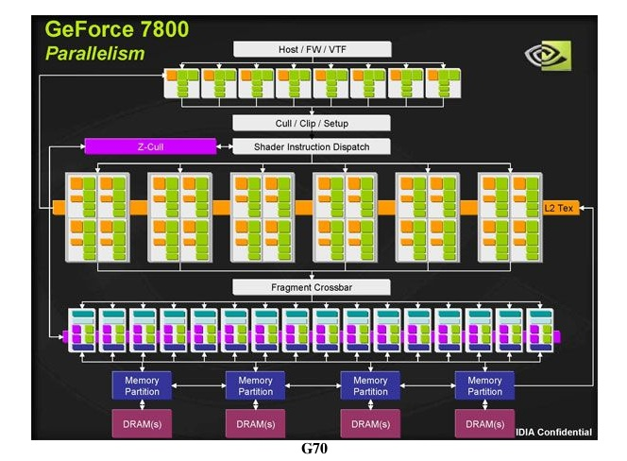
NVIDIA G70

Slide 7
Parallelism
Computer Scientists have been looking for a way to use multiple CPUs to speed up calculations
Obstacles include
  Sequential nature of many computations
  Fighting over shared data
    a[i] = a[i-1] + i;
There have been isolated areas of success
  Numerical Simulations
  SQL

Slide 8
Graphics
Shading polygoins is another place for parallelism
I can tranform v₁ and v₂ independently
Many scan lines with many fragments
I can scan line x + y = 2 without affecting x - y = 3
I can also scan x + y = 2, x < 50
  without affecting x + y = 2, x > 50
Both write to frame buffer and z buffer, but update different spots.

Slide 9
Two models
SIMD
  Single Instruction, Multiple Data
  One code path, multiple processors working in parallel
Data Driven streams
  Sea of data washes over bed of computational units
  Data module has all relevant information
  When a complete data unit meets a free computational unit, the data is transformed
  Flows down stream for the next operation

Slide 10
Graphics Languages
Unlike CPU, GPU architecture details hidden
OpenGL or DirectX provide a state machine that represents the rendering pipeline.
Early GPU programs used properties of the state machine to “program” the GPU.
Tools like Renderman provided sophisticated shader languages, but these were not part of the rendering pipeline.

Slide 11
Prior Art
One “programmed” in OpenGL using state variables like blend functions, depth tests and stencil tests
  glClearColor(0.0, 0.0, 0.0, 0.0);
  glClearStencil(0);
  glStencilMask(1); // Can only write LSBit
  glEnable(GL_STENCIL_TEST);
  glClear(GL_COLOR_BUFFER_BIT | GL_STENCIL_BUFFER_BIT);
  glStencilFunc(GL_ALWAYS, 1, 1);
  glStencilOp(GL_KEEP, GL_KEEP, GL_REPLACE);

Slide 12
Programmable Shaders, v1
As rendering pipeline became more complex, new functionality was added to the state machine via extensions.
The introduction of vertex and fragment programs provided full programmability to the pipeline.
With fragment programs, one could write general programs to process each fragment
MUL tmp, fragment.texcoord[0], size.x;
FLR intg, tmp;
FRC frac, tmp;
SUB frac_1, frac, 1.0;
Writing (pseudo)-assembly code is clumsy and error-prone.

Slide 13
GLSL
Current GPU languages, such as Cg and GLSL allow programmer to work in something resembling C
uniform float time; /* in milliseconds */
void main(){
  float s;
  vec4 t = gl_Vertex;
  t.y = 0.1*sin(0.001*time+ 5.0*gl_Vertex.x) *sin(0.001*time+5.0*gl_Vertex.z);
  gl_Position = gl_ModelViewProjectionMatrix * t;
  gl_FrontColor = gl_Color;
}

Slide 14
Model
All the language models share basic properties:
They view the pipeline as an array of “pixel computers”, with the same program running at each computer
  In fact, there are two types of computers: vertex computers and fragment computers
Data is streamed to each pixel computer
The pixel programs have limited state.
Issues – communication between components
  Between CPU and pixel computers
  Between Vertex and Fragment Shaders
  Between different Vertex (Fragment) Shaders

Slide 15
Programmable Pipeline Elements
We will define vertex shader and fragment shader programs
There are predefined:
  variables, holding position, color, etc
  OpenGL state, such as
    matrices: Model and View transformation
Order of operations is implicit
We can define new variables and functions
  We need to declare the scope of these variables

Slide 16
Pass Through Vertex Shader
void main()
{
  gl_Position = gl_ProjectionMatrix * gl_ModelViewMatrix * gl_Vertex;
}
Vertex shader does not know anything about connectivity of vertices
  There is a Geometry Processor – we won't say more about this
The job of the vertex shader is to take the attributes provided by the CPU:
  the projection Matrix and the View matrix
  gl_Vertex - the position of the vertex in world space
And produce something for the Rasterizer, which feeds the fragment shaders:
  gl_Position

Slide 17
Pass Through Vertex Shader
void main()
{
  gl_Position = gl_ProjectionMatrix * gl_ModelViewMatrix * gl_Vertex;
}
// Simpler version
void main()
{
  gl_Position = gl_ModelViewProjectionMatrix * gl_Vertex;
}

Slide 18
Fragment Shader
// fPassThrough.glsl
// Pass through fragment shader.
void main()
{
  gl_FragColor = gl_Color;
}
The job of fragment shader is to take attributes provided by the vertex shader
And define the color that will be stored in the frame buffer

Slide 19
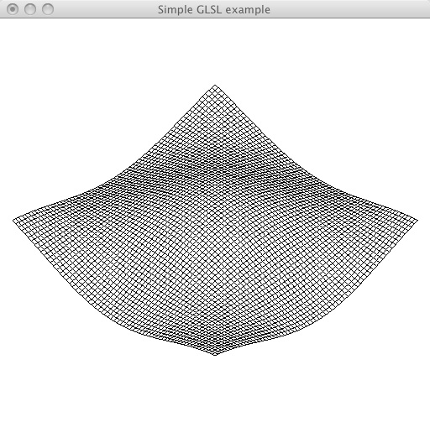
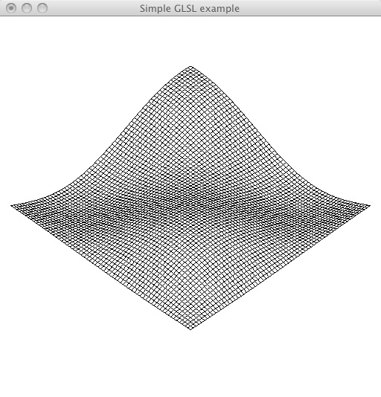
Wave example

Slide 20
Non-trivial Vertex Shader
// We walk through this in the next slide
uniform float time; /* in milliseconds */
void main()
{
  float s;
  vec4 t = gl_Vertex;
  t.y = 0.1*sin(0.001*time+5.0*gl_Vertex.x) * sin(0.001*time+5.0*gl_Vertex.z);
  gl_Position = gl_ModelViewProjectionMatrix * t;
  gl_FrontColor = gl_Color;
}

Slide 21
Variable Scope
const: compile time constant
uniform: parameter is fixed over a glBegin/glEnd pair
attribute: per-vertex information send from CPU:
  coordinates, texture coords, normals, color, …
  Predefined and user defined
varying: interpolated data that a vertex shader sends to the fragment shaders

Slide 22
Datatypes
Singletons -
  float, bool, int – no bitmaps
    float a,b;
    int c = 2;
    bool d = true;
Vectors
  vec{2, 3, 4} – vector of floats
    vec4 eyePosition = gl_ModelViewMatrix * gl_Vertex;
    vec2 a = vec2(1.0,2.0);
    vec2 b = vec2(3.0,4.0);
    vec4 c = vec4(a,b) // c = vec4(1.0,2.0,3.0,4.0);
  bvec{2, 3, 4} – boolean vector
  ivec{2, 3, 4} – integer vector

Slide 23
Vertex Shader
// The CPU modifies the value of time in the update routine
uniform float time; /* in milliseconds */
void main()
{
  float s;
  // gl_Vertex is pre-vertex attributed passed by CPU
  vec4 t = gl_Vertex;
  // t is a vector: we will modified the vertex position
  t.y = 0.1*sin(0.001*time+5.0*gl_Vertex.x) * sin(0.001*time+5.0*gl_Vertex.z);
  // Use new value of vertex to update gl_Position
  gl_Position = gl_ModelViewProjectionMatrix * t;
  // Pass through color
  gl_FrontColor = gl_Color;
}

Slide 24
Vertex builtins
Per Vertix attributes
  in int gl_VertexID;
  in int gl_InstanceID;
  out gl_PerVertex {
    vec4 gl_Position;
    float gl_PointSize;
    float gl_ClipDistance[];
  };
Global Attributes
  in vec4 gl_Color;
  in vec4 gl_SecondaryColor;
  in vec3 gl_Normal;
  in vec4 gl_Vertex;
  in vec4 gl_MultiTexCoord0;…
  in vec4 gl_MultiTexCoord7;
  in float gl_FogCoord;

Slide 25
Sending time from CPU
// wave.c program running in CPU
GLint timeParam;
GLuint program = 0; /* program object id */
/* GLSL initialization */
static void initShader(const GLchar* vShaderFile, const GLchar* fShaderFile)
{
  ...
  program = glCreateProgram();
  ...
  timeParam = glGetUniformLocation(program, "time");
}
static void draw(void)
{
  /* send elapsed time to shaders */
  glUniform1f(timeParam, glutGet(GLUT_ELAPSED_TIME));
  ...

Slide 26
Read Shader Source
// These routines can be used to read any pair of shaders
static char* readShaderSource(const char* shaderFile)
{
  FILE* fp = fopen(shaderFile, "rb");
  char* buf;
  long size;
  if (fp==NULL)
    return NULL;
  fseek(fp, 0L, SEEK_END);
  size = ftell(fp);
  fseek(fp, 0L, SEEK_SET);
  buf = (char*) malloc((size+1) * sizeof(char));
  fread(buf, 1, size, fp);
  buf[size] = '\0';
  fclose(fp);
  return buf;
}

Slide 27
initShader
static void initShader(const GLchar* vShaderFile, const GLchar* fShaderFile)
{
  GLint status;
  GLchar *vSource, *fSource;
  GLuint vShader, fShader;
  /* read shader files */
  vSource = readShaderSource(vShaderFile);
  if (vSource==NULL)
  {
    printf( "Failed to read vertex shader\n");
    exit(EXIT_FAILURE);
  }
  fSource = readShaderSource(fShaderFile);
  if (fSource==NULL)
  {
    printf("Failed to read fragment shader");
    exit(EXIT_FAILURE);
  }

Slide 28
initShader (cont)
/* create program and shader objects */
vShader = glCreateShader(GL_VERTEX_SHADER);
fShader = glCreateShader(GL_FRAGMENT_SHADER);
program = glCreateProgram();
/* attach shaders to the program object */
glAttachShader(program, vShader);
glAttachShader(program, fShader);
/* read shaders */
glShaderSource(vShader, 1, (const GLchar**) &vSource, NULL);
glShaderSource(fShader, 1, (const GLchar**) &fSource, NULL);

Slide 29
initShader (cont)
glCompileShader(vShader);
/* error check */
glGetShaderiv(vShader, GL_COMPILE_STATUS, &status);
if (status==GL_FALSE)
{
  printf("Failed to compile the vertex shader.\n");
  glGetShaderiv(vShader, GL_INFO_LOG_LENGTH, &elength);
  ebuffer = malloc(elength*sizeof(char));
  glGetShaderInfoLog(vShader, elength, NULL, ebuffer);
  printf("%s\n", ebuffer);
  exit(EXIT_FAILURE);
}
/* compile fragment shader shader */
glCompileShader(fShader);
/* error check */
glGetShaderiv(fShader, GL_COMPILE_STATUS, &status);
if (status==GL_FALSE) // Blah, Blah, Blah...

Slide 30
initShader (cont)
  /* link and error check */
  glLinkProgram(program);
  glGetProgramiv(program, GL_LINK_STATUS, &status);
  if (status==GL_FALSE)
  {
    printf("Failed to link program object.\n");
    glGetProgramiv(program, GL_INFO_LOG_LENGTH, &elength);
    ebuffer = malloc(elength*sizeof(char));
    glGetProgramInfoLog(program, elength, &elength, ebuffer);
    printf("%s\n", ebuffer);
    exit(EXIT_FAILURE);
  }
  /* use program object */
  glUseProgram(program);
  /* set up uniform parameter */
  timeParam = glGetUniformLocation(program, "time");
}

Slide 31
mesh – build mesh
void mesh()
{
  int i,j;
  glMatrixMode(GL_MODELVIEW);
  glLoadIdentity();
  gluLookAt(2.0, 2.0, 2.0, 0.5, 0.0, 0.5, 0.0, 1.0, 0.0);
  for(i=0; i<N; i++) for(j=0; j<N;j++)
  {
    glColor3f(1.0, 1.0, 1.0);
    glBegin(GL_POLYGON);
      glVertex3f((float)i/N, data[i][j], (float)j/N);
      glVertex3f((float)i/N, data[i][j], (float)(j+1)/N);
      glVertex3f((float)(i+1)/N, data[i][j], (float)(j+1)/N);
      glVertex3f((float)(i+1)/N, data[i][j], (float)(j)/N);
    glEnd();
    glColor3f(0.0, 0.0, 0.0);
    glBegin(GL_LINE_LOOP);
      glVertex3f((float)i/N, data[i][j], (float)j/N);
      glVertex3f((float)i/N, data[i][j], (float)(j+1)/N);
      glVertex3f((float)(i+1)/N, data[i][j], (float)(j+1)/N);
      glVertex3f((float)(i+1)/N, data[i][j], (float)(j)/N);
    glEnd();
  }
}

Slide 32
Main Program
int main(int argc, char** argv) {
  int i,j;
  /* flat mesh */
  for(i=0;i<N;i++)
    for(j=0;j<N;j++)
      data[i][j]=0.0;
  glutInit(&argc, argv);
  glutInitDisplayMode(GLUT_RGBA | GLUT_DOUBLE);
  glutInitWindowSize(512, 512);
  glutCreateWindow("Simple GLSL example");
  glutDisplayFunc(draw);
  glutReshapeFunc(reshape);
  glutKeyboardFunc(keyboard);
  glutIdleFunc(idle);
  init();
  initShader("vmesh.glsl", "fPassthrough.glsl");
  glutMainLoop();
  return 0;
}

Slide 33
Recap
Program loads vertex and fragment shaders
Shaders take standard attributes and any program specific additions, such as time in this example
and compute standard results, and additional variables
We have only seen use of standard attributes to communicate between vertex and fragment shader.
  We will create some per-vertex attributes for velocity in the Particle example
  We create varying data in toon example to pass information from vertex shader to fragment shader

Slide 34
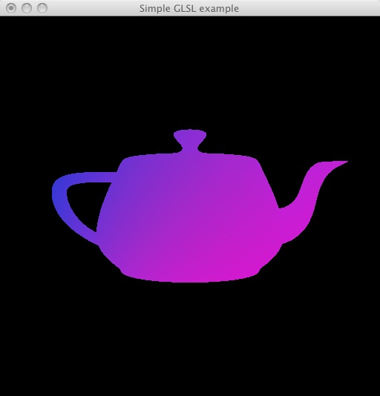
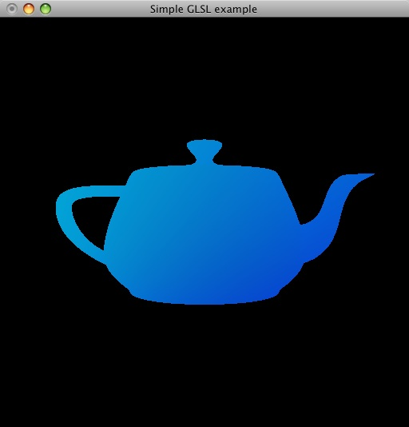
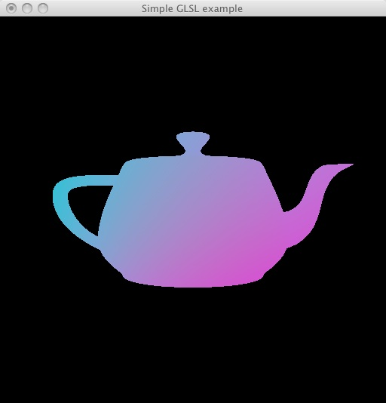
Teapot Colors
Example with pass-through vertex shader, with work done in fragment shader

Slide 35
Trivial Vertex Shader
void main()
{
gl_Position = gl_ModelViewProjectionMatrix * gl_Vertex;
gl_FrontColor = gl_Color;
}

Slide 36
Fragment Shader
uniform float time;
void main()
{
float d = length(gl_FragCoord.xy);
gl_FragColor.r = 0.5*(1.0+sin(0.001*time))*gl_FragCoord.x/d;
gl_FragColor.g = 0.5*(1.0+cos(0.001*time))*gl_FragCoord.y/d;
gl_FragColor.b = gl_FragCoord.z;
gl_FragColor.a = 1.0;
}
Fragment shader is in charge of color – easy thing for it to change
The rest of the program is as before: the main program opens and reads the shaders, and passes in the current time.
We will walk through this

Slide 37
Fragment Shader
uniform float time;
void main()
{
float d = length(gl_FragCoord.xy);
gl_FragColor.r = 0.5*(1.0+sin(0.001*time))*gl_FragCoord.x/d;
gl_FragColor.g = 0.5*(1.0+cos(0.001*time))*gl_FragCoord.y/d;
gl_FragColor.b = gl_FragCoord.z;
gl_FragColor.a = 1.0;
}
(From GLSL Spec) The built-in special variables that are accessible from a fragment shader are intrinsically declared as follows:
  in vec4 gl_FragCoord;
  in bool gl_FrontFacing;
  in float gl_ClipDistance[];
  out vec4 gl_FragColor; // deprecated
  out vec4 gl_FragData[gl_MaxDrawBuffers]; // deprecated
  out float gl_FragDepth;

Slide 38
Communication
For CPU to communicate to Shaders
Can used predefined attributes
Can define uniform variables
Can use textures (called samplers)

Slide 39
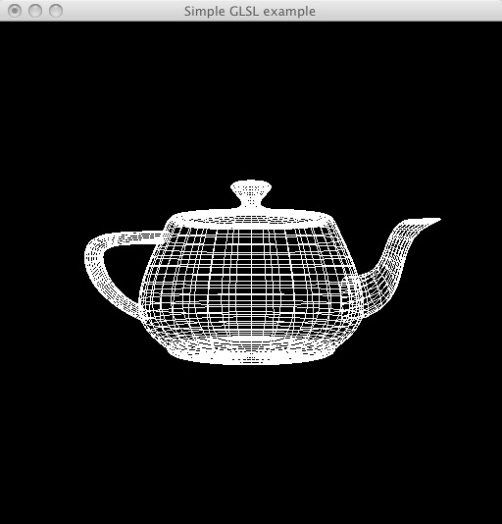
Vertex Float
uniform float time;
void main()
{
gl_Position = gl_ModelViewProjectionMatrix * gl_Vertex;
gl_Position.xyz =
      (1.0+0.1*sin(0.001*time))*gl_Position.xyz;
gl_FrontColor = gl_Color;
}

Slide 40
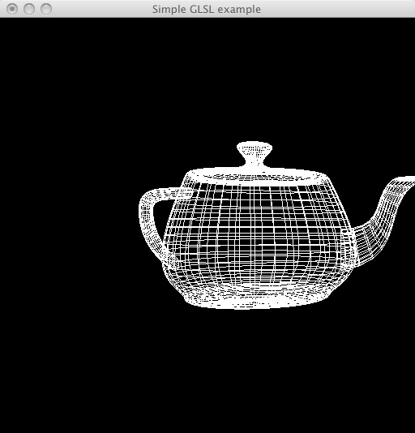
Vertex Twist
uniform float time;
void main()
{
float d;
float twist = 0.1*sin(0.001*time);
gl_Position = gl_ModelViewProjectionMatrix * gl_Vertex;
d = length(gl_Position.xz);
gl_Position.x = cos(d*twist)*gl_Position.x-sin(d*twist)*gl_Position.z;
gl_Position.z = cos(d*twist)*gl_Position.z+sin(d*twist)*gl_Position.x;
gl_FrontColor = gl_Color;
}

Slide 41
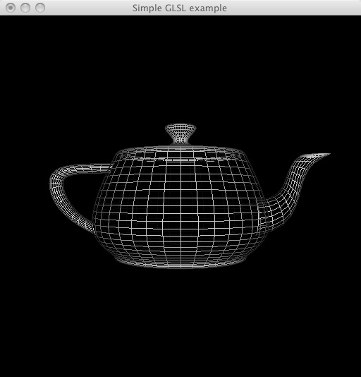
Vertex Phong
uniform float time;
void main()
{
gl_Position = gl_ModelViewProjectionMatrix * gl_Vertex;
vec4 eyePosition = gl_ModelViewMatrix * gl_Vertex;
vec4 eyeLightPos = gl_LightSource[0].position;
vec3 eyeNormalVec = normalize(gl_NormalMatrix * gl_Normal);
vec3 eyeLightVec = normalize(eyeLightPos.xyz - eyePosition.xyz);
vec3 eyeViewVec = -normalize(eyePosition.xyz);
vec3 eyeHalfVec = normalize(eyeLightVec + eyeViewVec);
float Kd = max(dot(eyeLightVec, eyeNormalVec), 0.0);
float Ks = pow(dot(eyeNormalVec, eyeHalfVec), gl_FrontMaterial.shininess);
float Ka = 1.0;
gl_FrontColor = Kd * gl_FrontLightProduct[0].diffuse + Ks * gl_FrontLightProduct[0].specular + gl_FrontLightModelProduct.sceneColor;
}

Slide 42
Example
So far, we have limited ourselves to standard graphics
Can we think outside the Frustum?
Angel gives one example:
Problem is normalizing vectors
Have (x, y, z), and need a normalized version
He proposes uses a texture map to speed up the computation (!?!$!!)

Slide 43
Normalize
Store a 3D Texture Norm
For each value (x, y, z), store 1/sqrt(x² + y² + z²)
Take (x, y, z) * T(x, y, z)
Issues –
  We need to precompute in the CPU
  The solution is an estimate, due to aliasing

Slide 44
Example: Voronoi
You need to mail a letter – where is the closest Post Office?
Given a set of points S in the plane (3 space) The Voronoi diagram splits the plane (3 space) into sets of points closest to a member of S.

Slide 45
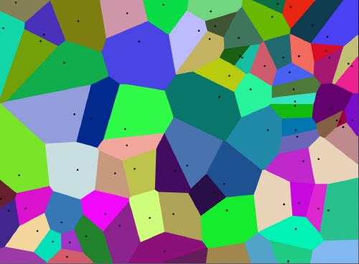
Voronoi

Slide 46
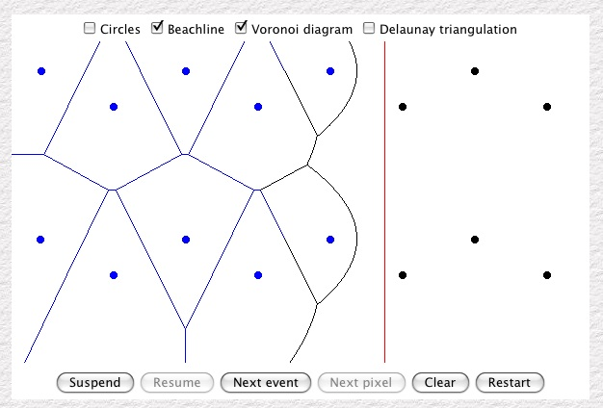
Example: Voronoi
How can we compute Voronoi Diagrams quickly?
They are an important datastructure – much studied
http://www.cs.cornell.edu/info/people/chew/oldDelaunay.html
http://www.pi6.fernuni-hagen.de/GeomLab/VoroGlide/index.html.en
http://www.diku.dk/hjemmesider/studerende/duff/Fortune/
Can we use parallel computation to help?

Slide 47
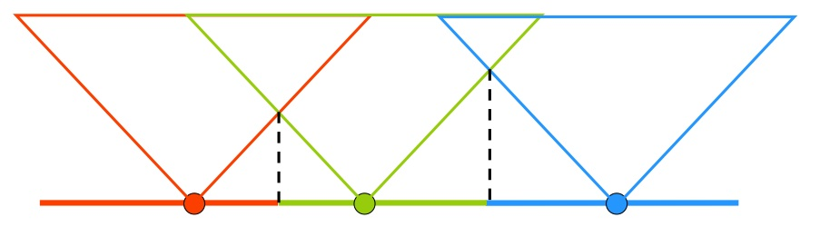
Example: Voronoi
Can we use parallel computation to help?
  Hint: Use an additional dimension

Slide 48
Voronoi Computation
Each point in S is given a unique color
In order to compute the lower envelope, we need to determine, at each pixel, the fragment with the smallest depth value.
This can be done with a simple depth test.
  Allow a fragment to pass only if it is smaller than the current depth buffer value, and update the buffer accordingly.
The fragment that survives has the correct color.

Slide 49
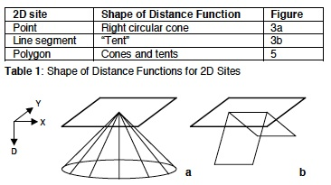
Voronoi 2D Computation
We embed 2 dimensions in three
Distance function for a point is a Cone
We estimate the cone with a triangle fan

Slide 50
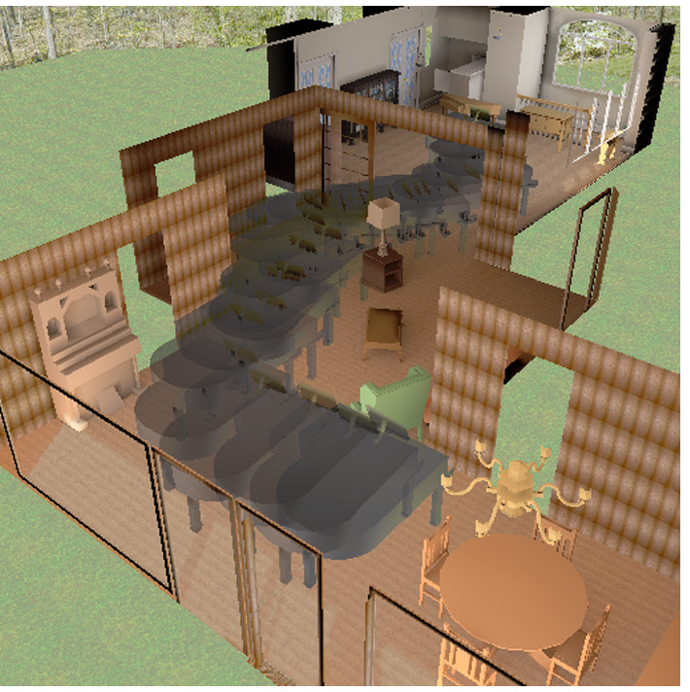
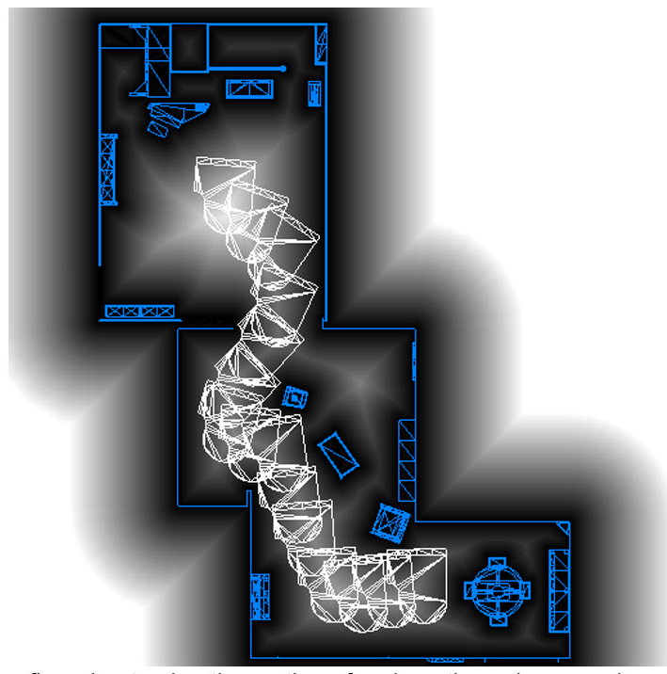
Motion Planning
The Piano Mover Problem – move along Voronoi Boundary

Slide 51
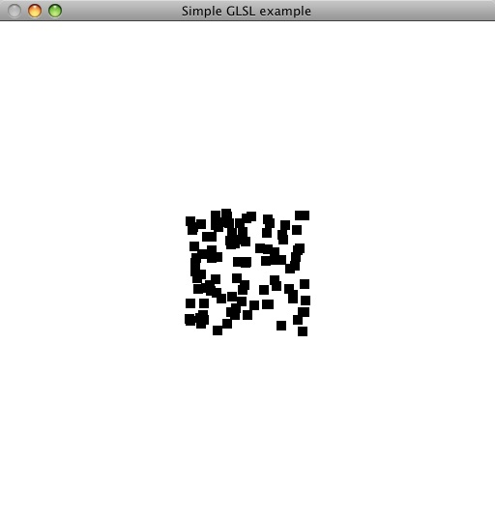
Particle Vertex
uniform float time;
attribute float vx, vy;
void main()
{
float a = -0.00000001;
vec4 t = gl_Vertex;
t.y = gl_Vertex.y + 0.0001*vy*time + 0.5*a*time*time;
t.x = gl_Vertex.x + 0.0001*vx*time;
gl_Position = gl_ModelViewProjectionMatrix*t;
gl_FrontColor = gl_Color;
}

Slide 52
Main
int main(int argc, char** argv)
{
  int i;
  // Set initial velocities
  for(i=0;i<N;i++)
  {
    velocity[i][0]=2.0*((random()%256)/256.0-0.5);
    velocity[i][1]=2.0*((random()%256)/256.0-0.5);
  }

Slide 53
Communication
static void initShader(const GLchar* vShaderFile, const GLchar* fShaderFile)
{
  ...
  /* set up uniform parameter */
  timeParam = glGetUniformLocation(program, "time");
  vxParam = glGetAttribLocation(program, "vx");
  vyParam = glGetAttribLocation(program, "vy");
}
static void draw(void)
{

Slide 54
Communication
  vxParam = glGetAttribLocation(program, "vx");
  vyParam = glGetAttribLocation(program, "vy");
}
static void draw(void) {
  ...
  glUniform1f(timeParam, glutGet(GLUT_ELAPSED_TIME));
  glClear(GL_COLOR_BUFFER_BIT | GL_DEPTH_BUFFER_BIT);
  glBegin(GL_POINTS);
    for(i=0; i<N; i++)
    {
      glVertexAttrib1f(vxParam, velocity[i][0]);
      glVertexAttrib1f(vyParam, velocity[i][1]);
      glVertex2f(0.5, 0.5);
    }
  glEnd();

Slide 55
Variable Scope
const: compile time constant
uniform: parameter is fixed over a glBegin/glEnd pair
attribute: per-vertex information send from CPU:
  coordinates, texture coords, normals, color, …
  Predefined and user defined
varying: interpolated data that a vertex shader sends to the fragment shaders

Slide 56
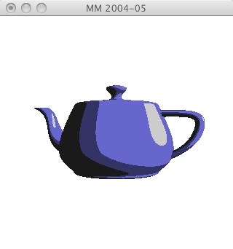
toon vertex shader
// simple toon vertex shader
// www.lighthouse3d.com
varying vec3 normal, lightDir;
void main()
{
lightDir = normalize(vec3(gl_LightSource[0].position));
normal = normalize(gl_NormalMatrix * gl_Normal);
gl_Position = ftransform();
}

Slide 57
toon fragment shader
varying vec3 normal, lightDir;
void main()
{
float intensity;
vec3 n;
vec4 color;
n = normalize(normal);
intensity = max(dot(lightDir,n),0.0);
if (intensity > 0.98)
color = vec4(0.8,0.8,0.8,1.0);

Slide 58
toon fragment shader
varying vec3 normal, lightDir;
void main()
{
...
if (intensity > 0.98)
color = vec4(0.8,0.8,0.8,1.0);
else if (intensity > 0.5)
color = vec4(0.4,0.4,0.8,1.0);
else if (intensity > 0.25)
color = vec4(0.2,0.2,0.4,1.0);
else
color = vec4(0.1,0.1,0.1,1.0);
gl_FragColor = color;
}

Slide 59
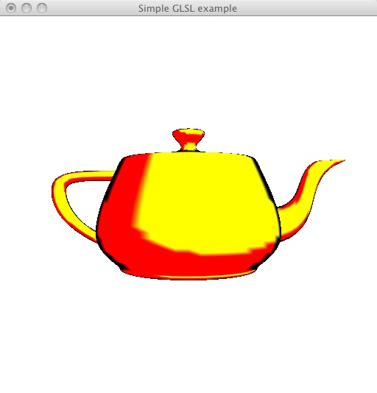
Vertex NonPhoto
void main()
{
  const vec4 yellow = vec4(1.0, 1.0, 0.0, 1.0);
  const vec4 red = vec4(1.0, 0.0, 0.0, 1.0);
  const vec4 black = vec4(0.0, 0.0, 0.0, 1.0);
  gl_Position = gl_ModelViewProjectionMatrix * gl_Vertex;
  vec4 ambient;
  vec4 diffuse;
  vec4 specular;

Slide 60
Vertex NonPhoto
vec4 eyePosition = gl_ModelViewMatrix * gl_Vertex;
vec4 eyeLightPos = gl_LightSource[0].position;
vec3 N = normalize(gl_NormalMatrix * gl_Normal);
vec3 L = normalize(eyeLightPos.xyz - eyePosition.xyz);
vec3 E = -normalize(eyePosition.xyz);
vec3 H = normalize(L + E);
float Kd = max(dot(L, N), 0.0);
float Ks = pow(max(dot(N, H), 0.0), gl_FrontMaterial.shininess);
float Ka = 0.0;

Slide 61
Vertex NonPhoto
  ambient = Ka*gl_FrontLightProduct[0].ambient;
  diffuse = Kd*gl_FrontLightProduct[0].diffuse;
  specular = Ks*gl_FrontLightProduct[0].specular;
  if (Kd > 0.6)
    diffuse = yellow;
  else
    diffuse = red;
  gl_FrontColor = diffuse;
  if (abs(dot(E,N))<0.25)
    gl_FrontColor = black;
}

Slide 62
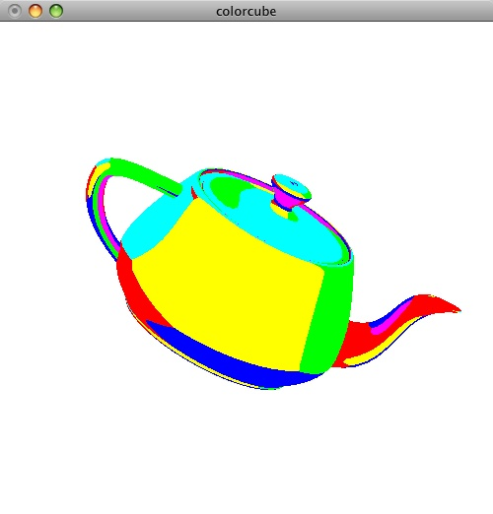
Vertex Cubemap
varying vec3 R;
void main()
{
gl_Position = gl_ModelViewProjectionMatrix * gl_Vertex;
vec3 N = normalize(gl_NormalMatrix*gl_Normal);
vec4 eyePos = gl_ModelViewMatrix*gl_Vertex;
R = reflect(eyePos.xyz, N);
}

Slide 63
CPU Init
void init()
{
GLubyte red[3] = {255, 0, 0};
GLubyte green[3] = {0, 255, 0};
GLubyte blue[3] = {0, 0, 255};
GLubyte cyan[3] = {0, 255, 255};
GLubyte magenta[3] = {255, 0, 255};
GLubyte yellow[3] = {255, 255, 0};
glEnable(GL_DEPTH_TEST);
glEnable(GL_TEXTURE_GEN_S);
glEnable(GL_TEXTURE_GEN_T);
glEnable(GL_TEXTURE_GEN_R);
glEnable(GL_TEXTURE_CUBE_MAP);

Slide 64
CPU Init
glGenTextures(1, &tex);
glBindTexture(GL_TEXTURE_CUBE_MAP, tex);
glTexImage2D(GL_TEXTURE_CUBE_MAP_POSITIVE_X ,0,3,1,1,0,GL_RGB,GL_UNSIGNED_BYTE, red);
glTexImage2D(GL_TEXTURE_CUBE_MAP_NEGATIVE_X ,0,3,1,1,0,GL_RGB,GL_UNSIGNED_BYTE, green);
glTexImage2D(GL_TEXTURE_CUBE_MAP_POSITIVE_Y ,0,3,1,1,0,GL_RGB,GL_UNSIGNED_BYTE, blue);
glTexImage2D(GL_TEXTURE_CUBE_MAP_NEGATIVE_Y ,0,3,1,1,0,GL_RGB,GL_UNSIGNED_BYTE, cyan);
glTexImage2D(GL_TEXTURE_CUBE_MAP_POSITIVE_Z ,0,3,1,1,0,GL_RGB,GL_UNSIGNED_BYTE, magenta);
glTexImage2D(GL_TEXTURE_CUBE_MAP_NEGATIVE_Z ,0,3,1,1,0,GL_RGB,GL_UNSIGNED_BYTE, yellow);

Slide 65
CPU Init
glTexParameteri(GL_TEXTURE_CUBE_MAP,GL_TEXTURE_WRAP_S,GL_REPEAT);
glTexParameteri(GL_TEXTURE_CUBE_MAP,GL_TEXTURE_WRAP_T,GL_REPEAT);
glTexParameteri(GL_TEXTURE_CUBE_MAP,GL_TEXTURE_WRAP_R,GL_REPEAT);
glTexParameteri(GL_TEXTURE_CUBE_MAP,GL_TEXTURE_MAG_FILTER,GL_NEAREST);
glTexParameteri(GL_TEXTURE_CUBE_MAP,GL_TEXTURE_MIN_FILTER,GL_NEAREST);
glClearColor(1.0,1.0,1.0,1.0);

Slide 66
Summary
We can offload a great deal of processing to GPU
We cannot depend upon global variables to pass information around
However, we can augment the standard attributes

Slide 67
Resources
The OpenGL® Shading Language – The Orange Book
Sample programs from Angel –
  Book examples on my examples page
  Examples from his Primer can be found off his webpage
LightHouse tutorials
  www.lighthouse3d.com/opengl/glsl/
LightHouse Source
  www.lighthouse3d.com/opengl/glsl/examples/
OpenGL(R) Shading Language, Randi Rost, John M Kessenich
The Cg Tutorial: The Definitive Guide to Programmable Real-Time Graphics Randima Fernando, Mark Kilgard
SIGGRAPH GP GPU course
  http://gpgpu.org/s2004
Journal of Graphics, GPU, and Game tools - http://jgt.akpeters.com/

