Slide 1
Buffers
© Jeff Parker, 2009

Slide 2
Objectives
Look at your prototype applications
Introduce additional OpenGL buffers
  Buffers in General
  Alpha Blending
  Accumulation Buffers
  Stencil Buffers
Please fill out the on-line evaluations

Slide 3
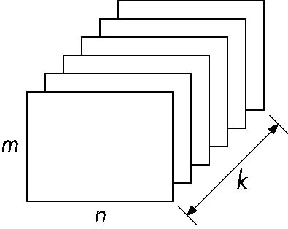
Buffer
Define a buffer by
Spatial resolution (n x m) and its
Depth (or precision) k, the number of bits/pixel
Purpose
pixel
Angel: Interactive Computer Graphics 4E © Addison-Wesley 2004

Slide 4
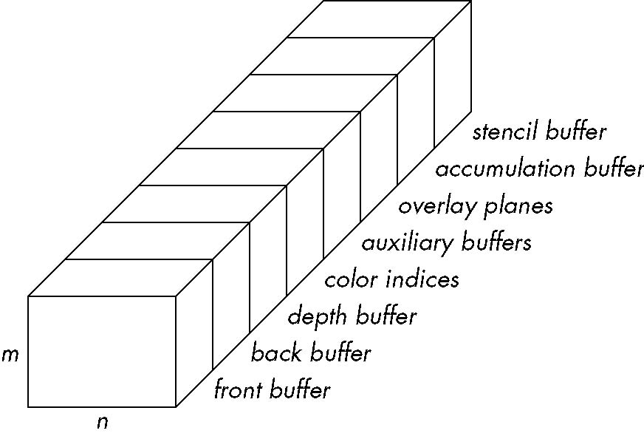
OpenGL Frame Buffer
We will focus on two tonight
  Accumulation Buffer
    Accumulate – add up
  Stencil Buffer
    Single out - mark
Angel: Interactive Computer Graphics 4E © Addison-Wesley 2004

Slide 5
Writing in Buffers
Conceptually, we can consider all of memory as a large two-dimensional array of pixels
We read and write rectangular block of pixels
  Bit block transfer (bitblt) operations
The frame buffer is part of this memory
memory
source
frame buffer
(destination)
writing into frame buffer
Angel: Interactive Computer Graphics 4E © Addison-Wesley 2004

Slide 6
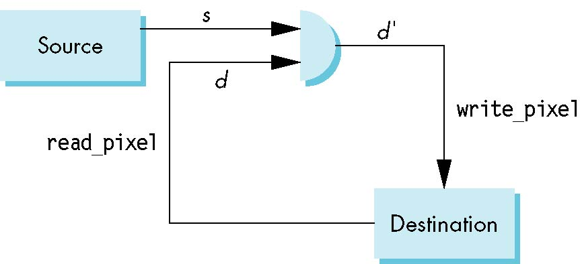
Writing Model
Read destination pixel before writing source
Angel: Interactive Computer Graphics 4E © Addison-Wesley 2004

Slide 7
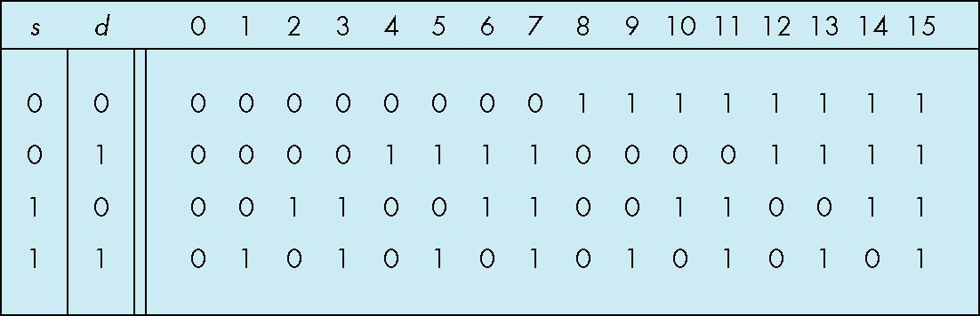
Bit Writing Modes
Source and destination bits are combined bitwise
16 possible functions (one per column in table)
replace
XOR
OR
Angel: Interactive Computer Graphics 4E © Addison-Wesley 2004

Slide 8
XOR mode
Recall from Chapter 3 that we can use XOR by enabling logic operations and selecting the XOR write mode
XOR is especially useful for swapping blocks of memory such as menus that are stored off screen
If S represents screen and M represents a menu
the sequence
S ← S ⊕ M
M ← S ⊕ M
S ← S ⊕ M
swaps the S and M
Angel: Interactive Computer Graphics 4E © Addison-Wesley 2004

Slide 9
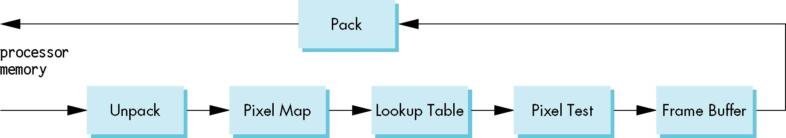
The Pixel Pipeline
OpenGL has a separate pipeline for pixels
  Writing pixels involves
    Moving pixels from processor memory to the frame buffer
    Format conversions
    Mapping, Lookups, Tests
  Reading pixels
    Format conversion
Angel: Interactive Computer Graphics 4E © Addison-Wesley 2004

Slide 10
Buffer Selection
OpenGL can draw into or read from any of the color buffers (front, back, auxiliary)
Default to the back buffer
Change with glDrawBuffer and glReadBuffer
Note that format of the pixels in the frame buffer is different from that of processor memory and these two types of memory reside in different places
  Need packing and unpacking
  Drawing and reading can be slow
Angel: Interactive Computer Graphics 4E © Addison-Wesley 2004

Slide 11
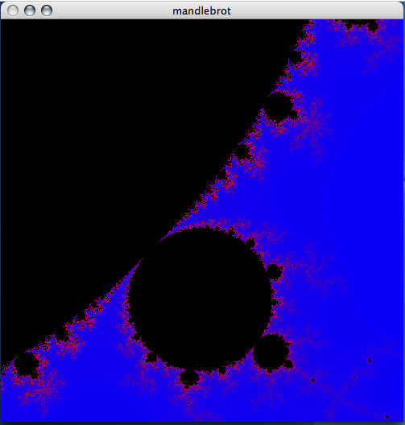
Examples
We have seen two examples that write to frame buffer
  Mandelbrot
  RayTracer
void display()
{
glClear(GL_COLOR_BUFFER_BIT);
glDrawPixels(n,m,GL_COLOR_INDEX,
      GL_UNSIGNED_BYTE, image);
glFlush();
}

Slide 12
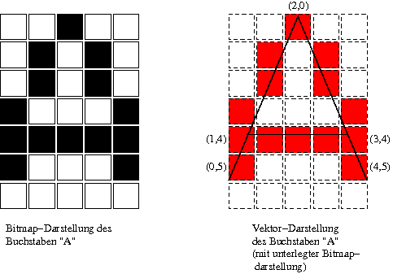
Bitmaps
OpenGL treats 1-bit pixels (bitmaps) differently from multi-bit pixels (pixelmaps)
Bitmaps are masks that determine if the corresponding pixel in the frame buffer is drawn with the present raster color
  0 ⇒ color unchanged
  1 ⇒ color changed based on writing mode
Bitmaps are useful for raster text
  GLUT font: GLUT_BIT_MAP_8_BY_13
OpenGL maintains a Raster Position, where new character will be placed
We saw this used in the paint program early in the semester
Angel: Interactive Computer Graphics 4E © Addison-Wesley 2004

Slide 13

Stencil Buffer
Used to control drawing based on values in the stencil buffer
  Fragments that fail the stencil test are not drawn
  Example: create a mask in stencil buffer and draw only objects not in mask area
We will return to this after a visit with the Accumulation Buffer
Notes:
An Interactive Introduction to OpenGL Programming
Unlike other buffers, we do not draw into the stencil buffer. We set its values with the stencil functions. However, the rendering can alter the values in the stencil buffer depending on whether a fragment passes or fails the stencil test.

Slide 14

Alpha Blending
It is possible to blend colors together
The gives the appearance of translucent materials
We blend the current destination with the source
The results are order dependant
glEnable(GL_BLEND)
glBlendFunc(source_factor,
destination_factor)
Notes:
An Interactive Introduction to OpenGL Programming
Unlike other buffers, we do not draw into the stencil buffer. We set its values with the stencil functions. However, the rendering can alter the values in the stencil buffer depending on whether a fragment passes or fails the stencil test.

Slide 15

Alpha Blending
Two routines - Both use the alpha channel
static void drawLeftTriangle(void)
{
/* draw yellow triangle on LHS of screen */
  glBegin (GL_TRIANGLES);
    glColor4f(1.0, 1.0, 0.0, 0.75);
    glVertex3f(0.1, 0.9, 0.0);
    glVertex3f(0.1, 0.1, 0.0);
    glVertex3f(0.7, 0.5, 0.0);
  glEnd();
}
Notes:
An Interactive Introduction to OpenGL Programming
Unlike other buffers, we do not draw into the stencil buffer. We set its values with the stencil functions. However, the rendering can alter the values in the stencil buffer depending on whether a fragment passes or fails the stencil test.

Slide 16
Which first?
void display(void)
{
  glClear(GL_COLOR_BUFFER_BIT);
  if (leftFirst) {
    drawLeftTriangle();
    drawRightTriangle();
  }
  else {
    drawRightTriangle();
    drawLeftTriangle();
  }
  glFlush();
}
Notes:
An Interactive Introduction to OpenGL Programming
Unlike other buffers, we do not draw into the stencil buffer. We set its values with the stencil functions. However, the rendering can alter the values in the stencil buffer depending on whether a fragment passes or fails the stencil test.

Slide 17
Issue: Average in Place
We want to average three numbers: 1, 1, and 97.
  If average 1 and 97, we get 49
  If we average 1 and 49, we get 25
However, if we average 1's first, and then average in the 97, we get 49
Right answer is (1 + 1 + 97)/3 = 33
In the first case, we divide 97 by 4: in the second by 2. Want to divide by 3.
Notes:
An Interactive Introduction to OpenGL Programming
Unlike other buffers, we do not draw into the stencil buffer. We set its values with the stencil functions. However, the rendering can alter the values in the stencil buffer depending on whether a fragment passes or fails the stencil test.

Slide 18
Accumulation Buffer
We may want to combine multiple pixels to arrive at a result
We could use blending, but blending is order dependant
We would rather compute a true average.
If I wish to average the values of 4 pixels, I run the risk of overflow
  I could divide before addition, but then I loose precision
The Accumulation Buffer is designed for such purposes
  Stores a floating point number for each color value in pixel buffer
Protocol
  Clear the buffer
  Add to it with a scaling factor
  Copy results back to frame buffer

Slide 19
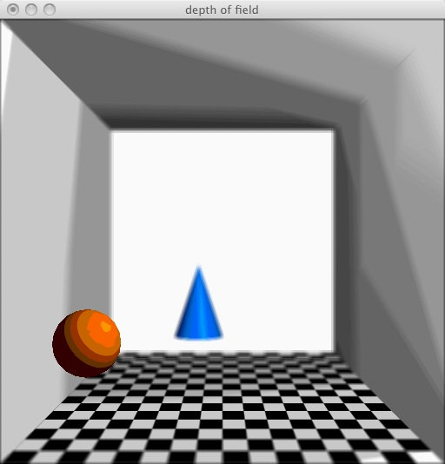
Applications
We can combine images
Or perform image processing on single image
We can use this for
  Motion blur
  Antialiasing
  Depth of Field

Slide 20
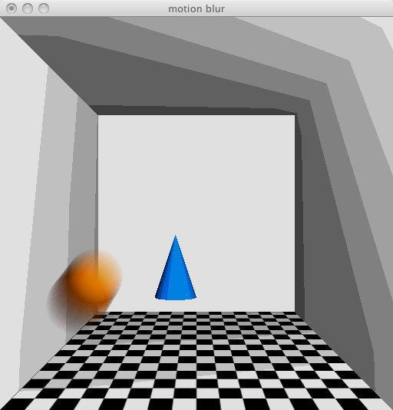
Motion Blur
SIGGRAPH 1996
motionblur.c
Render the ball multiple times, moving the ball between passes

Slide 21
Using Accumulation Buffer
void redraw(void) {...
  switch(rendermode) {
    case NONE:
      render(0.f, 0.f, 0.f);
      break;
    case FIELD:...
      glClear(GL_ACCUM_BUFFER_BIT);
      for (i = 0; i < max; i++) {
        render(dx * i, dy * i, dz * i);
        glAccum(GL_ACCUM, 1.f/max);
      }
      glAccum(GL_RETURN, 1.f);
      break;
Clear buffer
Add into accumulation buffer
Copy result to frame buffer

Slide 22
Render
void
render(GLfloat dx, GLfloat dy, GLfloat dz)
{
  ...
  glPushMatrix();
  glTranslatef(-80.f + dx, -60.f + dy, -420.f + dz);
  glCallList(SPHERE);
  glPopMatrix();
  glPushMatrix();
  glTranslatef(-20.f, -80.f, -600.f);
  glCallList(CONE);
  glPopMatrix();
Note that we waste time reimaging everything, when only the sphere moves

Slide 23
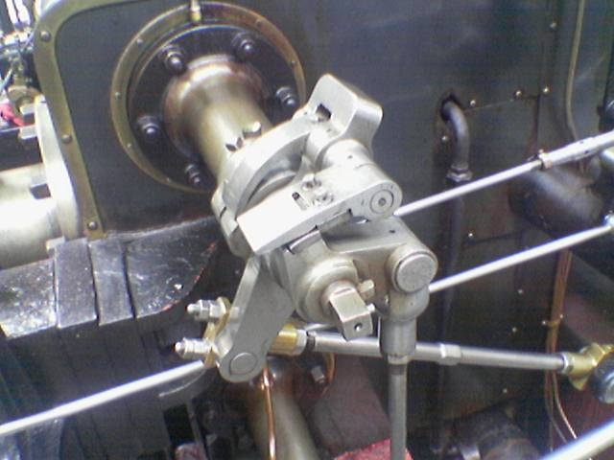
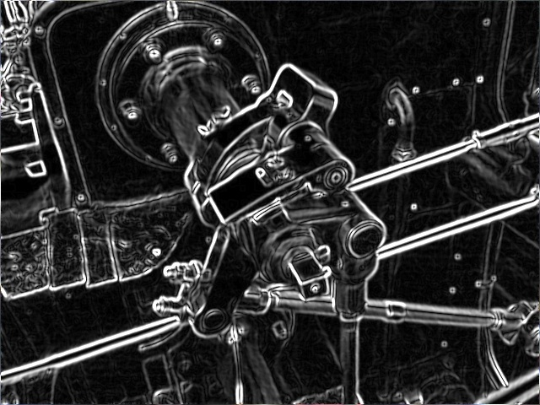
Convolutions
It is common in image processing to use convolutions
A common use is to find edges

Slide 24
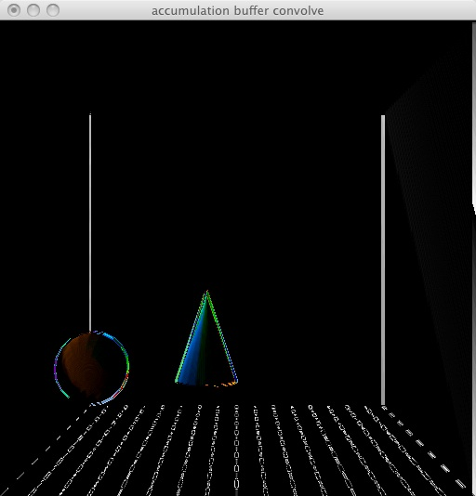
Convolutions
SIGGRAPH 1996
convolve.c
This is a version of the cone and sphere picture after applying the Sobel edge detector
We are looking for edges as x increases
Note that we waste time reimaging everything, when only the sphere moves

Slide 25
Convolutions
void redraw(void) {
  glClearAccum(curmat->bias, curmat->bias, curmat->bias, 1.0);
  glClear(GL_ACCUM_BUFFER_BIT);
  convolve(render, curmat);
  glViewport(0, 0, winWidth, winHeight); /* !?! */
  glAccum(GL_RETURN, curmat->scale);
  glutSwapBuffers();
}

Slide 26
Convolutions
void
convolve(void (*draw)(void), Filter *mat)
{
  ...
  for(j = 0; j < jmax; j++) {
    for(i = 0; i < imax; i++) {
      glViewport(-i, -j, winWidth - i, winHeight - j);
      draw();
      glAccum(GL_ACCUM, mat->array[i + j * imax]);
    }
  }
}

Slide 27
Sobel Filter
void sobel(Filter *mat)
{
  static GLfloat sobel[] = {-.5f, 0.f, .5f,
  -1.f, 0.f, 1.f,
  -.5f, 0.f, .5f};
  resize(mat, 3, 3);
  memcpy(mat->array, sobel, sizeof(sobel));
  mat->scale = 2.f;
  mat->bias = 0.f;
}

Slide 28
Resize
/* doesn't re-initialize matrix */
void
resize(Filter *mat, int rows, int cols) {
  if (mat->rows != rows || mat->cols != cols) {
    free(mat->array);
    mat->array = (GLfloat *)realloc(mat->array, rows * cols * sizeof(GLfloat));
  }
  mat->rows = rows;
  mat->cols = cols;
}

Slide 29
Extra Free!
/* doesn't re-initialize matrix */
void
resize(Filter *mat, int rows, int cols) {
  if (mat->rows != rows || mat->cols != cols) {
    /* free(mat->array); 1) Done by realloc 2) Free before using? Ouch! */
    mat->array = (GLfloat *)realloc(mat->array, rows * cols * sizeof(GLfloat));
  }
  mat->rows = rows;
  mat->cols = cols;
}

Slide 30
realloc
The realloc() function tries to change the size of the allocation pointed to by ptr to size, and returns ptr. If there is not enough room to enlarge the memory allocation pointed to by ptr, realloc() creates a new allocation, copies as much of the old data pointed to by ptr as will fit to the new allocation, frees the old allocation, and returns a pointer to the allocated memory.

Slide 31
Depth of Field
SIGGRAPH 1996
field.c
How can we get the effect of the depth of field?

Slide 32
Image
for(j = min; j < max; j++) {
  for(i = min; i < max; i++) {
    dx = scale * i * FRUSTNEAR/focus;
    dy = scale * j * FRUSTNEAR/focus;
    glMatrixMode(GL_PROJECTION);
    glLoadIdentity();
    glFrustum(-FRUSTDIM + dx, FRUSTDIM + dx, -FRUSTDIM + dy, FRUSTDIM + dy, FRUSTNEAR, FRUSTFAR);
    glMatrixMode(GL_MODELVIEW);
    glLoadIdentity();
    glTranslatef(scale * i, scale * j, 0.f);
    render();
    glAccum(GL_ACCUM, 1.f/count);
    }
  }
glAccum(GL_RETURN, 1.f);

Slide 33
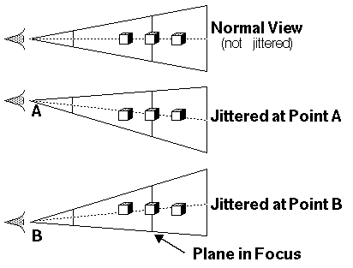
Jitter
What is happening?
We tweak the eye point and the direction the eye is looking
For items at the right distance (focal plane) there is no movement

Slide 34
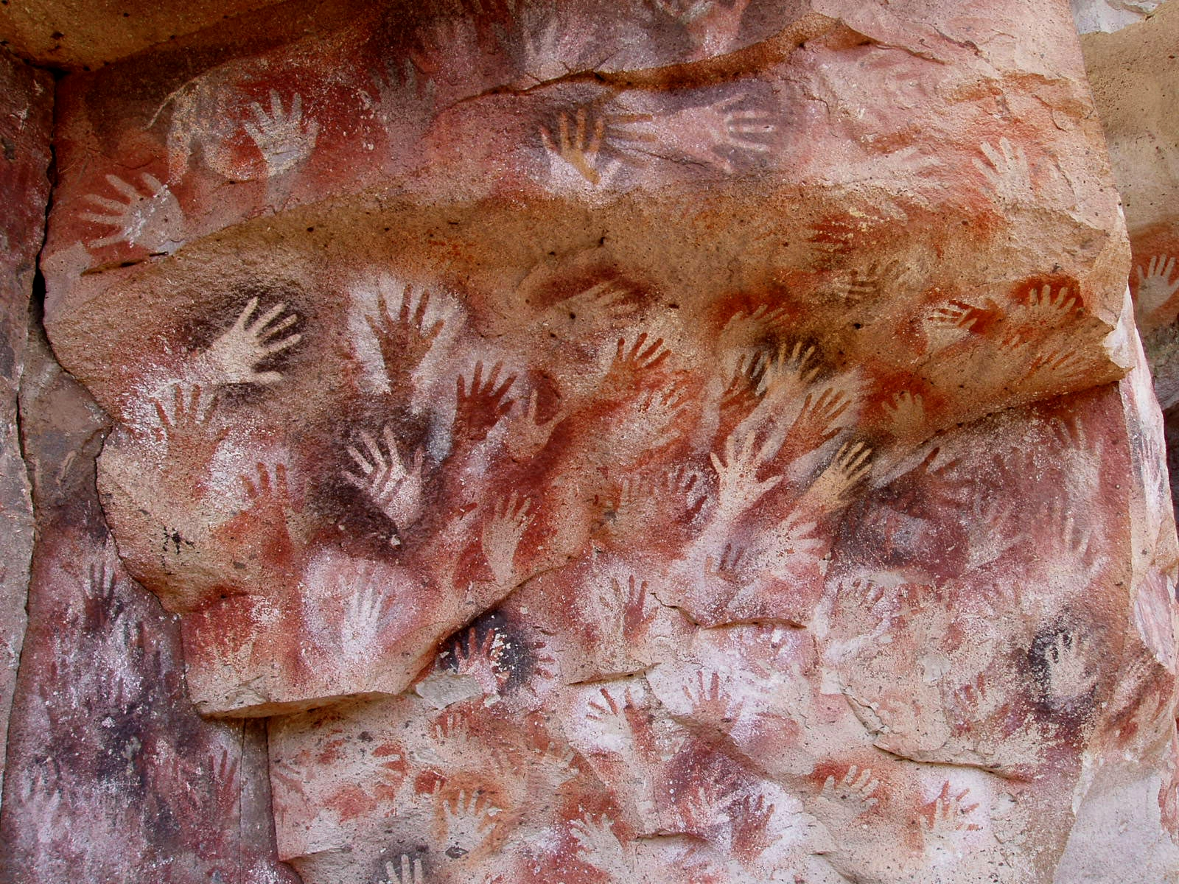
Stencil

Slide 35
Stencil Buffer
For a fragment to make it to the frame buffer, it has a number of testing stages to go through.
The tests that a fragment must pass are:
  scissor test - an additional clipping test
  alpha test - a filtering test based on the alpha color component
  stencil test - a pixel mask test
  depth test - fragment occlusion test
Each controlled by glEnable() capability.
If a fragment passes all enabled tests, it is then blended, dithered and/or logically combined with pixels in the framebuffer.
We turn now to the Stencil Test
Angel: Interactive Computer Graphics 4E © Addison-Wesley 2004

Slide 36
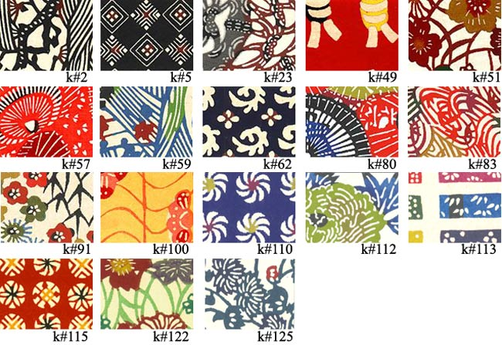
Stencil Buffer
Fragments that fail the stencil test are not drawn
Notes:
An Interactive Introduction to OpenGL Programming
Unlike other buffers, we do not draw into the stencil buffer. We set its values with the stencil functions. However, the rendering can alter the values in the stencil buffer depending on whether a fragment passes or fails the stencil test.

Slide 37
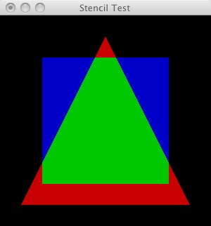
Redbook stenciltest.c
Unlike other buffers, we do not draw into the stencil buffer.
We set its values with the stencil functions.
However, rendering can alter the values in the stencil buffer depending on whether a fragment passes or fails the stencil test.
This example distinguishes four areas: background, red, green, and blue.
Implementations are required to support at least one bit of stencil. Almost all support 8 today.

Slide 38
Initialize
glClearColor(0.0, 0.0, 0.0, 0.0);
glClearStencil(0);
glStencilMask(1); // Now we can only write LSBit
glEnable(GL_STENCIL_TEST);
glClear(GL_COLOR_BUFFER_BIT|GL_STENCIL_BUFFER_BIT);
// ? Didn’t we do this
The glClear function sets the bitplane area of the window to values previously selected by ... glClearStencil...

Slide 39
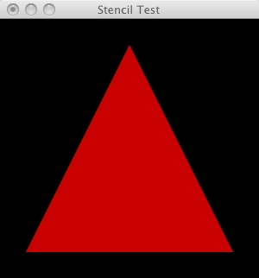
Draw
static void Draw(void)
{
glClear(GL_COLOR_BUFFER_BIT|GL_STENCIL_BUFFER_BIT);
glStencilFunc(GL_ALWAYS, 1, 1);
glStencilOp(GL_KEEP, GL_KEEP, GL_REPLACE);
glColor3ub(200, 0, 0);
glBegin(GL_POLYGON);
glVertex3i(-4, -4, 0);
glVertex3i( 4, -4, 0);
glVertex3i( 0, 4, 0);
glEnd();

Slide 40

First Layer
00000100000
00001110000
00011111000
00111111100
01111111110
Values in the stencil buffer

Slide 41
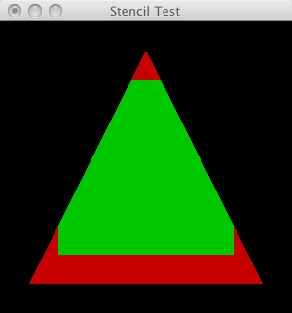
Second Layer
static void Draw(void)
{
...
glStencilFunc(GL_EQUAL, 1, 1);
glStencilOp(GL_INCR, GL_KEEP, GL_DECR);
glColor3ub(0, 200, 0);
glBegin(GL_POLYGON);
glVertex3i(3, 3, 0);
glVertex3i(-3, 3, 0);
glVertex3i(-3, -3, 0);
glVertex3i(3, -3, 0);
glEnd();
Note that depth test has not been enabled

Slide 42
Painting in Green
glStencilFunc(GL_EQUAL, 1, 1);
glStencilOp(GL_INCR, GL_KEEP, GL_DECR);
What does the stencil hold?
Note that depth test has not been enabled

Slide 43
Painting in Green
glStencilFunc(GL_EQUAL, 1, 1);
glStencilOp(GL_INCR, GL_KEEP, GL_DECR);
00000100000
00110001100
00100000100
00000000000
01111111110

Slide 44
Translation
glStencilFunc(GL_EQUAL, 1, 1);
glStencilOp(GL_INCR, GL_KEEP, GL_DECR);
  void glStencilOp( GLenum fail, GLenum zfail, GLenum zpass);
fail: The action to take when the stencil test fails.
  GL_KEEP Keeps the current value. …
  GL_INCR Increments the current stencil buffer value. Clamps to the maximum representable unsigned value.
  GL_DECR Decrements the current stencil buffer value. Clamps to zero.
zfail: Stencil action when the stencil test passes, but the depth test fails.
zpass: Stencil action when both the stencil test and the depth test pass, or when the stencil test passes and either there is no depth buffer or depth testing is not enabled.

Slide 45
Last Layer
static void Draw(void)
{ ...
glStencilFunc(GL_EQUAL, 1, 1);
glStencilOp(GL_KEEP, GL_KEEP, GL_KEEP);
glColor3ub(0, 0, 200);
glBegin(GL_POLYGON);
glVertex3i(3, 3, 0);
glVertex3i(-3, 3, 0);
glVertex3i(-3, -3, 0);
glVertex3i(3, -3, 0);
glEnd();

Slide 46
Painting in Blue
glStencilFunc(GL_EQUAL, 1, 1);
glStencilOp(GL_KEEP, GL_KEEP, GL_KEEP);
00000100000
00110001100
00100000100
00000000000
01111111110

Slide 47
Translation
The stencil buffer is the same size as the frame buffer, but is not displayed.
Like the depth buffer
The stencil buffer holds (8 bit) unsigned numbers
The depth buffer holds real numbers in the range 0.0 – 1.0
We can use the stencil buffer to tag pixels. Based on the tags, we can accept or reject a pixel, and update the stencil value.
The depth buffer compares new value to old, and replaces old when the new value is closer to viewer

Slide 48
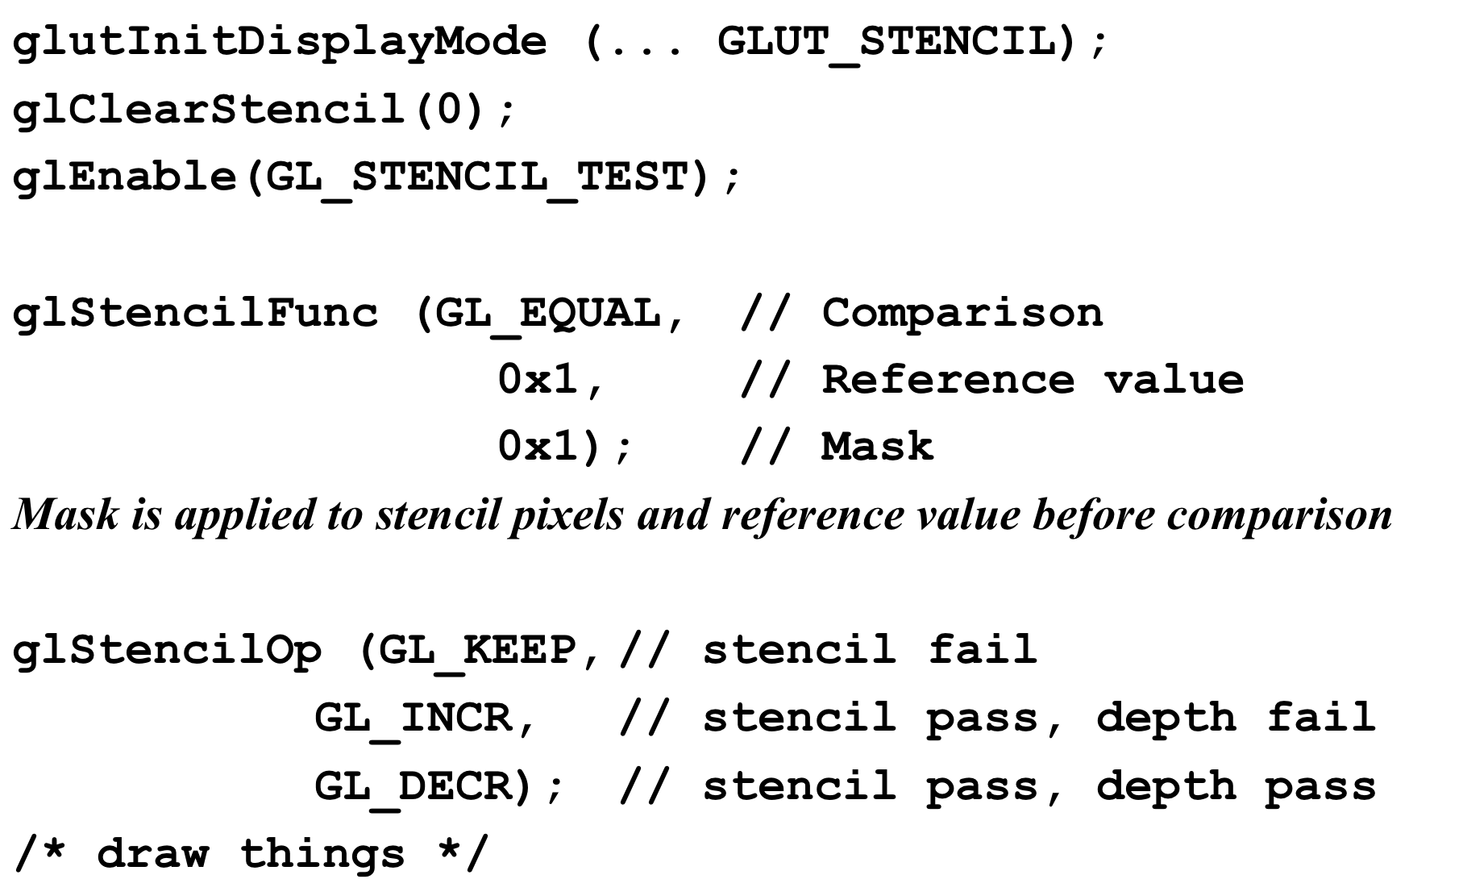
Protocol

Slide 49
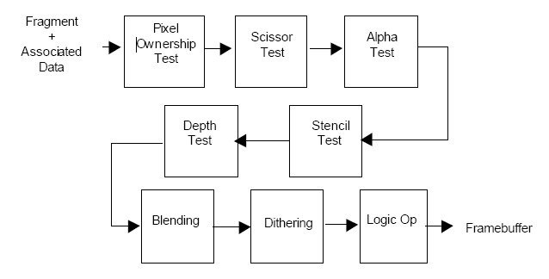
Bit Tests

Slide 50
glStencilFunc
glStencilFunc(GL_ALWAYS, 1, 1);
glStencilFunc(GLenum func, GLint ref, GLuint mask);
func - comparison function,
ref
The reference value for the stencil test. The ref parameter is clamped to the range [0,2n 1], where n is the number of bitplanes in the stencil buffer.
maskA
  mask that is ANDed with both the reference value and the stored stencil value when the test is done.
The function can be GL_NEVER, GL_ALWAYS, ..GL_EQUAL,…
By default, func is GL_ALWAYS, ref is 0, mask is all 1s, and stenciling is disabled.

Slide 51
glStencilOp
glStencilOp(GL_INCR, GL_KEEP, GL_DECR);
void glStencilOp( GLenum fail, GLenum zfail, GLenum zpass);
fail: The action to take when the stencil test fails.
  GL_KEEP Keeps the current value.
  GL_ZERO Sets the stencil buffer value to zero.
  GL_REPLACE Sets the stencil buffer value to ref, as specified by glStencilFunc.
  GL_INCR Increments the current stencil buffer value. Clamps to the maximum representable unsigned value.
  GL_DECR Decrements the current stencil buffer value. Clamps to zero.
  GL_INVERT Bitwise inverts the current stencil buffer value.
zfail: Stencil action when the stencil test passes, but the depth test fails. Accepts the same symbolic constants as fail.
zpass: Stencil action when both the stencil test and the depth test pass, or when the stencil test passes and either there is no depth buffer or depth testing is not enabled. Accepts the same symbolic constants as fail.

Slide 52
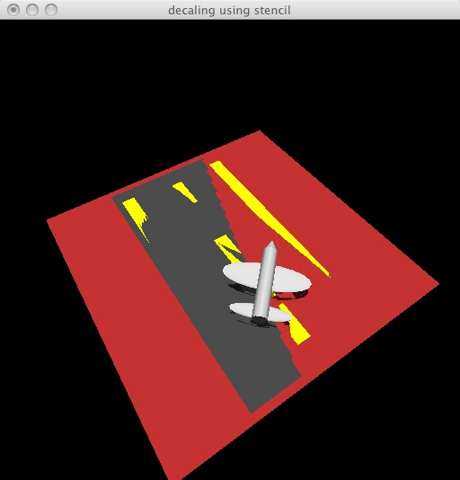
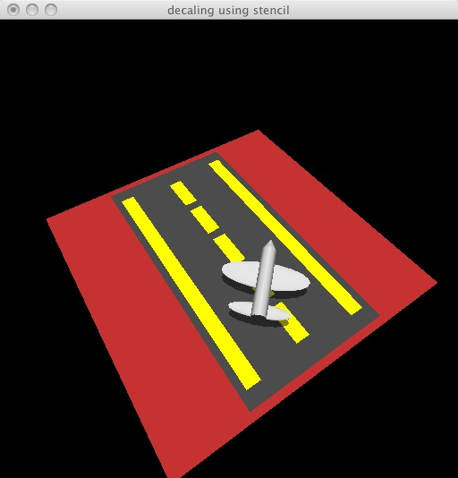
SIGGRAPH 1997 decal.c

Slide 53
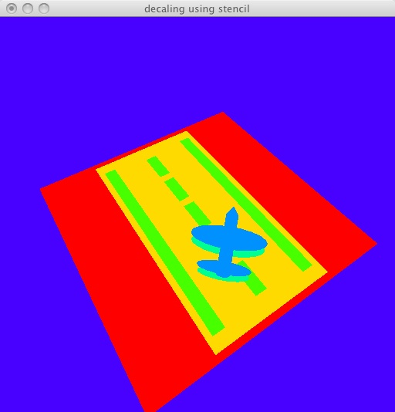
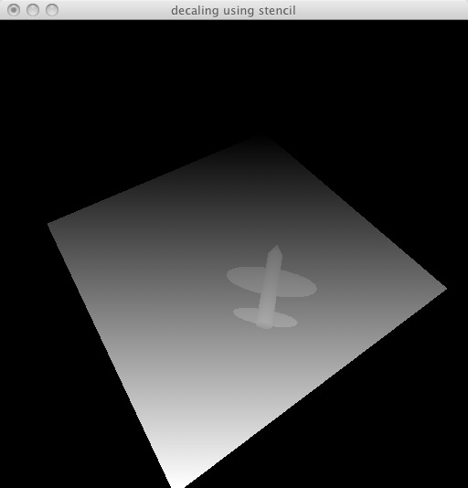
Draw Stencil state as colors
doneWithFrame:
...
switch(dataChoice) {
case COLOR:
break; /* color already in back buffer */
case STENCIL:
copyStencilToColor(GL_BACK);
break;
case DEPTH:
copyDepthToColor(GL_BACK);
break;
}
glutSwapBuffers();
}

Slide 54
Array of colors
These colors are used to map stencil values to figure
unsigned char colors[][3] = {
  {255, 0, 0}, /* red */
  {255, 218, 0}, /* yellow */
  {72, 255, 0}, /* yellowish green */
  {0, 255, 145}, /* bluish cyan */
  {0, 145, 255}, /* cyanish blue */
  {72, 0, 255}, /* purplish blue */
  {255, 0, 218}, /* reddish purple */
};

Slide 55
Decal
void setupDecalState(int decalNum)
{
if (useStencil) {
glDisable(GL_DEPTH_TEST);
glDepthMask(0);
glEnable(GL_STENCIL_TEST);
glStencilFunc(GL_GREATER, decalNum, 0xff);
glStencilOp(GL_KEEP, GL_KEEP, GL_REPLACE);
}
}

Slide 56
Decal
The following is only used for the Red Base
void setupBasePolygonState(int maxDecal)
{
  glEnable(GL_DEPTH_TEST);
  if (useStencil) {
    glEnable(GL_STENCIL_TEST);
    glStencilFunc(GL_ALWAYS, maxDecal + 1, 0xff);
    glStencilOp(GL_KEEP, GL_REPLACE, GL_ZERO);
  }
}

Slide 57
Draw
drawAirplane(); …
setupBasePolygonState(3); /* 2 decals */
drawGround();
/* decal # 1 = the runway asphalt */
setupDecalState(1);
drawAsphalt();
/* decal # 2 = yellow paint on the runway */
setupDecalState(2);
drawStripes();
/* decal # 3 = the plane's shadow */
setupDecalState(3);
...

Slide 58
Decal
void setupDecalState(int decalNum)
{
if (useStencil) {
glDisable(GL_DEPTH_TEST);
glDepthMask(0);
glEnable(GL_STENCIL_TEST);
glStencilFunc(GL_GREATER, decalNum, 0xff);
glStencilOp(GL_KEEP, GL_KEEP, GL_REPLACE);
}
}

Slide 59
Translation
glStencilFunc(GL_EQUAL, 1, 1);
glStencilOp(GL_INCR, GL_KEEP, GL_DECR);
  void glStencilOp( GLenum fail, GLenum zfail, GLenum zpass);
fail: The action to take when the stencil test fails.
  GL_KEEP Keeps the current value. …
  GL_INCR Increments the current stencil buffer value. Clamps to the maximum representable unsigned value.
  GL_DECR Decrements the current stencil buffer value. Clamps to zero.
zfail: Stencil action when the stencil test passes, but the depth test fails.
zpass: Stencil action when both the stencil test and the depth test pass, or when the stencil test passes and either there is no depth buffer or depth testing is not enabled.

Slide 60
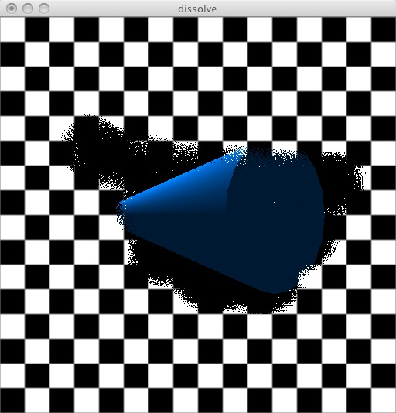
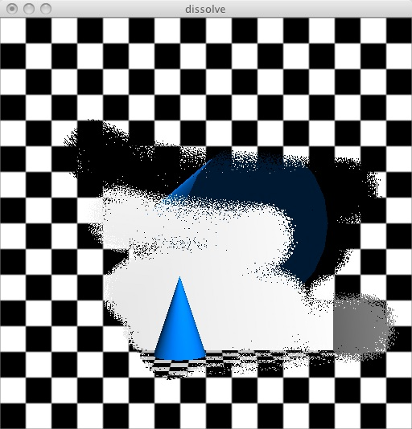
SIGGRAPH 1997 dissolve.c

Slide 61
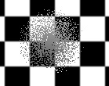
Eraser
void makeEraser(void) {
...
for(y = 0; y < eraserHeight; y++)
for(x = 0; x < eraserWidth; x++)
{
dx = x - eraserWidth / 2;
dy = y - eraserHeight / 2;
d = sqrt(dx * dx + dy * dy);
if(pow(drand48(), .75) * eraserWidth / 2 > d)
{
eraserpix[i + 0] = 255;
eraserpix[i + 1] = 255;
eraserpix[i + 2] = 255;
eraserpix[i + 3] = 255;
}
i += 4;
}
}

Slide 62
Mouse
/* left button, first layer, middle button, second layer */
void
mouse(int button, int state, int x, int y)
{
if (state == GLUT_DOWN) {
eraser = GL_TRUE;
if (button == GLUT_LEFT_BUTTON)
layer = 1;
else /* GLUT_MIDDLE: GLUT_RIGHT is for menu */
layer = 0;
} else { /* GLUT_UP */
eraser = GL_FALSE;
}
glutPostRedisplay();
}
I don't have a middle button: I removed the menu to restore this functionality to right button

Slide 63
DrawEraser
void draweraser(void)
{
glMatrixMode(GL_PROJECTION);
glLoadIdentity();
gluOrtho2D(0, winWidth, 0, winHeight);
glMatrixMode(GL_MODELVIEW);
glLoadIdentity();
/* replace with this layer */
glStencilFunc(GL_ALWAYS, layer, 0);
glStencilOp(GL_KEEP, GL_REPLACE, GL_REPLACE);
glDisable(GL_LIGHTING);
glDisable(GL_DEPTH_TEST);
glEnable(GL_ALPHA_TEST);
glAlphaFunc(GL_NOTEQUAL, 0);
glRasterPos2i(eraserpos[X], eraserpos[Y]);
glBitmap(0, 0, 0.f, 0.f, -winWidth/8.f, -winHeight/12.f, 0);
glDrawPixels(eraserWidth, eraserHeight, GL_RGBA, GL_UNSIGNED_BYTE, eraserpix);
glDisable(GL_ALPHA_TEST);
}
Larger on next page…

Slide 64
DrawEraser
void draweraser(void)
{ ...
/* replace with this layer */
glStencilFunc(GL_ALWAYS, layer, 0);
glStencilOp(GL_KEEP, GL_REPLACE, GL_REPLACE);
glDisable(GL_LIGHTING);
glDisable(GL_DEPTH_TEST);
glEnable(GL_ALPHA_TEST);
glAlphaFunc(GL_NOTEQUAL, 0);
glRasterPos2i(eraserpos[X], eraserpos[Y]);
glBitmap(0, 0, 0.f, 0.f, -winWidth/8.f, -winHeight/12.f, 0);
glDrawPixels(eraserWidth, eraserHeight, GL_RGBA,
      GL_UNSIGNED_BYTE, eraserpix);
glDisable(GL_ALPHA_TEST);
}

Slide 65
Draw Routine
Larger on next page…
void redraw(void)
{
if (glutLayerGet(GLUT_NORMAL_DAMAGED) || clearstencil == GL_TRUE) {
glClear(GL_COLOR_BUFFER_BIT | GL_DEPTH_BUFFER_BIT | GL_STENCIL_BUFFER_BIT);
clearstencil = GL_FALSE;
} else
glClear(GL_COLOR_BUFFER_BIT | GL_DEPTH_BUFFER_BIT);
glStencilOp(GL_KEEP, GL_KEEP, GL_KEEP);
glStencilFunc(GL_EQUAL, 2, (unsigned)~0);
drawlayer2();
glStencilFunc(GL_EQUAL, 1, (unsigned)~0);
drawlayer1();
glStencilFunc(GL_EQUAL, 0, (unsigned)~0);
drawlayer0();
if (eraser)
draweraser(); ...
}

Slide 66
glStencilFunc
glStencilFunc(GL_ALWAYS, 1, 1);
glStencilFunc(GLenum func, GLint ref, GLuint mask);
func - comparison function,
ref
The reference value for the stencil test. The ref parameter is clamped to the range [0,2n 1], where n is the number of bitplanes in the stencil buffer.
maskA
  mask that is ANDed with both the reference value and the stored stencil value when the test is done.
The function can be GL_NEVER, GL_ALWAYS, ..GL_EQUAL,…
By default, func is GL_ALWAYS, ref is 0, mask is all 1s, and stenciling is disabled.

Slide 67
glStencilOp
glStencilOp(GL_INCR, GL_KEEP, GL_DECR);
void glStencilOp( GLenum fail, GLenum zfail, GLenum zpass);
fail: The action to take when the stencil test fails.
  GL_KEEP Keeps the current value.
  GL_ZERO Sets the stencil buffer value to zero.
  GL_REPLACE Sets the stencil buffer value to ref, as specified by glStencilFunc.
  GL_INCR Increments the current stencil buffer value. Clamps to the maximum representable unsigned value.
  GL_DECR Decrements the current stencil buffer value. Clamps to zero.
  GL_INVERT Bitwise inverts the current stencil buffer value.
zfail: Stencil action when the stencil test passes, but the depth test fails. Accepts the same symbolic constants as fail.
zpass: Stencil action when both the stencil test and the depth test pass, or when the stencil test passes and either there is no depth buffer or depth testing is not enabled. Accepts the same symbolic constants as fail.

Slide 68
Draw Routine
void redraw(void)
{
...
glStencilOp(GL_KEEP, GL_KEEP, GL_KEEP);
glStencilFunc(GL_EQUAL, 2, (unsigned)~0);
drawlayer2();
glStencilFunc(GL_EQUAL, 1, (unsigned)~0);
drawlayer1();
glStencilFunc(GL_EQUAL, 0, (unsigned)~0);
drawlayer0();
if(eraser)
draweraser(); ...
}

Slide 69
Layer 2
void drawlayer2(void)
{
...
glDisable(GL_LIGHTING);
glDisable(GL_DEPTH_TEST);
glEnable(GL_TEXTURE_2D);
glBegin(GL_QUADS);
glTexCoord2i(0, 0);
glVertex2i(0, 0);
glTexCoord2i(1, 0);
glVertex2i(winWidth, 0);
glTexCoord2i(1, 1);
glVertex2i(winWidth, winHeight);
glTexCoord2i(0, 1);
glVertex2i(0, winHeight);
glEnd();
glDisable(GL_TEXTURE_2D);
}

Slide 70
Layer 0
Layer 1 is similar, but more complex…
void drawlayer0(void)
{
static GLfloat lightpos[] = {50.f, 50.f, 0.f, 1.f};
glMatrixMode(GL_PROJECTION);
glLoadIdentity();
glOrtho(-50.f, 50.f, -50.f, 50.f, 0.f, 100.f);
glMatrixMode(GL_MODELVIEW);
glLoadIdentity();
glTranslatef(0.f, 0.f, -50.f);
glRotatef(angle, 0.f, 1.f, 0.f);
glRotatef(90.f, 0.f, 0.f, 1.f);
glTranslatef(0.f, -25.f, 0.f);
glEnable(GL_LIGHTING);
glEnable(GL_LIGHT0);
glLightfv(GL_LIGHT0, GL_POSITION, lightpos);
glCullFace(GL_BACK);
glTexParameteri(GL_TEXTURE_2D, GL_TEXTURE_MIN_FILTER, GL_NEAREST);
glCallList(CONE);
}

Slide 71
Init
glClearStencil(2);
glEnable(GL_STENCIL_TEST); /* used all the time */
glEnable(GL_CULL_FACE);
glCullFace(GL_BACK);

Slide 72
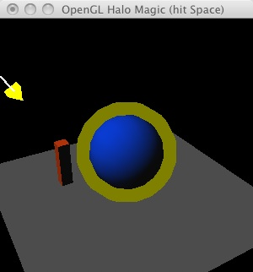
Halo
When your action figure acquires super powers, draw her with a halo
However, don't want to obscure her face with yellow schmutz
So set reference stencil value and draw her normally
Then expand her, and draw the enlarged area that does not touch the old values with the halo color, blending with background color

Slide 73
Summary
We can use buffers to do some powerful image processing
One more way to harness the power in your graphics card
Have a great vacation!

Slide 74
Resources
Excellent paper "Improving Shadows and Reflections via the Stencil Buffer" by Mark Kilgard.
The alpha blending and stenciltest examples are from the redbook
  http://www.opengl.org/resources/code/samples/redbook/
halomagic - http://www.sgi.com/products/software/opengl/examples/glut/examples/
The rest are from 1996 and 1997 SIGCSE Advanced OpenGL talks
  http://www.sgi.com/products/software/opengl/examples/glut/advanced/
  http://www.opengl.org/resources/code/samples/advanced/advanced97/programs/programs.html
  Several of them require multiple source files and data files.
    1996 - motionblur.c, convolve.c, field.c – depth of field
    1997 – decal.c, dissolve.c

