Slide 1
Bezier Curves and Surfaces
© Jeff Parker, Nov 2009

Slide 2
Review
Fill out the course evaluations!
We often wish to draw generate curves
  Through selection of arbitrary points
  Smooth (many derivatives)
  Fast to compute
  Easy to deal with
It is hard to get all of these
We will talk about some ideas used to achieve some of these

Slide 3
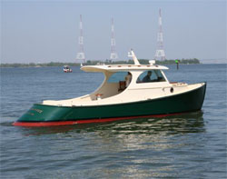
History
These ideas were developed twice:
  Pierre Bézier, at Renault
  Paul de Casteljau, at Citroën
Used by people who needed to bend sheet metal or wood to achieve a smooth shape

Slide 4
Background
Given a set of n points (x_{i}, y_{i}) we may be able to define a polynomial that goes through each point.
Lagrange Polynomial
Assumes that we don't have two points with the same x but different ys.
As the number of points rises, the curve can start to wobble to hit each mark.

Slide 5
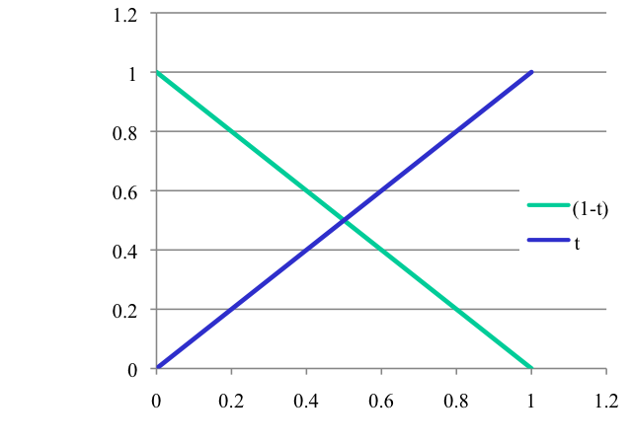
Reminder
Wrote line segment as weighted sum of endpoints
Can view this as the convex sum of two points
The curves below lie in [0..1], sum to 1

Slide 6
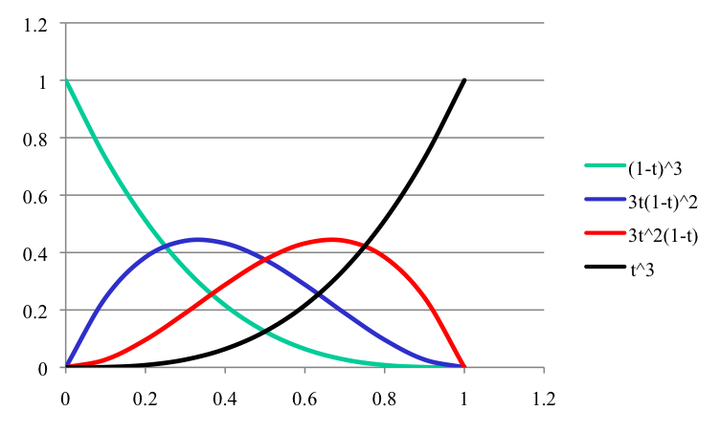
Bezier Curve
We write a Bezier as the weighted sum of control points
The control points are multiplied by Bernstein polynomials
Convex sum of polynomials with values in [0..1] that sum to 1
Each polynomial pulls curve towards it's control point

Slide 7
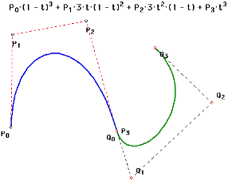
Terminology
The Bezier interpolates the first and fourth control point
  That is, the curve passes through them
The middle two control points draw the curve towards them

Slide 8
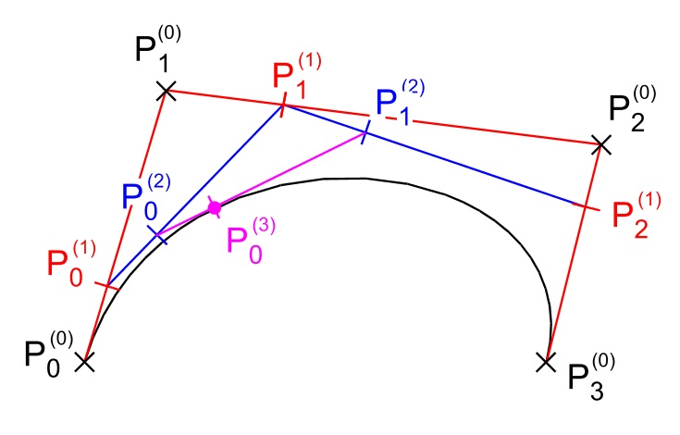
De Casteljau's Method
We can compute points on the curve without evaluating polynomials
Can use the midpoints, so only need to shift right

Slide 9
De Casteljau
Let's spell out what this means
Notation differs from figure

Slide 10
Expand one level

Slide 11
Expand last level

Slide 12
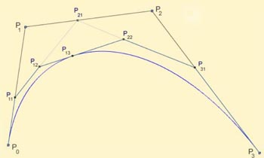
Recursive Drawing Algorithm
We can take four control points
Recursively subdivide, just using shifts
Get two Beziers, with 7 control points
Curve lies inside the convex hull
Continue until the convex hull is one pixel wide
At each step, subcurves
  are shorter
  are much less wide
Can make this formal

Slide 13
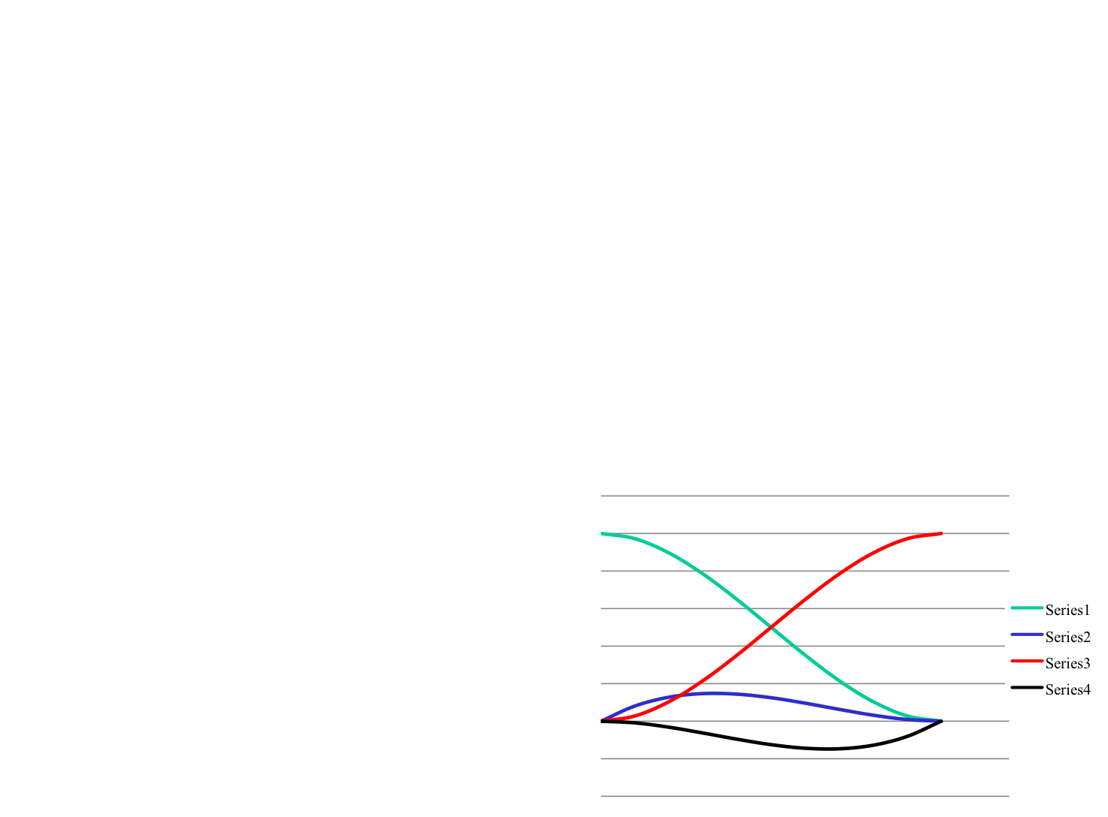
Hermite Polynomial
Sometimes we want to avoid sharp corners
Can define the slope at the endpoints
Hermite Polynomials use a new blending functions to define curve

Slide 14
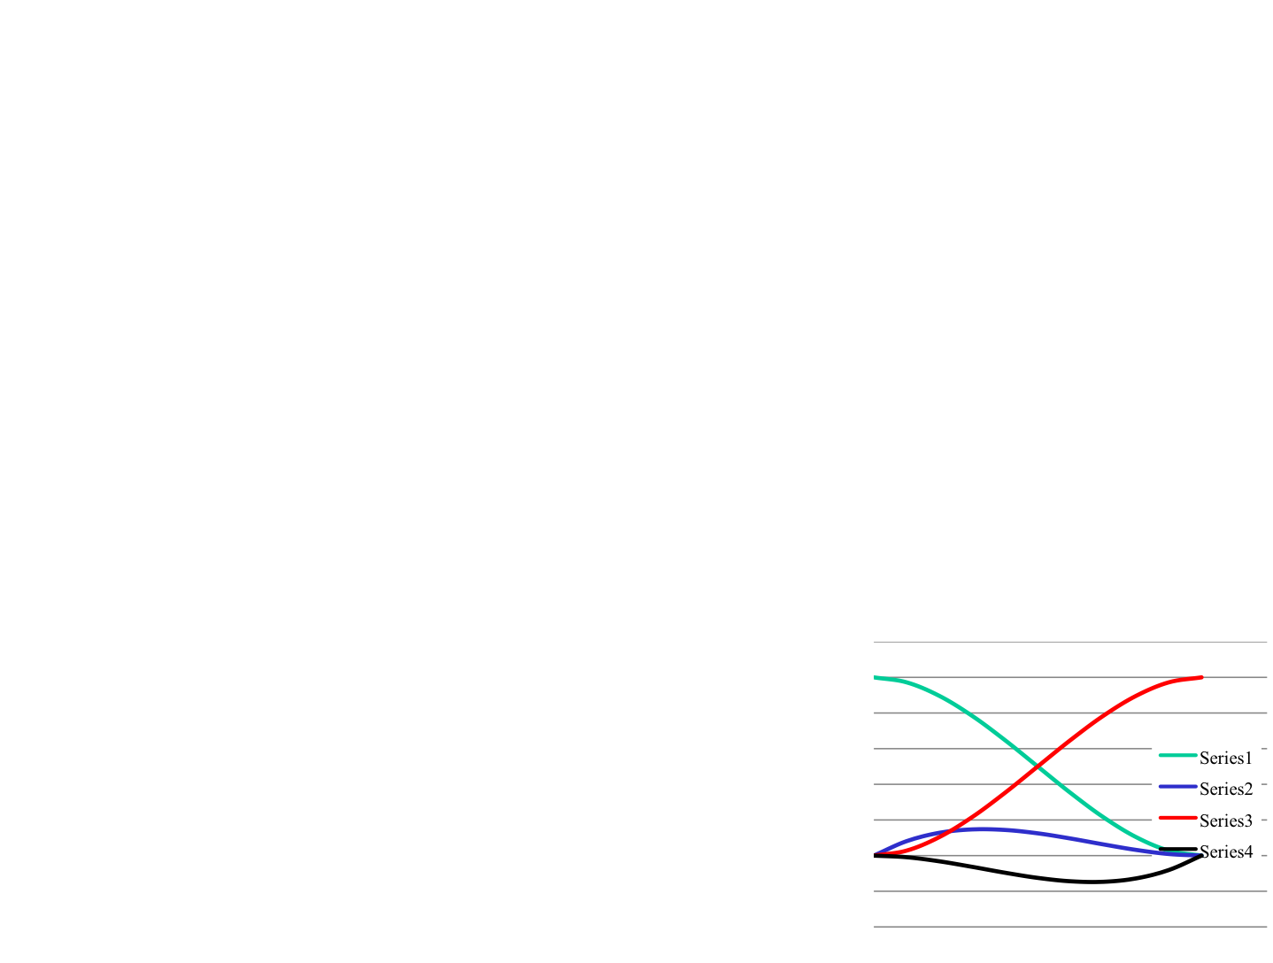
Hermite Polynomial

Slide 15
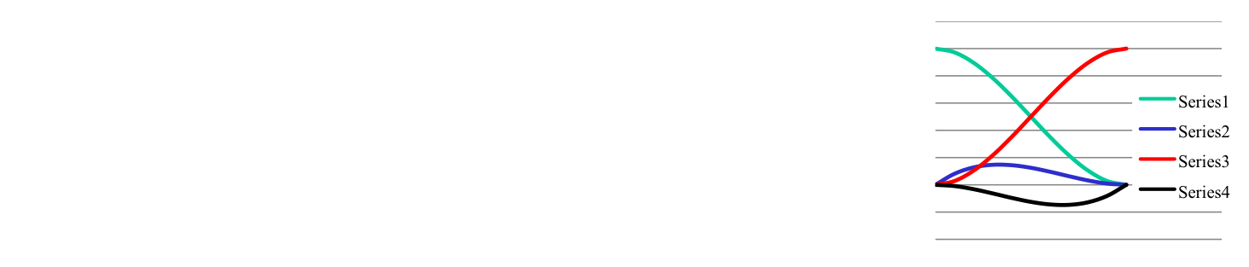
Hermite Polynomial

Slide 16
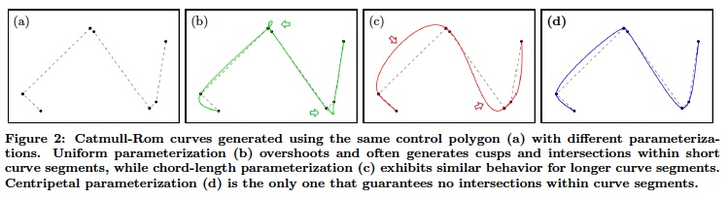
Catmull-Rom
We can get a similar effect with Bezier curves
One way of auto-generating the right slopes to a set of interpolated points was introduced by Catmull and Rom
Idea is to use slope between previous and next point as the slope at the current point.
If distance between points is uneven, can overshoot

Slide 17
Interactive Websites to try
Bill Casselman's Bezier Applet
  http://www.math.ubc.ca/people/faculty/cass/gfx/bezier.html
Wikepedia Animation
  http://en.wikipedia.org/wiki/Bezier_curve
Edward A. Zobel's Animation
  http://id.mind.net/~zona/mmts/curveFitting/bezierCurves/bezierCurve.html
POV-Ray Cyclopedia Tutorial
  http://www.spiritone.com/~english/cyclopedia/bezier.html
Andy Salter's Spline Tutorial
  http://www.doc.ic.ac.uk/%7Edfg/AndysSplineTutorial/index.html
Evgeny Demidov's Interactive Tutorial
  http://ibiblio.org/e-notes/Splines/Intro.htm

Slide 18
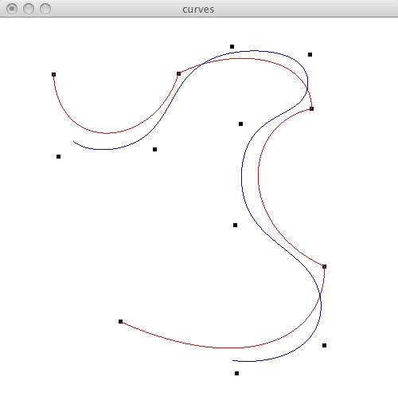
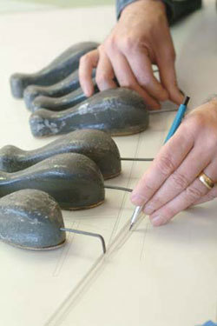
Splines
Make everything a central control point
  (Image is of a traditional spline used in boat building)

Slide 19
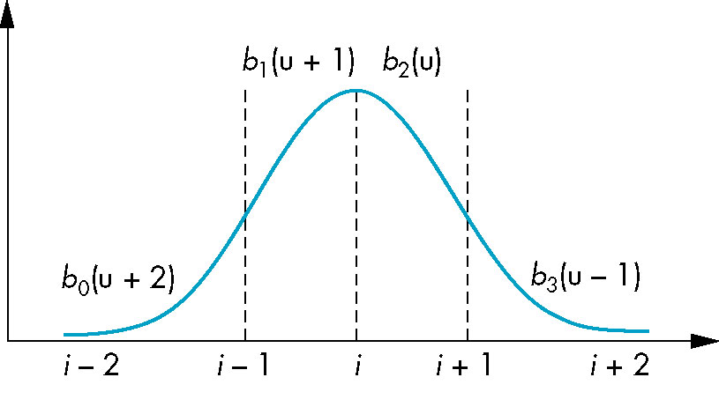
Basis Functions
In terms of the blending polynomials

Slide 20
In OpenGL
We could evaluate these by hand, given the formulas above.
It is simpler to use Evaluators, provided by OpenGL
Evaluators provide a way to use polynomial or rational polynomial mapping to produce vertices, normals, texture coordinates, and colors. The val-ues produced by an evaluator are sent to further stages of GL processing just as if they had been presented using glVertex, glNormal, glTexCoord, and glColor commands, except that the generated values do not update the current normal, texture coordinates, or color.
All polynomial or rational polynomial splines of any degree (up to the maximum degree supported by the GL implementation) can be described using evaluators. These include almost all splines used in computer graphics: B-splines, Bezier curves, Hermite splines, and so on. (From the man page)

Slide 21
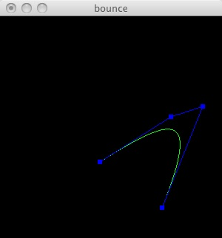
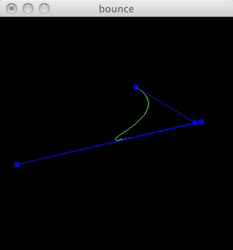
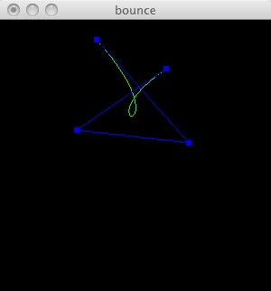
Bezier Curve
void drawCurve() {
  int i;
  GLfloat pts[4][3];
  /* Copy the coordinates from balls to array */
  for (i = 0; i < 4; i++) {
    pts[i][0] = (GLfloat)cp[i]->x;
    pts[i][1] = (GLfloat)wh - (GLfloat)cp[i]->y;
    pts[i][2] = (GLfloat)0.0;
  }
  // Define the evaluator
  glMap1f(GL_MAP1_VERTEX_3, 0.0, 1.0, 3, 4, &pts[0][0]);
  /* type, u_min, u_max, stride, num points, points */
  glEnable(GL_MAP1_VERTEX_3);
  setLineColor();
  glBegin(GL_LINE_STRIP);
    for (i = 0; i <= 30; i++)
      /* Evaluate the curve when u = i/30 */
      glEvalCoord1f((GLfloat) i/ 30.0);
  glEnd();

Slide 22
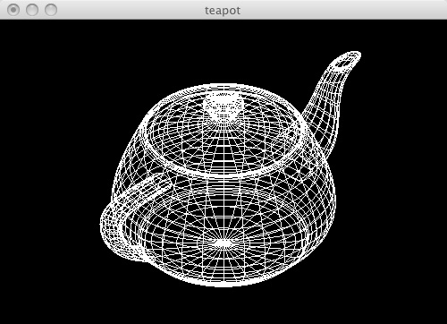
bteapot.c
// vertices.h
GLfloat vertices[306][3]={{1.4 , 0.0 , 2.4}, {1.4 , -0.784 , 2.4},
{0.784 , -1.4 , 2.4}, {0.0 , -1.4 , 2.4}, {1.3375 , 0.0 , 2.53125},
{1.3375 , -0.749 , 2.53125}, {0.749 , -1.3375 , 2.53125}, {0.0 , -1.3375 , 2.53125},
{1.4375 , 0.0 , 2.53125}, {1.4375 , -0.805 , 2.53125}, {0.805 , -1.4375 , 2.53125},
...
// patches.h
int indices[32][4][4]={{1, 2, 3, 4, 5, 6, 7, 8, 9, 10, 11, 12, 13, 14, 15, 16},
{4, 17, 18, 19, 8, 20, 21, 22, 12, 23, 24, 25, 16, 26, 27, 28},
{19, 29, 30, 31, 22, 32, 33, 34, 25, 35, 36, 37, 28, 38, 39, 40},
...

Slide 23
bteapot.c
/* 32 patches each defined by 16 vertices, arranged in a 4 x 4 array */
/* NOTE: numbering scheme for teapot has vertices labeled from 1 to 306 */
/* remnent of the days of FORTRAN */
#include "patches.h"
void display(void)
{
  int i, j, k;
  glClear(GL_COLOR_BUFFER_BIT | GL_DEPTH_BUFFER_BIT);
  glColor3f(1.0, 1.0, 1.0);
  glLoadIdentity();
  glTranslatef(0.0, 0.0, -10.0);
  glRotatef(-35.26, 1.0, 0.0, 0.0);
  glRotatef(-45.0, 0.0, 1.0, 0.0);
  /* data aligned along z axis, rotate to align with y axis */
  glRotatef(-90.0, 1.0,0.0, 0.0);

Slide 24
bteapot.c
for(k=0;k<32;k++)
{
  glMap2f(GL_MAP2_VERTEX_3, 0, 1, 3, 4, 0, 1, 12, 4, &data[k][0][0][0]);
  for (j = 0; j <= 8; j++)
  {
    glBegin(GL_LINE_STRIP);
      for (i = 0; i <= 30; i++)
        glEvalCoord2f((GLfloat)i/30.0, (GLfloat)j/8.0);
    glEnd();
    glBegin(GL_LINE_STRIP);
      for (i = 0; i <= 30; i++)
        glEvalCoord2f((GLfloat)j/8.0, (GLfloat)i/30.0);
    glEnd();
  }
}
glFlush();
}

