Slide 1
Shadows and Reflections
© Jeff Parker, 2009
"What is written without effort is in general read without pleasure.”
-- Samuel Johnson

Slide 2
Outline
Fill out your course evaluations!
Look at a vexing problem: How to deal with shadows
Wide variety of topics that provide a good review of course
  Hidden Surface Removal
  Clipping
  Counting Crossings – in or out?
  zBuffer
  Transformations
  Aliasing
We'll look at three shadow algorithms in detail
Images from a number of sources, including SIGGRAPH courses by Björn Kühl, and by Mark Kilgard of Nvidia

Slide 3
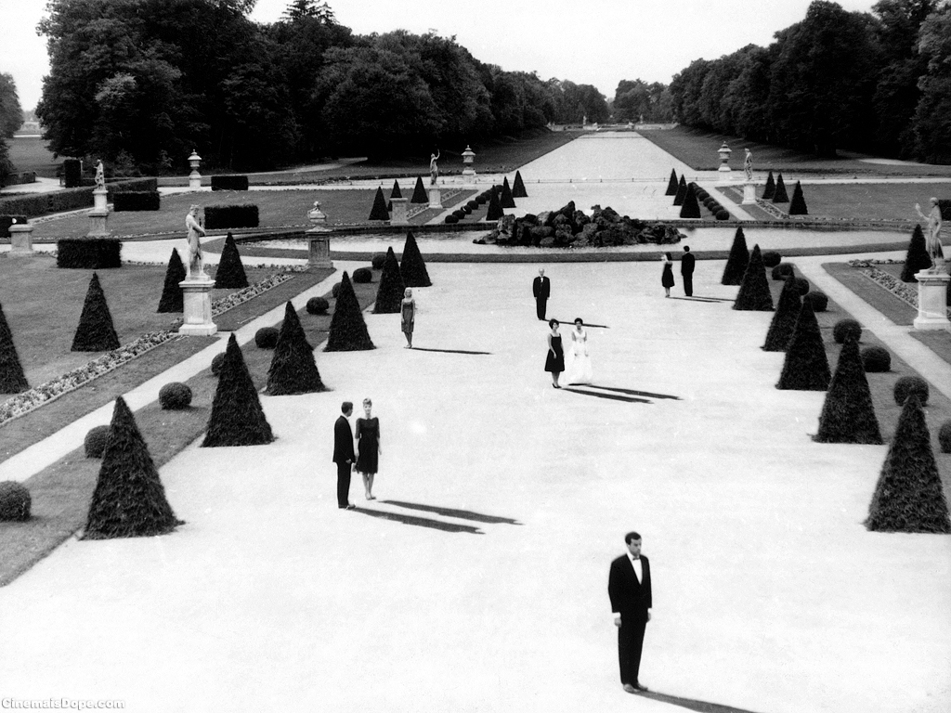
Why do we need shadows?
Why do we need shadows?

Slide 4
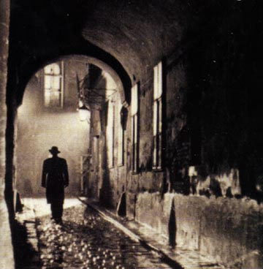
Shadows
Shadows help to create atmosphere

Slide 5
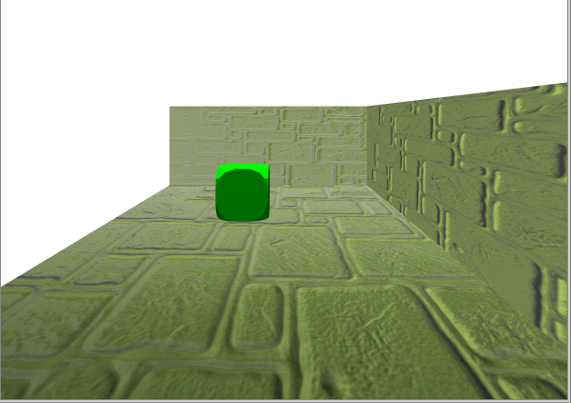
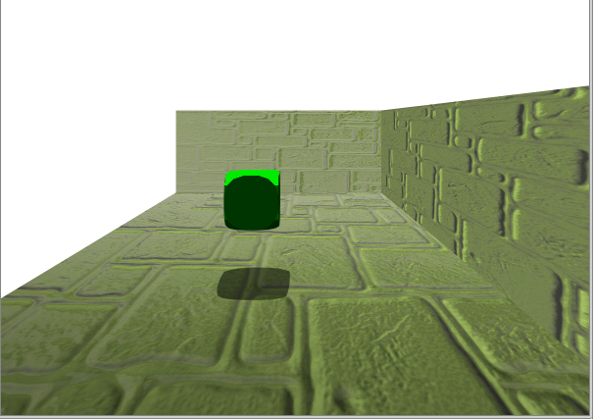
Shadows provide clues
Clues to the position of objects casting and receiving shadows
Clues to the position of the light sources

Slide 6

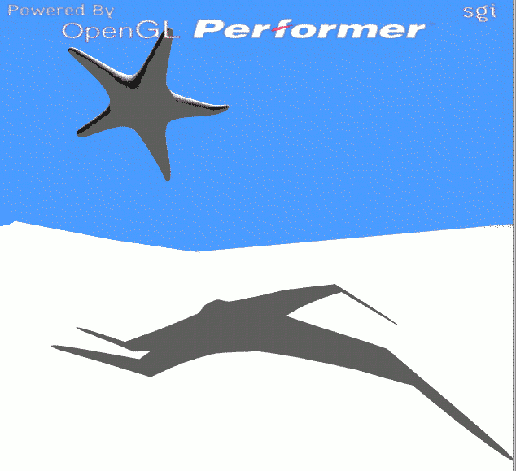
Shadows provide clues
Clues about the shape of casting objects
Clues about the shape of receiving objects

Slide 7
Atherton, Weiler & Greenberg
Adapt hidden surface removal to generating shadows
Build the image from the light's point of view
  Sort from back to front
  Build list of visible polygons: subdivide and clip
Merge lit set with rest of polygons
When drawing, those not in lit set are in shadow
Can handle multiple lights
To do clipping right is hard work

Slide 8
Ground Plane Shadows
Described by Blinn in “Me and My (Fake) Shadow” 1988.
Given light position and ground plane, project all objects in scene onto ground plane.
  The shadow is a pile of polygons on the ground plane.
  Polygons are co-planar, so pile has no height.
The trick is to construct the projection matrix, then concatenate the matrix with the model-view matrix.
Then the shadow is rasterized into the ground plane by re-rendering the object.

Slide 9
Prepare the view transform
Load the modelview matrix with the view transform. For example, given the eye location, the center of viewing, and up direction vector, the view transform can be set as follows:
  glMatrixMode(GL_MODELVIEW);
  glLoadIdentity();
  gluLookAt(eye[0], eye[1], eye[2],
    center[0], center[1], center[2],
    up[0], up[1], up[2]);

Slide 10
Draw the image
Given a light position and plane equation for the ground plane, for all objects between the plane and the light, enable the light source, and draw the object and the ground plane with depth buffering:
// local light location (LX,LY,LZ)
GLfloat lightPosition[4] = { LX, LY, LZ, 1.0 };
// A*x + B*y + C*z + D = 0
Glfloat groundPlaneEquation[4] = { A, B, C, D };
glLightfv(GL_LIGHT0, GL_POSITION, lightPosition);
glEnable(GL_LIGHT0);
glEnable(GL_LIGHTING);
drawObject();
drawGroundPlane();

Slide 11
Construct shadow projection
Push the modelview matrix:
  glPushMatrix();
Given the light source position and ground plane equation, construct a shadow matrix. Then, multiply the current modelview matrix with the shadow matrix.
GLfloat matrix [4][4];
// Compute matrix based on light position and
// ground plane equation. See Appendix B.
shadowMatrix(&matrix[0][0], lightPosition, groundPlaneEquation);
glMultMatrixf(&matrix[0][0]);

Slide 12
Make shadow non-planar
The ground plane and any shadow polygons projected to the ground plane will be very nearly co-planar, causing z-fighting.
Use OpenGL’s polygon offset functionality to nudge the shadow polygon fragments slightly nearer
glEnable(GL_POLYGON_OFFSET_FILL);
glPolygonOffset(1.0, 2.0); // add 2 depth buffer
// precision units plus slope factor
This way the shadow will always be slightly nearer and therefore visible.

Slide 13
Create the shadow
Disable lighting, set current color to dark gray, and draw the object again.
glDisable(GL_LIGHTING);
glColor3f(0.25, 0.25, 0.25); // dark gray
drawObject(); // draw object as projected shadow
This rasterizes the object’s shadow right on top of the ground plane.
Cleanup the rendering state.
  glDisable(GL_POLYGON_OFFSET);
  glPopMatrix();

Slide 14
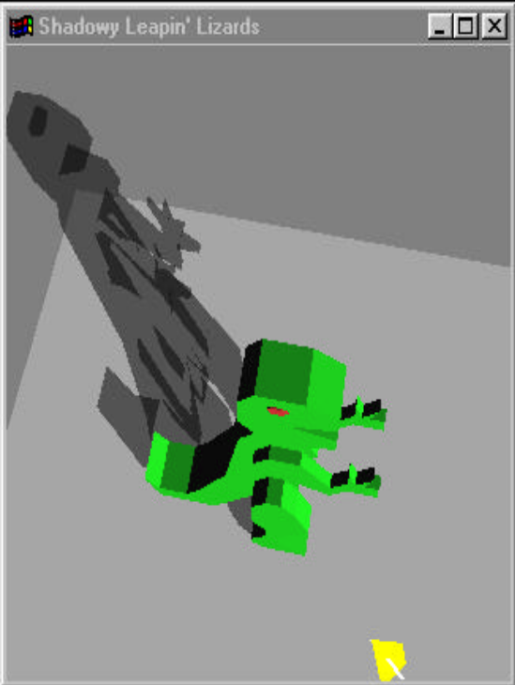
Limitations
This only works when projecting onto planes
Assumes an infinite plane
Gives hard edged shadows
Textured surfaces are hard to deal with
  To get a good match with floor that is not in shadow, we want to blend
  If we blend, we blend once for each polygon.
    But multiple polygons may overlap

Slide 15
Improved algorithm
Use stencil buffer to make limits of plane and limits of shadow
Assign a unique non-zero stencil value to the pixels belonging to the ground plane. Then draw the ground plane polygons like this:
glEnable(GL_STENCIL_TEST);
glStencilFunc(GL_ALWAYS, uniqueStencilValue, ~0);
glStencilOp(GL_KEEP, GL_KEEP, GL_REPLACE);
drawGroundPlane();
glDisable(GL_STENCIL_TEST);

Slide 16
When Drawing Shadow
glDisable(GL_LIGHTING);
glEnable(GL_BLEND); // enable blending to
glBlendFunc(GL_DST_COLOR, GL_ZER0); // modulate existing color...
glColor3f(0.5, 0.5, 0.5); // ... by 50%
glDisable(GL_DEPTH_TEST);
glEnable(GL_STENCIL_TEST);
// Only update pixels tagged with uniqueStencilValue and set stencil value to zero once updated.
glStencilFunc(GL_EQUAL, uniqueStencilValue, ~0);
glStencilOp(GL_KEEP, GL_KEEP, GL_ZERO);
drawObject(); // draw object as planar projected shadow
// Allows us to avoid offset to resolve z-fighting

Slide 17
Two Bit test
Blending is adequate for quick-and-dirty rendering, but you may be able to have more realistic rendering with a separate pass.
When selecting an otherwise unused stencil value v for tagging the planar surface’s shadow, also ensure that v+1 is also otherwise unused.
When rendering the projected shadow, instead of blending with the pixels on the planar surface, increment the pixel’s stencil value and do not update the color buffer.
Then re-render the planar surface again with lighting enabled but the blocked light source disabled and use stenciling to replace only pixel’s with the the value v+1.

Slide 18
Two Bit test
glPushMatrix();
// apply the planar projected shadow matrix
shadowMatrix(&matrix[0][0], lightPosition, groundPlaneEquation);
glMultMatrixf(&matrix[0][0]);
glDisable(GL_BLEND); // no blending!
glDisable(GL_DEPTH_TEST); // no depth testing needed
// accept only pixels matching the planar surface’s stencil value
glStencilFunc(GL_EQUAL, uniqueStencilValue, ~0);
// increment the stencil value if accepted
glStencilOp(GL_KEEP, GL_KEEP, GL_INCR);
glColorMask(0,0,0,0);
drawObject(); // draw object as planar projected shadow

Slide 19
Two Bit test
drawObject(); // draw object as planar projected shadow
glColorMask(1,1,1,1);
glPopMatrix();
glEnable(GL_LIGHTING); // enable lighting
glDisable(GL_LIGHT0); // but disable the shadowed light source;
// ambient light and light from other light sources is still computed
// accept only pixels matching incremented stencil value
glStencilFunc(GL_EQUAL, uniqueStencilValue+1, ~0);
glStencilOp(GL_KEEP, GL_KEEP, GL_DECR);
// re-render shadowed ground plane pixels with the light disabled
drawGroundPlane();
We will only increment a value once, as after the increment, the pixel will fail the stencil test.

Slide 20
Evaluation
Can handle multiple light sources: need unique v, v+1 for each
Still assumes ground is a plane

Slide 21
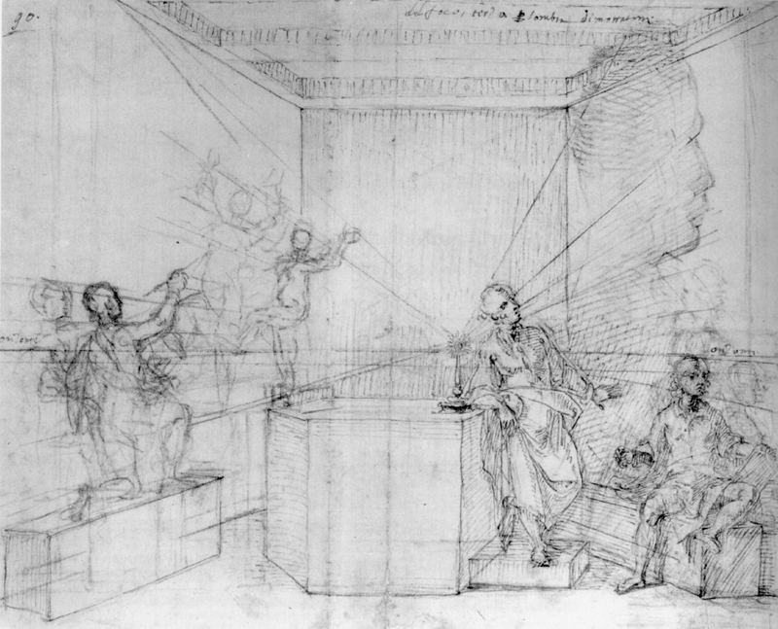
Shadow Volumes
Crow, Shadow algorithms for computer graphics, 1977
  Compute regions of shadow in 3D
    Object-space algorithm
    Cast shadows onto arbitrary receiver geometry
From the School of Leonardo Da Vinci

Slide 22
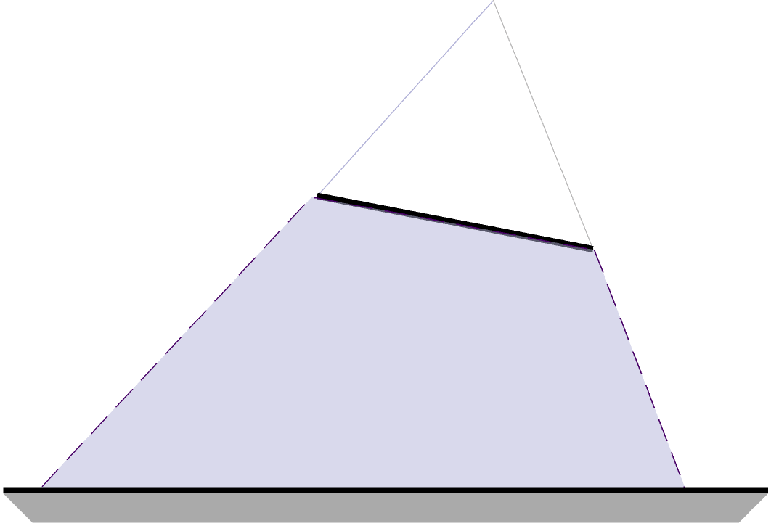
Shadow Volumes
Extend occluder polygons to form semi-infinite volumes
  Light source is center-of-projection
  Everything behind occluder is in shadow
  Test if point is in at least one volume !
  Extend to reach outside of view frustum
Light Source
Occluder
Shadow Region

Slide 23
Shadow Volumes
surface outside
shadow volume
(illuminated)
shadowing
object
light
source
shadow
volume
(infinite extent)
eye
position
partially
surface inside
shadow volume
(shadowed)
shadowed
object

Slide 24
Shadow Volumes
Shadow volume generation
  Trivial way: One volume for each polygon
  Better: Silhouette-based approach
      Goal: one shadow volume
    Selected occluders only

Slide 25




Shadow Volumes
Detect silhouette edges
  An edge is a silhouette edge if it is an edge shared by a front-facing and back-facing triangle/polygon
Light
Light
FF
BF
FF
FF
Silhouette Edge (v0,v1) !
No Silhouette Edge !

Slide 26
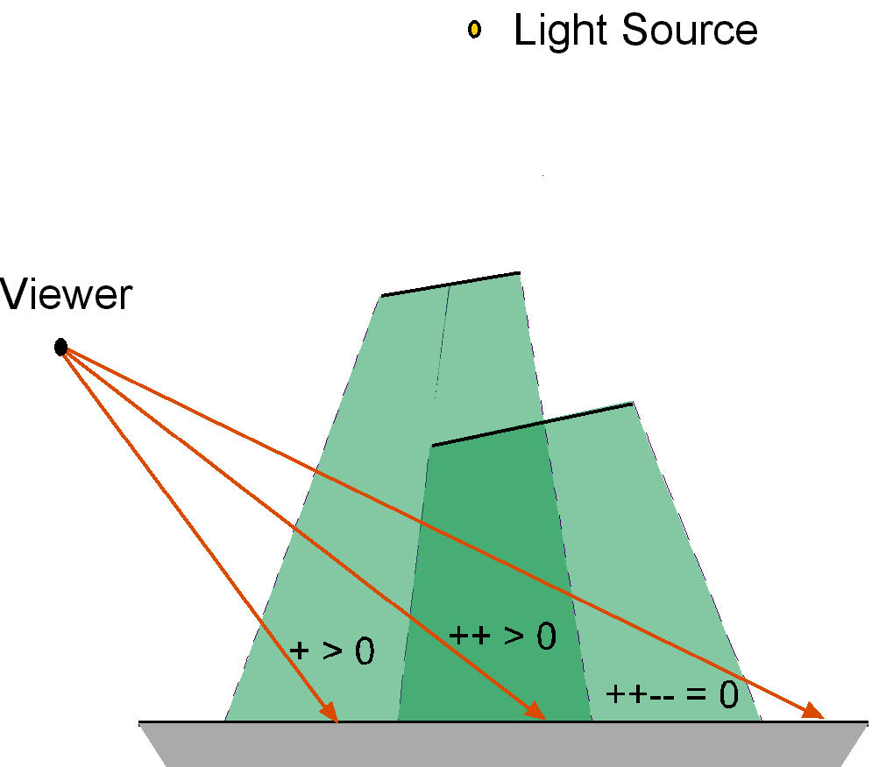
Shadow Volumes
Shadow test: in-out counter
  Counter == 0: lit
  Counter >=0: shadowed

Slide 27
Use Stencil Buffer as Counter
1. Render scene in ambient color – in shade
2. Render front-facing parts of shadow volumes with stencil operation increment (enter)
3. Render back-facing parts of shadow volumes with stencil operation decrement (exit)
4. Render scene (fully lit) with stencil test equal zero

Slide 28
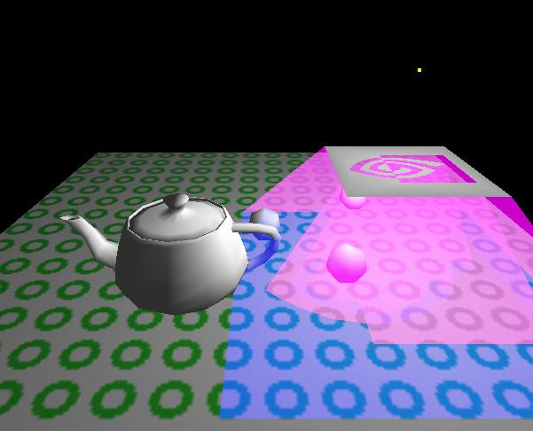
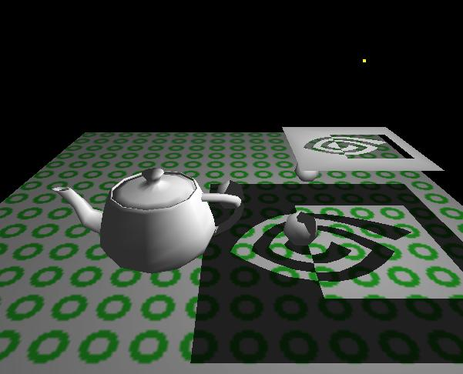
Shadow Volumes
Implementation
  Generate volumes in software (object space)
  Counting can be done in hardware (image space)
Images from Mark Kilgard’s shadow volume demo (NVIDIA).

Slide 29
Shadow Volumes
Counting problems
  Viewer in shadow (correct counter initialization)
  Correct ownership of adjacent polygons (no double hits)
    OpenGL renderer should do this (specification)
  Clipping of shadow volumes
    Near clipping plane could cut-away parts of the shadow volume.
    Need to cap shadow volumes !

Slide 30
Shadow Volumes
light
near plane
eye
light
volume be clipped !
missing stencil increment
near plane
eye
correct stencil
in-out

Slide 31
Shadow Volume Summary
Shadow volumes in object precision
  CPU intensive, requires polygon representation
Shadow test in image precision
  Stencil buffer count
  Hardware-accelerated
Many, large shadow polygons
  Fill rate, geometry processing
Frustum clipping can destroy volumes
  see Robust Stencil Shadow Volumes (NVIDIA 2002)

Slide 32
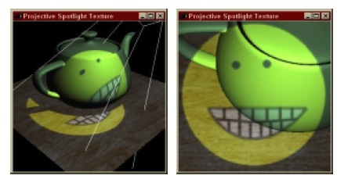
Shadow Mapping
Lance Williams, Casting Curved Shadows on Curved Surfaces, 1978
Fast technique: two passes over objects
Image-space based (we'll see what that means)
Very general: can deal well with arbitrary shapes
Has issues with Aliasing
Widely used: Pixar's RenderMan

Slide 33
Shadow Map Concept
First pass: render depth buffer from the light’s point-of-view
  "Paint" all visible points
Second pass: render from observer's viewpoint
  If the pixel is not painted, it is in the shade
Problems: How do we "paint" a pixel?
  Pixels do not exist in object space – they are an artifact of screen space

Slide 34
Shadow Map Concept
Fast z-Buffer Depth testing from the light’s point-of-view
First pass: render depth buffer from the light’s point-of-view
  The resulting “depth map” is called the “shadow map”
  2D map indicating the distance of the closest pixels to light
Second pass: render from observer's viewpoint
  Use the shadow map to decide which pixels are in shade

Slide 35
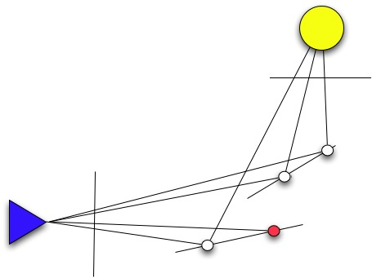
Second Phase
First pass prepares shadow map from Light's point of view
In second phase, have (x, y, z) – is it in shadow map?

Slide 36
Second Phase
Second Pass renders scene from observer's point-of-view
For each rasterized fragment
  We know the (x, y, z) position
  Translate into Light's view, and extract depth
    If the depth matches, point is light.
    If it does not, point is in shade.
It is customary to use the term z – but note that the light's z may be the observer's x, or x+y-z.

Slide 37
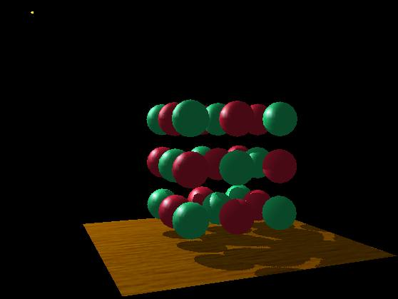
Example
A fairly complex scene with shadows
the point
light source

Slide 38
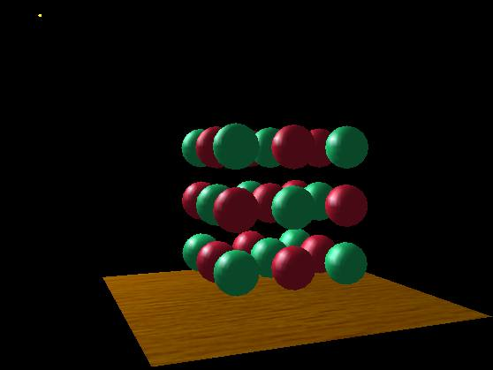
Example
Compare with and without shadows
with shadows
without shadows

Slide 39
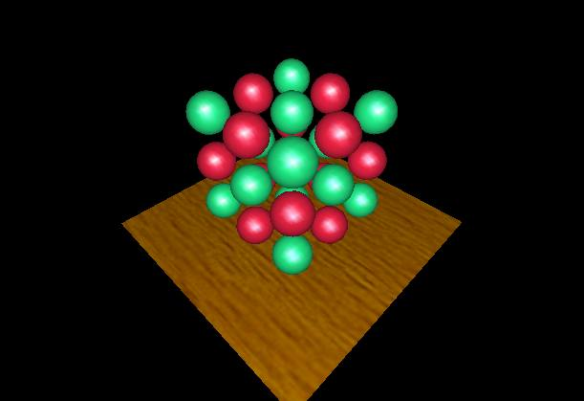
Example
The scene from the light’s point-of-view
from the eye’s
point-of-view again

Slide 40

Example
The depth buffer from the light’s point-of-view
from the light's
point-of-view

Slide 41
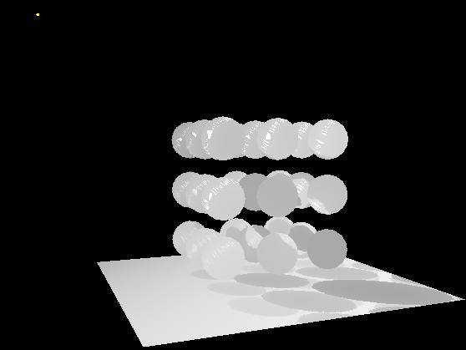
Example
Projecting the depth map onto the eye’s view
from the light's
point-of-view

Slide 42
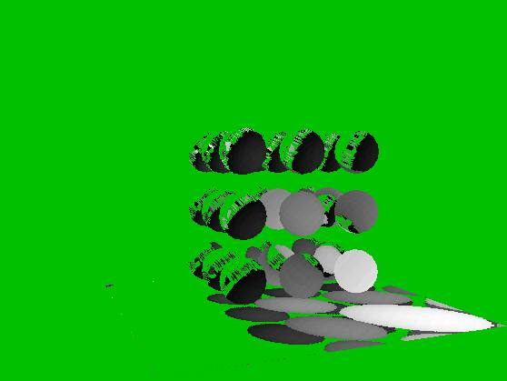
Example
Comparing light distance to light depth map
Green is where the light planar distance and the light depth map are approximately equal
Non-green is where shadows should be

Slide 43
Example
Complete scene with shadows
Notice how specular highlights never appear in shadows
Notice how curved surfaces cast shadows on each other

Slide 44
Comparison
Two values
  A = Z value from depth map at fragment’s light XY position
  B = Z value of fragment seen from the eye
If B is greater than A, then there must be something closer to the light than the fragment
  Then the fragment is shadowed
If A and B are approximately equal, the fragment is lit

Slide 45
Shadow Mapping
The A < B shadowed fragment case
depth map image plane
depth map Z = A
light
source
eye
position
eye view image plane,
a.k.a. the frame buffer
fragment’s
light Z = B

Slide 46
Shadow Mapping
The A == B shadowed fragment case
depth map image plane
depth map Z = A
light
source
eye
position
eye view image plane,
a.k.a. the frame buffer
fragment’s
light Z = B

Slide 47
Shadow Mapping
with a Picture in 2D (3)
Note image precision mismatch!
The depth map
could be at a
different resolution
from the framebuffer
This mismatch can
lead to artifacts

Slide 48
Construct Shadow Map
Realizing the theory in practice
  Constructing the depth map
    Use existing hardware depth buffer
    Use glPolygonOffset to offset depth value back
    Read back the depth buffer contents
  Depth map can be copied to a 2D texture
    Unfortunately, depth values tend to require more precision than 8-bit typical for textures
    Depth precision typically 16-bit or 24-bit

Slide 49
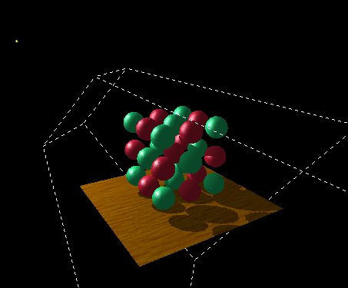
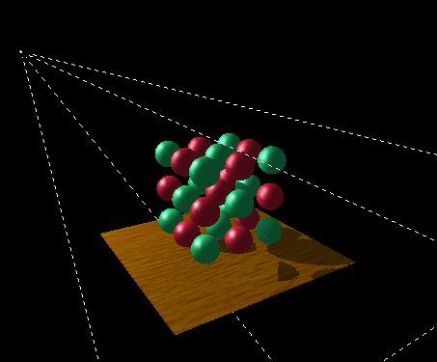
Dual-texture Shadow
Mapping Precision
Conserving your 8-bit depth map precision
Frustum confined to
objects of interest
Frustum expanded out considerably
breaks down the shadows

Slide 50
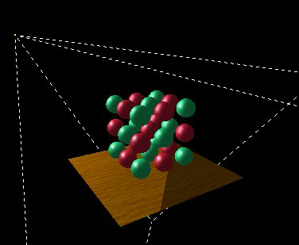
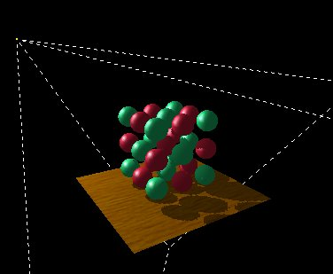
More Precision Allows
Larger Lights Frustums
Compare 8-bit to 16-bit precision for large frustum
8-bit: Large frustum breaks down the shadows, not enough precision
16-bit: Shadow looks just fine

Slide 51

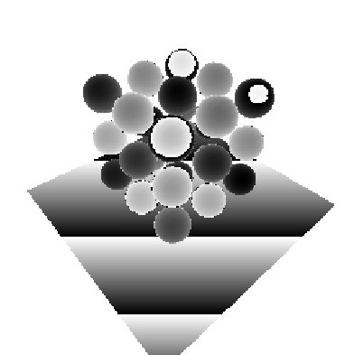
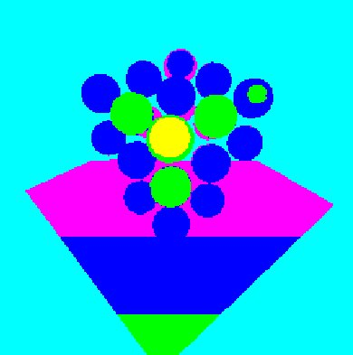
Why Extra Precision
Helps
Where the precision is for previous images
Most significant 8 bits of the depth map, pseudo-color inset magnifies variations
Least significant 8 bits of the depth map, here is where the information is!

Slide 52
Aliasing issues
Two types of problems
  Jagged shadow edges
  Incorrect self shadowing artifacts

Slide 53
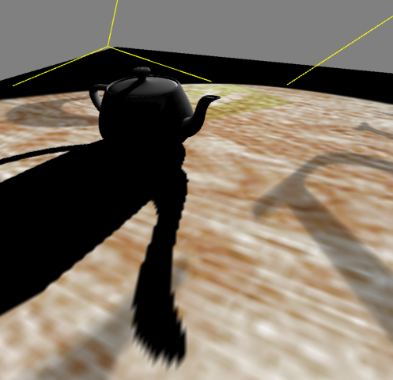
Dueling Frusta Blocky Edges
Notice that shadow edge is well defined in the distance.
Light position out here pointing towards the viewer.
Blocky shadow edge artifacts.

Slide 54
Shadow Boundaries
Shadow map (depth buffer) has finite resolution
Many pixels could map to the same texel
Resolution mismatch
Can be arbitrarily bad using projection!

Slide 55
Example
Look at shadow/lit edge

Slide 56
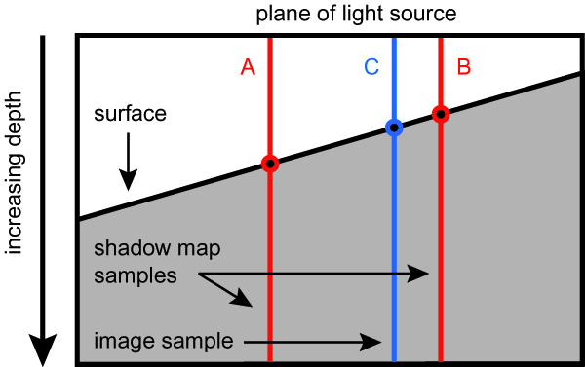
Sampling Issue
Depth buffer contains “window space” depth values
  Post-perspective divide means non-linear distribution
  glPolygonOffset is guaranteed to be a window space offset
Doing a “clip space” glTranslatef is not sufficient
  Common shadow mapping implementation mistake
  Actual bias in depth buffer units will vary over the frustum
  No way to account for slope of polygon

Slide 57
Precision Mismatch
Depth buffer contains “window space” depth values
  Post-perspective divide means non-linear distribution
  glPolygonOffset is guaranteed to be a window space offset
Doing a “clip space” glTranslatef is not sufficient
  Common shadow mapping implementation mistake
  Actual bias in depth buffer units will vary over the frustum
  No way to account for slope of polygon

Slide 58
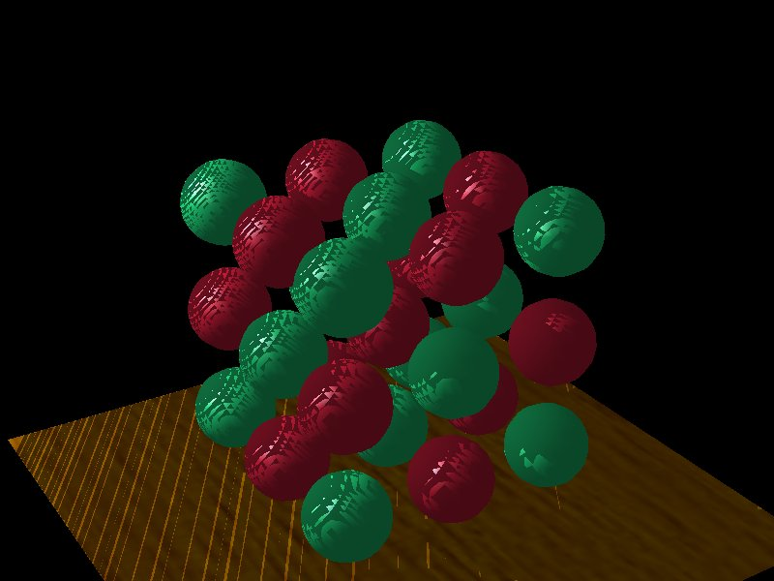
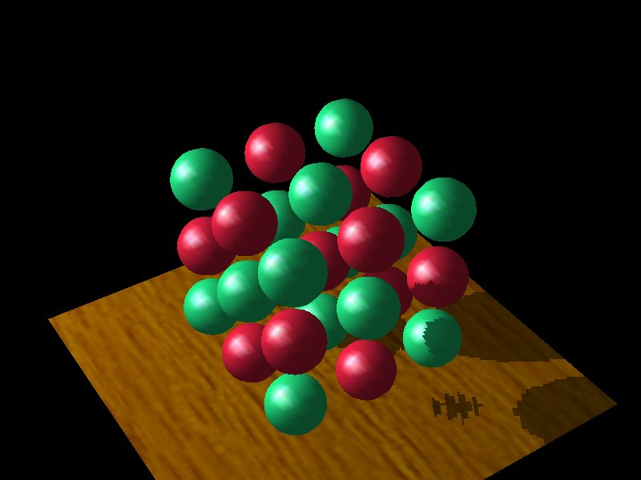
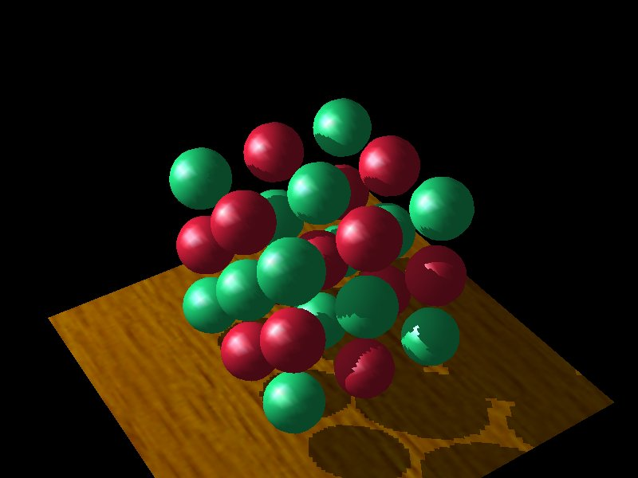
Depth Map Bias
Differences in polygon offset bias
Too little bias,
everything begins to
shadow
Too much bias, shadow
starts too far back
Just right

Slide 59
How to do this in practice?
Realizing the theory in practice
  Fragment’s light position can be generated using eye-linear texture coordinate generation
    specifically OpenGL’s GL_EYE_LINEAR texgen
    generate homogenous (s, t, r, q) texture coordinates as light-space (x, y, z, w)
    T&L engines such as GeForce accelerate texgen!
    relies on projective texturing

Slide 60
Shadow Mapping Issues
  Prone to aliasing artifacts
    “percentage closer” filtering helps this
    normal color filtering does not work well
  Depth bias is not completely foolproof
  Requires extra shadow map rendering pass and texture loading
  Higher resolution shadow map reduces blockiness
    but also increase texture copying expense

Slide 61
Shadow Mapping Issues
  Shadows are limited to view frustums
    could use six view frustums for omni-directional light
  Objects outside or crossing the near and far clip planes are not properly accounted for by shadowing
    move near plane in as close as possible
    but too close throws away valuable depth map precision when using a projective frustum

Slide 62
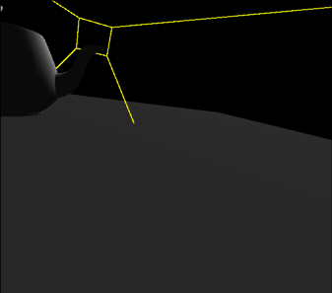
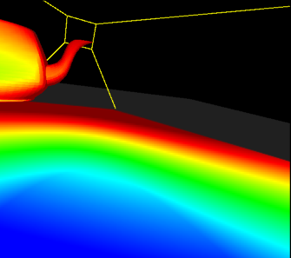
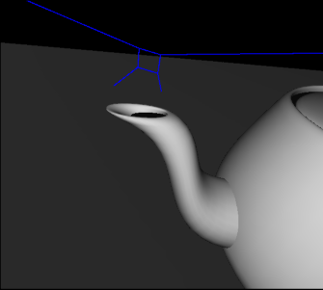
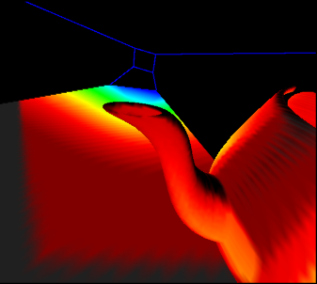
Four Images of Dueling Frusta Case
Eye’s View with projection
of color-coded
mipmap levels
from light:
Red = minification
Blue = magnification
Eye’s
View
Light’s
View
Light’s View with
re-projection
of above image
from the eye

Slide 63
Interpretation of the Images of the Dueling Frusta Case
Region that is smallest in the light’s view is a region that is very large in the eye’s view. This implies that it would require a very high-resolution shadow map to avoid obvious blocky shadow edge artifacts.
Eye’s
View
Light’s
View

Slide 64
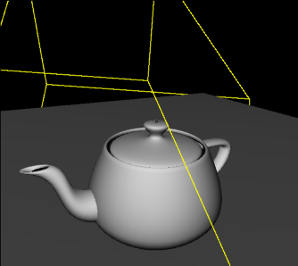
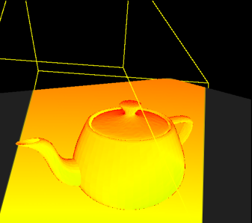
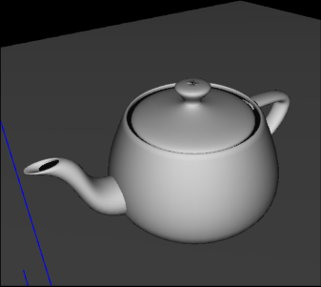
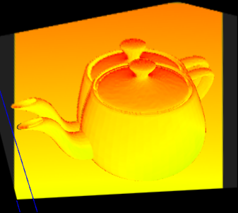
Good Situation, Close to the Miner’s Lamp
Note how the color-coded images share similar pattern and the coloration is uniform. Implies single depth map resolution would work well for most of the scene.
Eye’s
View
Very similar views
Light’s
View
Ghosting is where projection would be in shadow.

Slide 65
Evaluation
Shadow mapping offers real-time shadowing effects
  Independent of scene complexity
  Very compatible with multi-texturing
    Does not mandate multi-pass as stenciled shadow volumes do
  Ideal for shadows from spotlights
Consumer hardware shadow map support here today
  GeForce3, GeForce4 Ti, Xbox
  Dual-texturing technique supports legacy hardware
Same basic technique used by Pixar to generate shadows in their computer-generated movies

Slide 66
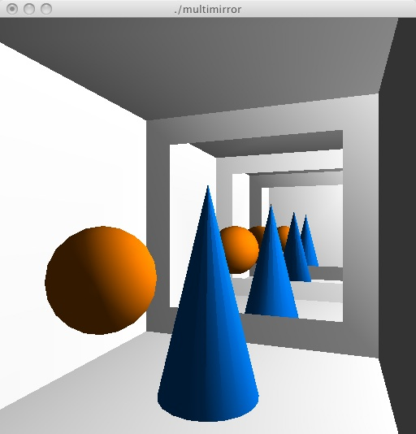
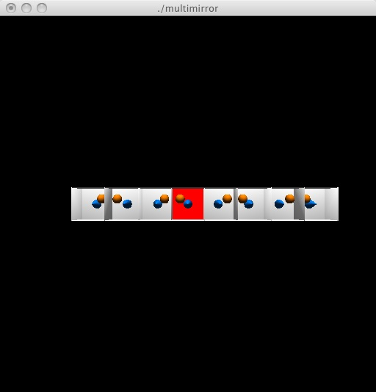
multimirror
SIGGRAPH 1997 Advanced OpenGL tutorial
Can add or remove rooms: > <
Can change viewpoint: h

Slide 67
multimirror
typedef struct {
  GLfloat verts[4][3];
  GLfloat scale[3]; /* Scale */
  GLfloat trans[3]; /* Translation */
} Mirror;
Mirror mirrors[] = {
  /* mirror on the left wall */
  {{{-1., -.75, -.75}, {-1., .75, -.75}, {-1., .75, .75}, {-1, -.75, .75}},
  {-1, 1, 1}, /* x = -x */
  {2, 0, 0}}, /* x = x + 2 */
int nMirrors = 2;
Room is 2x2x2 cube centered at origin

Slide 68
draw_mirror
void draw_mirror(Mirror *m)
{
  glBegin(GL_QUADS);
    glVertex3fv(m->verts[0]);
    glVertex3fv(m->verts[1]);
    glVertex3fv(m->verts[2]);
    glVertex3fv(m->verts[3]);
  glEnd();
}
does not draw what you see in mirror

Slide 69
reflect
/* It would be easier to use push and pop to
* save and restore the matrices, but stack
* is very shallow */
GLenum reflect_through_mirror(Mirror *m, GLenum cullFace)
{
  GLenum newCullFace = ((cullFace == GL_FRONT) ? GL_BACK : GL_FRONT);
  glMatrixMode(GL_PROJECTION);
  glScalef(m->scale[0], m->scale[1], m->scale[2]);
  glTranslatef(m->trans[0], m->trans[1], m->trans[2]);
  glMatrixMode(GL_MODELVIEW);
  /* must flip the cull face */
  glCullFace(newCullFace);
  return newCullFace;
}

Slide 70
reflect
void undo_reflect_through_mirror(Mirror *m, GLenum cullFace)
{
  glMatrixMode(GL_PROJECTION);
  glTranslatef(-m->trans[0], -m->trans[1], -m->trans[2]);
  glScalef(1./m->scale[0], 1./m->scale[1], 1./m->scale[2]);
  glMatrixMode(GL_MODELVIEW);
  glCullFace(cullFace);
}

Slide 71
drawroom
void draw_room(void)
{
  /* material for the walls, floor, ceiling */
  static GLfloat wall_mat[] = {1.f, 1.f, 1.f, 1.f};
  glMaterialfv(GL_FRONT, GL_AMBIENT_AND_DIFFUSE, wall_mat);
  glBegin(GL_QUADS);
    /* floor */
    glNormal3f(0, 1, 0);
    glVertex3f(-1, -1, 1);
    glVertex3f(1, -1, 1);
    glVertex3f(1, -1, -1);
    glVertex3f(-1, -1, -1);

Slide 72
make viewpoint
void make_viewpoint(void)
{
  if (headsUp) {
    ...
  } else {
    glMatrixMode(GL_PROJECTION);
    glLoadIdentity();
    gluPerspective(60, 1, .01, 4 + 2*(draw_passes / nMirrors)); /* far */
    gluLookAt(-2, 0, .75,
      0, 0, 0,
      0, 1, 0);
  }

Slide 73
draw callback
void draw(void) {
  GLenum err;
  GLfloat secs = get_secs();
  glDisable(GL_STENCIL_TEST);
  glClear(GL_COLOR_BUFFER_BIT | GL_DEPTH_BUFFER_BIT | GL_STENCIL_BUFFER_BIT);
  if (!headsUp) glEnable(GL_STENCIL_TEST);
  draw_scene(secs, draw_passes, GL_BACK, 0, (unsigned)-1);
  glDisable(GL_STENCIL_TEST);
  ...
}

Slide 74
draw_scene
void draw_scene(GLdouble secs, int passes, GLenum cullFace, GLuint stencilVal, GLuint mirror)
{
  GLenum newCullFace;
  int passesPerMirror, passesPerMirrorRem;
  unsigned int curMirror, drawMirrors;
  int i;
  /* one pass to draw the real scene */
  passes--;
  /* only draw in my designated locations */
  glStencilFunc(GL_EQUAL, stencilVal, 0xffffffff);
  /* draw things which may obscure the mirrors first */
  draw_sphere(secs);
  draw_cone();

Slide 75
draw_scene
/* now draw the appropriate number of mirror reflections. for
* best results, we perform a depth-first traversal by allocating
* a number of passes for each of the mirrors. */
if (mirror != 0xffffffff) {
  passesPerMirror = passes / (nMirrors - 1);
  passesPerMirrorRem = passes % (nMirrors - 1);
  if (passes > nMirrors - 1) drawMirrors = nMirrors - 1;
  else drawMirrors = passes;
} else {
  /* mirror == -1 means that this is the initial scene (there was no
  * mirror) */
  passesPerMirror = passes / nMirrors;
  passesPerMirrorRem = passes % nMirrors;
  if (passes > nMirrors) drawMirrors = nMirrors;
  else drawMirrors = passes;
}

Slide 76
draw_scene
for (i = 0; drawMirrors > 0; i++) {
  curMirror = i % nMirrors;
  if (curMirror == mirror) continue;
  drawMirrors--;
  /* draw mirror into stencil buffer but not color or depth buffers */
  glColorMask(0, 0, 0, 0);
  glDepthMask(0);
  glStencilOp(GL_KEEP, GL_KEEP, GL_INCR);
  draw_mirror(&mirrors[curMirror]);
  glColorMask(1, 1, 1, 1);
  glDepthMask(1);
  glStencilOp(GL_KEEP, GL_KEEP, GL_KEEP);

Slide 77
draw_scene
for (i = 0; drawMirrors > 0; i++) {
  curMirror = i % nMirrors;
  if (curMirror == mirror) continue;
  drawMirrors--;
  /* draw mirror into stencil buffer ... */
  ...
  /* draw reflected scene */
  newCullFace = reflect_through_mirror(&mirrors[curMirror], cullFace);
  if (passesPerMirrorRem) {
    draw_scene(secs, passesPerMirror + 1, newCullFace, stencilVal + 1, curMirror);
    passesPerMirrorRem--;
  } else {
    draw_scene(secs, passesPerMirror, newCullFace, stencilVal + 1, curMirror);
}
undo_reflect_through_mirror(&mirrors[curMirror], cullFace);

Slide 78
Perpare view
1. Load the modelview matrix with the view transform. For example, given the eye location, the center of viewing, and up direction vector, the view transform can be set as follows:
    glMatrixMode(GL_MODELVIEW);
    glLoadIdentity();
    gluLookAt(eye[0], eye[1], eye[2],
      center[0], center[1], center[2],
      up[0], up[1], up[2]);
2. Push the modelview matrix:
    glPushMatrix();

Slide 79
Reflection Transform
3. Multiply the current modelview matrix by a reflection matrix that reflects the scene through the plane of the mirror. Consider the special case where the mirror happens to lie in the z=0 plane. This special case reflection is a simple scaling matrix that negates the Z coordinate:
    glScalef(1.0, 1.0, -1.0);
For an arbitrary plane, a 4 by 4 matrix can be constructed to reflect through the plane
4. If using back face culling, cull front faces instead. The reflective transformation flips the front/back orientation of transformed polygons.
    glCullFace(GL_FRONT);

Slide 80
Reflected Scene
5. Draw the scene, but be careful to render only objects on the reflective side of the mirror plane. Otherwise, objects behind the mirror that should properly be obscured by the mirror will be rendered as if they are actually in front of the mirror plane.
6. Resume normal back face culling and undo the reflection matrix.
    glCullFace(GL_BACK);
    glPopMatrix();

Slide 81
Mirror Surface
7. Optionally, to give the appearance of a semi-reflective surface such as polished marble, or
simply a dull or dirty mirror, a textured planar surface coincident with the mirror plane can
be blended on top of the reflection rendered in Step 5. For example:
  glEnable(GL_BLEND);
  glBlendFunc(GL_ONE, GL_ONE); // additive blending
  renderMarbleTexturedMirrorSurfacePolygons();
  glDisable(GL_BLEND);
Even if mirror surface is not blended with a semi-reflective surface, it is important to
render the mirror surface polygons into the depth buffer to ensure that when the scene is
rendered again in the next step that objects properly are occluded by the mirrors.
  glColorMask(0,0,0,0); // disable color buffer updates
  renderMirrorSurfacePolygons();
    // update depth buffer with the mirror surface
  glColorMask(1,1,1,1); // re-enable color buffer updates

Slide 82
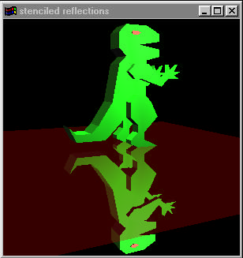
Unreflected Scene
8. Finally, now render the unreflected scene.
This type of rendering algorithm is often referred to as multi-pass because the sequence of operations involves rendering the scene or portions of the scene multiple times. Notice that steps 5 and 8 each render the scene but with different model view transformations.
Assumes that you cannot look behind the plane of the mirror.
Reflective stairs…

Slide 83
Mirrors with Stencil Buffer
When clearing the frame buffer at start, also clear the stencil buffer to zero.
For each mirror in the scene, the application must maintain a data structure that
contains the non-overlapping and co-planar polygons that compose the mirror surface.
For a standard rectangular mirror, the coordinates of four vertices are sufficient.
Clear the color, depth, and stencil buffers. Then render the scene, excluding the mirror
surfaces, with depth buffering but without stencil testing.
  glClearStencil(0);
  glClear(GL_COLOR_BUFFER_BIT | GL_DEPTH_BUFFER_BIT |
  GL_STENCIL_BUFER_BIT);
  glEnable(GL_DEPTH_BUFFER_BIT);
  glDisable(GL_STENCIL_TEST);
  drawScene(); // draw everything except mirrors

Slide 84
Set the bits in Stencil Buffer
Then for each mirror, perform the following sequence:
1. Set up stenciling to write the value 1 into the stencil buffer when the depth test passes.
Also disable writes to the color buffer. Then draw the mirror’s polygons.
  glEnable(GL_STENCIL_TEST);
  glStencilOp(GL_KEEP, GL_KEEP, GL_REPLACE);
  glStencilFunc(GL_ALWAYS, 1, ~0);
  glColorMask(0,0,0,0);
  renderMirrorSurfacePolygons(thisMirror);
This step “tags” all the mirror’s visible pixels with a stencil value 1. Depth testing prevents occluded mirror pixels from being tagged.

Slide 85
Mirrors with Stencil Buffer
2. With the color buffer writes still disabled, set the depth range to write the farthest value possible for all updated pixels and set the depth test to always pass. Also, set the stencil test to only update pixels tagged with the stencil value 1. Then draw the mirror’s polygons.
  glDepthRange(1,1); // always
  glDepthFunc(GL_ALWAYS);
    // write the farthest depth value
  glStencilFunc(GL_EQUAL, 1, ~0);
    // match mirror’s visible pixels
  glStencilOp(GL_KEEP, GL_KEEP, GL_KEEP);
    // do not change stencil values
  renderMirrorSurfacePolygons(thisMirror);
This step resets the depth buffer to its cleared maximum value for all the mirror’s visible pixels.

Slide 86
Prepare the mirror space
3. Restore the depth test, color mask, and depth range to their standard settings:
  glDepthFunc(GL_LESS);
  glColorMask(1,1,1,1);
  glDepthRange(0,1);

Slide 87
Draw the Reflection
We are now ready to render the reflection itself. The pixels belonging to the reflection with the stencil value 1, and these same pixels also have their depth values cleared to the farthest depth value. The stencil test remains enabled and only updating pixels with the stencil value 1, i.e. those pixels on the visible mirror. And the less than depth test will ensure subsequent rendering to the mirror pixels will determine visible surfaces appropriately.
4. Rendering the reflection requires reflecting the scene through the mirror plane, but we must also be careful to only render objects on the reflective side of the mirror Therefore, we establish a user-defined clip plane to render only objects on the reflective side of the mirror plane. The reflection itself is accomplished by concatenating the appropriate reflection matrix to the modelview matrix so that everything is reflected through the mirror plane. Because the reflection flips the sense of back and front facing polygons, the cull face state is reversed. Then the scene is rendered.

Slide 88
Draw the Reflection
GLfloat matrix[4][4];
GLdouble clipPlane[4];
glPushMatrix();
// returns world-space plane equation for mirror plane to use as clip plane
computeMirrorClipPlane(thisMirror, &clipPlane[0]);
// set clip plane equation
glClipPlane(GL_CLIP_PLANE0, &clipPlane);
// returns mirrorMatrix (see Appendix A) for given mirror
computeReflectionMatrixForMirror(thisMirror, &matrix[0][0]);
// concatenate reflection transform into modelview matrix
glMultMatrixf(&matrix[0][0]);
glCullFace(GL_FRONT);
drawScene(); // draw everything except mirrors
drawOtherMirrorsAsGraySurfaces(thisMirror); // draw other mirrors as
// neutral “gray” surfaces
glCullFace(GL_BACK);
glDisable(GL_CLIP_PLANE0);
glPopMatrix();

Slide 89
Draw the Reflection
Now the mirror’s reflection is rendered correctly. Other mirrors visible in the reflection of this mirror are rendered gray so at least they properly occlude objects behind them even if they do not reflect objects correctly. Immediately following, we sketch a recursive algorithm that handles reflections of reflections.
5. Finally, we reset to zero the stencil value of all the mirror’s pixels so the pixels are not confused with another mirror’s pixels while rendering the reflections of subsequent mirrors. Also update the depth buffer to reflect the mirror’s proper depth so this mirror may properly occlude any subsequent mirrors. Do not update the color buffer during this step.
    glColorMask(0,0,0,0);
    glStencilOp(GL_KEEP, GL_KEEP, GL_ZERO);
    glDepthFunc(GL_ALWAYS);
    renderMirrorSurfacePolygons(thisMirror);
    glDepthFunc(GL_LESS);
    glColorMask(1,1,1,1);

Slide 90
References
Atherton, Weiler, and Greenberg, "Polygon Shadow Generation"
James Blinn, "Me and my (fake) Shadow
Mark Kilgard, "Improving Shadows and Reflections via the Stencil Buffer"
Everitt and Kilgard, "Practical and Robust Stenciled Shadow Volumes for Hardware-Accelerated Rendering"
Shadow Maps
Lance Williams, “Casting Curved Shadows on Curved Surfaces,” SIGGRAPH 78
William Reeves, David Salesin, and Robert Cook (Pixar), “Rendering antialiased shadows with depth maps,” SIGGRAPH 87
Mark Segal, et. al. (SGI), “Fast Shadows and Lighting Effects Using Texture Mapping,” SIGGRAPH 92
http://www.paulsprojects.net/opengl/shadowmap/shadowmap.html

Slide 91
Sample Programs
SIGGRAPH Advanced OpenGL class, 1996
  shadowfun.c – Mark Kilgard – Projection with Stencil
  shadowvol.c – Tom McReynolds – demonstraton of shadow vvolumes
  shadowmap.c – Tom McReynolds – shadow map, using OpenGL extensions
  softshadows.c – Tom McReynolds –Soft Shadows
SIGGRAPH Advanced OpenGL class, 1997
  softshadow2.c – Simon Hui – Uses method of Heckbert and Herf
  projtex.c – David Yu – based on Segal, Korobkin, van Widenfelt, Foran, and Haeberli, "Fast Shadows and Lighting Effects Using Texture Mapping", SIGGRAPH '92

Slide 92
