Slide 1
Super East Gate
Jon Caron
Ryan Fleming
Tony Guarino
Mike LoVerme

Slide 2
Introduction
1.1 Purpose of the system
1.2 Scope of the system
1.3 Objectives and success criteria of the project
1.4 Definitions, acronyms, and abbreviations
1.5 References
1.6 Overview

Slide 3
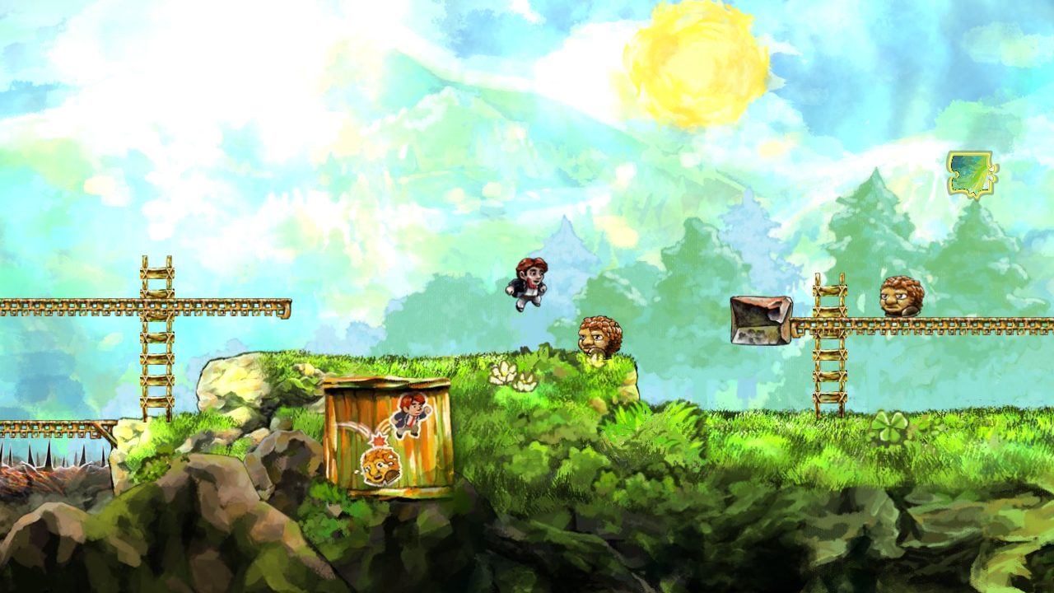
Current System
Braid

Slide 4
Proposed System
3.1 Overview
3.2 Functional requirement
3.2.1 Gameplay Character
3.2.2 Enemy Character
3.2.3 World Map

Slide 5
Proposed System
3.3 Nonfunctional requirements
3.3.1 Usability
3.3.2 Reliability
3.3.3 Performance
3.3.4 Supportability
3.3.5 Implementation
3.3.6 Interface
3.3.7 Packaging

Slide 6
Proposed System
3.4 System models
3.4.1 Scenarios
3.4.2 Use case model
3.4.3 Object model
3.4.4 Dynamic model
3.4.5 User Interface

Slide 7
Scenarios
Scenario Name | PlayLevel
Participating Actor Instances | Richard: GameUser
Flow Of Events | 1) Richard enters level 2) Richard approaches GamePiece and a) Jumps on top of it b) Smashes it (if Richard is in Big State) c) Releases Item (if ItemBlock) 3) Richard then approaches gap in floor and a) Falls into it and dies b) Jumps over it 4) Richard then approaches AIObject and a) Jumps on it, reducing its state b)Jumps over it and moves on c) Throw ActionObject at it, reducing its state d) Gets hit by AIObject and reduces its state 5) Richard then approaches a pipe and a) Jumps onto it and then off again b) Jumps onto it, and goes down into sublevel 6) Richard pauses the level by accessing the menu and enters the appropriate option a) Richard then resumes the game by accessing the menu and enters the appropriate option 7) Richard approaches the end of the level and a) Brought to the next level

Slide 8
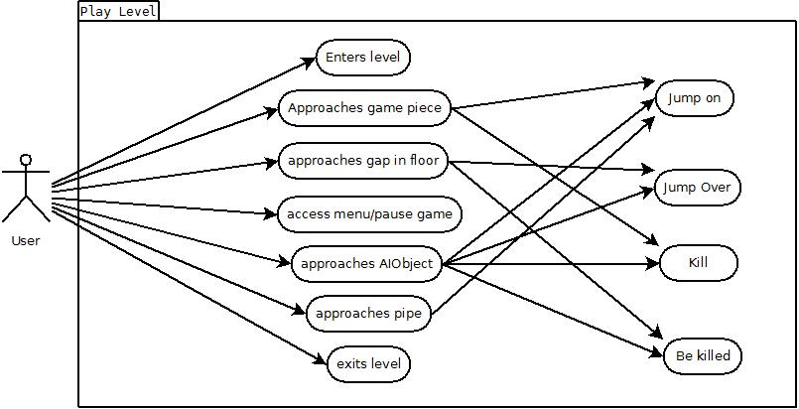
Use Case

Slide 9
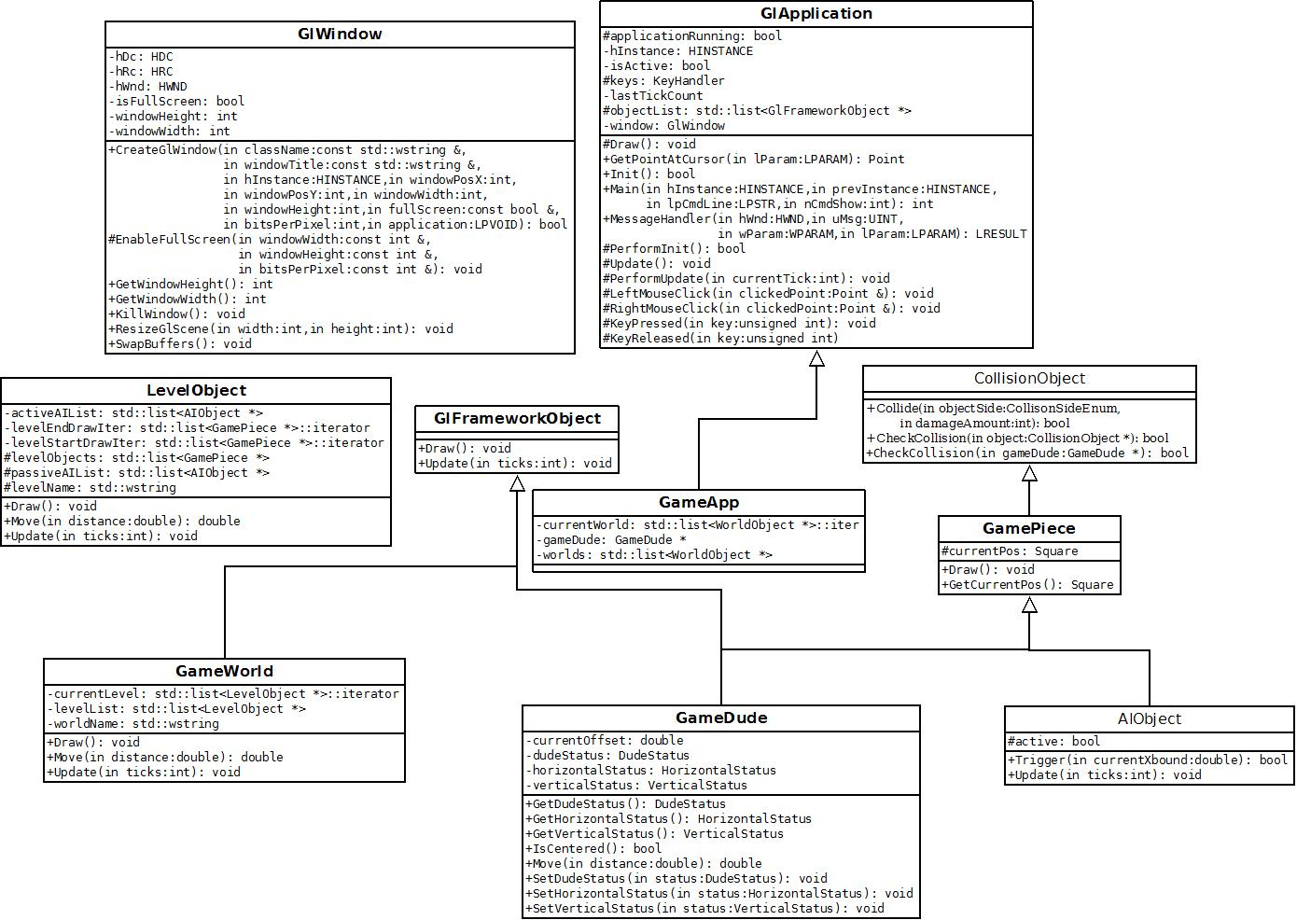
Object Model

Slide 10
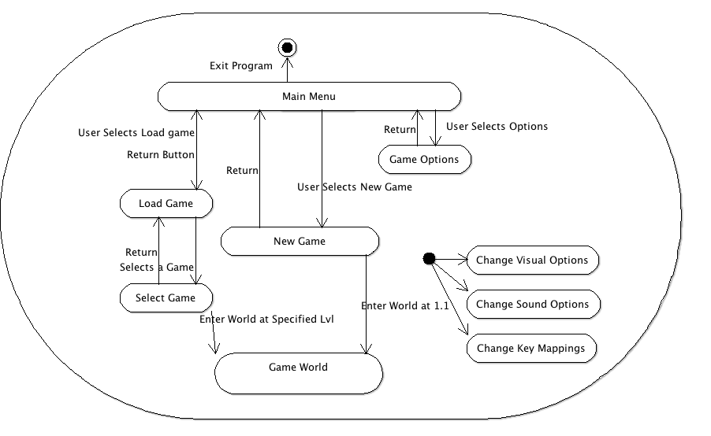
Dynamic Model

Slide 11
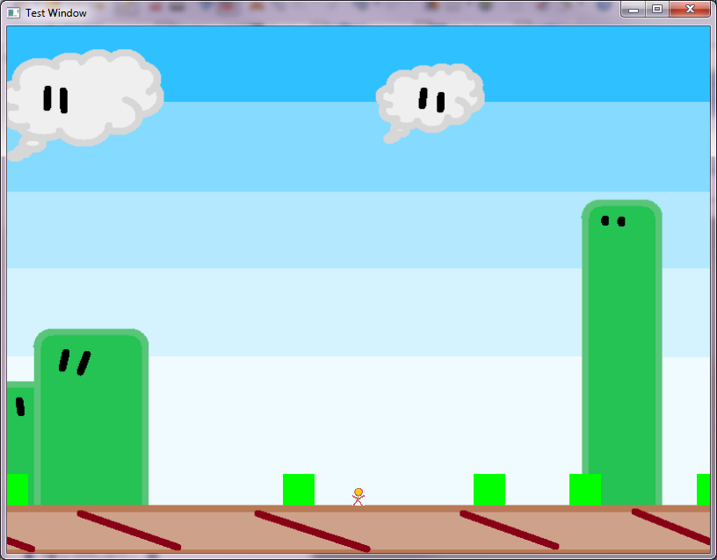
User Interface

