Slide 1

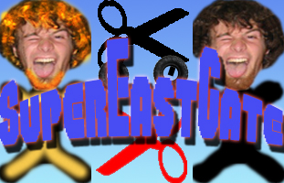
Super Eastgate
Jon Caron, Ryan Fleming, Antonio Guarino, and Mike LoVerme
Merrimack College
Introduction
High level Design
OpenGL
OpenAL
Game Play
Level Creation
Future Goals

