Slide 1
System Design Document
Jon Caron
Ryan Fleming
Tony Guarino
Mike LoVerme

Slide 2
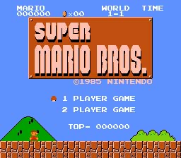
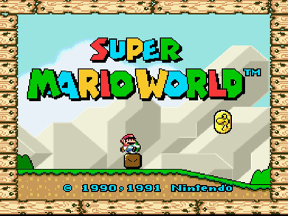
Purpose of the system

Slide 3

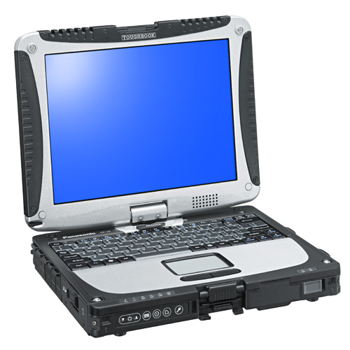
Design Goals
Usability
Portability
Encapsulation
Data Abstraction
Availability
Memory
Robustness

Slide 4
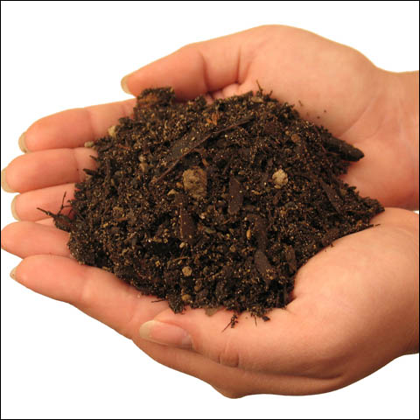


Definitions, Acronyms, And Abbreviations
SOIL
  Simple OpenGL Image Library
SDK
  Software Development Kit
API
  Application Programming Interface
HUD
  Heads Up Display

Slide 5


Proposed System Architecture
Overview
Subsystem decomposition
Hardware/Software Mapping
Persistent data management
Global Software control

Slide 6
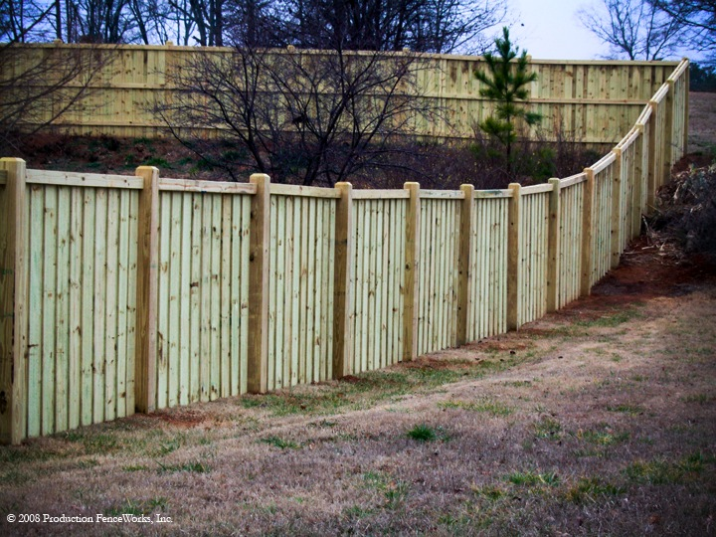


Proposed System Architecture
Boundary conditions
  Start up behavior
  Game play behavior
  Exit behavior

Slide 7
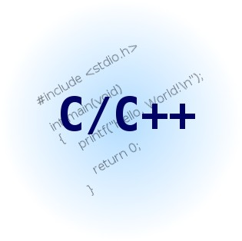
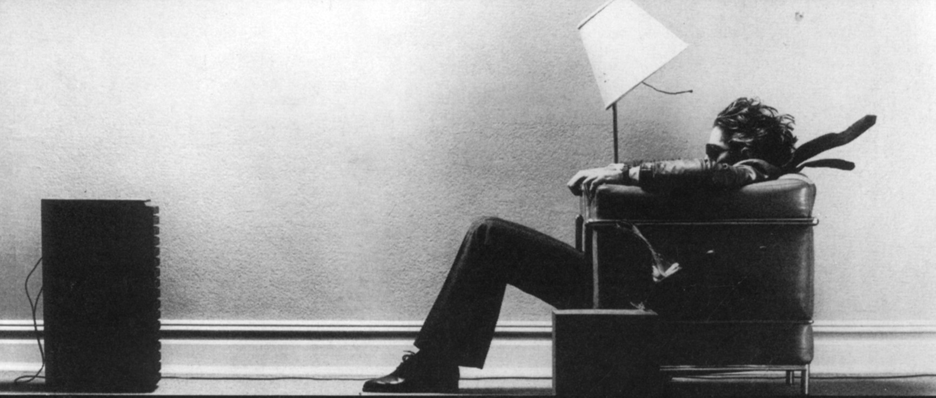
Subsystem Services
User Interface Subsystem
Middleware Subsystem
Graphics Subsystem
Audio Subsystem

Slide 8


Questions

