Slide 1


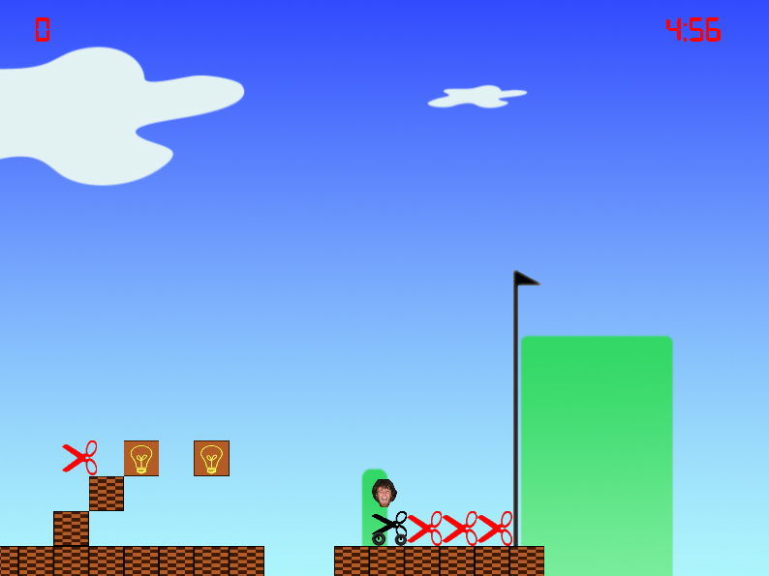
Super EastGate
Jon Caron, Ryan Fleming, Antonio Guarino, and Mike LoVerme
Merrimack College
Introduction
Super EastGate is a 2D side scroller game that mimics the classic Super Mario Brothers game. This game is unique in that is designed for a Windows based computer and is fully customizable with different game packs. Each game pack includes level sets, different graphics, and different sounds. Each different game pack gives the user a completely different experience. Also, anyone can create new levels by simply editing a file. The main game pack is about a student at Merrimack College named Jason EastGate. His goal is to make it through the levels without getting a hair cut or shaving his beard.
High level Design
OpenGL
OpenAL
Game Play
Level Creation
Future Goals

