Slide 1
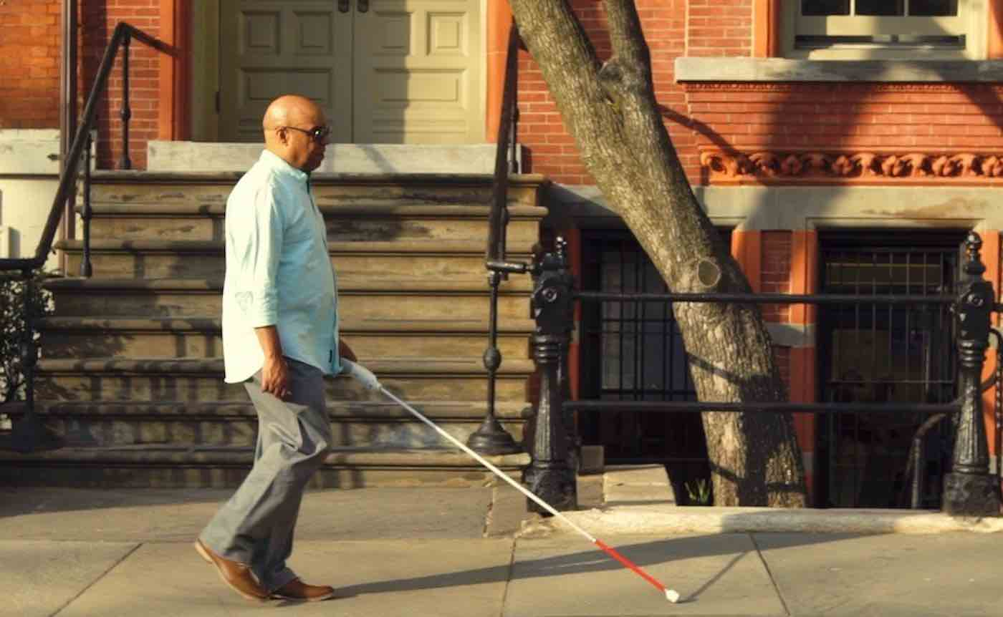
Smart blind stick for the blinds and physically challenged people
Submitted By
Arunava Banerjee 11705516056
Abhishek Purkayastha 11705516060
Under the guidance of
Sir. Arijit Ghosh, Project Mentor
Department of Applied Electronics and Instrumentation Engineering
RCC Institute of Information Technology
Canal South Road, Beleghata, Kolkata, West Bengal- 700015

Slide 2




Smart Blind Stick

Slide 3
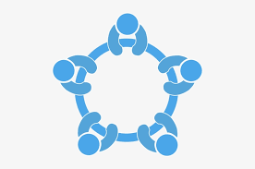

Table of Contents
Introduction
Objectives
-Past
-Present
Components
Use of different hardware and software components
- Chlorinated Polyvinyl Chloride(CPVC) Pipe
- Node Micro Controller Unit
- Global Positioning System Module
- Transmitter-Receiver with Buzzer
- Ultrasonic Sensor with Buzzer
- Use of Blynk App
Interfacing with Controller

Slide 4
acknowledgement
It is a great privilege for us to express our profound gratitude to our respected teacher Mr. Arijit Ghosh, Applied Electronics &Instrumentation Engineering, RCC Institute of Information Technology, for his constant guidance, valuable suggestions, supervision and inspiration throughout the course work without which it would have been difficult to complete the work within scheduled time.
We would like to express our gratitude towards Naiwrita Dey, Srijan Bhattacharyya, Kalyan Biswas, Debabrata Bhattacharyya & Abhishek Paul for his kind co-operation and encouragement which helped us in completion of this project.
Notes:
After you’ve done your research, it’s time to put your presentation together. The first step in the process is to introduce the topic. This is a great time to connect your topic to something that your audience can relate. In other words, why should they listen to all the information you will be sharing in your research presentation? What is in it for them? You may also want to include a graphic or image to grab their attention.
Feel free to duplicate this slide by right-clicking on this slide in the slides pane to the left and select Duplicate Slide.
The next step in your presentation is to state your claim or topic clearly. Your teacher may even call this your thesis. As you state your thesis, you may find that this layout is not the best layout for your claim or topic. You can change the layout by clicking the drop-down menu next to the Layout in the Slides menu section. You can choose Two Content, Comparison, or Picture with Caption. Note: A different layout might change the look of the icons on this page.
You will also want to state your facts. You have done the research now share some of the interesting facts with your audience. Facts do not have to be boring; you can communicate facts in a variety of ways by going to the Insert Tab. In the Insert tab you can:
Insert pictures from your computer or online.
Add a chart
Create some SmartArt
Insert a variety of icons to help your facts come to life. Note: You can change the color of the icons by selecting the icon and then click on the Format tab and then Graphics Fill. From there, you will choose a color from the list or choose More Fill Colors to give you more options.
Since this research presentation is a result of your hard work and searching, you want to make sure you support the claims or points in your presentation with facts from your research findings. Make sure you give the author proper credit for helping you share your ideas. If one of your sources has a video that is relevant to your topic, you can add the video as added support. Keep in mind the length of the video and the amount of time you have for your presentation. For a 5 minute speech, the video should be no longer than 30 seconds.
Questions to consider:
How will you state the author of the source?
Will you need to cite the source on the slide?
What are some ways you can engage your audience so they feel like they are a part of the presentation? Some ideas to consider is by taking a quick poll like: by a show of hands, how many of you think school uniforms are a way to cut down on bullying? Another suggestion is to have them hold up a certain number of fingers to see if they agree or disagree. Finally, you can share a story that the audience can relate to that makes them laugh.
After all the applause, your audience may have some questions. Be prepared to answer some of their questions by making a list of questions you think they might ask. You may also want to share the presentation with them by providing the link to your presentation, if they want more information.

Slide 5
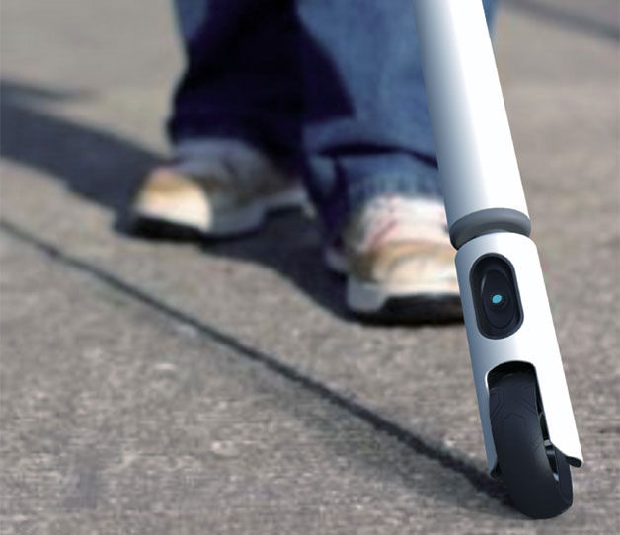
Introduction
Vision is the most important part of human physiology as 83% of information human being gets from the environment is via sight. The 2011 statistics by the World Health Organization (WHO) estimates that there are 285 billion people in world with visual impairment, 39 billion of which are blind and 246 with low vision.
Presently, blind people use a stick as a tool for directing themselves when they move or walk from one place to another.
Here, we develop a smart tool which can serve as a blind stick which is being more efficient and helpful than the conventional one, and which will also assist them from hurdles by providing an early indication as a detector.

Slide 6
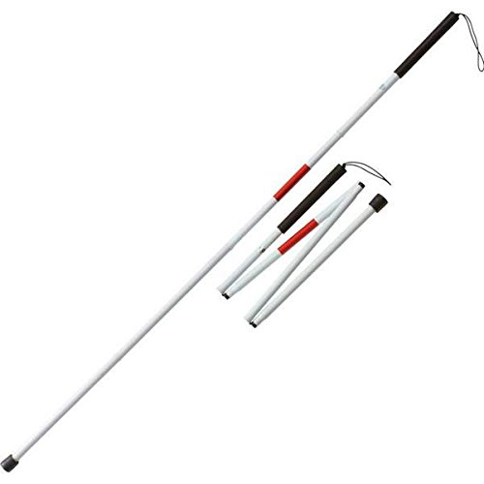
Slide 3
components
Chlorinated Polyvinyl Chloride(CPVC) Pipe
Node MicroController Unit(MCU)
Global Positioning System(GPS) Module
Transmitter-Receiver with Buzzer
Ultrasonic Sensor with Buzzer
Blynk Application

Slide 7

Slide 3
Objectives
Past
A stick integrated with ultrasonic sensor just to help visually challenged people.

Slide 8

Slide 3
present
A smart blind stick integrated with-
Ultrasonic sensor and a buzzer
GPS module and an app to detect the location
Transmitter-receiver to detect where the stick has been kept

Slide 9
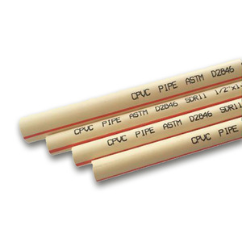
Slide 3
1. Why Chlorinated Polyvinyl Chloride(CPVC) Pipe?
We have kept in mind the weight and flexibility of the stick so that anyone can carry it easily from one place to another.
Specifications of the CPVC Pipe used-
Three ½ inches size
Outside diameter= 0.84 inches
Minimum wall thickness= 0.109 inches
Inside diameter= 0.622 inches
Weight= 17 lb/100 ft
We have only used 2.75/100 feet of CPVC Pipe
1 lb= 454 gram (approx.)
Ours is only 0.4675 lb= 212.245 gram

Slide 10
Slide 3
2. Node microcontroller unit- nodemcu
We have used the latest version of the board (V1.0)
Wi-Fi Module- ESP-12E module similar to ESP-12 module but with 6 extra GPIOs
USB- micro USB port for power, programming and debugging
When compared to Arduino UNO-
Flash - 32KB for Arduino , 4MB for NodeMCU
SRAM - 2KB for Arduino, upto 50KB for NodeMCU
Clock Speed - 16MHz(ATMEGA328 can handle upto 20MHz) for Arduino, 24–52MHZ(CPU can handle 80MHz) for NodeMCU
GPIO pins - 14(6 PWM) for Arduino, 17(All PWM) for NodeMCU
ADC - 6 for Arduino , 1 for NodeMCU
Why did we went with nodeMCU and not other microcontrollers?

Slide 11
NodeMCU’s main feature is Wi-Fi, so for most IoT applications everyone uses NodeMCU.
When compared to Raspberry Pi-
The NodeMCU is not as powerful as the Raspberry Pi, since the Pi is an actual Computer and the NodeMCU is just an embedded microprocessor System on Chip(SoC).
It’s like comparing a battleship with a fishing boat.
The best advantage that it has over a Pi is it’s price, allowing it to be an obvious choice for specific and niche IoT applications. (e.g: sending humidity values to the cloud). Putting a Pi there would be excessive and expensive.

Slide 12
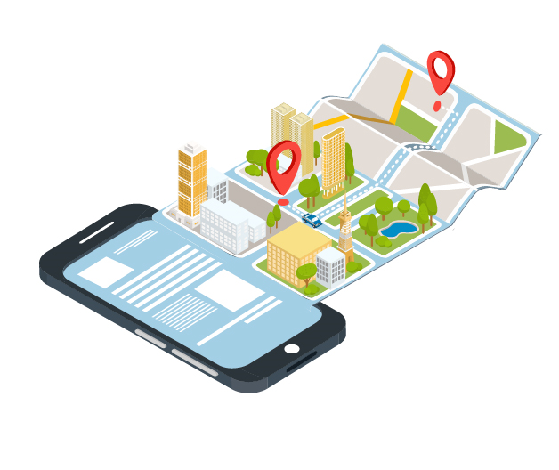
3. Global positioning system module
Comes with external U.FL ceramic antenna for better reception.
Operating voltage: 3.3V to 5VDC.
LED signal indicator.
RX: Data receive in (input to GPS module)
TX: Data transmit out (Out from GPS module)
GND: Ground (Logic and power ground)
VCC: 3.3 to 5VDC
Based on u-blox NEO-6M GPS Module
Advantages
A battery is also included so that you can obtain a GPS lock faster.
The antenna is connected to the module through a ufl cable which allows for flexibility in mounting the GPS such that the antenna will always see the sky for best performance.

Slide 13
4. Transmitter-Receiver with Buzzer
IR Transmitter
Any remote device
9V Battery
IR Receiver
TSOP1738
IR Receiver: TSOP1738
Highly immune to ambient light
Low power consumption
Buzzer

Slide 14
5.ULTRASONIC SENSOR WITH BUZZER
9v battery
Microcontroller
Distance
And
Buzzer
Ultrasonic
Sensor
Easily detectable any object in front of the sensor.
High sensitive and high penetrating power
Very easy to use

Slide 15
6.USE OF BLYNK APP
GPS Module
NEO-6MV2
Microcontroller
It shows the live location.
Can access from anywhere of the World
Easily compatible with any kind of microcontroller

Slide 16
INTERFACING WITH MICROCONTROLLER
NodeMCU
Vin to VCC
Ultrasonic
sensor
NodeMCU
3.3v to VCC
GPS Module
NEO-6MV2
D3 to echo
D2 to RX
D4 to trigg
D1 to TX
Gnd to Gnd
Gnd to Gnd
Notes:
When conducting research, it is easy to go to one source: Wikipedia. However, you need to include a variety of sources in your research. Consider the following sources:
Who can I interview to get more information on the topic?
Is the topic current and will it be relevant to my audience?
What articles, blogs, and magazines may have something related to my topic?
Is there a YouTube video on the topic? If so, what is it about?
What images can I find related to the topic?

Slide 17

FUTURE SCOPE
Addition of moisture/water detection beneath the stick without any sensors.
An LDR to indicate the blind person about the surroundings (light/dark) he is entering into.
Interfacing a single servo motor with the ultrasonic sensor so as to have a rotation of 180 degrees.
Google voice detection system to find the Smart Blind Stick (if someone forgets where it has been kept).
Notes:
Once you find your sources, you will want to evaluate your sources using the following questions:
Author:
Who is the author?
Why should I believe what he or she has to say on the topic?
Is the author seen as an expert on the topic? How do you know?
Current:
How current is the information in the source?
When was the source published?
Is the information out-of-date?
Accuracy:
Is the content accurate?
Is the information presented objectively? Do they share the pros and cons?

Slide 18
conclusion
The project proposed the design and architecture of a new concept of Smart Electronic Guiding Stick for blind people. The advantage of the system lies in the fact that it can prove to be very low cost solution to millions of blind person worldwide. The proposed combination of various working units makes a real-time system that monitors position of the user and provides dual feedback making navigation more safe and secure.
Notes:
After consulting a variety of sources, you will need to narrow your topic. For example, the topic of internet safety is huge, but you could narrow that topic to include internet safety in regards to social media apps that teenagers are using heavily. A topic like that is more specific and will be relevant to your peers. Some questions to think about to help you narrow your topic:
What topics of the research interest me the most?
What topics of the research will interest my audience the most?
What topics will the audience find more engaging? Shocking? Inspiring?

Slide 19
References
https://www.youtube.com/watch?v=Ikqi-XLCfMs&t=177s
https://www.google.com/search?q=interfacing+with+gps+module+with+nodemcu&rlz=1C1RLNS_enIN837IN837&oq=interfac&aqs=chrome.1.69i57j69i59l3j69i60l2.8282j0j7&sourceid=chrome&ie=UTF-8
https://www.instructables.com/id/Distance-Measurement-Using-HC-SR04-Via-NodeMCU/
https://www.youtube.com/watch?v=7nxOZek1iGI&t=1s
Notes:
After you’ve done your research, it’s time to put your presentation together. The first step in the process is to introduce the topic. This is a great time to connect your topic to something that your audience can relate. In other words, why should they listen to all the information you will be sharing in your research presentation? What is in it for them? You may also want to include a graphic or image to grab their attention.
Feel free to duplicate this slide by right-clicking on this slide in the slides pane to the left and select Duplicate Slide.
The next step in your presentation is to state your claim or topic clearly. Your teacher may even call this your thesis. As you state your thesis, you may find that this layout is not the best layout for your claim or topic. You can change the layout by clicking the drop-down menu next to the Layout in the Slides menu section. You can choose Two Content, Comparison, or Picture with Caption. Note: A different layout might change the look of the icons on this page.
You will also want to state your facts. You have done the research now share some of the interesting facts with your audience. Facts do not have to be boring; you can communicate facts in a variety of ways by going to the Insert Tab. In the Insert tab you can:
Insert pictures from your computer or online.
Add a chart
Create some SmartArt
Insert a variety of icons to help your facts come to life. Note: You can change the color of the icons by selecting the icon and then click on the Format tab and then Graphics Fill. From there, you will choose a color from the list or choose More Fill Colors to give you more options.
Since this research presentation is a result of your hard work and searching, you want to make sure you support the claims or points in your presentation with facts from your research findings. Make sure you give the author proper credit for helping you share your ideas. If one of your sources has a video that is relevant to your topic, you can add the video as added support. Keep in mind the length of the video and the amount of time you have for your presentation. For a 5 minute speech, the video should be no longer than 30 seconds.
Questions to consider:
How will you state the author of the source?
Will you need to cite the source on the slide?
What are some ways you can engage your audience so they feel like they are a part of the presentation? Some ideas to consider is by taking a quick poll like: by a show of hands, how many of you think school uniforms are a way to cut down on bullying? Another suggestion is to have them hold up a certain number of fingers to see if they agree or disagree. Finally, you can share a story that the audience can relate to that makes them laugh.
After all the applause, your audience may have some questions. Be prepared to answer some of their questions by making a list of questions you think they might ask. You may also want to share the presentation with them by providing the link to your presentation, if they want more information.

