Slide 1
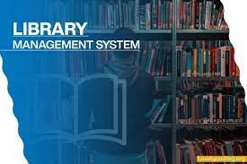
Library Management System

Slide 2
Developers
Arijit Nayak(24400119044)
Debangshu Ganguli(24400119038)
Arunava Mukherjee(24400119010)
Rajnandini(24400119032)

Slide 3
Introduction
In covid19 pandemic situation we have faced lot of major Problems. We can’t go outside for buying our needed books . In this monotonous situation we have to change our mind by reading some books for our own refreshment. Only an e-book can fulfill reader’s wish. An e-book (short for electronic book), also known as an e-book or eBook, is a book publication made available in digital form, consisting of text, images, or both, readable on the flat-panel display of computers or other electronic devices. Although sometimes defined as "an electronic version of a printed book", some e-books exist without a printed equivalent. E-books can be read on dedicated e-reader devices, but also on any computer device that features a controllable viewing screen, including desktop computers, laptops, tablets and smartphones.

Slide 4
Objective
Study Anywhere and Anytime:
An eBook is easy to carry around. Instead of carrying a bag full of books, it is easier to carry a mobile device that supports eBooks. Most students these days always carry a mobile-based device. It could be a smart phone, a tablet or a laptop.
Edutainment Value:
The course content doesn’t have to be only text. You can include music, animations, videos and audio explanations into the learning module.
Save Printing Costs:
eBooks do not require paper. Authors can submit their work in a PDF format, which can be converted into electronic books. Paper does not come into the picture. So, it saves all your costs

Slide 5
Project Category
This application is basically a client server based application system that means though having users interaction and input-output conversation, yet it will be operated from any machine, which are attached with the server. Basically it will maintain a server based communication and exchange ideas and also they can receive services from every corner of the organization. Any type of response can generate on the real time basis, i.e. instantly the user can get their answers against various queries.

Slide 6
Software and Hardware Requirements
Software requirements
Operating System:- Windows XP/7/10
Front End:- HTML ,CSS.
Back End:- MY SQL, Javascript.
Framework:- Visual Studio Code
Hardware requirements
Processor:- Intel core processor or higher
RAM:- 3gb or more
Hard Drive:- 20gb for database

Slide 7
Performance and Security Requirements
The proposed system that are we are going to be develop will be used as the chief performance system within the library of the institute which interact with institute staff’s and students. The system shall accommodate high number of books and users without any fault.
We are going to developed a secure database for the university. There are different categories of users namely teaching staff, administrator, students etc. Depends upon the category of user the access rights are decided.

Slide 8
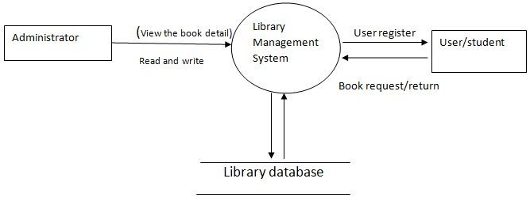
DFD level

Slide 9
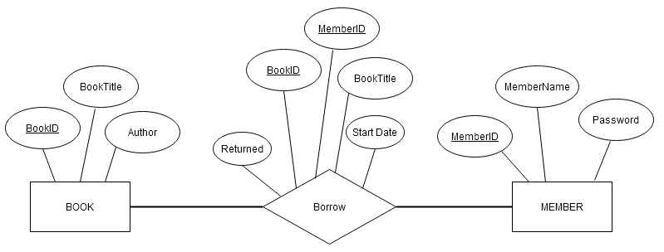
E-R Diagram

Slide 10
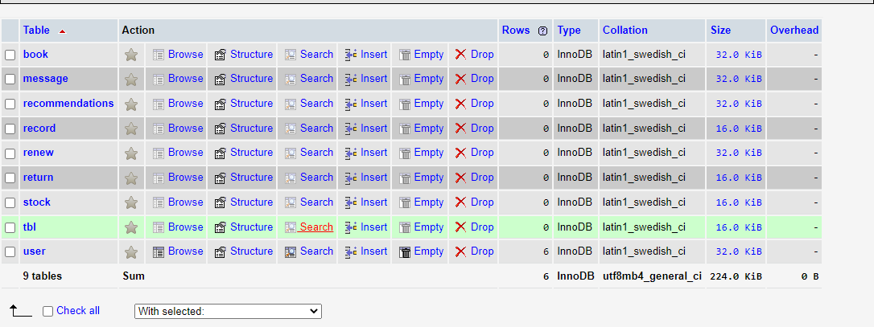
Database Table

Slide 11
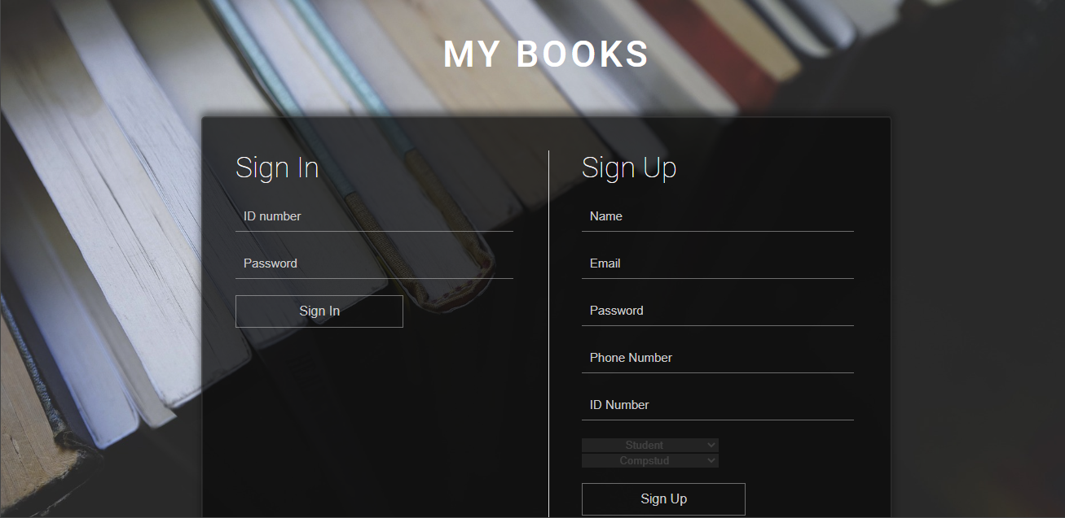
Login and Registration page

Slide 12
Future Scope
There is a future scope of this facility that many more features such as online lectures video tutorials can be added by teachers as well as online assignments submission facility , a feature Of group chat where students can discuss various issues of engineering can be added to this project thus making it more interactive more user friendly and project which fulfills each users need in the best way possible.

Slide 13
Conclusion
The Library Management System is much more user-friendly, faster in operation and easy to manage than the manual one. Through the use of it, the librarian can manage the whole data of the library in a single database in different tables with a much more security than the traditional way.

