Slide 1
People & Learning
Overview for the Audit Team
September 2026

Slide 2





Executive Summary
Status of key learning & development programmes and Great Place To Work® 2026 certification
SparX
Fresher talent transformation
Managerial Excellence
Leadership programme
LearnX LMS
Digital learning platform
Great Place To Work®
2026 certification
2,520
20
500+
96%
training man-hours delivered
leaders (M4 and above) enrolled
employees have used LearnX
survey response rate (84% in 2025)
Batch 2 completed 1 Sep 2026 (23-day programme)
16 participants, incl. 11 fresher trainees
Hands-on lab, VR and core skills training
6 of 11 milestones completed; closure planned Jan 2027
Average session rating of 4.5 / 5
Modules span self, people and performance leadership
Launched 26 Aug 2026 (Enzene India & Inc.)
Leadership, communication, digital & AI and technical courses
Refreshed interface rolling out in Oct
Certification retained (Jan 2026 – Jan 2027)
586 of 611 employees took part in the 2026 survey
Survey run by Great Place To Work® Institute, India
Next steps
Oct 2026 – Jan 2027
01
Set up a Buffer Preparation Lab in the Learning Academy
02
Deliver the “Winning Together” MEP module on 9 Oct 2026
03
Run SparX impact reviews: 30-day (Batch 2) and 60-day (Batch 1)
04
Expand the LearnX video library with technical and behavioural courses
Source: Learning Data – Monthly Closing Deck (Sep 2026); Great Place To Work® 2026 survey report

Slide 3
Learning & Development Programmes
Programme scope, progress to date and digital learning reach (as of September 2026)
SparX
Fresher talent transformation system
Managerial Excellence Program
20 leaders, M4 and above
LearnX LMS
Launched 26 Aug 2026
2,520
23
16
6 of 11
500+
man-hours
training days
participants
milestones completed · avg. session rating 4.5 / 5
employees have used LearnX (Enzene India & Inc.)
Batch 2 completed on 1 Sep 2026
Programme study & design
Oct 2025
Content library
Focus areas: Manufacturing, Quality and Bio Process Development
Department overviews plus hands-on lab training in pipetting and gowning
VR-based training and core skills, incl. buffer preparation theory
Programme design: boot camp, 12-month rotation, soft skills, competency measurement and 30/60/90-day follow-up
Self-Leadership
Nov 2025
Leading Self & Others
Communication & Effectiveness
Refresher session
Aug 2026
Executive Presence
Aug 2026
Digital & AI
Technical Skills
Developing High Performers
Sep 2026
Cohort Coaching 1
Sep 2026
How it is used
Winning Together
9 Oct 2026
Influencing without Authority
24 Nov 2026
SparX pre-work and refreshers
Role-based learning paths
Completion reports and leaderboard
Refreshed interface from Oct 2026
Conflict Management
9 Dec 2026
Cohort Coaching 2
4 Jan 2027
Final review & closure
28 Jan 2027
Source: Learning Data – Monthly Closing Deck (Sep 2026)

Slide 4


Great Place To Work® 2026
Certification retained for 2026, with a marked rise in employee survey participation
96%
+12 pts
611
survey response rate in 2026
increase in participation vs 2025
employees invited to the survey
Survey participation
Trust Index© survey, Study 2025 vs Study 2026
2025
84% (514 of 610 employees)
2026
96% (586 of 611 employees)
What the survey measures
Five Trust Index© dimensions
Certification valid
Jan 2026 – Jan 2027
Credibility
Respect
Fairness
Pride
Camaraderie
Source: Great Place To Work® Institute, India – 2026 survey report

Slide 5

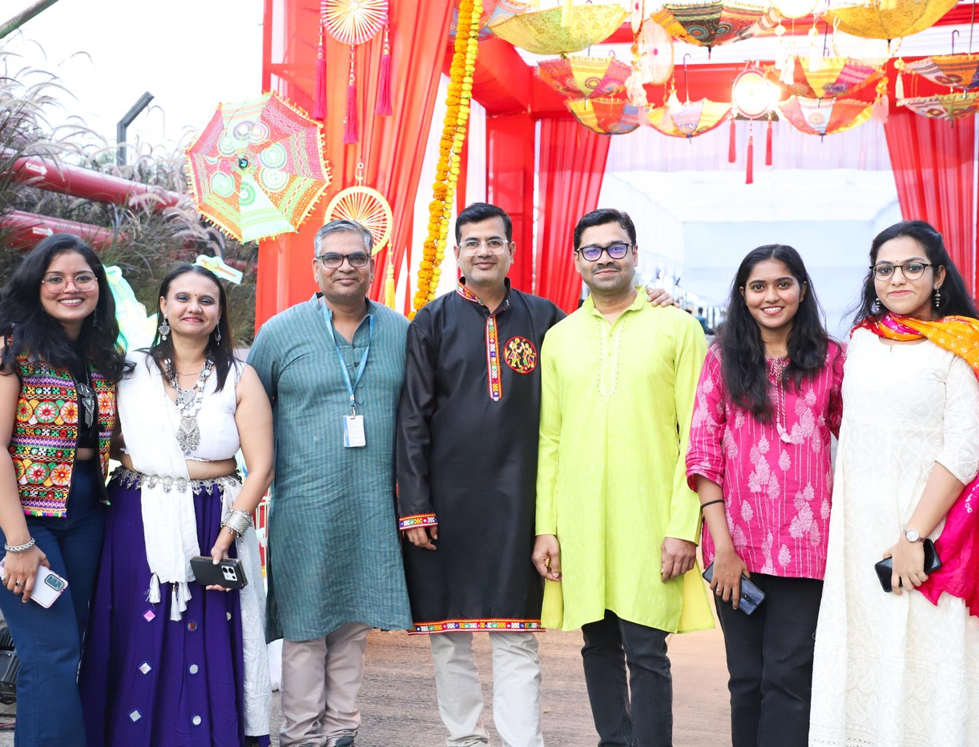
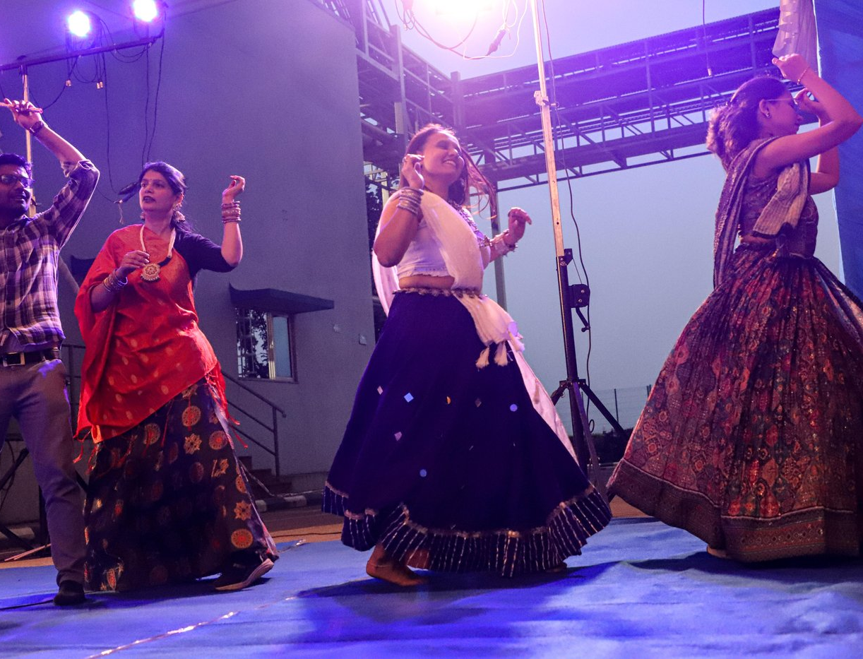
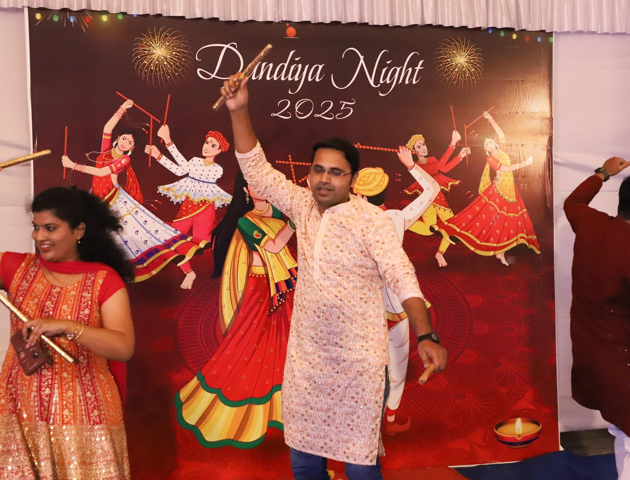
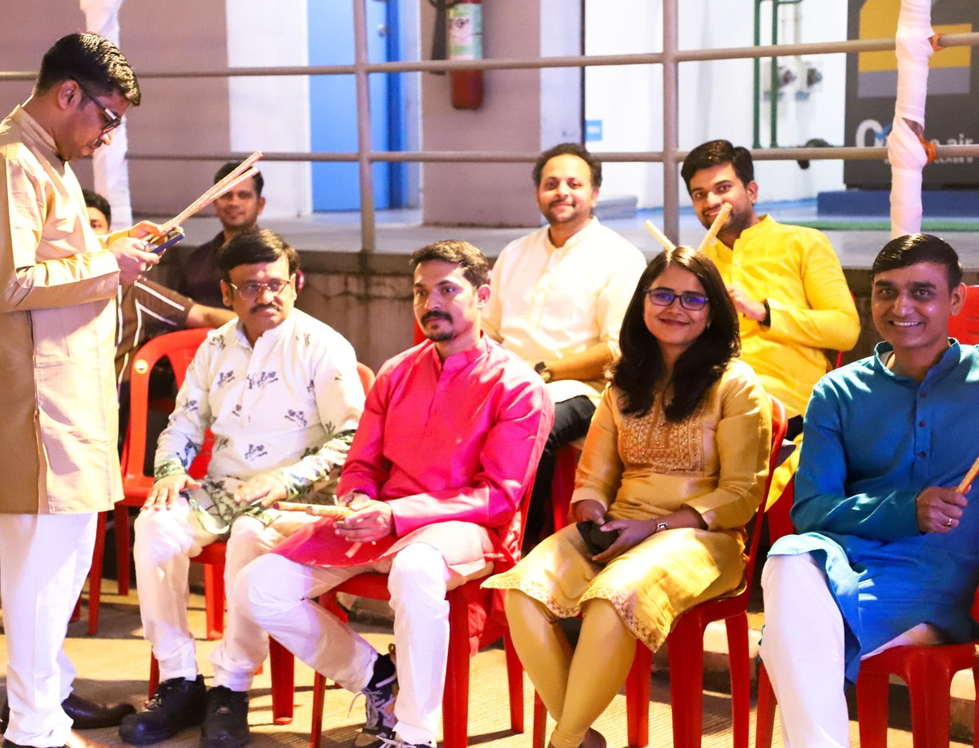
Dandiya Night 2025
Colleagues came together to celebrate Navratri with music, dance and festive colour
Life at Enzene
Photos: Enzene Celebrations – Dandiya Night 2025

Slide 6
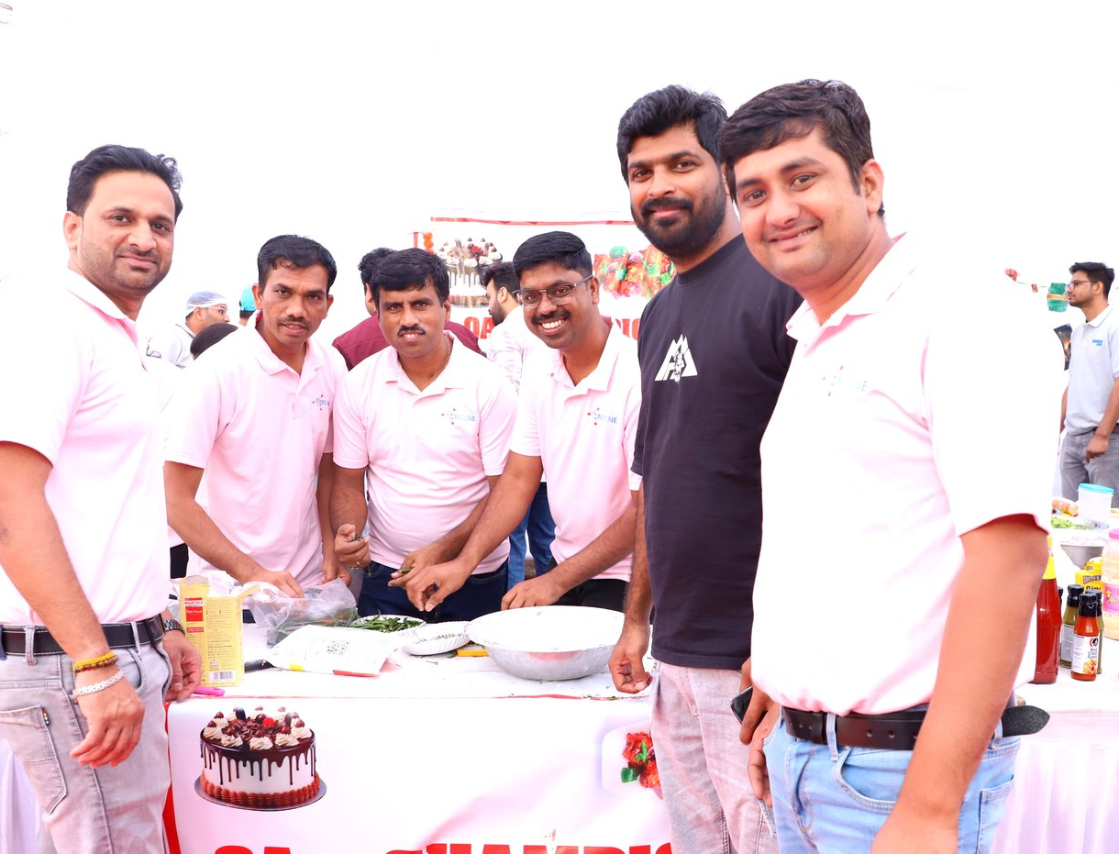
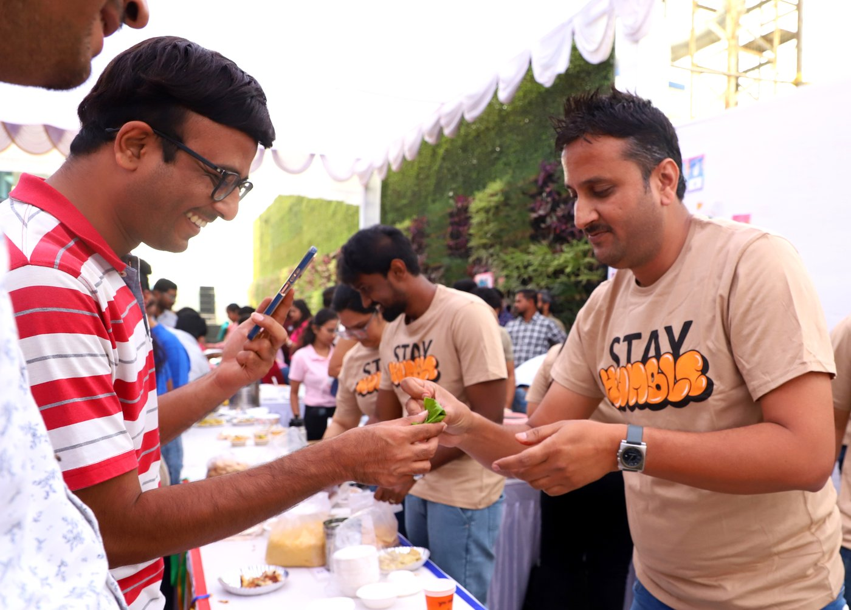
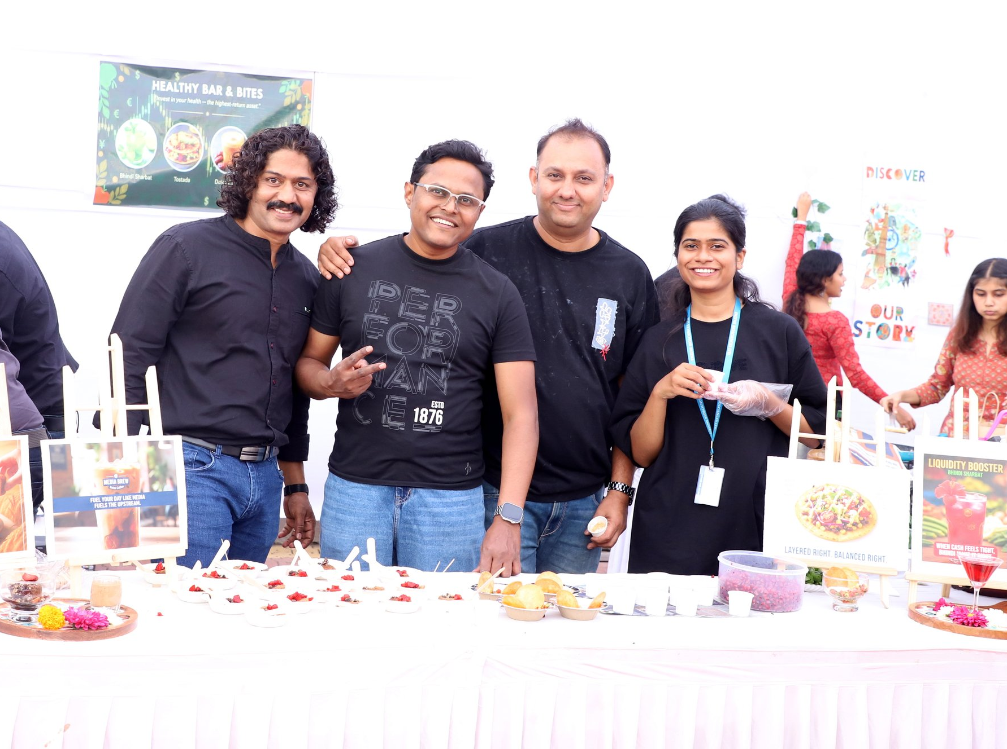
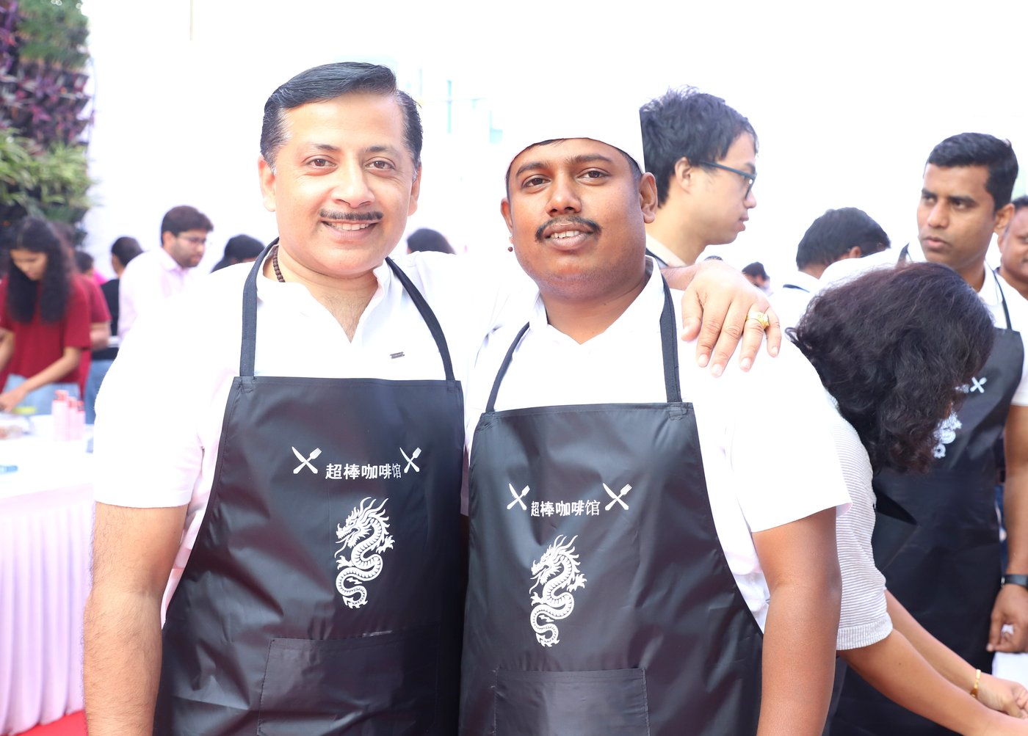
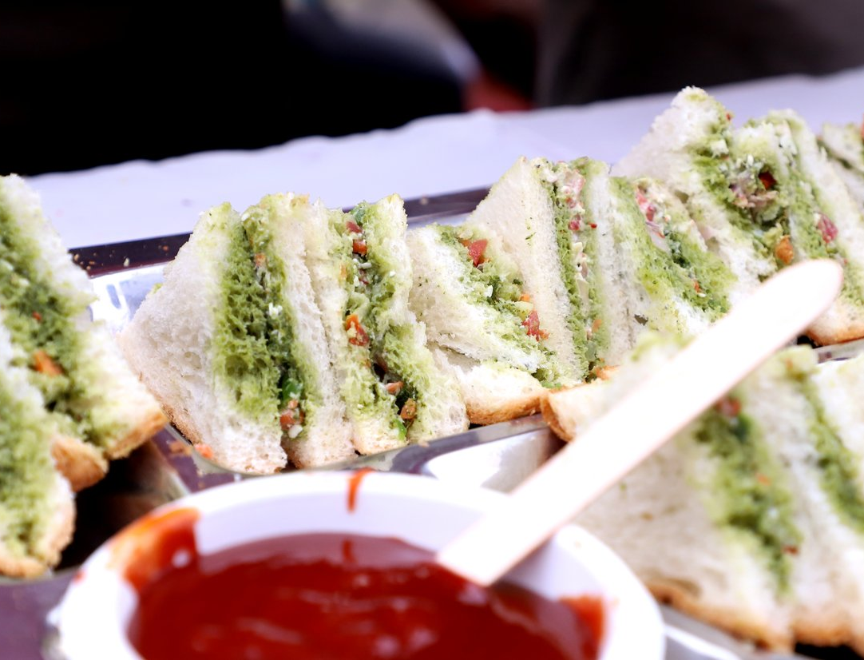
Potluck & Reflections 2025
Teams set up food stalls, shared home-cooked dishes and celebrated together
Life at Enzene
Photos: Enzene Celebrations – Potluck and Reflections 2025

Slide 7
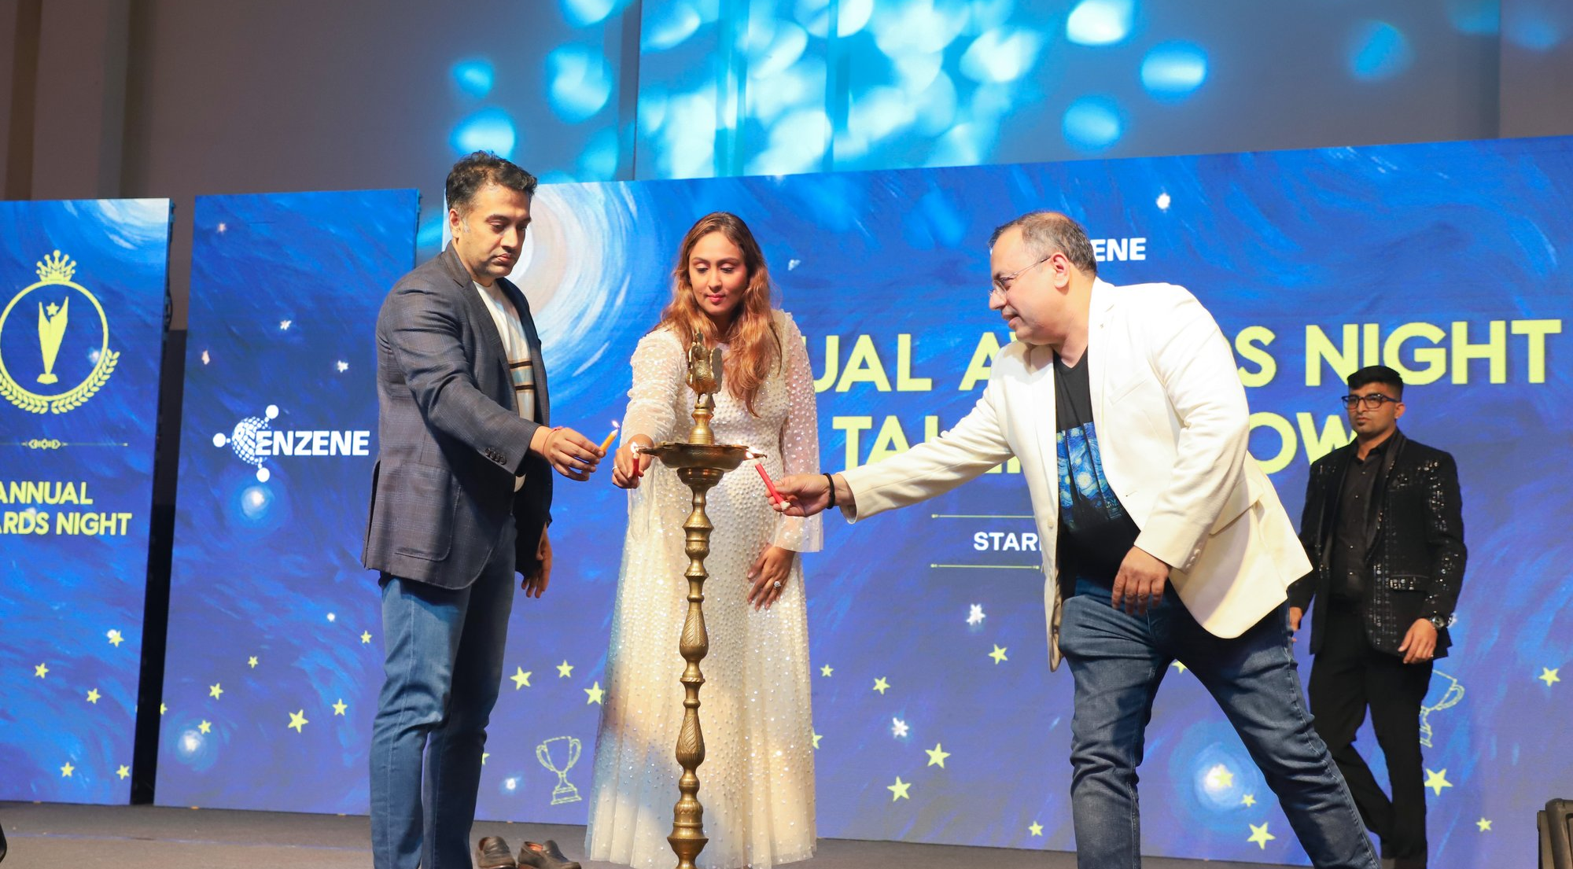
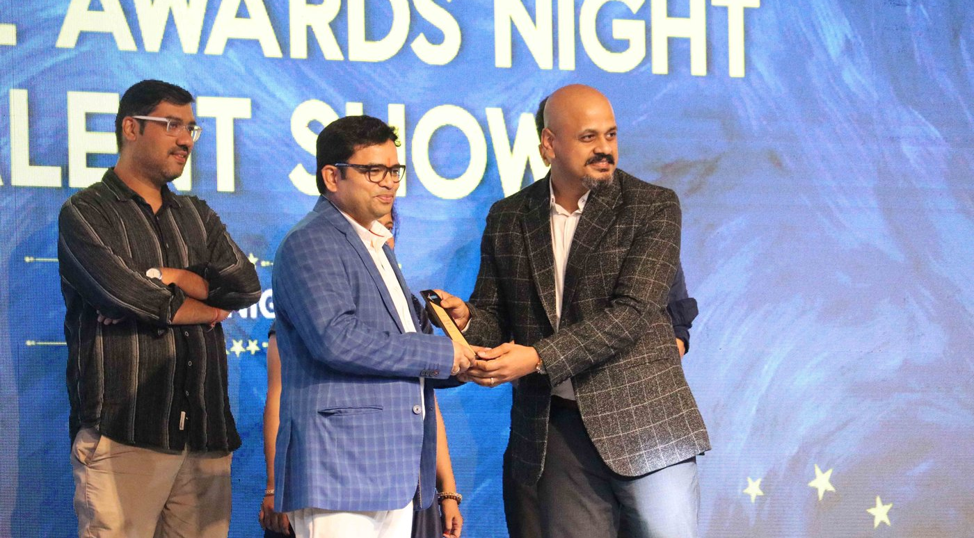
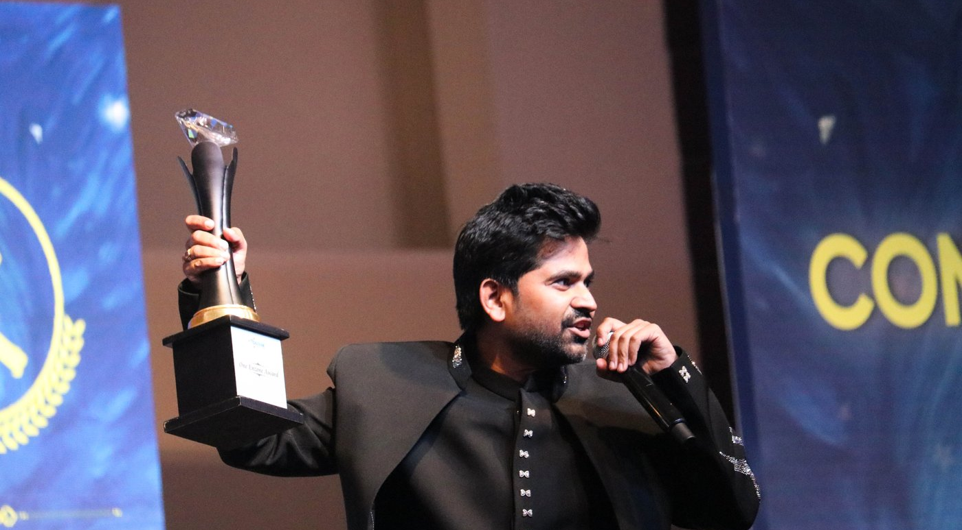
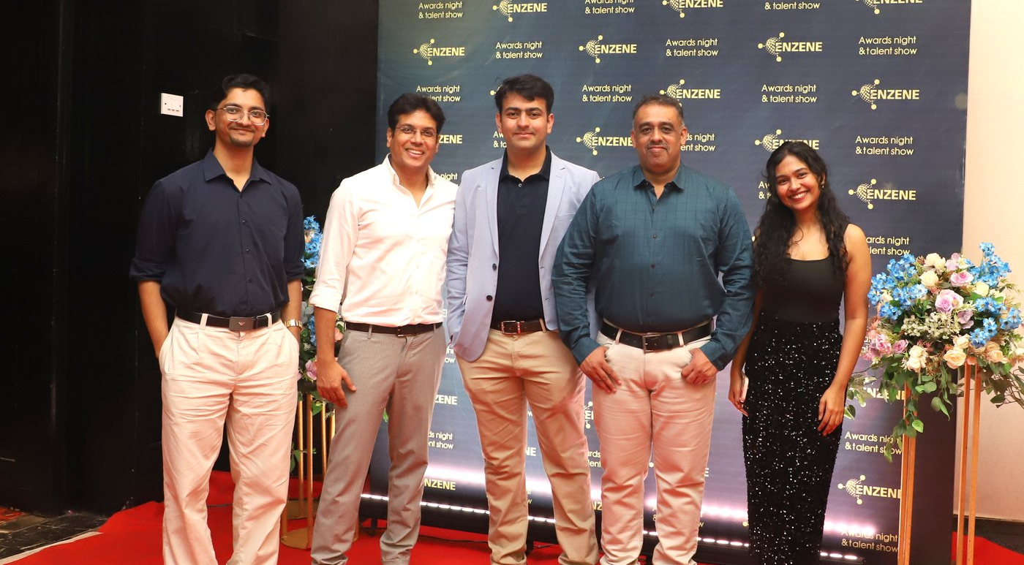
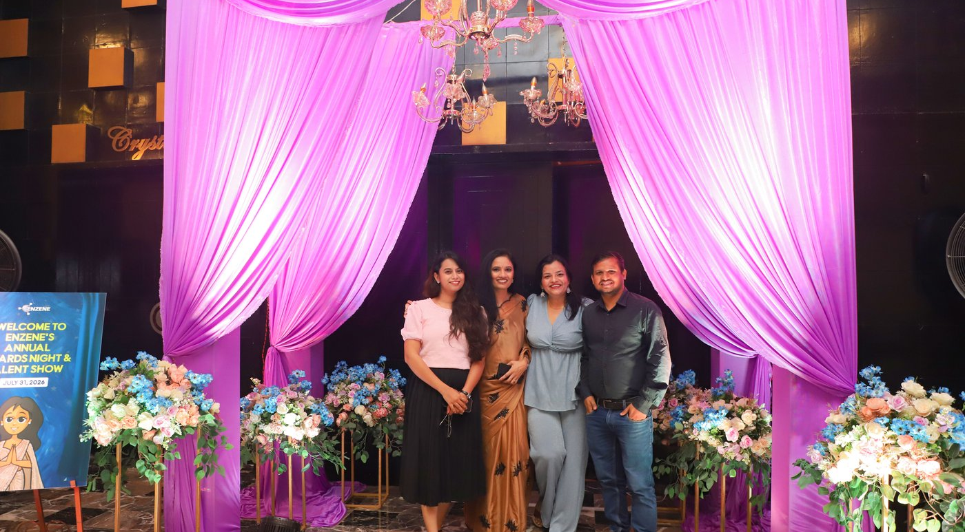

Annual Awards Night 2026
Recognising outstanding contributions at the Annual Awards Night & Talent Show, 31 July 2026
Life at Enzene
Photos: Enzene Annual Awards Night & Talent Show 2026

Slide 8

Thank you
For more information visit www.enzene.com
Passion. Innovation. Life.

