Slide 1
Spring Framework

Slide 2
Objectives
After the completion of this topic the participant should be aware of the following topics
What is Spring Framework
Dependency injection
Should be able to work with different wring

Slide 3
Topics
What is Spring framework?
Why Spring framework?
Spring framework architecture
Usage scenario
Dependency Injection (DI)
BeanFactory
Autowiring
ApplicationContext

Slide 4
What is Spring Framework?
Light-weight yet comprehensive framework for building Java SE and Java EE applications

Slide 5
The Spring Framework Mission Statement
J2EE should be easier to use
It's best to program to interfaces, rather than classes. Spring reduces the complexity cost of using interfaces to zero
JavaBeans offer a great way of configuring applications
Checked exceptions are overused. A framework should not force to catch

Slide 6
Key Features
JavaBeans-based configuration management, applying Inversion-of-Control principles, specifically using the Dependency Injection technique
This aims to reduce dependencies of components on specific implementations of other components.
A core bean factory, which is usable globally
Generic abstraction layer for database transaction management

Slide 7
Key Features
Built-in generic strategies for JTA and a single JDBC DataSource
This removes the dependency on a Java EE environment for transaction support.
Integration with persistence frameworks Hibernate, JDO and iBATIS.
MVC web application framework, built on core Spring functionality, supporting many technologies for generating views, including JSP, FreeMarker, Velocity, Tiles, iText, and POI.

Slide 8
Key Features
Extensive aspect-oriented programming (AOP) framework to provide services such as transaction management
As with the Inversion-of-Control parts of the system , this aims to improve the modularity of systems created using the framework.

Slide 9
Why Use Spring?
Wiring of components through Dependency Injection
Promotes de-coupling among the parts that make the application
Design to interfaces
Insulates a user of a functionality from implementation details
Test-Driven Development (TDD)
POJO classes can be tested without being tied up with the framework

Slide 10
Declarative programming through AOP
Easily configured aspects, esp. transaction support
Simplify use of popular technologies
Abstractions insulate application from specifics, eliminate redundant code
Handle common error conditions
Underlying technology specifics still accessible

Slide 11
Why Use Spring?
Conversion of checked exceptions to unchecked
Extremely modular and flexible
Well designed
Easy to extend
Many reusable classes

Slide 12
Why Use Spring?
Integration with other technologies
EJB for J2EE
Hibernate, iBates, JDBC (for data access)
Velocity (for presentation)
Struts and WebWork (For web)

Slide 13
Spring software
You can download the Spring distribution from Spring’s website: http://www.springframework.org
Choose the downloads link from the left-hand menu and look for the Spring 2.5 or Spring 3.1 download.
Download spring-framework-2.5-with-dependencies.jar file

Slide 14
Some of the spring jars
spring.jar | Contains most of the modules of the Spring Framework in one convenient JAR file.
spring-aspects.jar | Spring’s AspectJ-specific classes.
spring-aop.jar | The Spring AOP module.
spring-beans.jar | The Spring bean factory module.
spring-core.jar | Classes that are core to the Spring Framework.
spring-dao.jar | The basis for Spring’s DAO support.
spring-hibernate3.jar | Hibernate 3 support
spring-jdbc.jar | Spring jdbc module
spring-webmvc.jar | Spring’s web application context and utilities.
spring-web.jar | Spring mvc module

Slide 15
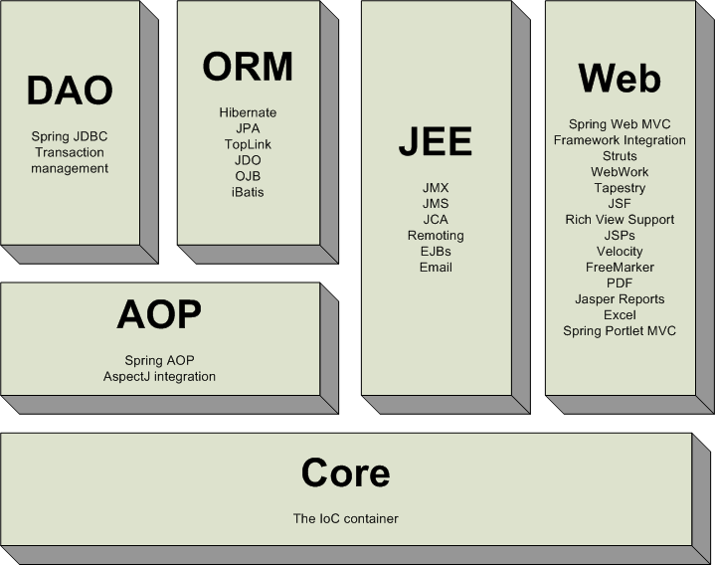
Spring Framework - Architecture

Slide 16
Core Package
Core package is the most fundamental part of the framework and provides the IoC and Dependency Injection features
The basic concept here is the BeanFactory, which provides a sophisticated implementation of the factory pattern which removes the need for programmatic singletons and allows you to decouple the configuration and specification of dependencies from your actual program logic

Slide 17
DAO Package
The DAO package provides a JDBC-abstraction layer that removes the need to do tedious JDBC coding and parsing of database-vendor specific error codes
The JDBC package provides a way to do programmatic as well as declarative transaction management, not only for classes implementing special interfaces, but for all your POJOs (plain old Java objects)

Slide 18
ORM Package
The ORM package provides integration layers for popular object-relational mapping APIs, including JPA, JDO, Hibernate, and iBatis.
Using the ORM package you can use all those O/R-mappers in combination with all the other features Spring offers, such as the simple declarative transaction management feature mentioned previously

Slide 19
AOP Package
Spring's AOP package provides an AOP Alliance-compliant aspect-oriented programming implementation allowing you to define, for example, method-interceptors and pointcuts to cleanly decouple code implementing functionality that should logically speaking be separated
Using source-level metadata functionality you can also incorporate all kinds of behavioral information into your code

Slide 20
MVC Package
Spring's MVC package provides a Model-View-Controller (MVC) implementation for webapplications
Spring's MVC framework is not just any old implementation; it provides a clean separation between domain model code and web forms, and allows you to use all the other features of the Spring Framework.

Slide 21
Usage Scenarios
You can use Spring in all sorts of scenarios, from applets up to fully-fledged enterprise applications using Spring's transaction management functionality and web framework integration

Slide 22
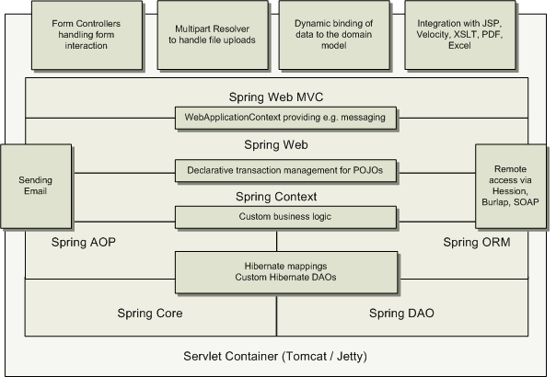
Typical Full-fledged Spring Web App

Slide 23
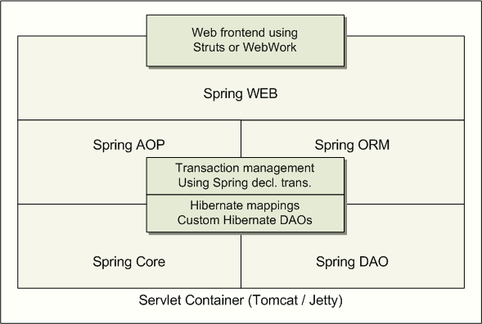
Spring Middle-tier Using 3rd party Web Framework

Slide 24
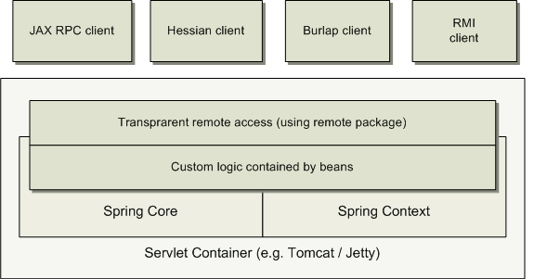
Remoting Usage Scenario

Slide 25
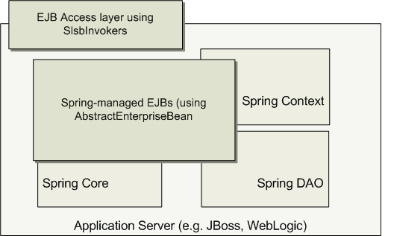
EJBs – Wrapping Existing POJOs

Slide 26
Dependency Injection (DI): Basic concept

Slide 27
Spring Dependency Injection
A kind of Inversion of Control (IoC)
“Hollywood Principle”
Don't call me, I'll call you
“Container” resolves (injects) dependencies of components by setting implementation object (push)
As opposed to component instantiating or Service Locator pattern where component locates implementation (pull)

Slide 28
Benefits of Dependency Injection
Flexible
Avoid adding lookup code in business logic
Testable
No need to depend on external resources or containers for testing
Maintainable
Allows reuse in different application environments by changing configuration files instead of code
Promotes a consistent approach across all applications and teams

Slide 29
Two Dependency Injection Variants
Constructor dependency Injection
Dependencies are provided through the constructors of the component
Setter dependency injection
Dependencies are provided through the JavaBean style setter methods of the component
More popular than Constructor dependency injection

Slide 30
Constructor Dependency Injection
public class ConstructorInjection {
private Dependency dep;
public ConstructorInjection(Dependency dep) {
this.dep = dep;
}
}

Slide 31
Setter Dependency Injection
public class SetterInjection {
private Dependency dep;
public void setMyDependency(Dependency dep) {
this.dep = dep;
}
}

Slide 32
Dependency Injection (DI): DI Support in Spring

Slide 33
Sub-topics
BeanFactory interface
XmlBeanFactory implementation
Bean configuration file
Setter dependency injection
Constructor dependency injection
Beans
Injection parameters

Slide 34
BeanFactory
BeanFactory object is responsible for managing beans and their dependencies
Your application interacts with Spring's DI container through BeanFactory interface
BeanFactory object has to be created by the application typically XmlBeanFactory
BeanFactory object, when it gets created, read bean configuration file and performs the wiring
Once created, the application can access the beans via BeanFactory interface

Slide 35
BeanFactory Implementations
XmlBeanFactory
Convenience extension of DefaultListableBeanFactory
that reads bean definitions from an XML document

Slide 36
Reading XML Configuration File via XmlBeanFactory class
public class XmlConfigWithBeanFactory {
public static void main(String[] args) {
XmlBeanFactory factory =
new XmlBeanFactory(new FileSystemResource("beans.xml"));
SomeBeanInterface b =
(SomeBeanInterface) factory.getBean(“nameOftheBean”);
}
}

Slide 37
Bean Configuration File
Each bean is defined using <bean> tag under the root of the <beans> tag
The id attribute is used to give the bean its default name
The class attribute specifies the type of the bean

Slide 38
Bean Configuration File Example
<!DOCTYPE beans PUBLIC "-//SPRING//DTD BEAN//EN"
"http://www.springframework.org/dtd/spring-beans.dtd">
<beans>
<bean id="renderer" class="StandardOutMessageRenderer">
<property name="messageProvider">
<ref local="provider"/>
</property>
</bean>
<bean id="provider" class="HelloWorldMessageProvider"/>
</beans>

Slide 39
Wiring a Bean

Slide 40
Beans
The term “bean” is used to refer any component managed by the BeanFactory
The “beans” are in the form of JavaBeans (in most cases)
no arg constructor
getter and setter methods for the properties
Beans are singletons by default
Properties the beans may be simple values or references to other beans
Beans can have multiple names

Slide 41
What is Wiring?
The act of creating associations between application components is referred to as wiring
There are many ways to wire a bean but common approach is via XML

Slide 42
Wiring example
<?xml version="1.0" encoding="UTF-8"?>
<!DOCTYPE beans PUBLIC "-//SPRING//DTD BEAN//EN"
"http://www.springframework.org/dtd/spring-beans.dtd">
<beans>
<bean id="greetBean“ class="GreetingServiceImpl">
<property name="greeting">
<value>Hello friends of Spring</value>
</property>
</bean>
</beans>

Slide 43
Wiring the beans
Spring beans can be driven from any configuration
Properties files
Relational database
an LDAP
Preferred Choice for configuration is XML
Several Spring containers support wiring through xml
XmlBeanFactory
ClasspathXmlApplicationContext
FileSystemApplicationContext
XmlWebApplicationContext

Slide 44
Wiring the beans
<?xml version="1.0" encoding="UTF-8"?>
<!DOCTYPE beans PUBLIC "-//SPRING//DTD BEAN//EN"
"http://www.springframework.org/dtd/spring-beans.dtd">
<beans>
<bean id=“mybean“ class=“com.jp.TestBean">
</bean>
</beans>
The root element
bean’s id
Bean instance
(beans class name)

Slide 45
Wiring the beans
Prototype and Singleton beans
all spring beans are singleton
but prototype beans can also be defined
<bean id =“myBean” class=“com.jp.TestBean”
singleton=“false”/>
singleton = “false” returns a prototype bean
singleton = “true” returns a singleton bean
default value for “singleton” is “true”

Slide 46
Wiring the beans
Initialization and Destruction
beans can be initialized and destroyed by calling bean specific methods
init-method : calls bean specific initialization method
destroy-method : calls bean specific cleanup method

Slide 47
Wiring the beans
Initialization and Destruction (example)
public class MyConnectionPool {
public void initialize(){
//initialize a connection;
}
public void cleanup() {
//release connection;
}
}
configuration:
<bean id=“myBean” class =“com.jp.MyConnectionPool”
init-method=“initialize” destroy-method=“cleanup” />

Slide 48
Spring Dependency Injection - Revisted….
Two types of Dependency Injection
setter injection
dependency injected via setter methods
constructor injection
dependency injected via constructor

Slide 49
Spring Dependency Injection
Setter Injection
<bean id=“test” class=“com.jp.TestBean”>
<property name=“greeting”>
<value>Hello friends</value>
</property>
</bean>
Set the greet property by
calling setGreeting( “Hello Friends” )

Slide 50
Spring Dependency Injection
Referencing other beans
<beans>
<bean id=“test” class =“com.jp.TestBean”>
<property name=“greeting”>
<ref bean=“greetBean”/>
</property>
<bean id=“greetBean” class =“com.jp.GreetBean” />
<beans>

Slide 51
Spring Dependency Injection
Constructor Injection
<bean id=“test” class=“com.jp.testBean”>
<constructor-arg>
<value>Hello friends</value>
</constructor-arg>
</bean>
<bean id=“test” class=“com.jp.testBean”>
<constructor-arg>
<ref bean=“greetBean”/>
</constructor-arg>
</bean>
constructs a TestBean
object through
its constructor

Slide 52
Wiring Collections
Spring supports Many types of Collections as bean properties
Supported types are:
XML | Types
<list> | java.util.List, arrays
<set> | java.util.Set
<map> | java.util.Map
<props> | java.util.Properties

Slide 53
Dependency Injection: Autowiring

Slide 54
Auto Wiring
So far we wired beans explicitly using <property> tag
Spring can also do Wiring automatically
<bean id="foo" class="com.jp.spring.Foo“ autowire= "autowire type"/>

Slide 55
Autowiring Properties
Beans may be auto-wired (rather than using <ref>)
Per-bean attribute autowire
Explicit settings override
autowire=“name”
Bean identifier matches property name
autowire=“type”
Type matches other defined bean
autowire=”constructor”
Match constructor argument types
autowire=”autodetect”
Attempt by constructor, otherwise “type”

Slide 56
Bean Naming
Each bean must have at least one name that is unique within the containing BeanFactory
Name resolution procedure
If a <bean> tag has an id attribute, the value of the id attribute is used as the name
If there is no id attribute, Spring looks for name attribute
If neither id nor name attribute are defined, Spring use the class name as the name
A bean can have multiple names
Specify comma or semicolon-separated list of names in the name attribute

Slide 57
Bean Naming Example
<bean id=”mybeanid” class=”mypackage.MyClass”/>
<bean name=”mybeanname” class=”mypackage.MyClass”/>
<bean class=”mypackage.MyClass”/>
<bean id=”mybeanid” name=”name1,name2,name3”
class=”mypackage.MyClass”/>

Slide 58
What is ApplicationContext?
Extension of BeanFactory
It provides all the same functionality and more
Reduces the amount of code you need
In a more framework-oriented style
Add new features over BeanFactory
Resource management and access
Additional life-cycle interfaces
Improved automatic configuration of infrastructure components
Event publication
Internationalization

Slide 59
When to Use ApplicationContext?
Use ApplicationContext over BeanFactory to take advantage of its extended functionality
Except for a few limited situations such as perhaps in an Applet, where memory consumption might be critical, and a few extra kilobytes might make a difference

Slide 60
Using MessageSource
The ApplicationContext interface extends an interface called MessageSource, and therefore provides messaging (i18n or internationalization)functionality
<beans>
<bean id="messageSource”
class="org.springframework.context.support.ResourceBundleMessageSource">
<property name="basenames">
<list>
<value>format</value>
<value>exceptions</value>
<value>windows</value>
</list>
</property>
</bean>
</beans>

Slide 61
Propagating Events
Event handling in the ApplicationContext is provided through the ApplicationEvent class and ApplicationListener interface
If a bean which implements the ApplicationListener interface is deployed into the context, every time an ApplicationEvent gets published to the ApplicationContext, that bean will be notified
Essentially, this is the standard Observer design pattern.

Slide 62
Three Built-in Events
ContextRefreshEvent
ApplicationContext is initialized or refreshed
ContextClosedEvent
ApplicationContext is closed
RequestHandleEvent
A web-specific event telling all beans that a HTTP request has been serviced

Slide 63
Example: Event Handling
Configuration
<bean id="emailer" class="example.EmailBean">
<property name="blackList">
<list>
<value>black@list.org</value>
<value>white@list.org</value>
<value>john@doe.org</value>
</list>
</property>
</bean>
<bean id="blackListListener" class="example.BlackListNotifier">
<property name="notificationAddress" value="spam@list.org"/>
</bean>

Slide 64
Example: Event Handling
Notifier class
public class BlackListNotifier implement ApplicationListener {
/** notification address */
private String notificationAddress;
public void setNotificationAddress(String notificationAddress) {
this.notificationAddress = notificationAddress;
}
public void onApplicationEvent(ApplicationEvent evt) {
if (evt instanceof BlackListEvent) {
// notify appropriate person
}
}
}

Slide 65
How to use ApplicationContext?
Many users will use ApplicationContext in a completely declarative fashion, not even having to create it manually, but instead relying on support classes such as ContextLoader to automatically start an ApplicationContext as part of the normal startup process of a J2EE webapp
it is still possible to programmatically create an ApplicationContext

Slide 66
Spring BeanFactory
BeanFactory is core to the Spring framework
Lightweight container that loads bean definitions and manages your beans.
Configured declaratively using an XML file, or files, that determine how beans can be referenced and wired together.
Knows how to serve and manage a singleton or prototype defined bean
Responsible for lifecycle methods.
Injects dependencies into defined beans when served
Avoids the use of singletons and factories

Slide 67
Spring ApplicationContext
A Spring ApplicationContext allows you to get access to the objects that are configured in a BeanFactory in a framework manner.
ApplicationContext extends BeanFactory
Adds services such as international messaging capabilities.
Add the ability to load file resources in a generic fashion.
Several ways to configure a context:
XMLWebApplicationContext – Configuration for a web application.
ClassPathXMLApplicationContext – standalone XML application context
FileSystemXmlApplicationContext
Allows you to avoid writing Service Locators

Slide 68
Summary
Using dependency injection we can inject the dependencies into our application
IOC reduces the programmers burden
Different types of wring gives us more flexibility

