Slide 1
Web Services

Slide 2
Abstract
Web Services is a technology applicable for computationally distributed problems, including access to large databases
What other technologies were/are available and how they compare with Web Services?

Slide 3
Why to use more than one computer?
Distributed resources
access to shared data
access to shared programs
access to CPU (e.g. many desktop PCs together), to memory, to special devices (e.g. printer)
Complete independence on the internal implementation

Slide 4
Distributed architecture
gives
access to distributed resources
development encapsulation
maintainability, re-usability, legacy-awareness
implementation independence
requires
adding a communication layer between parts
synchronization of efforts
including such nasty things as distributed garbage collection

Slide 5
Distributed architecture
Waiting for requests
(known location,
known port)
Sending requests, getting results
Communication protocol, Data format
Basic questions are:
What kind of protocol to use, and what data to transmit
What to do with requests on the server side
Notes:
A basic scenario of a distributed computing. RPC based communications. Various protocols.

Slide 6
Traditional CGI-based approach
Waiting for requests
(known location,
known port)
Sending requests, getting results
Data as name/value pairs
cgi-bin scripts:
Data transmitted as name-value pairs (HTML forms)
Transport over (state-less) HTTP protocol
no standards for keeping user sessions (state-fullness)
server side: a script is called
Notes:
A basic scenario of a distributed computing. RPC based communications. Various protocols.

Slide 7
CORBA-based approach
Waiting for requests
(known location,
known port)
Sending requests, getting results
Data in binary format
CORBA:
Data transmitted as objects (at least it looks like that)
Transport (usually) over well standardised IIOP protocol
user sessions (state-fullness) very inter-operable
server side: an RPC call is made
Notes:
A basic scenario of a distributed computing. RPC based communications. Various protocols.

Slide 8
SOAP-based communication
Waiting for requests
(known location,
known port)
Sending requests, getting results
Data in XML format
SOAP:
Data in a well-defined XML format
Transport over various protocols
HTTP, SMTP are the most used, perhaps because they are firewall-friendly
server side: either an RPC call or a message delivered
Notes:
A basic scenario of a distributed computing. RPC based communications. Various protocols.

Slide 9
Web services
A collection of XML-based technologies developed by the e-business community to address issues of:
service discovery
interoperable data exchange and/or application invocation
service compositions (workflow, business processes)
Major developers include:
Apache, IBM, HP, SUN & Microsoft (.NET)
http://www.webservices.org/

Slide 10
W3C (working group) definition
"A Web service is a software application identified by a URI, whose interfaces and bindings are capable of being defined, described and discovered as XML artefacts. A Web service supports direct interactions with other software agents using XML based messages exchanged via internet-based protocols."
http://www.w3c.org/TR/2002/WD-wsa-reqs-20020819

Slide 11
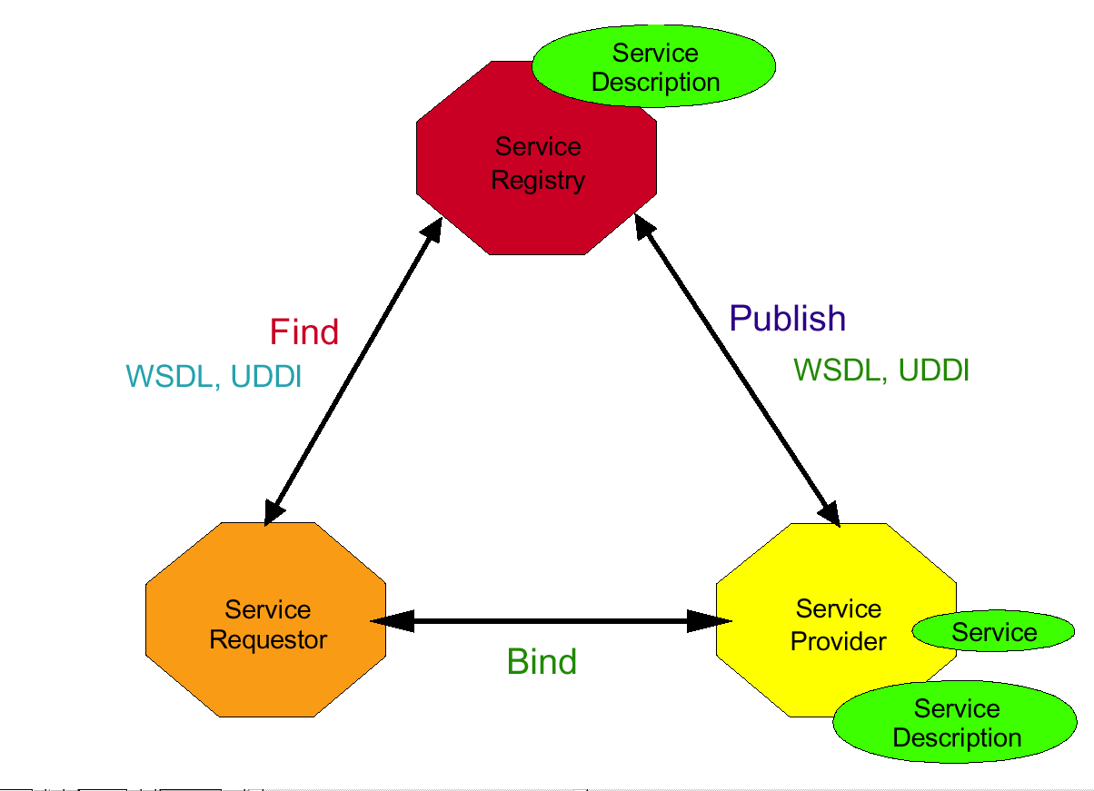
Web Services Architecture
Let a program “click on a web page”

Slide 12
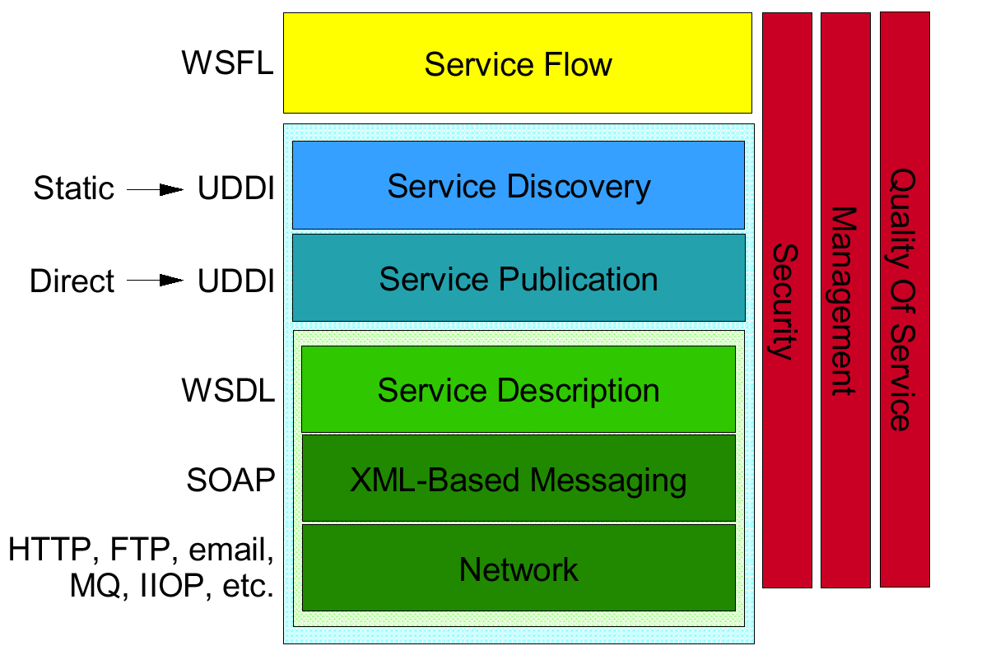
Web Services Stack

Slide 13
SOAP
Simple Object Access Protocol
http://www.w3c.org/TR/SOAP/
A lightweight protocol for exchange of information in a decentralised, distributed environment
Two different styles to use:
to encapsulate RPC calls using the extensibility and flexibility of XML
…or to deliver a whole document without any method calls encapsulated

Slide 14
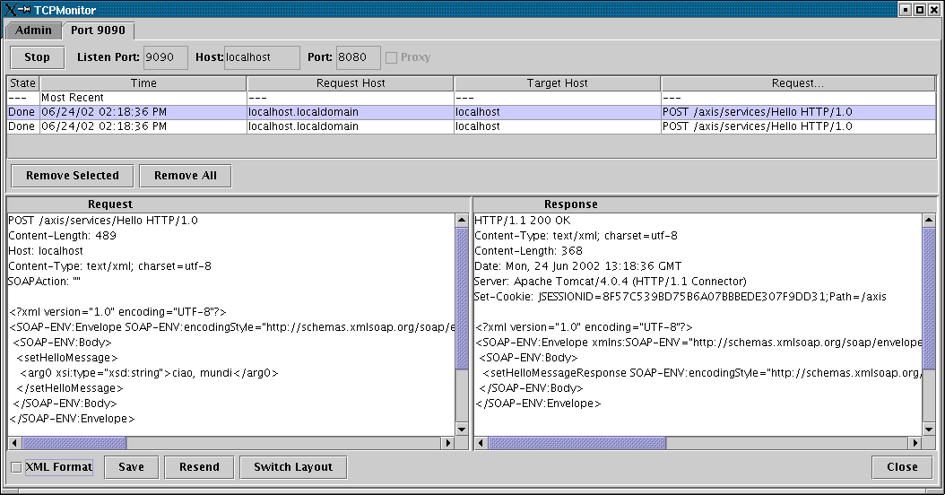
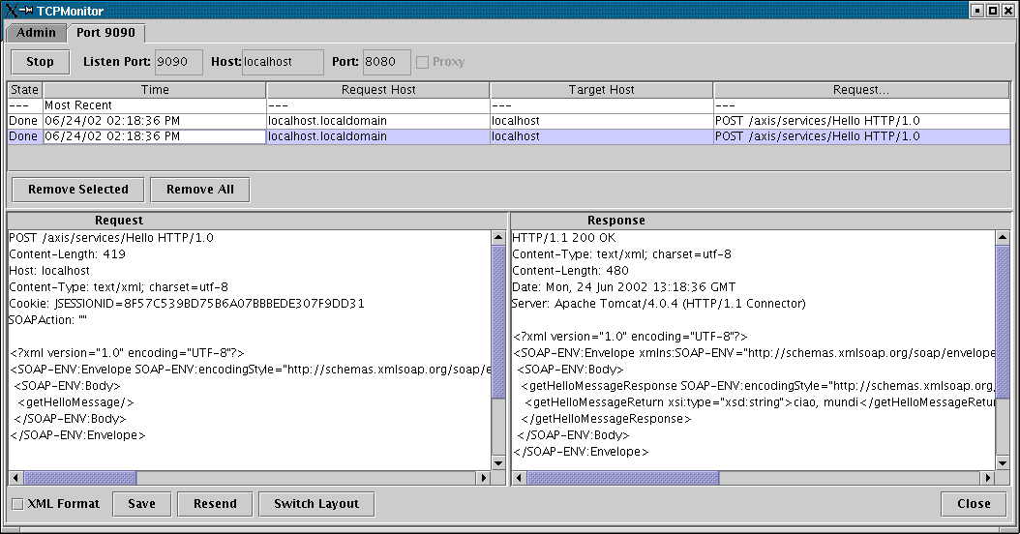
Request: setHelloMessage
Request: getHelloMessage

Slide 15
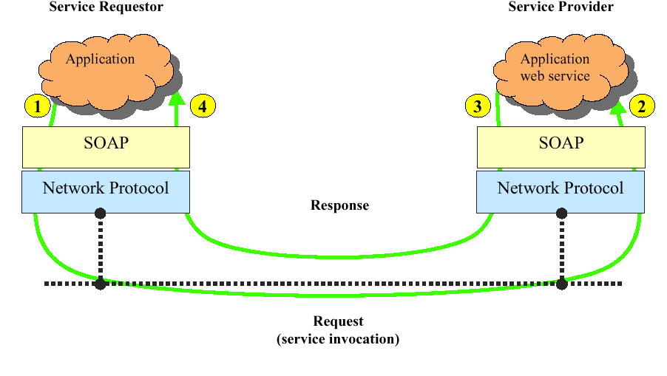
XML Messaging Using SOAP

Slide 16
WSDL
Web Services Definition Language
http://www.w3.org/TR/wsdl/
An XML-based language for describing Web Services
what the service does (description)
how to use it (method signatures)
where to find the service
It does not depend on the underlying protocol
But: It is not much human-readable

Slide 17
Hello.wsdl
<?xml version="1.0" encoding="UTF-8"?>
<wsdl:definitions targetNamespace="http://localhost:8080/axis/services/Hello" xmlns="http://schemas.xmlsoap.org/wsdl/" xmlns:SOAP-ENC="http://schemas.xmlsoap.org/soap/encoding/" xmlns:impl="http://localhost:8080/axis/services/Hello-impl" xmlns:intf="http://localhost:8080/axis/services/Hello" xmlns:wsdl="http://schemas.xmlsoap.org/wsdl/" xmlns:wsdlsoap="http://schemas.xmlsoap.org/wsdl/soap/" xmlns:xsd="http://www.w3.org/2001/XMLSchema"> <wsdl:message name="setHelloMessageRequest"> <wsdl:part name="in0" type="xsd:string"/> </wsdl:message> <wsdl:message name="getHelloMessageResponse"> <wsdl:part name="return" type="xsd:string"/> </wsdl:message> <wsdl:message name="setHelloMessageResponse"> </wsdl:message> <wsdl:message name="getHelloMessageRequest"> </wsdl:message> <wsdl:portType name="HelloWorldService"> <wsdl:operation name="getHelloMessage"> <wsdl:input message="intf:getHelloMessageRequest"/> <wsdl:output message="intf:getHelloMessageResponse"/> </wsdl:operation> <wsdl:operation name="setHelloMessage" parameterOrder="in0"> <wsdl:input message="intf:setHelloMessageRequest"/> <wsdl:output message="intf:setHelloMessageResponse"/> </wsdl:operation> </wsdl:portType> <wsdl:binding name="HelloSoapBinding" type="intf:HelloWorldService"> <wsdlsoap:binding style="rpc" transport="http://schemas.xmlsoap.org/soap/http"/> <wsdl:operation name="getHelloMessage"> <wsdlsoap:operation soapAction=""/> <wsdl:input> <wsdlsoap:body encodingStyle="http://schemas.xmlsoap.org/soap/encoding/" namespace="getHelloMessage" use="encoded"/> </wsdl:input> <wsdl:output> <wsdlsoap:body encodingStyle="http://schemas.xmlsoap.org/soap/encoding/" namespace="http://localhost:8080/axis/services/Hello" use="encoded"/> </wsdl:output> </wsdl:operation> <wsdl:operation name="setHelloMessage"> <wsdlsoap:operation soapAction=""/> <wsdl:input> <wsdlsoap:body encodingStyle="http://schemas.xmlsoap.org/soap/encoding/" namespace="setHelloMessage" use="encoded"/> </wsdl:input> <wsdl:output> <wsdlsoap:body encodingStyle="http://schemas.xmlsoap.org/soap/encoding/" namespace="http://localhost:8080/axis/services/Hello" use="encoded"/> </wsdl:output> </wsdl:operation> </wsdl:binding> <wsdl:service name="HelloWorldServiceService"> <wsdl:port binding="intf:HelloSoapBinding" name="Hello"> <wsdlsoap:address location="http://localhost:8080/axis/services/Hello"/> </wsdl:port> </wsdl:service>
</wsdl:definitions>

Slide 18
UDDI (and alternatives)
Universal Description, Discovery and Integration
http://www.uddi.org
UDDI creates a platform-independent, open framework & registry for:
Describing services
Discovering businesses
Integrating business services
The UDDI may be less used than predicted, especially on the Internet level
BioMoby - an alternative for Life Sciences domain?

Slide 19
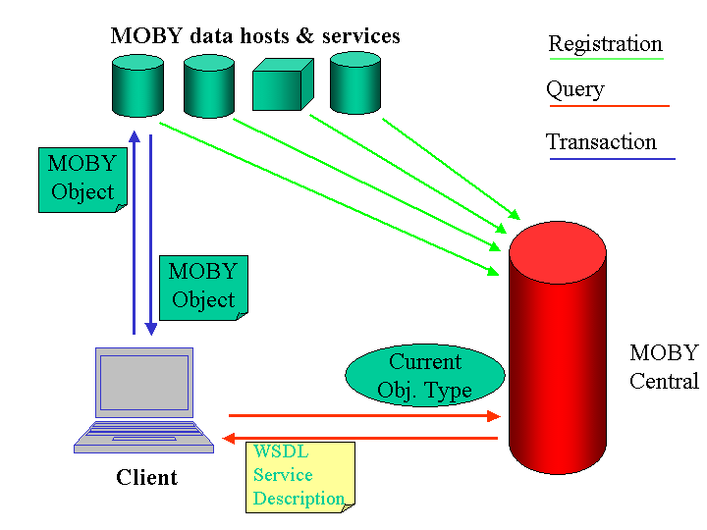
BioMoby http://biomoby.org

Slide 20
A Web Service example in Java
HTTP Server
Servlet engine (e.g. Apache Tomcat)
Any class
processing
the incoming
requests
(“business logic”
Any class
processing
the incoming
requests
(“business logic”
Any class
processing
the incoming
requests
(“business logic”
Any class
processing
the incoming
requests
(“business logic”
SOAP-aware
Servlet
(e.g. Apache Axis)
Sending requests, getting results

Slide 21
Usual principles of Java toolkits
Writing server is easier than writing clients (but only regarding the toolkit, not the business logic)
Servers may be written independently on the used toolkit
Always test interoperability with a non-Java client (because of data serialization and de-serialization)
Steps:
write your service implementation
make all your classes available to the toolkit
deploy your service (usually done just once)
restart the whole servlet engine
test it with a client request

Slide 22
Java SOAP Toolkits
Apache SOAP (was IBM’s SOAP4J)
Apache Axis (a follow-on to the Apache SOAP)
…and many others
…but let’s stay with Apache Axis:
http://ws.apache.org/axis/

Slide 23
hello/HelloWorld.java
package hello;
public interface HelloWorld {
String getHelloMessage();
void setHelloMessage (String newHello);
}
hello/HelloWorldService.java
package hello;
public class HelloWorldService
implements HelloWorld {
String message = "Hello, world!";
public String getHelloMessage() {
return message;
}
public void setHelloMessage (String newMessage) {
message = newMessage;
}
}

Slide 24
HelloWorldClient.java
import org.apache.axis.client.*;
public class HelloWorldClient {
public static void main (String [] args) {
try {
// prepare the call (the same for all called methods)
Call call = (Call) new Service().createCall();
call.setTargetEndpointAddress
(new java.net.URL("http://localhost:8080/axis/services/Hello"));
// call "get message"
if (args.length == 0) {
call.setOperationName ("getHelloMessage");
String result = (String) call.invoke ( new Object [] {} );
System.out.println (result);
System.exit (0);
}
// call "set message" and afterwards "get message"
call.setMaintainSession (true); // TRY also without this line...
call.setOperationName ("setHelloMessage");
call.invoke ( new Object [] { args[0] } );
call.setOperationName ("getHelloMessage");
System.out.println (call.invoke ( new Object [] {} ));
} catch (Exception e) {
System.err.println ("ERROR:\n" + e.toString());
}
}
}

Slide 25
Generated for HelloWorld
1. Make an instance of this
HelloWorldService
2. Use it to make an instance of this
implements
HelloWorldServiceLocator
getHello()
HelloWorld
3. Call methods on this proxy object
implements
HelloSoapBindingStub

Slide 26
HelloWorldClientFromStubs.java
public class HelloWorldClientFromStubs {
public static void main (String [] args) {
try {
// prepare the calls (the same for all called methods)
hello.generated.HelloWorldService service =
new hello.generated.HelloWorldServiceLocator();
hello.generated.HelloWorld myHelloProxy = service.getHello();
// call "get message"
if (args.length == 0) {
String result = myHelloProxy.getHelloMessage()
System.out.println (result);
System.exit (0);
}
// call "set message" and afterwards "get message”
myHelloProxy.setHelloMessage (args[0]);
System.out.println (myHelloProxy.getHelloMessage());
} catch (Exception e) {
System.err.println ("ERROR:\n" + e.toString());
}
}
}

Slide 27
Java <=> XML Data Mapping
How Java objects are converted to/from XML data (in order to be able to be put into SOAP messages)
Important especially for the non-basic data types
It’s easier if your non-basic data types are Java Beans (having set/get methods for members)

Slide 28
A Web Service example in Perl
#!/usr/bin/perl -w -- Perl –
use SOAP::Transport::HTTP;
SOAP::Transport::HTTP::CGI
-> dispatch_to('HelloPerl')
-> handle;
This is a cgi-bin
script
package HelloPerl;
use strict;
use vars qw( $Message );
$Message = 'Hello, here is Perl.';
sub getHelloMessage { $Message; }
sub setHelloMessage { $Message = shift; }
1;
This is a module implementing
the “business logic”
#!/usr/bin/perl –w
use SOAP::Lite
on_fault => sub {…};
print SOAP::Lite
-> uri ('HelloPerl')
-> proxy ('http://localhost/cgi-bin/helloserver.cgi')
-> getHelloMessage
-> result;
This is a client

Slide 29
SOAP::Lite
a collection of (many) modules
but they are loaded automatically when needed
supports SOAP 1.1 specification
all methods can be used for both setting and retrieving values:
if you provide no parameters, you will get current value, and if parameters are provided, a new value will be assigned to the object
and the method in question will return the current object (if not stated otherwise) which is is suitable for stacking these calls like:
$lite = SOAP::Lite
-> uri(’openBQS')
-> proxy('http://industry.ebi.ac.uk/soap/openBQS')
;

Slide 30
Using “wsdl” - directly
getting “.wsdl” file by using its URL
then, you do not need to worry about autotyping
#!/usr/bin/perl -w
use SOAP::Lite on_fault => sub {…};
print SOAP::Lite
-> service ('file:/home/senger/ws-ws/perl/Hello.wsdl')
-> setHelloMessage (123);
#!/usr/bin/perl -w
use SOAP::Lite on_fault => sub {…};
my $service = SOAP::Lite -> service ('file:./Hello.wsdl');
$service->setHelloMessage ($ARGV[0] or "Hello!!!");
print $service->getHelloMessage, "\n";

Slide 31
Why to use Web Services… (comparing to CORBA)
WS are easier to deploy because of their firewall-friendliness
WS are quite well marketed (both from IT companies and Open Source projects)
However:
user sessions are less standardised
many parts yet-to-be-done (notification, transactions, security, etc.)
The programming effort and maintainability is similar to other distributed technologies

Slide 32
1. What is similar
The programming effort and maintainability is roughly the same both for Web Services and CORBA
For CORBA I need an ORB
…but do you know anybody doing WS without a SOAP toolkit?
For CORBA I need an IDL compiler
…not always (ask Perl folks)
…for WS you use frequently stubs generated from WSDL
…similar answers for valuetype/custom encoding, etc.

Slide 33
Conclusions
Distributed computing is inevitable
More accesses by programs than by clicking on hyperlinks
More technologies of distributed architecture will collaborate
The better standards we have the better results we’ll get
Web Services is not a new hype but a trend to follow

