Slide 1
Hibernate

Slide 2

Agenda
Introduction to Hibernate
Hibernate Architecture
Features of Hibernate
Getting Started with Hibernate
Hibernate O/R Mapping
Hibernate Mapping In Depth
Hibernate Query Language
Hibernate Complete Example

Slide 3
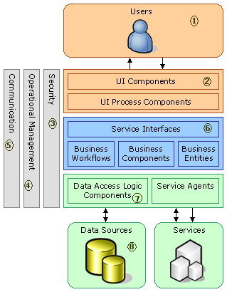
A platform for building business application
Front End
Middleware
Back-end

Slide 4

Introduction to JDBC
JDBC allows developers to connect, query and update a database using the SQL.
JDBC API standard provides Java developers to interact with different RDBMS and access table data through Java application.

Slide 5
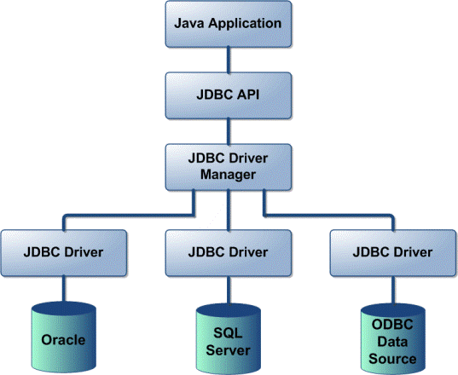
JDBC Architecture
How JDBC makes the interaction with RDBMS?.

Slide 6

JDBC Interaction with RDBMS
Load the RDBMS specific JDBC driver.
Open the connection to database using JDBC URL.
Create JDBC Statement object.
Execute statement which returns resultset(s).
Process the result set.
Close the connection.

Slide 7
Large Business Applications using jdbc
Oracle
Business Apps.
Sql+
MySql
Sql Server

Slide 8
Large Business Applications using Hibernate
Oracle
Business Apps.
H
I
B
E
R
N
A
T
E
Sql+
Sql Server

Slide 9
Introduction to Hibernate
Object-Relational Mapping (ORM) solution for JAVA
Develop persistent classes following object-oriented idiom.
Provides query retrievals using Java classes.
Automatic Key generation for related tables.
Supports all Collections,, SWING and EJB applications
Supports associations One-Many, Many- One, Many-Many etc
HQL supports multiple RDBMS and Native SQL queries.
Supports Cache and Versioning.

Slide 10
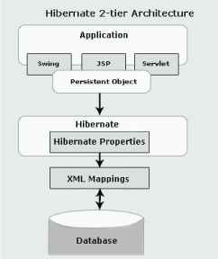
Hibernate Architecture

Slide 11
Hibernate itself opens connection to database.
Converts HQL statements to db specific statement.
Receives result set.
Performs mapping of these database specific data to Java objects which are directly used by Java application.
Provides query and retrieval facilities.

Slide 12
Software Requirements
JDK 1.5 onwards
Eclipse/NetBeans
Any Web/Apps Server
Hibernate Jar Files
Any RDBMS (Oracle, Mysql, SQL Server, ..)
RDBMS Jar Files

Slide 13
Required Files for Configuration
Hibernate Configuration File (hibernate.cfg.xml)
Hibernate Mapping File (hibernate.hbm.xml)
Reverse Engineering File (reveng.xml)
POJO ( Plain Old Java Object )
Hibernate Util Class ( HibernateUtil.java)
Hibernate Helper Class (FileHelper.java)

Slide 14
Role of Configuration
Oracle
Business Apps.
H
I
B
E
R
N
A
T
E
Configuration
Sql+
Sql Server

Slide 15
Hibernate.cfg.xml
<?xml version="1.0" encoding="UTF-8"?>
<!DOCTYPE hibernate-configuration PUBLIC "-//Hibernate/Hibernate Configuration DTD 3.0//EN" "http://hibernate.sourceforge.net/hibernate-configuration-3.0.dtd">
<hibernate-configuration>
<session-factory>
<property name="hibernate.dialect“>
org.hibernate.dialect.MySQLDialect</property>
<property name="hibernate.connection.driver_class">
com.mysql.jdbc.Driver</property>
<property name="hibernate.connection.url">
jdbc:mysql://localhost:3306/courses</property>
<property name="hibernate.connection.username">root</property>
<property name="hibernate.connection.password">root</property>
<property name="hibernate.show_sql">true</property>
<property name="hibernate.current_session_context_class">thread</property>
<property name="hibernate.query.factory_class">
org.hibernate.hql.ast.ASTQueryTranslatorFactory</property>
<mapping resource="hiber/Course.hbm.xml"/>
</session-factory>
</hibernate-configuration>

Slide 16
Role of Reverse Engineering
Oracle
T1
T2
T3
T4
Business Apps.
H
I
B
E
R
N
A
T
E
Reverse Engg.

Slide 17
Hibernate.revenge.xml :-wizard to map the Database Schema and tables
<?xml version="1.0" encoding="UTF-8"?>
<!DOCTYPE hibernate-reverse-engineering PUBLIC "- //Hibernate/Hibernate Reverse Engineering DTD 3.0//EN" "http://hibernate.sourceforge.net/hibernate-reverse-engineering- 3.0.dtd">
<hibernate-reverse-engineering>
<schema-selection match-catalog="courses"/>
<table-filter match-name="course"/>
</hibernate-reverse-engineering>

Slide 18
Role of POJO
POJO
H
I
B
E
R
N
A
T
E
Oracle
T1
T2
T3
T4
T1
Business Apps.
T2
T3
T4

Slide 19
POJO: Course.java :- Java Persistent objected created by Hibernate tool
package hiber;
public class Course implements java.io.Serializable
{ private int courseId;
private String courseName;
public Course() { }
public Course(int courseId)
{ this.courseId = courseId; }
public Course(int courseId, String courseName)
{ this.courseId = courseId;
this.courseName = courseName; }
public int getCourseId()
{ return this.courseId; }
public void setCourseId(int courseId)
{ this.courseId = courseId; }
public String getCourseName()
{ return this.courseName; }
public void setCourseName(String courseName)
{ this.courseName = courseName; }
}

Slide 20
Role of Hibernate Mapping
POJO
H
I
B
E
R
N
A
T
E
Oracle
T1
T2
T3
T4
T1
T1.hbm.xml
Business Apps.
T2
T2.hbm.xml
T3
T3.hbm.xml
T4
T4.hbm.xml

Slide 21
EmployeeBean.hbm.xml File
<?xml version="1.0" encoding="utf-8" ?>
<!DOCTYPE hibernate-mapping PUBLIC
"-//Hibernate/Hibernate Mapping DTD 3.0//EN"
"http://hibernate.sourceforge.net/hibernate-mapping-3.0.dtd">
<hibernate-mapping>
<class name="com.mf.bean.EmployeeBean" table="t_employee">
<id name="id" type="string" unsaved-value="null">
<column name="id" sql-type="varchar(32)" not-null="true"/>
<generator class="uuid"/>
</id>
<property name="name">
<column name="name" />
</property>
<property name="salary">
<column name="salary" />
</property>
</class>
</hibernate-mapping>

Slide 22
Hibernate communication with RDBMS
Load the Hibernate configuration file and create configuration object. It will automatically load all hbm mapping files
Create session factory from configuration object
Get one session from this session factory
Create HQL query
Execute query to get list containing Java objects

Slide 23
Hibernate Util
Creates a SessionFactory object which in turn can open up new Session's.
package hiber;
import org.hibernate.cfg.AnnotationConfiguration;
import org.hibernate.SessionFactory;
public class HibernateUtil {
private static final SessionFactory sessionFactory;
static {
try {
sessionFactory = new AnnotationConfiguration().configure().buildSessionFactory();
} catch (Throwable ex) {
System.err.println("Initial SessionFactory creation failed." + ex);
throw new ExceptionInInitializerError(ex);
}
}
public static SessionFactory getSessionFactory() {
return sessionFactory;
}
}

Slide 24
Session Factory
SessionFactory creates Sessions
Usually an application has a single SessionFactory.
Threads servicing client requests obtain Sessions from the factory
Implementors must be threadsafe.
SessionFactorys are immutable.
The behaviour of a SessionFactory is controlled by properties supplied at configuration time.
These properties are defined on Environment.

Slide 25
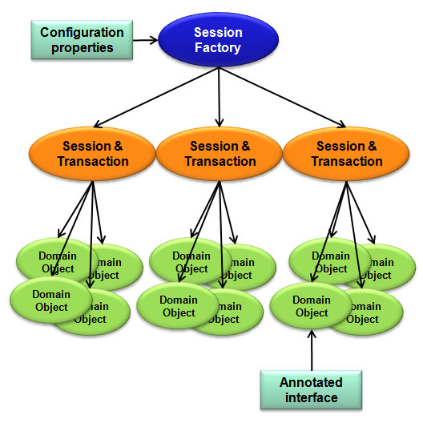

Slide 26
Session
The main runtime interface between a Java application and Hibernate.
The lifecycle of a Session is bounded by the beginning and end of a logical transaction.
The main function of the Session is to offer create, read and delete operations for instances of mapped entity classes. Instances may exist in one of three states: transient: never persistent, not associated with any Session persistent: associated with a unique Session detached: previously persistent, not associated with any Session

Slide 27
Transaction
Transaction simply means a unit of work, which is atomic. When we consider database, Transaction groups a set of tatements/commands which gets committed together.
If a single statement fails, whole work will be rolled back.
Session sess = factory.openSession();
Transaction tx;
try { tx = sess.beginTransaction(); //do some work ...
tx.commit();
} catch (Exception e) {
if (tx!=null) tx.rollback();
throw e;
} finally {
sess.close();
}

Slide 28
Features of Hibernate
Transparent persistence without byte code processing
Object-oriented query language
Object / Relational mappings
HDLCA (Hibernate Dual-Layer Cache Architecture)
J2EE integration
EJB3 draft specification support for POJO persistence and annotations.
Custom Data Types
Collections
Uni and Bi-directional entity Associations
Transactions and concurrency
Connection Pooling

Slide 29

Why is Hibernate better than JDBC
Relational, Transparent Persistence for JAVA
Database Dependent Code
Hibernate is built on top of JNDI, JDBC, JTA
It uses XML based configuration files for mapping
Hibernate used to address the issues of Collections, Entity Beans
Supports many databases like Sybase, Oracle, My SQL , etc.
Easy migration from one vendor database to another
Provides quite powerful object query language known as Hibernate Query Language (HQL)

Slide 30
Hibernate Vs Others
Other popular ORMs are
iBatis
JPA
TopLink
Castor
Cocobase

Slide 31
CONCLUSION
Hibernate is the solution to relieve the developer from 95 percent of common data persistence related programming tasks.
Easy to learn.
Instant gratification
Plenty of job opportunities in the market
Most big enterprises use Hibernate for their persistence needs
Very efficient in replacing complex queries
A very good skill addition for any Java developer

Slide 32
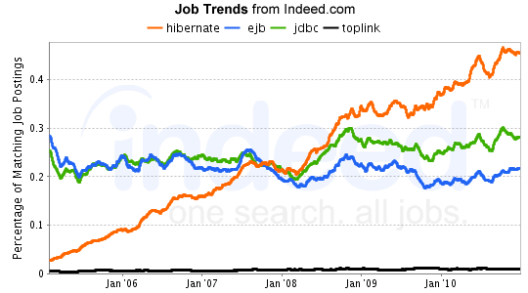
Job Trend on Hibernate

Slide 33
THANK YOU

