Slide 1
TEAM-6
E-LETTER
Krishna Prasad
Pooja
Gnana Deepika
Srikanth
Yaswanth

Slide 2
PROBLEM STATEMENT
The HR of ADP needs to generate E letters to selected candidates.
You have a template in Word with placeholders for name, address, ctc, doj etc.
Develop an application which allows the HR to enter the placeholder details manually for one candidate at a time or can generate all the selected candidates by uploading CSV file.
After the HR enters the details and clicks on “Generate E Letter" button in the application, the placeholder fields in the Word template should be replaced with the details entered in the application.
The Word document should be converted to PDF.

Slide 3
USE CASES
As a HR I can,
Login to the page using user-name and password.
Select the Template such as offer letter, bonus letter, appreciation letter
Select an option called generate individual E Letter.
Enter the details of the candidate in the form for generating E Letter for one candidate.
Select an option called bulk E-letters.
Select CSV file for generating bulk offer letters.
Generate E Letters.
View History.
Logout.

Slide 4
EMPATHY MAP PERSONA -HR
SAYS:
I can be able to enter the details manually.
Can I see the history of offer letters generated.
Is this providing access to only HR to generate offer letters.
Will it be a real time?
Is this providing security and confidentiality to handle sensitive candidate info.
Can I be able to edit the details.
what fields are you updating in the E- letter when sending to bulk candidates.
DOES:
Utilize the existing templates or standardized formats.
sends offer letter to any particular candidate
sends offer letter to bulk number of candidates in a time efficient manner.
edit the details
Searches candidate data using name ,role and address
Check history of the offer letter.
THINKS:
Will I able to generate the e-letters on time?
Will I able to reach candidate expections?
Will it save my time?
What better it can do?
Is This Trustworthy?
How do I know whether the e-letters is generate successful or not?
Will I able to generate the bulk e-letters at a time?
FEELS:
Excited
satisfied
minimizing repetitive task
making work simpler
quick generation of E-letters
more effective
Name of Event Here

Slide 5
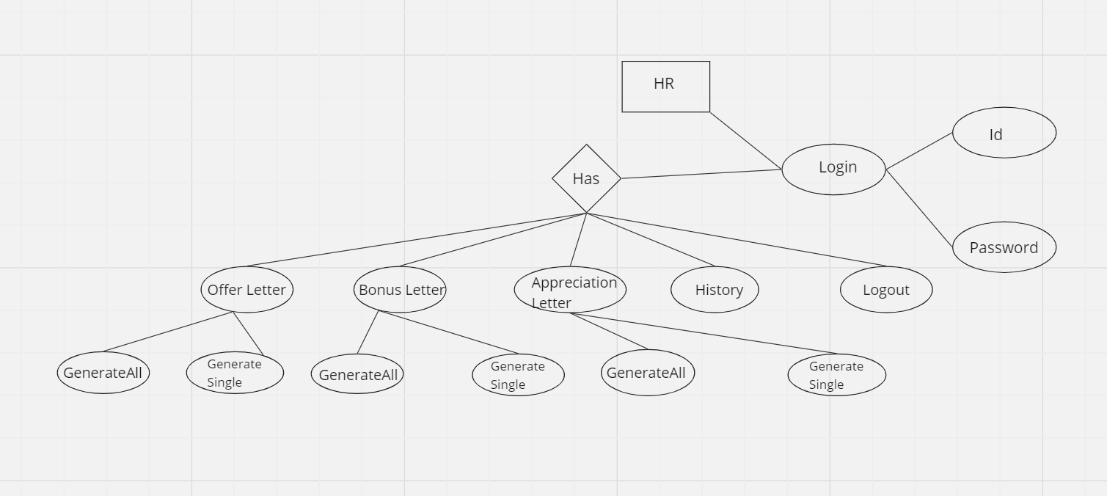
ER-DIAGRAM

Slide 6
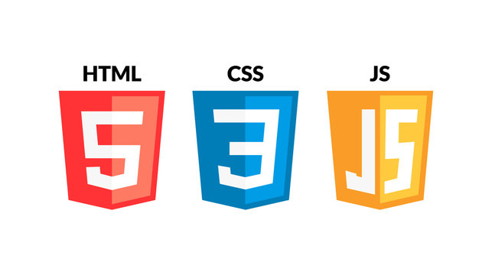








TECHNOLOGIES:
FRONT END
BACKEND
TESTING
DEVOPS

Slide 7
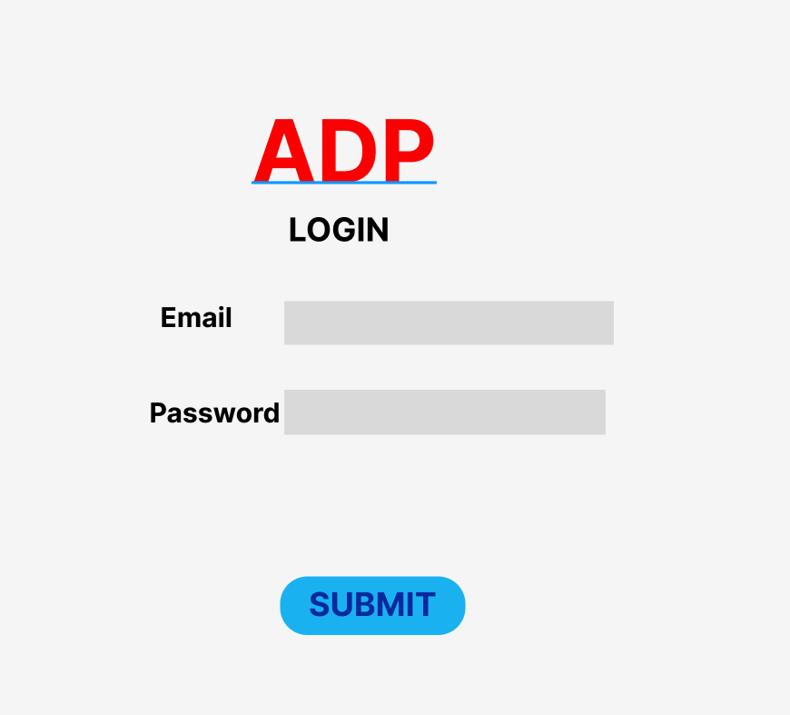
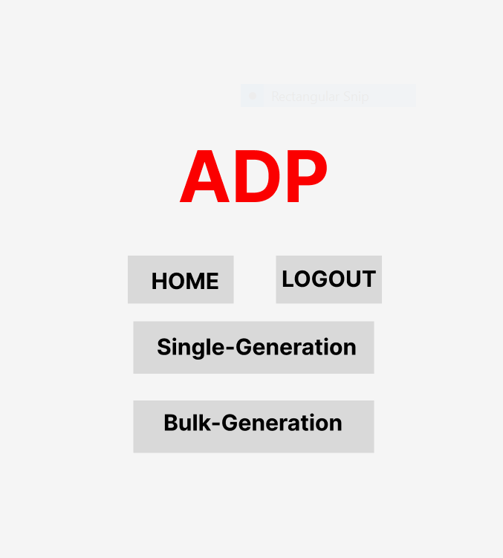
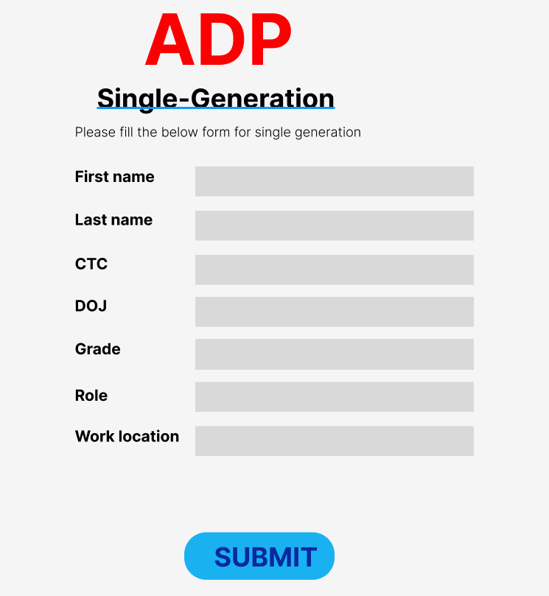
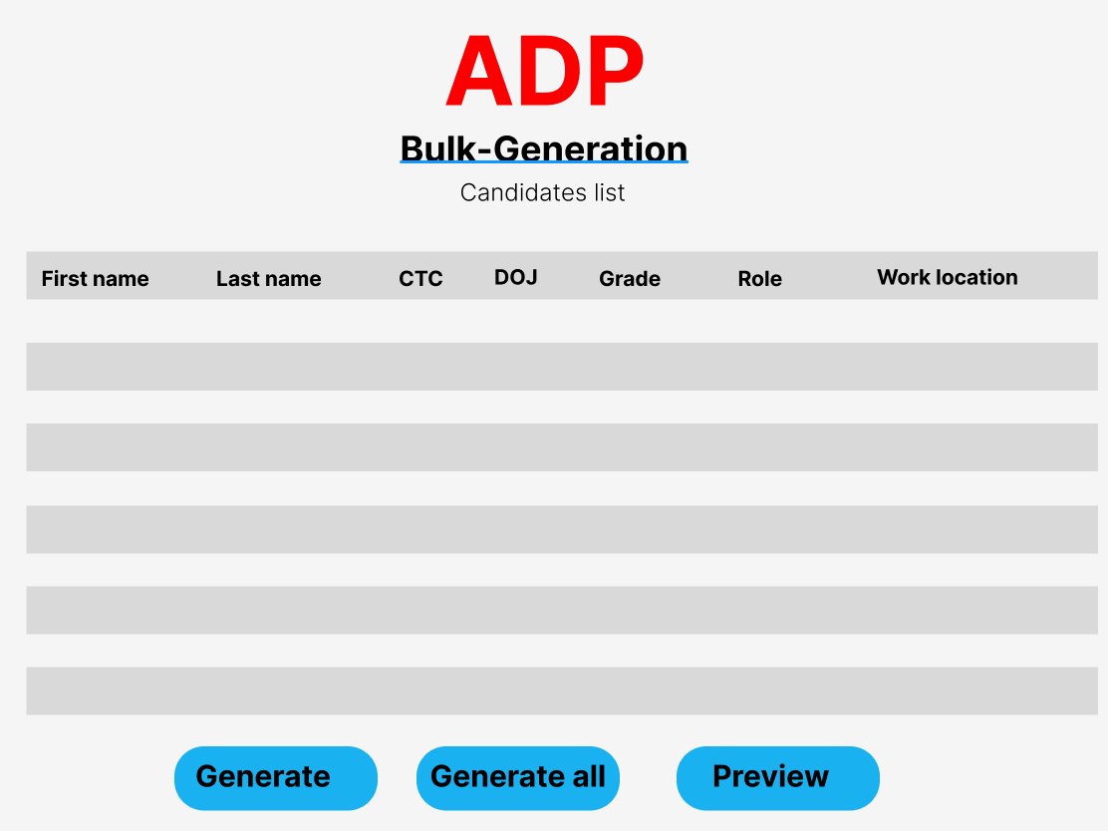
WIREFRAMES:

Slide 8
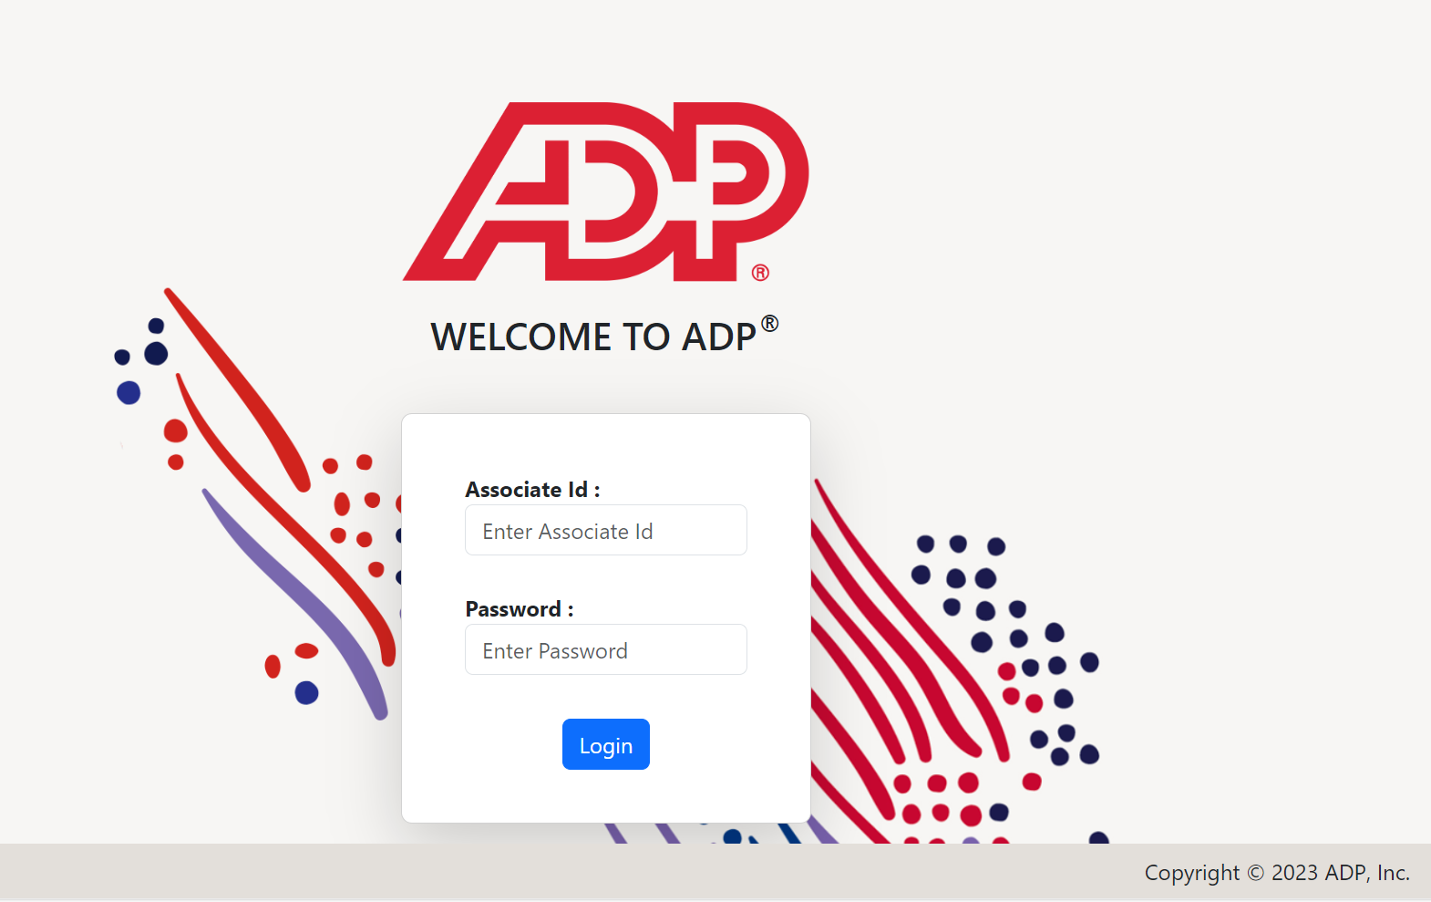
LOGINPAGE

Slide 9
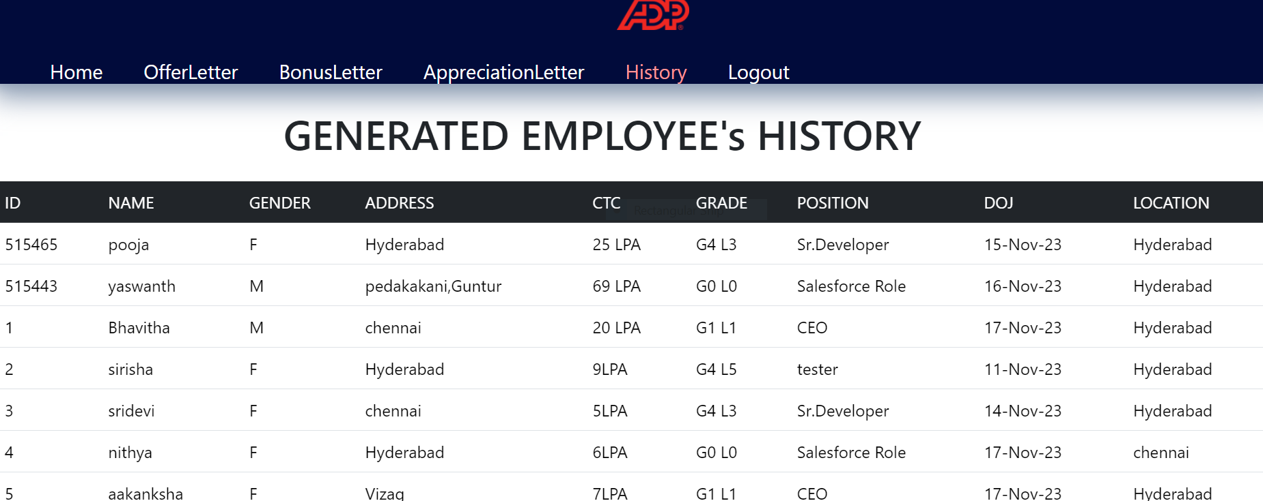
HISTORY PAGE

Slide 10
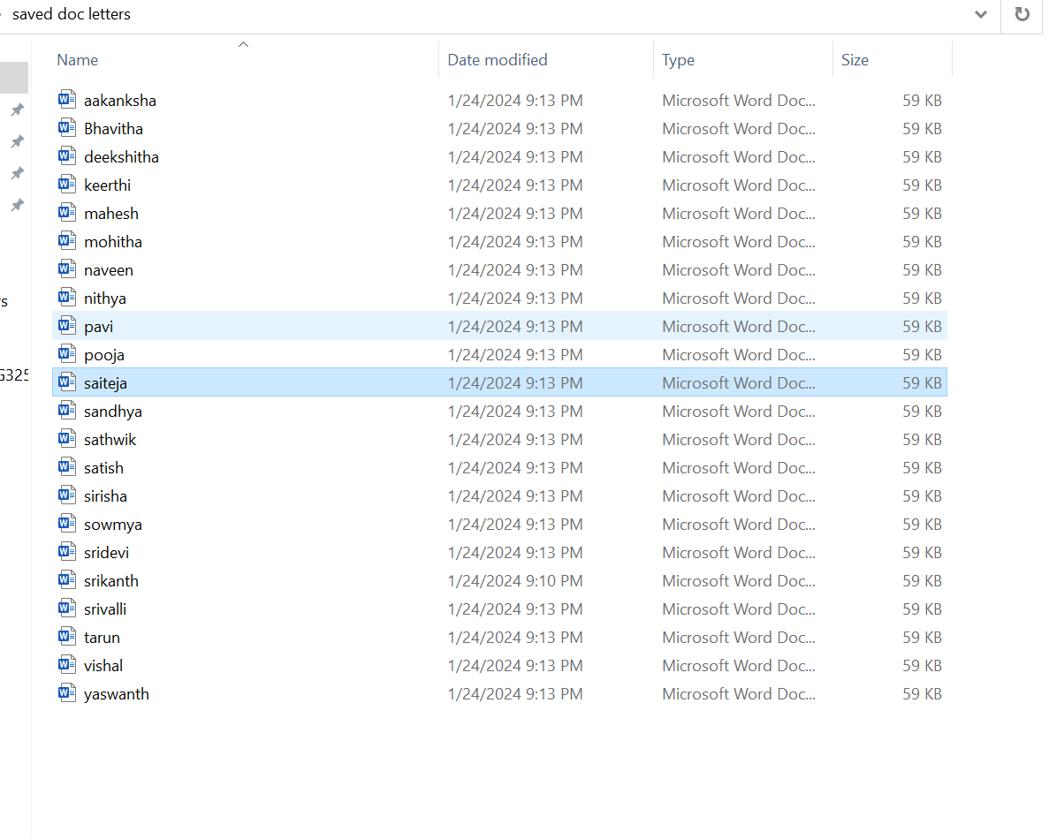
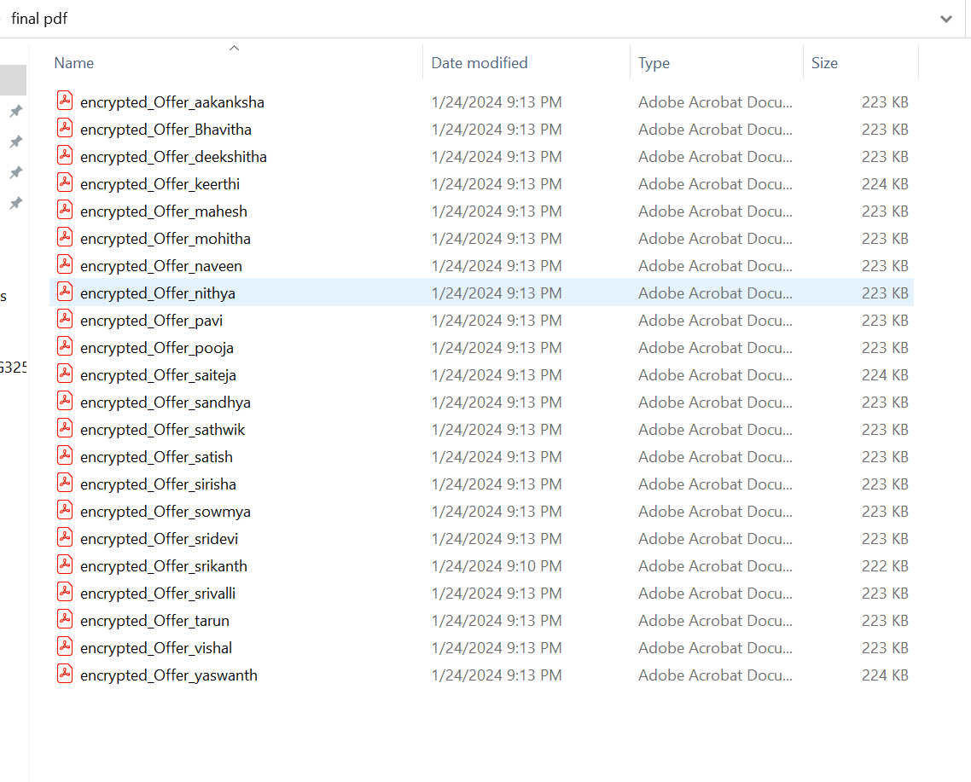
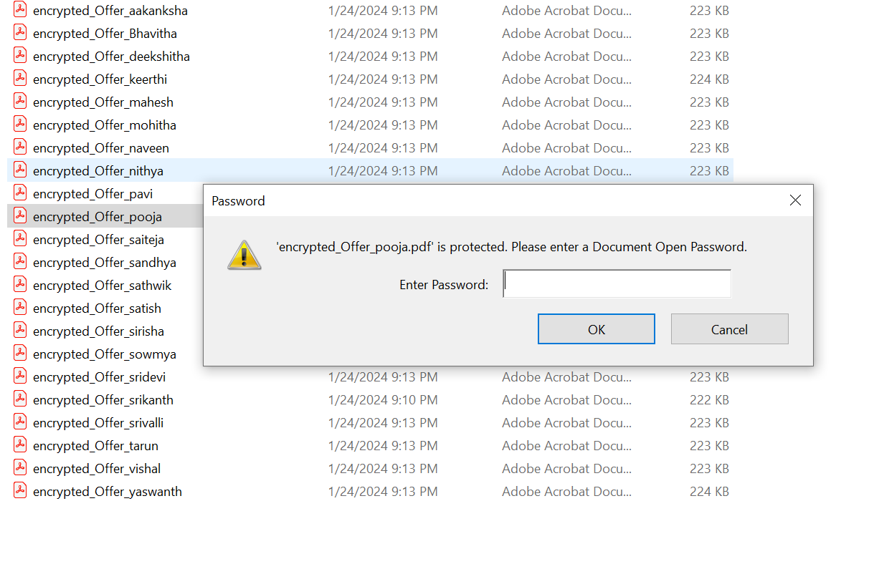
RESULTS

Slide 11
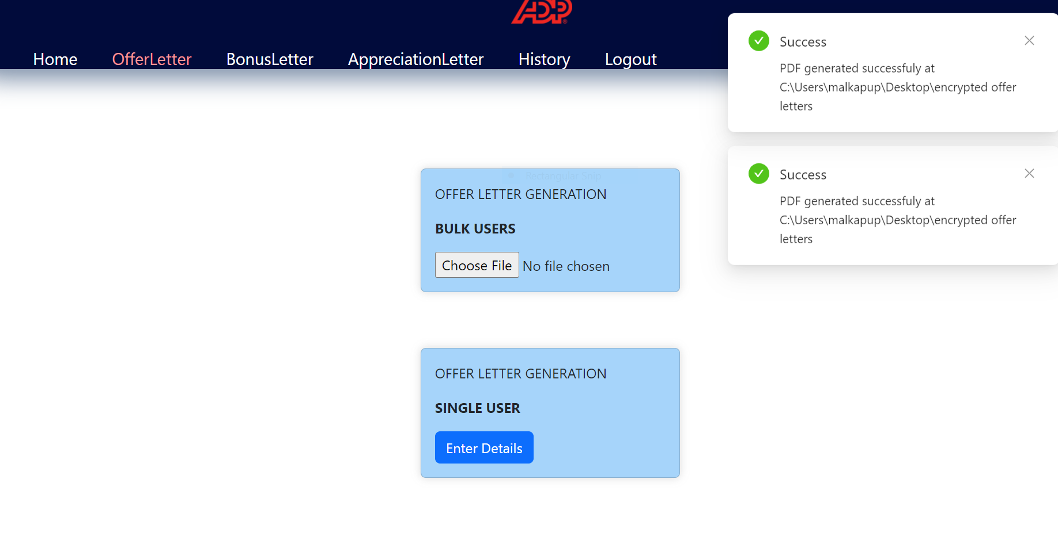

Slide 12
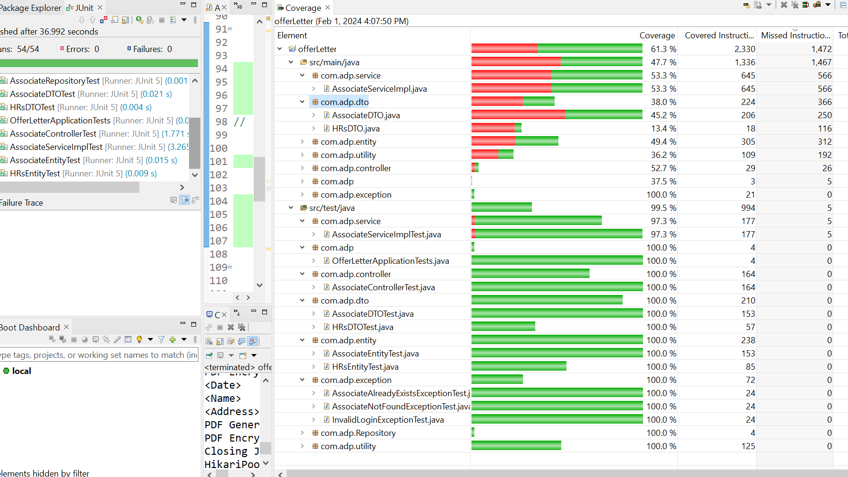
CODE COVERAGE:

Slide 13


