Slide 1
EMPLOYEE AND TEAM CALENDAR
Batch-3 Team-5
Lakshmi Manasa
Umesh Chandra
Bhavitha
Naga Sai
Venkanna Babu

Slide 2
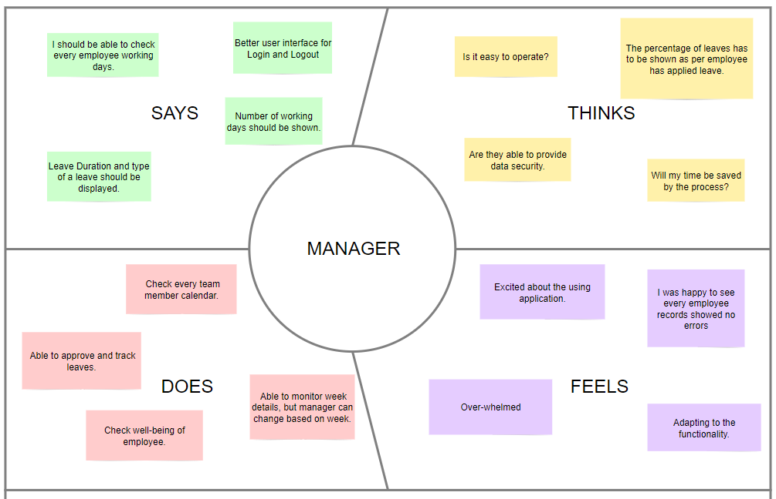
Manager Empathy Map

Slide 3
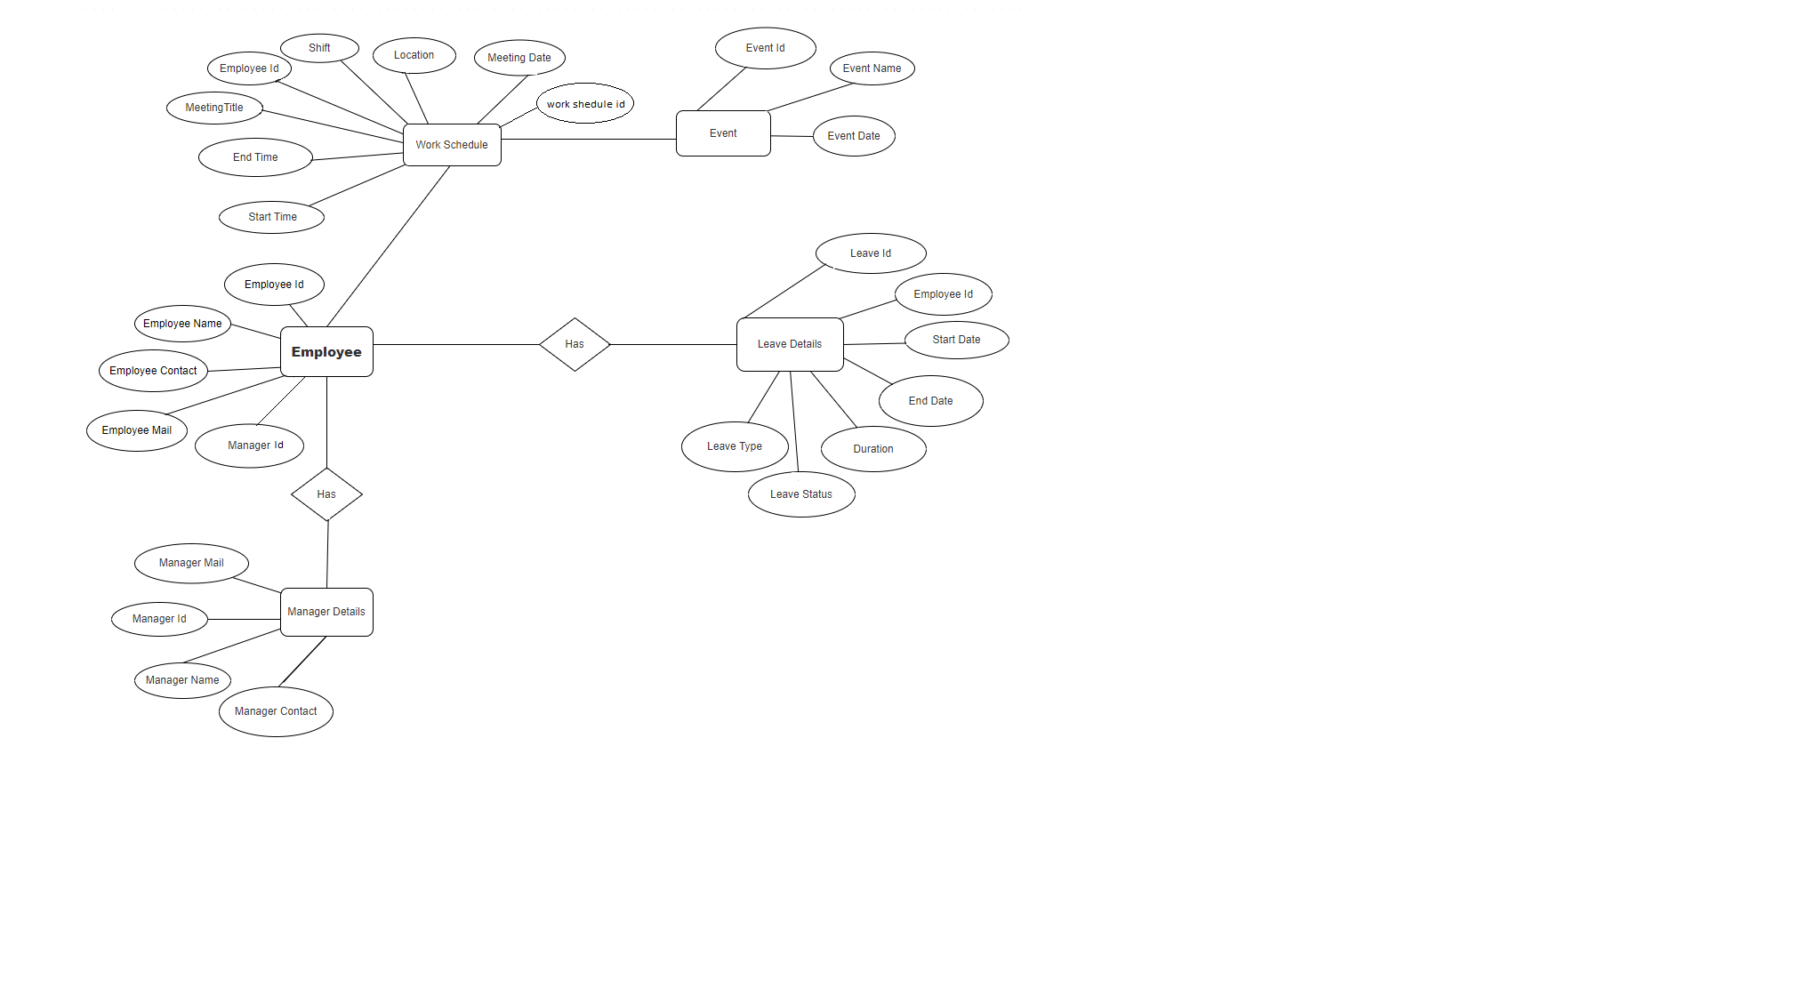
ER Diagram

Slide 4
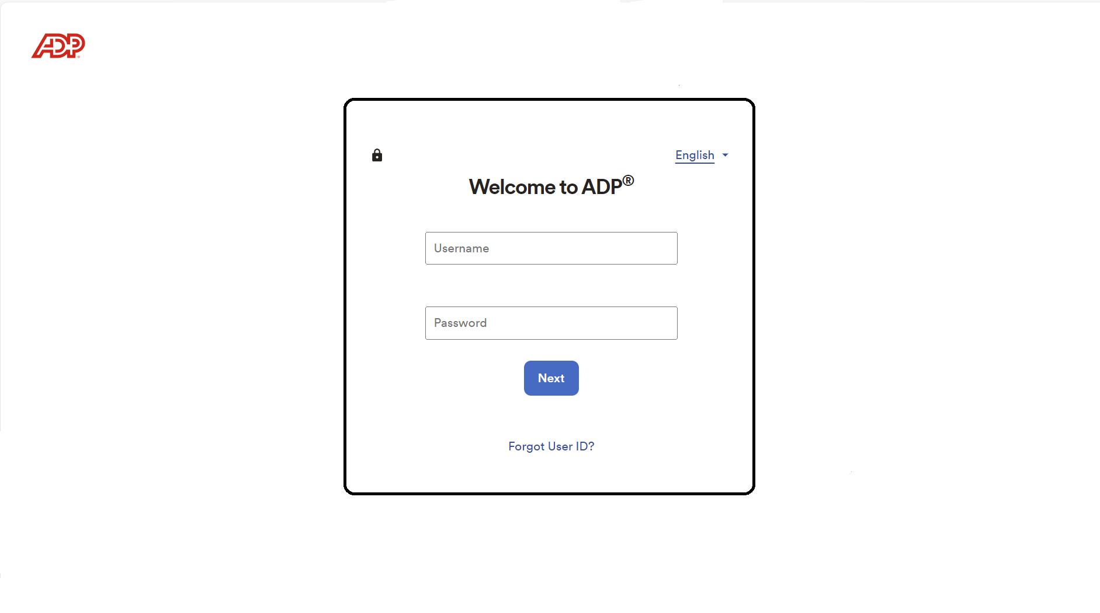
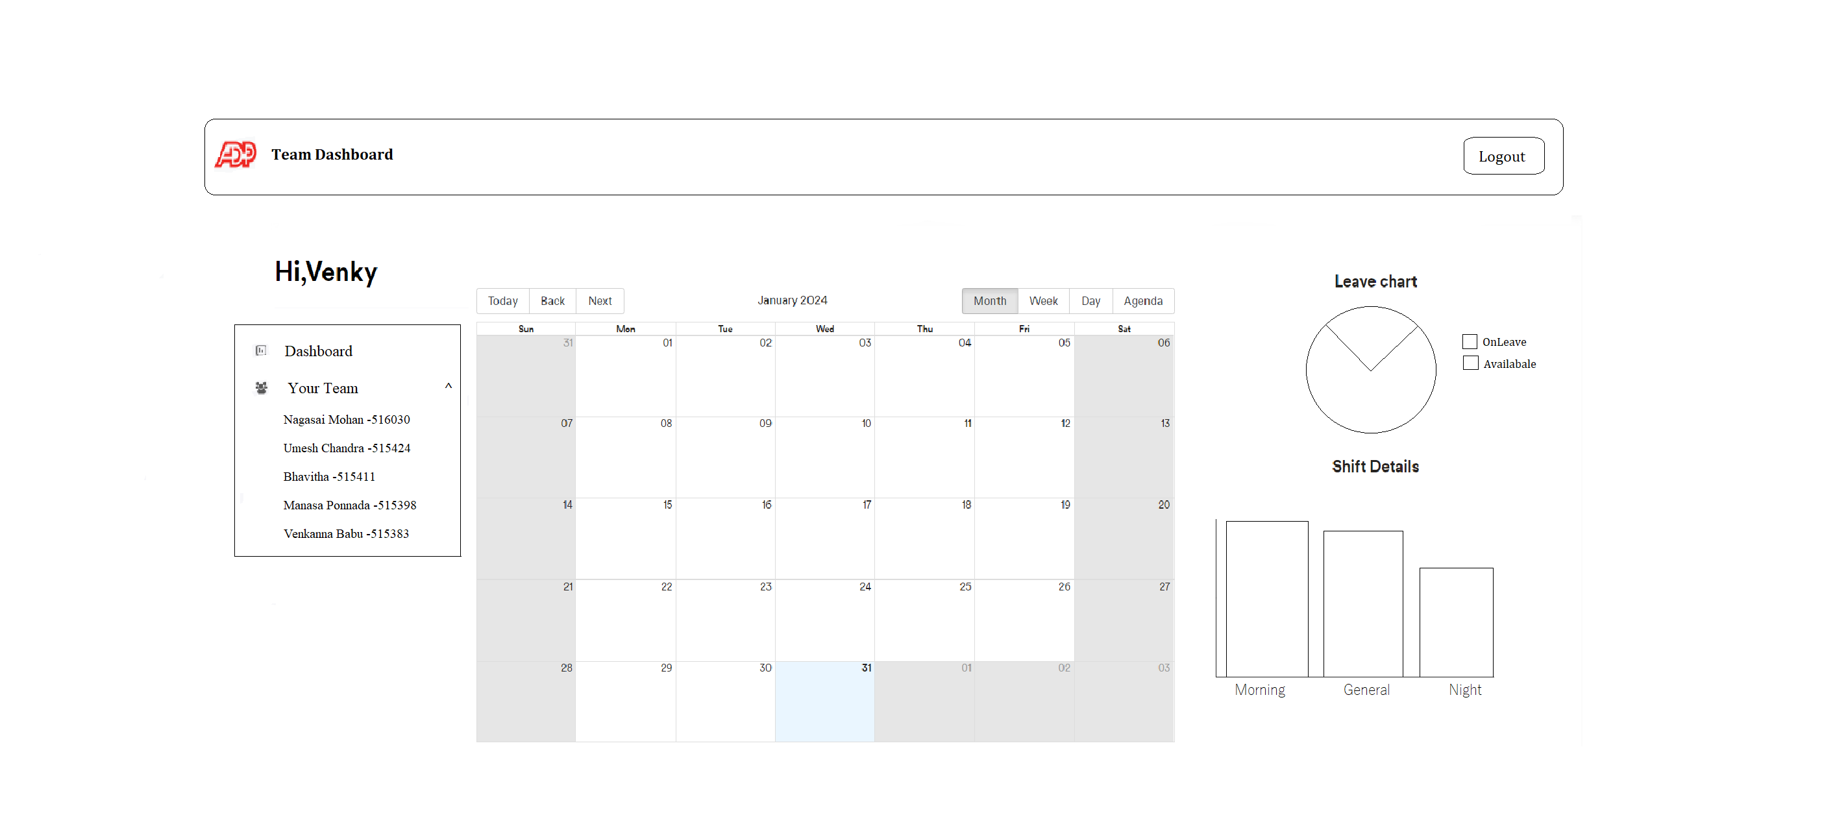
Wireframes

Slide 5
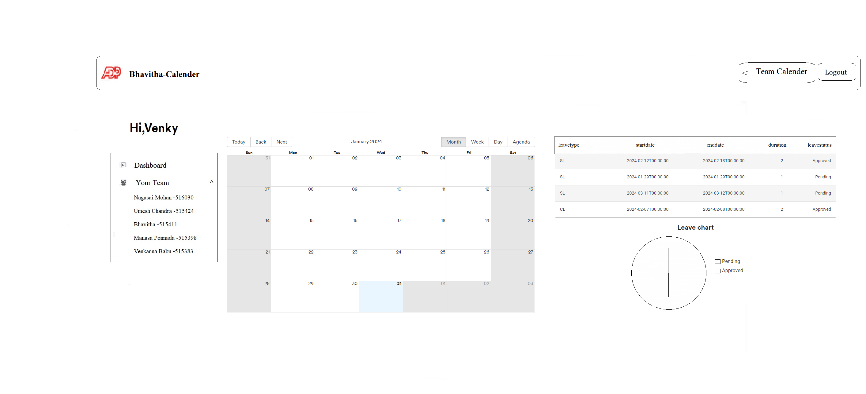
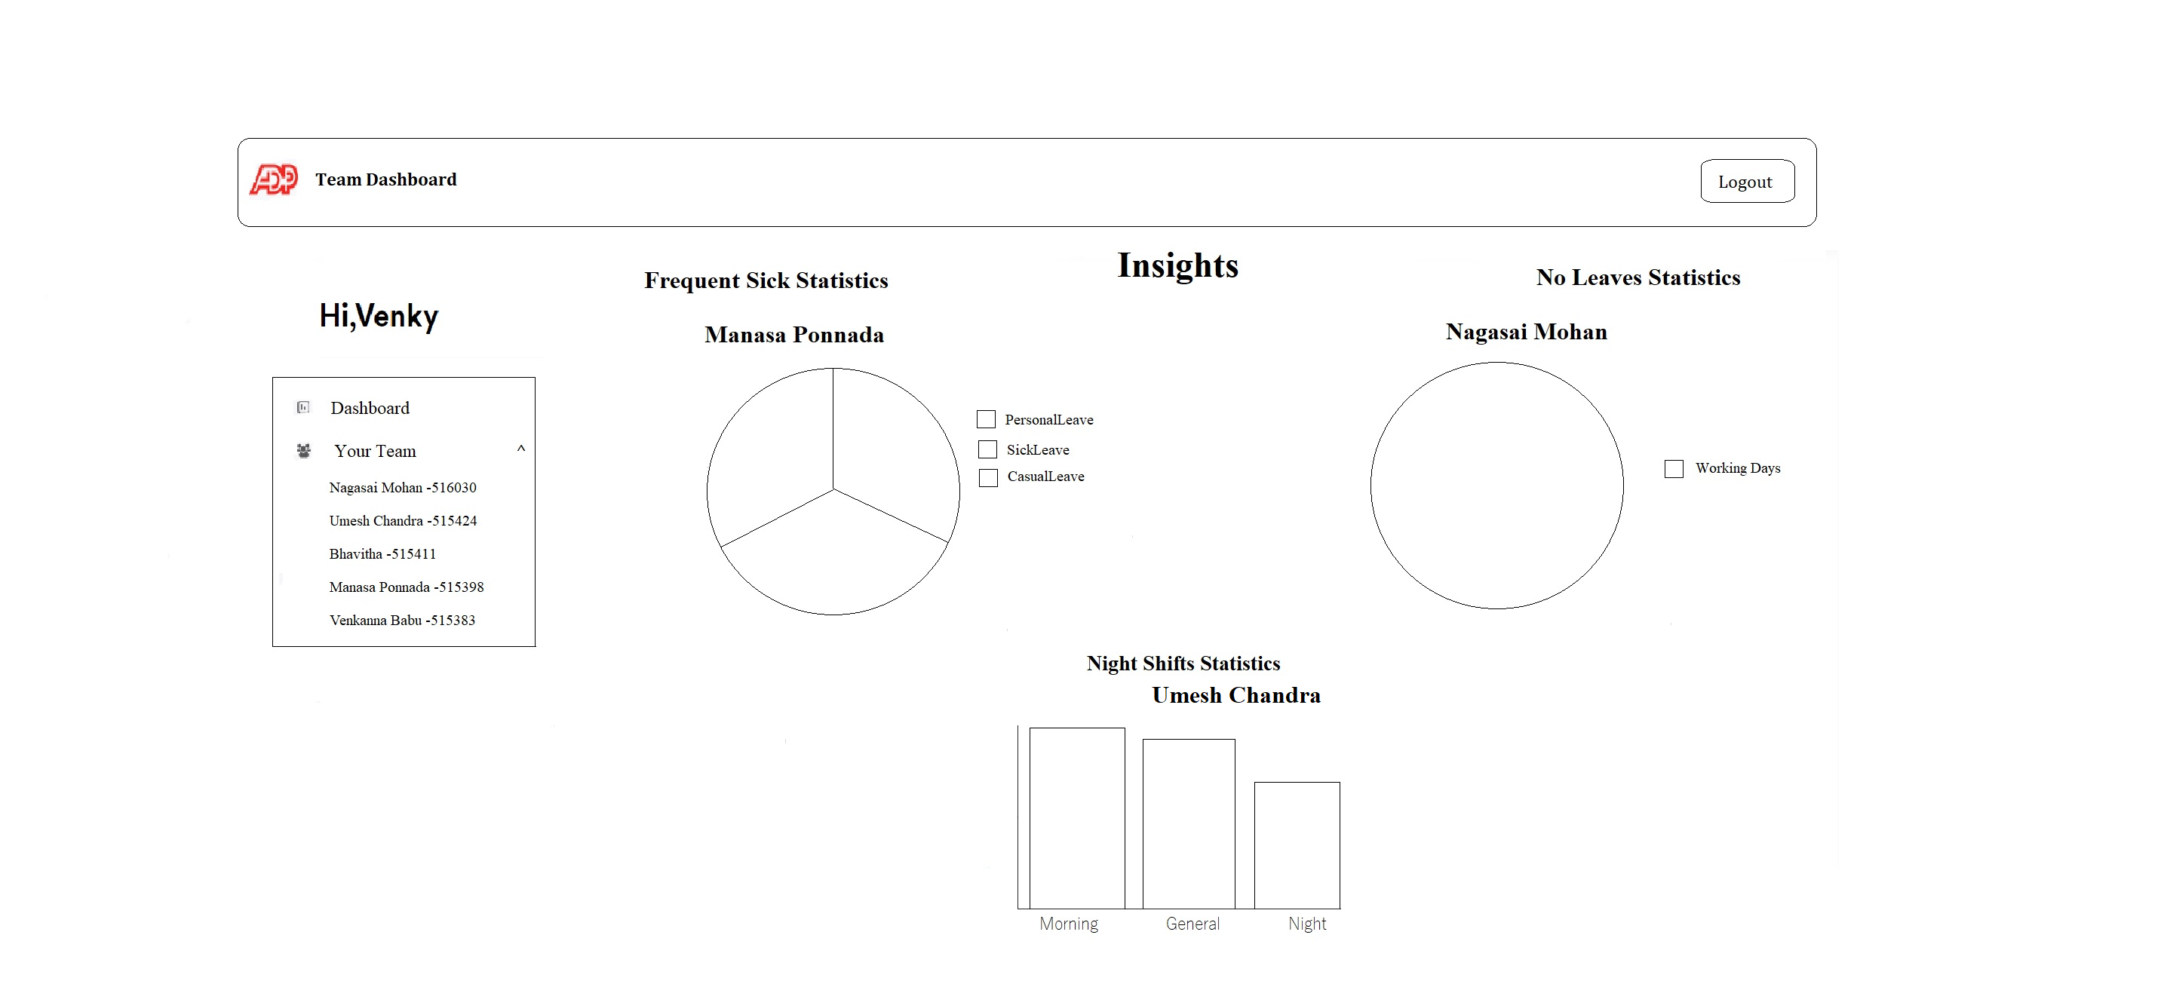
Wireframes

Slide 6
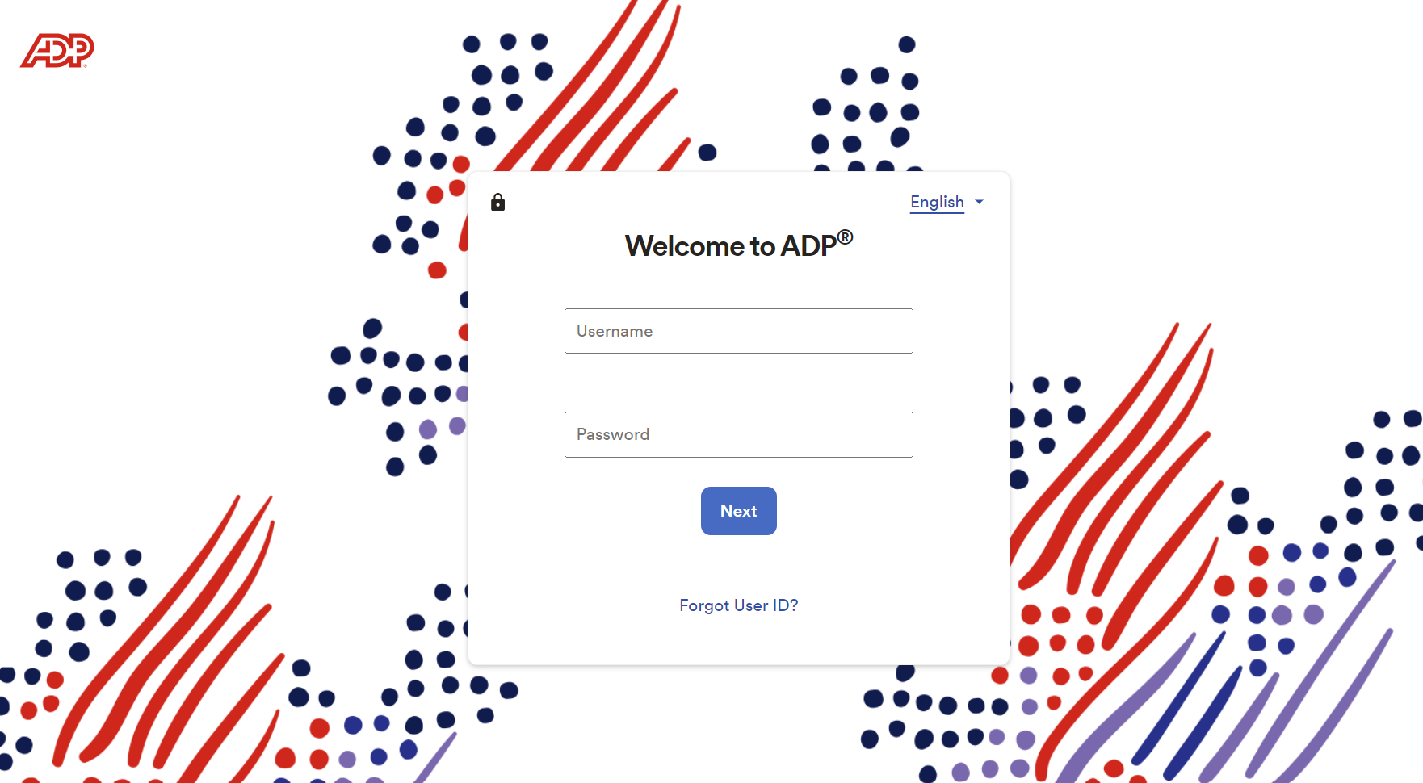
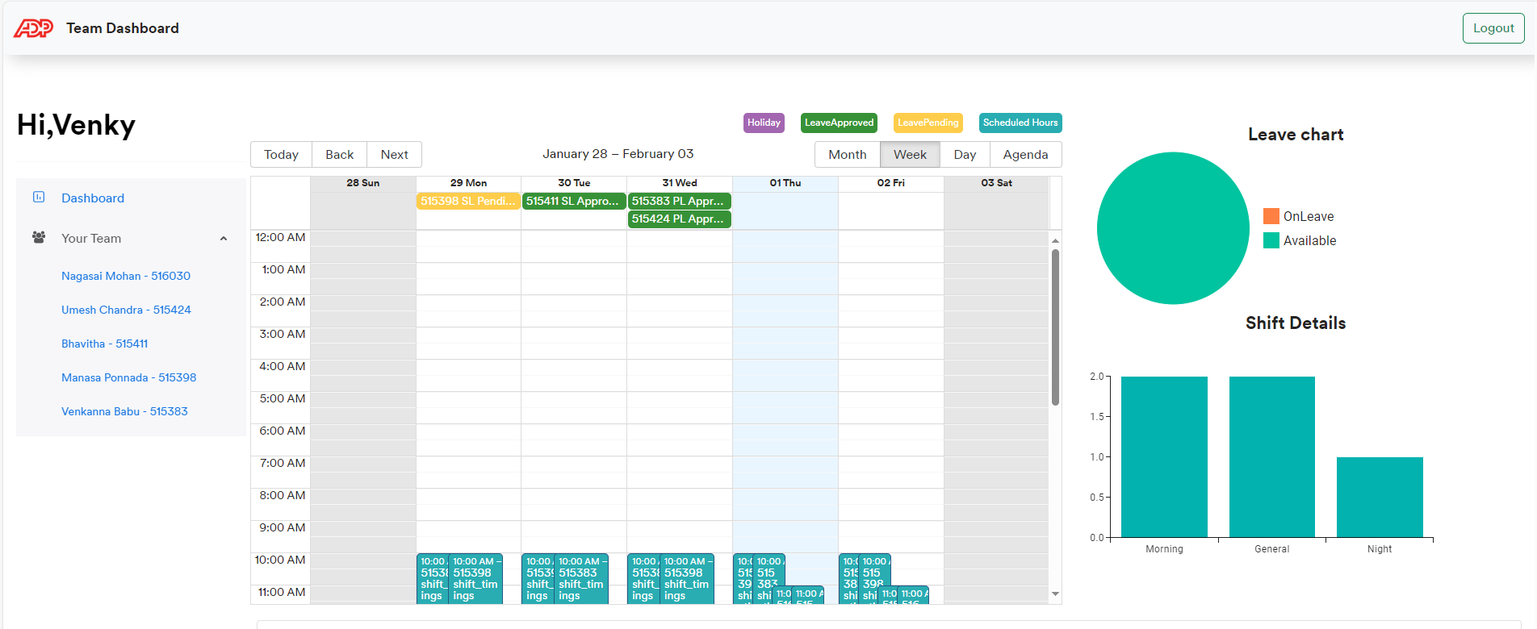
Outputs
Login page:
Manager Dashboard:

Slide 7
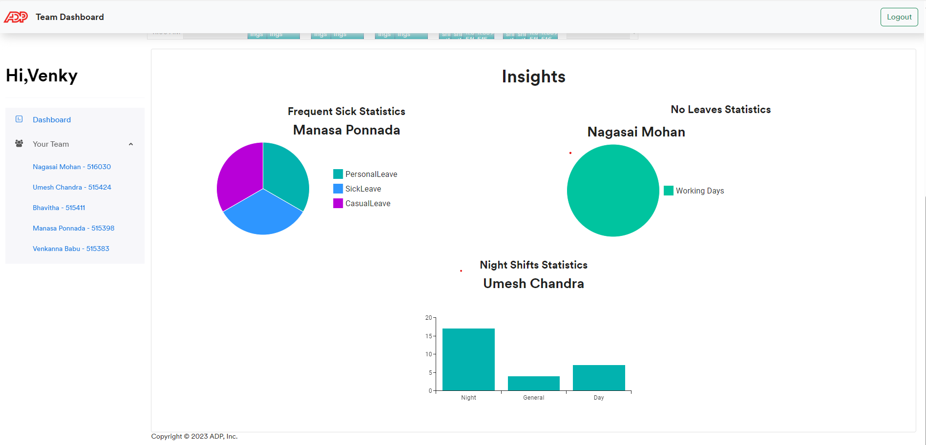
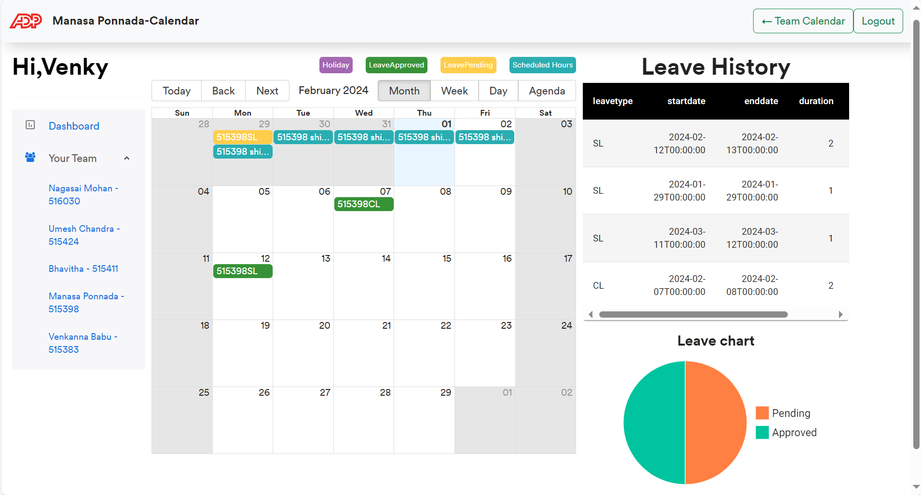
Insights:
Employee Calendar:

Slide 8
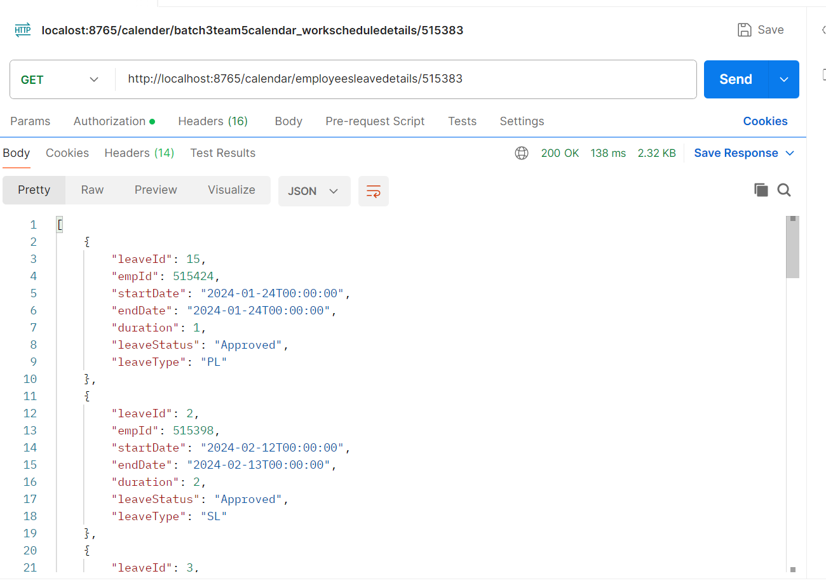
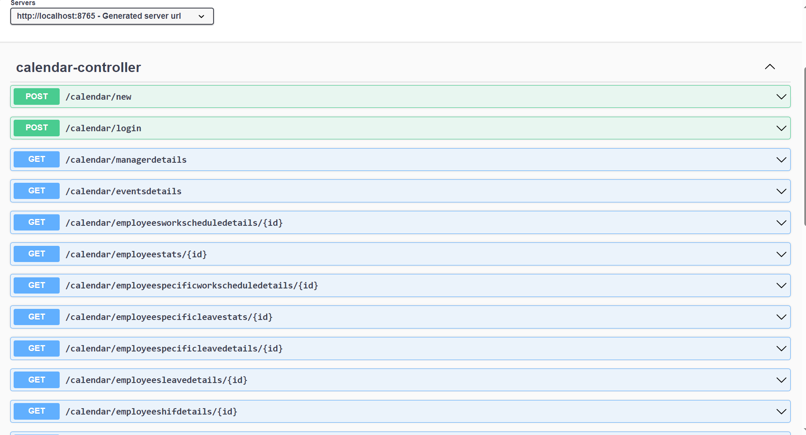
API test screenshot:
Swagger:

Slide 9
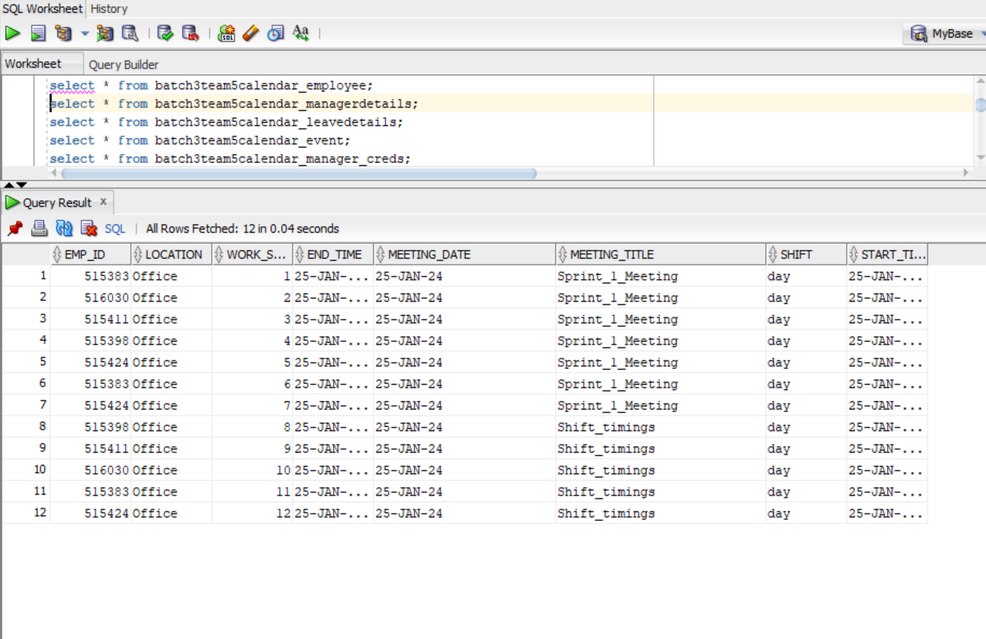
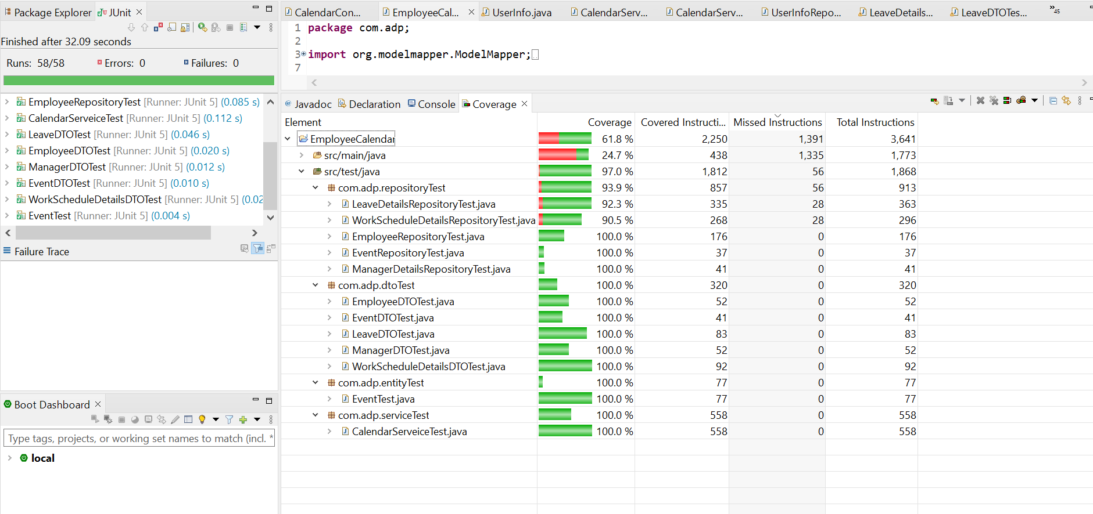
Tables:
Test coverage:

Slide 10
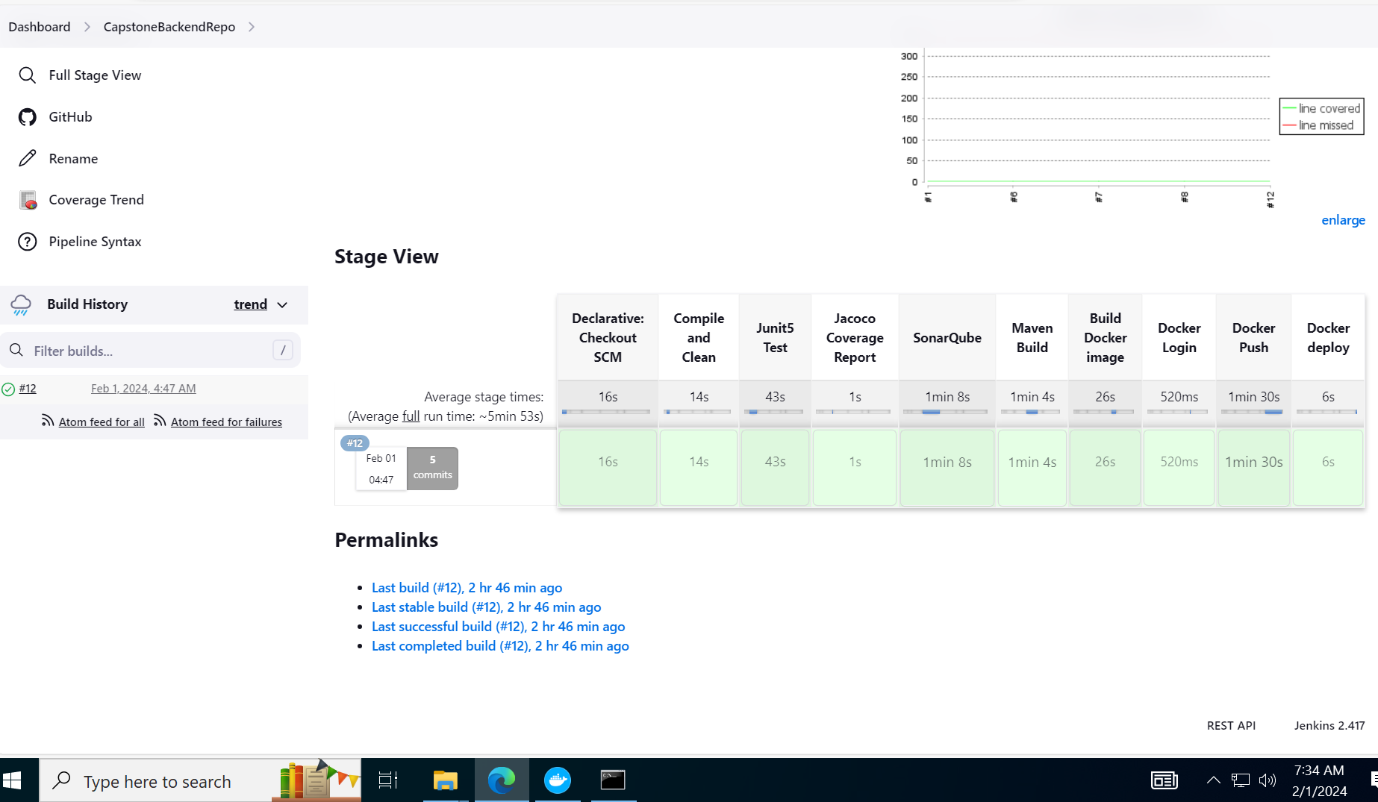
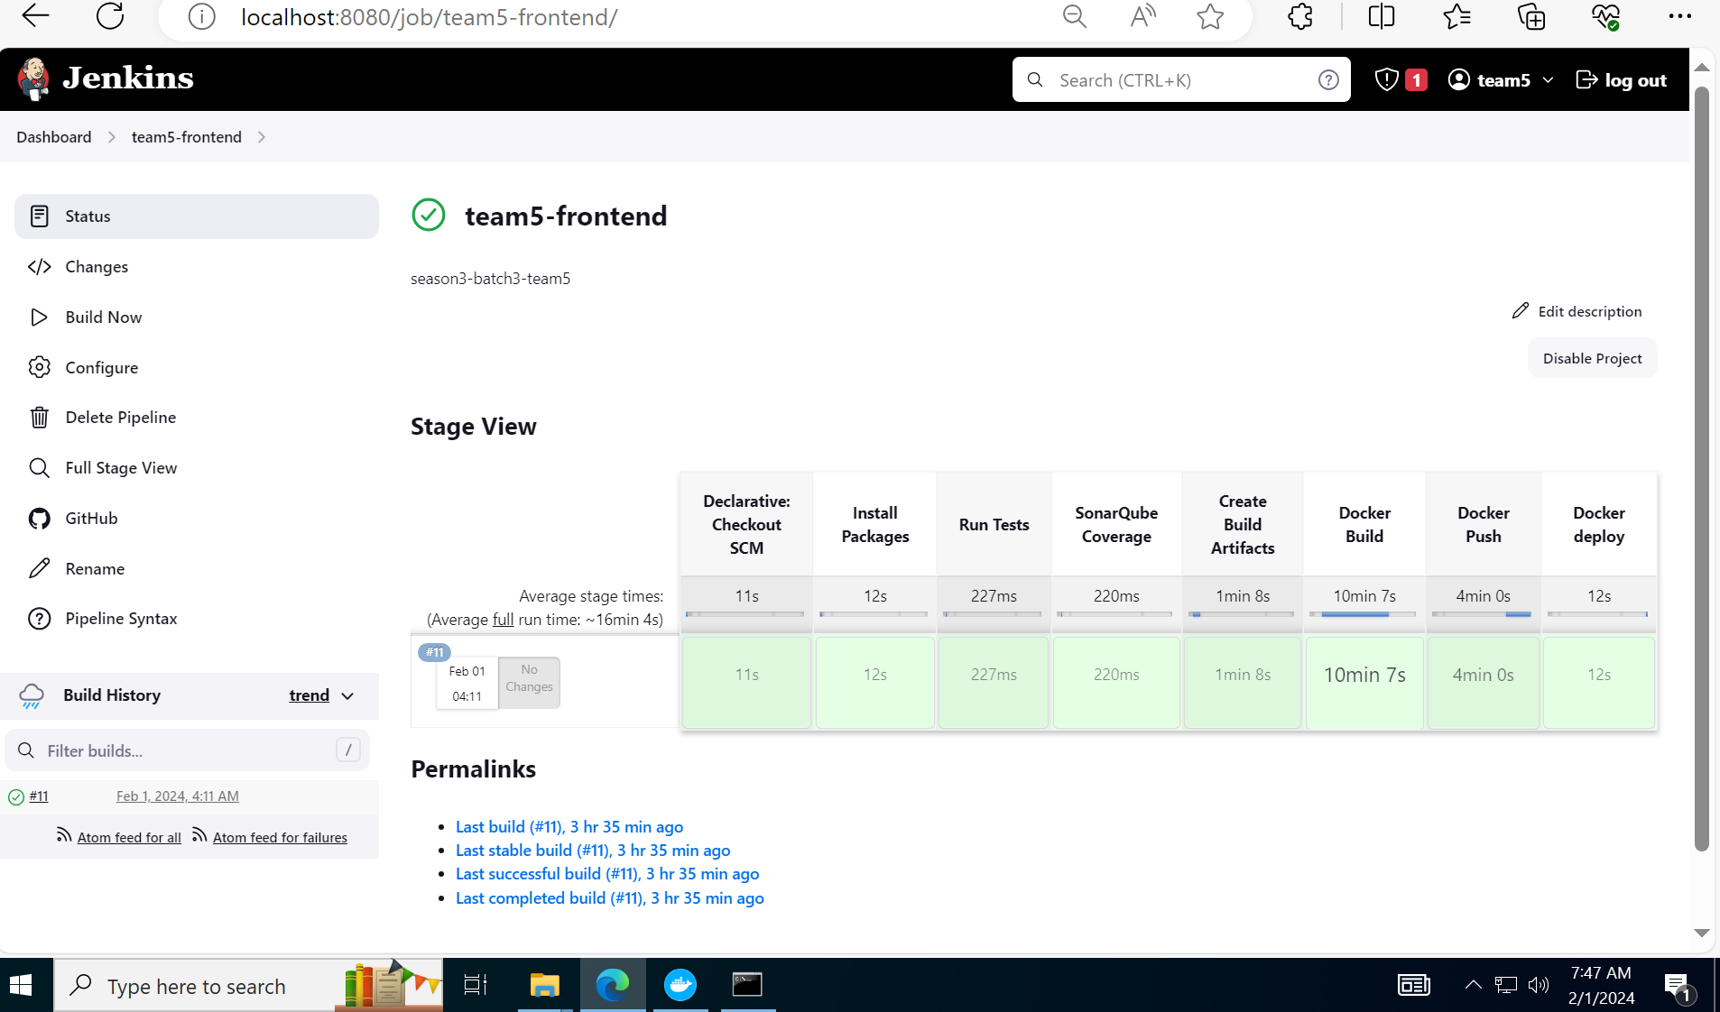
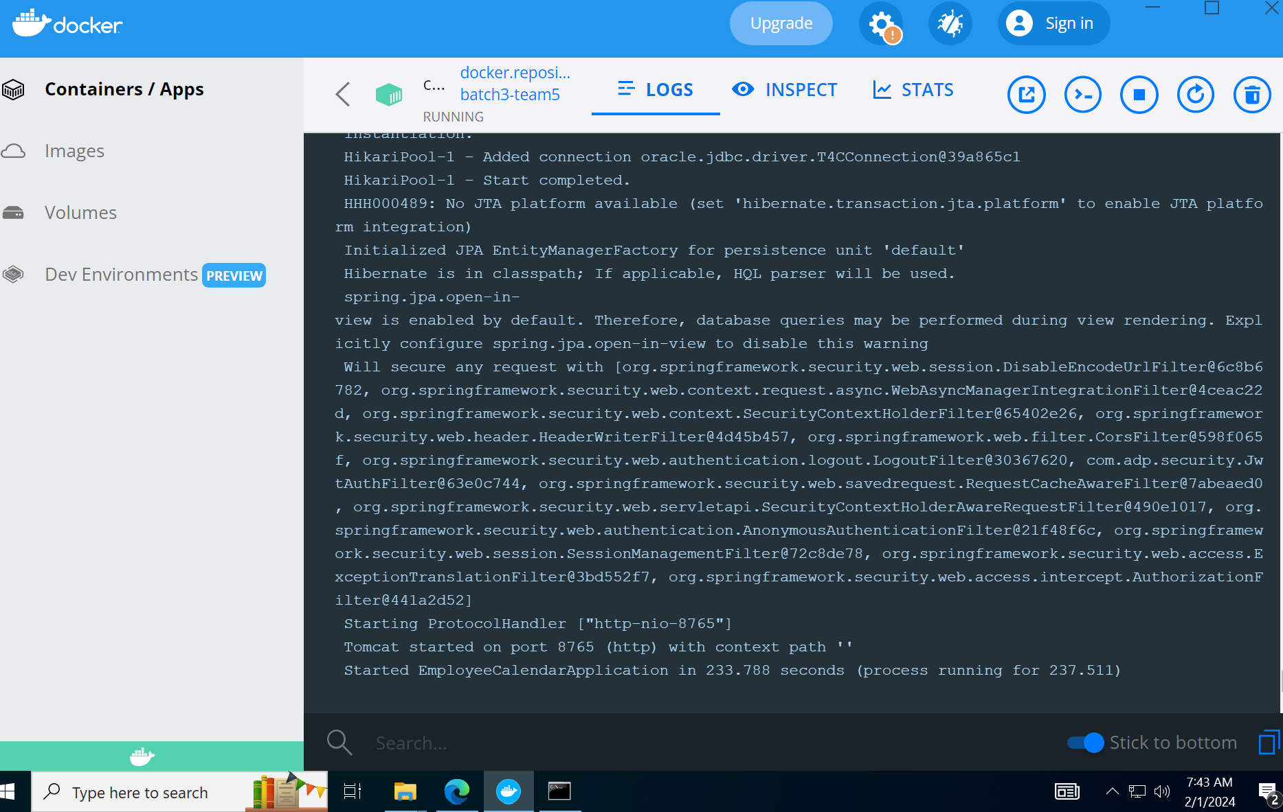
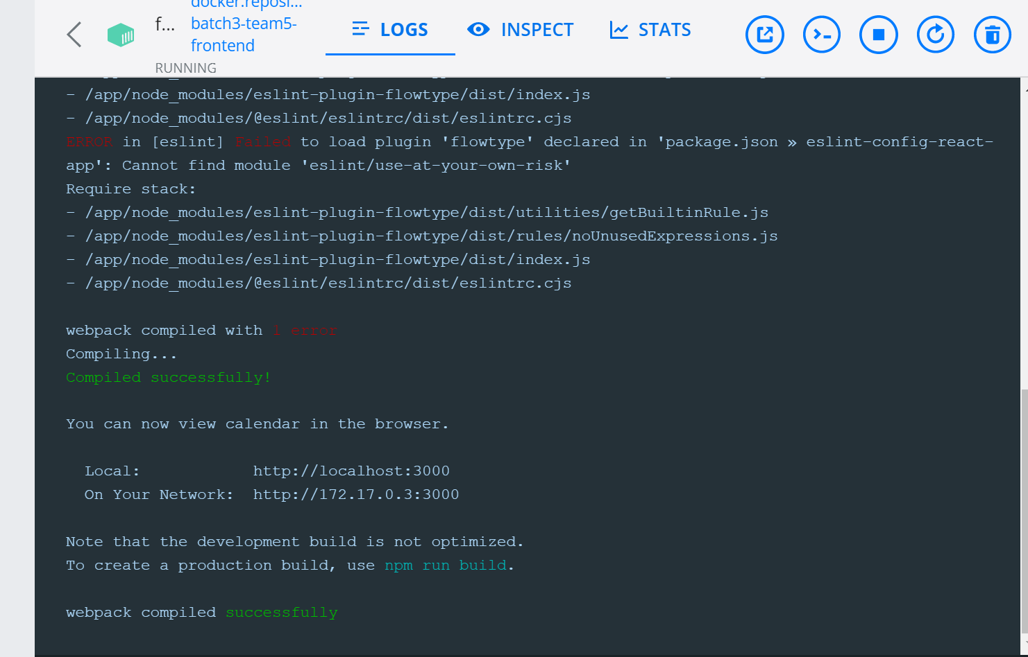
Pipeline Backend:
Pipeline Frontend:

Slide 11









Tech Stack
Tables:

Slide 12
THANK YOU

