Slide 1

Open source, high performance database

Slide 2

Comparison between Mumps & MongoDB
MongoDB built for Electronic Records
Introduction to MongoDB
MongoDB Security

Slide 3





The MongoDB community and ecosystem are expanding.
Community
9,000 people participated in 23 MongoDB Days in 2011
42 MongoDB User Groups
Global reach with events in London, Munich, Paris, Tokyo, and Beijing
Ecosystem
IaaS and PaaS partners offer Cloud hosting solutions
MongoDB Database-as-a-Service offerings available
Business Intelligence, Security, and Hadoop integration solutions
offered by partners
Customized hardware and storage
Set the direction & contribute code to MongoDB
Foster community & ecosystem
Provide commercial services
Provide MongoDB management services

Slide 4


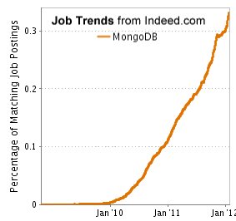
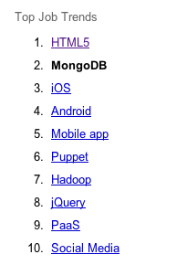
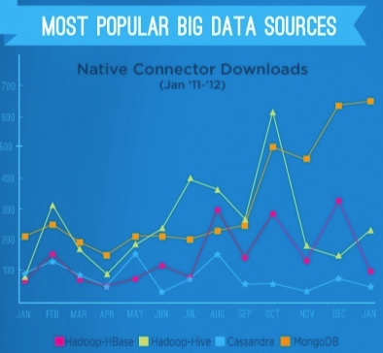
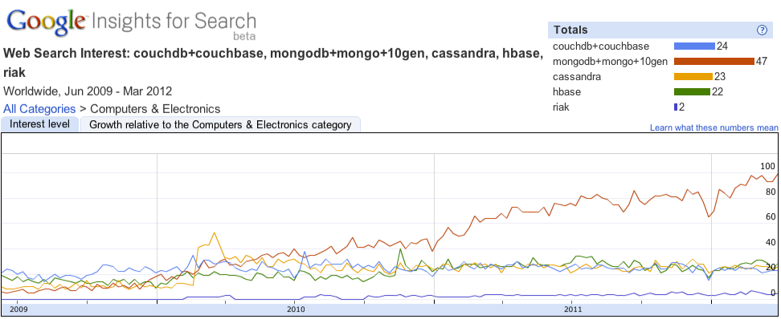
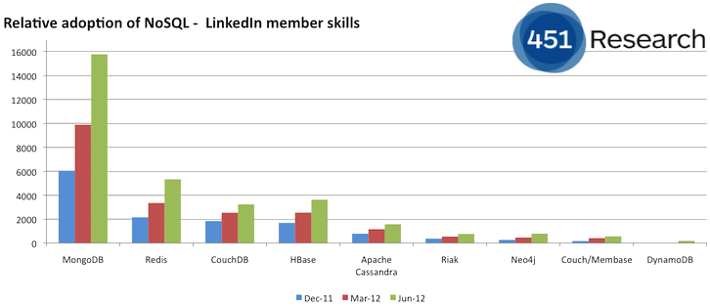
#2 ON INDEED’S FASTEST GROWING JOBS
JASPERSOFT BIGDATA INDEX
Demand for MongoDB, the document-oriented NoSQL database, saw the biggest spike with over 200% growth in 2011.
451 GROUP
“MONGODB INCREASING ITS DOMINANCE”
GOOGLE SEARCHES

Slide 5

MUMPS
  Created 1960
  Document / Object oriented database
  Predates C and has a very different syntax and terminology
Difficult to hire people that know this technology
Expensive to maintain
Time consuming to change / adapt to new requirements
Difficult to integrate with new solutions / technologies
MongoDB
  Created 2009
  Document Oriented Database
  Designed with latest NoSQL theory
  Open Source Technology
  Massive Community
  Drives innovation
  Cost effective
Hot technology, lots of buzz, attracts sharpest and brightest minds, large user base
Easy to find resources with MongoDB skill sets
Build from ground up for Cloud Computing Architecture

Slide 6

Examples: HL7, EDI, MARC, MODS, DDMS
Electronic records typically document oriented in nature: XML, JSON, Free text, or even binary
Massive variation in used fields
  Sparse data problem in RBMS
Constantly evolving to support all the business cases
Volume and velocity often in Big Data scale

Slide 7

{"ClinicalDocument": {
"recordTarget": {
"patientRole": {
"patient": {
"name": {
"given": "Henry",
"family": "Levin",
"suffix": "the 7th” },
"birthTime": {"value": 19320924} },
"providerOrganization": {"name": "Good Health Clinic"} }
},
"author": {
"time": 20000407130000+0500,
"assignedAuthor": {
"assignedPerson": {"name": {
"given": "Robert",
"family": "Dolin",
"prefix": "Dr.” } },
"representedOrganization": { "name": "Good Health Clinic” } }
}
}
Notes:
Notice the nested structure here.
A bit easier to read with the human eye.
Same format used for storage and wire transportation (binary makes it smaller, faster.
Good for data transport and requires no special assembly or disassembly on either end – a natural fit for many programming languages!

Slide 8
MongoDB was created to make
it easy to code, scale, and manage databases.
Agile and Scalable

Slide 9

Scale horizontally over commodity hardware
RDBMSs great so keep what works
  Ad hoc queries
  Fully featured indexes
  Secondary indexes
What doesn’t distribute well?
  Long running multi-row transactions
  Joins
  Both artifacts of the relational data model
Do not homogenize programming interfaces
Local storage first class citizen for DB storage

Slide 10

General Purpose
Rich data model
Full featured indexes
Sophisticated query language
Easy to Use
Easy mapping to object oriented code
Native language drivers in all popular languages
Simple to setup and manage
Fast & Scalable
Operates at in-memory speed wherever possible
Auto-sharding built in
Dynamically add / remove capacity with no downtime

Slide 11

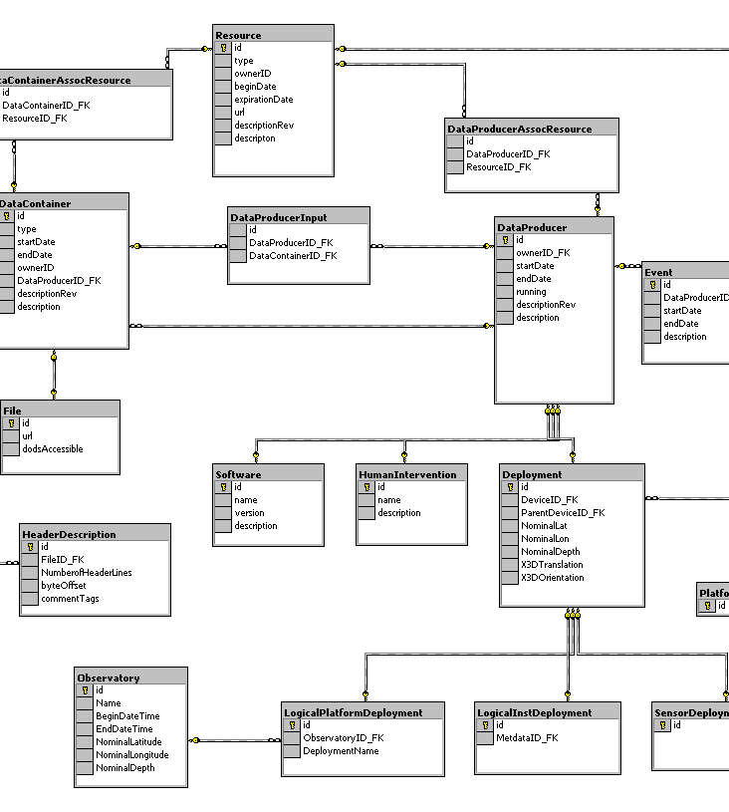
{
title: ‘MongoDB’,
contributors: [
{ name: ‘Eliot Horowitz’,
email: ‘eliot@10gen.com’ },
{ name: ‘Dwight Merriman’,
email: ‘dwight@10gen.com’ }
],
model: {
relational: false,
awesome: true
}
}

Slide 12



MySQL
MongoDB
START TRANSACTION;
INSERT INTO contacts VALUES
(NULL, ‘joeblow’);
INSERT INTO contact_emails VALUES
( NULL, ”joe@blow.com”,
LAST_INSERT_ID() ),
( NULL, “joseph@blow.com”,
LAST_INSERT_ID() );
COMMIT;
db.contacts.save( {
userName: “joeblow”,
emailAddresses: [
“joe@blow.com”,
“joseph@blow.com” ] } );

Slide 13

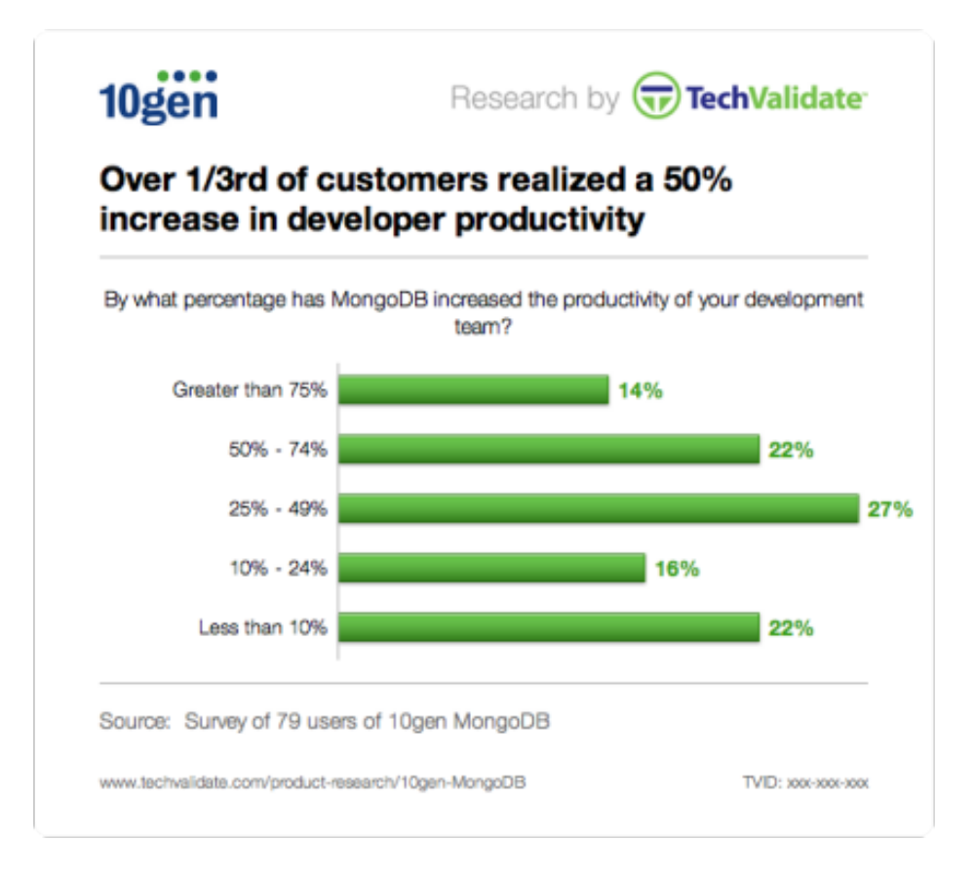


Slide 14

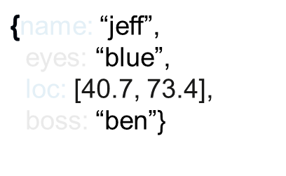



MongoDB does not need any pre-defined data schema
Every document could have different data!
{name: “will”,
eyes: “blue”,
birthplace: “NY”,
aliases: [“bill”, “la ciacco”],
loc: [32.7, 63.4],
boss: ”ben”}
{name: “brendan”,
aliases: [“el diablo”]}
{name: “matt”,
pizza: “DiGiorno”,
height: 72,
loc: [44.6, 71.3]}
Notes:
Applications enforce the data “schema” and integrity, much like MUMPS does in VistA

Slide 15




Better data locality
In-Memory
Caching
Distributed Architecture
Replication /HA
Relational
MongoDB
Horizontal Scaling
We just can't get any faster than the way MongoDB handles our data.
Tony Tam
CTO, Wordnik

Slide 16

SSL
  between client and server
  Intra-cluster communication
Authorization at the database level
  Read Only/Read+Write/Administrator
Security Roadmap (tentative)
  Pluggable authentication (PAM) 2.4
  Auditing 2.4
  Cell level security 2.6
  Common Criteria certification

Slide 17


NoSQL is popular for development & deployment of data-centric applications.
MongoDB makes it easy to code, scale, and operate NoSQL.
10gen is the company behind MongoDB

Slide 18

MongoDB is open source and there is no cost to download and use it
10gen are experts in database technology
OSEHRA are experts in Healthcare solutions
Combine 10gen and OSEHRA expertise to build a working prototype that will directly benefit our Veterans Healthcare

