Slide 1
Bootstrap
Introduction to Bootstrap
Notes:
Add instructor notes here.

Slide 2

Lesson Objectives
Introduction to Bootstrap
Why Bootstrap?
Bootstrap Advantages
SCSS Introduction
Creating Bootstrap page
Notes:
Add instructor notes here.

Slide 3
1.1: Introduction Bootstrap Introduction
Bootstrap is the most popular, open source HTML, CSS, JavaScript framework for developing responsive, mobile first projects on the web.(static website as well as dynamic web application)
Bootstrap 4 is the newest version of Bootstrap and it’s 4.0.0 beta version was released in August 2017.
Mobile-first approach is at it’s core of Bootstrap 4 development similar to prior version i.e. version 3.
Bootstrap was developed by Mark Otto and Jacob Thornton at Twitter. It was released as an open source product in August 2011 on GitHub.
getbootstrap.com is the Official Website of Twitter Bootstrap.
Notes:
Mobile first approach uses the grid system in particular is to layout designs first on small screens, such as those that come on a mobile phone and then it can be scaled up the size of those designs to larger and larger environments.
Prior to Bootstrap 3 It doesn't support mobile first approach and as a optional feature it supports Responsive web design.
Add instructor notes here.

Slide 4
1.1: Introduction Why Bootstrap?
We can design the front end for a website with a little knowledge of HTML and CSS. i.e. Developers can easily create professional WebPages like a web designers
Bootstrap's responsive design adjusts to range of screen sizes such as Desktops, Tablets and Mobiles.
Bootstrap provides scaffolding feature by providing a basic structure with Grid System, link styles, background.
Provides a clean and uniform solution for building an interface for developers.
Notes:
Add instructor notes here.

Slide 5
1.1: Introduction Why Bootstrap?
Bootstrap contains a dozen built-in reusable components and to provide iconography, dropdowns, navigation, alerts, popovers, and much more
It also provides custom jQuery plugins
It is supported by all popular browsers.

Slide 6
1.1: Introduction Bootstrap Advantages
Speed of Development
Responsiveness
Consistency
Customizable
Support
Notes:
Advantages of Bootstrap:
Speed of Development - The speed of development is one of the major reason of utilizing Bootstrap. If you want to develop an application or a website quickly, it is vitally important to consider using Bootstrap. Why? Because, It helps to save your coding effort by offering less(prior version 4) CSS functionality and pre-built blocks of code rather than need of structuring your code from the scratch. You can buy ready-made themes of Bootstrap and use them either as it is or you can even alter them to fit your requirements which will help to achieve efficient results in development.
Responsiveness – With the huge growth in usage of varied kinds of mobile devices, over the period of time, the requirement to have a responsive website that will fit in every size has become compulsory and important. Bootstrap is equipped with responsive layout and 12-column grid system that help dynamically adjust the website to a suitable screen resolution. The ‘responsive utility classes’ feature of Bootstrap enables you to hide / show a certain section of content for a particular screen size.
Consistency -Consistency was the fundamental principle behind the introduction of Bootstrap. It ensures the ultimate consistency regardless of designer/developer, who is working on it. Moreover, the results work uniformly across various browsers and the output remains same.
Customizable - Bootstrap facilitates you to customize it as per the designs of your project and helps in designing tailor made websites, according to your specifications. It has the facility to select any feature that is actually needed to create a customized website(. The web developers can make a choice to select the aspects which are required which can be simply complete by utilizing Bootstrap customize page. ). With this feature, one can get rid of what they do not require.
Support -Bootstrap helps to fix issues promptly with an immense support community. Bootstrap also releases continual updates to fix any new issues. Currently, it is being developed, hosted and maintained by GitHub with over 9000 commits and 500 contributors.

Slide 7
1.1: Introduction SASS Introduction
SASS stands for Syntactically awesome style sheets.
It is a pre-processor scripting language that is compiled into Cascading Style Sheets (CSS).
The official implementation of SASS is open-source and coded in Ruby. Other implementations also exists which includes Dart, PHP, and a high-performance implementation in C called libSass.
SASS is fully CSS-compatible and it comes with a wide range of useful features that are not available in traditional CSS, such as variables, mixins, nested rules, functions, and operators.
The easiest way to compile LESS files is to install Node.js and use its package manager NPM to install SASS.
We can also compile SASS online via https://www.sassmeister.com/
Notes:
SASS Introduction: (Explanation of SASS vs SCSS on the sass-lang.com website)
Sass has two syntaxes. The most commonly used syntax is known as “SCSS” (for “Sassy CSS”), and is a superset of CSS3’s syntax. This means that every valid CSS3 stylesheet is valid SCSS as well. SCSS files use the extension .scss.
The second, older syntax is known as the indented syntax (or just “.sass”). Inspired by Haml’s terseness, it’s intended for people who prefer conciseness over similarity to CSS. Instead of brackets and semicolons, it uses the indentation of lines to specify blocks. Files in the indented syntax use the extension .sass.”
We can install SASS by using following command.
npm install -g sass
This will install SAA globally on your system. Now that you have SAA installed, its time to create your first SCSS file. Create a new folder named scss and css in the project root and then create a file named demo-style.scss in it. Add the following code to your newly created file.
$font-family: Arial;
$text-color: red;
body {
font-family: $font-family;
color: $text-color;
}
To compile the file, navigate to your project root and run the following command:
sass demo-style.scss --compile > demo-style.css
You can also make Sass watch your SCSS files and make it compile to CSS(even when the SCSS file changes). Type the following in the command and Sass will “watch” your /scss and /css folders:
sass --watch scss:css
This will produce the following output:
body {
font-family: Arial;
color: red;
}
Add instructor notes here.

Slide 8
Demo
Online SASS Compiler using sassmeister.com
Notes:
Koala is a Windows GUI for SASS.js we can download it from http://koala-app.com/
Add instructor notes here.

Slide 9
1.1: Introduction What's new in Bootstrap 4?
Revamped grid tiers(to add a fifth option)
Flexbox is enabled by default
Dropping support for IE9 and iOS 6 , Supporting IE 10 and higher
Dropping support for Glyphicons (Font-Awesom or other icon libraries can be used)
Source CSS file format changed from Less to Sass
Primary CSS unit, Switched from px to rem
Non-responsive usage of Bootstrap is no longer supported
Notes:
Add instructor notes here.

Slide 10
1.1: Introduction Mobile First Strategy
Bootstrap 4 is too mobile first in the sense that the code for Bootstrap starts by targeting smaller screens like mobile devices, tablets, and then "expands" components and grids for larger screens such as laptops, desktops.
Following points need to be considered for mobile first strategy
Content : Determine what is most important.
Layout : Design to smaller widths first. i.e. Base CSS address mobile device first. media queries address for tablet and desktops
Progressive Enhancement : Add elements as screen size increases
Notes:
Add instructor notes here.

Slide 11
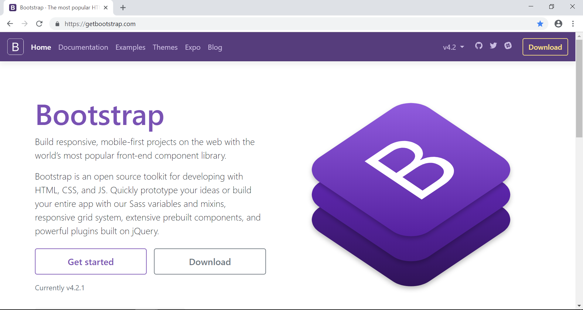
1.2: Getting Started with Bootstrap Bootstrap home page
Notes:
Add instructor notes here.

Slide 12
1.2: Getting Started with Bootstrap Downloading Bootstrap
We can work with Bootstrap using two ways
By downloading compiled and minified CSS, JavaScript, and fonts.
By using CDN(Content Delivery Network) links.
We can also download Bootstrap source code which includes the latest Bootstrap SCSS, JavaScript source code and documentation files.
Bootstrap 4 has dropped the online Customizer in favour of more extensive setup documentation and customized builds.
Theming and component changes can be done with new built-in Sass variables for global style preferences.
Notes:
Theming Bootstrap
Bootstrap 4 can be customize with new built-in Sass variables for global style preferences for easy theming and component changes.
In Bootstrap 3, theming was largely driven by variable overrides in LESS, custom CSS, and a separate theme stylesheet that we included in our dist files. With some effort, one could completely redesign the look of Bootstrap 3 without touching the core files. Bootstrap 4 provides a familiar, but slightly different approach.
Now, theming is accomplished by Sass variables, Sass maps, and custom CSS. There’s no more dedicated theme stylesheet; instead, you can enable the built-in theme to add gradients, shadows, and more.
Add instructor notes here.

Slide 13
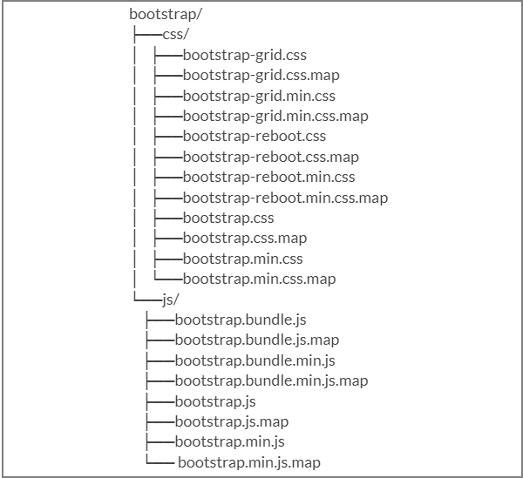
1.2: Getting Started with Bootstrap Bootstrap 4 pre-compiled folder structure
Notes:
Bootstrap 4 Precompiled – Folder Structure
Once the compiled version Bootstrap 4 is downloaded, after extracting the ZIP file, you will be able to see the file/directory structure as shown in the slide.
There are compiled CSS and JS (bootstrap.*), as well as compiled and minified CSS and JS (bootstrap.min.*).
The less/, js/, and fonts/ are the source code for CSS, JS, and icon fonts (respectively).
The dist/ folder includes everything listed in the precompiled download section above.
The docs/ folder includes the source code for documentation, and examples/ of Bootstrap usage
Add instructor notes here.

Slide 14

1.2: Getting Started with Bootstrap Bootstrap 4 source code folder structure
Notes:
Bootstrap 4 source code – Folder Structure
Downloaded Bootstrap 4 source code will have the file structure as shown in the slide.
The files under js/ and scss/ are the source code for Bootstrap CSS and JavaScript.
The dist/ folder include everything listed in the precompiled download section as shown in earlier slide.
The docs/examples/, includes source code for Bootstrap documentation and examples of Bootstrap usage.

Slide 15
1.2: Getting Started with Bootstrap Bootstrap 4 Global Styles
Bootstrap provides us the following default styles to webpage which is included in the bootstrap.css file.
Margin has been removed from the body, and content will snug up to the edges of the browser window.
Background-color white is by default applied to <body>.
Bootstrap 4 is using the $font-family-base, $font-size-base, and line-height-base attributes as our typographic base applied to the <body>. This allows the height of headings and other content around the site to maintain a similar line height.
Bootstrap sets the global link color via $link-color and applies link underlines only on :hover
Notes:
Add instructor notes here.

Slide 16
1.2: Getting Started with Bootstrap Responsive Design
To turn on the responsive features of Bootstrap, we need to add a <meta> tag to the <head> of your web page.
It represents mobile specific meta data.
<!DOCTYPE html>
<html lang="en">
<head>
<title>Creating Sample website</title>
<!-- Mobile Specific Meta -->
<meta name="viewport" content="width=device-width, initial-scale=1, maximum-scale=1">
<!-- Latest compiled and minified CSS -->
<link href="../bootstrap-4.2.1-dist/css/bootstrap.min.css" rel="stylesheet">
</head>
<body></body>
</html>
Notes:
Non-responsive usage of Bootstrap is no longer supported(from release version 4)
Add instructor notes here.

Slide 17
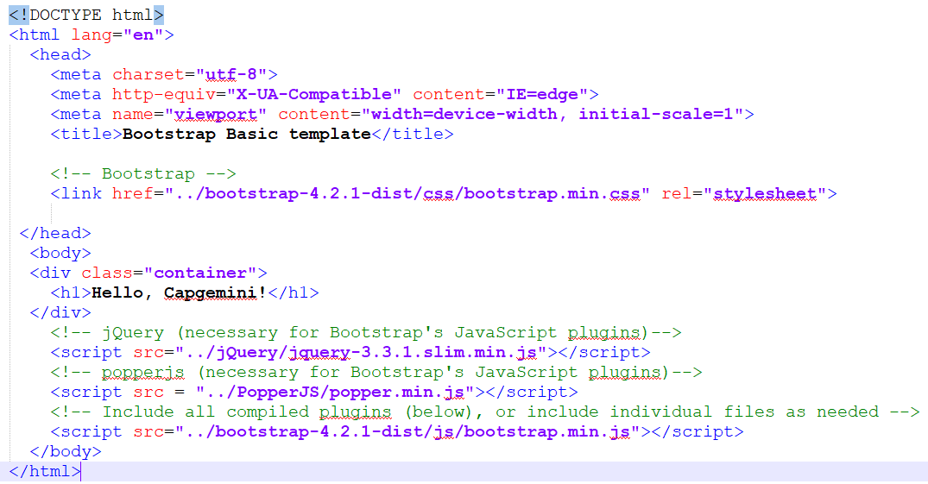
1.2: Getting Started with Bootstrap Bootstrap basic template
Notes:
Add instructor notes here.

Slide 18
Demo
Basics
Notes:
Add instructor notes here.

Slide 19

Summary
Using bootstrap we can design the front end for a website with a little knowledge of HTML and CSS.
Bootstrap is supported by all popular browsers
Like Bootstrap 3, Bootstrap 4 too has been build to have a mobile-first approach.
SASS is a dynamic style sheet language that is compiled into CSS
Notes:
Add the notes here.
Add instructor notes here.

