Slide 1

Conditional Execution
Chapter 3

Slide 2
Creative Commons Attribution 3.0 License
Copyright 2010- Charles Severance
These slides are a derivative work based on the original slides, “Python for Informatics : Exploring Information”, created by Charles Severance. The original slides are located at www.pythonlearn.com
This modified set of slides was done by John Alexander (2013).
The primary purpose of this derivative work is to make the highest quality Python courseware available to instructors so that they can teach Python, and insure that the slides are properly formatted for easy, out-of-the-box, use by both Microsoft PowerPoint and OpenOffice Impress.
Unless otherwise noted, the content of this course material is licensed under a Creative Commons Attribution 3.0 License (The “BY” variant of the license)
http://creativecommons.org/licenses/by/3.0/.

Slide 3
Conditional Steps
x = 5
X < 10 ?
Yes
print 'Smaller'
Program:
x = 5
if x < 10:
print 'Smaller‘
if x > 20:
print 'Bigger'
print 'Finis'
X > 20 ?
Yes
print 'Bigger'
print 'Finis'

Slide 4
Comparison Operators
Boolean expressions = an expression that evaluates to true or false
Boolean expressions use comparison operators evaluate to - True or False
Comparison operators look at variables but do not change the variables
<
Less than
<=
Less than or Equal
==
Equal to
>=
Greater than or Equal
>
Greater than
!=
Not equal
Remember: “=” is used for assignment.

Slide 5
Comparison Operators
x = 5
if x == 5 :
print 'Equals 5‘
if x > 4 :
print 'Greater than 4’
if x >= 5 :
print 'Greater than or Equal 5‘
if x < 6 :
print 'Less than 6'

Slide 6
X == 5 ?
Yes
No
print 'Is 5'
x = 5
if x == 5 :
print 'Is 5‘
print 'Is Still 5'
print 'Third 5’
print 'Still 5'
print 'Third 5'
The IF Statement

Slide 7
Indentation Rules
Increase indent after an if statement or for statement (after : )
Maintain indent to indicate the scope of the block (which lines are affected by the if/for)
Reduce indent to back to the level of the if statement or for statement to indicate the end of the block
Blank lines are ignored - they do not affect indentation
Comments on a line by themselves are ignored w.r.t. indentation

Slide 8
Warning: Turn Off Tabs
Most text editors can turn tabs into spaces - make sure to enable this feature
  NotePad++: Settings -> Preferences -> Language Menu/Tab Settings
  TextWrangler: TextWrangler -> Preferences -> Editor Defaults
Python cares a *lot* about how far line is indented. If you mix tabs and spaces, you may get “indentation errors” even if everything looks fine

Slide 9
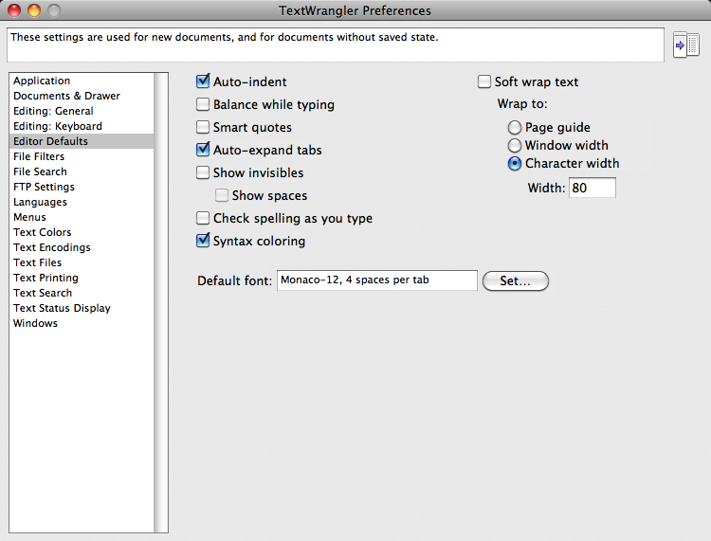

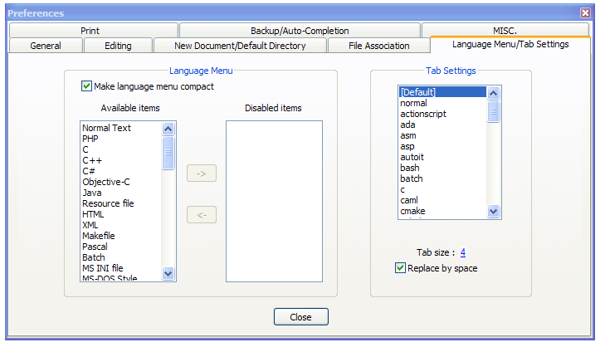
This will save you much unnecessary pain.

Slide 10
increase / maintain after if or for
decrease to indicate end of block
blank lines and comment lines ignored
x = 5
if x > 2 :
# comments
print 'Bigger than 2'
# don’t matter
print 'Still bigger'
# but can confuse you
print 'Done with 2'
# if you don’t line
# them up
x = 5
if x > 2 :
print 'Bigger than 2'
print 'Still bigger'
print 'Done with 2'
for i in range(5) :
print i
if i > 2 :
print 'Bigger than 2'
print 'Done with i', i

Slide 11
Two Way Decisions
X = 4
Sometimes we want to do one thing if a logical expression is true and something else if the expression is false
It is like a fork in the road - we must choose one or the other path but not both
no
x > 2
yes
print 'Not bigger'
print 'Bigger'
print 'All Done'

Slide 12
Two-way branch using else :
X = 4
x = 4
if x > 2 :
print 'Bigger'
else :
print 'Smaller'
print 'All done'
no
x > 2
yes
print 'Smaller'
print 'Bigger'
print 'All Done'

Slide 13
Nested Decisions
x > 1
yes
no
print 'More than one'
x = 42
if x > 1 :
print 'More than one'
if x < 100 :
print 'Less than 100'
print 'All done'
x < 100
yes
no
print 'Less than 100'
print 'All Done'

Slide 14
Chained Conditionals
yes
x < 2
print 'Small'
if x < 2 :
print 'Small'
elif x < 10 :
print 'Medium'
else :
print 'LARGE'
print 'All done'
no
x<10
yes
print 'Medium'
no
print 'LARGE'
print 'All Done'

Slide 15
Chained
Conditional
if x < 2 :
print 'Small'
elif x < 10 :
print 'Medium'
elif x < 20 :
print 'Big'
elif x< 40 :
print 'Large'
elif x < 100:
print 'Huge'
else :
print 'Ginormous'
# No Else
x = 5
if x < 2 :
print 'Small'
elif x < 10 :
print 'Medium'
print 'All done'

Slide 16
Multi-way Puzzles
if x < 2 :
print 'Below 2'
elif x < 20 :
print 'Below 20'
elif x < 10 :
print 'Below 10'
else :
print 'Something else'
Which will never print?
if x < 2 :
print 'Below 2'
elif x >= 2 :
print 'Two or more'
else :
print 'Something else'

Slide 17
The try / except Structure
You surround a dangerous section of code with try and except.
If the code in the try works - the except is skipped
If the code in the try fails - it jumps to the except section

Slide 18
astr = 'Hello Bob‘
istr = int(astr)
print 'First‘
istrastr = '123‘
istr = int(astr)
print 'Second', istr
$ python notry.py Traceback (most recent call last): File "notry.py", line 2, in <module> istr = int(astr)ValueError: invalid literal for int() with base 10: 'Hello Bob'

Slide 19
astr = 'Hello Bob'
try:
istr = int(astr)
except:
istr = -1
print 'First', istr
astr = '123'
try:
istr = int(astr)
except:
istr = -1
print 'Second', istr
When the first conversion fails - it just drops into the except: clause and the program continues.
Output:
First -1
Second 123
When the second conversion succeeds - it just skips the except: clause and the program continues.

Slide 20
try / except
astr = 'Bob'
print 'Hello'
astr = 'Bob'
try:
print 'Hello'
istr = int(astr)
print 'There'
except:
istr = -1
print 'Done', istr
istr = int(astr)
print 'There'
istr = -1
print 'Done', istr
Safety net

Slide 21
Sample try / except
rawstr = raw_input('Enter a number:')
try:
ival = int(rawstr)
except:
ival = -1
if ival > 0 :
print 'Nice work’
else:
print 'Not a number’
Enter a number:42
Nice work
Enter a number:fourtytwo
Not a number

Slide 22
Exercise
Write a pay computation program that gives the employee 1.5 times the hourly rate for hours worked above 40 hours (and regular 1.0 rate for less than 40 hours)
Enter Hours: 45
Enter Rate: 10
Pay: 475.0
475 = 40 * 10 + 5 * 15

Slide 23
Exercise
Rewrite your pay program using try and except so that your program handles non-numeric input gracefully.
Enter Hours: 20
Enter Rate: nine
Error, please enter numeric input
Enter Hours: forty
Error, please enter numeric input

Slide 24
Summary
Comparison operators == <= >= > < !=
Logical operators: and or not
Indentation
One Way Decisions
Two way Decisions if : and else :
Nested Decisions and Multiway decisions using elif
Try / Except to compensate for errors

